Slide 1
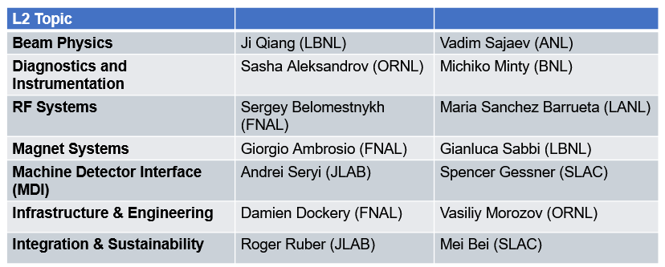
Higgs Factory Committee Meeting
L2 Talks: Diagnostics and Instrumentation
S. Aleksandrov, M. Minty - HFC meeting, FNAL ( 15-16 Jan 2025 )

Slide 2
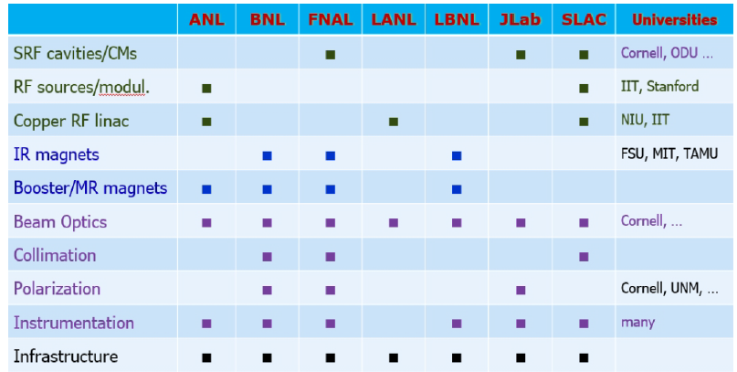
Area 1 “RF Systems”
Area 2 “Magnets and MDI”
Area 3 “Modeling, Design, Collimation, Polarization, Instrumentation”
2
S. Aleksandrov, M. Minty - HFC meeting, FNAL ( 15-16 Jan 2025 )

Slide 3
Pre-injectors
Positron source and transport: monitors for production efficiency, detectors and schemes for beam loss minimization, energy spread monitors where relevant
Polarimetry throughout the injector complex (FCC: if polarized sources are realized)
LINACs and transfer lines
Bunch longitudinal distribution (dE/z) as beam loading compensation monitor
Bunch compression (transverse mode cavities, laser-based for higher resolution?)
Coherent synchrotron radiation monitors (if not excluded?)
“DC beam” monitors in switchyards (check for dark currents)
Infrastructure for diagnostic pulse
Wire scanners for higher-order correction of e.g. chromatic aberrations (SLC experience)
Damping ring (s)
Synchrotron light transport and monitors for beam size evolution
Streak camera(s) for bunch length and profile monitoring
3
S. Aleksandrov, M. Minty - HFC meeting, FNAL ( 15-16 Jan 2025 )

Slide 4
Injector synchrotrons and transfer lines (FCC)
(Check sufficiency of existing diagnostics in SPS and LHC)
Precision intensity monitors and controls for top-up (including system designs for synchronization and bunch placement – phase/arrival time monitors)
Collider Rings
Injection tuning diagnostics (6D) – transverse dimensions dependent on selected injection scheme
Beam Loss and Collimation: novel monitors adapted to advanced collimation schemes; e.g. “back-scattered” detector for primary/electron beam alignment for hollow electron beam based collimation, laser collimation?
Fast loss monitors (in lieu of Super-KEKB experiences)
AC dipoles for optics measurements
Photon-based diagnostics for polarization wiggler tuning
Emittance Monitors
low current conventional (for example: wire scanners)
high current non-invasive (for example: sync light, fluorescence, laser wires, ionization(?), Schottky)
Tune, coupling and chromaticity monitors for feedback applications
4
S. Aleksandrov, M. Minty - HFC meeting, FNAL ( 15-16 Jan 2025 )

Slide 5
Collider Rings, continued
Head-tail monitor for instability diagnoses
Beam transfer function (BTF) measurements and cross-beam BTFs
Fast feedback design and signal processing
Electron cloud monitors?
Thermal monitors (distributed for heat load due to synchrotron radiation, localized where needed elsewhere – collimators, cavity couplers, etc.)
Dedicated instrumentation-based systems for optimization of beam-switching geometries
Collider Interaction Regions
IP BPMs (Beam Position Monitors close to the Interaction Points) including high time-resolution signal processing
Beamstrahlung monitors
Vibration monitors (e.g. accelerometers) for final focus triplet
Diagnostics and methods for crab cavity and monochromatization optimization
Luminosity Monitors (radiative Bhabha) as adapted to HF operating modes and integrated into collision optimization feedback
Fast synch light monitors (could be located elsewhere) for flip-flop detection
5
S. Aleksandrov, M. Minty - HFC meeting, FNAL ( 15-16 Jan 2025 )

Slide 6
Polarimetry
as adapted to requirements for energy calibration (and rf depolarizer if not underway)
spin vector orientation monitor (ensure no systematic errors from type-3 snakes)
Other
AI/ML-based instrumentation development including for beam distributions
Halo Monitor if needed (dynamic range the challenge)
Consider merits of dedicated controls for injection setup tuning using diagnostic-pulses in both pre-injector and injector transfer lines
Other as required to support other groups
Cryo diagnostics (quench protection)
RF – dedicated beam phase and cavity vector voltage monitors for polarized bunches in collider abort gaps
Many measurements for input to Machine Protection Safety Systems (focus on those not provided by technical support groups – e.g. top-up related
And more (if needed)
Other ideas: Electron beam test stand for top-up scheme (need 0 to 5 nC)
6
S. Aleksandrov, M. Minty - HFC meeting, FNAL ( 15-16 Jan 2025 )

Slide 7
Next Steps
Complete list of known instrumentation needs
Add as necessary to meet new challenges and/or requirements (if any)
Establish contact within FCC to identify priorities
Develop working group to further define capabilities, interests and possible future commitments
7
S. Aleksandrov, M. Minty - HFC meeting, FNAL ( 15-16 Jan 2025 )

