Slide 1

RF for Higgs factories: U.S. perspective through the prism of ESPPU
Sergey Belomestnykh (FNAL) and Maria Sanchez Barrueta (LANL)
Higgs Factory Committee Meeting
Fermilab, January 15, 2025

Slide 2
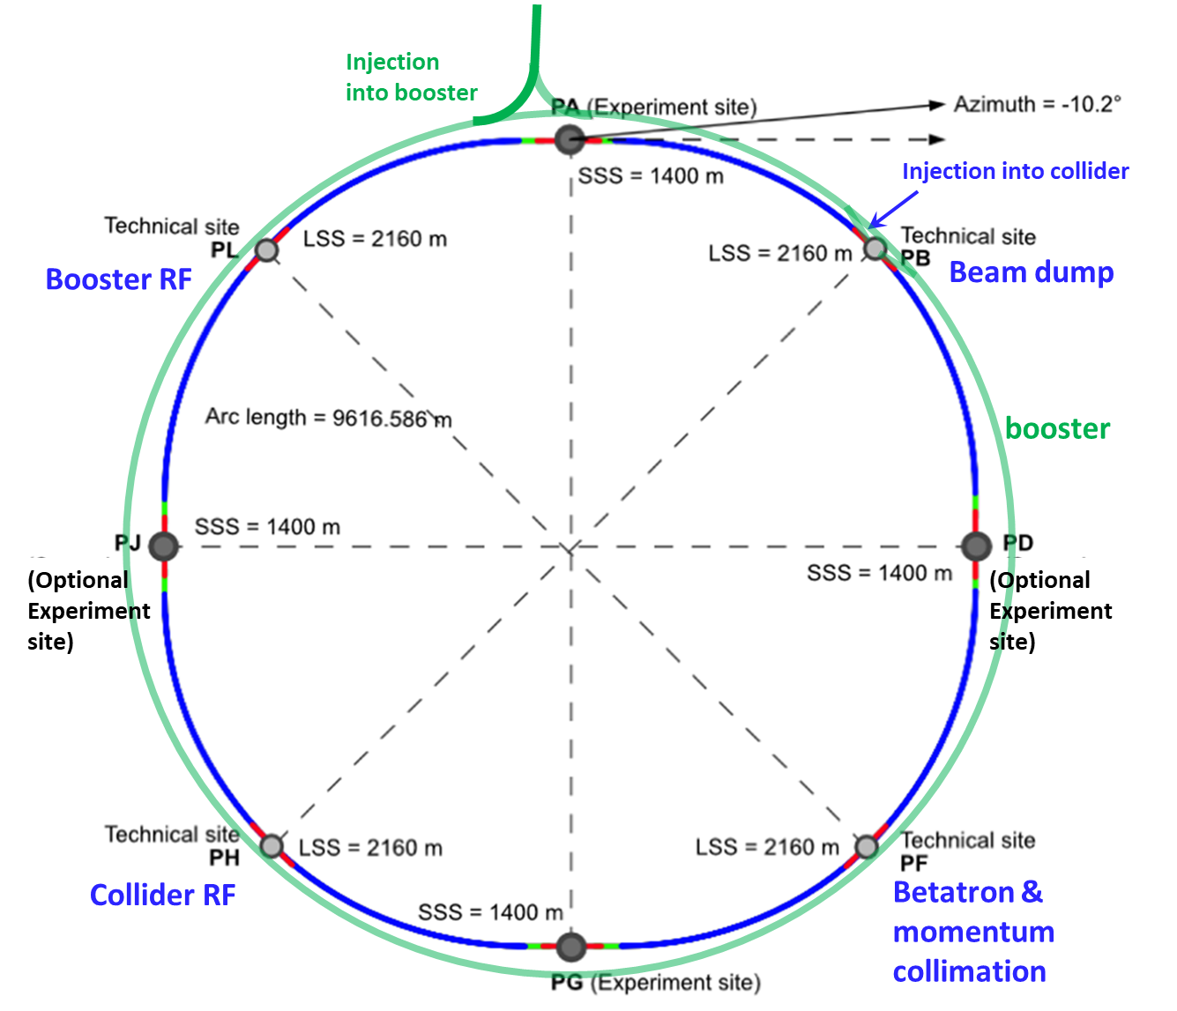
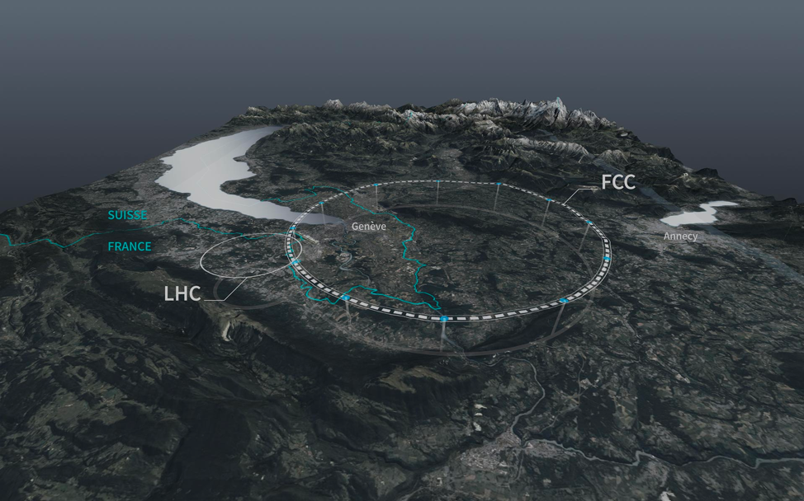
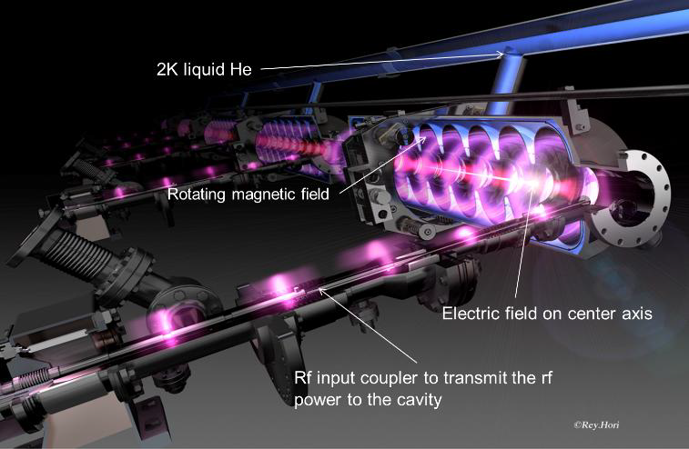
Introduction
“I always tend to assume there's an infinite amount of money out there."
”There might as well be, "Arsibalt said, "but most of it gets spent on […], sugar water and bombs. There is only so much that can be scraped together for particle accelerators.”
– Anathem by Neal Stephenson
ESPPU will consider options for a future HEP facility at CERN
There are two main options for a Higgs factory: FCC-ee and a linear collider (either NCRF or SRF) at CERN
P5, in Recommendation 2c, specified that “The US should actively engage in feasibility and design studies” for an off-shore Higgs factory
In this presentation we briefly outline some possibilities for the U.S. RF community to contribute
We are seeking your input for more possibilities
RF capabilities in the U.S. can offer to support these studies and could be relied upon to provide an in-kind contributions, a la HL-LHC AUP, for a to be selected Higgs factory
FCC-ee
ILC250
From P5 Report:
Recommendation 2c: An off-shore Higgs factory, realized in collaboration with international partners, in order to reveal the secrets of the Higgs boson. The current designs of FCC-ee and ILC meet our scientific requirements. The US should actively engage in feasibility and design studies. […]

Slide 3
FCC-ee: Main RF parameters
  one RF system per beam
  common RF system for both beams
  Total of 351 cryomodules and 1404 cavities (38% for booster)
from F. Peauger et al, FCC-ee SRF Cavity Design and RF Powering Scheme, FCC Week San Francisco, 2024
As it was reported already (D. Passarelli), we collaborating with CERN on initial development of 800 MHz SRF cavities (now 6-cell cavities) and cryomodules. This is a well-defined scope.
Related R&D:
  Nb₃Sn could potentially benefit FCC-ee (operation at 4.5 K). However, this technology is not prime-time ready. More R&D, funded by GARD and small-scale demonstration applications, is needed to solve technical difficulties, demonstrate repeatability, and reliability of operation.
  Developing Nb/Cu technology for 400 MHz SRF system

Slide 4
FCC-ee: RF power sources
with booster duty cycle of 40-30-40-90 % (worst case)
from F. Peauger et al, FCC-ee SRF Cavity Design and RF Powering Scheme, FCC Week San Francisco, 2024
For most options, it assumed that klystrons with 80% efficiency will be available (no existing today), will save 20 MW compared to 70% efficiency today. Also, it is assumed 90% efficiency for modulators and 95% for waveguide network. Alternatives for booster RF: IOT and SSA’s – focus on lowering capital cost rather than efficiency.
Potential contribution: a complete 800 MHz RF system based of high-efficiency SSA’s in collaboration with U.S. industry (SSA’s, circulators, waveguide distribution).

Slide 5
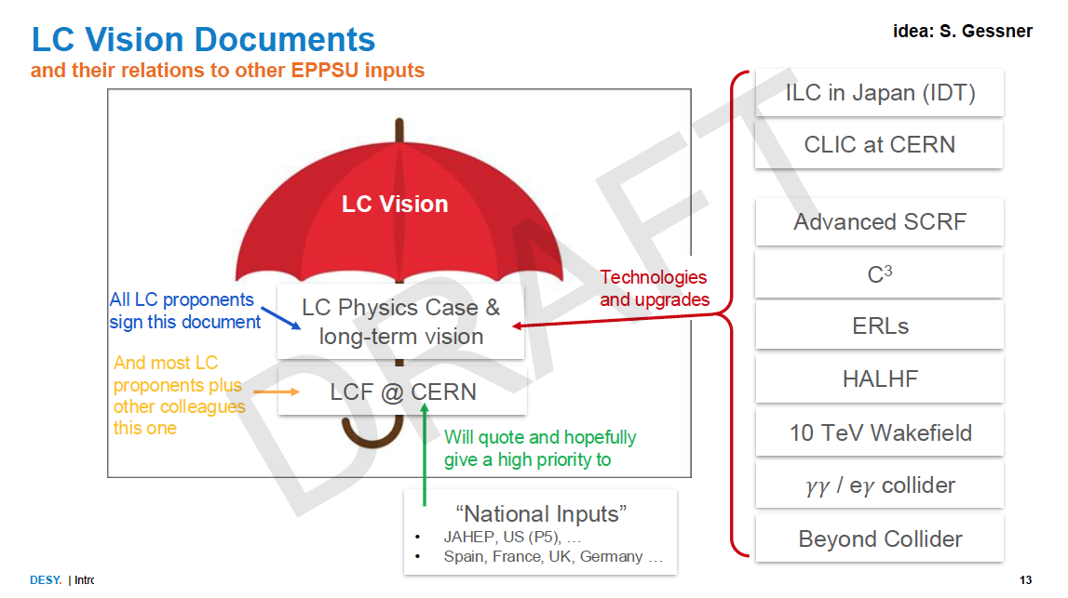
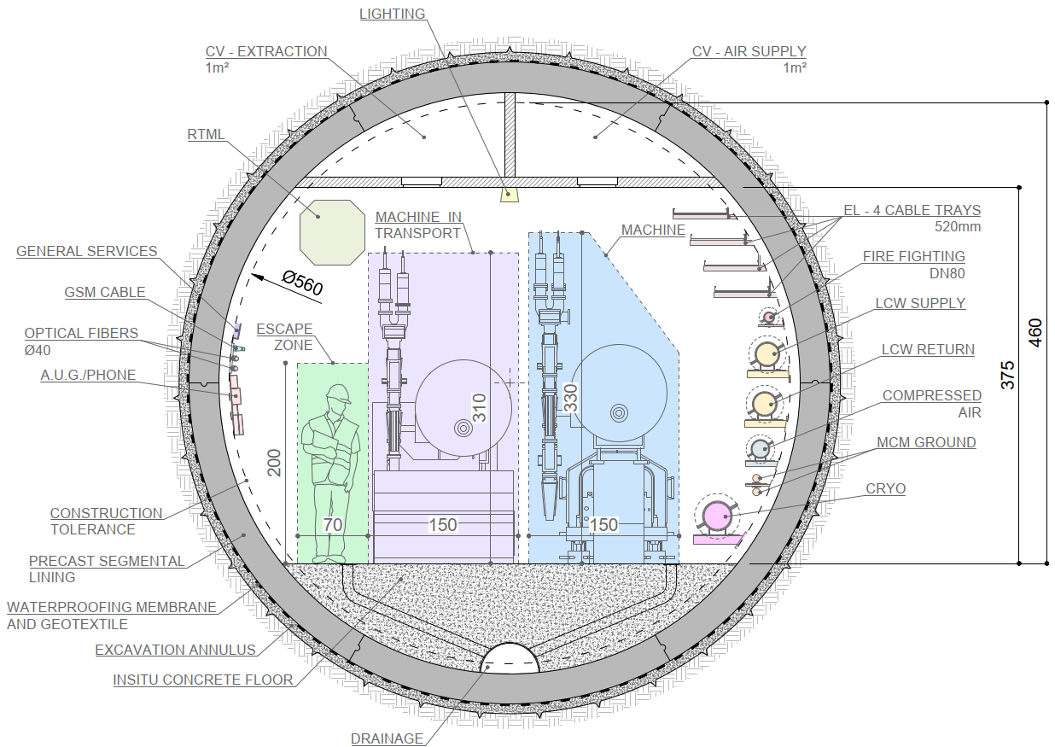
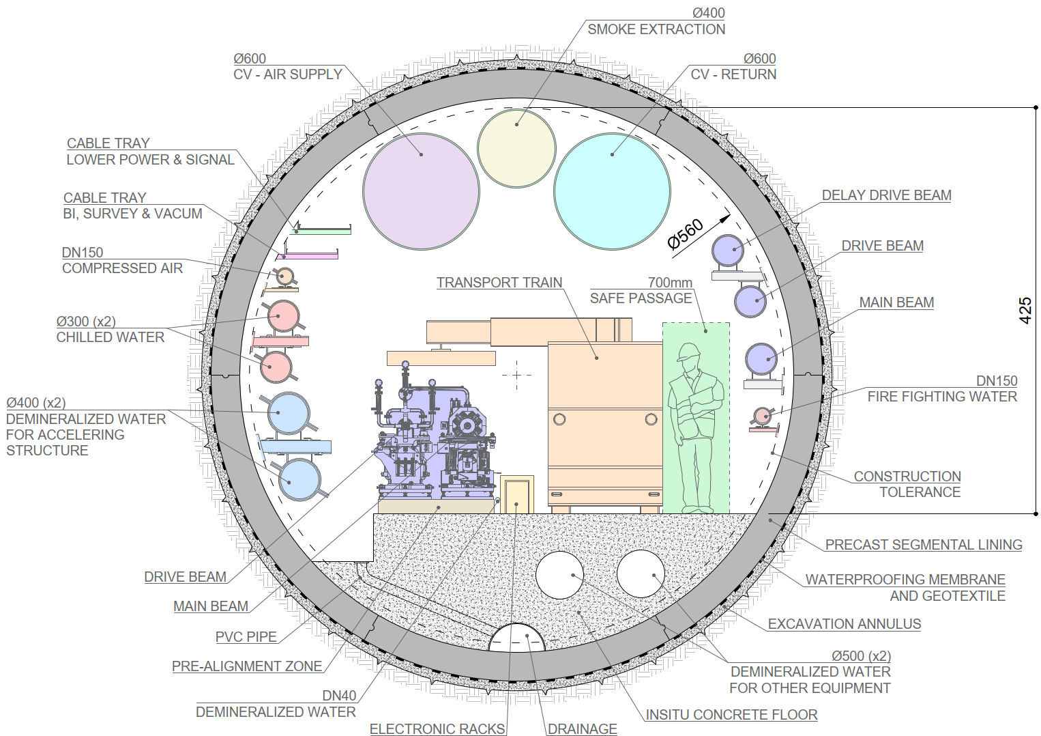
LC Vision for ESPPU
LC community is preparing a couple of large documents for ESPPU
The LCF@CERN will include two options: ILC and CLIC
The tunnel design is compatible with both options
ILC
CLIC

Slide 6
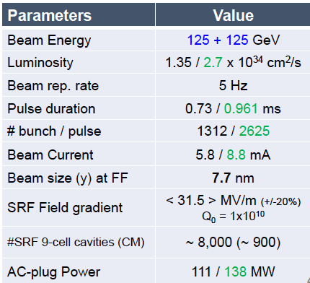
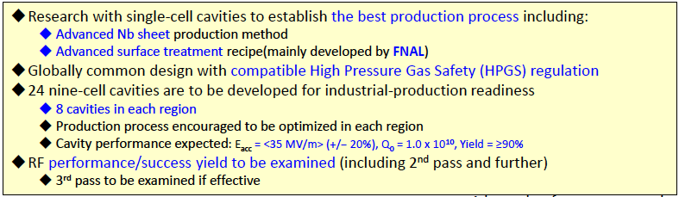
SRF R&D for ILC250 and upgrades
ILC 250 baseline and luminosity upgrade
Cryomodule design
Crab cavity prototyping
Focus on improving the reliability and repeatability and demonstration of industrialization
from S. Michizono, ILC Technology Network (ITN), LC Vision Event, CERN, 2025
There are opportunities for SRF R&D related to ILC energy upgrades
5-year horizon: 50 MV/m in a cryomodule, energy upgrade to 380GeV
10 years: traveling wave SRF with 65 MV/m for 500 GeV center of mass energy
Longer time scale: Nb3Sn and other advanced SRF superconductors

Slide 7
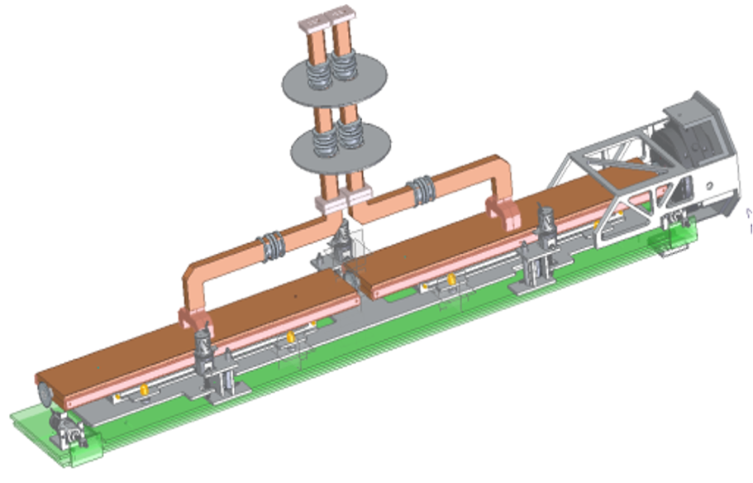
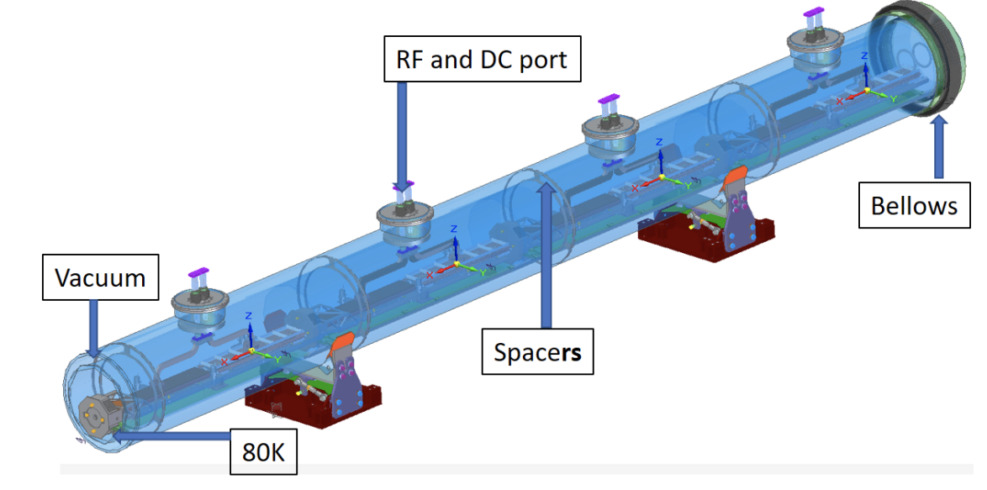
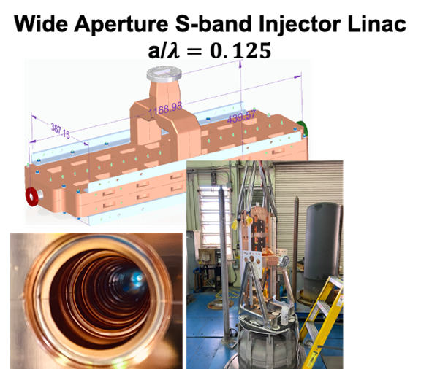
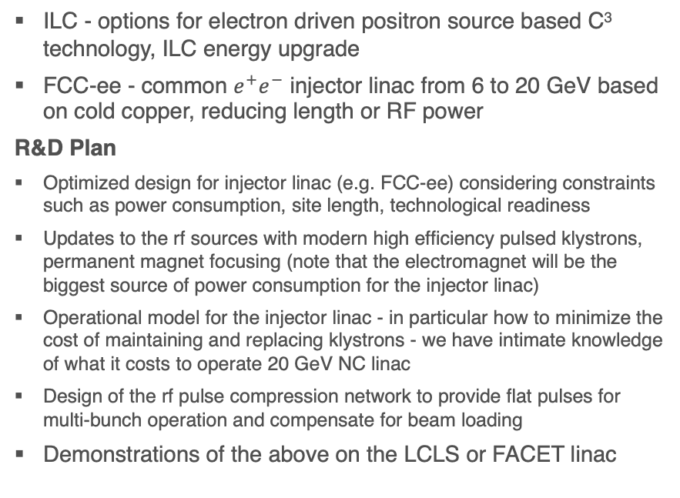
C³ technology fo Higgs factories
ILC - options for electron driven positron source based C³ technology, ILC energy upgrade
FCC-ee - common $e^{+}e^{−}$ injector linac from 6 to 20 GeV based on cold copper, reducing length or RF power
R&D Plan
Optimized design for injector linac (e.g. FCC-ee) considering constraints such as power consumption, site length, technological readiness
Updates to the rf sources with modern high efficiency pulsed klystrons, permanent magnet focusing (note that the electromagnet will be the biggest source of power consumption for the injector linac)
Operational model for the injector linac - in particular how to minimize the cost of maintaining and replacing klystrons - we have intimate knowledge of what it costs to operate 20 GeV NC linac
Design of the rf pulse compression network to provide flat pulses for multi-bunch operation and compensate for beam loading
Demonstrations of the above on the LCLS or FACET linac
Cryomodule

Slide 8
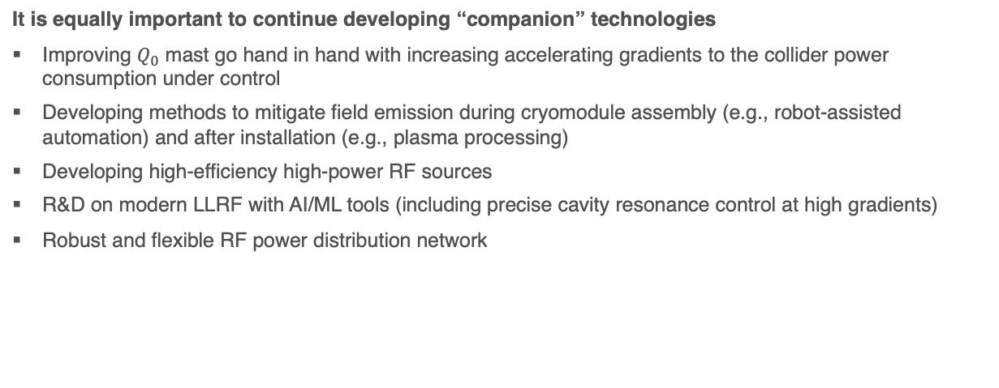
Other RF R&D for superconducting LC Higgs factory
It is equally important to continue developing “companion” technologies
Improving $Q_{0}$ mast go hand in hand with increasing accelerating gradients to the collider power consumption under control
Developing methods to mitigate field emission during cryomodule assembly (e.g., robot-assisted automation) and after installation (e.g., plasma processing)
Developing high-efficiency high-power RF sources
R&D on modern LLRF with AI/ML tools (including precise cavity resonance control at high gradients)
Robust and flexible RF power distribution network

Slide 9
RF components US capabilities
The US is competitive in the production of high-power components
Circulators, combiners and other waveguide/coaxial components
HOM traps and RF windows
Klystrons, IOTs
High voltage components
Packaged designs for modulators, capacitor banks, etc.
US produces high power GaN solid state devices
Reaching multi-kW per device
Increasing its competitiveness with RF tube solutions
Promise of long support for devices
US industry can produce packaged solutions for entire amplifier

Slide 10
Seeking your input

Slide 11
Thank you!

