Slide 1
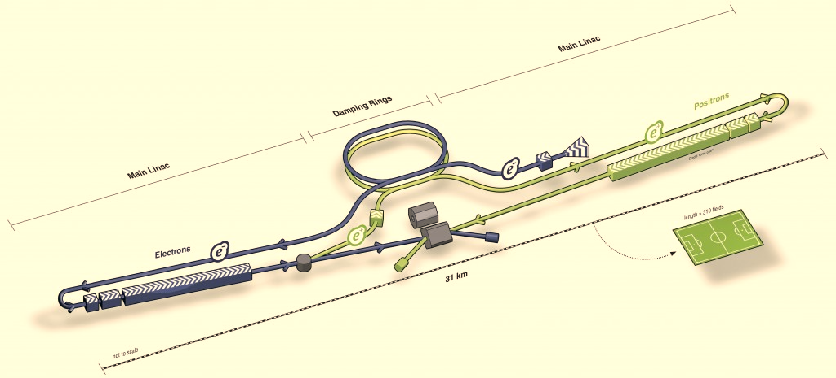
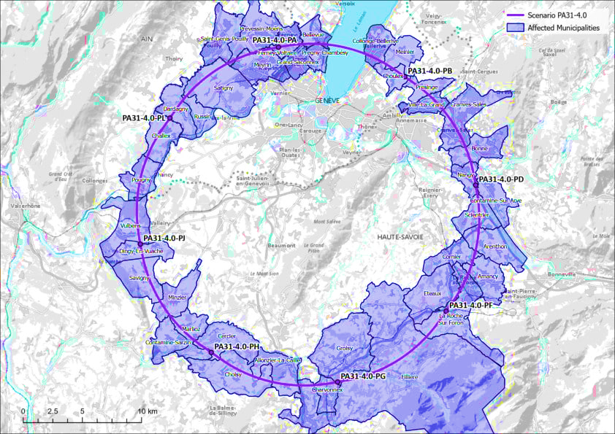
US-HFCC-Acc Integration and Sustainability
Roger Ruber, JLab, ruber@jlab.org
Mei Bai, SLAC, mbai@slac.stanford.edu
Integration
idea

Slide 2
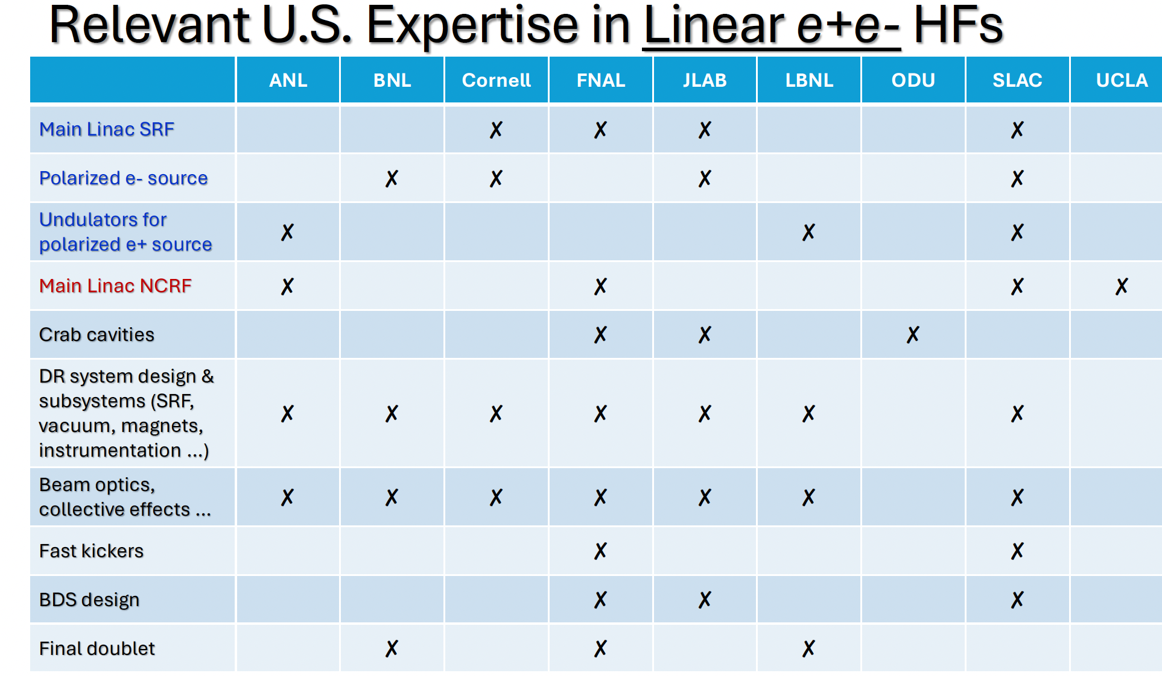
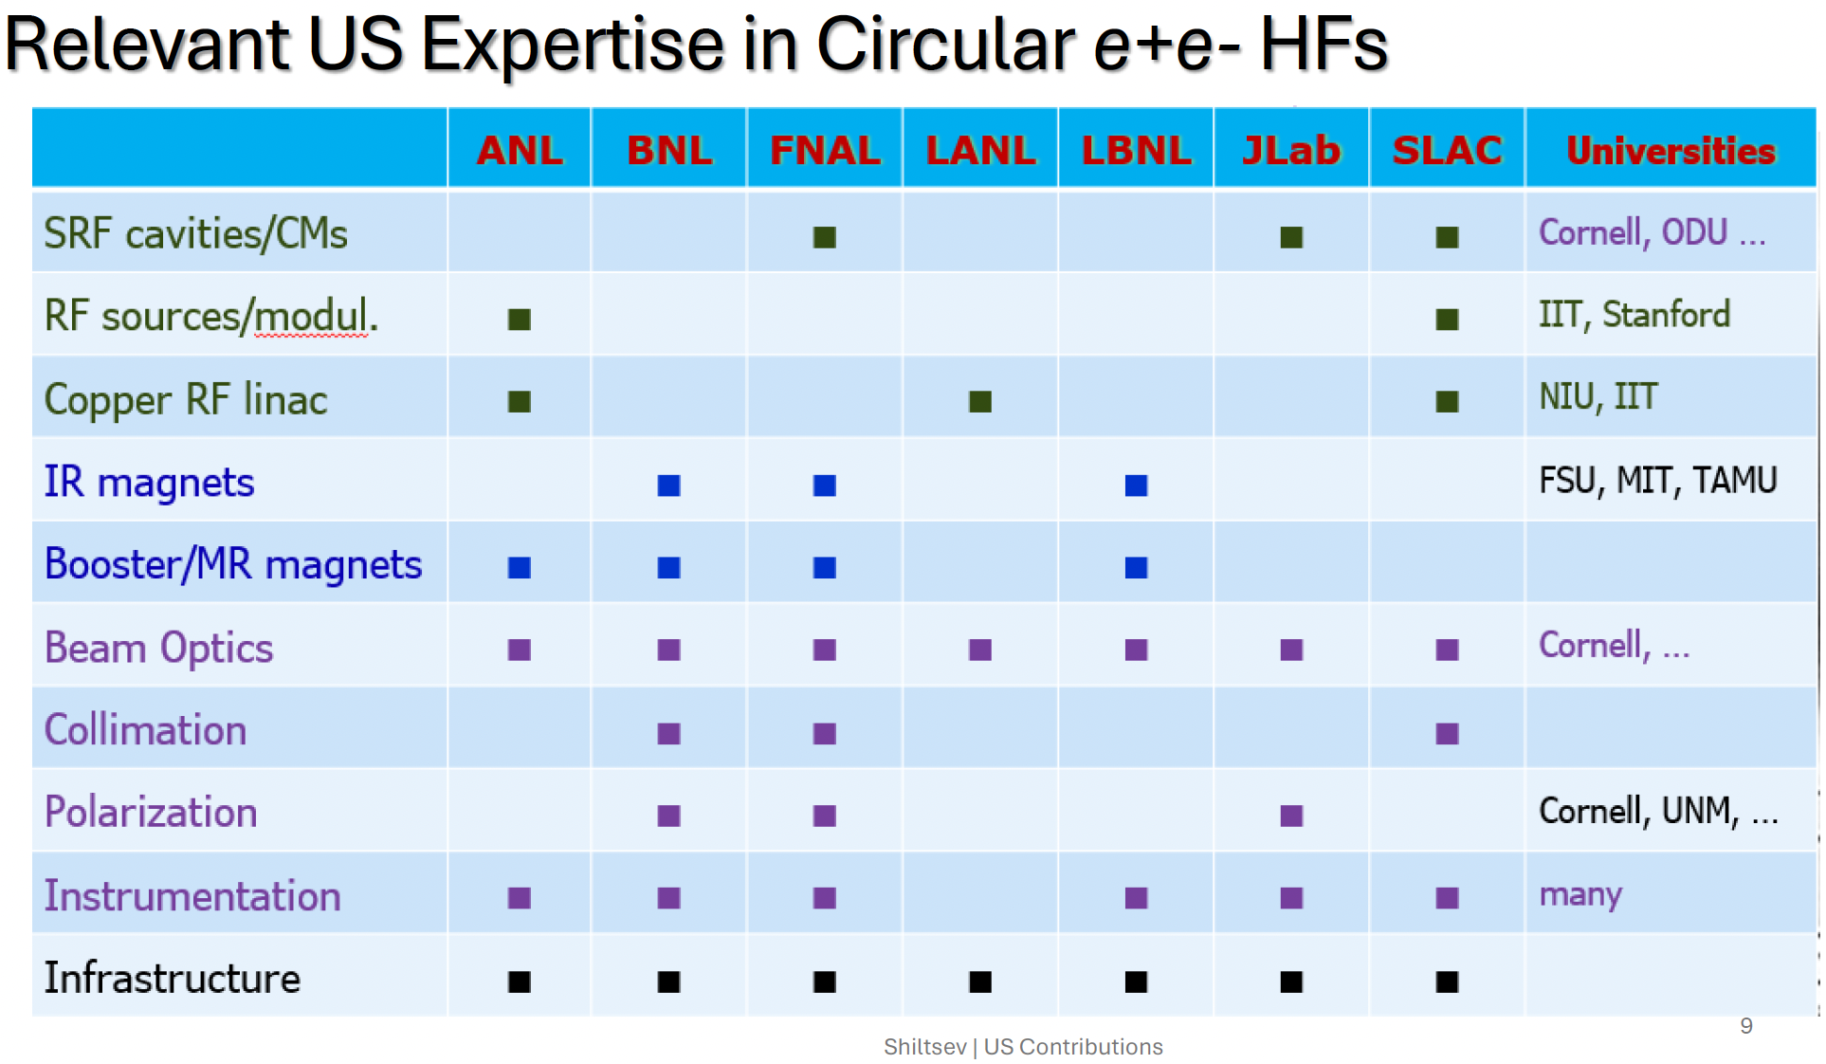
Guidance from HFCC-Acc L-1
7 L-2 topics with initial input from V. Shiltsev P5 presentation on Potential US Technology Contributions to [Off-Shore] Future Colliders

Slide 3
Focus of our topic on Integration and Sustainability
Facilitate L-1 to develop the framework of integrating the US accelerator contributions across the US HFCC-Acc L-2 topics in Beam Physics, Diagnostics and Instrumentation, RF Systems, Magnet Systems, Machine Detector Interface, and Infrastructure
Identify the R&D topics in sustainability across design, technology choice for cost effective construction and robust operation

Slide 4
Our initial thoughts regarding potential topics
high efficiency high power RF source
radiation hard cryocoolers for HTS magnet, etc
integrated IR design: beam dynamics, magnets, MDI
Integrated controls
Safety systems
Integrated HG injector linac and beam line design
Generative AI for Software management and global systems
Transforming Legacy Scientific Equipment for Future Innovations
…
Next steps:
Work with other L-2 convenors on the scope of their topics
Reach out to the community including sustainability groups in Europe to collect inputs

