Slide 1
Test Results from the Pre-series Magnet
-PIP II SSR Solenoid FDR
Miao Yu, FNAL
Kumud, BARC
01/15/2025

Slide 2
Pre-series Magnets Test Overview
Main Coil Parameter | TRS
Focusing strength (T²m) | >4.2
Current in the solenoid (A) | <90
Solenoid operating range (%) | 5-100
Solenoid ramp time to max. current (s) | <70
Number of quenches allowed | -
Quench training memory | -
Effective length of the solenoid field (mm) | 185
Beam pipe to beam pipe distance (mm) | 237
4 pre-series magnets have been fabricated.
3 pre-series magnets (007, 003 and 008) are located at FNAL, while the fourth one(009) is at BARC.
Parameter | TRS | 007 |  | 003 | 008
 |  | BARC | FNAL | BARC | BARC
Focusing strength (T²m) | >4.5 | 4.5 | -- | 4.56 | 4.5
Current in Solenoid (A) | <90 | 45 | 43.5 | 47.5 | 43.5
Effective Length (mm) | 185 | 161.8 | - | 179 | 180
Quench # | - | 15 | 25* | 13 | 12
Ramp time to max. current (s) | <70 | 6250 | 1000 | 6250 | 6250
Current in the corrector (A) | <50 | 50 | 50** | 50 | 50
Dipole Corrector Coil Parameter | TRS
Integral of the dipole field (mT-m) | >5
Current in the corrector (A) | <50
Filed quality of corrector coils (%) | +/-5
Corrector field good field region (mm) | 24
Corrector field operating range (%) | -100 - +100
Corrector ramp time to max. current (s) | <10
*During the 2nd thermal cycle, the magnet lost the quench training memory.
**While holding a current of 40 A in the solenoid, powering the D triggered the solenoid to quench.

Slide 3
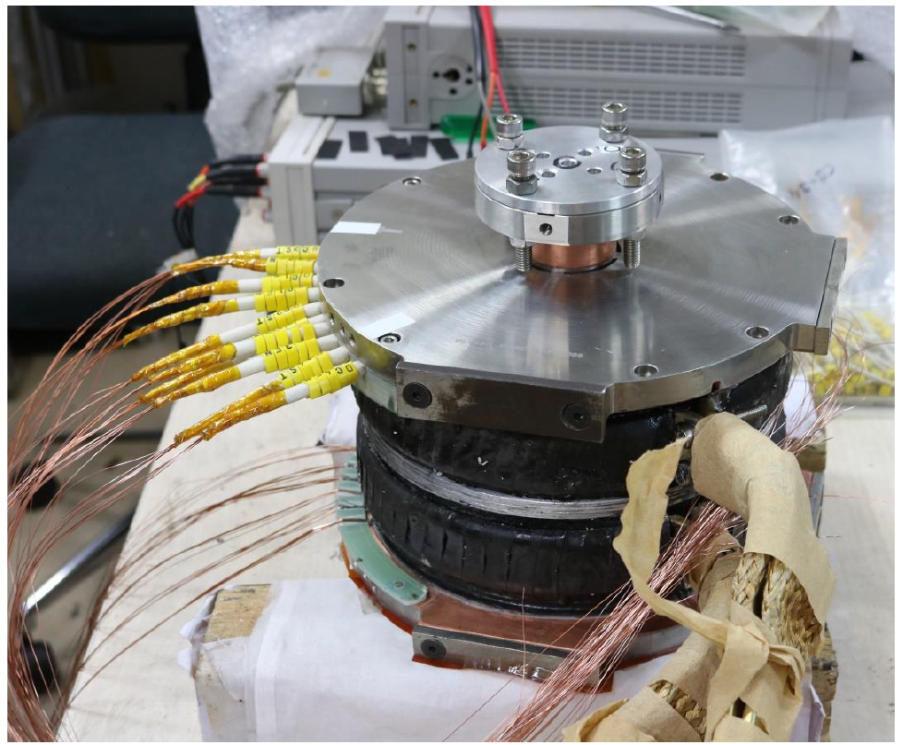
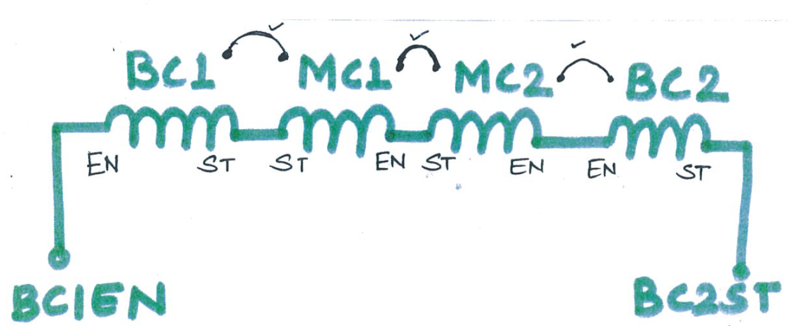
SSR Solenoid Pre-series 007
The magnet was initially tested at BARC using conduction cooling.
After its delivery to FNAL, it underwent further testing with conduction cooling, during which multiple quenches occurred due to either thermal or mechanical issues .
To isolate these issues and identify the root cause of the quenches, the magnet was subsequently tested in LHe.

Slide 4
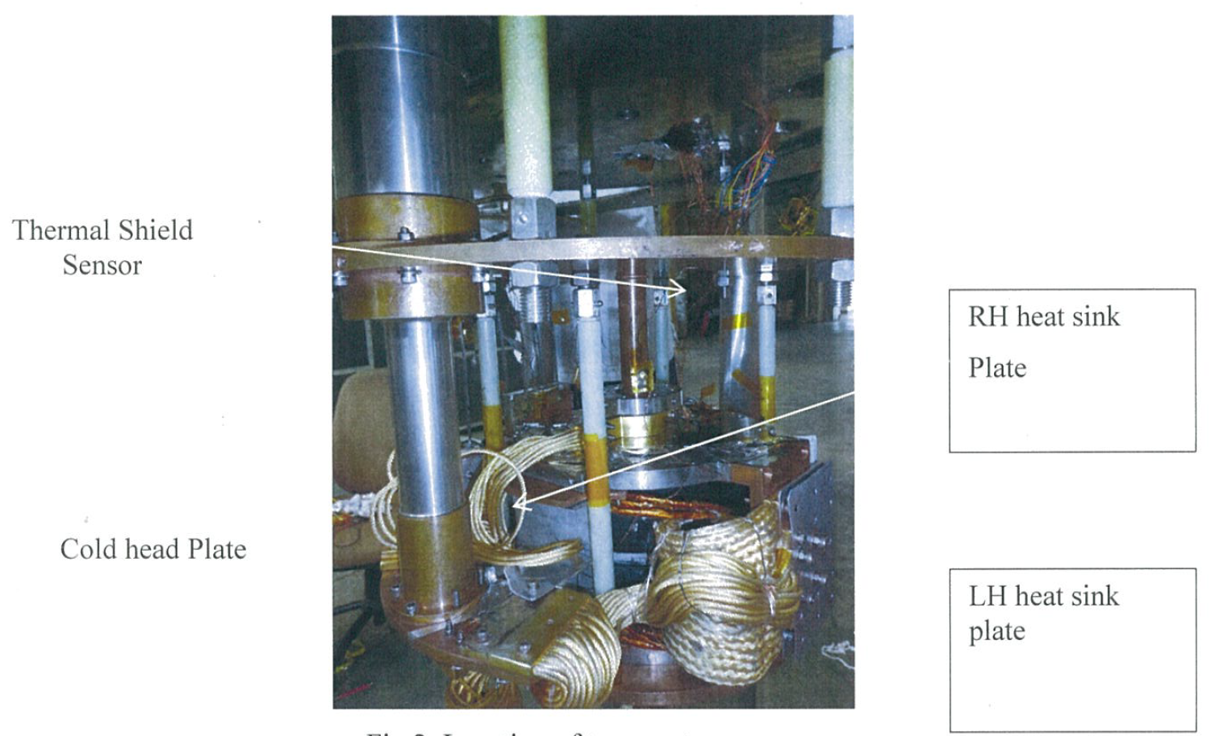
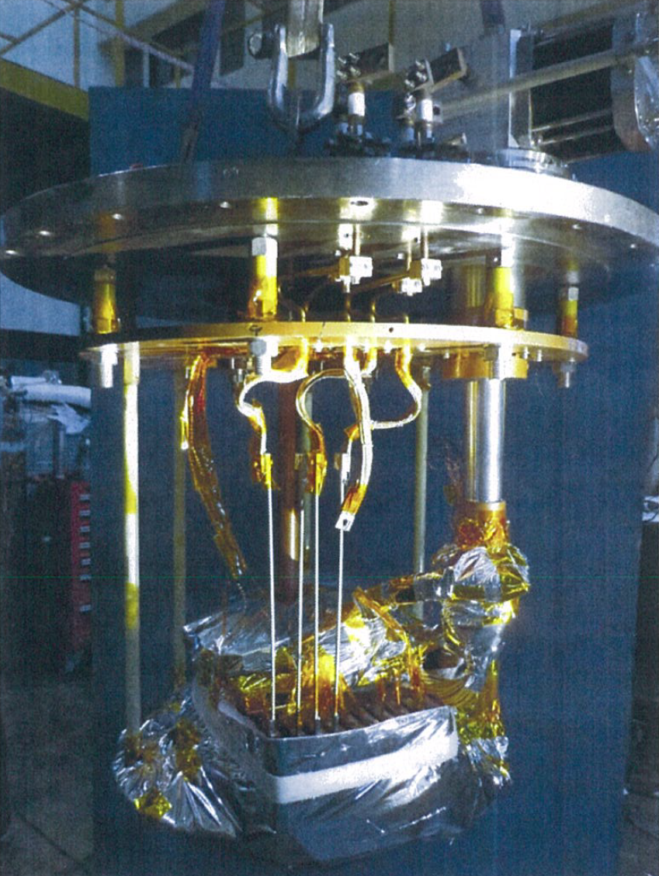
Pre-series 007 Test Setup at BARC
The magnet was conduction cooled.
The magnet was wrapped with Multi-layer insulation to keep the temperature.
There are a total of 10 current leads: 2 for MC-BC and 8 for DC. By design, all leads shall be connected, however during testing, only two current leads were connected to prevent the temperature from exceeding the critical point for the magnet.

Slide 5
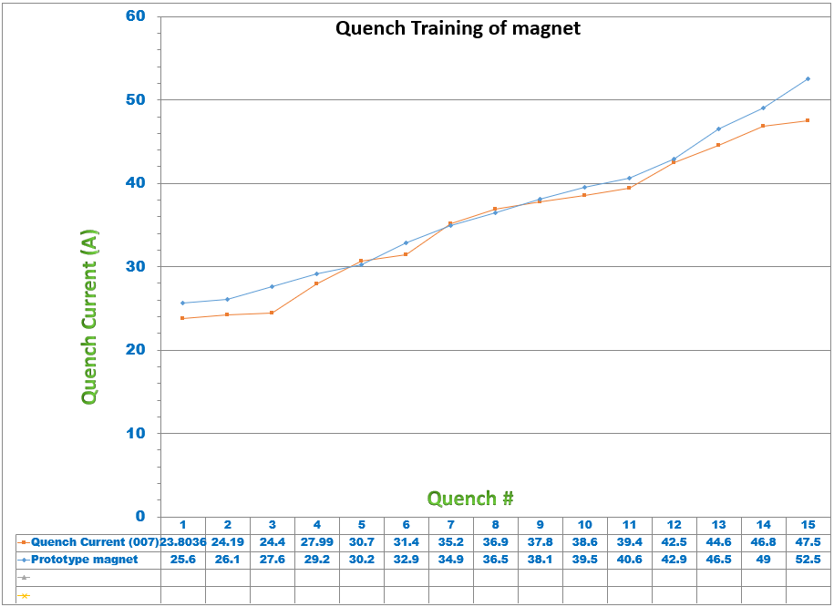
Pre-series 007 Test Results at BARC
Ramp rate < 0.01 A/s.
The nominal current for this magnet is 50 A for integrated field strength 4.5 T²m.
The magnet reached 47.5 A after 15 quenches.

Slide 6
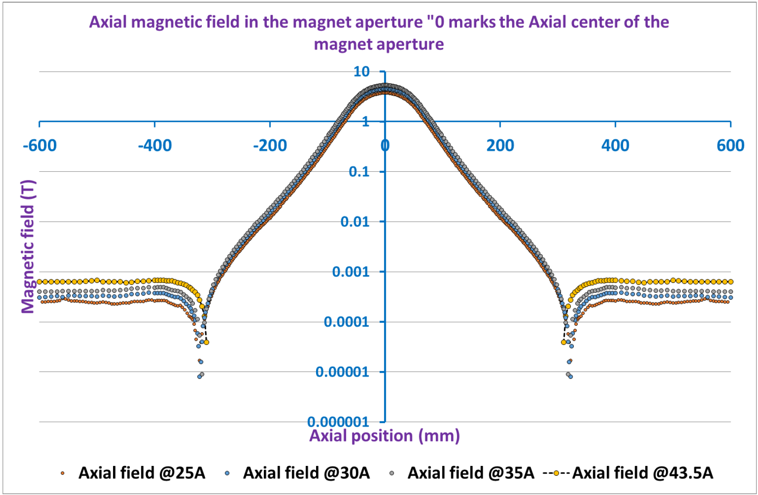
Pre-series 007 Test Results at BARC
When the solenoid was powered at 43.5 A, the fringe field beyond 0.42 m was measured to be <6 Gauss.
Extrapolating to 50 A, the fringe field was expected to be <6 Gauss.

Slide 7
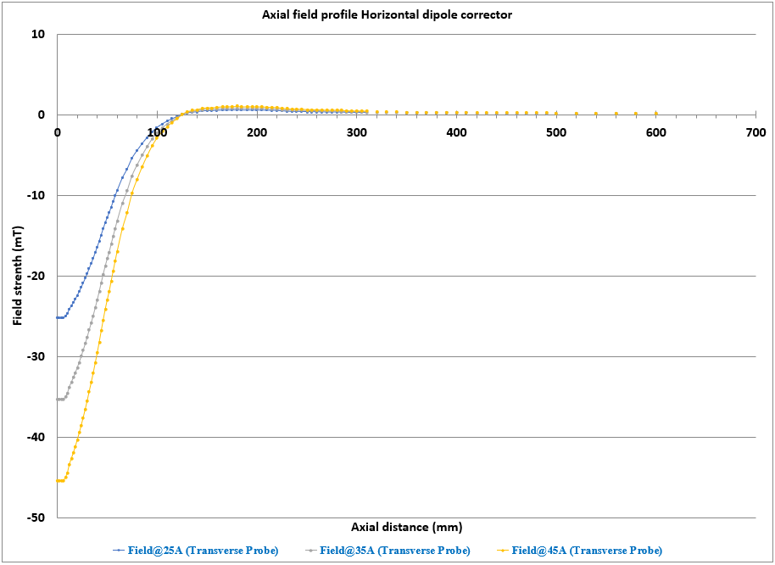
Pre-series 007 Test Results at BARC
When the dipole coils were powered at 45 A, the dipole field was measured along the axial direction.
The integral field strength was calculated to be 4.4 mT-m.
Extrapolating to 50 A, the integral field strength is expected to be 4.9 mT-m.

Slide 8
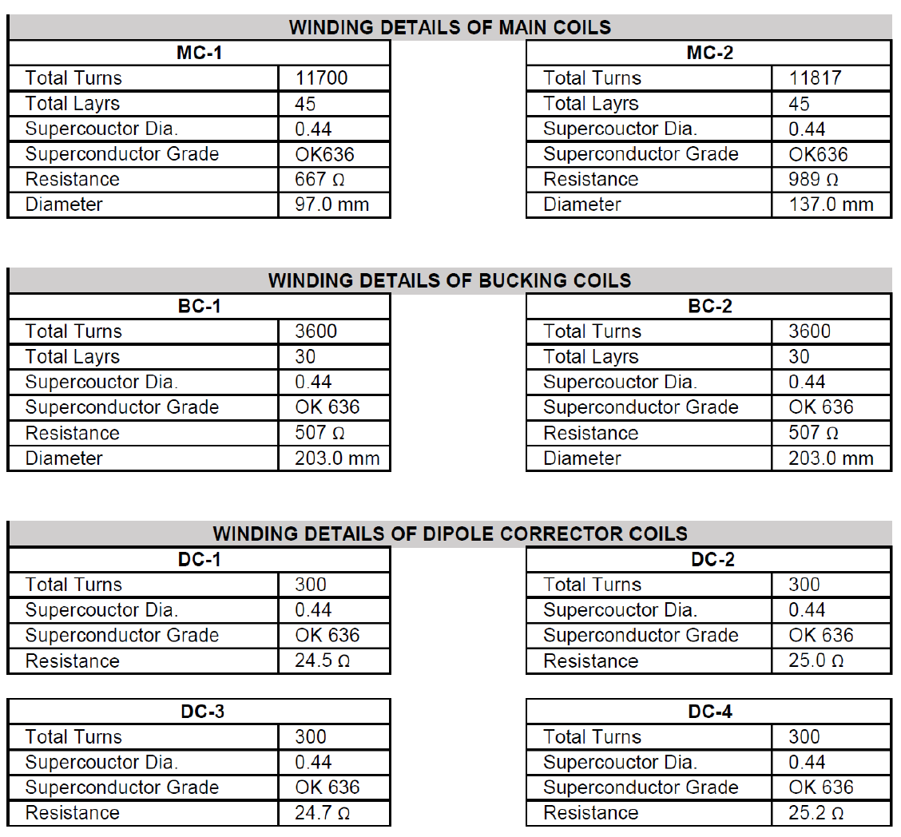
Incoming Inspection at FNAL
Measurement | MC1 (FNAL) | MC1 (BARC) | MC2 (FNAL) | MC2 (BARC) | BC1 (FNAL) | BC1 (BARC) | BC2 (FNAL) | BC2 (BARC)
Resistance (Ω) | 669 | 680.74 | 856 | 1009.75 | 479 | 516.51 | 503 | 516.65
GND Check >20MΩ | ✓ | N/A | ✓ | N/A | ✓ | N/A | ✓ | N/A
L @ 100Hz (mH) | 2662 | 3793.3 | 2595.2 | 6284.7 | 1439 | 1467.5 | 1551 | 1580.6
Q @ 100Hz | 1.2 | 2.11 | 0.7 | 1.5 | 0.7 | 0.81 | 0.9 | 0.88
L @ 1KHz (mH) | 1498 | 2002.4 | 917.9 | 650.75124 | 379.7 | 775.5126 | 886.1 | 846.8501
Q @ 1KHz | 1.5 | 1.09 | 1.2 | 0.25 | 0.8 | 1.49 | 1.9 | 1.36
Measurement | DC1 (FNAL) | DC1 (BARC) | DC2 (FNAL) | DC2 (BARC) | DC3 (FNAL) | DC3 (BARC) | DC4 (FNAL) | DC4 (BARC)
Resistance (Ω) | 24.07 | 25.31 | 24.1 | 25.35 | 24.09 | 25.32 | 24.14 | 25.39
GND Check >20MΩ | ✓ | N/A | ✓ | N/A | ✓ | N/A | ✓ | N/A
L @ 100Hz (mH) | 16 | 15.8824 | 15 | 15.9361 | 16 | 15.9904 | 15 | 15.9266
Q @ 100Hz | 0.4 | 0.4 | 0.4 | 0.4 | 0.4 | 0.4 | 0.4 | 0.4
L @ 1KHz (mH) | 15 | 14.9065 | 15 | 14.9908 | 15 | 15.0373 | 15 | 14.9805
Q @ 1KHz | 3.3 | 3.21 | 3.3 | 3.23 | 3.3 | 3.24 | 3.3 | 3.23

Slide 9
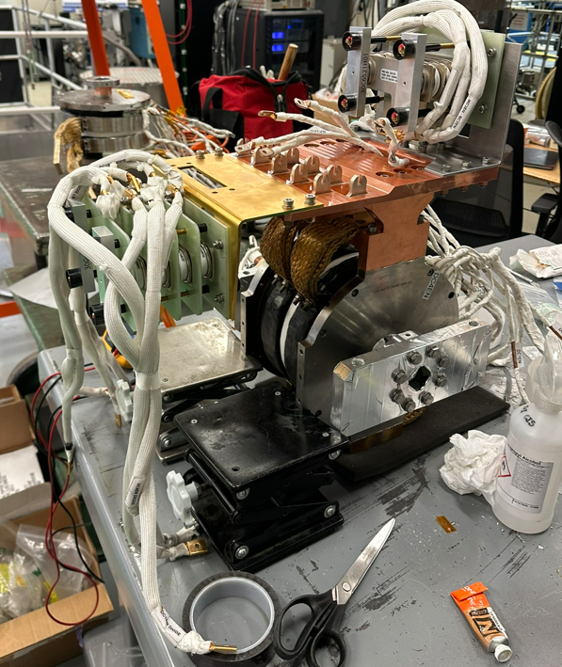
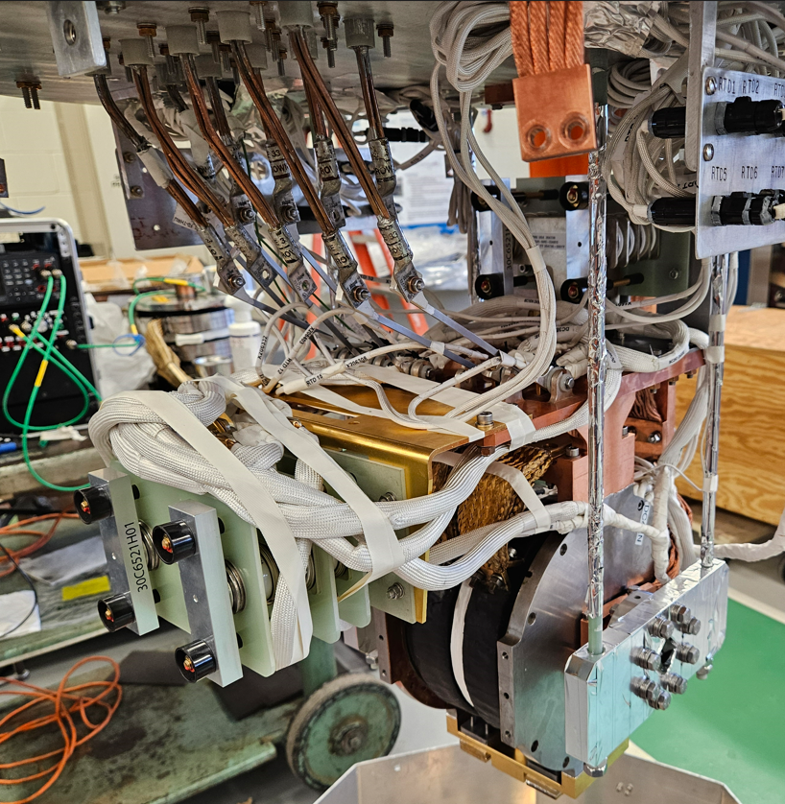
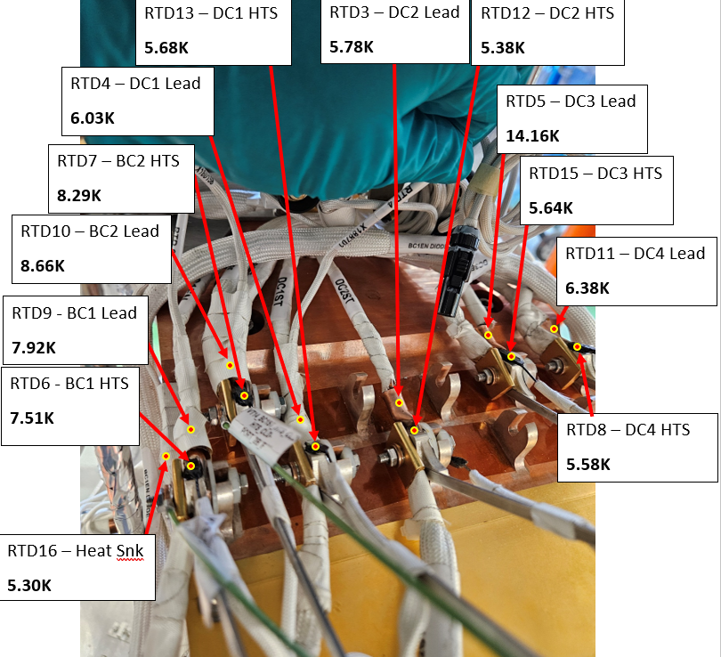
Pre-series 007 Test Setup at FNAL
The magnet was conduction cooled with all the current leads connected.
After cooldown, the temperature at current leads was ~8K, while the coil temperature remained unknown.

Slide 10
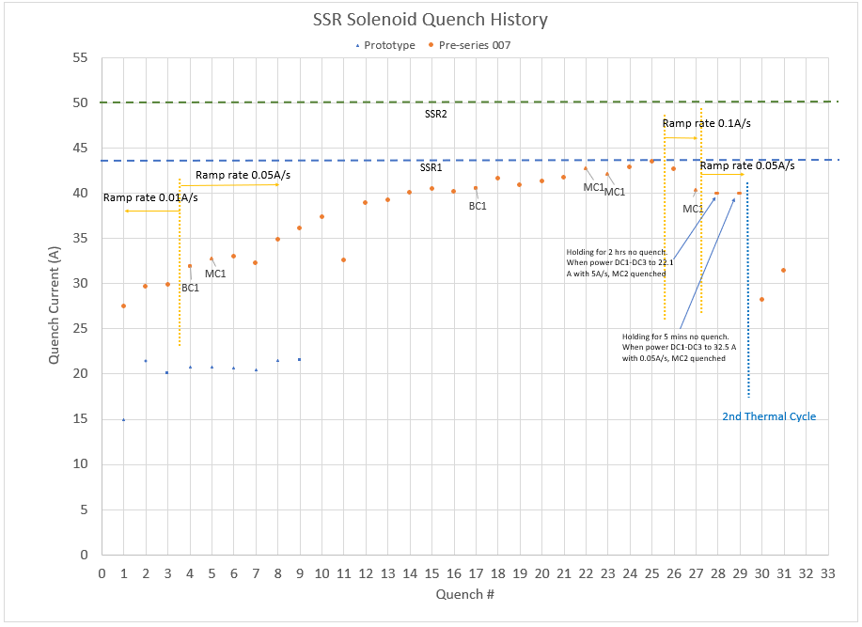
Pre-series 007 Quench History at FNAL_Conduction-Cool Testing
Dipole Coil:
DC1-DC3 and DC2-DC4 were powered up to 42 A with a ramp rate of 5 A/s, no quench. ​
Main Coil – Bucking Coil:
With ramp rate 0.01 A/s: 3 quenches occurred, with the first quench at a current of 27.5 A
With ramp rate 0.05 A/s: After 22 quenches the magnet reached 43.5 A, with most quenches occurring in MC2.
With ramp rate 0.1 A/s: the magnet detrained to 40 A.
Holding Test: The magnet was ramped up to 40 A at a ramp rate of 0.05 A/s and held steady at 40 A without any quench.
Coupling Effect: While holding 40 A in the solenoid, powering the dipole coils triggered a quench.
Thermal Cycle Test:
After the 2nd thermal cycle, the magnet lost its training memory.

Slide 11
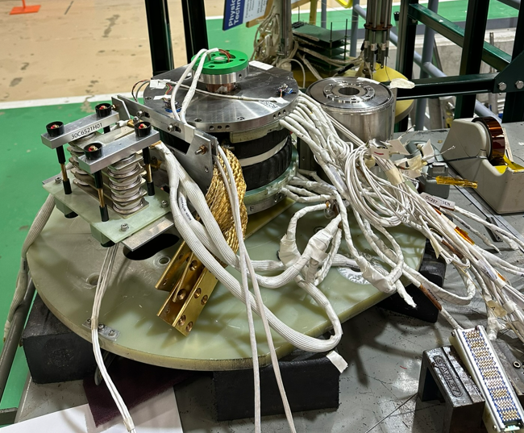
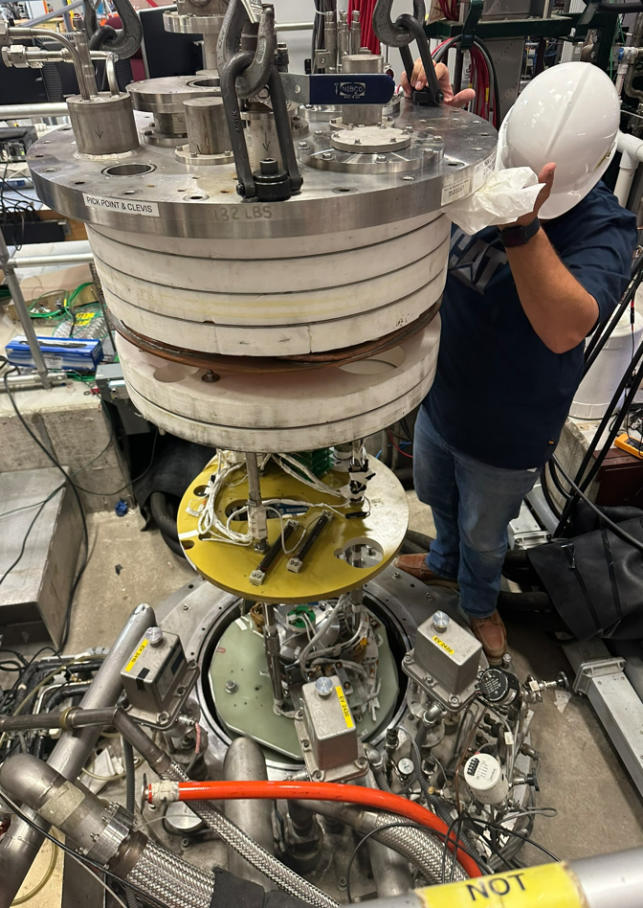
Pre-series 007 LHe Test Setup at FNAL
The magnet was equipped with the quench antenna and the acoustic sensors.
After cooldown, the temperature of the magnet reached 4.5 K.

Slide 12
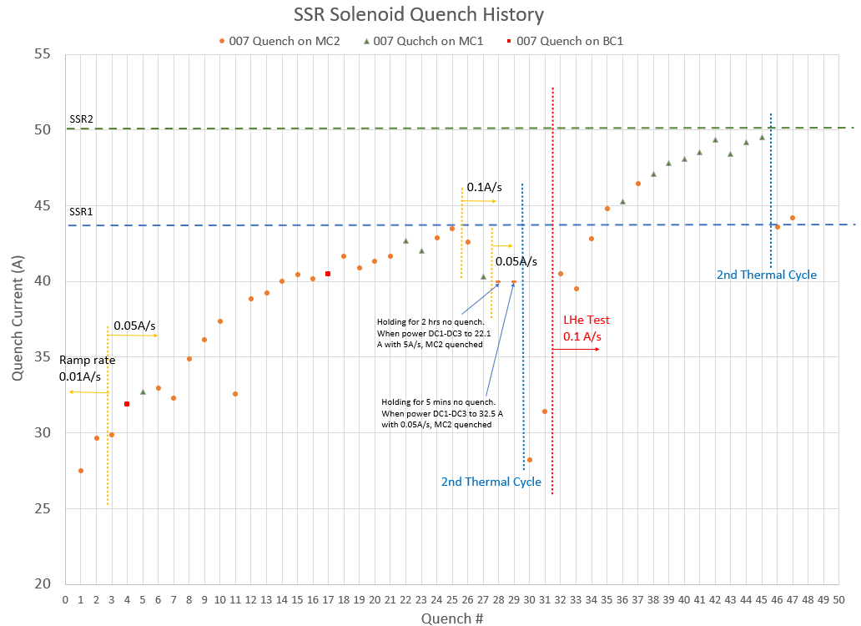
Pre-series 007 Quench History at FNAL_LHe Testing
Test at 4.5 K in Vertical Magnet Test Facility:
Quench Training: With a ramp rate of 0.1 A/s, the first quench occurred at 40.5 A. After 14 quenches over 2 days, the magnet reached to 49.5 A.
Quench Locations: At lower currents, quenches were primarily located in MC2 , with the quench antenna indicating that the location was close to the axial center of the solenoid. At higher currents, quenches shifted to MC1.
Thermal cycle test: After the 2nd thermal cycle, the magnet lost its training memory.

Slide 13
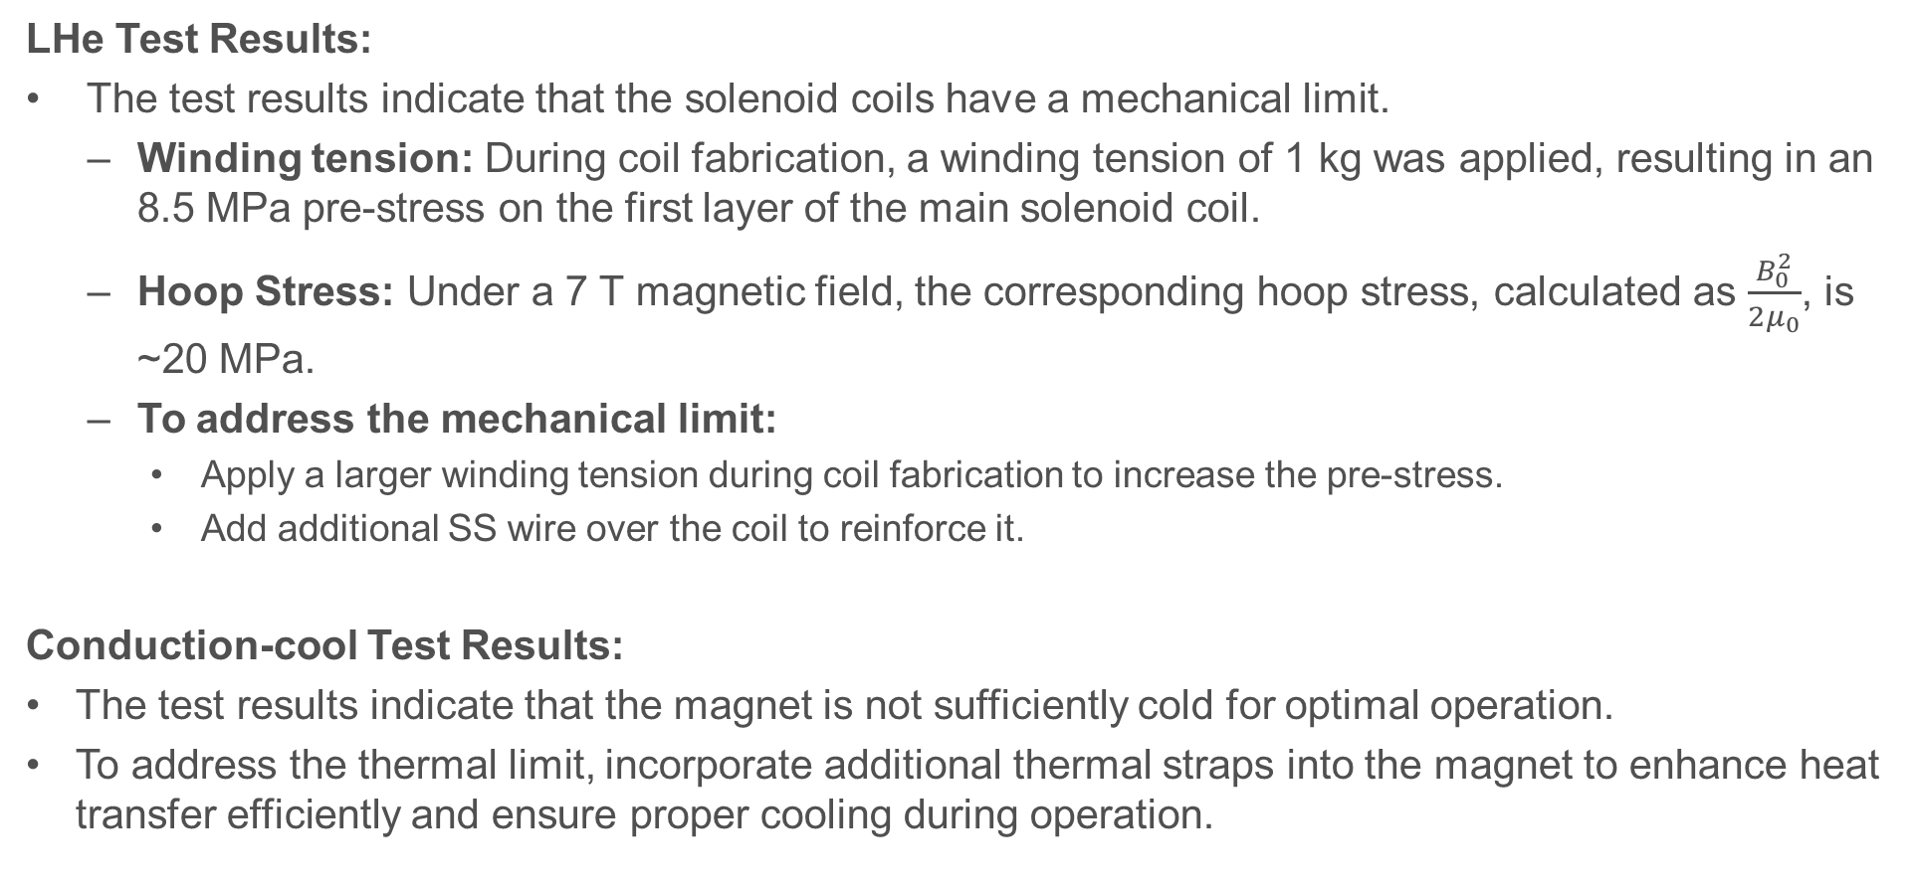
Summary
LHe Test Results:
The test results indicate that the solenoid coils have a mechanical limit.
  Winding tension: During coil fabrication, a winding tension of 1 kg was applied, resulting in an 8.5 MPa pre-stress on the first layer of the main solenoid coil.
  Hoop Stress: Under a 7 T magnetic field, the corresponding hoop stress, calculated as $\frac{B_{0}^{2}}{2μ_{0}}$, is ~20 MPa.
  To address the mechanical limit:
    Apply a larger winding tension during coil fabrication to increase the pre-stress.
    Add additional SS wire over the coil to reinforce it.
Conduction-cool Test Results:
The test results indicate that the magnet is not sufficiently cold for optimal operation.
To address the thermal limit, incorporate additional thermal straps into the magnet to enhance heat transfer efficiently and ensure proper cooling during operation.

