Slide 1
Updated PRD and TRS
-PIP II SSR Solenoid FDR
Miao Yu
01/15/2025

Slide 2
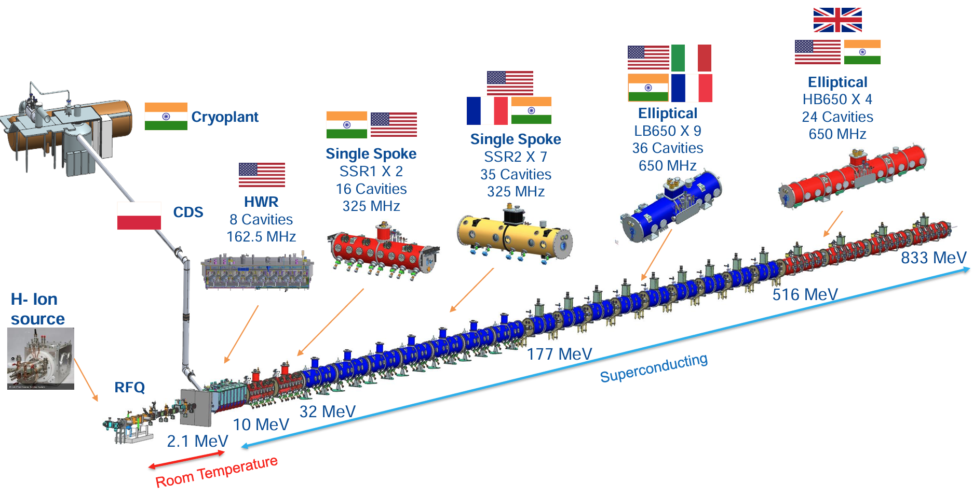
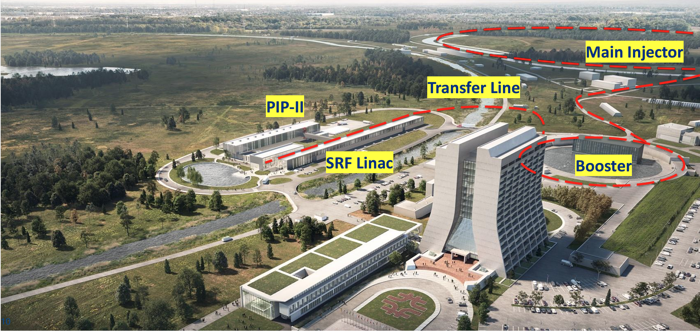
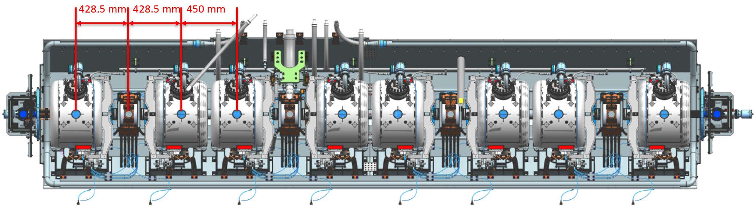
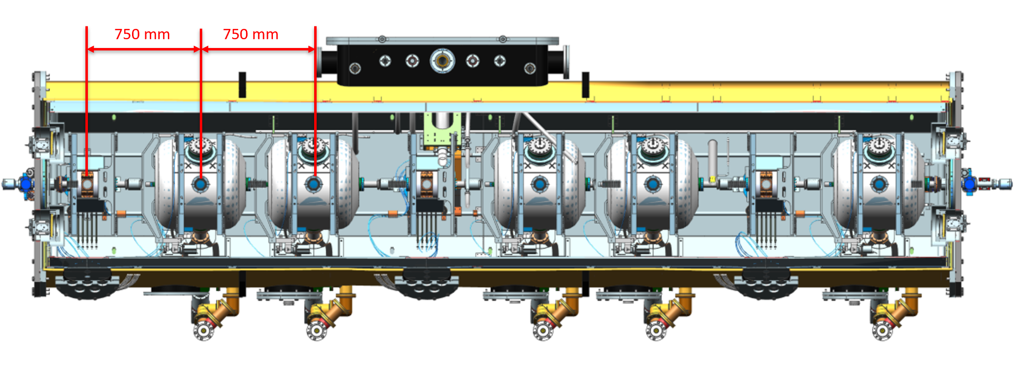
PIP-II SSR Solenoids
29 solenoids focusing lenses
Identical design for both SSR1 and SSR 2
4 solenoids per SSR1
3 solenoids per SSR2
Contributors:
Primary: In-kind contributions from BARC, India
Backup: a US industrial vendor
SSR1
SSR2

Slide 3
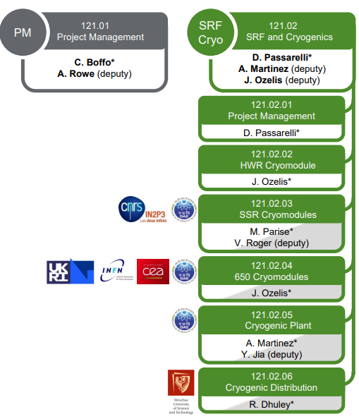



Organization
USA
DAE/BARC
Kumud Singh (SPC)
Fermilab
Miao Yu (SPM)

Slide 4
Plan for 2025
FDR Session 1: EM design, January 2025
FDR Session 2: Thermal and Mechanical design, February 2025
  Conduction cooling performance and thermal management
  Mechanical stress analysis under operational conditions
  Fabrication and Assembly:
    Winding process, pre-stress, and mechanical reinforcement strategies
    Material selection and QA process
    Instrumentation plan: Voltage taps, temperature sensors.
    Assembly procedures and integration with the SSR cryomodule
    Drawing package
Prototype Magnet: Tested in May-June 2025 at BARC
  Thermal performance
  Magnet quench performance including quench training memory during 2nd thermal cycle
  Magnetic field measurements, including focusing strength, fringe field, bending integral strength and dipole field quality.

Slide 5
Plan for 2025
Procurement readiness review (PRR): Aug.-Sept. 2025
  Prototype testing results
  Design and Manufacturing Readiness
    Verification of the final design against operational and interface requirements
    Validation of manufacturing procedures, including coil winding, potting, and assembly.
  Procurement scope and specification
  Vendor assessment
  Production and Delivery Plan (2-3 pre-series magnets + production magnets)
  Testing Plan
  Documentation and Reporting

Slide 6
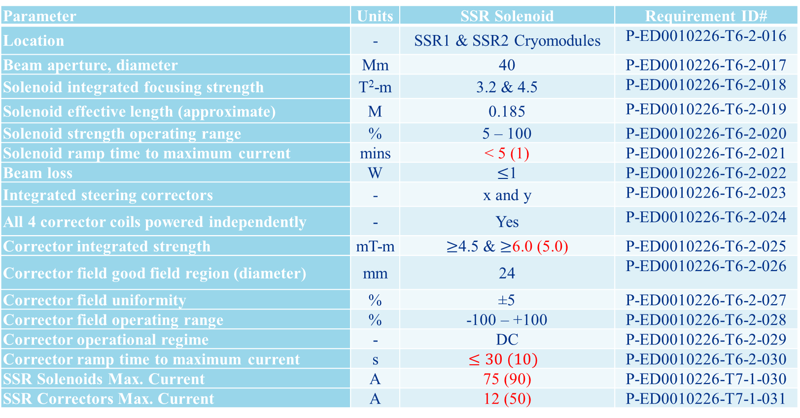
Updated Physics Requirement Document (PRD)
Parameter | Units | SSR Solenoid | Requirement ID#
Location | - | SSR1 & SSR2 Cryomodules | P-ED0010226-T6-2-016
Beam aperture, diameter | Mm | 40 | P-ED0010226-T6-2-017
Solenoid integrated focusing strength | T²-m | 3.2 & 4.5 | P-ED0010226-T6-2-018
Solenoid effective length (approximate) | M | 0.185 | P-ED0010226-T6-2-019
Solenoid strength operating range | % | 5 – 100 | P-ED0010226-T6-2-020
Solenoid ramp time to maximum current | mins | < 5 (1) | P-ED0010226-T6-2-021
Beam loss | W | $≤$1 | P-ED0010226-T6-2-022
Integrated steering correctors | - | x and y | P-ED0010226-T6-2-023
All 4 corrector coils powered independently | - | Yes | P-ED0010226-T6-2-024
Corrector integrated strength | mT-m | $≥$4.5 & $≥$6.0 (5.0) | P-ED0010226-T6-2-025
Corrector field good field region (diameter) | mm | 24 | P-ED0010226-T6-2-026
Corrector field uniformity | % | ±5 | P-ED0010226-T6-2-027
Corrector field operating range | % | -100 – +100 | P-ED0010226-T6-2-028
Corrector operational regime | - | DC | P-ED0010226-T6-2-029
Corrector ramp time to maximum current | s | $$≤30 (10)$$ | P-ED0010226-T6-2-030
SSR Solenoids Max. Current | A | 75 (90) | P-ED0010226-T7-1-030
SSR Correctors Max. Current | A | 12 (50) | P-ED0010226-T7-1-031
Note:
The revised parameters are highlighted in red, with the previous value shown in ( ).
The full document is available on indico page.

Slide 7
Updated Technical Requirement Specifications (TRS)
 | Parameter for Main Coil and Bucking Coils | Value | Unit
T-13800PSSR1and2FLCL-110 | Focusing strength | >4.5 (4.2) | T²m
T-13800PSSR1and2FLCL-111 | Max. Current in the solenoid | 75 (90) | A
T-13800PSSR1and2FLCL-164 | Solenoid operating range | 5-100 | %
T-13800PSSR1and2FLCL-165 | Solenoid ramp time to max. current | <300 (60) | s
T-13800PSSR1and2FLCL-112 | Effective length of the solenoid field | 185 ± 30 (<150) | mm
 | Parameter for Dipole Correctors | Value | Unit
T-13800PSSR1and2FLCL-113 | Integral of the dipole field | >6 (5) | mT-m
T-13800PSSR1and2FLCL-114 | Current in the corrector | <12 (50) | A
T-13800PSSR1and2FLCL-166 | Filed quality of corrector coils | ±5 | %
T-13800PSSR1and2FLCL-167 | Corrector field good field region (diameter) | 24 | mm
T-13800PSSR1and2FLCL-168 | Corrector field operating range | ±100 | %
T-13800PSSR1and2FLCL-169 | Corrector ramp time to max. current | <30 | s
Note:
The revised parameters are highlighted in red, with the previous value shown in ( ).

Slide 8
Other Technical Requirement Specifications for EM
T-13800PSSR1and2FLCL-105 | The main coils and the bucking coils of each lens shall be in series and in the same electrical circuit (one set of current leads).
T-13800PSSR1and2FLCL-106 | Each corrector coil in each lens shall have its own separate electrical circuit, thus current leads set.
T-13800PSSR1and2FLCL-107 | All the coils in the focusing lens shall be protected in case of a quench. Design of the coils and the quench protection system shall ensure that the temperature in any coil does not exceed 100 K.
T-13800PSSR1and2FLCL-108 | All coils of each focusing lens shall be equipped with voltage taps to assure magnet safety during quenching. An appropriate detection scheme shall be developed.
T-13800PSSR1and2FLCL-109 | When the focusing lenses are powered, the field should be less than 10 G at the outer surfaces of the adjacent cavity, or an imaginary circle which is centered on the beamline axis, having a diameter of 0.70m, 0.42m distance from the center of the magnet.
T-13800PSSR1and2FLCL-115 | The beampipe aperture shall be 40 mm.
T-13800PSSR1and2FLCL-119 | Insulation material with appropriate thickness must be used to form the ground and interlayer insulation. The insulation voltage requirements must be generated using results of a quench analysis of a chosen quench protection scheme.
Note:
The full document is available on indico page.

