Slide 1
ELECTROMAGNETIC DESIGN
CONDUCTION COOLED SSR MAGNET ASSEMBLY FOR PIP-II
Electromagnetic Applications & Instrumentation Division,
Bhabha Atomic Research Centre
Department of Atomic Energy (DAE), India
Team members:
Kumud Singh
Janvin Itteera
Mahima
Vikas Tiwari
Himanshu Bisht
R R Singh
R K Jalan
Sanjay Howal

Slide 2
Outline
Introduction
BARC contribution for LINAC magnets in PIP-II technology map
Power diode connected in shunt with magnet
Electromagnetic Design of Conduction cooled magnet
Functional requirement specification
EM design for main solenoid
Corrector coil design
Fringe field on the cavity surface
Bucking coil optimization & tolerance studies on BC dimensions
Tolerance studies on bucking coil
Superconducting wire selection
Magnet load line & design operating margin
Cryostat housing magnet
Electronics rack
Vacuum pumps
Quench Studies
Quench initiated in main coil (variation in heat pulse, coil configuration & quench location)
Quench initiated in Bucking coil
Quench protection circuit

Slide 3
Magnet Contribution- PIP-II LINAC Technology map
IS
LEBT
RFQ
MEBT
β=0.11
β=0.22
β=0.51
β=0.61
β=0.9
RT
SC
162.5 MHz
0.03-11 MeV
325 MHz
11-177 MeV
650 MHz
177-800 MeV
MEBT and HEBT Magnet assemblies
Quadrupoles magnets: 34 No.
Dipole Magnets : 15 No.
2. SSR Superconducting Magnet assemblies
3. LB650 and HB 650 warm doublet
DELIVERED
Section | Freq | Energy (MeV) | Cav/mag/CM | Type
RFQ | 162.5 | 0.03-2.1
HWR (β_{opt}=0.11) | 162.5 | 2.1-11 | 8/8/1 | HWR, solenoid
SSR1 (β_{opt}=0.22) | 325 | 11-38 | 16/8/ 2 | SSR, Solenoid
SSR2 (β_{opt}=0.51) | 325 | 38-177 | 35/21/7 | SSR, Solenoid
LB 650 (β_{G}=0.61) | 650 | 177-480 | 33/22/11 | 5-cell elliptical, doublet*
HB 650 (β_{G}=0.9) | 650 | 480-800 | 24/8/4 | 5-cell elliptical, doublet*
*Warm doublets external to cryomodules

Slide 4
Functional Requirement Specifications (FRS)
Primary Design objectives:
High Field (focusing strength)
Low stray field as fringe field level on the adjacent spoke cavity surface is a major concern.
Dipole field and skew quadrupole field coils incorporated in the same magnet package.
Parameters | SSR1/SSR2 New specification (Ver 2.) | SSR1/SSR2 New specification (Ver.3)
Focusing Strength | 4.5 T²m | 4.5T²m
Bending strength of Dipole correctors | 5 mT-m | $≥$6.0 (5.0) mT-m
Beam pipe aperture | 40 mm | 40 mm
Uncertainty in the location of magnetic axis w.r.t Reference points (Transverse and angular alignment) | <0.1mm RMS <0.5 mrad RMS | <0.1mm RMS <0.5 mrad RMS
Effective length of solenoid (FWHM) | <18cm | <18.5cm
Active magnetic shielding requirements | ~ <10G | ~<10G
Maximum current in the solenoid | 100A | 90
Maximum current in the dipole correctors | 50 A | 12 (50)

Slide 5
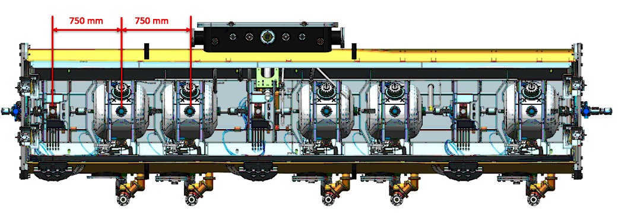
Arrangement of magnet assemblies in cryomodule
Magnet cavity string arrangement in SSR1 Cryomodule
Magnet cavity string arrangement in SSR2 Cryomodule

Slide 6
Electromagnetic Design
Active shielding coils
Main Coil
Y Corrector Coils
Corrector Coils
X Corrector Coils

Slide 7
Magnetic Field Due to a Solenoid
Peak magnetic Field is given by:-
$B_{0}=JaF\left(αβ\right)$
Where
$F(αβ$)= $μ_{0}βln\left\{\frac{α+({α^{2}+β^{2})}^{\frac{1}{2}}}{1+({1+β^{2})}^{\frac{1}{2}}}\right\} and α=\frac{b}{a}$ , $β=\frac{l}{a}$
The magnetic field (B_{w}) responsible for determining critical current density is close to the winding is proportional to B₀ .
B_{w}= c₀ B₀
where c₀ is a function of shape factor $α$ and $β$ .
The magnetic field on axis of the solenoid is given by:-
${ B}_{z}=\frac{1}{2}Ja \{ F\left(α,β1\right)$+ $F\left(α,β2\right)$ }
where
$β1$= $\frac{\text{(}\text{l}\text{ – }\text{z}\text{)}}{a}$ and $β2$= $\frac{\text{(}\text{l}\text{ + }\text{z}\text{)}}{a}$

Slide 8
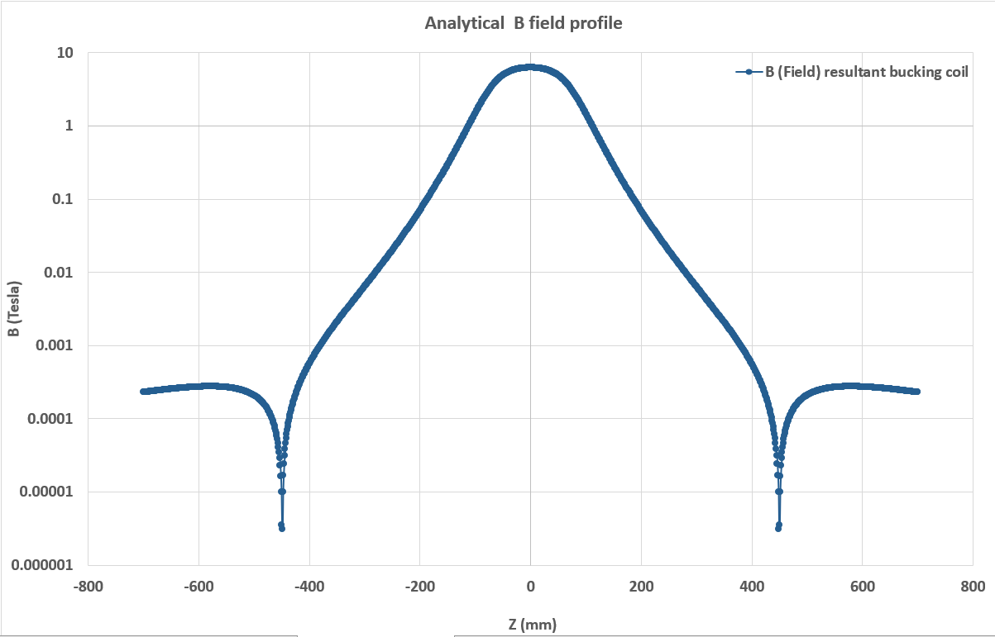
Focussing strength and spherical aberration

Slide 9
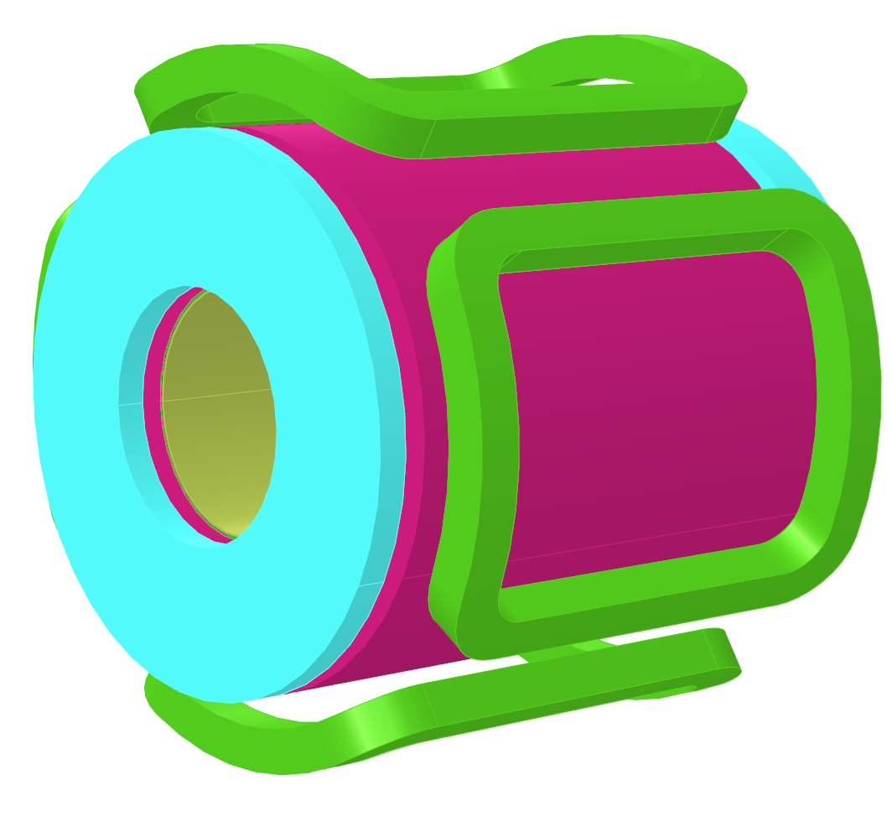
Electromagnetic Design
Configuration 1:
No extra benefit in spatial occupancy
Configuration 2:
Less axial field uniformity
More longitudinal foot print
Configuration 3:
Good axial field uniformity
Optimized axial and longitudinal footprint
$$X$$
$$X$$
$$√$$

Slide 10
Electromagnetic Design
Sr. no | Parameter | Value | Unit
1. | Length of solenoid coils in the lens | 140 | mm
2. | Main coil inner radius | 38 | mm
3. | Main coil outer radius | 75 | mm
4. | Strand diameter bare (with insulation) | 0.5(0.54) | mm
5. | Winding fill factor | 0.8
6. | Number of turns in the main coil | ~14089
Objective function :
$\int{B_{z}^{2}}. dz ≥$ 4.5 T²m
Minimize $\int^{r=0.3}{B.dl }$ at z= 0.42m cavity location
Sr. no | Parameter | Value | Unit
1. | Length of Bucking Coils | 64 | mm
2. | Bucking coil inner radius | 100 | mm
3. | Bucking Coil outer radius | 112.5 | mm
4. | Strand diameter | 0.5(0.54) | mm
5. | Bucking Coil Z location* | 38 | mm
6. | Winding fill factor | 0.8
7. | Number of turns in the Bucking coil | ~2171
Constraints:
$Effective length$≤ 185 cm +/- 30mm ; I _{exc} < 90A
Optimization Parameters:
N_{main}, OR _{main,} IR _{main ,} IR _{BC ,} OR _{BC} L _{BC} , Z _{center-BC}

Slide 11
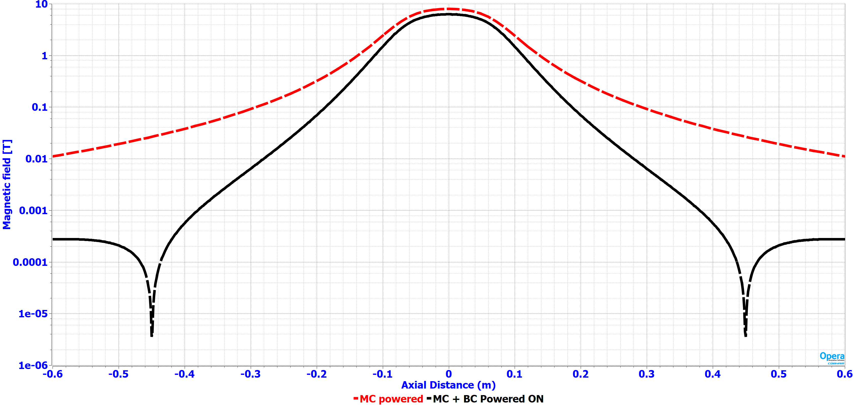
Electromagnetic Design… continued
Main Coil Powered on
Main Coil Powered along with active shielding coil
B_{mod} field vs axial distance plot

Slide 12
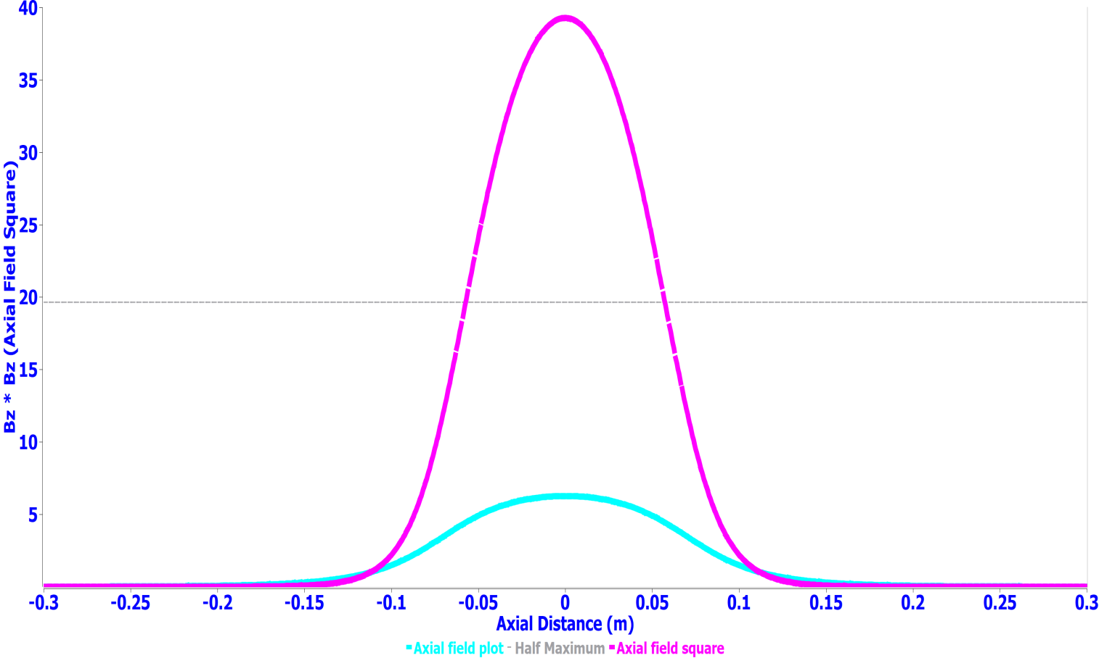
Electromagnetic design … continued
Focusing strength req. : 4.5 T²m
Achieved : 4.57T²m
Effective length : <185+/-30 mm
Zonal plot of Magnetic field at the magnet center (field homogeneity 1.1% @ r=18 mm)
B field plot and B² Plot along the axial length
(Focusing strength of 4.57 T²m)

Slide 13
Dipole corrector design
Sr. no | Parameter | Value | Unit
1. | Straight Length of Dipole corrector coils (H1) | 10 | mm
2. | Width cross-Section in radial direction | 15 | mm
3. | Thickness cross-section in azimuthal direction | 35 | mm
4. | Radius of the Mandrel (R1) | 80 | mm
8. | Strand diameter (bare/insulated) | 0.5/0.54 | mm
9. | Number of turns in the dipole corrector coil | ~1851
10. | Operating current density at nominal bending strength | 28 | A/mm²
11. | Winding fill factor | ~0.85
Corrector coils used in space between the main solenoid and active shielding coil to reduce the operating current requirement
Sr. no | Parameter | Value | Unit
1. | Designed value of Bending strength of corrector coils | 6.3 | mT-m
2. | Peak Magnetic field on the corrector coil wire strand | 2.8 | T
3. | Quadrupole Gradient in skew Quadrupole mode | 3.25 | T/m
5. | Nominal current | ~10 | A
6. | Transfer function of the corrector coils | 0.1525 | mT/A

Slide 14
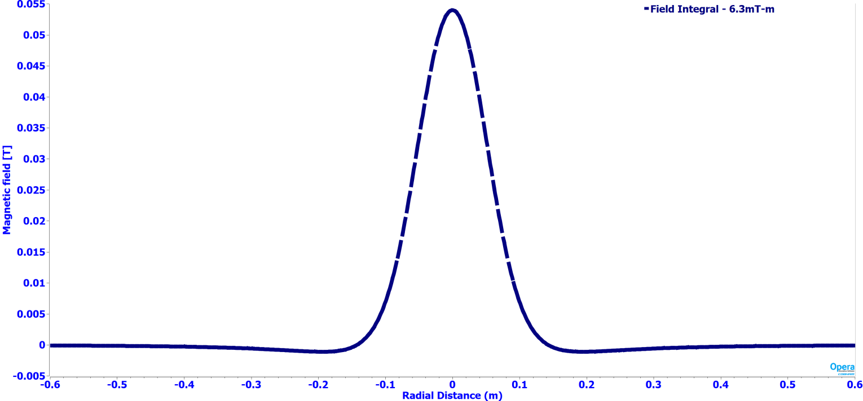
Dipole corrector design … continued
Bending strength req. : 6 mT-m
Achieved : 6.3 mT-m
Magnetic Field plot for the dipole field (Dipole field Integral 6.3 mT-m)
Zonal field plot of dipole field at the magnet center

Slide 15
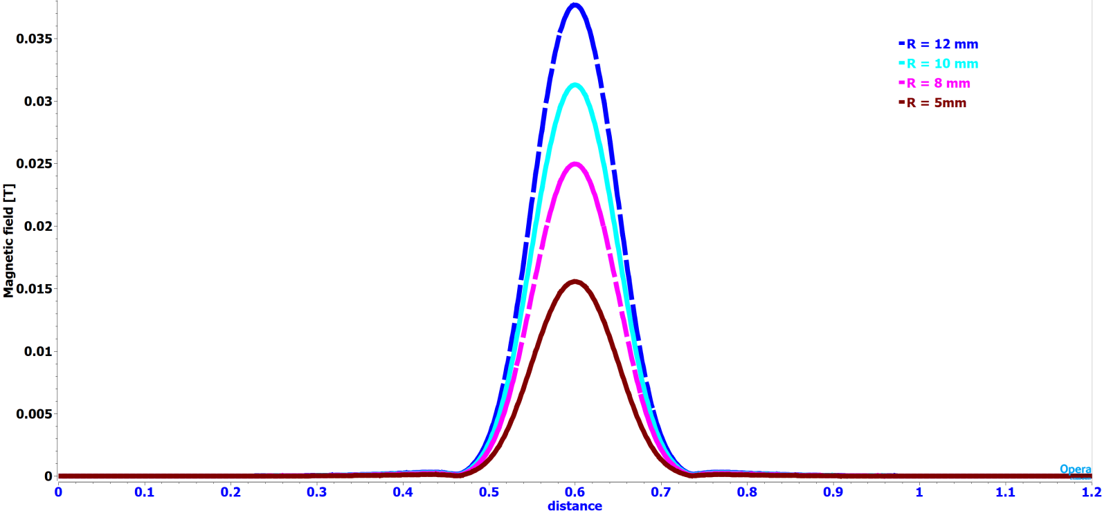
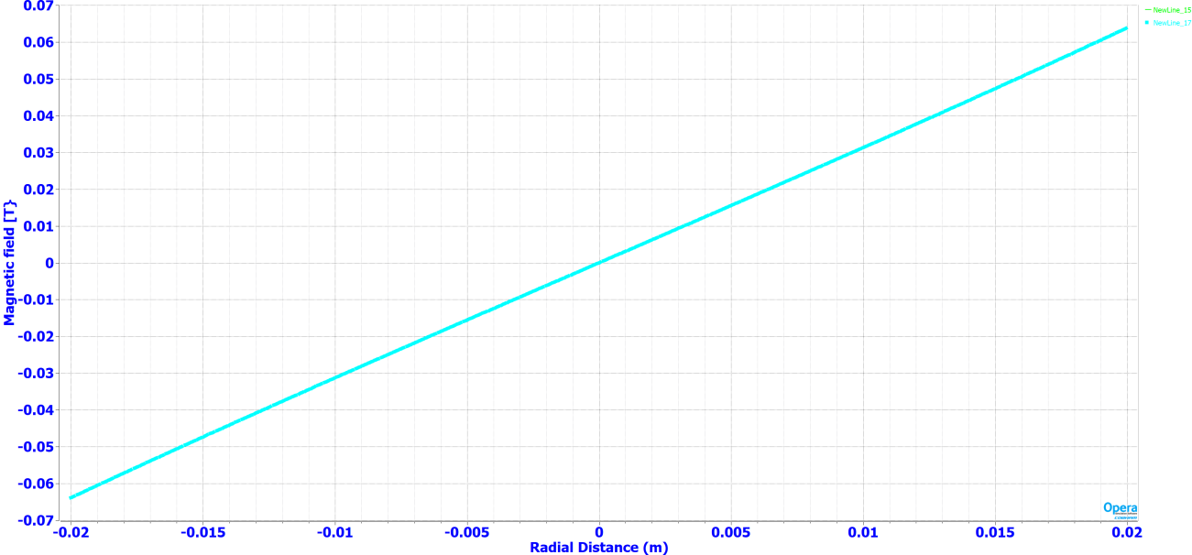
Dipole Corrector design (Quadrupole mode)
Magnetic Field (B_{x} or B_{y}) plot in the lens aperture at various radial locations when corrector coils are connected as skew quadrupole
Bx field plot vs radial distance in magnet aperture (Gradient = 3.25T/m)

Slide 16
Fringe field on cavity surface
Completely defined by the properties of superconducting material
Cavity Specific
Φ_{tr}= $\frac{\text{2}\text{μ}\text{0}\text{Φ}\text{0}}{\text{(}\text{Rs}\text{∙ }\text{ξ}\text{0}\text{2}\text{)}}$ * $\frac{\text{f}\text{∙}\text{V}}{(\text{ΛQ}\text{0})}$ *$\frac{\text{(}\text{1−}\text{η}\text{)}}{\text{η}}$
Acceptable degree of degradation η with allowed amount of the trapped flux.
Placement of a focusing lens inside the SSR cryomodule
μ₀=4π∙10⁻⁷H/m ; Φ₀=2∙10⁻¹⁵Wb
ξ₀=3.9∙10⁻⁸ m is the coherent length in Nb, f is the frequency of the cavity,
Rs is the surface resistance of Nb at this frequency,
V is the volume of the cavity,
Λ = $\frac{\text{Magnetic} \text{energy} \text{density} \text{at} \text{the} \text{location} \text{of} \text{the} \text{quench}}{\text{A}\text{verage} \text{energy} \text{density} \text{in} \text{the} \text{cavity} }$
Surface integral / line integral at the maximum magnetic energy density location needs to be minimized during the design of bucking coil

Slide 17
Tolerance studies on bucking coil geometrical parameters
Tight tolerance is required for the bucking coil winding dimensions and its placement w.r.t main coil.
The positional inaccuracy of the Bucking coil effects the fringe magnetic field on the cavity surface.
Effect on fringe field level at different axial position of the Bucking coil w.r.t Main coil
Sr. no | BC-Coil IR | BC-Coil OR | BC-Coil L | BC-Coil Z center | B max On cavity surface | Field Surface Integral at Axial distance of 0.42 m)
 | mm | mm | mm | mm | Gauss | G-m²
1. | 100 | 112.5 | 64 | 38 | 7.33 | 2.47
2. | 100 | 112 | 64 | 38 | 16 | 2.299
3. | 100.5 | 112 | 64 | 38 | 28 | 4.589
4. | 100.5 | 112.5 | 64 | 38 | 14 | 2.018
5. | 100.5 | 113 | 64 | 38 | 8.89 | 2.988

Slide 18
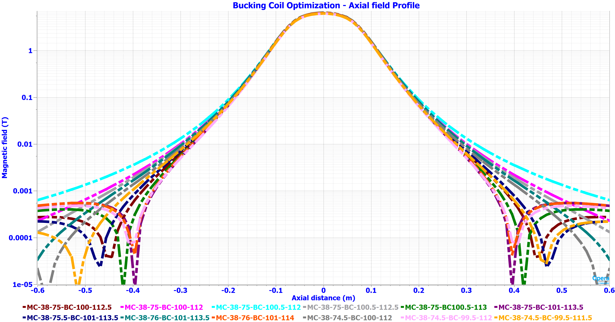
Bucking coil optimization
B field vs axial distance plot for different cases of Bucking coil dimensions

Slide 19
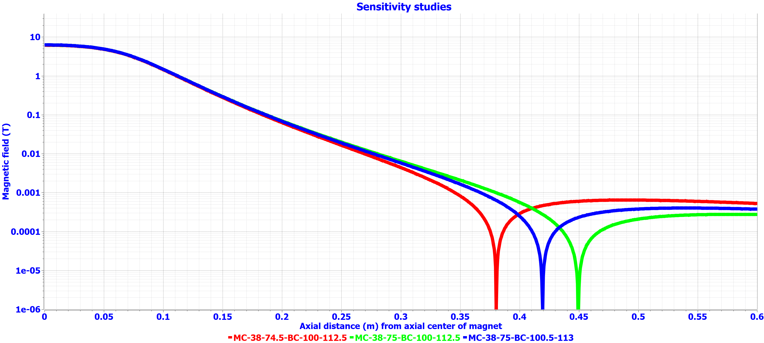
Bucking coil optimization
B field vs axial distance plot for different cases of Bucking coil dimensions

Slide 20
Tolerance studies on bucking and main coil geometrical parameters
Tight tolerance is required for the bucking coil and main coil winding dimensions and its placement w.r.t main coil.
The positional inaccuracy of the Bucking coil and main coil effects the fringe magnetic field on the cavity surface.
Effect on fringe field level at different axial position of the Bucking coil w.r.t Main coil
Sr. no | Main Coil IR | Main Coil OR | BC-Coil OR | Fringe Field at 420 mm | $$\int{B_{z}2ⅆz}$$
 | mm | mm | mm | Gauss | T² m
1. | 38 | 75 | 112.5 | 3 | 4.571
2. |  |  | 113 | 11 | 4.463
3. |  |  | 112 | 17 | 4.681
4. |  | 74.5 | 112.5 | 4.5 | 4.42
5. |  |  | 113 | 19 | 4.32
6. |  |  | 112 | 10 | 4.534
7. |  | 75.5 | 112.5 | 10 | 4.71
7. |  |  | 113 | 4 | 4.608
 |  |  | 112 | 22 | 4.830
Jan 8, 2025
FDR | Kumud Singh | Pre-production SSR lens
20

Slide 21
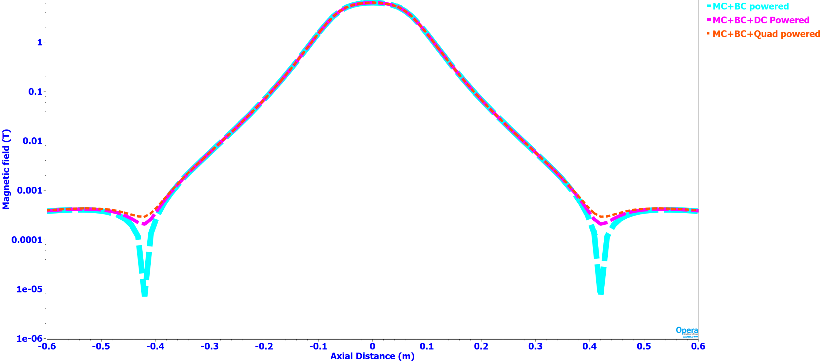
Combined-field-All coils-powered-on

Slide 22
Superconducting Wire strand material properties
All conduction cooled magnets are proposed to be wound using round 0.5 bare diameter /0.54 mm insulated strand (NbTi/ copper matrix 1:2 Sc:Cu Ratio).
$$B_{CT}= B_{c0} \left(1−{\left(\frac{T}{T_{c0}}\right)}^{2}\right)$$
The ratio of the maximum current density in the superconductor at any magnetic field and temperature to that at B = 5 T and T = 4.2 K can be found using the expression given below:
Jc(B,T) / Jc(5 T, 4.2 K)= C0/B∙b^{α}∙(1-b)^{β}∙(1-tn)^{γ}
Where, C₀ = 28.4 T, α = 0.80, β = 0.89, and γ = 1.87.
Power diode connected in shunt with magnet
Bare Wire Dia | Filament Diameter | Cu/Sc Ratio | Filament twist pitch | RRR | Ic @ 3 T , 4.2K | Ic @ 5 T , 4.2K | Ic @ 7 T , 4.2K | Ic @ 9 T , 4.2K
0.5mm |  | 2:1 |  | Min 60 | 240 A | 140A | 105A | 32A
Electronics rack
Vacuum pumps

Slide 23
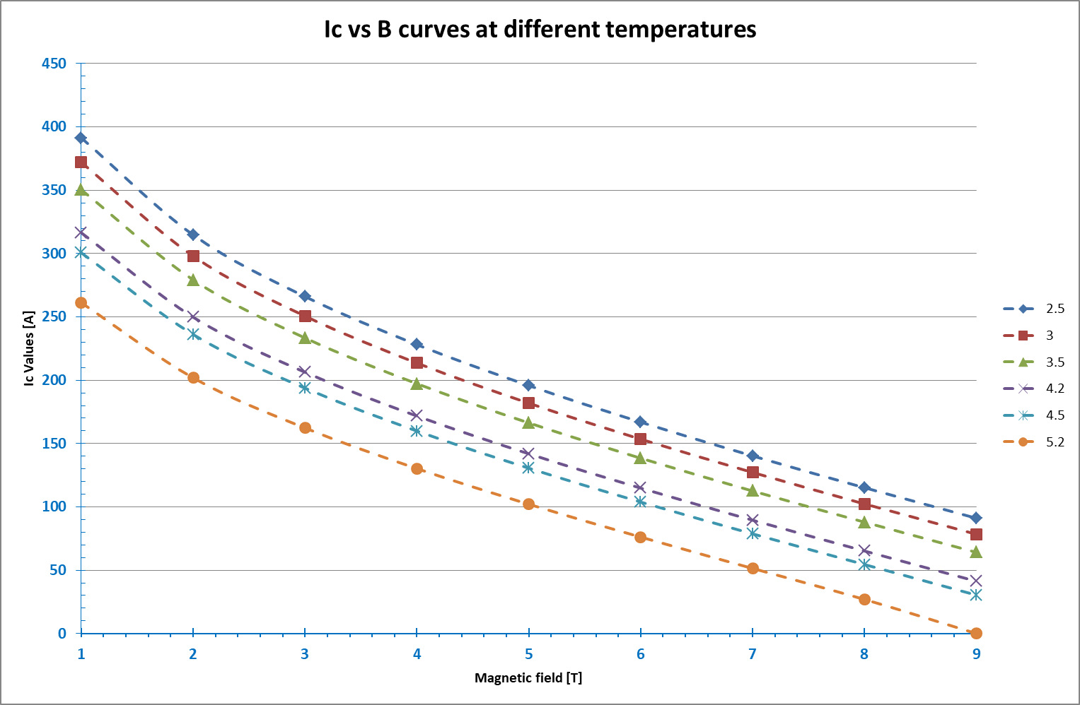
Superconducting Wire strand material properties
Power diode connected in shunt with magnet
Electronics rack
Vacuum pumps

Slide 24
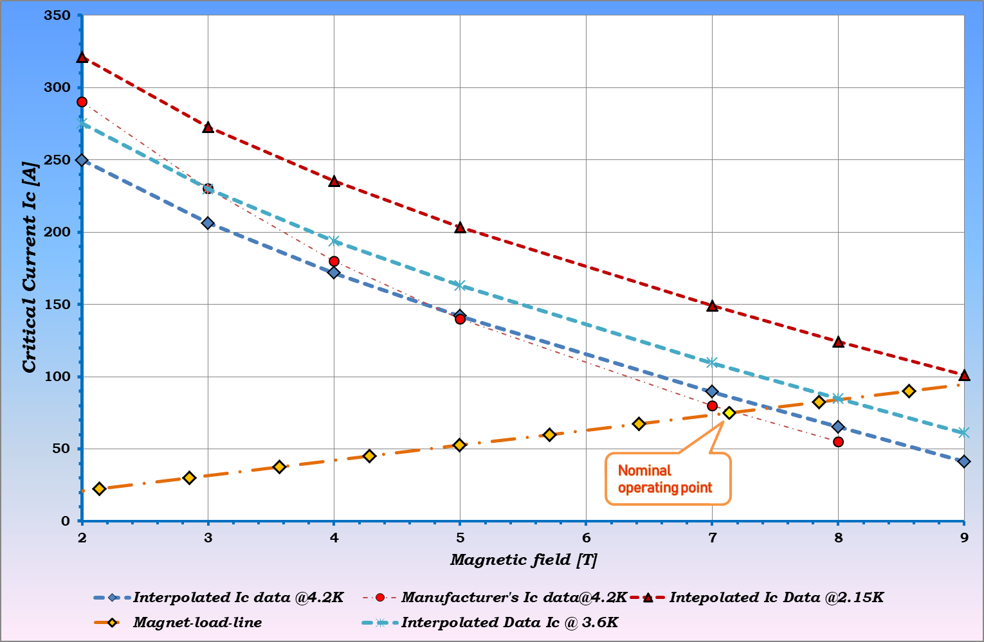
Magnet load line
Power diode connected in shunt with magnet
Comparing the manufacturer’s data it is clear that practically there is no margin @ 4.2 K
Electronics rack
Vacuum pumps

Slide 25
Quench Studies

Slide 26
Quench Studies (Quench initiated in main coil)
Power diode connected in shunt with magnet
At t = 0s
At t = 0.01s
At t = 0.1s
At t = 0.4s
Electronics rack
Vacuum pumps
Flux initiated by ~4W of heat deposition at peak B field location
To study peak temperature & peak coil voltages
At t = 20s
At t = 5s

Slide 27
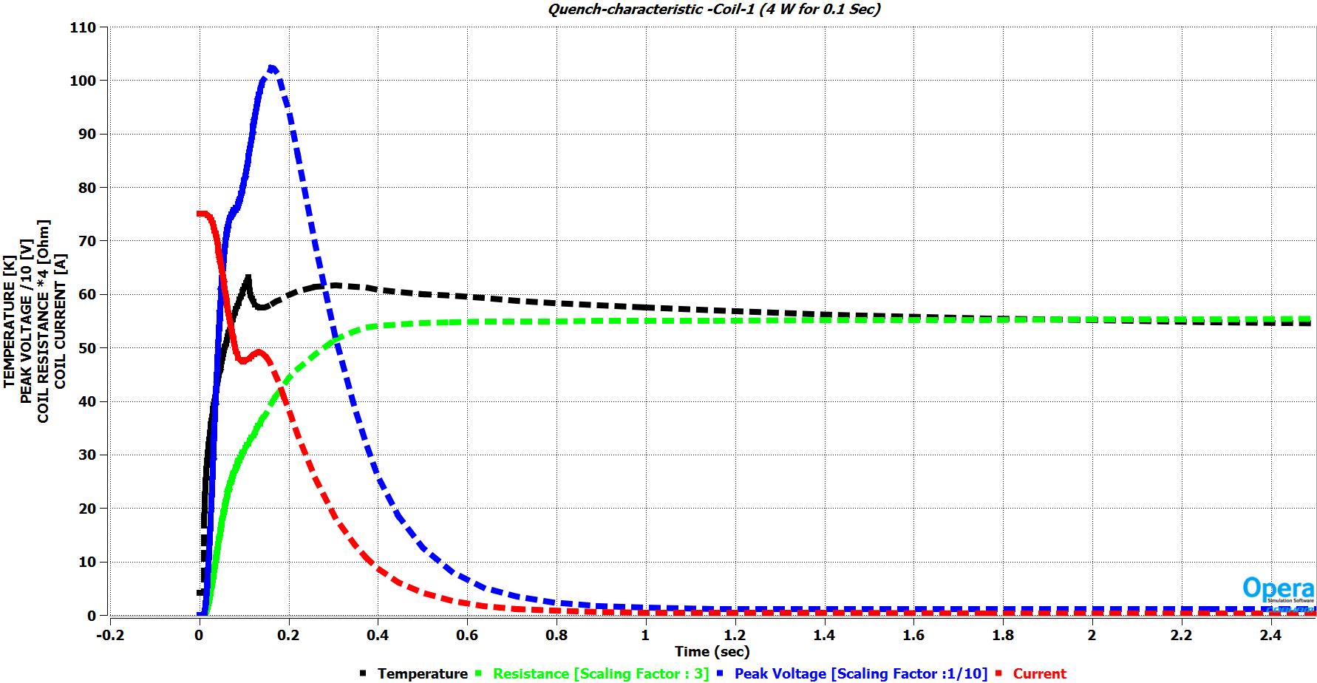
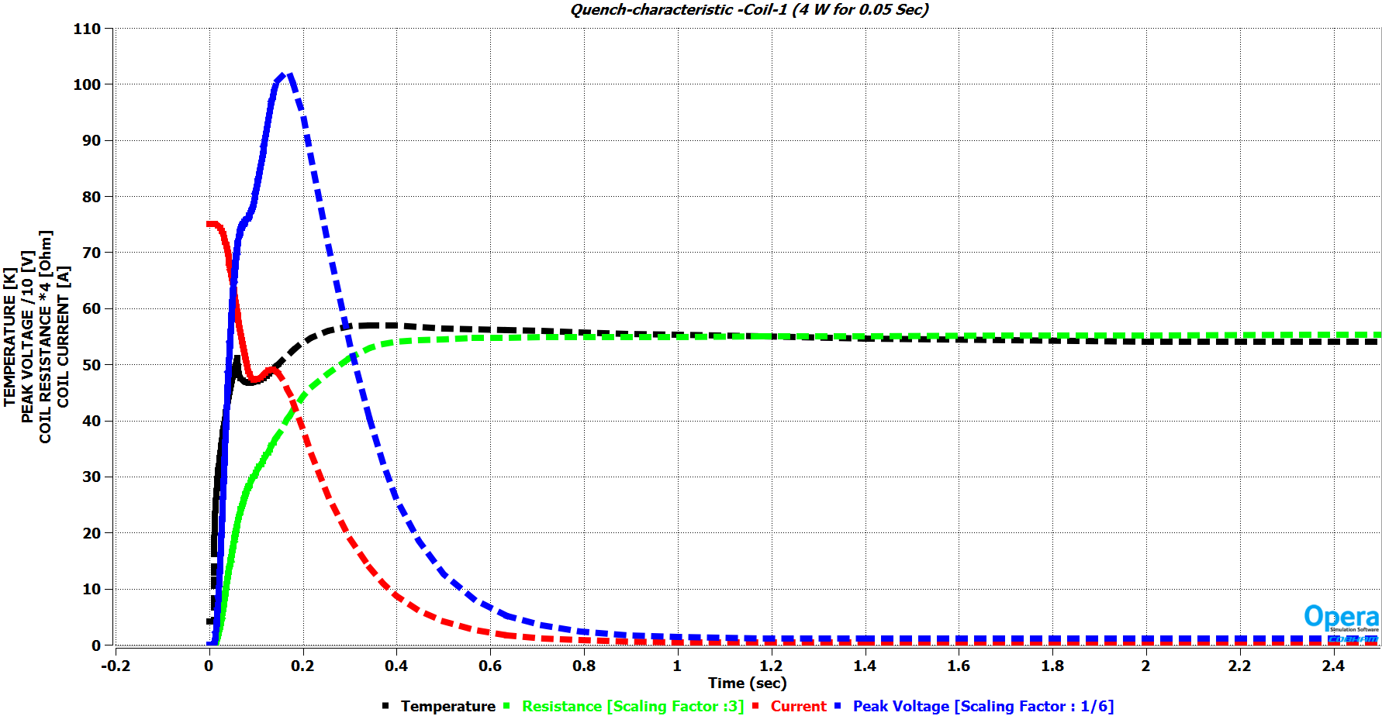
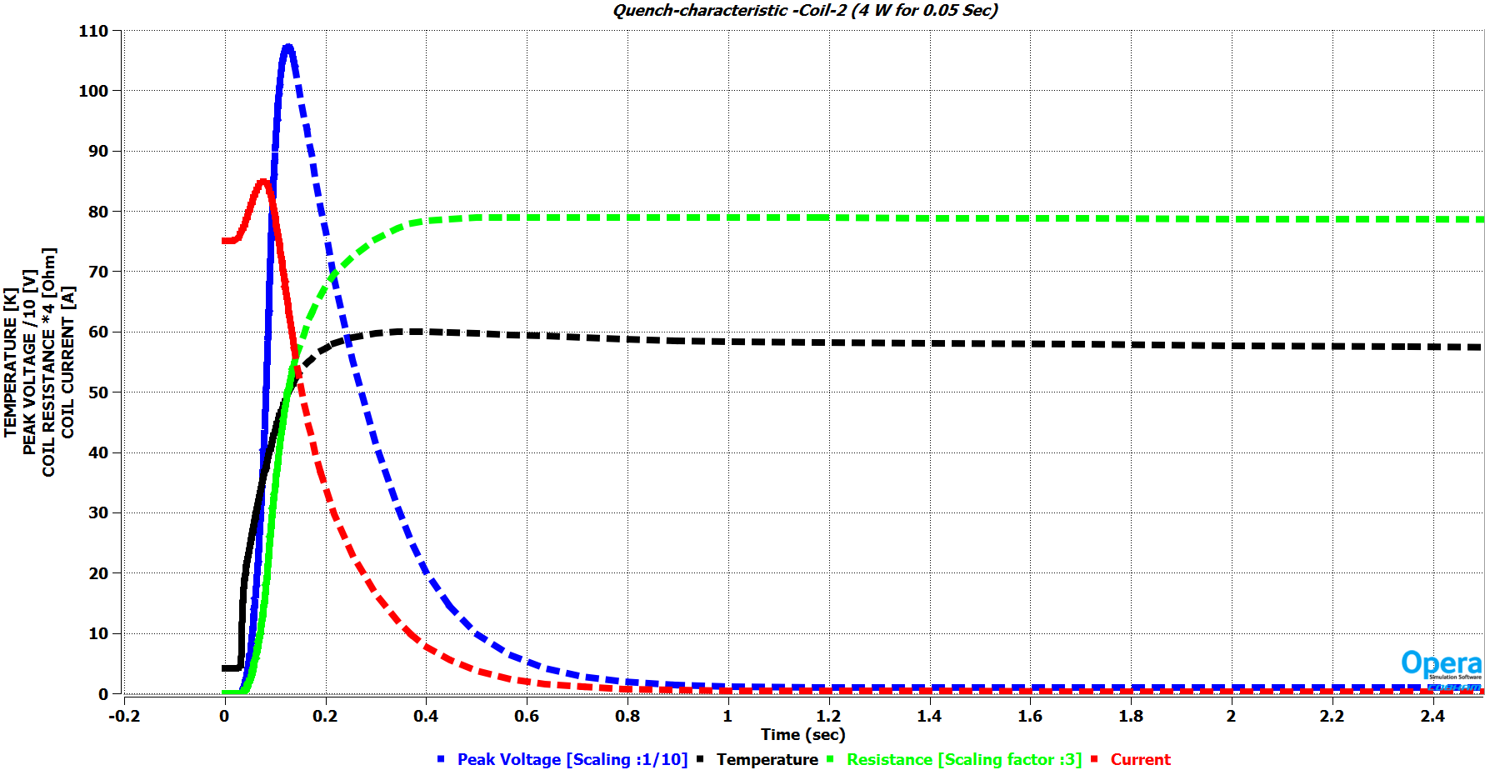
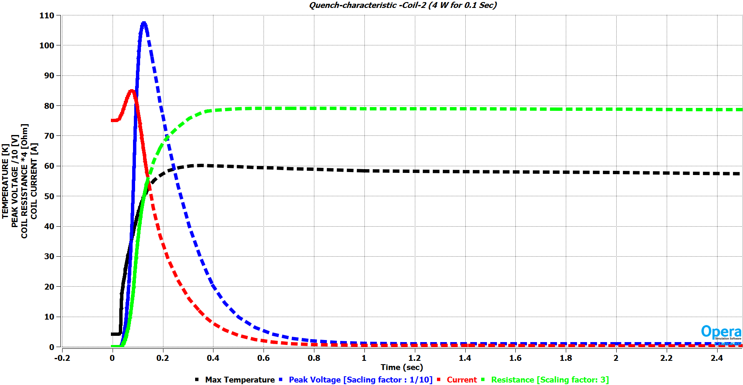
Quench Design (Variation in heat pulse)
Quench Characteristic for two coils sub-sections of main coil
Power diode connected in shunt with magnet
4W for 0.1 second
4W for 0.05 second

Slide 28
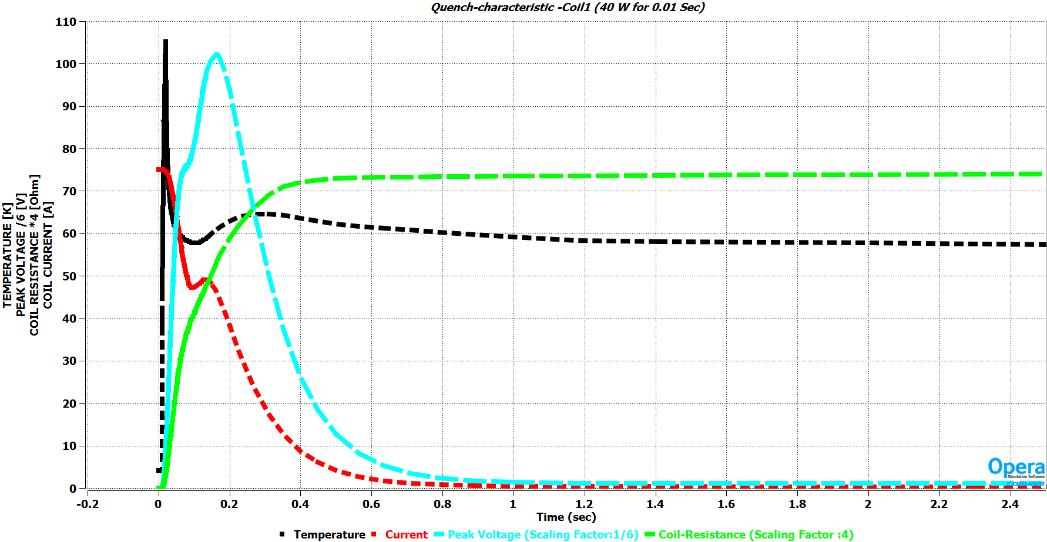
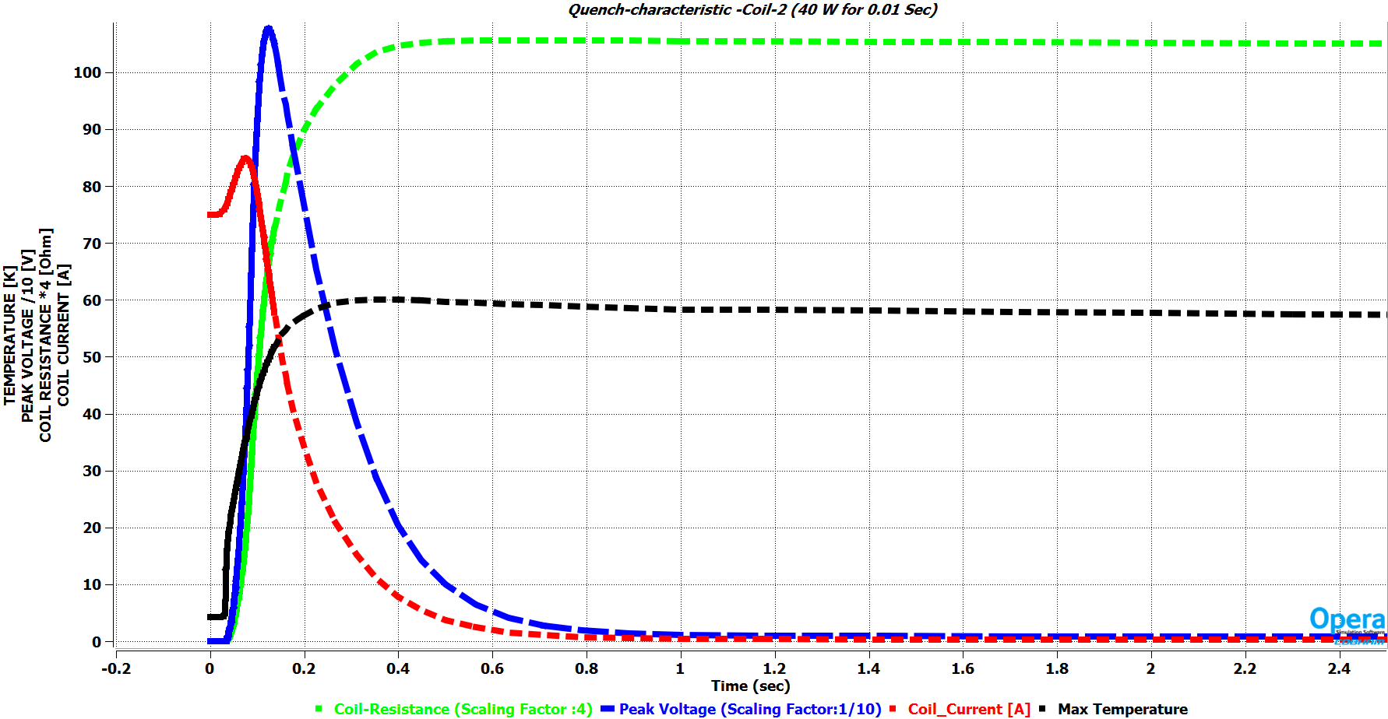
Quench Design (Variation in heat pulse)
Power diode connected in shunt with magnet
The amount of input heat energy does not play very significant role in determining the coil temperature
Once the quench has been initiated, by small amount of heat dissipation, the normal zone of the magnet will grow and decay the current
However the initial peak temperature of the hot spot (location at which quench is initiated) does depend slightly on the heat pulse.
40W for 0.1 second

Slide 29
Quench Design (Variation in quench location)
Power diode connected in shunt with magnet

Slide 30
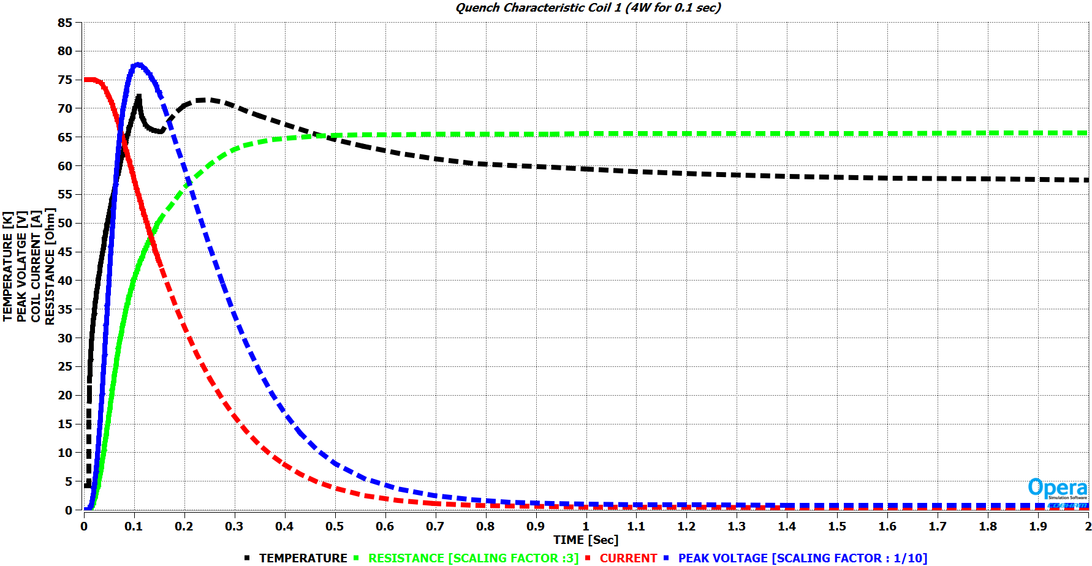
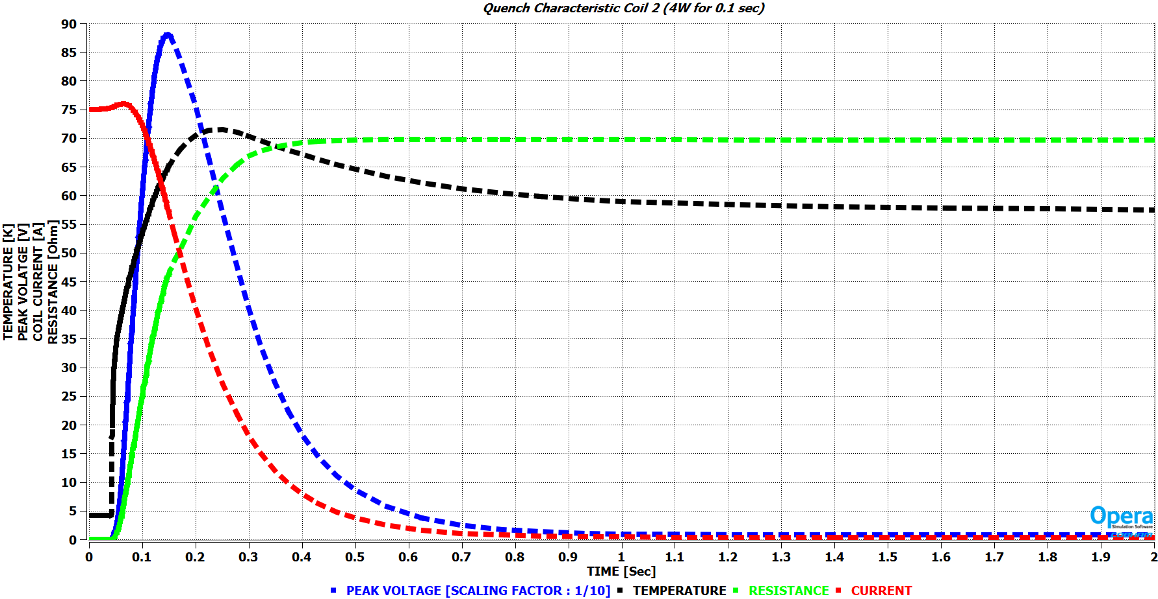
Quench Design (Variation in coil configuration)
Power diode connected in shunt with magnet
It is observed that location of quench initiation does not play a major role in determining the coil temperature, peak voltage and the resistance growth.
4W for 0.1 second

Slide 31
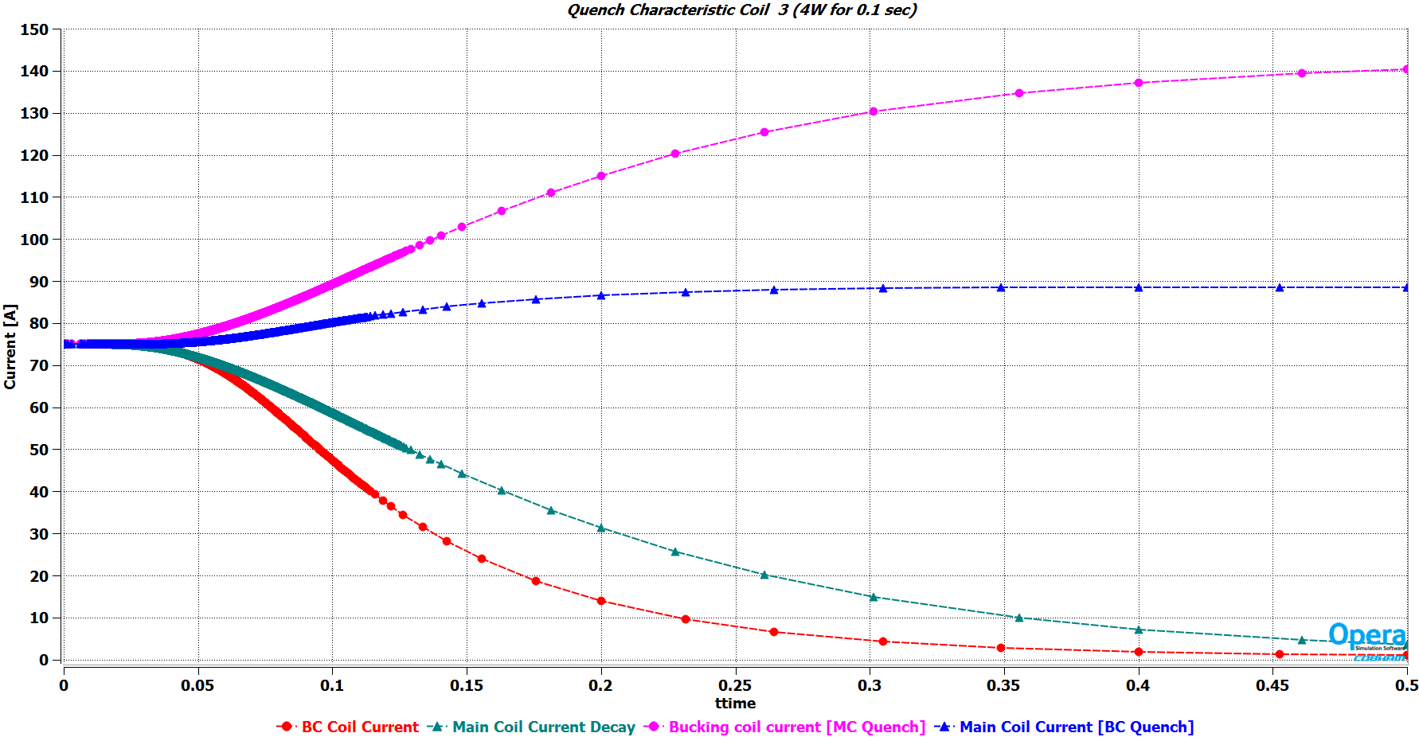
Main coil and Bucking coil Quench
Once the quench is initiated in the bucking coil, the main coil will also quench eventually.
The current profile of the main coil for the bucking coil quench case clearly shows that the quench in BC triggers the quench in MC.
Similarly any quench initiated in MC would also trigger quench in BC.

Slide 32
Quench protection circuit
+ PS -
Quench Protection by passive diodes
Differential Voltage sensed to detect Quench
Same Quench protection circuit for Dipole corrector coils
MC coil1
MC coil2
BC coil1
BC coil1

Slide 33
Final Magnet parameters
Coil1 Coil2 Coil3 Coil4
Coil1 5.15H 5.336H -1.260H -1.260H
Coil2 5.336H 9.44H -2.497H -2.4976H
Coil3 -1.260H -2.4976H 2.11H 1.02H
Coil4 -1.260H -2.4976H 1.02H 1.02H
Peak coil to ground voltage = 1.1kV
Peak temperature in case of quench = 65K
Stored energy = ~14KJ
Magnet physical length = 140 mm
Engineering current density ~ 382 A/mm ² | Excitation current 75A | Focusing strength 4.57 T²m | Solenoid
Engineering current density ~ 50.995 A/mm ² | Excitation current 10A | Focusing strength 6.3 mT-m | Dipole Corrector

Slide 34
Conclusion
Parameters | SSR1/SSR2 New specification (Ver.3) | Achieved
Focusing Strength | 4.5T²m | 4.57T²m
Bending strength of Dipole correctors | $≥$6.0 (5.0) mT-m | 6.3 mT-m
Beam pipe aperture | 40 mm | 40 mm
Uncertainty in the location of magnetic axis w.r.t Reference points (Transverse and angular alignment) | <0.1mm RMS <0.5 mrad RMS | Majorly from the Mechanical design of magnet former and winding accuracy
Effective length of solenoid (FWHM) | <18.5cm
Active magnetic shielding requirements | ~<10G | <10 G
Maximum current in the solenoid | 90 | 75 A
Maximum current in the dipole correctors | 12 (50) | 10 A

Slide 35
References
[1] PIP-II SSR2 CRYOMODULE FRS : ED0001829-D
[2] FOCUSING LENS FOR SSR1 AND SSR2 - Technical Requirements Specification (TRS)"
[3] BCR: SSR Solenoid design/validation test, PIP-II BCR
[4] “SSR1 Cavity Quenching in the Presence of Magnetic Field,” FNAL TD note TD-12-007, June 2012 , T. Khabiboulline, D. Sergatskov, and I. Terechkine,
[5] “Acceptable Level of Magnetic Field on the Surface of a Superconducting RF Cavity,” FNAL, TD note TD-12-008, June 2012T. Khabiboulline, T. Nicol, and I. Terechkine

Slide 36
Thank you for your kind attention

Slide 37
Back up slides

Slide 38
Summary of quench studies
With dump resistor in series with back to back diodes
Sr. no. | Series dump resistor value | Peak voltage in coil 1 Peak Voltage in coil 2 | Voltage across Coil1 Voltage across Coil2 | Coil 1 temperature Coil 2 temperature
1. | 0 Ohms | 600V 1100 V | 4V 4V | 60K 60K
2. | 0.005 Ohms | 60V 200V | ~ 4.5V ~ 4.5V | 45K 38K
3. | 5 Ohms | 100 V 120 V | ~ 400 V ~128 V | 38 K 27 K
With only back to back diodes in parallel with coil
Sr. no. | Configuration | Peak voltage in coil 1 Peak Voltage in coil 2 | Voltage across Coil1 Voltage across Coil2 | Coil 1 temperature Coil 2 temperature
1. | Radial Coil split (middle quench) No dump resistor 0.4J of energy deposition | 600V 1100 V | ~4V ~4V | 65K 60K
2. | Axial Coil split (middle quench) No dump resistor 0.4J of energy deposition | ~ 850V ~850V | ~4V ~4V | 75K 75K
3. | Axial Coil split (corner quench) No dump resistor 0.4J of energy deposition | ~ 850V ~850V | ~4V ~4V | 75K 75K

Slide 39
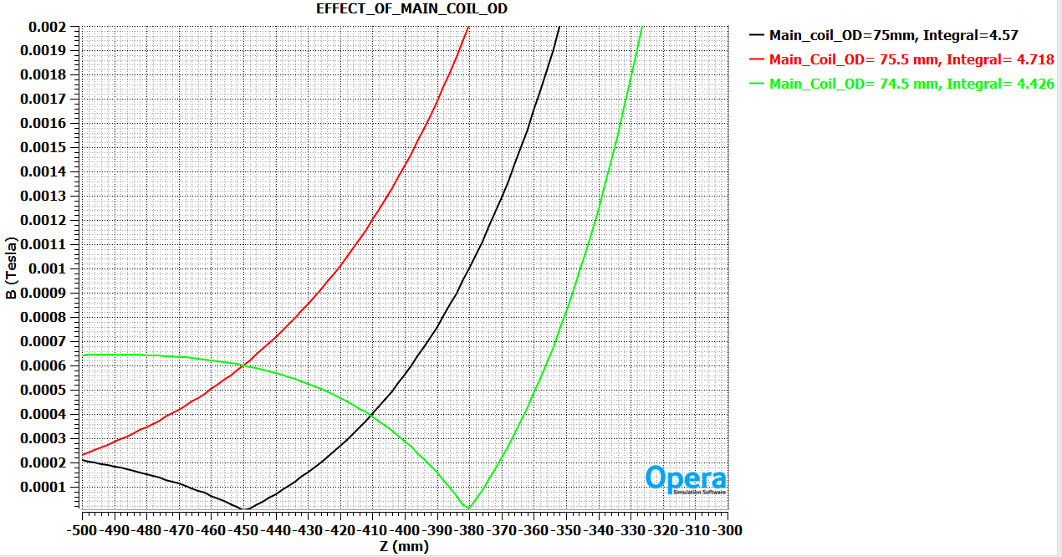
Sensitivity Studies
FDR | Kumud Singh | Pre-production SSR lens

Slide 40
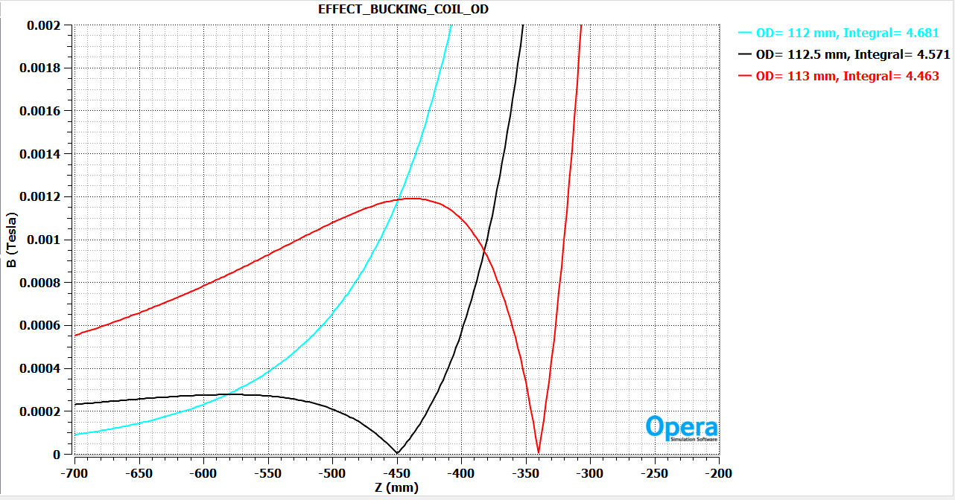
Sensitivity Studies

Slide 41
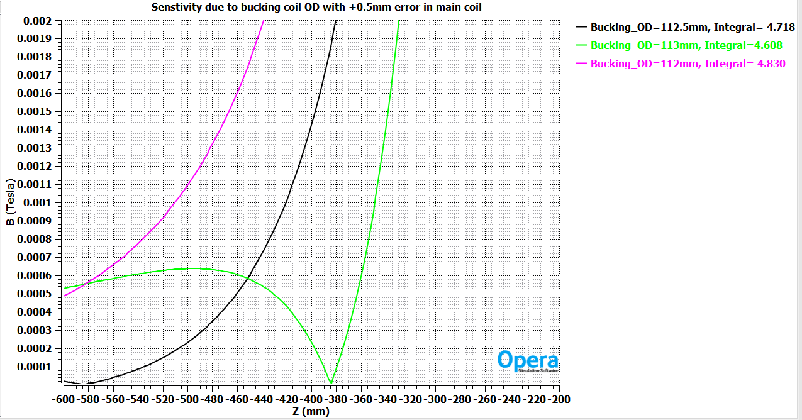
Bucking coil optimization
Jan 8, 2025
FDR | Kumud Singh | Pre-production SSR lens

Slide 42
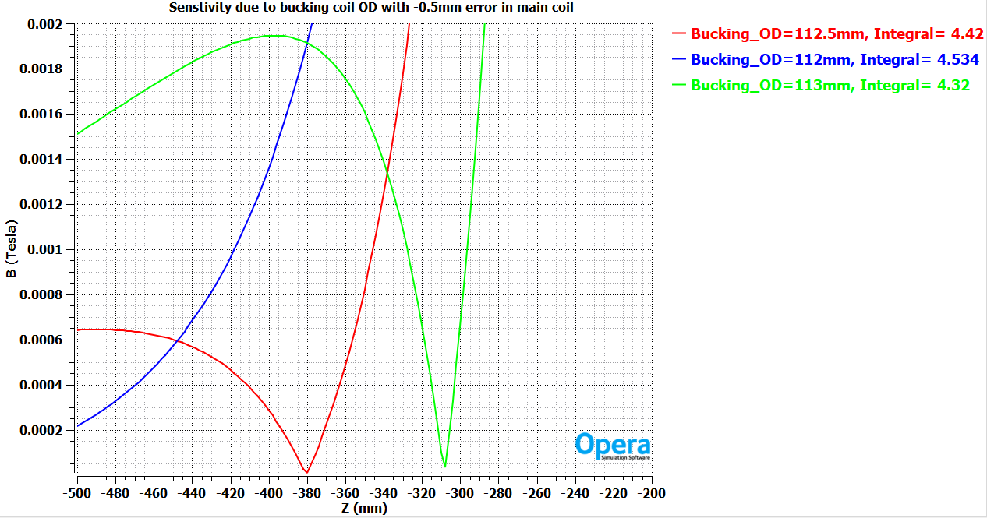
Sensitivity Studies

