Slide 1
ELECTROMAGNETIC DESIGN
CONDUCTION COOLED SSR MAGNET ASSEMBLY FOR PIP-II
(FDR – Phase I)
Electromagnetic Applications & Instrumentation Division,
Bhabha Atomic Research Centre
Department of Atomic Energy (DAE), India
Team members:
Kumud Singh
Janvin Itteera
Mahima
Vikas Tiwari
Himanshu Bisht
R R Singh
R K Jalan
Sanjay Howal

Slide 2
Outline
Introduction
BARC contribution for LINAC magnets in PIP-II technology map
Power diode connected in shunt with magnet
Electromagnetic Design of Conduction cooled magnet
Functional requirement specification
EM design for main solenoid
Corrector coil design
Fringe field on the cavity surface
Bucking coil optimization & tolerance studies on BC dimensions
Tolerance studies on bucking coil
Superconducting wire selection
Magnet load line & design operating margin
Cryostat housing magnet
Electronics rack
Vacuum pumps
Quench Studies
Quench initiated in main coil (variation in heat pulse, coil configuration & quench location)
Quench initiated in Bucking coil
Quench protection circuit

Slide 3
Magnet Contribution- PIP-II LINAC Technology map
IS
LEBT
RFQ
MEBT
β=0.11
β=0.22
β=0.51
β=0.61
β=0.9
RT
SC
162.5 MHz
0.03-11 MeV
325 MHz
11-177 MeV
650 MHz
177-800 MeV
MEBT and HEBT Magnet assemblies
Quadrupoles magnets: 34 No.
Dipole Magnets : 15 No.
2. SSR Superconducting Magnet assemblies
SSR1 magnet assemblies: 10 (8+2) No.
SSR2 Magnet Assemblies: 23No.
(21+2)
3. LB650 and HB 650 warm doublet
Quadrupole magnets: 47 No.
Dipole corrector : 45 No.
Construction phase : 9 triplets
DELIVERED
Section | Freq | Energy (MeV) | Cav/mag/CM | Type
RFQ | 162.5 | 0.03-2.1
HWR (β_{opt}=0.11) | 162.5 | 2.1-11 | 8/8/1 | HWR, solenoid
SSR1 (β_{opt}=0.22) | 325 | 11-38 | 16/8/ 2 | SSR, Solenoid
SSR2 (β_{opt}=0.51) | 325 | 38-177 | 35/21/7 | SSR, Solenoid
LB 650 (β_{G}=0.61) | 650 | 177-480 | 33/22/11 | 5-cell elliptical, doublet*
HB 650 (β_{G}=0.9) | 650 | 480-800 | 24/8/4 | 5-cell elliptical, doublet*
*Warm doublets external to cryomodules

Slide 4
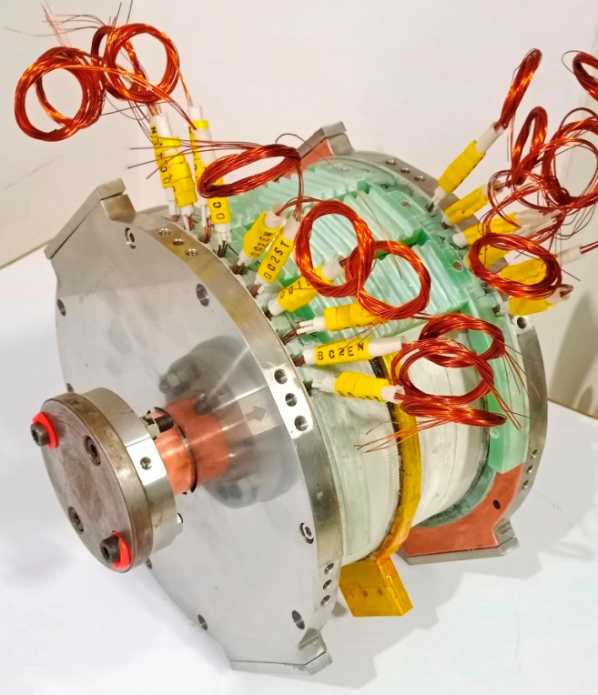
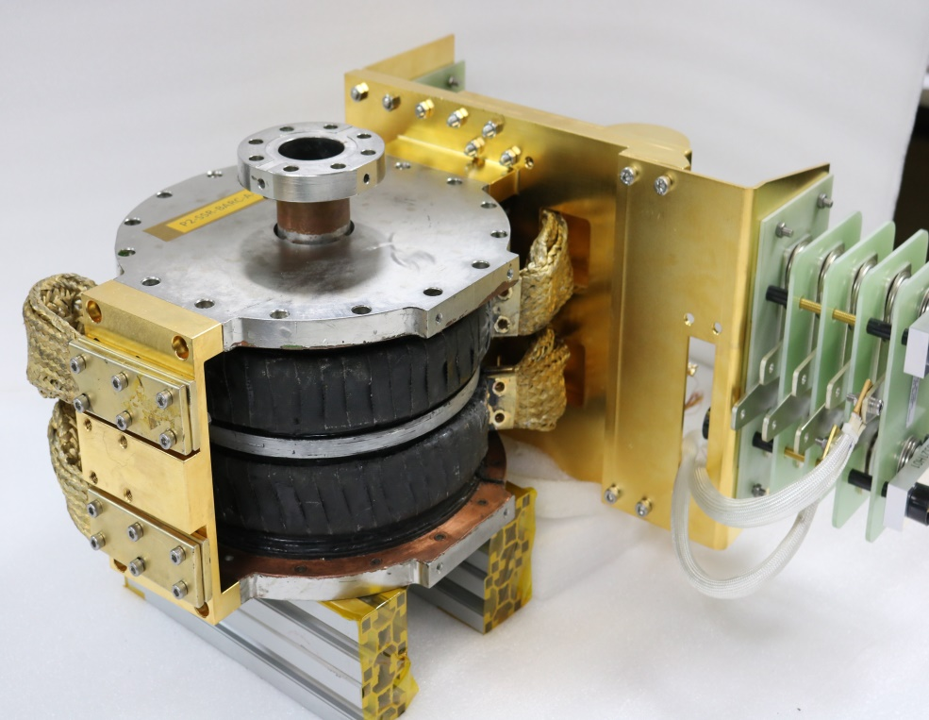
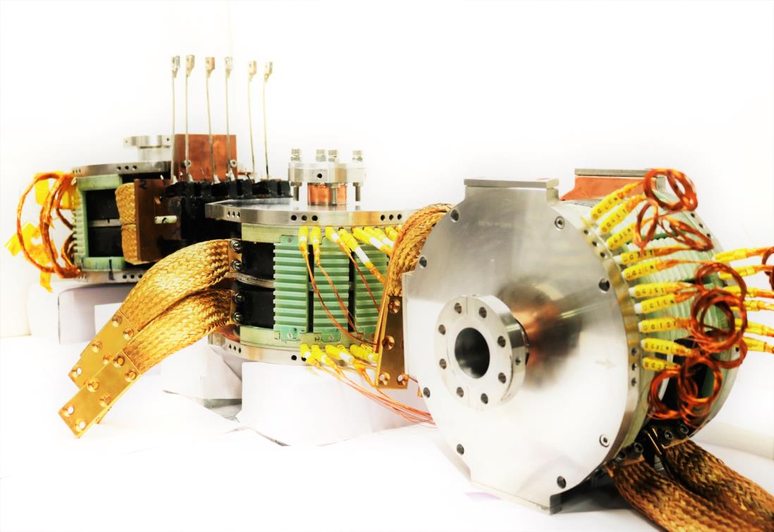
Pre-series magnet development
P2-SSR-BARC-A-PS-003
P2-SSR-BARC-A-PS-007
P2-SSR-BARC-A-PS-008
Pre-series Magnet development was carried out with 0.4mm bare diameter SC wire

Slide 5
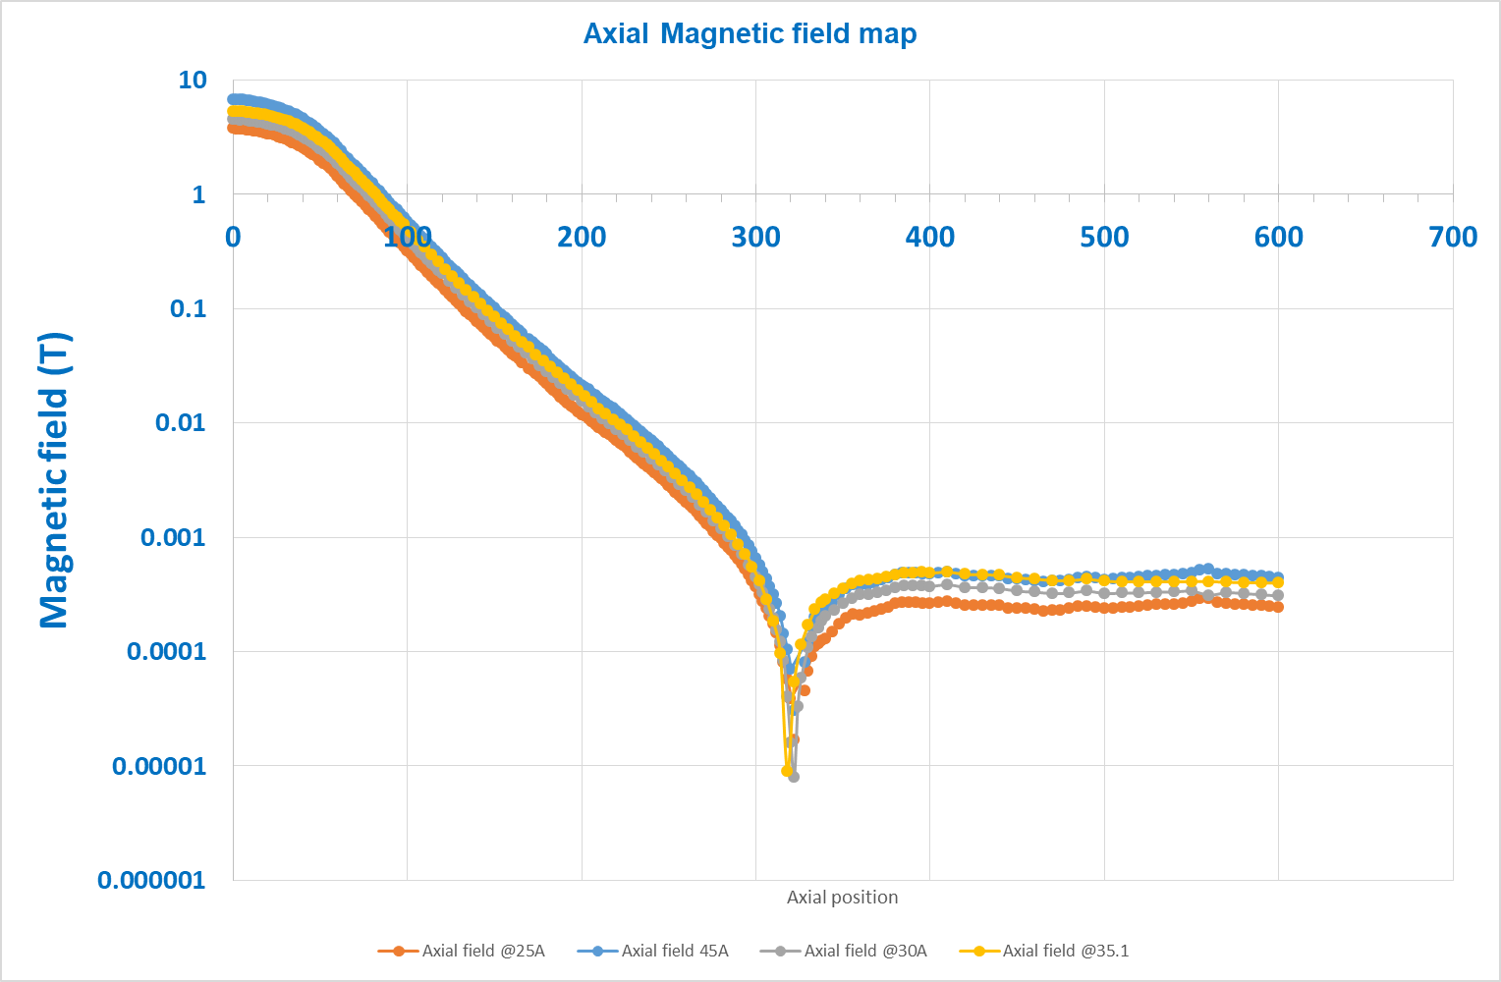
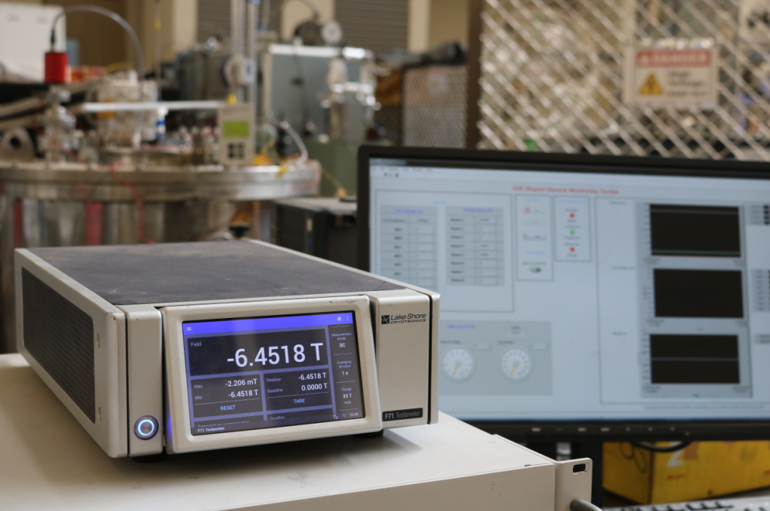
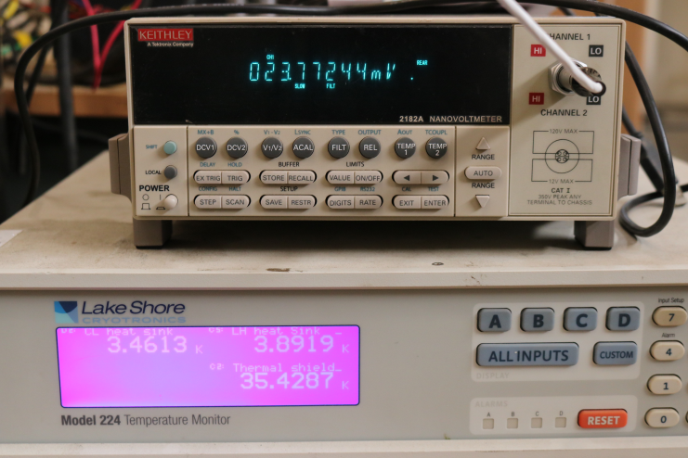
Pre-series magnet testing
Axial field mapping
Fringe field @35A - 4.1G
Fringe field @45A - 5.2G Integral strength

Slide 6
Functional Requirement Specifications (FRS)
Primary Design objectives:
High Field (focusing strength)
Low stray field as fringe field level on the adjacent spoke cavity surface is a major concern.
Dipole field and skew quadrupole field coils incorporated in the same magnet package.
Parameters | SSR1/SSR2 New specification (Ver 2.) | SSR1/SSR2 New specification (Ver.3)
Focusing Strength | 4.5 T²m | 4.5T²m
Bending strength of Dipole correctors | 5 mT-m | $≥$6.0 (5.0) mT-m
Beam pipe aperture | 40 mm | 40 mm
Uncertainty in the location of magnetic axis w.r.t Reference points (Transverse and angular alignment) | <0.1mm RMS <0.5 mrad RMS | <0.1mm RMS <0.5 mrad RMS
Effective length of solenoid (FWHM) | <18cm | <18.5cm
Active magnetic shielding requirements | ~ <10G | ~<10G
Maximum current in the solenoid | 100A | 90 A
Maximum current in the dipole correctors | 50 A | 12 A

Slide 7
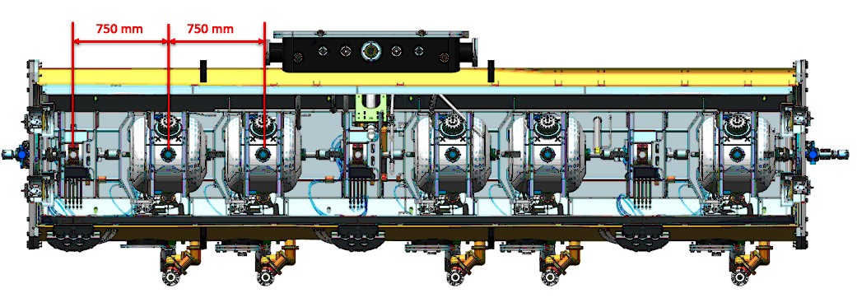
Arrangement of magnet assemblies in cryomodule
Magnet cavity string arrangement in SSR1 Cryomodule
Magnet cavity string arrangement in SSR2 Cryomodule

Slide 8
Electromagnetic Design
Active shielding coils
Main Coil
Y Corrector Coils
Corrector Coils
X Corrector Coils

Slide 9
Magnetic Field Due to a Solenoid
Peak magnetic Field is given by:-
$B_{0}=JaF\left(αβ\right)$
Where
$F(αβ$)= $μ_{0}βln\left\{\frac{α+({α^{2}+β^{2})}^{\frac{1}{2}}}{1+({1+β^{2})}^{\frac{1}{2}}}\right\} and α=\frac{b}{a}$ , $β=\frac{l}{a}$
The magnetic field (B_{w}) responsible for determining critical current density is close to the winding is proportional to B₀ .
B_{w}= c₀ B₀ , where c₀ is a function of shape factor $α$ and $β$ .
The magnetic field on axis of the solenoid is given by:-
${ B}_{z}=\frac{1}{2}Ja \{ F\left(α,β1\right)$+ $F\left(α,β2\right)$ }
where
$β1$= $\frac{\text{(}\text{l}\text{ – }\text{z}\text{)}}{a}$ and $β2$= $\frac{\text{(}\text{l}\text{ + }\text{z}\text{)}}{a}$

Slide 10
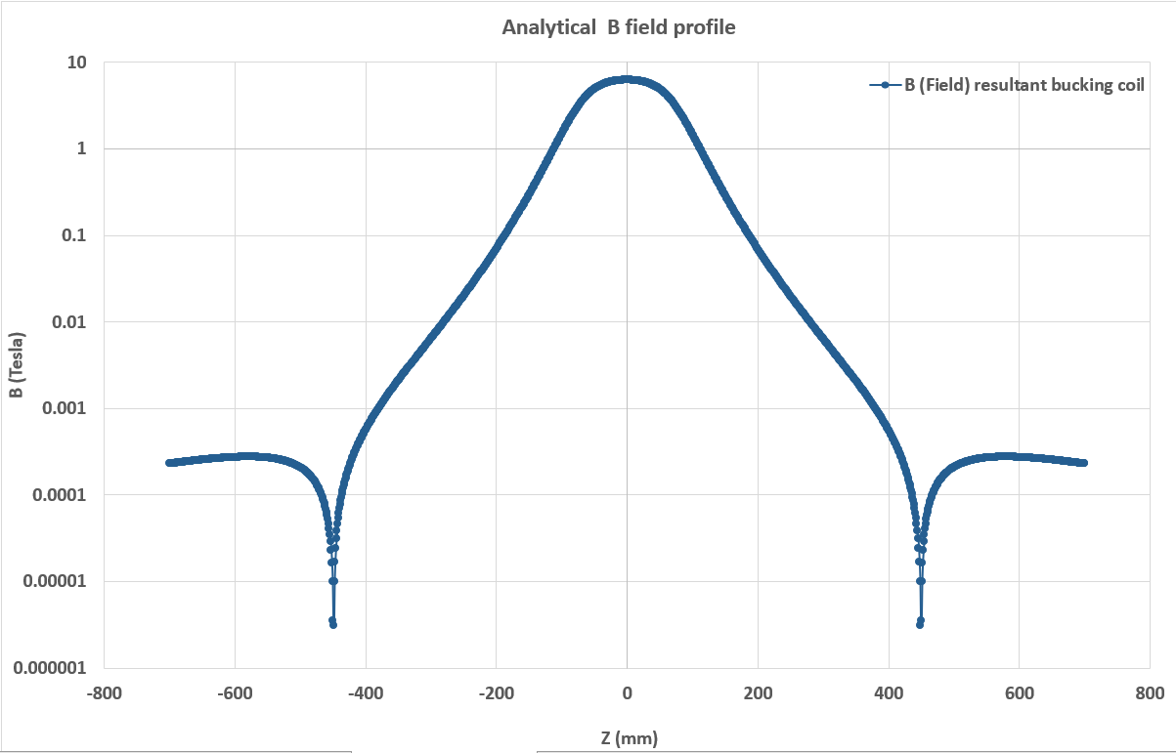
Focussing strength and spherical aberration
Focusing strength 4.42
Spherical coil aberration 71.15982352

Slide 11
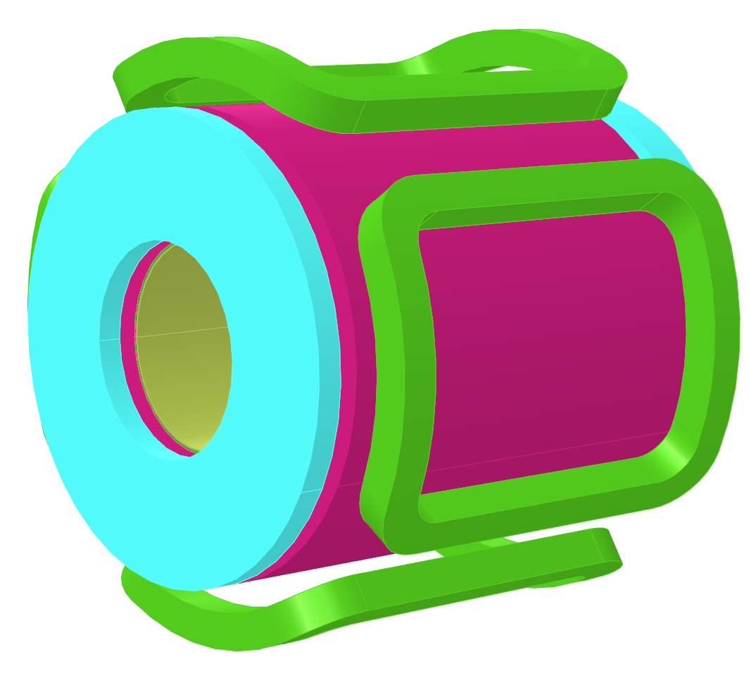
Electromagnetic Design
Configuration 1:
No extra benefit in spatial occupancy
Configuration 2:
Less axial field uniformity
More longitudinal foot print
Configuration 3:
Good axial field uniformity
Optimized axial and longitudinal footprint
$$X$$
$$X$$
$$√$$

Slide 12
Electromagnetic Design
Sr. no | Parameter | Value | Unit
1. | Length of solenoid coils in the lens | 140 | mm
2. | Main coil inner radius | 38 | mm
3. | Main coil outer radius | 75 | mm
4. | Strand diameter bare (with insulation) | 0.51(0.55) | mm
5. | Winding fill factor | 0.85
6. | Number of turns in the main coil | ~14554
Operating current 78A
Objective function :
$\int{B_{z}^{2}}. dz ≥$ 4.5 T²m
Minimize $\int^{r=0.3}{B.dl }$ at z= 0.42m cavity location
Sr. no | Parameter | Value | Unit
1. | Length of Bucking Coils | 64 | mm
2. | Bucking coil inner radius | 100 | mm
3. | Bucking Coil outer radius | 112.5 | mm
4. | Strand diameter | 0.51(0.55) | mm
5. | Bucking Coil Z location* | 38 | mm
6. | Winding fill factor | 0.85
7. | Number of turns in the Bucking coil | ~2247
Constraints:
$Effective length$≤ 185 cm +/- 30mm ; I _{exc} < 90A
Optimization Parameters:
N_{main}, OR _{main,} IR _{main ,} IR _{BC ,} OR _{BC} L _{BC} , Z _{center-BC}

Slide 13
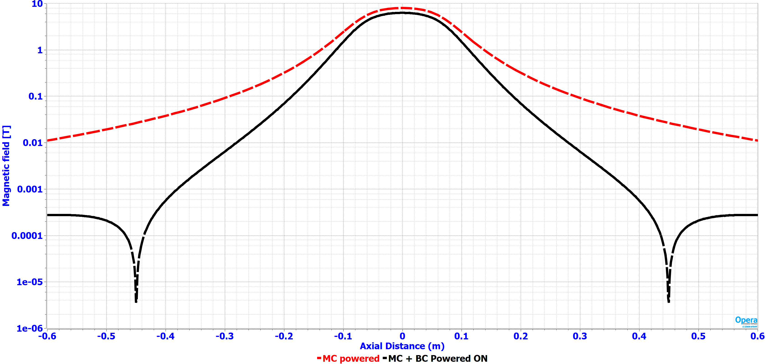
Electromagnetic Design… continued
Main Coil Powered on
Main Coil Powered along with active shielding coil
B_{mod} field vs axial distance plot

Slide 14
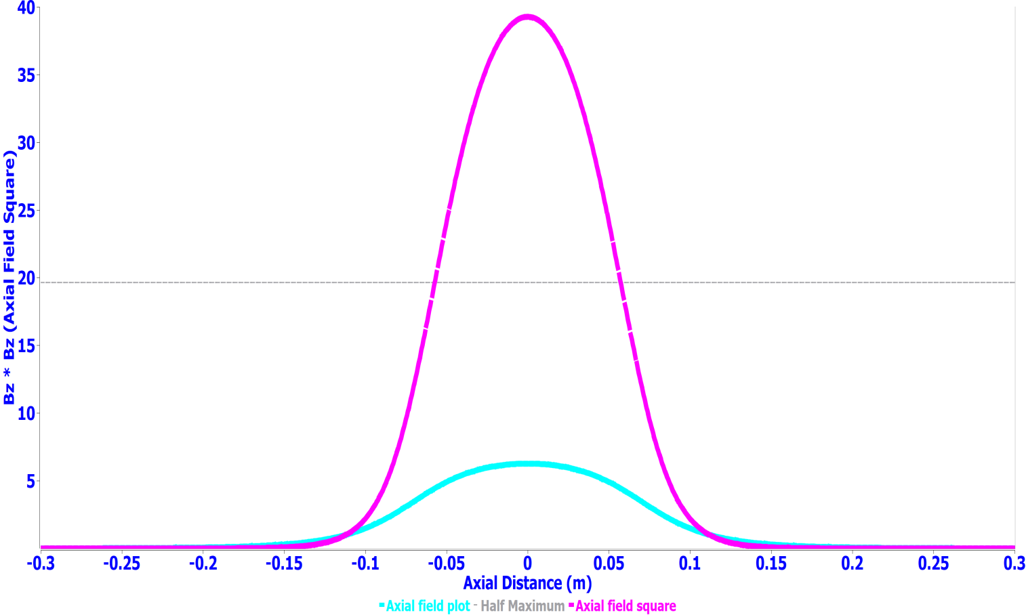
Electromagnetic design … continued
Focusing strength req. : 4.5 T²m
Achieved : 4.57T²m
Operating current 78A
Zonal plot of Magnetic field at the magnet center (field homogeneity 1.1% @ r=18 mm)
B field plot and B² Plot along the axial length
(Focusing strength of 4.57 T²m)

Slide 15
Dipole corrector design
Sr. no | Parameter | Value | Unit
1. | Straight Length of Dipole corrector coils (H1) | 10 | mm
2. | Width cross-Section in radial direction | 15 | mm
3. | Thickness cross-section in azimuthal direction | 35 | mm
4. | Radius of the Mandrel (R1) | 80 | mm
8. | Strand diameter (bare/insulated) | 0.51/0.55 | mm
9. | Number of turns in the dipole corrector coil | ~1475
10. | Operating current density at nominal bending strength | 28 | A/mm²
11. | Winding fill factor | ~0.85
Corrector coils used in space between the main solenoid and active shielding coil to reduce the operating current requirement
Sr. no | Parameter | Value | Unit
1. | Designed value of Bending strength of corrector coils | 6.3 | mT-m
2. | Peak Magnetic field on the corrector coil wire strand | 2.8 | T
3. | Quadrupole Gradient in skew Quadrupole mode | 3.25 | T/m
5. | Nominal current | ~10 | A
6. | Transfer function of the corrector coils | 0.1525 | mT/A

Slide 16
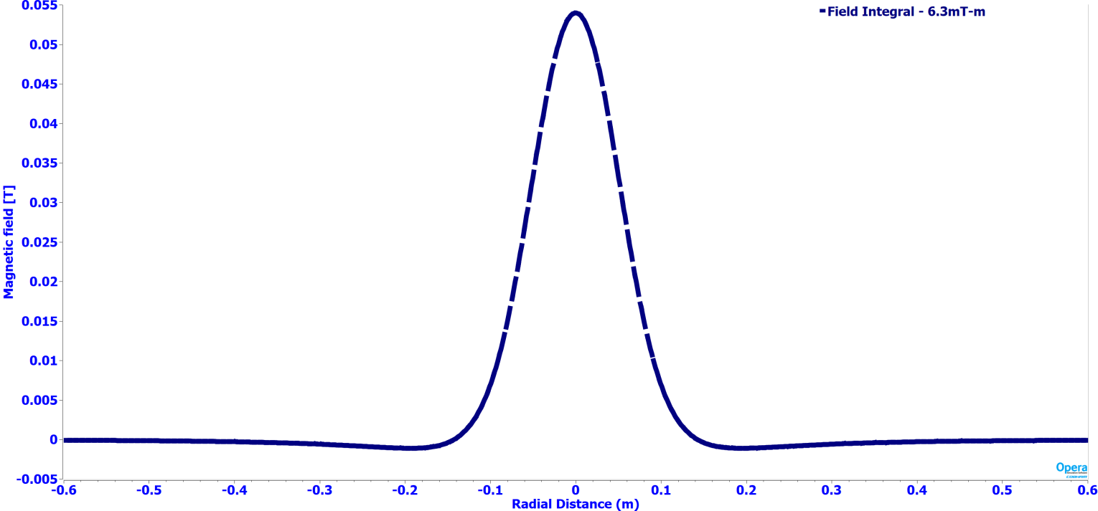
Dipole corrector design … continued
Bending strength req. : 6 mT-m
Achieved : 6.3 mT-m
Magnetic Field plot for the dipole field (Dipole field Integral 6.3 mT-m)
Zonal field plot of dipole field at the magnet center
Operating current ~10A

Slide 17
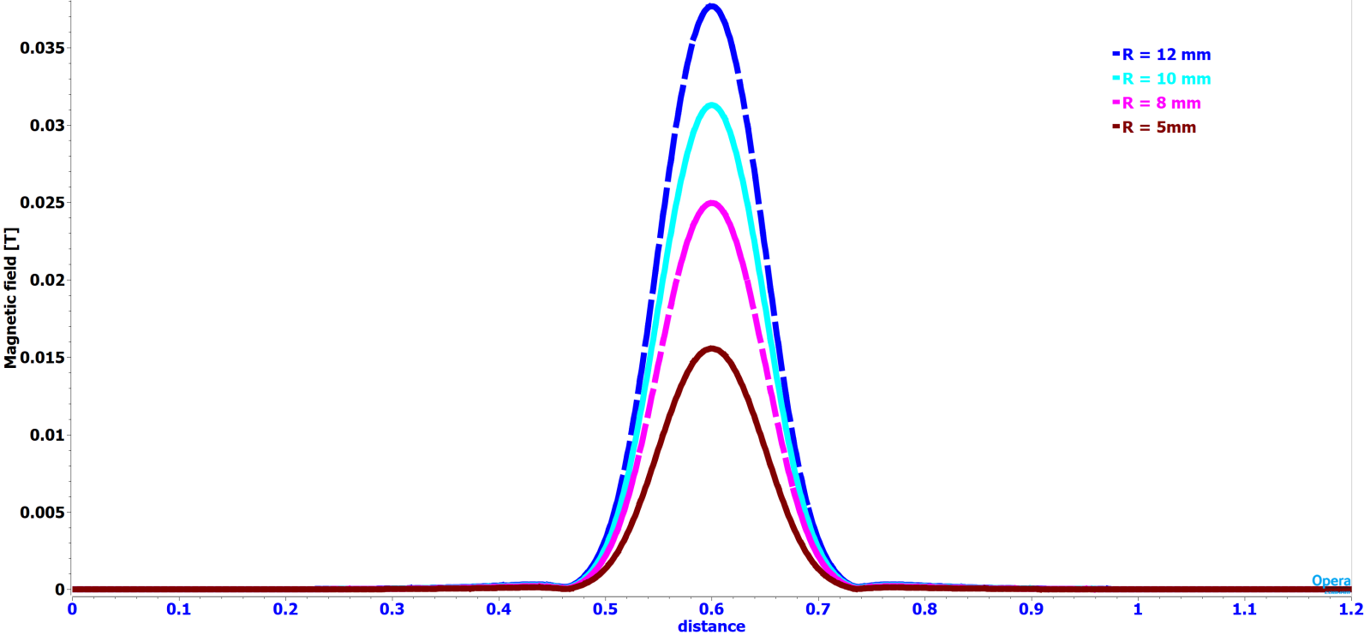
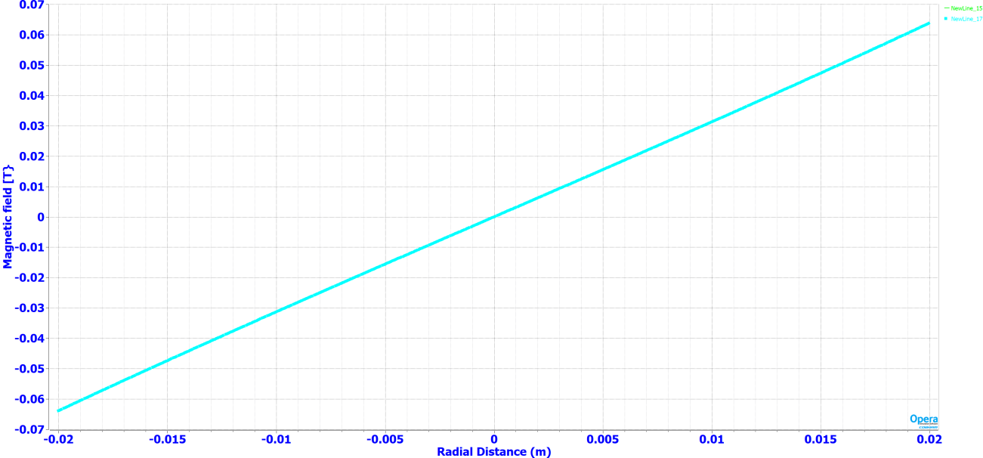
Dipole Corrector design (Quadrupole mode)
Magnetic Field (B_{x} or B_{y}) plot in the lens aperture at various radial locations when corrector coils are connected as skew quadrupole
Bx field plot vs radial distance in magnet aperture (Gradient = 3.25T/m)

Slide 18
Fringe field on cavity surface
Completely defined by the properties of superconducting material
Cavity Specific
Φ_{tr}= $\frac{\text{2}\text{μ}\text{0}\text{Φ}\text{0}}{\text{(}\text{Rs}\text{∙ }\text{ξ}\text{0}\text{2}\text{)}}$ * $\frac{\text{f}\text{∙}\text{V}}{(\text{ΛQ}\text{0})}$ *$\frac{\text{(}\text{1−}\text{η}\text{)}}{\text{η}}$
Acceptable degree of degradation η with allowed amount of the trapped flux.
Placement of a focusing lens inside the SSR cryomodule
μ₀=4π∙10⁻⁷H/m ; Φ₀=2∙10⁻¹⁵Wb
ξ₀=3.9∙10⁻⁸ m is the coherent length in Nb, f is the frequency of the cavity,
Rs is the surface resistance of Nb at this frequency,
V is the volume of the cavity,
Λ = $\frac{\text{Magnetic} \text{energy} \text{density} \text{at} \text{the} \text{location} \text{of} \text{the} \text{quench}}{\text{A}\text{verage} \text{energy} \text{density} \text{in} \text{the} \text{cavity} }$
Surface integral / line integral at the maximum magnetic energy density location needs to be minimized during the design of bucking coil

Slide 19
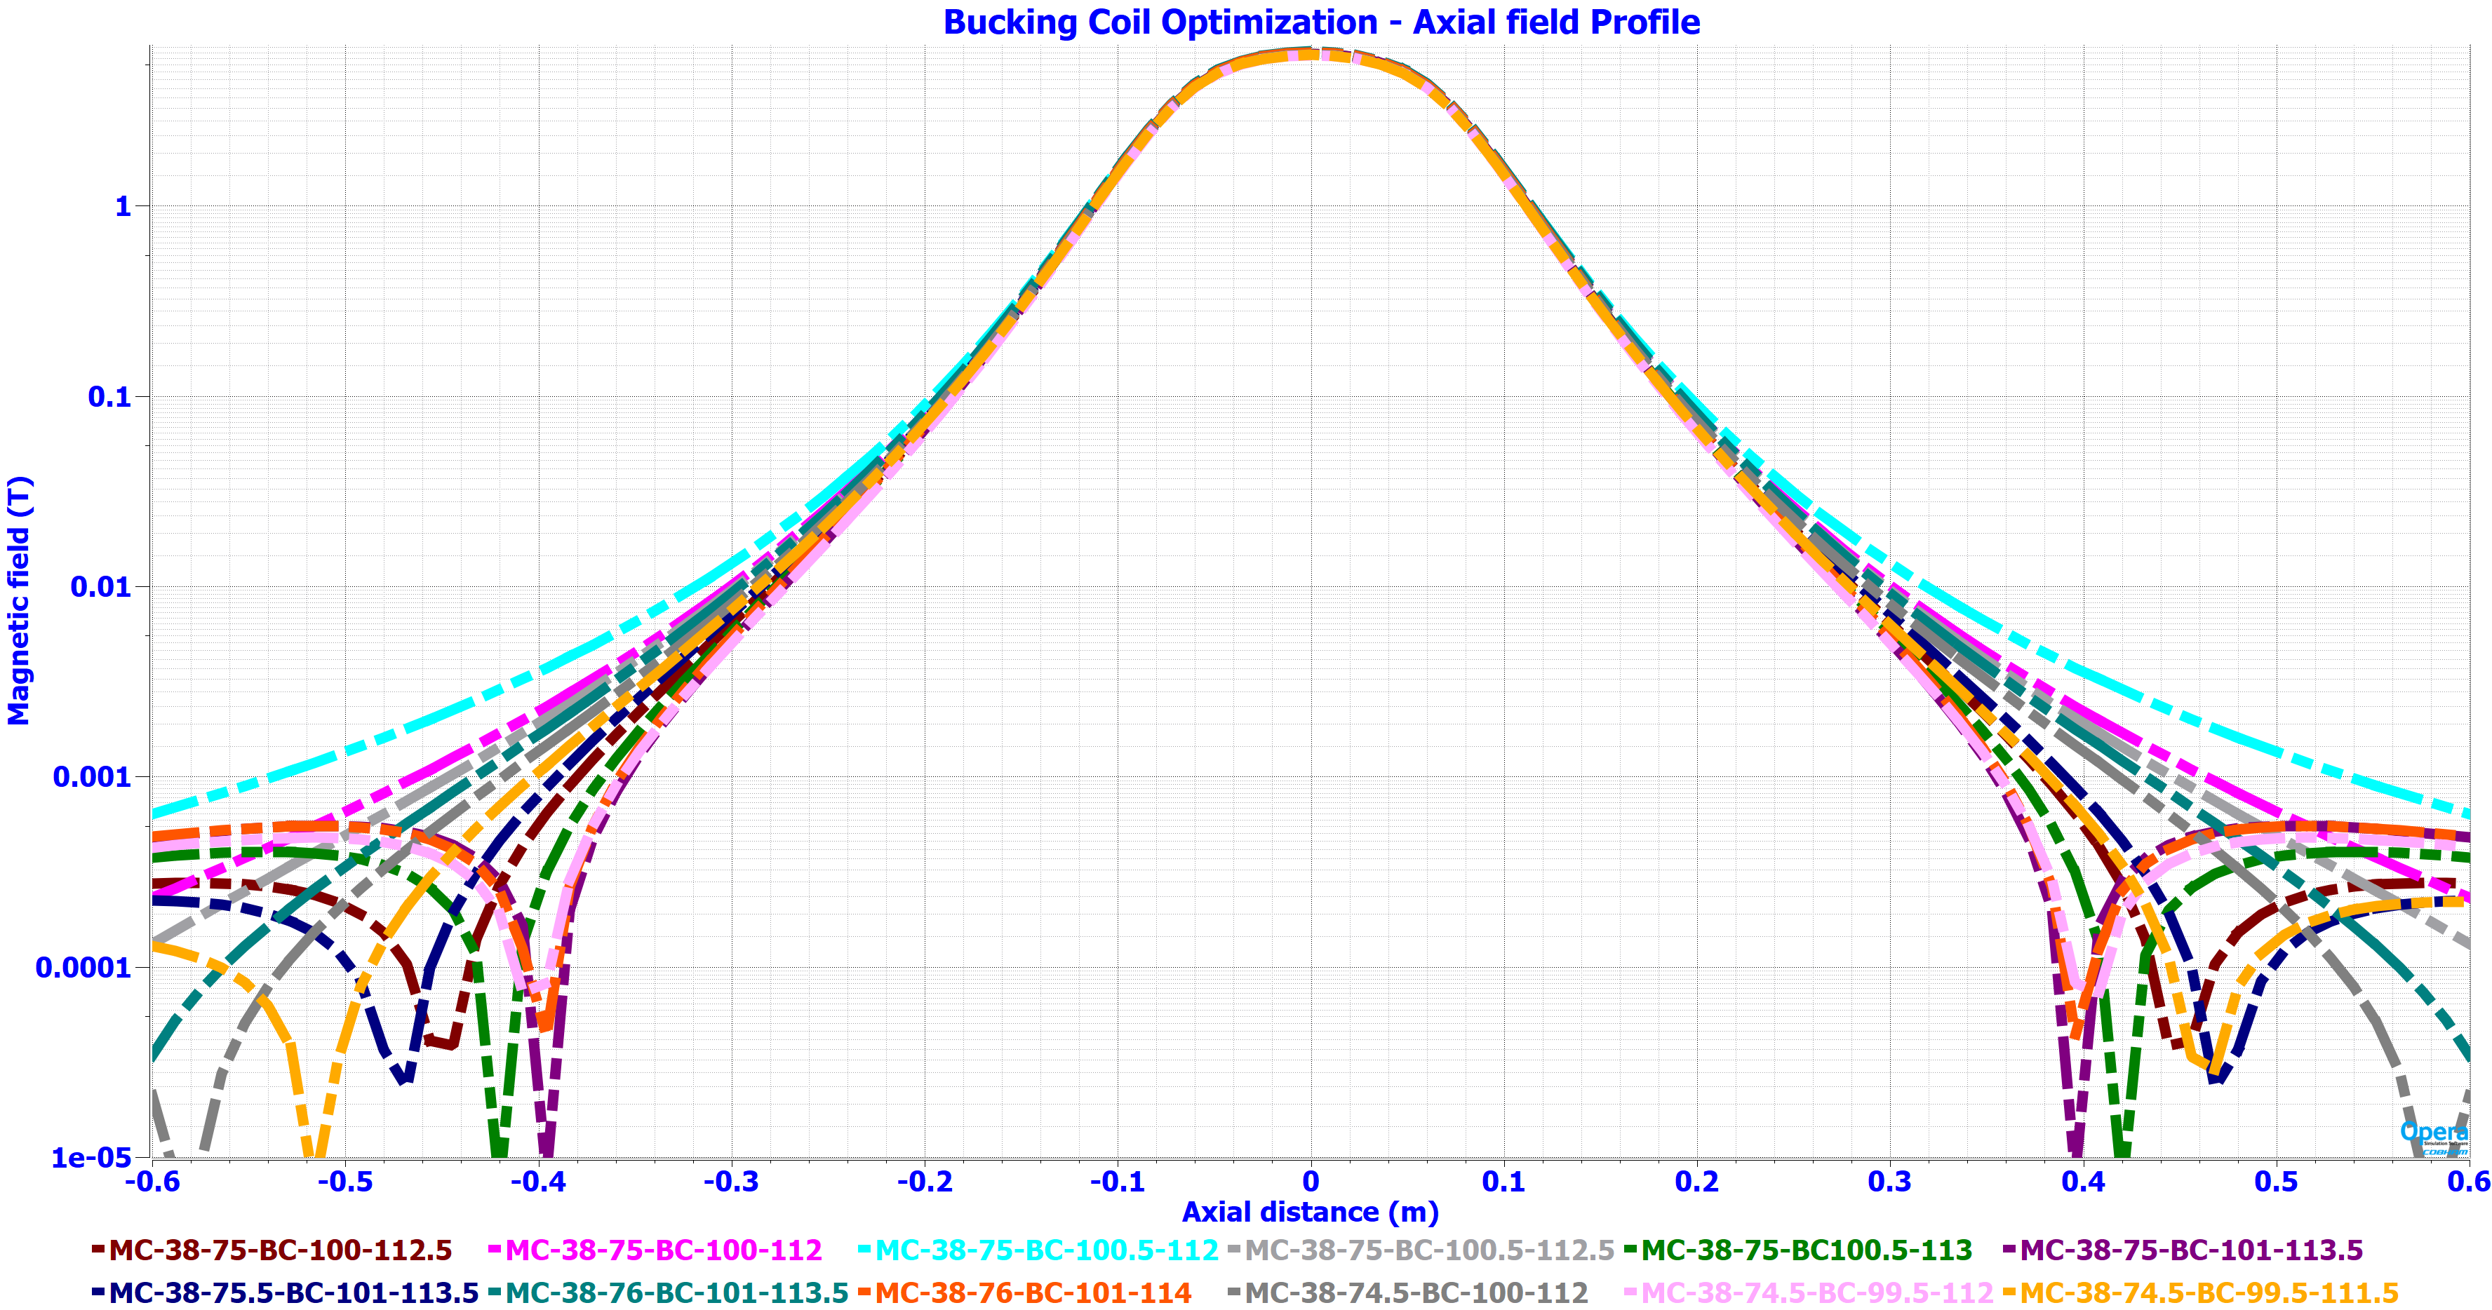
Bucking coil optimization
B field vs axial distance plot for different cases of Bucking coil dimensions

Slide 20
Tolerance studies on bucking coil geometrical parameters
Tight tolerance is required for the bucking coil winding dimensions and its placement w.r.t main coil.
The positional inaccuracy of the Bucking coil effects the fringe magnetic field on the cavity surface.
Effect on fringe field level at different axial position of the Bucking coil w.r.t Main coil
Sr. no | BC-Coil IR | BC-Coil OR | BC-Coil L | BC-Coil Z center | B max On cavity surface | Field Surface Integral at Axial distance of 0.42 m)
 | mm | mm | mm | mm | Gauss | G-m²
1. | 100 | 112.5 | 64 | 38 | 7.33 | 2.47
2. | 101 | 113 | 64 | 38 | 11 | 1.908
3. | 101 | 114 | 64 | 38 | 20 | 6.79
4. | 99 | 112 | 64 | 38 | 12 | 6.018
5. | 100.5 | 113 | 64 | 38 | 8.89 | 2.988
6. | 102 | 115 | 64 | 38 | 25 | 8.42
Two probable cases for detailed analysis

Slide 21
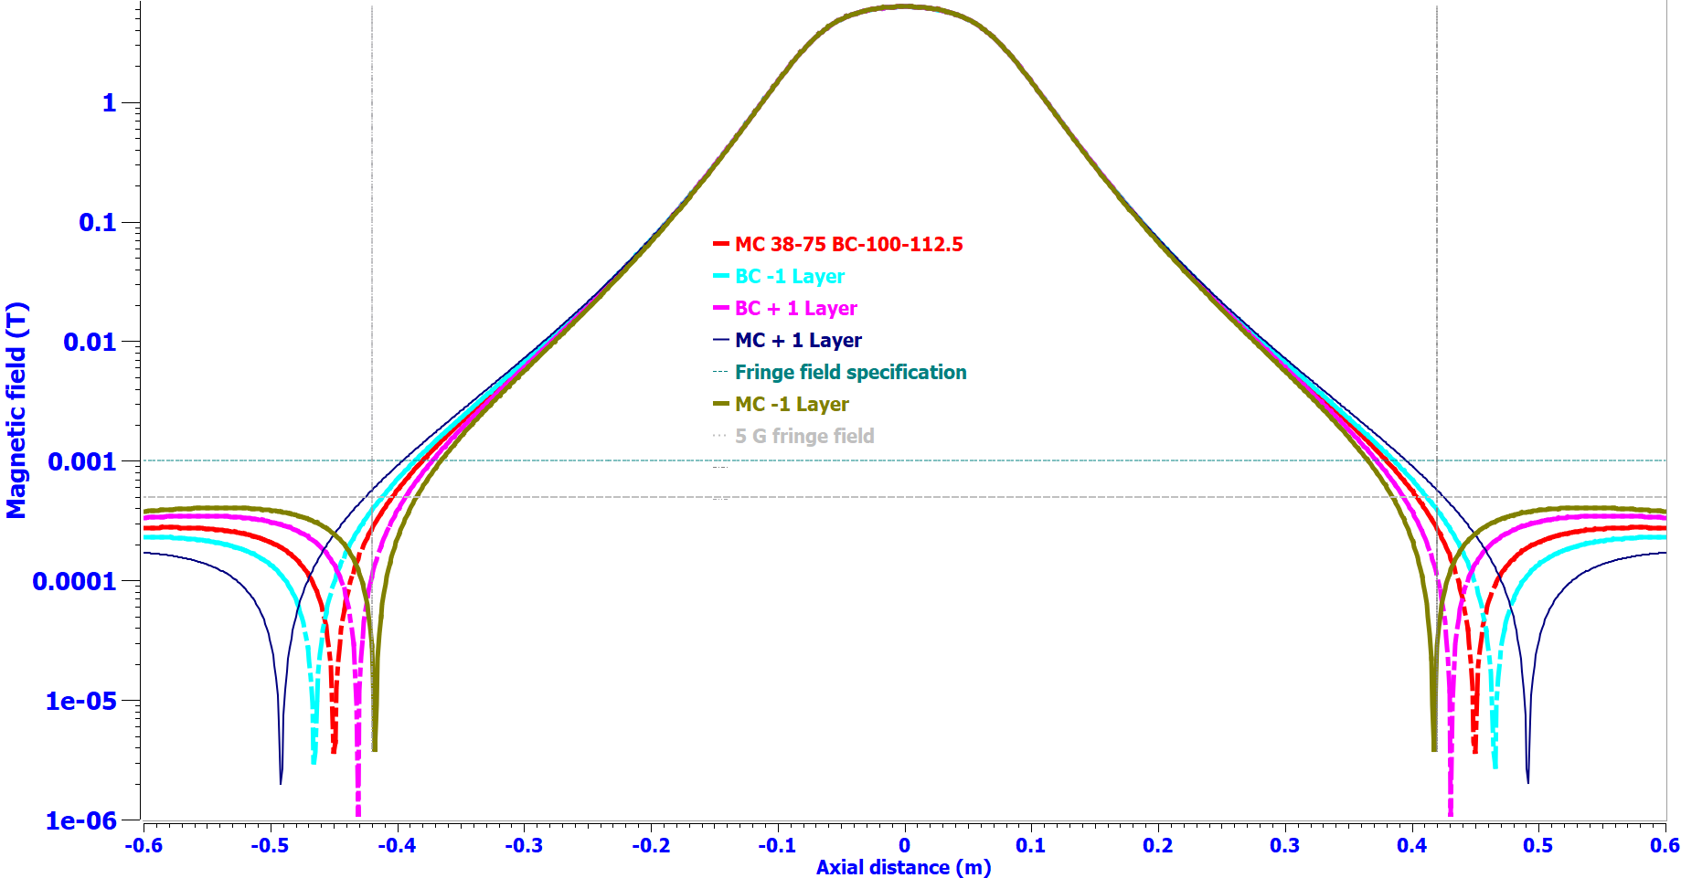
Error Sensitivity studies – Case (a)
Minimization point
B field vs axial distance plot for +/- one layer of bucking coil

Slide 22
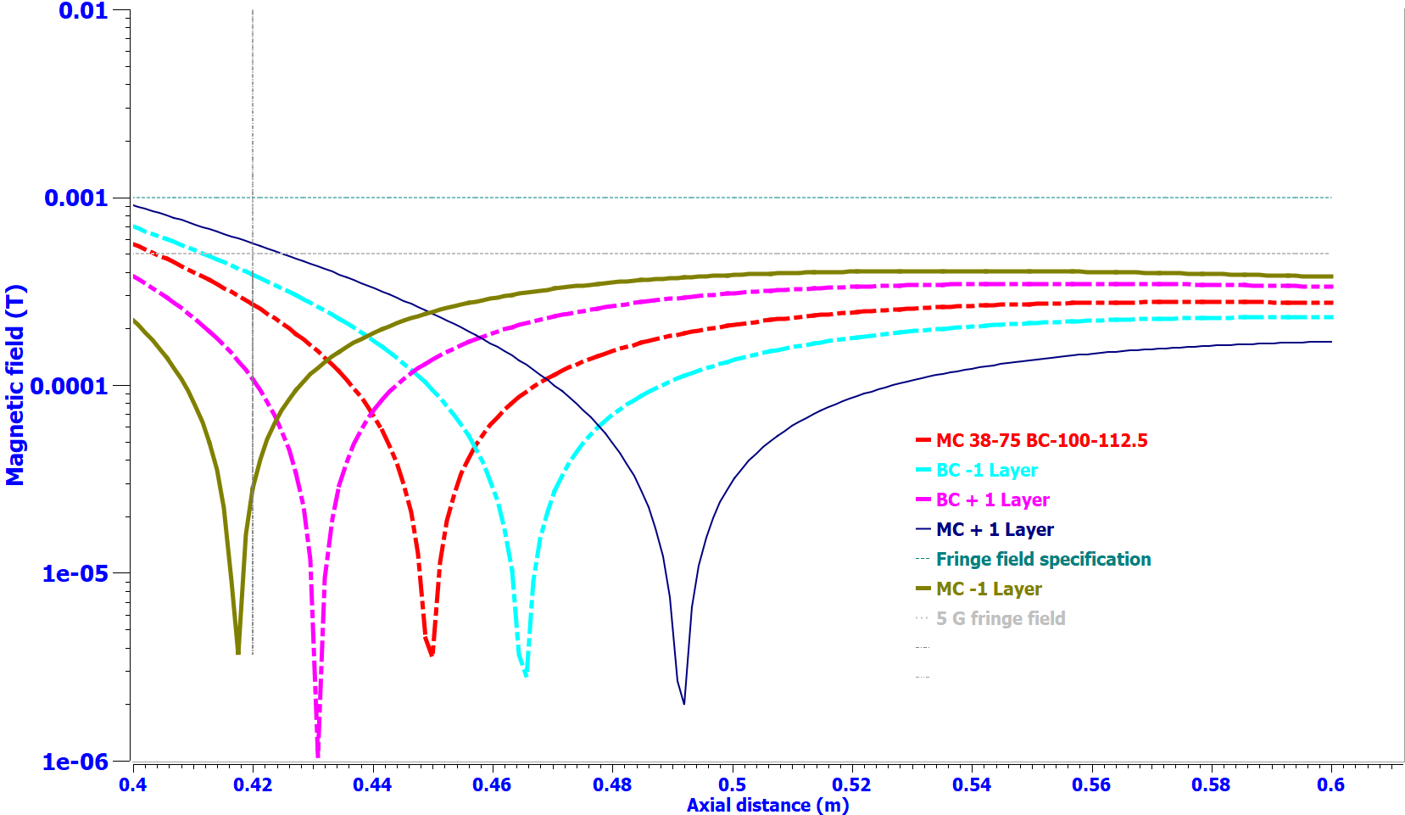
Error Sensitivity studies …continued Case (a)
Fringe field levels are well within the specified limits with manufacturing tolerances
B field vs axial distance plot for +/- one layer of bucking coil

Slide 23
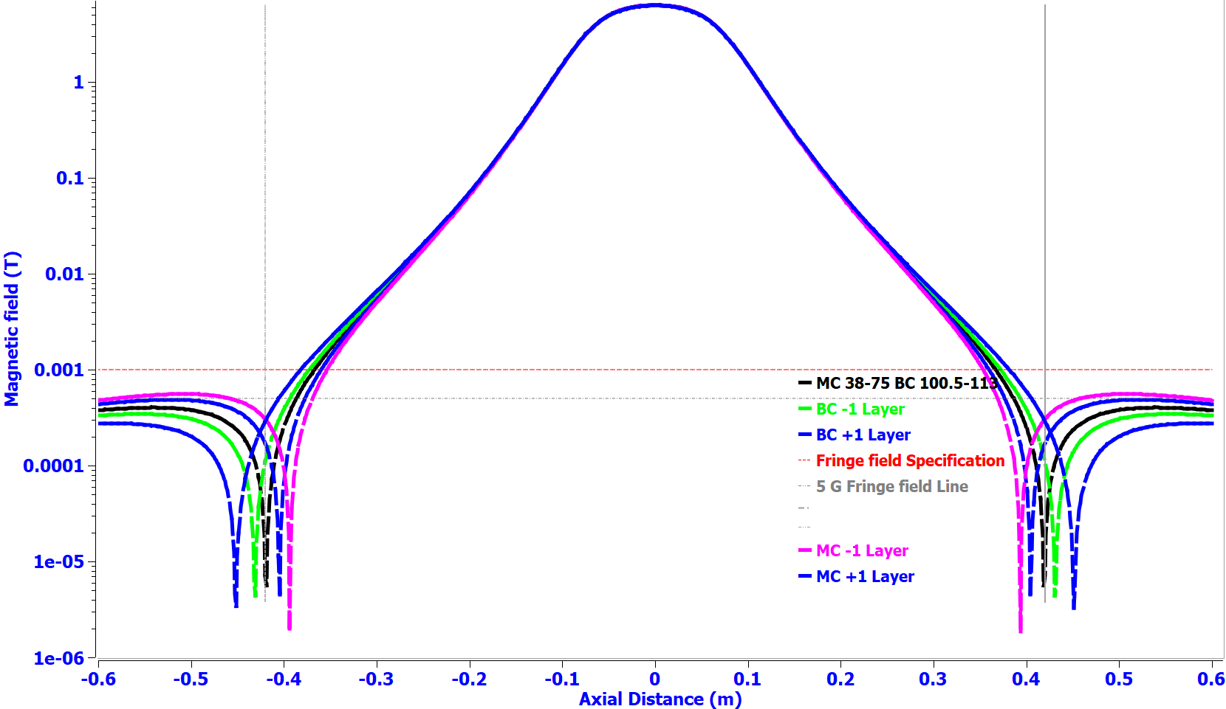
Error Sensitivity studies – Case (b)
B field vs axial distance plot for +/- one layer of bucking coil

Slide 24
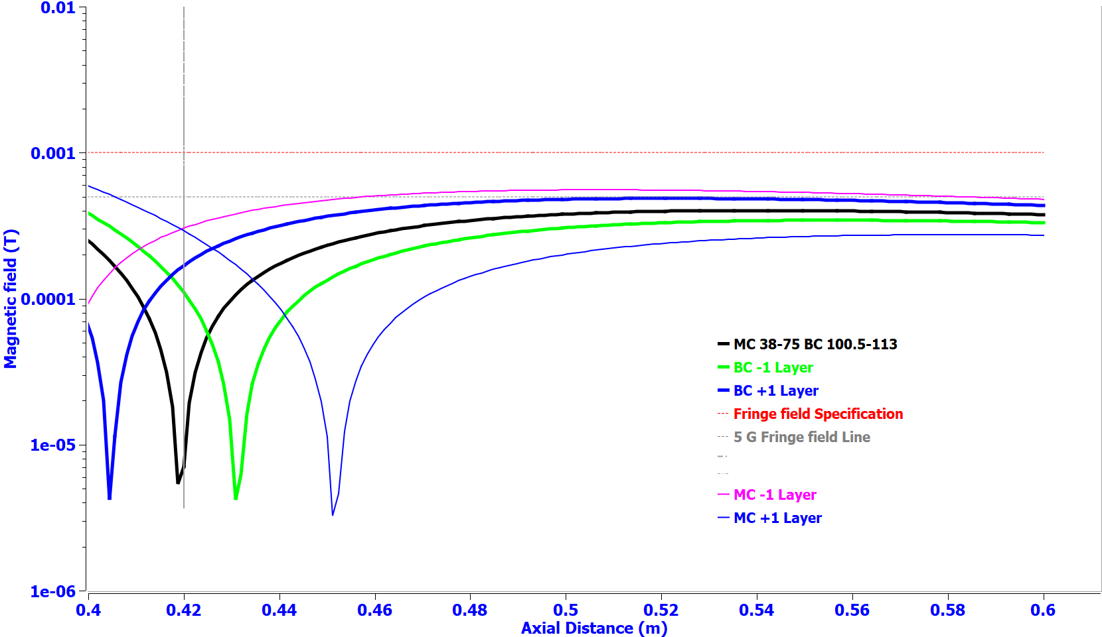
Error Sensitivity studies … continued – Case (b)
Fringe field levels are well within the specified limits with manufacturing tolerances
Case b fringe field levels < Case a fringe field levels
B field vs axial distance plot for +/- one layer of bucking coil

Slide 25
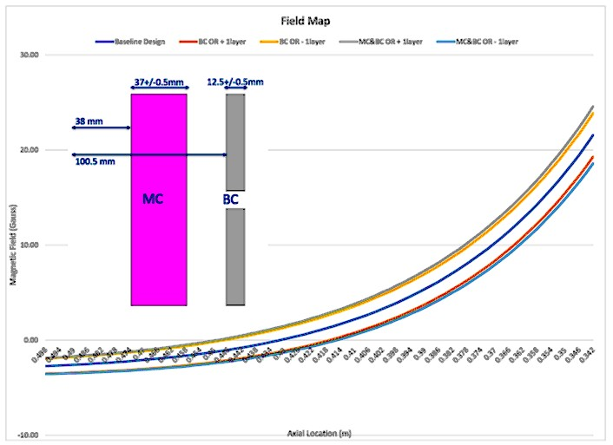
Validation with alternate solvers
Courtesy : Martin M Miao, FNAL
B field vs axial distance plot for +/- one layer of bucking coil

Slide 26
Validation with alternate solvers
CST Low frequency Magnetostatic Solver

Slide 27
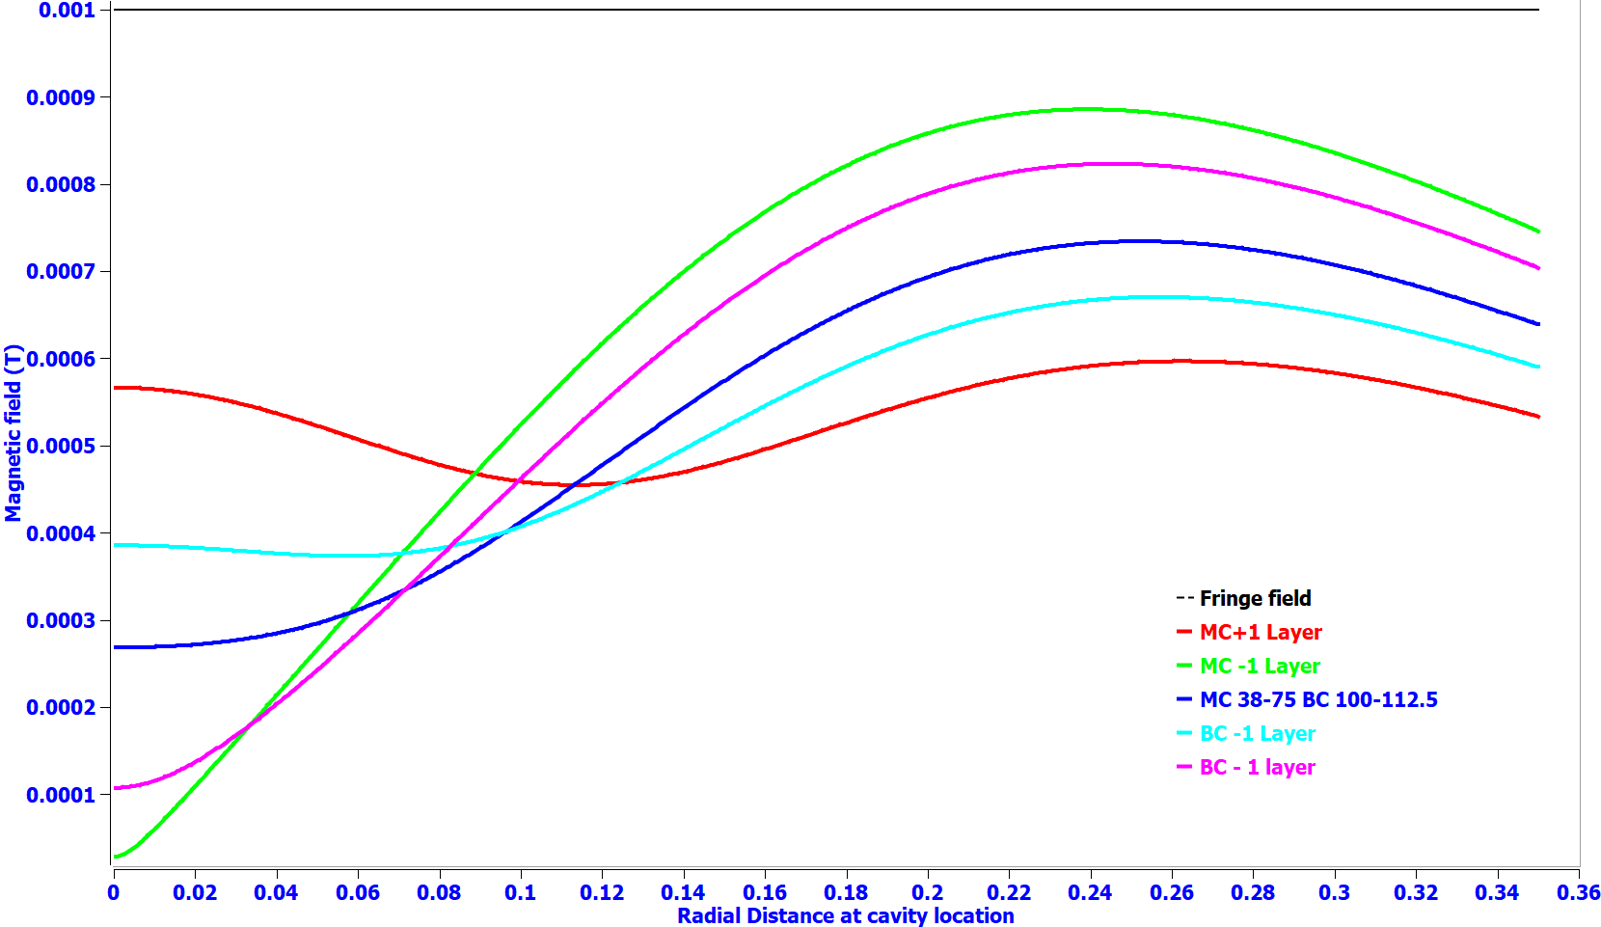
Radial field plot at cavity location for case (a)
B field vs axial distance plot for +/- one layer of bucking coil

Slide 28
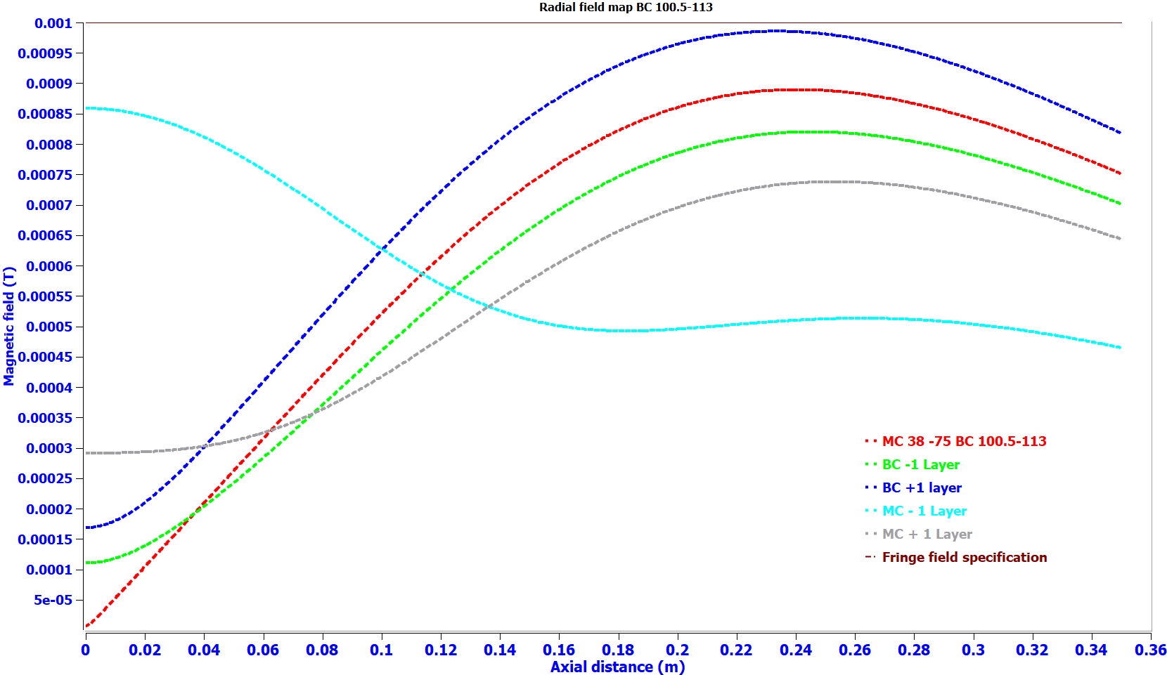
Radial field plot at cavity location for case (b)
Case (a) selected for optimized design
B field vs axial distance plot for +/- one layer of bucking coil

Slide 29
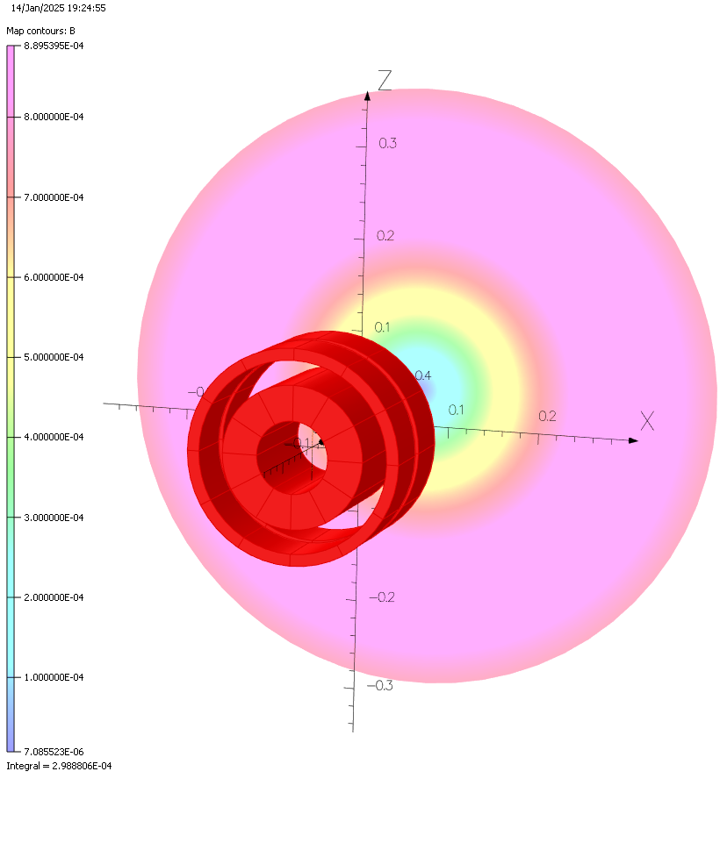
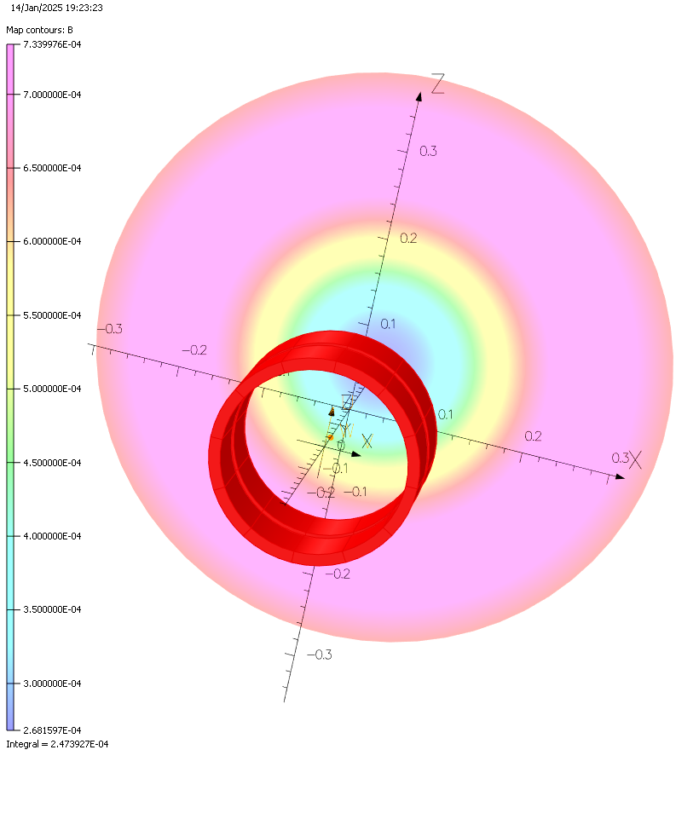
Surface plot at Cavity location
Case (a) : BC Baseline 100-112.5
Case (b) : BC Baseline 100.5-113
Case (a) selected for optimized design

Slide 30
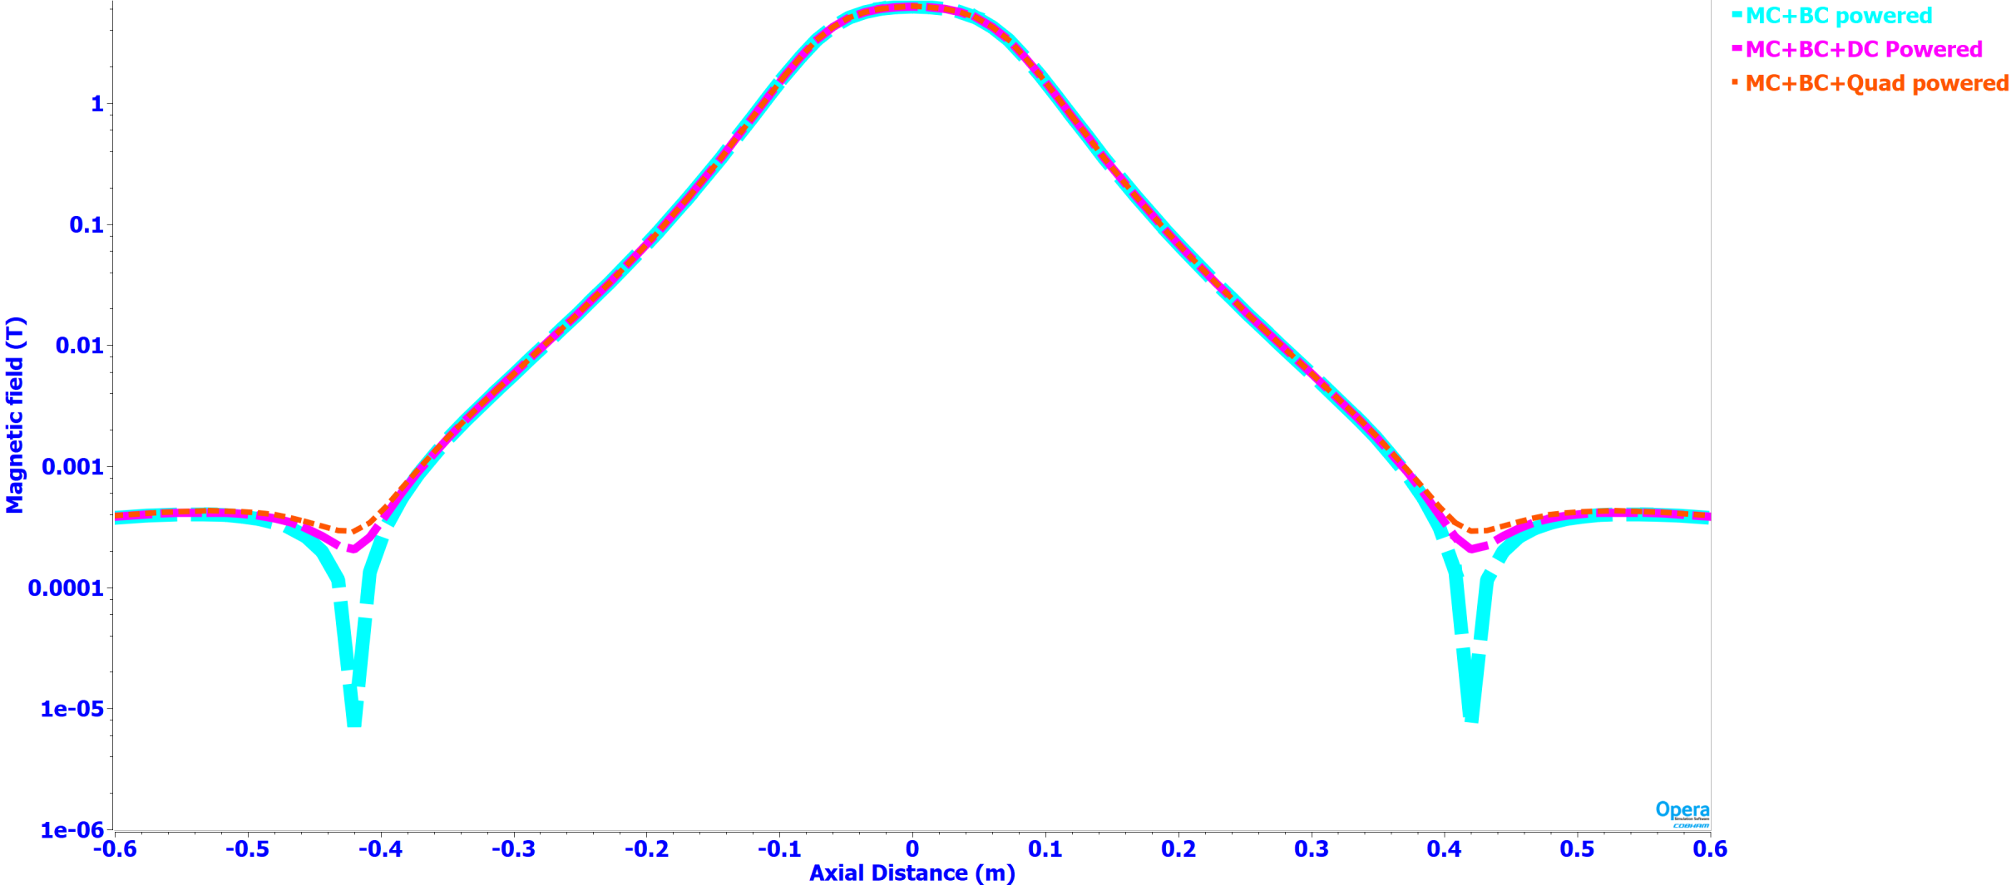
Combined-field-All coils-powered-on

Slide 31
Superconducting Wire strand material properties
All conduction cooled magnets are proposed to be wound using round 0.5 bare diameter /0.54 mm insulated strand (NbTi/ copper matrix 1:2 Sc:Cu Ratio).
$$B_{CT}= B_{c0} \left(1−{\left(\frac{T}{T_{c0}}\right)}^{2}\right)$$
The ratio of the maximum current density in the superconductor at any magnetic field and temperature to that at B = 5 T and T = 4.2 K can be found using the expression given below:
Jc(B,T) / Jc(5 T, 4.2 K)= C0/B∙b^{α}∙(1-b)^{β}∙(1-tn)^{γ}
Where, C₀ = 28.4 T, α = 0.80, β = 0.89, and γ = 1.87.
Power diode connected in shunt with magnet
Bare Wire Dia | Filament Diameter | Cu/Sc Ratio | Filament twist pitch | RRR | Ic @ 3 T , 4.2K | Ic @ 5 T , 4.2K | Ic @ 7 T , 4.2K | Ic @ 9 T , 4.2K
0.51mm |  | 2:1 |  | 70 | 240 A | 140A | 105A | 32A
Electronics rack
Vacuum pumps

Slide 32
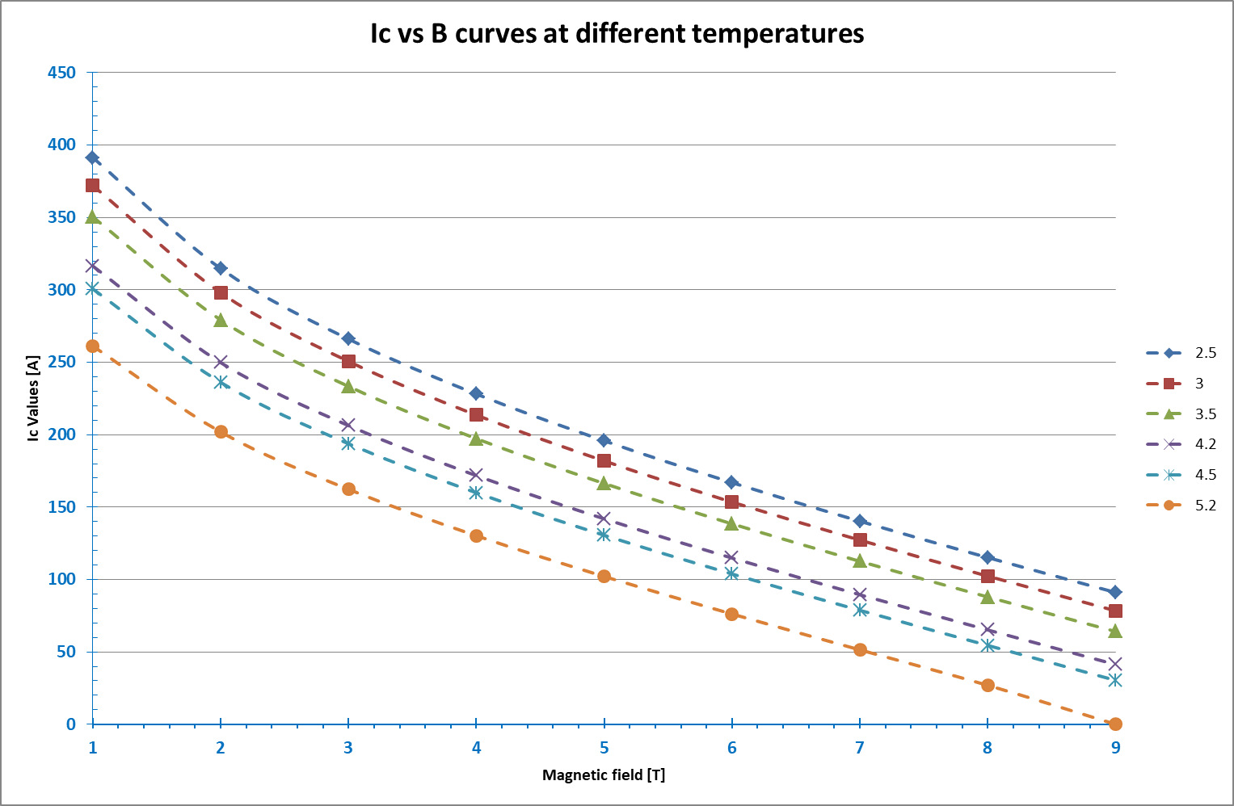
Superconducting Wire strand material properties
Power diode connected in shunt with magnet
Electronics rack
Vacuum pumps

Slide 33
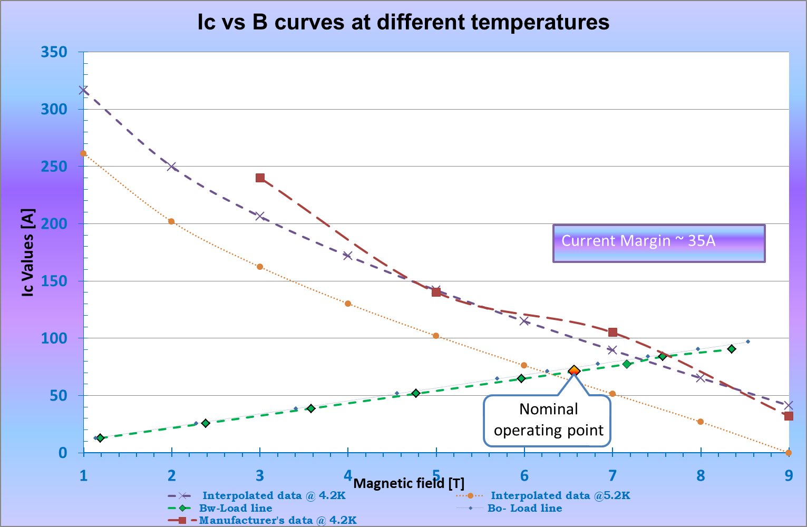
Magnet load line – New design
Power diode connected in shunt with magnet
Comparing the manufacturer’s data it is clear that practically there is a margin of ~ 35A @ 4.2K
Electronics rack
Vacuum pumps

Slide 34
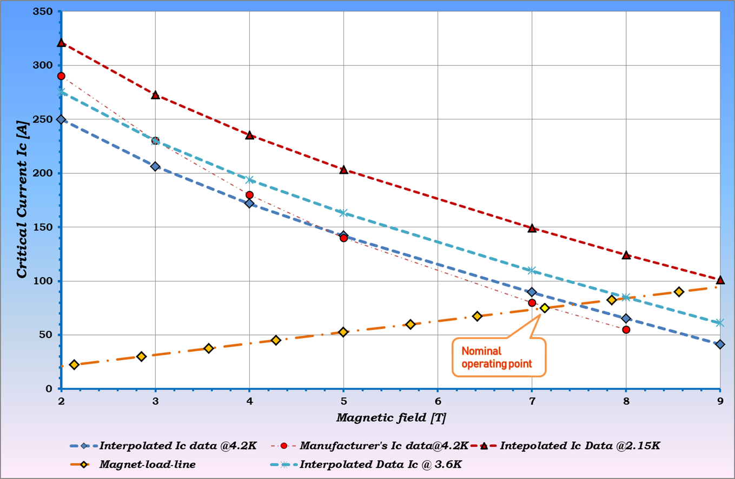
Magnet load line – Pre-series Magnet design (0.4mm bare dia wire)
Power diode connected in shunt with magnet
Practically no Margin @ 4.2K
~ 30A @ 2.15K
Electronics rack
Vacuum pumps

Slide 35
Quench Studies

Slide 36
Quench Studies (Quench initiated in main coil)
Power diode connected in shunt with magnet
At t = 0s
At t = 0.01s
At t = 0.1s
At t = 0.4s
Electronics rack
Vacuum pumps
Flux initiated by ~4W of heat deposition at peak B field location
To study peak temperature & peak coil voltages
At t = 20s
At t = 5s

Slide 37
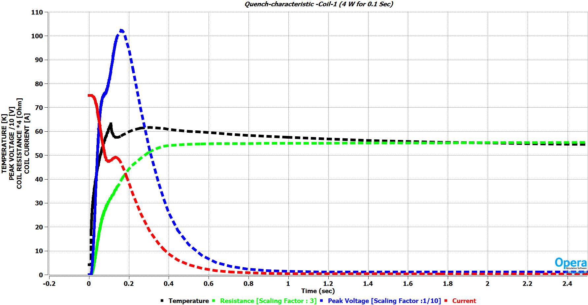
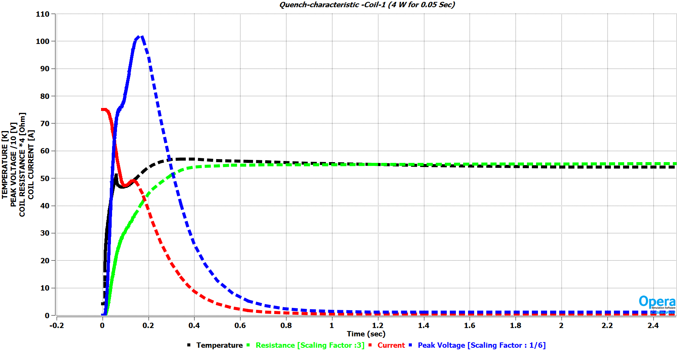
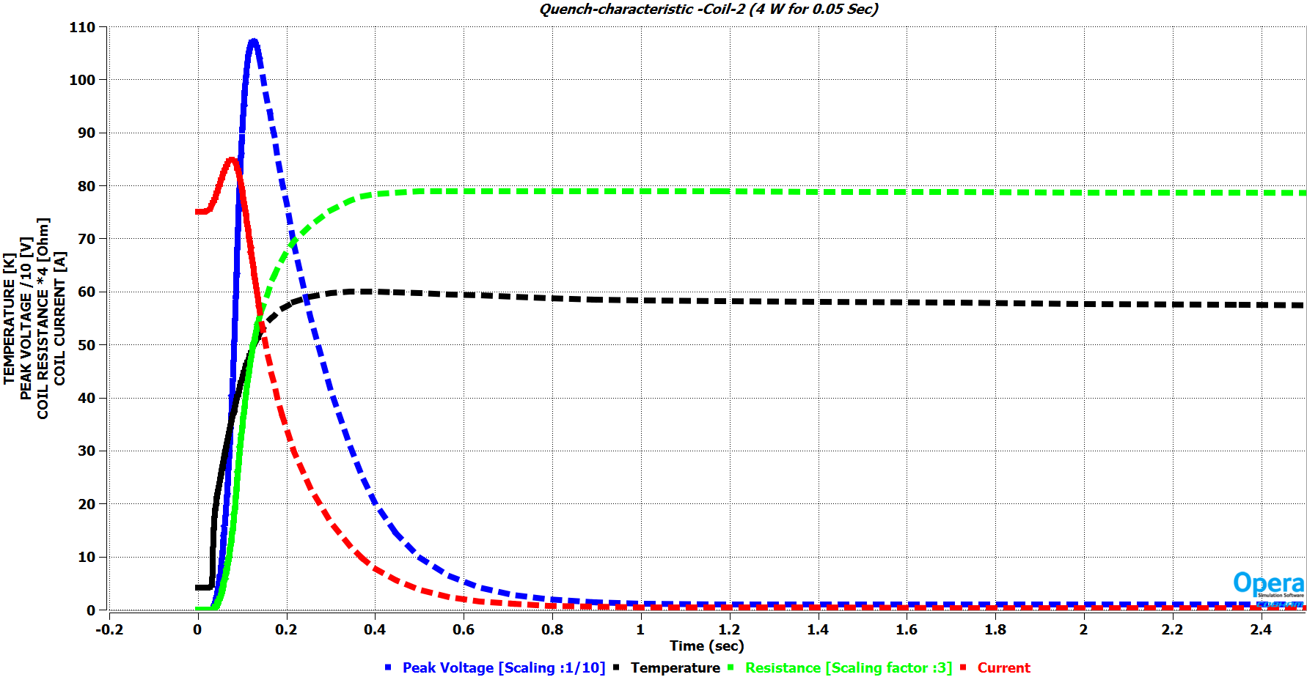
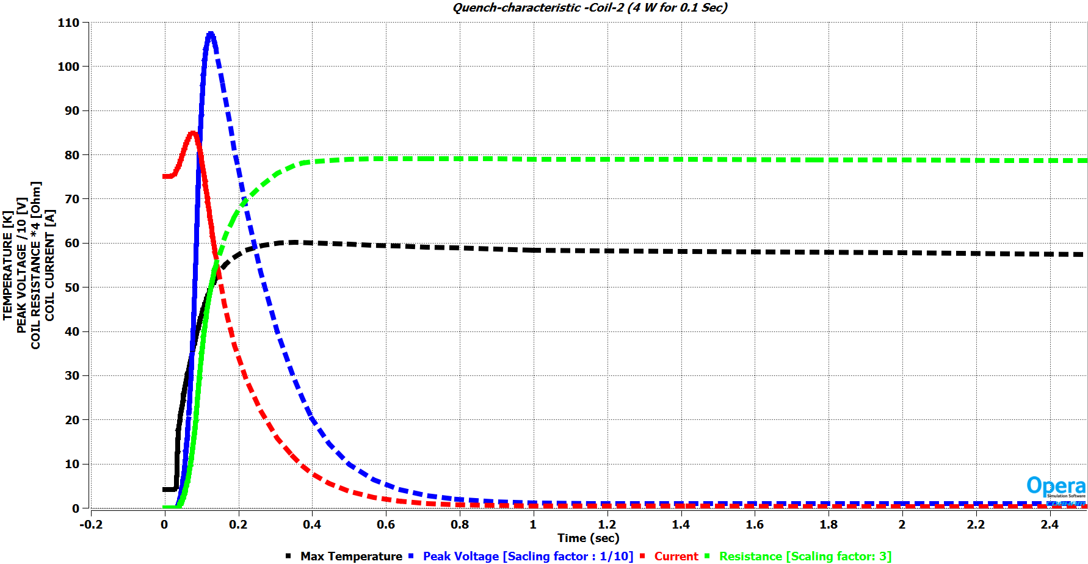
Quench Design (Variation in heat pulse)
Quench Characteristic for two coils sub-sections of main coil
Power diode connected in shunt with magnet
4W for 0.1 second
4W for 0.05 second

Slide 38
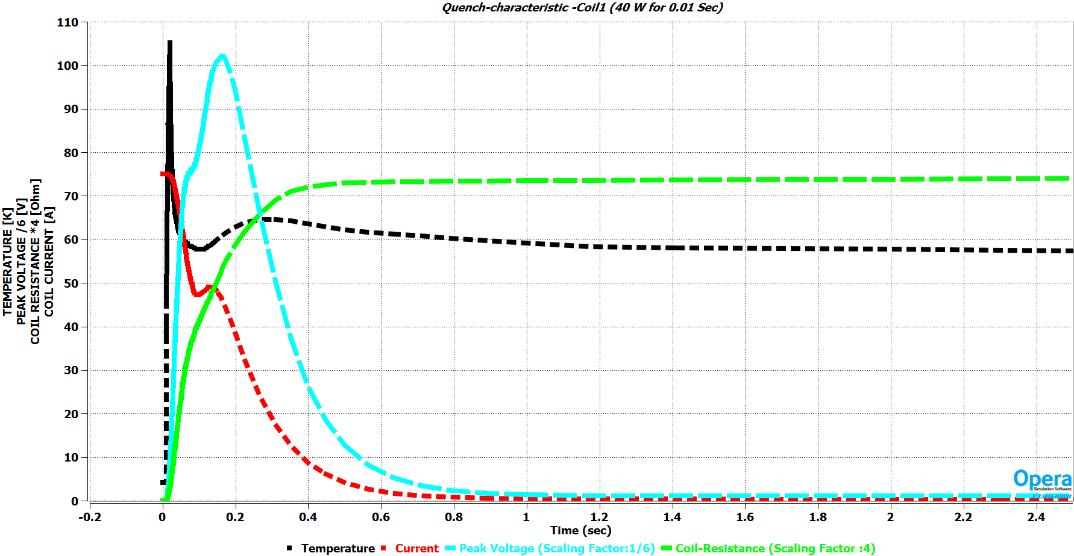
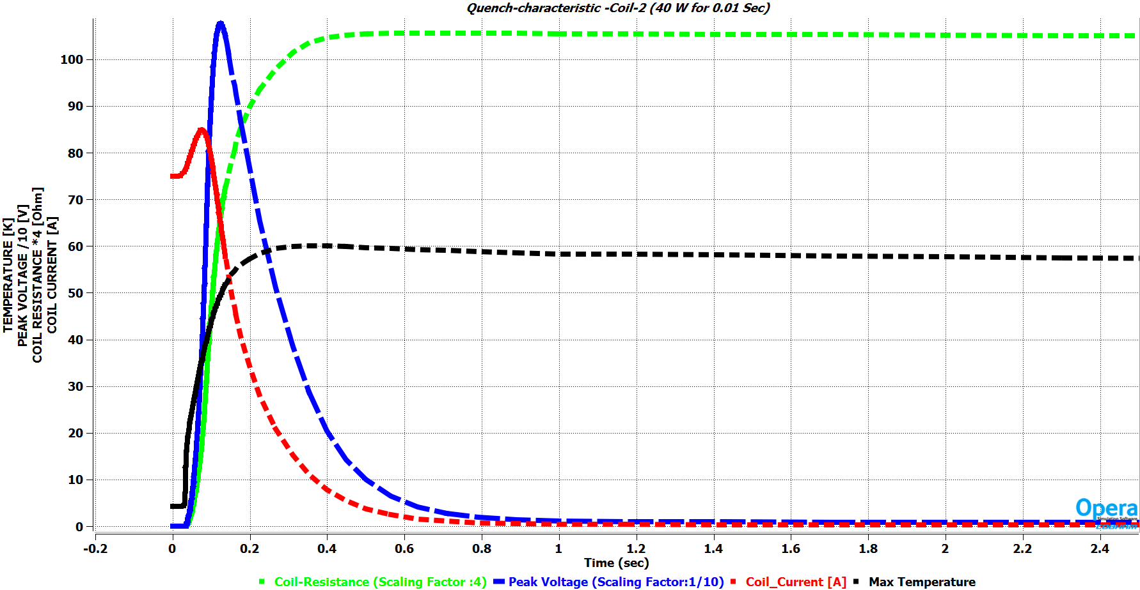
Quench Design (Variation in heat pulse)
Power diode connected in shunt with magnet
The amount of input heat energy does not play very significant role in determining the coil temperature
Once the quench has been initiated, by small amount of heat dissipation, the normal zone of the magnet will grow and decay the current
However the initial peak temperature of the hot spot (location at which quench is initiated) does depend slightly on the heat pulse.
40W for 0.1 second

Slide 39
Quench protection circuit
+ PS -
Quench Protection by passive diodes
Differential Voltage sensed to detect Quench
Same Quench protection circuit for Dipole corrector coils
MC coil1
MC coil2
BC coil1
BC coil1

Slide 40
Quench detection
Voltage taps to monitor and record any event of quench
Based on the theoretical studies and pre-series magnet quench measurement the quench detection circuit is considered to be efficinet to detect and protect the magnet in event of quench.

Slide 41
Final Magnet parameters
Coil1 Coil2 Coil3 Coil4
Coil1 5.82H 4.823H -0.319H -0.3191H
Coil2 4.823H 9.297H -0.722H -0.722H
Coil3 -0.319H -0.722H 1.461H 0.521H
Coil4 -0.319H -0.722H 0.521H 1.461H
Peak coil to ground voltage = 1.1kV
Peak temperature in case of quench = 65K
Magnet physical length = 140 mm
Engineering current density ~ 382 A/mm ² | Excitation current 75A | Focusing strength 4.57 T²m | Solenoid
Engineering current density ~ 50.995 A/mm ² | Excitation current 10A | Focusing strength 6.3 mT-m | Dipole Corrector

Slide 42
Conclusion
Parameters | SSR1/SSR2 New specification (Ver.3) | Achieved | Remarks
Focusing Strength | 4.5T²m | 4.57T²m | √
Bending strength of Dipole correctors | $≥$6.0 (5.0) mT-m | 6.3 mT-m | √
Beam pipe aperture | 40 mm | 40 mm
Uncertainty in the location of magnetic axis w.r.t Reference points (Transverse and angular alignment) | <0.1mm RMS <0.5 mrad RMS | Majorly from the Mechanical design of magnet former and winding accuracy
Active magnetic shielding requirements | ~<10G | <10 G | √
Maximum current in the solenoid | 90 | 75 A | √
Maximum current in the dipole correctors | 12 (50) | 10 A | √
Electromagnetic design of the SSR solenoid has been carried out meet the specified requirements
Predicted performance metrics and margins have been considered
In terms of (a) Operational margin (b) Manufacturing tolerance impact on performance (c) Fringe field on the cavity surface

Slide 43
Conclusion
New design considerably has higher margin compared to pre-series magnets
Dipole corrector current requirements have been reduced for reducing thermal load
Based on the magnetic measurements and design performance of pre-series magnets predicted electromagnetic design will meet the design requirements
Manufacturing tolerances has been accounted for during design and positioning accuracies of main coil and bucking coil shall be maintained to meet fringe field requirements under all conditions.

Slide 44
References
[1] PIP-II SSR2 CRYOMODULE FRS : ED0001829-D
[2] FOCUSING LENS FOR SSR1 AND SSR2 - Technical Requirements Specification (TRS)"
[3] BCR: SSR Solenoid design/validation test, PIP-II BCR
[4] “SSR1 Cavity Quenching in the Presence of Magnetic Field,” FNAL TD note TD-12-007, June 2012 , T. Khabiboulline, D. Sergatskov, and I. Terechkine,
[5] “Acceptable Level of Magnetic Field on the Surface of a Superconducting RF Cavity,” FNAL, TD note TD-12-008, June 2012T. Khabiboulline, T. Nicol, and I. Terechkine
[7] Electromagnetic design and performance of conduction cooled superconducting magnet for spoke resonator cryomodule for Proton Improvement Plan (PIP)-II, Kumud Singh, Janvin Itteera, Mahima , Vikas Tiwari , Himanshu Bisht , Sanjay Malhotra ,R.R. Singh , Rajesh Jalan , Sanjay Howal , Rajesh Chimurkar , Sunil Kumar , S. Stoynev ,M. Turenne , M. Yub, B. Hanna , J. Hayman , C. Boffo, July 2024 Elsevier, Superconductivity

Slide 45
Thank you for your kind attention

Slide 46
Back up slides

Slide 47
Summary of quench studies
With dump resistor in series with back to back diodes
Sr. no. | Series dump resistor value | Peak voltage in coil 1 Peak Voltage in coil 2 | Voltage across Coil1 Voltage across Coil2 | Coil 1 temperature Coil 2 temperature
1. | 0 Ohms | 600V 1100 V | 4V 4V | 60K 60K
2. | 0.005 Ohms | 60V 200V | ~ 4.5V ~ 4.5V | 45K 38K
3. | 5 Ohms | 100 V 120 V | ~ 400 V ~128 V | 38 K 27 K
With only back to back diodes in parallel with coil
Sr. no. | Configuration | Peak voltage in coil 1 Peak Voltage in coil 2 | Voltage across Coil1 Voltage across Coil2 | Coil 1 temperature Coil 2 temperature
1. | Radial Coil split (middle quench) No dump resistor 0.4J of energy deposition | 600V 1100 V | ~4V ~4V | 65K 60K
2. | Axial Coil split (middle quench) No dump resistor 0.4J of energy deposition | ~ 850V ~850V | ~4V ~4V | 75K 75K
3. | Axial Coil split (corner quench) No dump resistor 0.4J of energy deposition | ~ 850V ~850V | ~4V ~4V | 75K 75K

