Slide 1


302.4.04 – Cryo-assemblies Horizontal Test
Weekly status report
S. Stoynev / G. Chlachidze
Dec. 16th, 2024

Slide 2
Next Steps
LQXFA/B02 Test Traveler is closed
LQXFA/B02 Test Report released
LQXFA/B03 test preparations: in progress, documents finalized
Helium lines & N₂ vent line insulation work - Done
Update/Improve the controlled cooldown and warmup procedures for cryo-operators – Planned for first week of January (after discussions with cryo-engineers)
Investigating faulty GHe flow-meter: in progress
  No wiring problem was found
  The faulty has been removed from the system and has been shipped to Brooks Instrument for evaluation
  The dump file was sent to the Vendor – expecting analysis report soon

Slide 3
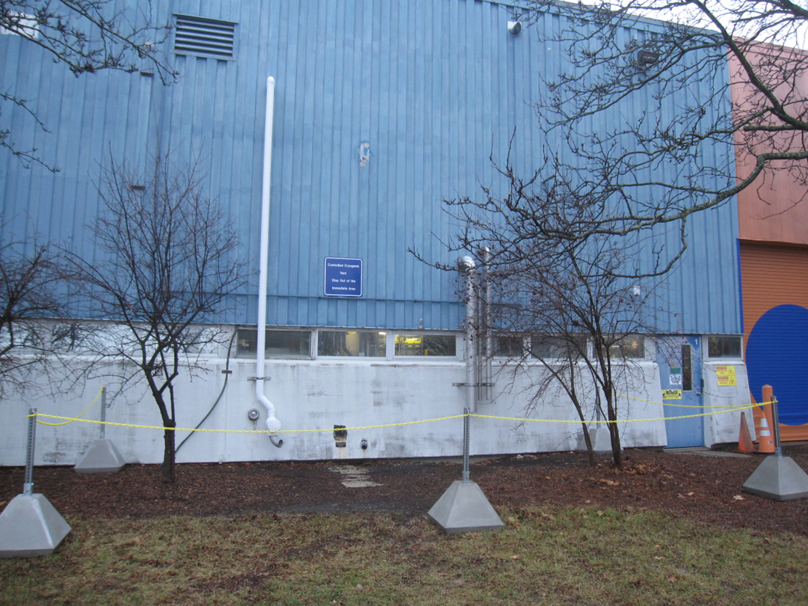
Next Steps (2)
Barriers will be installed around the N₂ vent line in IB1 – installed

Slide 4
Next Steps (3)
New warm finger materials
  SS inner tube of 4.25” OD and 0.083” thick wall not available. Custom order cost about $60-80k
  The only available option is 4.5” OD and 0.120” thick wall tubes
    Reducing the gap between the inner and outer tubes from 7.4 mm to 4.2 mm in radius. Room for about 10 layers of MLI instead of 15 layers in the baseline design
    Will increase the ID from 103.7 to 108.2 mm - requires different probe bearings
    3 more mirrors to be purchased ($5k) as they are glued to the bearing ring
  CERN was asked for help in purchasing the SS inner tube – we will contact a CERN provided vendor (to find if they can supply tubes with desired length)
Long term improvements: replacement of the HX at Stand 4
  Rough cost estimate is $100k

Slide 5
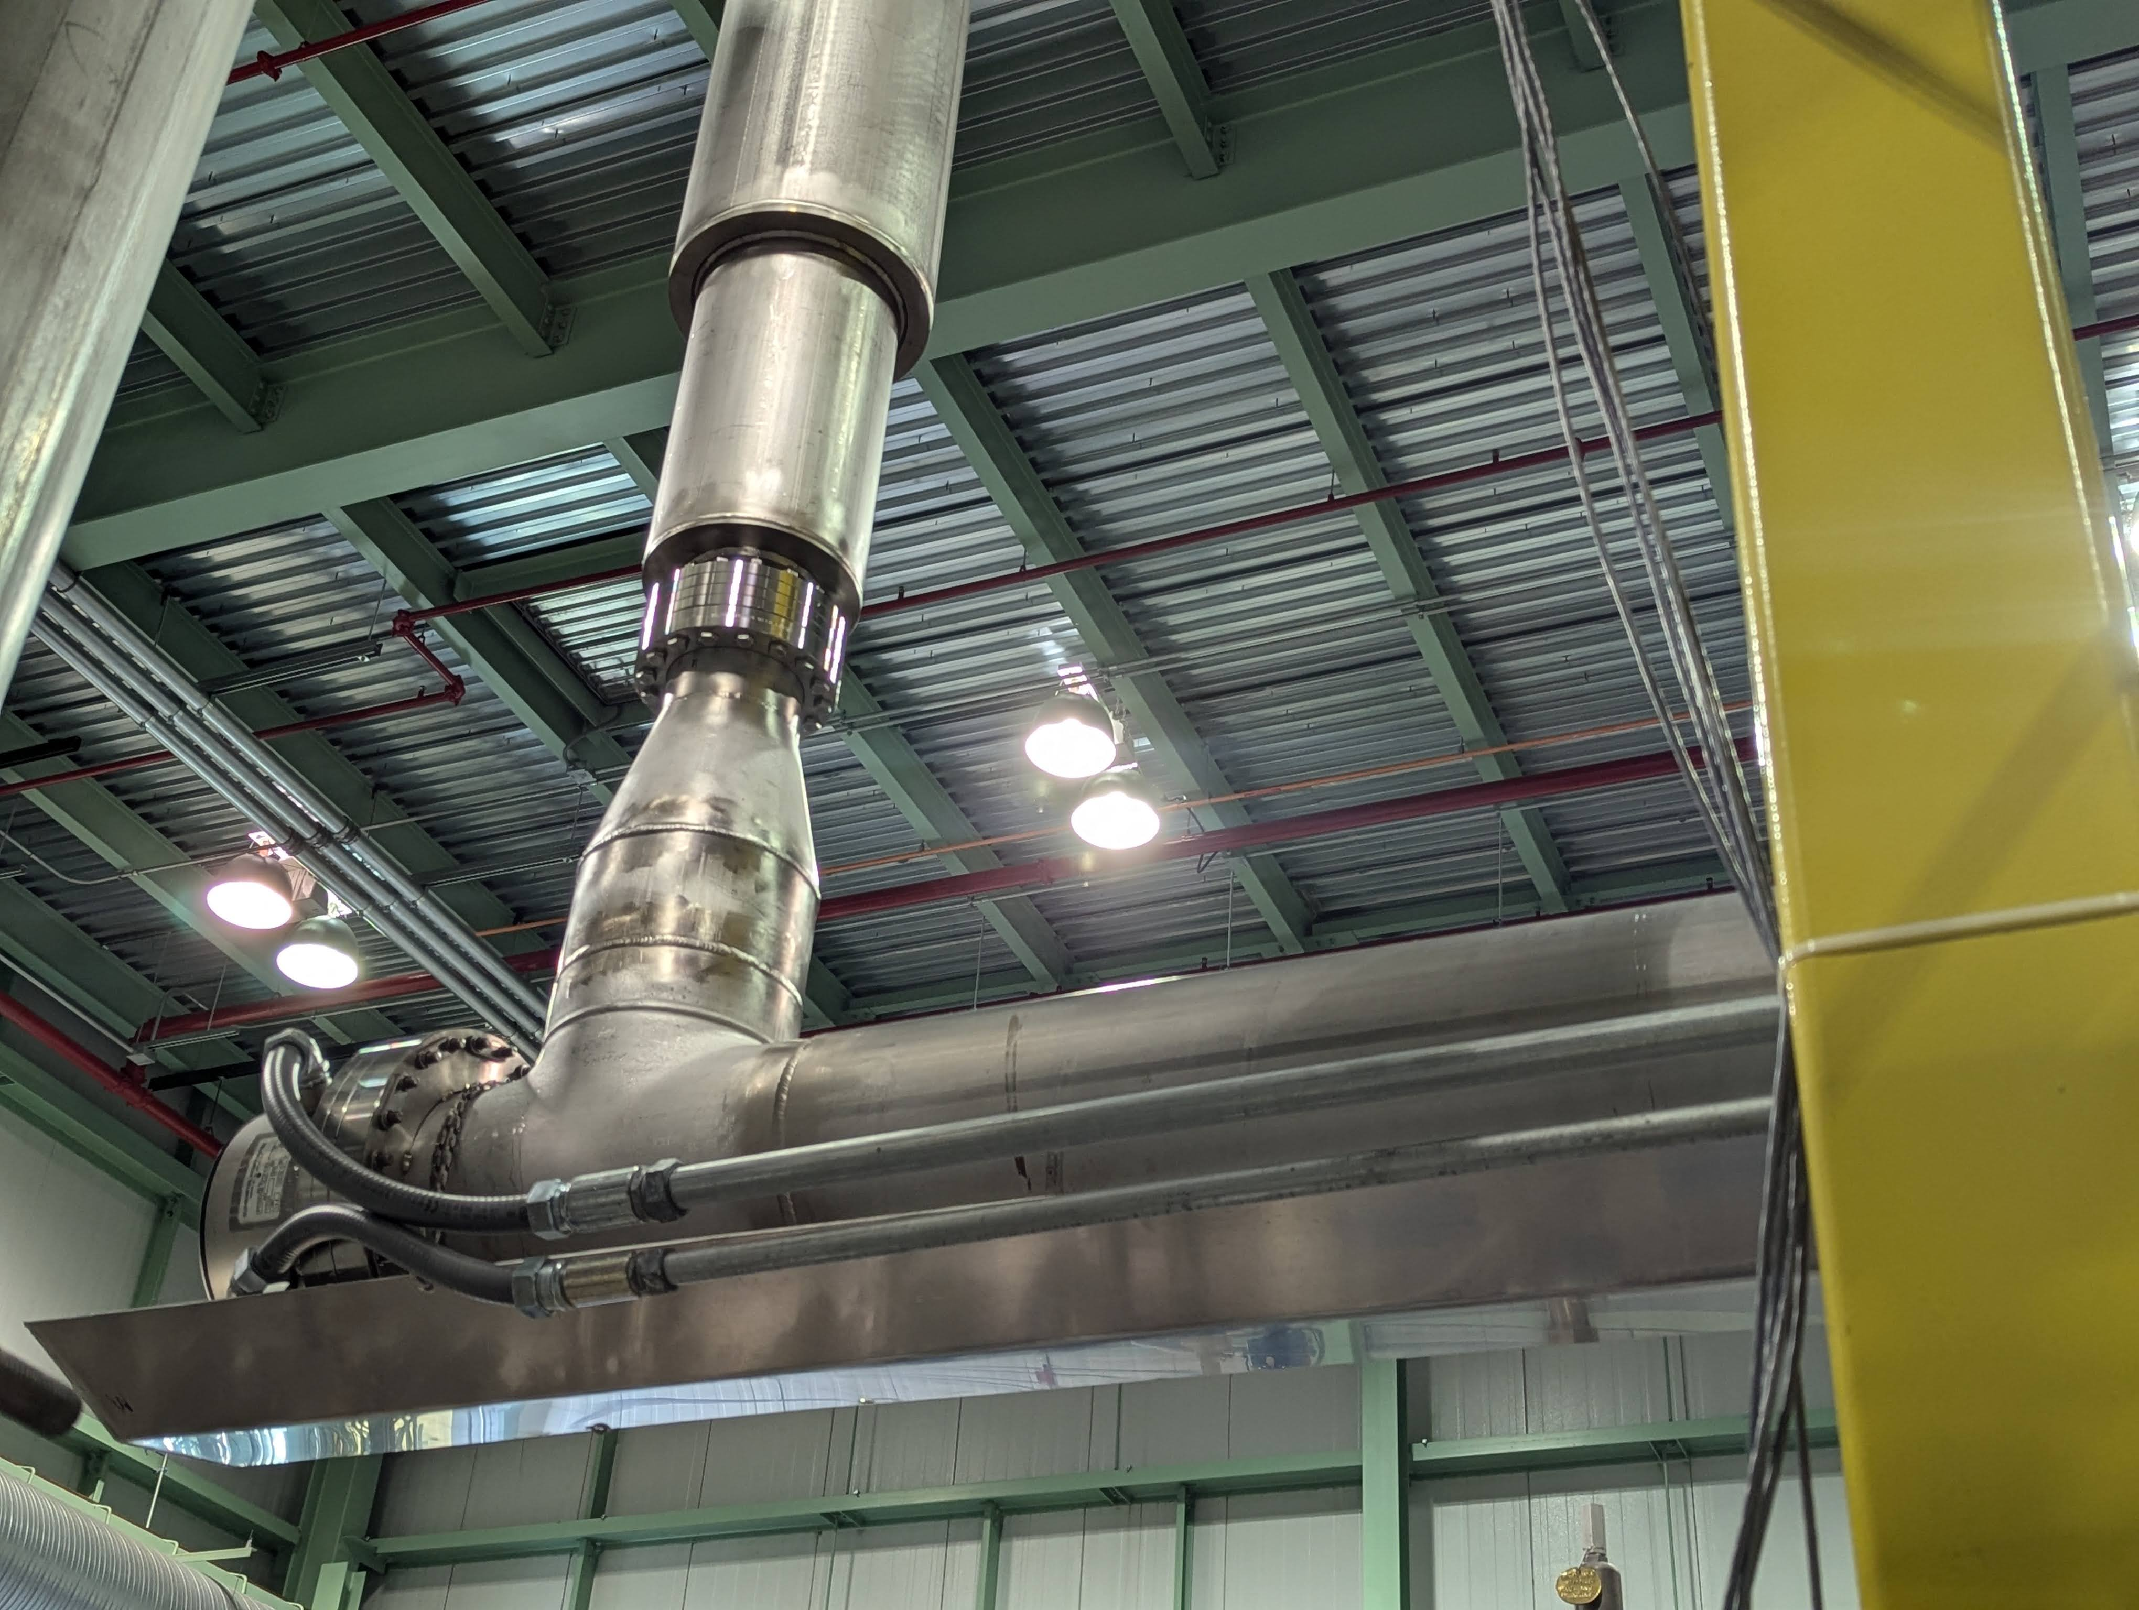
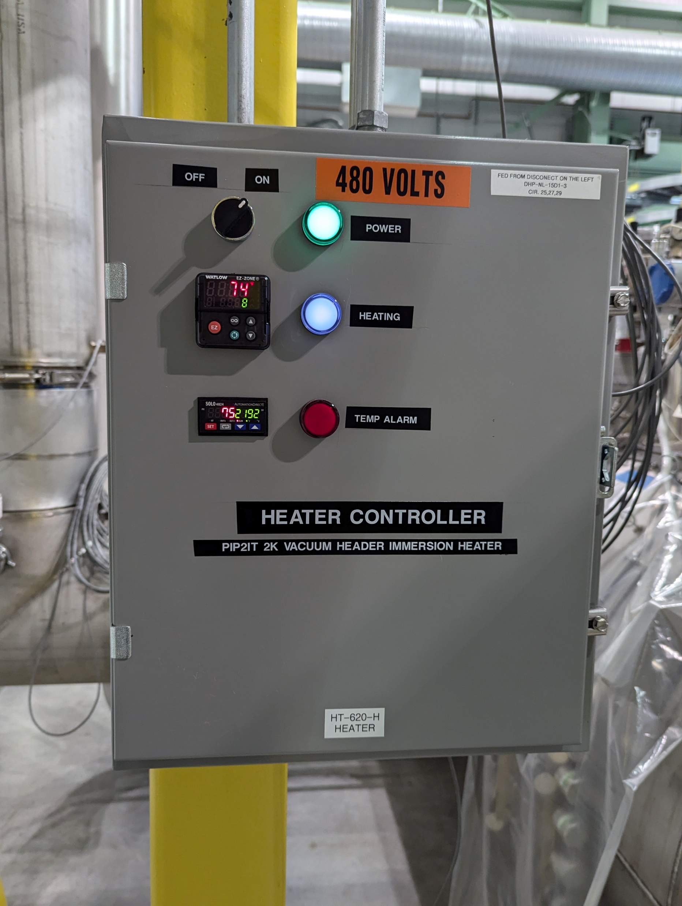
HX Replacement
Powerful immersion heaters already in use at various test facilities, including in IB1
Design for 16.5 kW heater is available, rough cost estimate 50-60 k$
With this improvement we could safely run with Ghe flow up to 18 g/s
  Need to replace the sub-cooler if we want to exceed 20 g/s
Helium flow
Immersion Heater with Conflat Flange

