Slide 1
72 Hour Summary
Patrick Dowdle
MCR Crew Chief
December 16, 2024

Slide 2
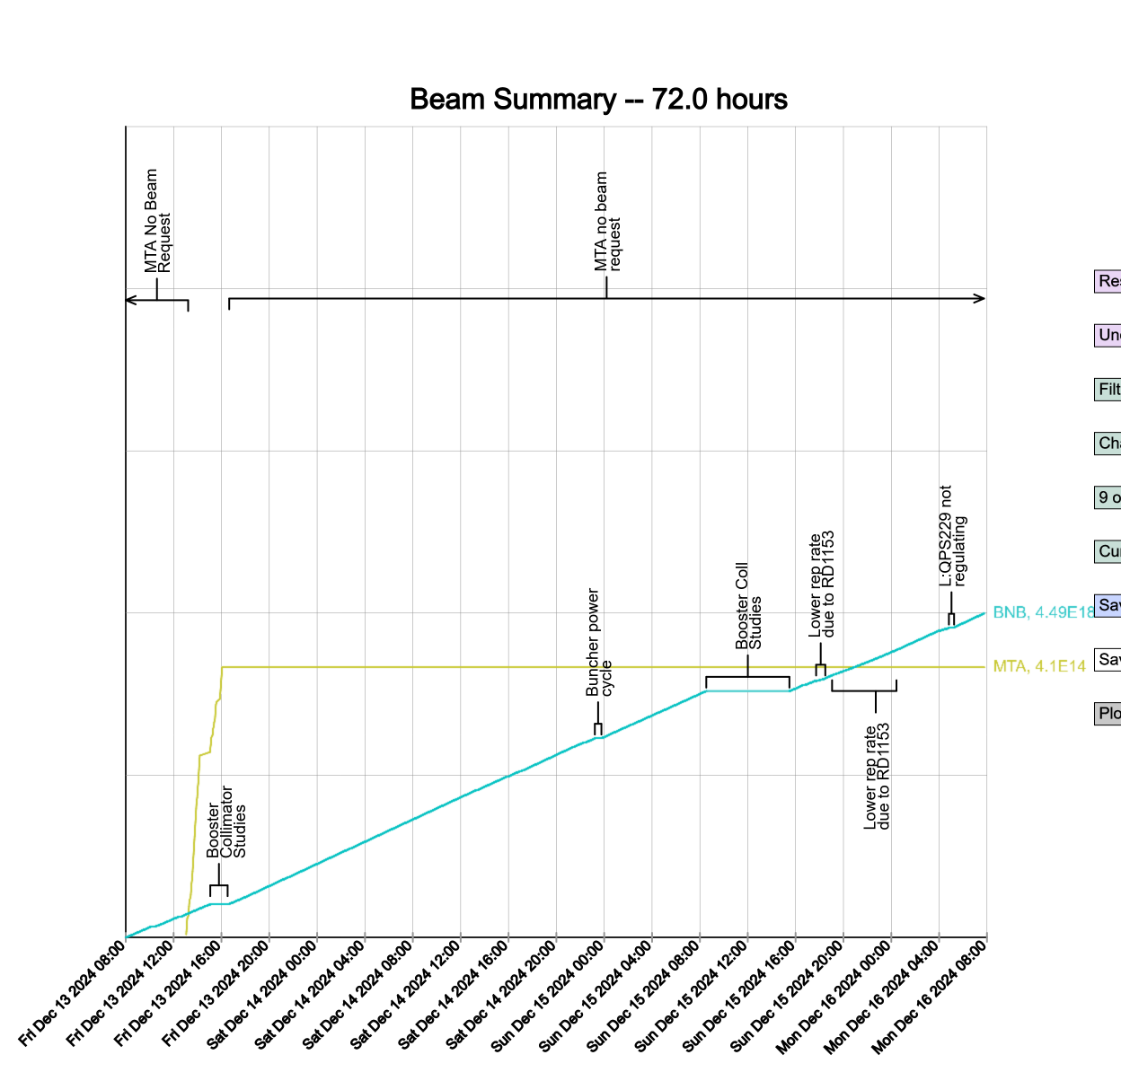
Summary
In general:
  Keeping Linac and Booster tuned up
  BNB Target Cave Exhaust Fan
  B88 reporting stale data from BLMW1, BLME1 and BLML3
Friday:
  DR interlocks dropped, secured Sunday
  Booster collimator studies
Saturday:
  LE Buncher regulation issue, power cycled/connection adjustment fixed issue
Sunday:
  Booster collimator studies
  G:RD1153 going high when starting at 5 Hz, ran reduced rep rate
  QPS229 acting up, replaced P4 card
Currently:
  Beam to BNB

