Slide 1
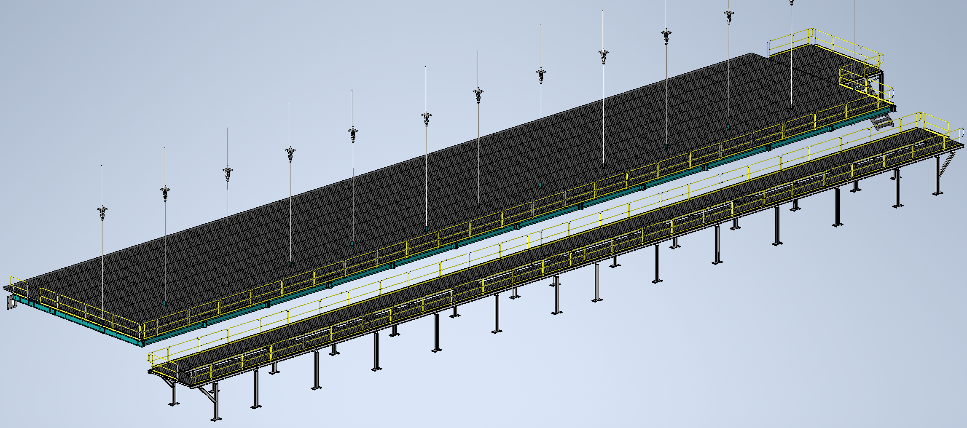
Mezzanine Flooring and Railing
Status
Design note and calculation note uploaded to edms
264185
Walking surface and railings for mezzanines
Install Activity:
Install flooring and railing onto detector, cryo, and ledge mezzanines
16-Sept-26
Tech Spec. | N/A | Empty
3D Model | N/A | Complete | 11/1/24
Design Note | N/A | First Draft Complete | 11/8/24
Eng. Analysis | N/A | First Draft Complete | 12/2/24
CO Report | N/A | Empty
2D Drawings | N/A | Empty
Schedule Contact | N/A | Empty
Install Procedure | N/A | In Process
Store/Move 120d - 4mo
Fabrication
30d – 1mo
Procurement plan
Decking and railings are COTS
Two types of custom railing mounts will be required
Self install
Procurement
90d – 3mo
Latest “Submit to Procurement”
16-Jan-26
Fabrication/delivery
PRR Target: Dec. 2024

Slide 2
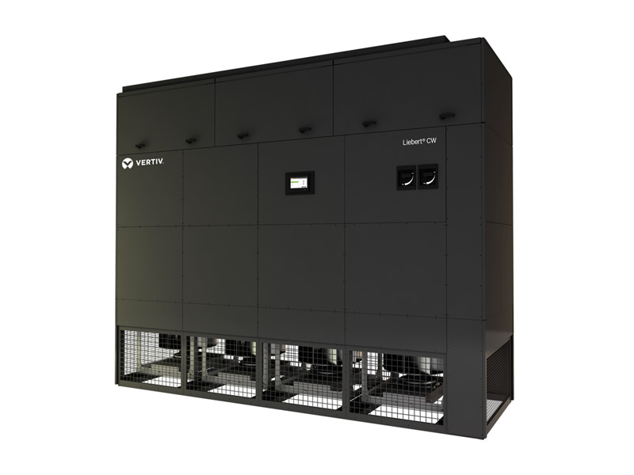
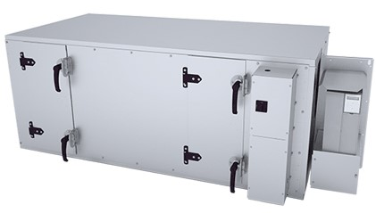
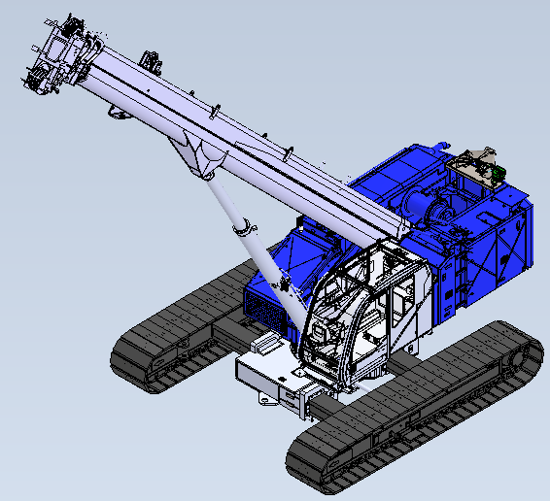
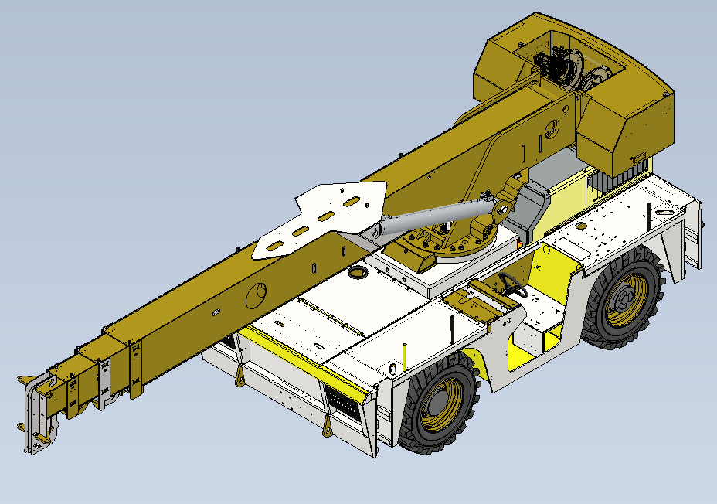
Last Week
DAQ AHU
Began looking into available options for AHU
CRAC/CRAH units
Purpose built for computing rooms
Tighter temperature control
Temp sensors integrated into racks
Must be installed in the computing room
Standard AHU
General use AHU
Considerably larger then CRAH units
Installed external to computing room
Condensation prevention piping
Generated manufacturing drawings
Underground Material Movement
Working with Jace to perform motion studies on mobile cranes for cryostat installation

