Slide 1
FD1/FD2 Installation Engineering Update
Nicholas Joniak
12/17/2024

Slide 2
Engineering Updates
Procurement Status:
  Upcoming:
    See engineering updates.
  Existing:
    No update.
FD2 TCO:
  Analysis Plans submitted to compliance office for review:
    TCO Hoist Beam.
  Analysis Plans reviewed with comments:
    TCO Platform.
      Comments noted and implemented.
      Engineering note in progress.

Slide 3
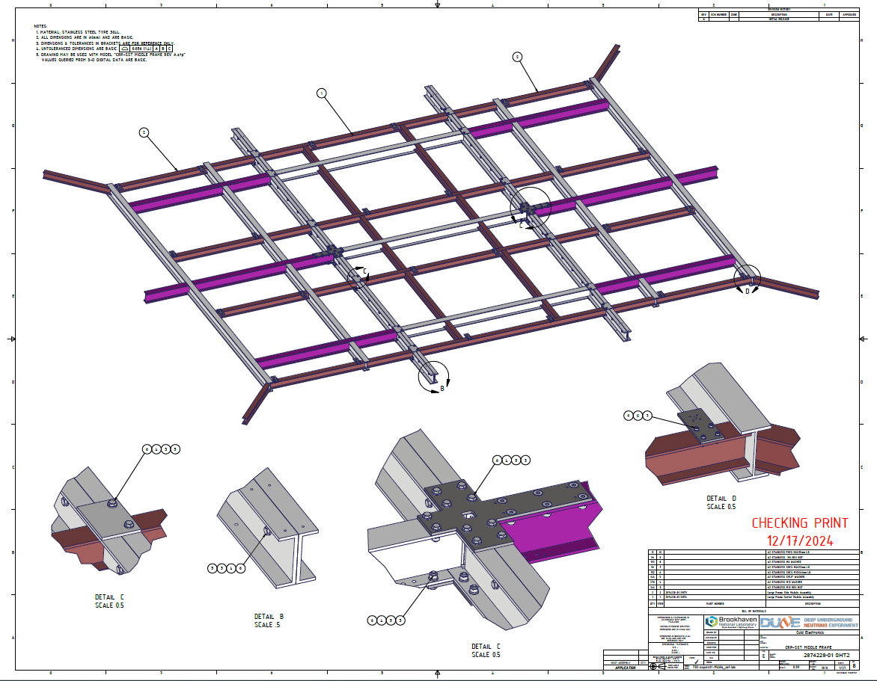
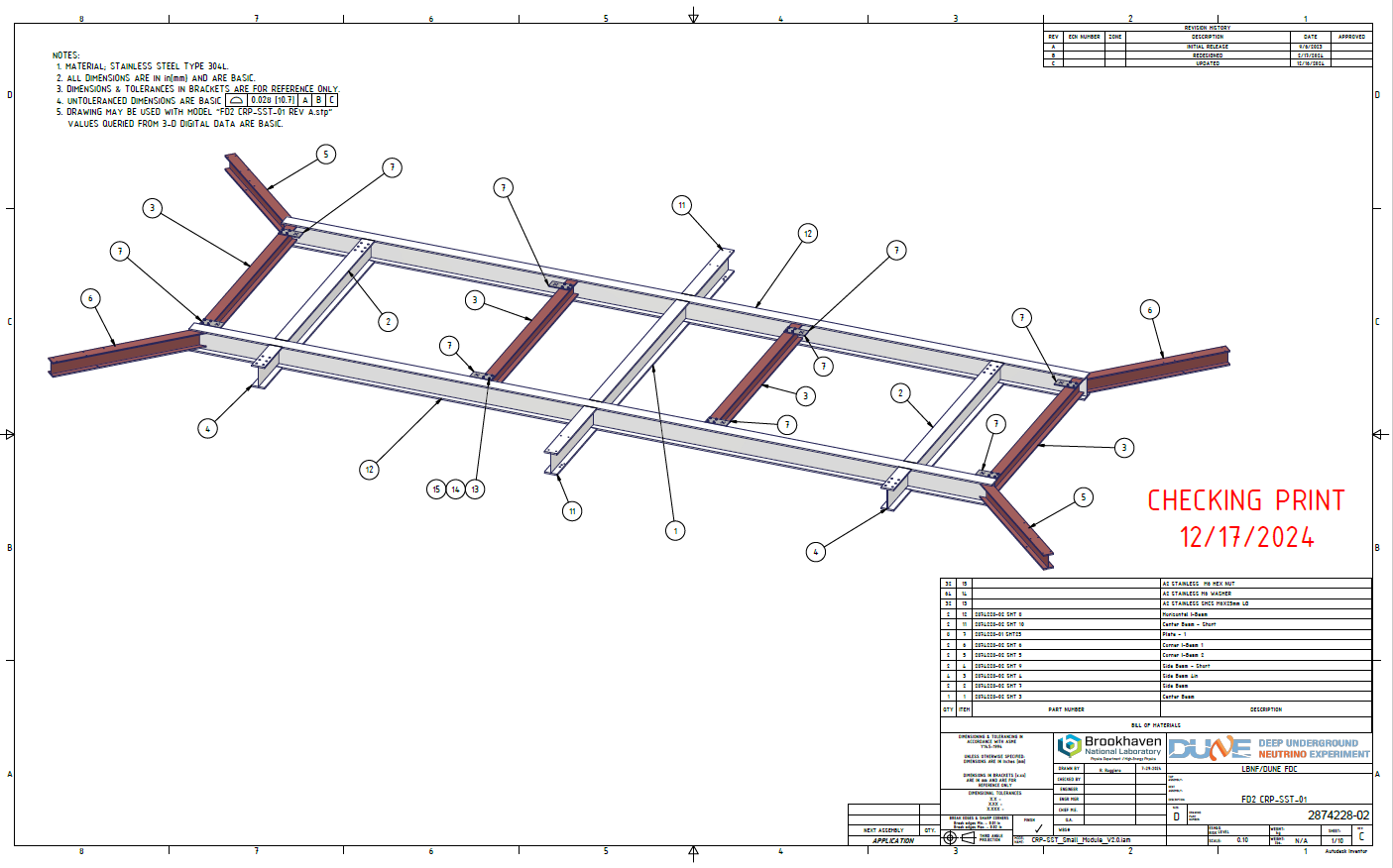
Engineering Updates
CRP-SST:
  Check copy received this morning for both large and small SST frames.
    Process for review?
CSU Cabling Test:
  Prototype parts sent out.
    ~13 m section of BDE cable tray.
    For BDE cable attachment and jig assembly construction tests only.

