Slide 1
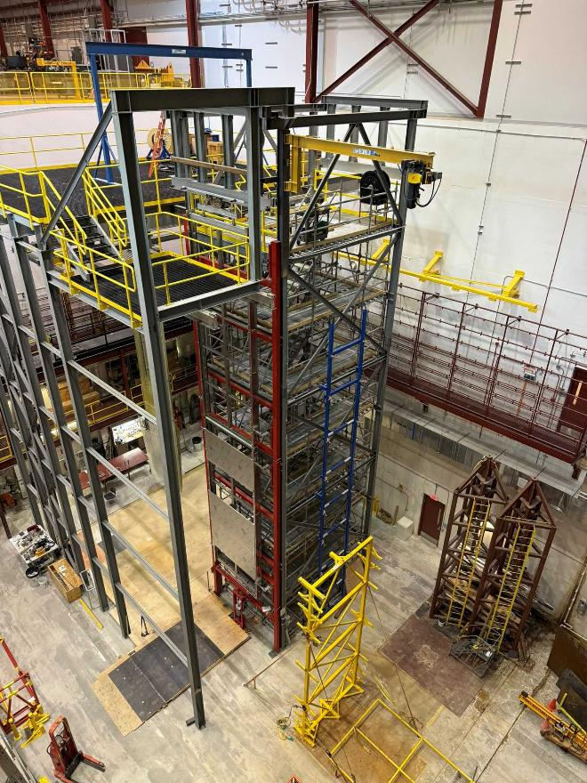
December 2024
APA tests at Ash River
Ship to SURF List
William Miller
December 3-13, 2024
Lessons Learned & Shipping Lists
Phase 2 DSS support structure, APA Tower and ASF at Ash River

Slide 2
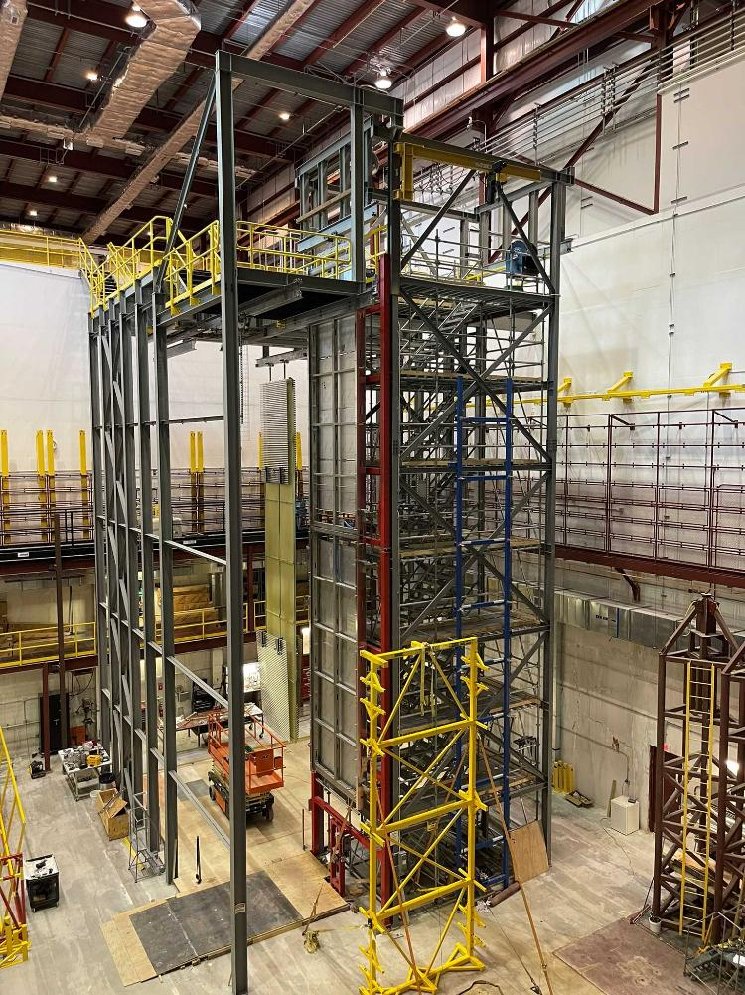
Goals – Dec. 3-13, 2024
Participants
APA Alignment in Assembly Frame
Using two doublets in Phase 2 Cryostat
Row 25 tests
What to Ship to SURF-Now
List of materials
Decommissioning Phase 2 and the APA tower
Closeout of DUNE work at Ash River

Slide 3
List of Visitors-Dec 3rd- 13th
Bill Miller
Jim Stewart
Marzio Nessi
Olga Beltramello
Eric James
Anselmo Villanueva
Tom Wieber
Kyle Rovick
Nickolas Carouso
Brian Rebel
Joe Munski (PSL)
Ash River Crew-Matt N., Brian L., Tina L., Karl K. Chris S.
Production APA pair cleaned, wrapped and in final stages of prep for shipping to Chicago

Slide 4
Workshop Summary
No real issues with any of the procedures
Excellent training for Nick and Kyle, we had them do most of the hands-on procedures
Kyle took care of all the survey details for checking the APA Envelope. I have not seen the recorded data yet, but we had no problem adjusting the APA linkage and getting to +/- 2mm level consistently.
It was good to have Joe Munski there from PSL paying attention to all the APA small details. I am hoping we will get some detailed feedback from him as well.
Tested VD Synchronized Hoists, they still need to be sent back to the supplier so one button controls both hoists.
Produced a reasonable list of items to pack up for shipment to SURF, PSL, and HV consortia
Two Completed Doublets with Deployed HV

Slide 5
First few Days
Eric, Kyle and Tom arrived on Tuesday, and we started the week building an End Wall so that Kyle could use our procedures firsthand. I took detailed notes on any comments or lessons learned.
Reduce the weight (42 lbs) of the End Wall hoist system, lifting it ~ 5 ft. above the deck of the scissor lift in cramped quarters is difficult at best.
Drill Motors are really maxed out, should order one piece impact deep sockets for drills so that you can’t drop socket attached standard ½” drive.
In numerous cases the links to drawings are wrong since they have been updated.
These procedures need to be updated with the consortia to include all QC tests, update to final drawings. They should be ported into Hajime’s HW Database program

Slide 6
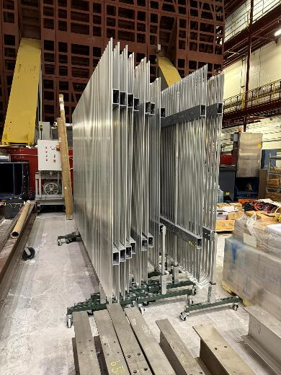
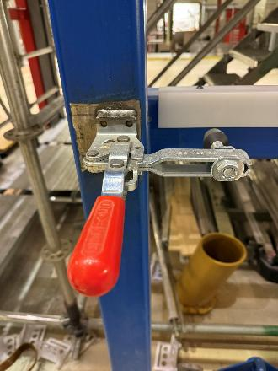
Organizing Shipments
HV Equipment
Received Detailed Requests from HV Consortia
LSU- 1-End Wall, all roller bases Al profiles, box beams
UMN- FC lifting fixture, FC Cart, Small spreader beam.
ANL- hoist system, FC Deployment too, CPA lifting tools, Associated hardware for CPA frame.
Send to SURF-End wall beam, endwall yoke, 1- complete end wall, associated hardware. Blue CPA Frame

Slide 7
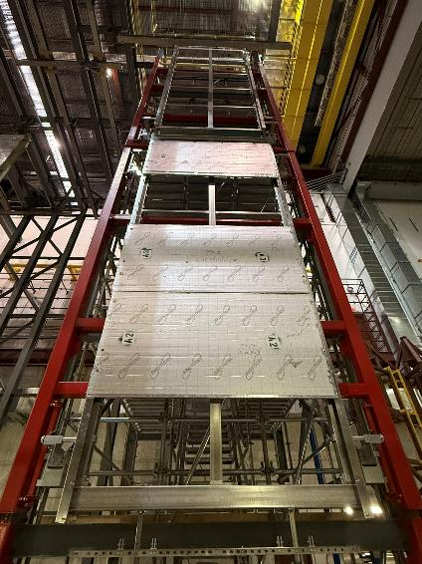
Organizing Shipments
APA
APA Production Frames:
Ship University of Chicago, Eric will pay for shipping
Cleaned with Isopropyl, Wrapped and inserted into ASF. Add Al skins, tape and send in Trapped flatbed.
APA Ash River Frames:
These need to go to SURF. Ship in enclosed truck with other equipment
Box up yokes, trolleys and all other APA hardware that did not go back to PSL
APA Assembly frame needs to be taken apart and stacked on pallets and shipped to PSL.
Is there anything else?
Thanks to Tom and Kyle for working hard with housekeeping to help organize hardware for shipments and better preparing us for the rest of the workshop

Slide 8
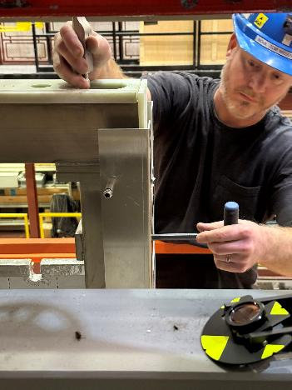
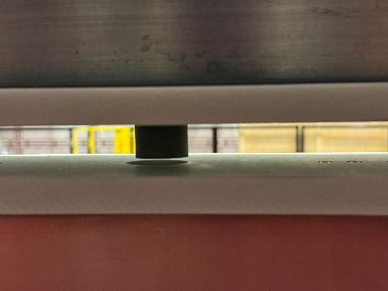
Testing APA Envelope Procedures
We spent most of Wednesday and Thursday morning testing APA adjustable link procedures and survey.
Did not take enough pictures! None showing the survey process!
We aligned, adjusted and surveyed numerous times.
Often had problems getting Vertical Alignment pin to go into the “Fake” electronics board.
Critical to make sure Top APA is as plumb as possible using beam clamps on the trolley since it is free to move. This helped it to work much better
Inserting APA linkage shoulder bolt, survey prism
Adjustable Linkage Bolt
Vertical Alignment Pin-Not Aligning!

Slide 9
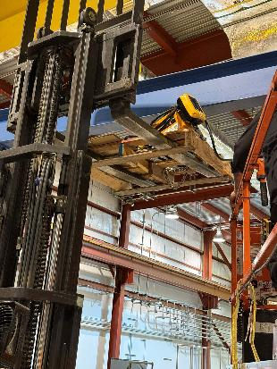
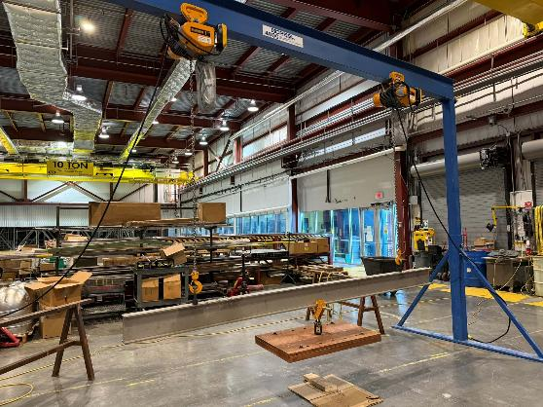
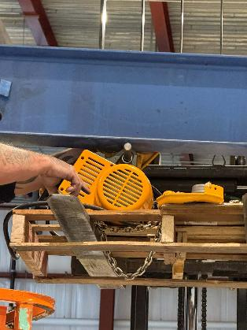
VD Synchronized Hoist
Test of VD Synchronized
Lifting Hoist onto gantry is basically impossible without lifting using forklift or something it weights ~150lbs.
Shown in the top two pictures is the hoist being lifted on a pallet.
The trolley for the hoist comes in 2 parts and needs to be fixed to the gantry.
We load tested the hoists and then tested it.
Unfortunately, the remote was wired wrong and can’t be controlled via 1 button. It will have to be shipped back down to Minneapolis, rewired and tested again before it is shipped to CERN. Scheduled to be fixed Dec 23rd.

Slide 10
Build Production APA Doublet-Move to Cryostat
We then surveyed the APA for the envelope and adjusted as needed.
We installed 4 prisms along the long axis of the doublet, with the intended purpose of making them colinear in a single axis.
We took measurements by releasing all stabilizer pins except the lowest set, and then shooting the 4 prisms, as well as the face of the APA to establish an axis, and then processed in AutoCAD.
We were able to get it +/- 2mm consistently, either by pre-measuring with calipers (fastest method) on the outside edge boards and then checking with survey
Better to use a step gauge, hard to measure with a real APA
Numerous times the adjustable link would get snagged when lowering the top APA. We had to continuously go up and down to make sure things did not jam.
We had problems with vertical alignment pin to get it to lined up, need to be careful that you do not raise top APA up!
We repeated the Doublet procedures one more time. This time we leveled the Top APA and put beam clamps in place to hold it.
This added step made the everything line up MUCH better.

Slide 11
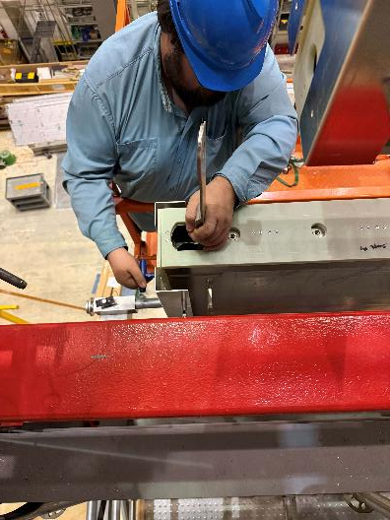
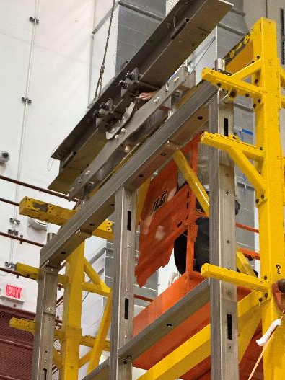
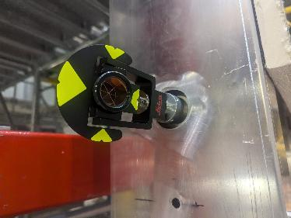
Build Production APA Doublet-Move to Cryostat
We completed moving the Production APA Doublet to the shuttle beam
Removed all the protection panels and side rails.
Add the FC Latches and prepared for it to move into its final position
We repeated this several times with Olga and Marzio present so they could see the survey and linkage adjustment process
We could not move the completed Doublet out of the APA Tower without moving the ASF out of our way! This is not an issue underground for DUNE.
Kyle and Nick moved APA Doublet thru the TCO and shuttle beam system into position and bolted the production APA to the DSS Beam

Slide 12
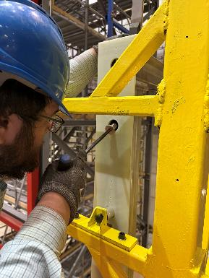
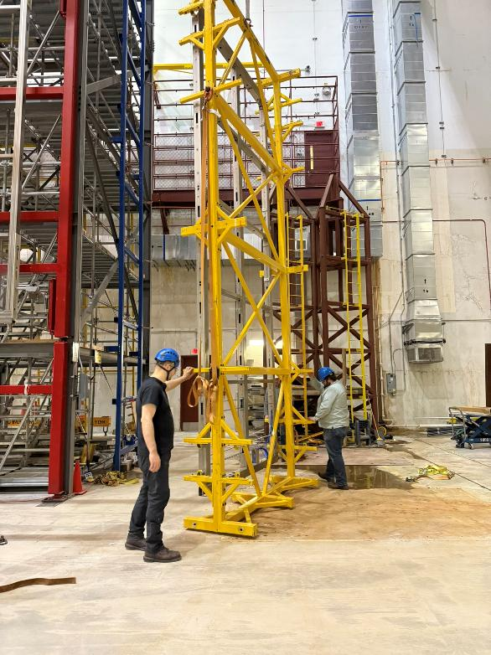
Building the Ash River APA Doublet
After loading the bottom APA into the APA tower we had to undo the straps securing the ASF to the floor, pick it up a few inches and slowly rotate it back into position. This is the same procedure we will need in the cleanroom.
Using the final production Yoke and Structural Tees, we loaded the Top APA into the APA Tower
Again, we went through the adjustable linkage and survey process. Getting much better at it!
Installing standard linkage for lifting Bottom APA
Rotating an ASF with only one APA in it was not an issue
Installing new Yoke

Slide 13
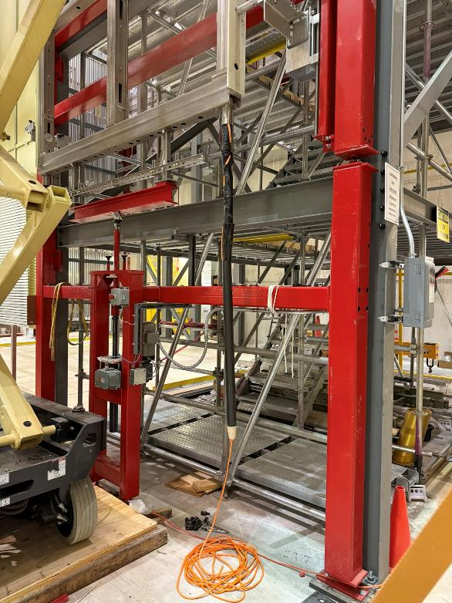
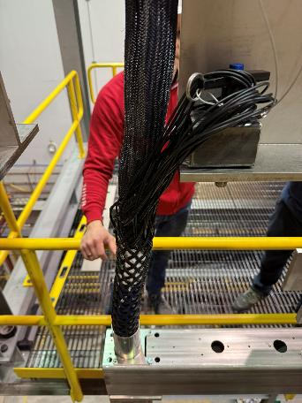
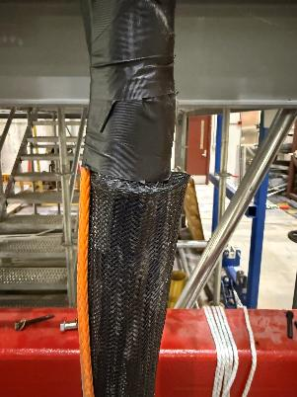
Re-Testing Cable insertion on APA Doublet
Once the Ash River APA Doublet was completed, we tested cable insertion process.
This is an older test cable bundle which has been used numerous times. The cable dressing several times got hung up going into the tube since it was not dressed properly. The cable dressing needs to be pulled tight when it is being installed.
But we easily lowered it and pulled it back out by hand
Inserting Cable Bundle Nosecone and Tube
Cable hanging by Harness
Cable dressing problem

Slide 14
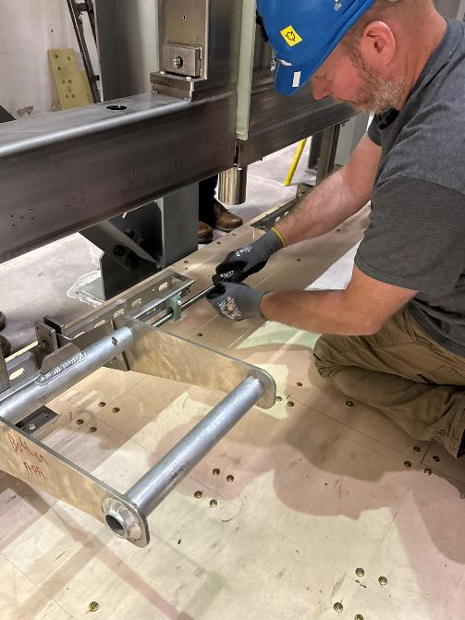
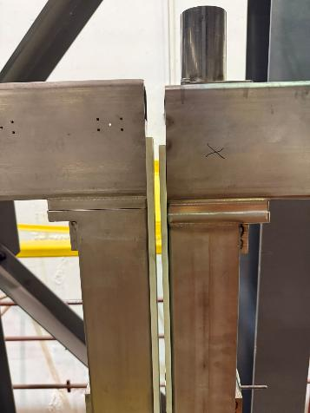
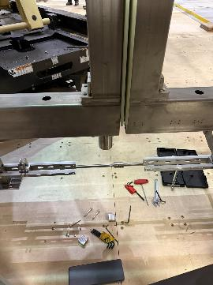
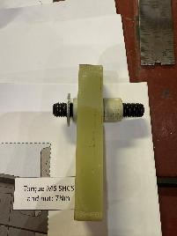
Two APA Doublets next to each other
Getting the two Doublets to come together was not as easy as we thought. Two big wet noodles! That do not hang plumb!
We had to start at the top and VERY slowly align pins from the top to the bottom. The only place you can adjust is but moving in and out holding the standoff bar at the bottom.
The G10 pins need to have a small chamfer to help
We did a quick survey on both sides of the two Doublets after they were joined. The formed a nice plane
APA to APA Pins
The doublets did not hang plumb by themselves, need to help align them
Installing APA Tie Bar Assembly

Slide 15
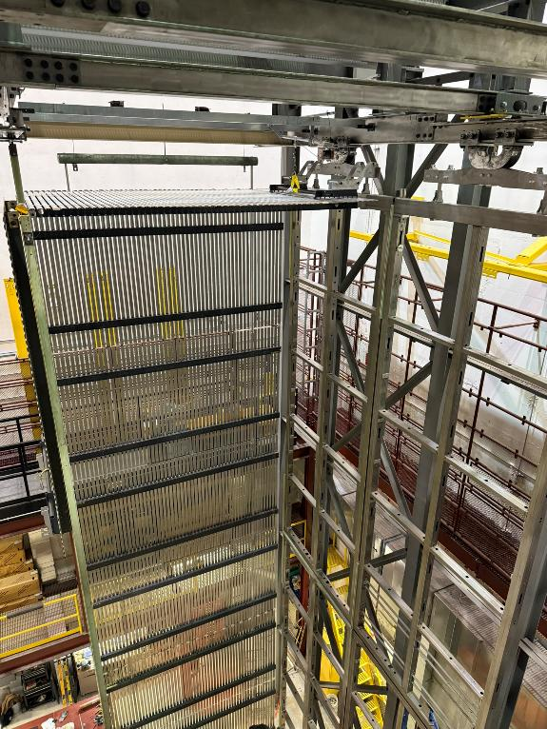
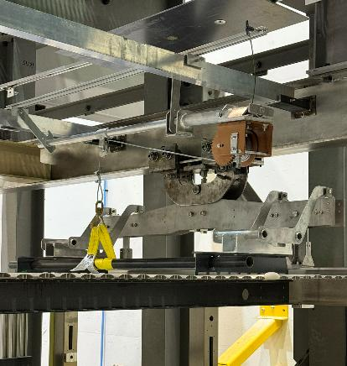
Deploying the FC
Again, not any great pictures of the deployment but there were no real issues.
Just the standard tricks of getting the latches to align since everything is so flexable

Slide 16
Detailed Day by Day Tasks and Lessons Learned Work in Progress Need some input from others, including photo’s taken

Slide 17
Decommissioning Phase 2 and APA Tower
Matt put together an RFI to understand what the costs would be to decommission. Estimates came in much higher then expected. $30k to take down the scaffold and only $5k for the scrap steel.
For sure we should take down the scaffolding ourselves and package that for shipment. It is standard pieces that can be added to as needed.
Marzio is VERY interested in both the APA tower and the Phase 2 steel structure. I will send him the drawings and 3D models to see if it is feasible to use it has part of the cleanroom.
If this is the best path forward it maybe we use Deputy Installation managers and Sr Techs to help take it down.
We should try and decide on the this soon.
Trucking costs appear to be one of the cost drivers
We would run out of DUNE funding for Ash River work in ~March depending on shipping and decommissioning costs. If we do not pay to have it taken down, it would increase the available labor Ash River has.

Slide 18
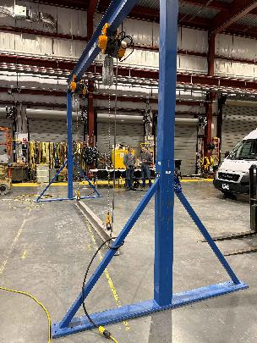
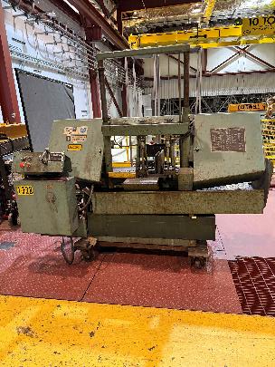
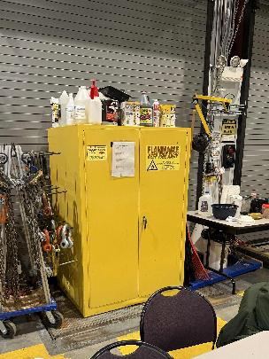
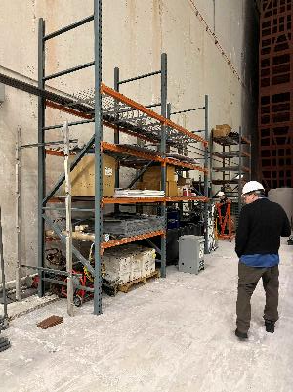
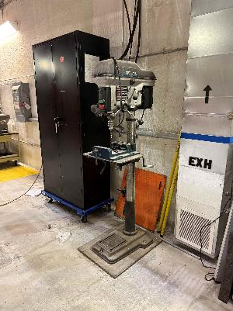
Soudan Lab and NOvA Tools
There are numerous tools and equipment that are no longer used at Ash River.
After looking over everything with Marzio and Jim we had a list, then agreed with Alec Habig (Lab Director) and Matt Nixon (Lab Manager) what items can go right away and what would be in a second shipment.
With the Ash River APA Frames and the size/weight of some of the tooling it will be several trucks worth.

Slide 19
Summary
It was very useful few weeks doing the final APA assembly tests as usual there was never enough time to properly document everything that happened.
It is going to take a few months to pack everything up and ship it to the proper locations. There is still a LARGE amount of work to do to clean and box properly.
We want to use the Hardware database system to make sure that we can properly track all the components, so we know what is exactly in what box. We have already communicated with Hajime to help with printing proper labels.
It has been a fantastic Trial Assembly Area for both ProtoDUNE and DUNE we started summer of 2016 and will complete spring of 2025!
It has greatly improved the installation plan, documentation and final design of the Horizontal Drift Detector!

