Slide 1
Technical Integration Group - 2024
Allan Rowe on behalf of the TIG
PIP-II All-Hands Meeting
17 December 2024

Slide 2
Goals for 2024 – How did we do?
✓
Successfully on-board the new PIP-II Project Engineer in February.
Maintain PDR/FDR schedule by completing all but 6 FDRs – 38 total! Many delayed until 2025.
Close out all technical reviews. Mostly – 7 remaining to be closed out.
Stabilize requirements (PRDs, TRSs). Mostly – several TRSs need to be released.
Finalize and release all Interface Specification Documents. Moderate progress made.
Finalize and Release all Acceptance Criteria Lists. Moderate progress made. New approach.
Support the procurement and production activities through Procurement Readiness Reviews and Manufacturing Readiness Reviews.
Support In-kind Partners with their SE functions, reports, procurements, and QA/QC obligations.
Deepen the coordination and interface activities with AD, APS-TD, and ISD.
Tighten and synchronize QA/QC activities across all project boundaries.
Considerably improve documentation visibility and access across the project.
The next slides show how we addressed the 2024 goals, what we’re doing about delays, highlight progress on new initiatives, and identify new goals for 2025 .
✓
✓
✓
✓
✓

Slide 3
How did we do completing designs?
Cost Weighted Design Maturity increased from 94.4% to 97.4%
Jan. 2024 forecast:
Complete 33 technical reviews in CY2024
CY2024 Actuals:
Completed 2 PDRs, 12 FDRs
One FDR was added
Delayed: 1 PDR, 19 FDRs
Jan 2025 forecast (projected with CY2026 corrections)
30 FDRs, 1 PDR
3 current FDRs in 2026 to be moved into 2025
79
45
31
4

Slide 4
2025 Design Goals
Maintain the current review schedule and advance all reviews but the LB650 Prod. CM FDR for 2026.
Begin review preparations two months in advance by writing charge statements, reviewing technical documentation status, and identifying review committees and committee chairs.
Train new PIP-II stakeholders how to prepare for and hold successful technical reviews.

Slide 5
Design Change Management: 16 DCRs Approved in 2024
DCR Number | Originator | DCR Name | Status
DCR-2022-006 | Passarelli, Donato | 650 MHz coupler (LB & HB) e-pick up probe change | Approved
DCR-2023-003 | Park, HyeKyoung | 650 MHz Cavity's coupler flange feature update | Approved
DCR-2023-007 | Dixon, Steven | CF: Linac Complex Bulletin No. 2 Changes | Approved
DCR-2023-008 | Geelhoed, Mike | AP Shielding Modification and Design | Approved
DCR-2024-002 | Passarelli, Donato | Changing coupler bias response timing | Approved
DCR-2024-003 | Dhuley, Ram | Tunnel ceiling embedded plates for CDS Warm Piping | Approved
DCR-2024-004 | Holzbauer, Jeremiah | Adding Beam Instrumentation Reference Line | Approved
DCR-2024-006 | Nudell, Jeremy | Changes to requirements documents | Approved
DCR-2024-008 | Holzbauer, Jeremiah | LLRF Warm Front End Controller Upgrade | Approved
DCR-2024-009 | Nudell, Jeremy | CM exhaust interface change, SSR1 and SSR2 | Approved
DCR-2024-010 | Nudell, Jeremy | Prototype SSR1 cryomodule to Linac Tunnel | Approved
DCR-2024-013 | Nudell, Jeremy | Cavity gradient acceptance criteria change | Approved
DCR-2024-015 | Grzelak, Victor | Change in Position of Vertical Penetration for LB/HB650 HPRF | Approved
DCR-2024-017 | Park, HyeKyoung | HB650 unity coupler change | Approved
DCR-2024-018 | Geelhoed, Mike | WFE Exclusion Area | Approved
DCR-2024-020 | Parise, Mattia | PIP-II SSR Magnets - Dipole Correctors Max Current/Ramp Time Change | Approved

Slide 6
Design change Status: DCRs Implemented, Draft in 2024
Implemented (Document changes complete)
DCR Number | Originator | DCR Name | Status
DCR-2021-003 | Steimel, James | LB650 Gallery Layout Change | Implemented
DCR-2024-001 | Hanna, Bruce | Power Supply Regulation System | Implemented
DCR-2024-005 | Mills, Larry | Controls Consolidated Infrastructure Updates | Implemented
DCR-2019-0089 | Boffo, Cristian | SSR Superconducting Solenoid - Conduction Cooled | Implemented
Draft (To be submitted in 2025)
DCR Number | Originator | DCR Name | Status
DCR-2020-008 | Passarelli, Donato | 650 MHz CM Demagnetization | Draft
DCR-2024-021 | Roger, Vincent | SSR and 650 CM Design changes based on pHB650 CM Test Results. | Draft
DCR-2024-016 | Nudell, Jeremy | Cavity radiation measurement standardization | Draft
DCR-2024-014 | Nudell, Jeremy | Booster Lattice Update | Draft

Slide 7
Requirements and Interface Management
Physics Requirements:
Now stable. Two PRDs are still in Teamcenter workflow.
Technical Requirements:
Mostly stable. Some TRSs are in workflow
A few need revision to align with ongoing design changes in Accel Sys. and Accel Upg.
Master Interface Control Document
Kept monthly revision cadence identifying dozens of required revisions.
Interface Specification Documents
Area requiring significant improvement. Design and scope clarification risk is high until ISDs are released.
Acceptance Criteria Lists – Currently establishing new approach to facilitate completion.
2025 Goals
Review of external interfaces for all L3 sub-systems.
Release all TRSs, ISDs, and ACLs (TRS metadata with verification, IKC ACLs, terminal ACLs).

Slide 8
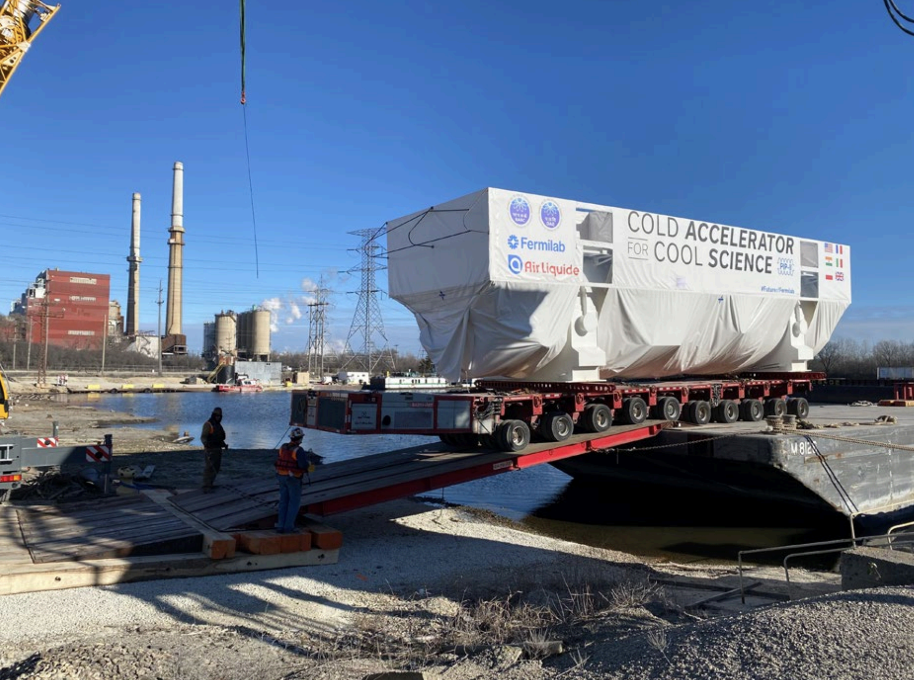
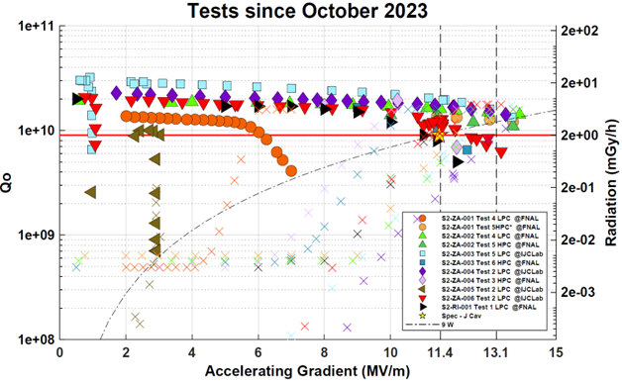
In-Kind Contribution (IKC) 2024 Successes & 2025 lookahead
DAE Cryoplant cold-box will arrive this Friday at Fermilab!
To be installed & commissioned over the next ~1.5 years
All DAE SSA designs nearly complete & some procurements started.
Several more DAE procurements planned in 2025.
DAE warm magnets’ procurements underway.
Initial deliveries expected in 2025.
CEA procuring items for LB CMs & preparing facility for CM assembly & testing.
First articles for CM0 delivered to CEA.
Upgraded Cryoplant cold-box commissioning ongoing.
CM0 to be assembled in 2025.
CNRS helped PIP-II qualify SSR2 cavities for the PPCM.
Significant collaboration & initiative by CNRS & FNAL.
Cryoplant cold-box offloading at Romeoville
SSR2 Qualification Progress

Slide 9
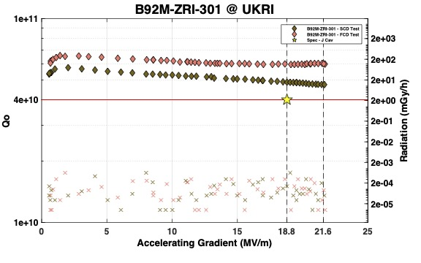
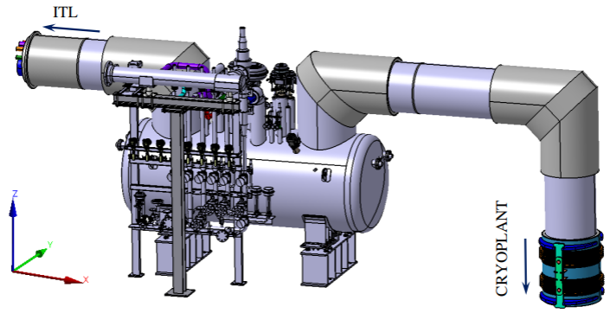
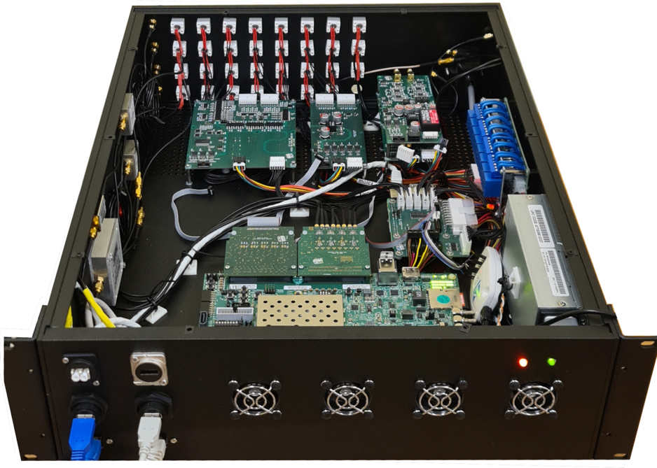
In-Kind Contribution (IKC) 2024 Successes & 2025 lookahead
INFN Nb contract near complete, with 2 of 3 batches delivered.
Last delivery anticipated in late Dec. or Jan.
INFN 38 jacketed cavity contract award is imminent.
MRR to be completed in 2025 and fabrication initiated.
UKRI jacketed cavity qualified with no field emission.
Completely manufactured & processed by UKRI’s vendor.
Validation of technology transfer from FNAL through UKRI to vendor.
UKRI procurements & preparations for HB CM progressing.
Several articles delivered; CM0 assembly to begin in 2025.
WUST funding proposal for DVB prepared.
Funding determination in early 2025, and subsequently will begin activities.
WUST DVB design mature, and incorporating FNAL optimizations.
TUL RFPI modules tested at FNAL & optimizations identified.
WUT applying for cost shared funding & work to begin in 2025.
UKRI HB Cavity
WUST DVB
TUL RFPI

Slide 10
IKC Coordination Goals for 2025
Obtain signatures on unsigned PPDs.
DAE, WUST, CEA, CNRS
Finalize and release all IKC Acceptance Plans.
Finalize and release al IKC Acceptance Criteria Documents.
Establish DAE monthly reporting cadence.
Fully integrate a BOM-centered IKC deliverable tracking tool in Sharepoint.

Slide 11
External Communications and Expectations Management
PIP-II Spares Plan completed.
BCRs will be entered for 2025.
Informs AD Field Work Proposals (FWP) to be submitted starting in 2025.
PIP-II Commissioning Plan completed.
Coordination planning for future operators.
Defines commissioning stages informing Accelerator Readiness Review sequence.
PIP-II Transition to Operations Plan completed.
Establishes clear components and sub-system handover protocols and schedule.
Facilitates FWP schedule for facility and building operations.
PIP-II MOA and Assumptions Document completed.
Look ahead to 2025
Development of the PIP-II Accelerator Readiness Review Plan.
Final Design Report Revision – started in 2024, will continue well into 2025.

Slide 12
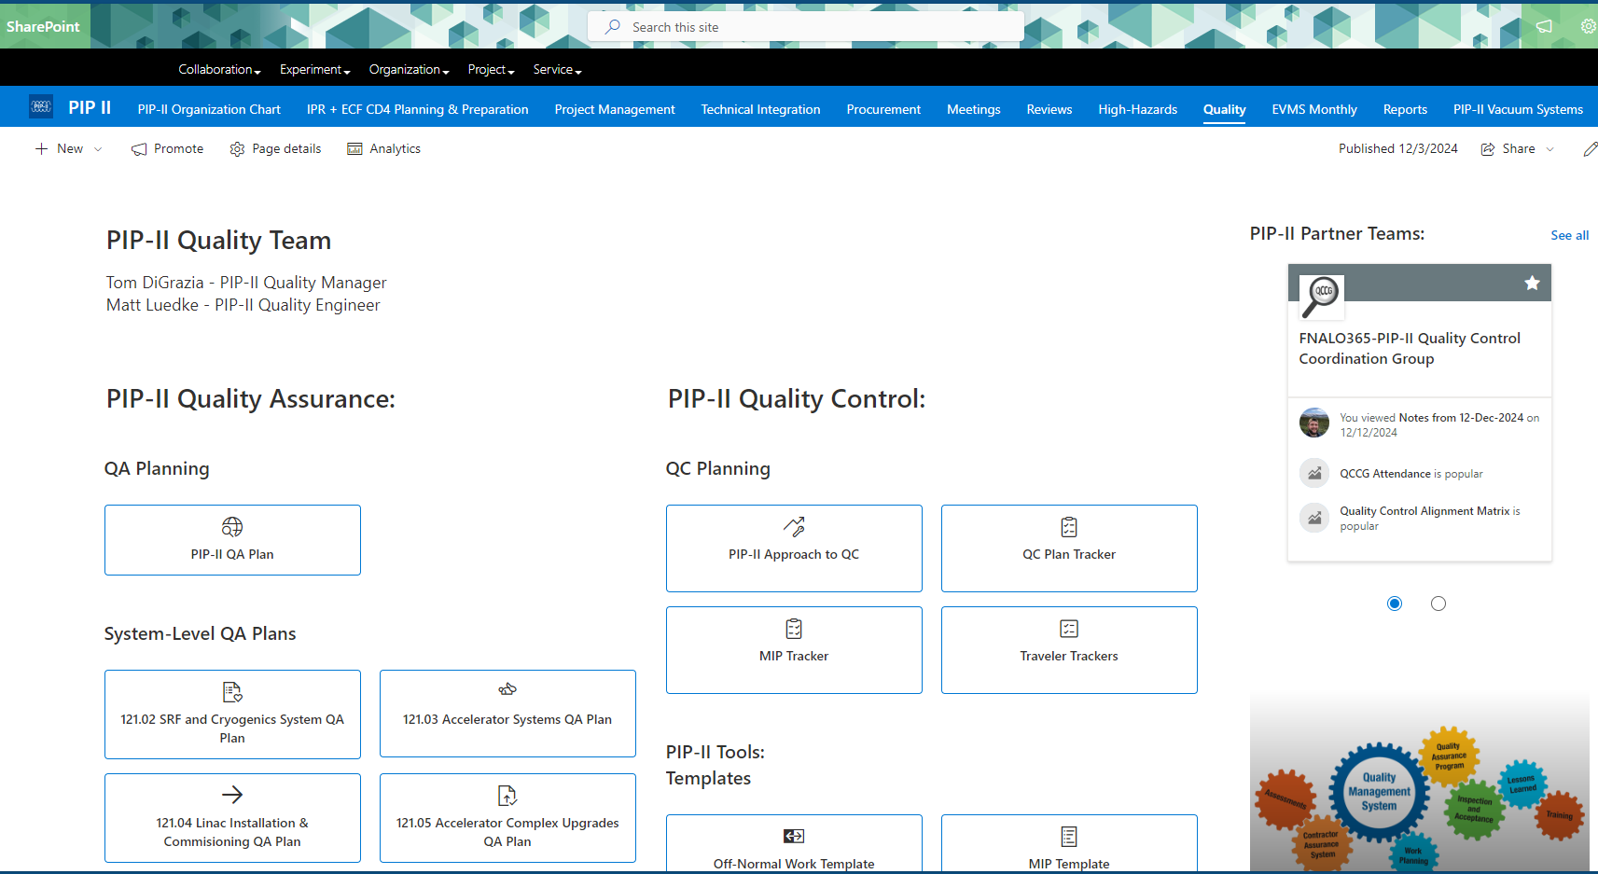
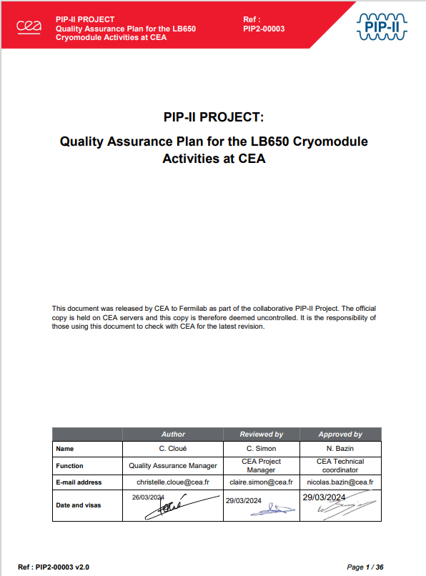
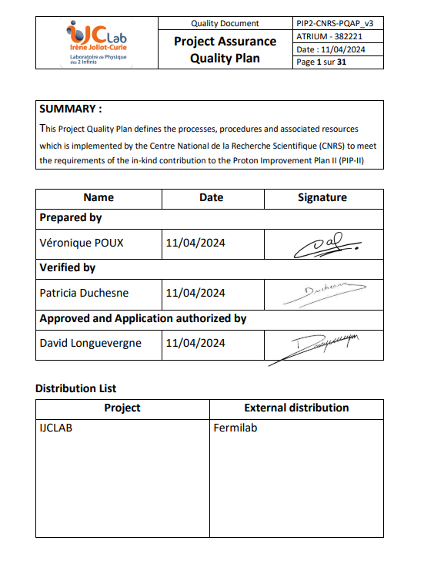
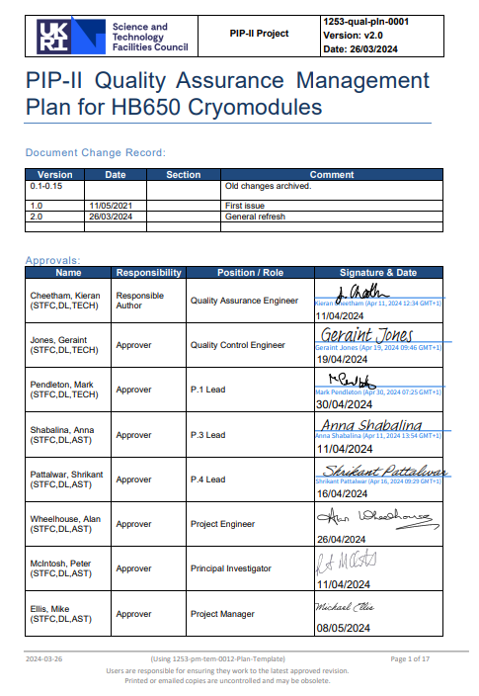
Quality Coordination 2024
New Quality Site
Revised several IKC Partner QA Plans.
Transitioned to new Quality SharePoint Site.
Created a comprehensive Template Gallery.
Improved PIP-II Nonconformance Log to better identify trends and provide data to System Managers.
Finalized IKC Partner documentation exchange process .
Completed two PIP-II self-assessments.
System Acceptance Review Process
Incoming Inspection & Acceptance
Established a Traveler tracker.
Improved lessons-learned communication.
Revised the PIP-II Technical Review Plan (TRP) ED0008163 to reflect process changes.
Updated Partner QA Plans

Slide 13
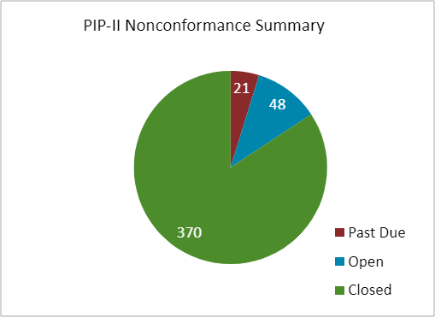
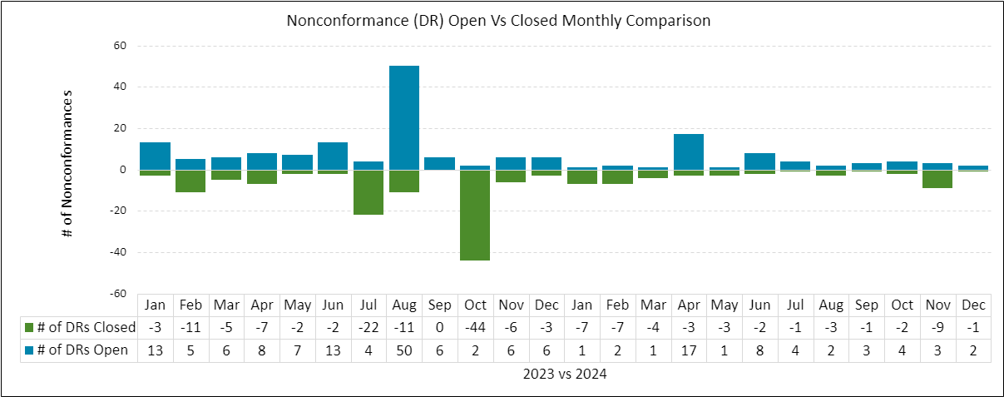
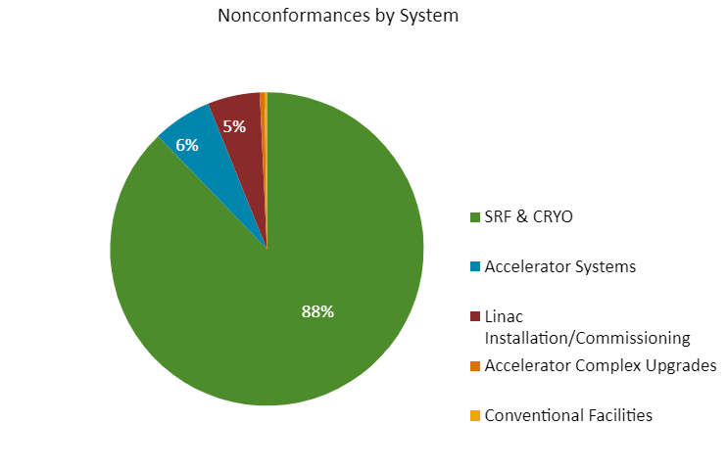
New graphs in Nonconformance Report Log

Slide 14
Quality Goals for 2025
Hold IKC Partner Quality Workshops.
Perform deep dive into SRF SSR cryomodule incoming inspection records.
Review, comment, and approve of procurement Statements of Work.
Improve QC consistency for critical SRF components.
Improve traveler clarity and consistency and implement SRF ICE Team outcomes.
Continue finalize remaining QC Plans and travelers based on their respective tracker status.
Implement full complement of PIP-II QA/QC processes in Accel. Systems and Accel. Upgrades areas.

Slide 15
Documentation Visibility and Access Improvement
PIP-II Sharepoint Site Improvements
PIP-II Documentation Hierarchy and Organization
PIP-II Documentation Review and Approval Matrix
PIP-II Documentation Control and Management Procedure
Created Teamcenter Libraries for:
PRDs | ED0039385
FRSs | ED0039384
TRSs | ED0039332
ISDs | ED0039294
CD4 ACLs | ED0038212
PDRs | ED0039831
FDRs | ED0039844
PRRs | ED0039863
IKC PRRs | ED0039866
DCCs* | TBD
*Established a new Documentation Completeness Check (DCC) process to minimize procurement risk as part of the Procurement Readiness Reviews.

Slide 16
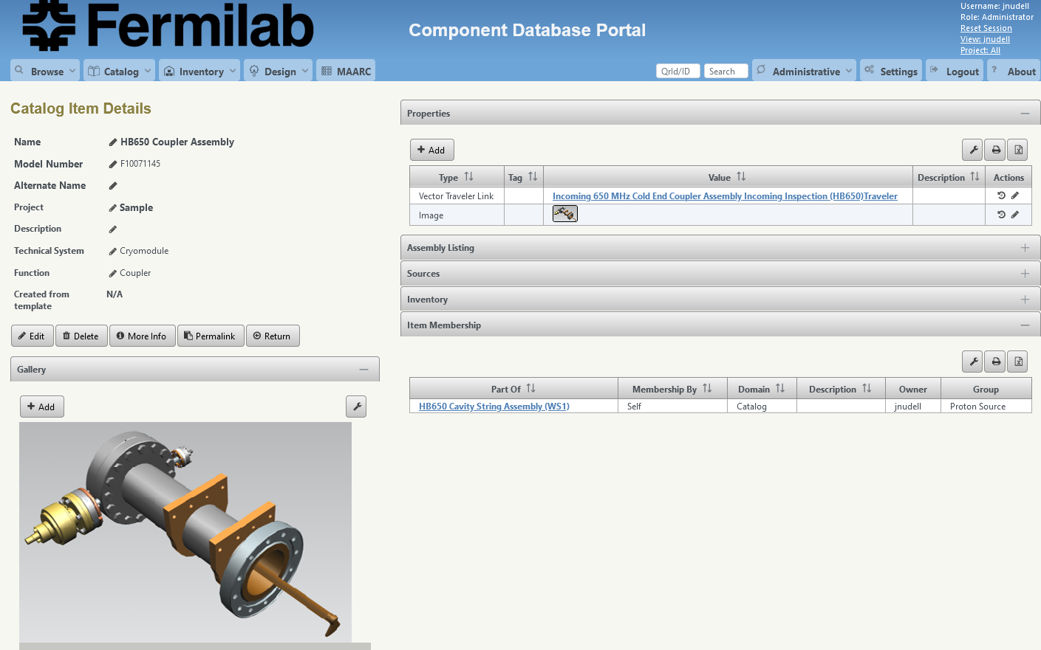
Established the PIP-II Component Database (CDB)
Component Database (CDB) was released for use by the PIP-II project after testing with several PIP-II technical groups.
Training Documents have been developed and posted
The software is used to:
Collect component design data
Track inventory
Link component travelers for incoming inspection/testing/assembly
Organize all component data prior to Handoff to Installation/Comm/Ops.
Goals for 2025:
Train all stakeholders
Create CDB entries for all existing inventory
Create CDB entries for critical components prior to procurement

Slide 17
PIP-II Logistics and Coordination
Started 2024 with an impending space crunch – only 6000 sq ft. total available to PIP-II for storage site-wide.
Added an additional 8000 sq ft. (14,000 sq. ft. total) from AD, PPD, and ISD throughout the year thereby alleviating the need to seek offsite storage in CY2025.
Additional space will be cleared in TeV service bldgs. and Site 38 in 2025
Established Title Transfer Procedure (now with DOE for final approval and to be adopted for all projects Lab-wide).
Implemented new import/export control process for DAE.
Mathworks software export served as example.
Received import duty relief on the cryoplant from DAE (saved $1,500,000)
Established process for tracking components in PIP-II CDB.
Coordinated dozens of local and international shipments.
Finalized the PIP-II Component Naming Convention Document TC ED0011740.

Slide 18
PIP-II Logistics and Coordination 2025 Goals
Transition PIP-II component tracking and control to CDB.
Create Logistics and Coordination Sharepoint site.
Create a shipping and receiving procedure to facilitate component shipments to/from IKC Partners.
Assess transportation risk for remaining shipments.
Assess storage and workspace needs monthly and expand PIP-II storage and workspace footprint.

Slide 19
TIG Conclusions for 2024
Made critical advances in designs and procurement preparedness.
2025 review cycle pressure is high and requires strong oversight from the L2Ms and significant support from the TIG to accomplish.
TRSs, ISDs, ACLs – major documentation push still required to complete. Should be a precursor to any procurement.
Made significant progress on QA/QC and documentation visibility and organization.
External stakeholder coordination is much better than at the beginning of 2024.
IKC technical developments are moving quickly and in concert with PIP-II needs generally, but key documents still need to be finalized.
Storage space crisis averted and projected 2025 requirements look under control.
Logistics continues to improve through CDB, procedure development, expectations alignment with DOE, Partners, and local directorate stakeholders.
CY2025 will be an exciting one!

Slide 20
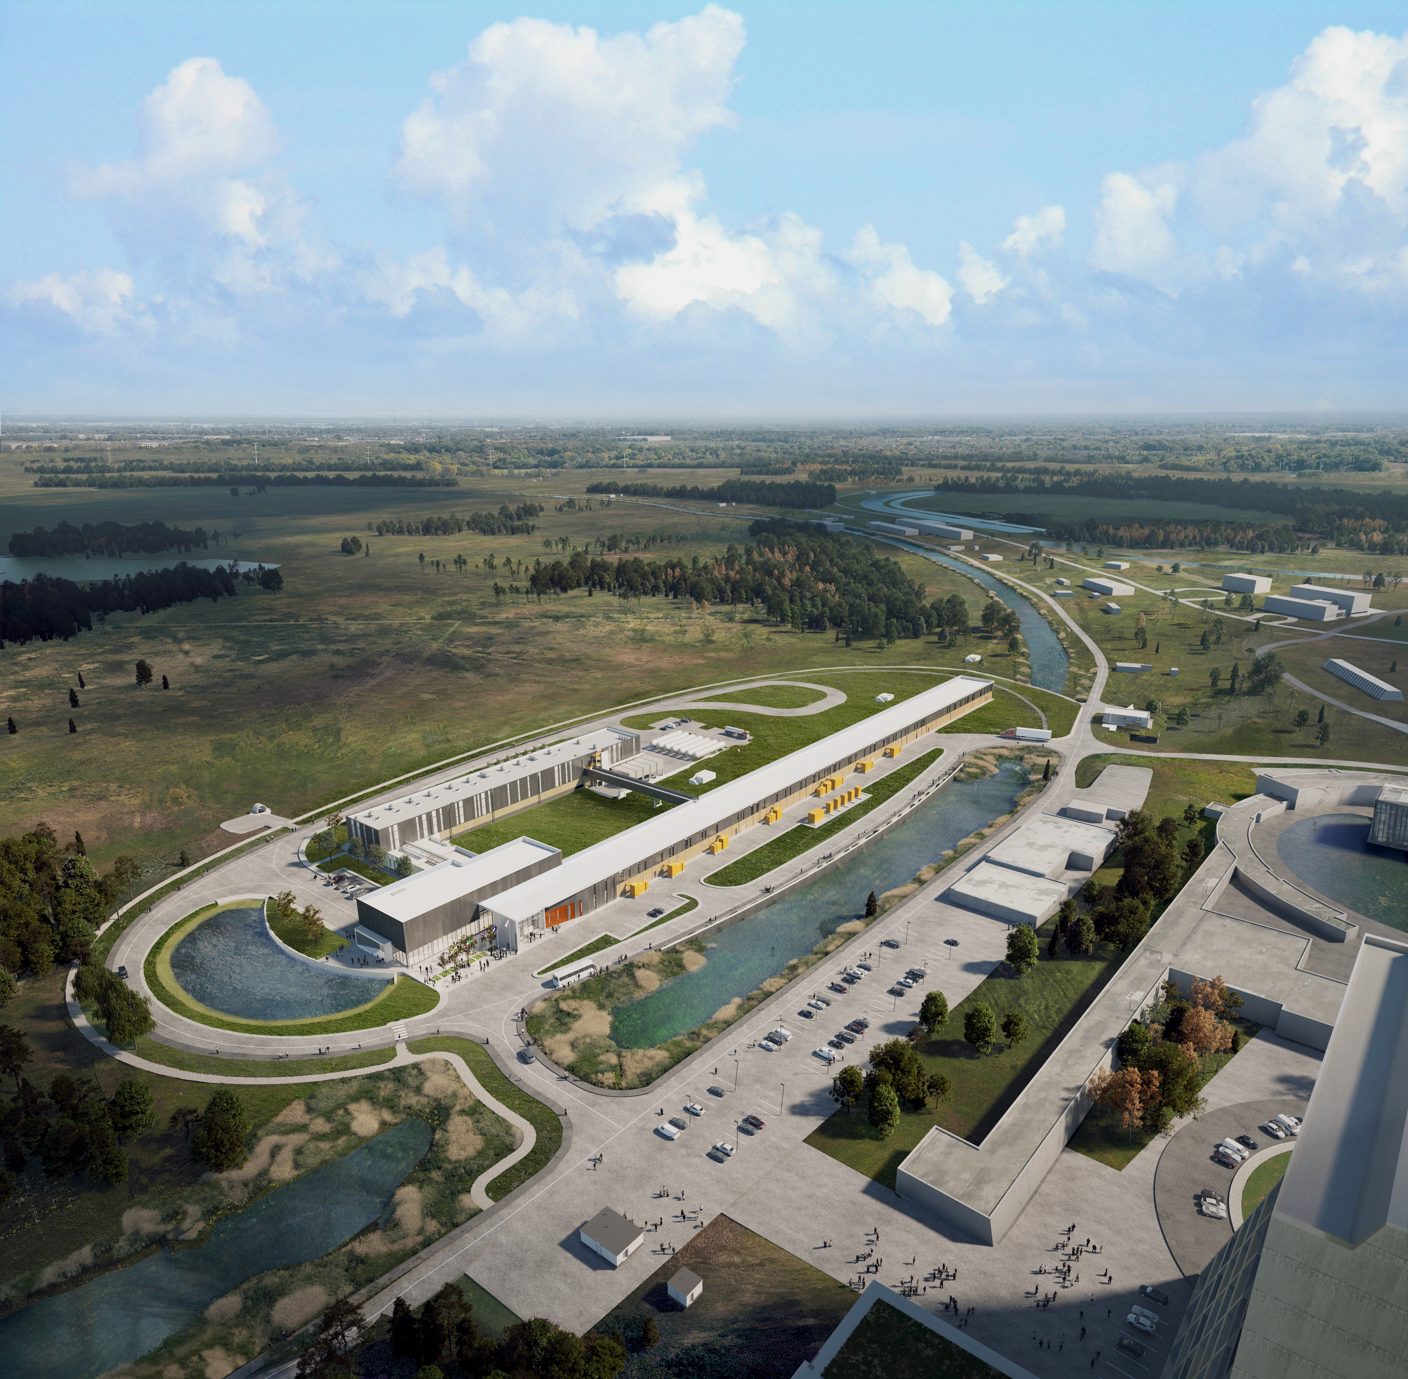
THE FUTURE OF FERMILAB
Follow us:
http://pip2.fnal.gov/
/showcase/pip-ii/

Slide 21
PIP-II Design, Procurement, and Integration Management
Physics Requirements
Functional Requirements
Technical Requirements
Design Documentation
PDR, FDR, Integration Reviews
Prevention Through Design Assessment
Failure Mode and Effect Analysis
Mechanical and Electrical Drawings and Models
Master Interface Control Document Entries
Interface Specification Documents
Engineering Notes and Analyses
Technical Review Presentations
Master Interface Control Document Entries
P&ID Files
Software Code
Engineering Risk Assessment
Value Engineering/Trade Off Analysis
Procurement and Manufacturing Documentation
PRR, MRR
Procurement Specifications
Manufacturing Specifications
Material Specifications
Acceptance Criteria List
Proposal Evaluation Form
Assembly Procedures
Bill of Materials
Procurement Readiness Review Form
Discrepancy Reports and Resolutions
Manufacturing Inspection Plan
Sub-system and Vendor QC Plans
Vendor Travelers
Acceptance, QC, Integration, Commissioning
Acceptance, IRR, Handoff
Material Certifications
Vendor Final Design Docs
Software Code
Redline drawings
Incoming QC Travelers
Storage Plan
Installation Document List
Operation and Maintenance Manuals
Spares List
Welding records, required code documentation
Verification and Testing and Procedures
Installation and Commissioning Plan

