Slide 1
PM Perspective
December 2024
C. Boffo
December 2024

Slide 2
Wrapping-up 2024
Great technical progress in all areas, we need to maintain the momentum.
Our schedule remains very stable
We are managing a tight budget, but with everyone’s help things are under control
The lab environment is challenging but our team remained very focused
Most of all, Steve is still on the Critical Path
2

Slide 3
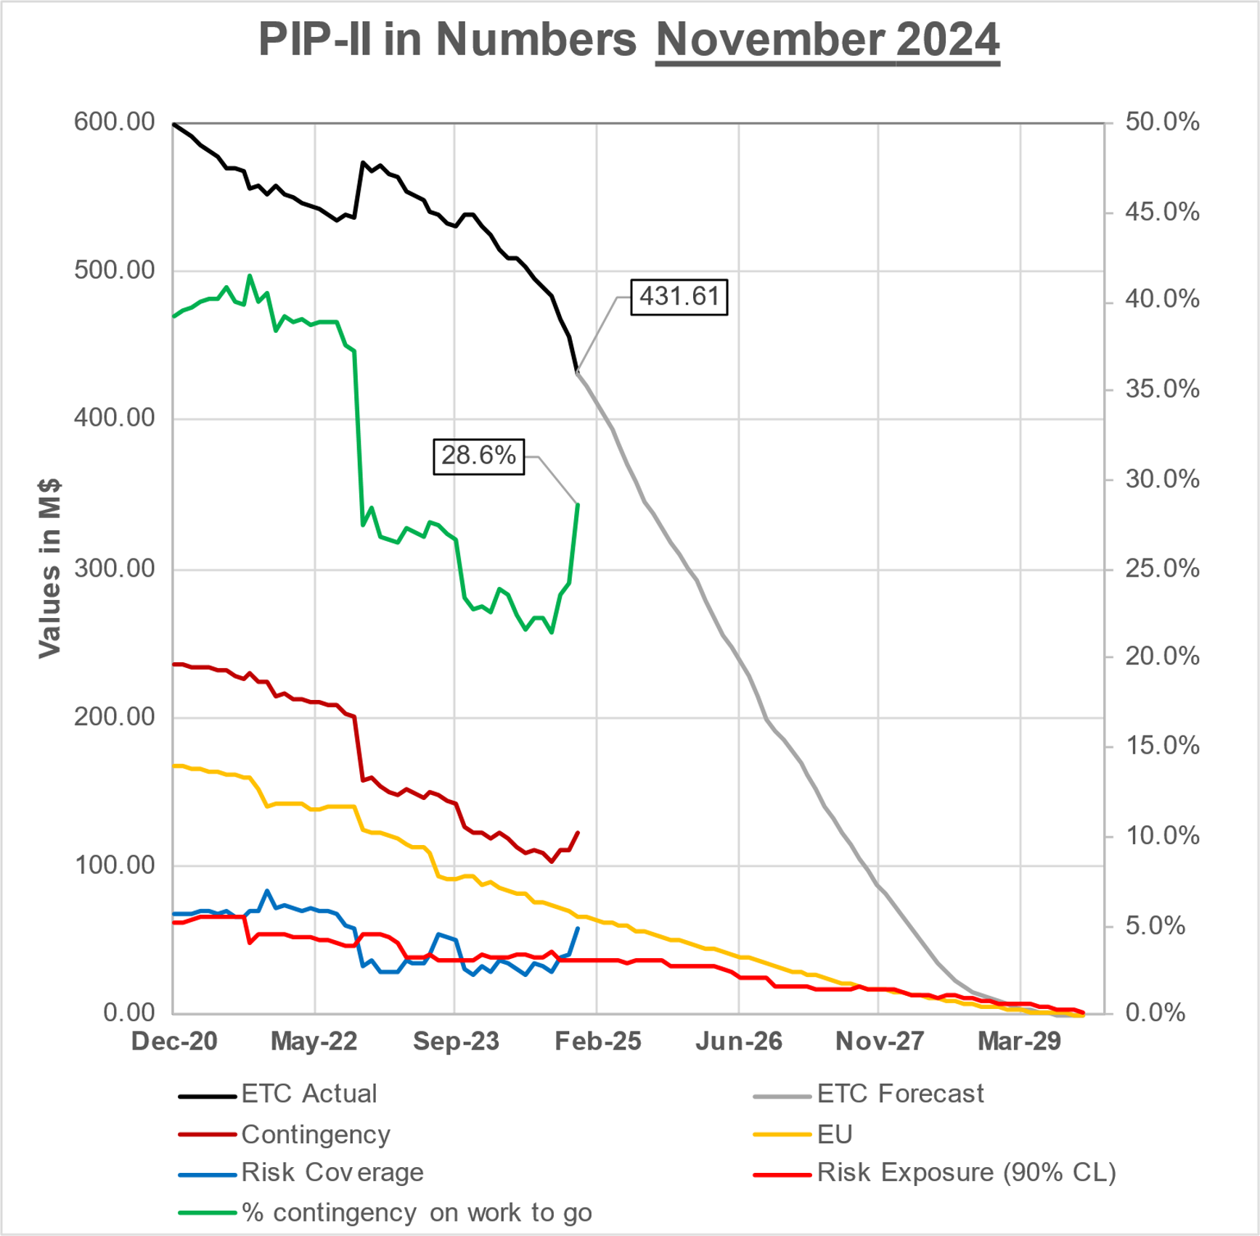
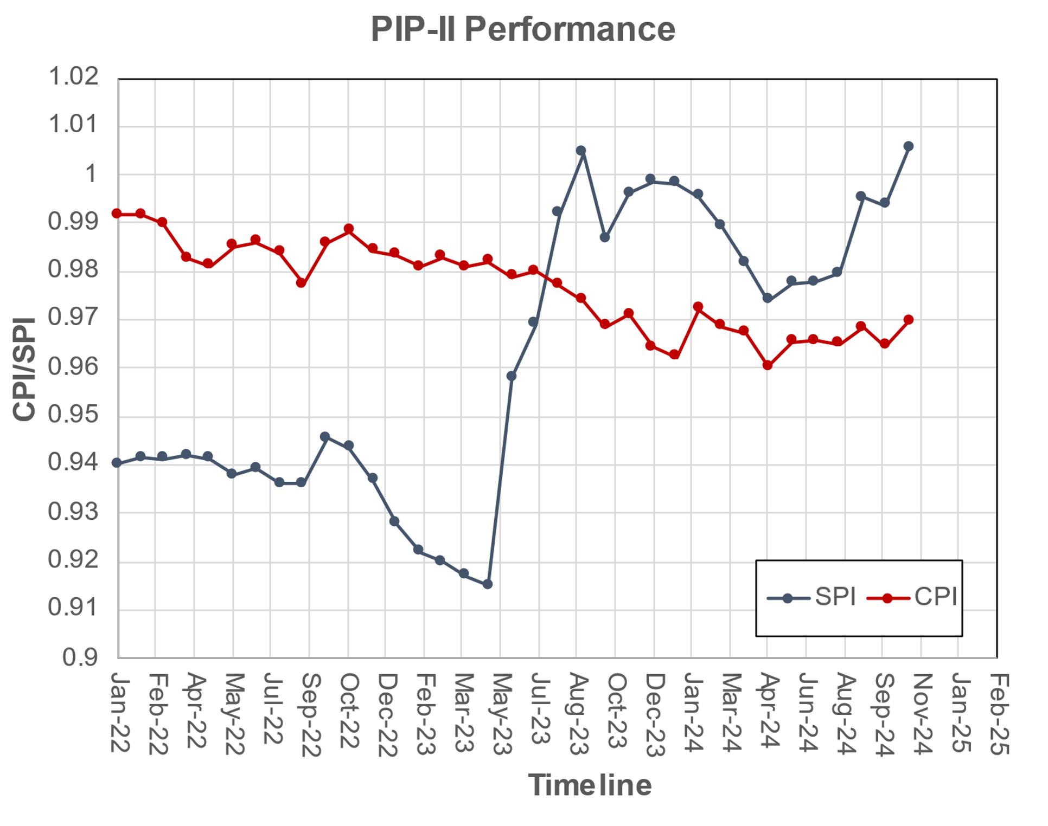
Financials
SPI
1.01
+0.01
BSI
0.93
-0.03
ETi
0.92
-0.04
CPI
0.97
0.00
BEI
0.92
-0.03
%Com
48.8
12.1

Slide 4
Project Office in Numbers
One Director review, two IPRs and one CD4
EVMS surveillance showed exceptional results
Internal Audit showed one minor recommendation
The risk workshop in August had a positive outcome
170 BCRs processed
1458 VARs completed
4

Slide 5
Procurement
Big positive changes compared to 2023
The team has been extremely efficient
REQ backlog has been processed
SOW template
Technical evaluation template
Procurement Dashboard on its way
548 REQ processed
5

Slide 6
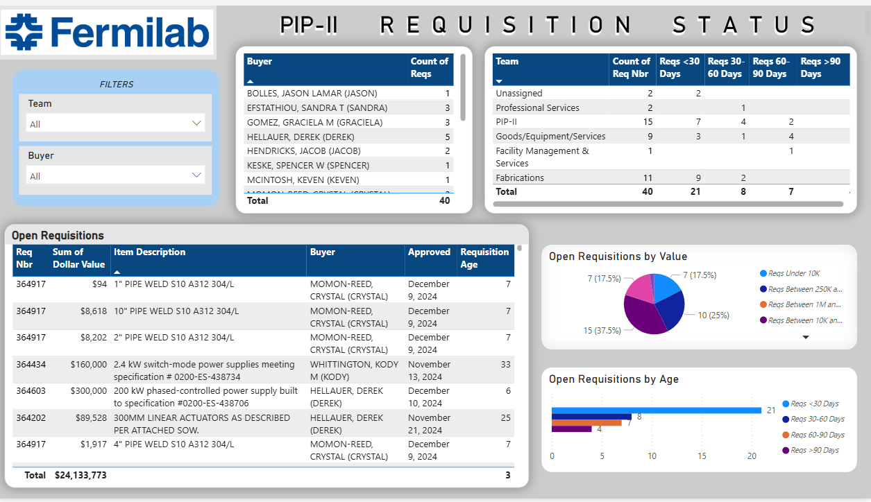
6

Slide 7
PIP-II in 2025
Welcome the Cold box and compressors on-site and perform a safe installation
Receive ESAAB and close the ECF subproject
Assembly of SSR2 cryomodule
Procure the CDS TTL and keep working with Poland for the DVB
Define a path forward for the SSAs
All this while:
Following the present schedule
Limit the number of BCRs to maintain a stable baseline
THANK YOU FOR YOUR DEDICATION TO PIP-II
7

Slide 8
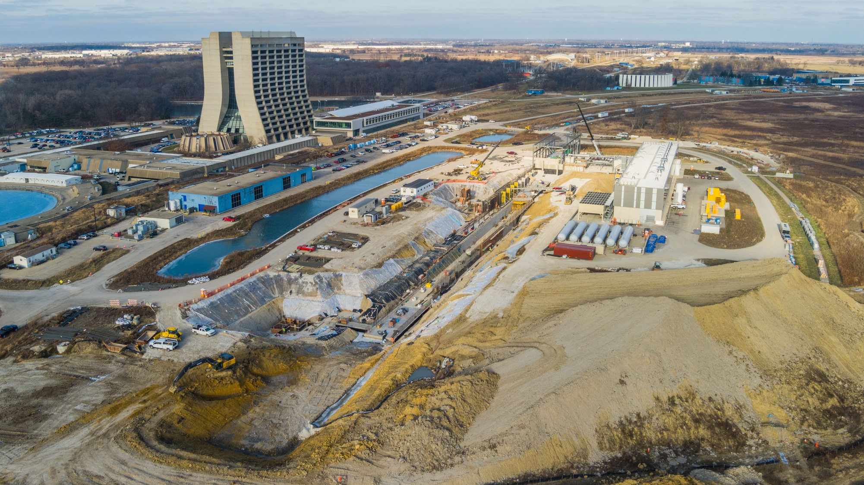
THE FUTURE OF FERMILAB
Follow us:
http://pip2.fnal.gov/
@PIP2accelerator
/showcase/pip-ii/

