Slide 1
F Sector Reconfiguration Task Force -
Dean Still
0900 Meeting Update
Dec 20, 2024

Slide 2
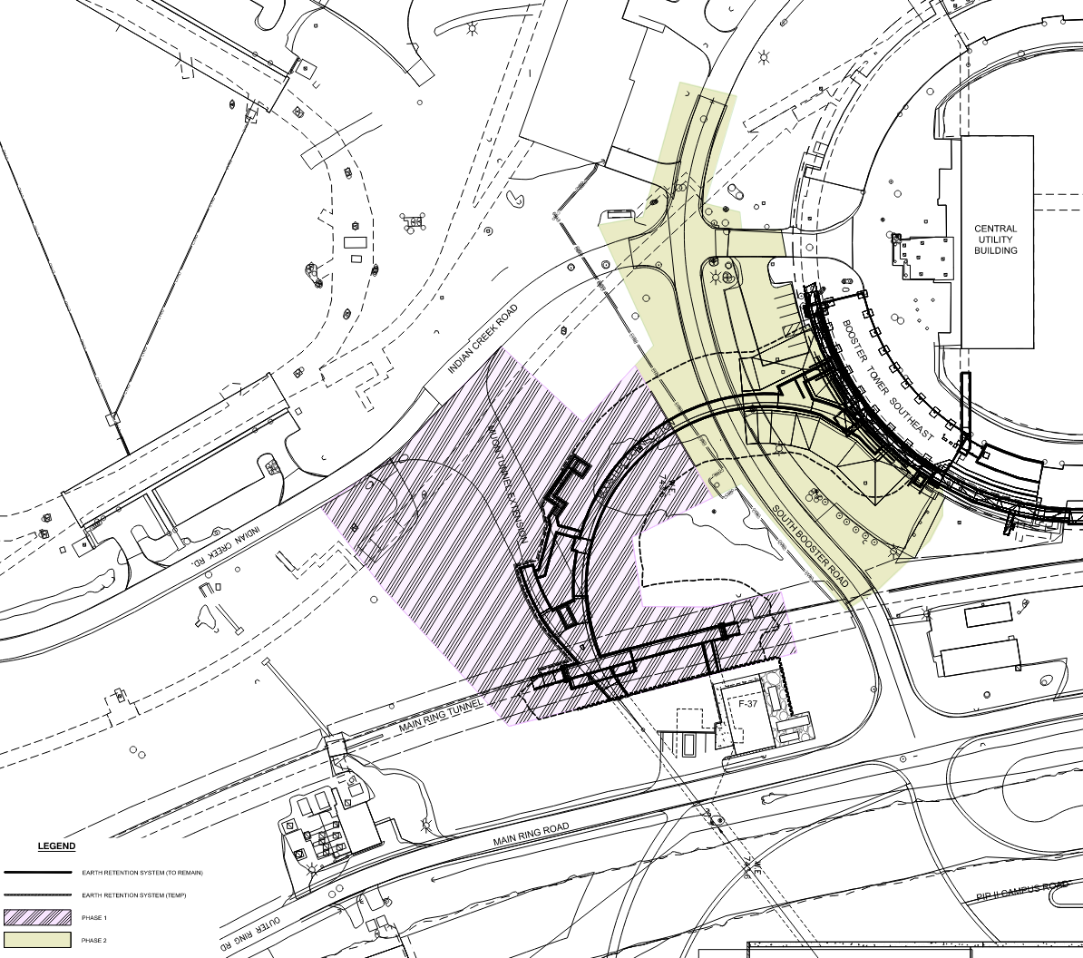
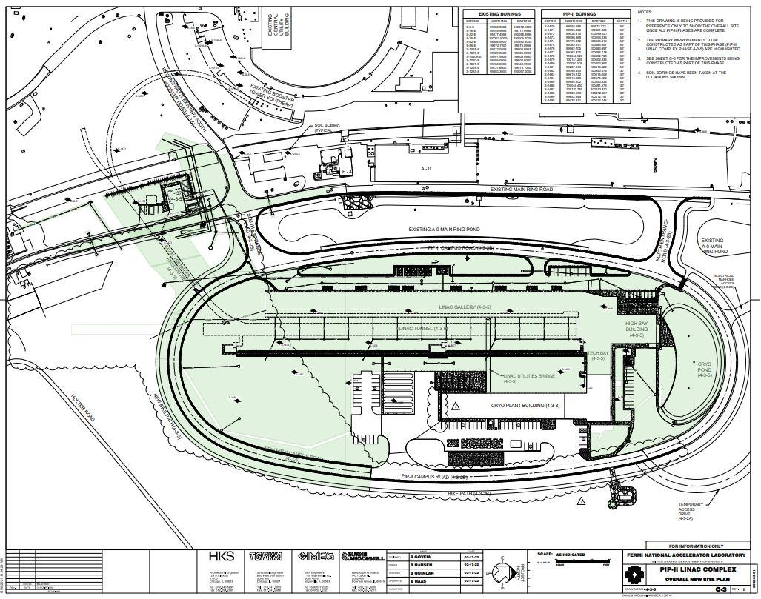
F Sector Reconfiguration Task Force:
Phase 1
Starts Dec 2026
Phase 2
Starts June 2028
Initiated in October 2024 by Mary Convery with 11 members.
Assess the impacts of PIP-II phased construction on Accelerator Operations.
Deliver an impact report by March 2025.
Task Force discovered impacts that were time sensitive with the start of PIP-II Linac Construction in Jan 2025.
Main impacts center around the excavation of the MR road which under the road carry the main power feeder duct and central communication duct.
Preliminary Report recommends feeder experts assess alternate power backfeed paths or alternate means of power impacted areas.
Preliminary Report can be found at (Beams-doc-10412)
BTL Construction
Phase 0
Starts Jan 2025
LINAC Construction

Slide 3
Lab Projected Schedule

Slide 4
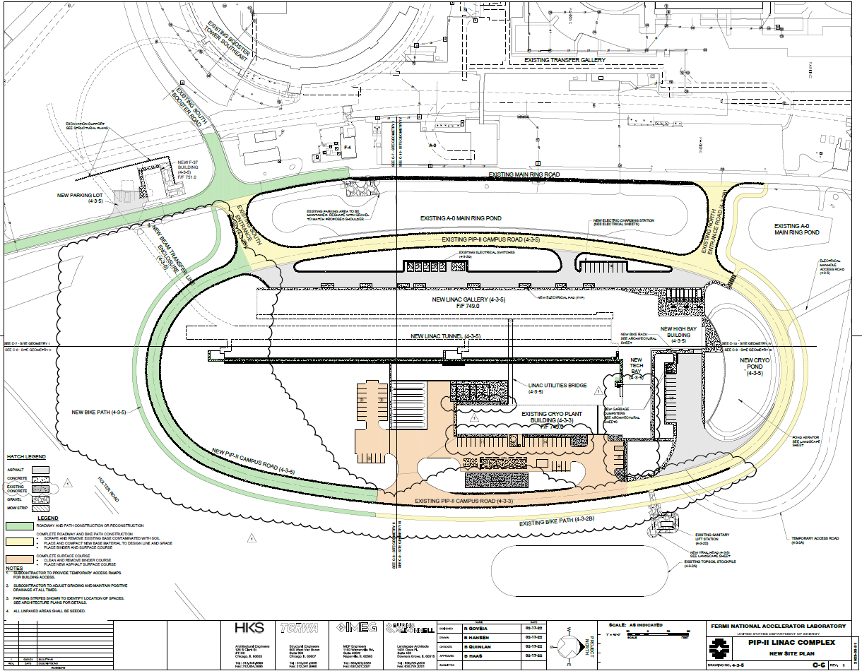
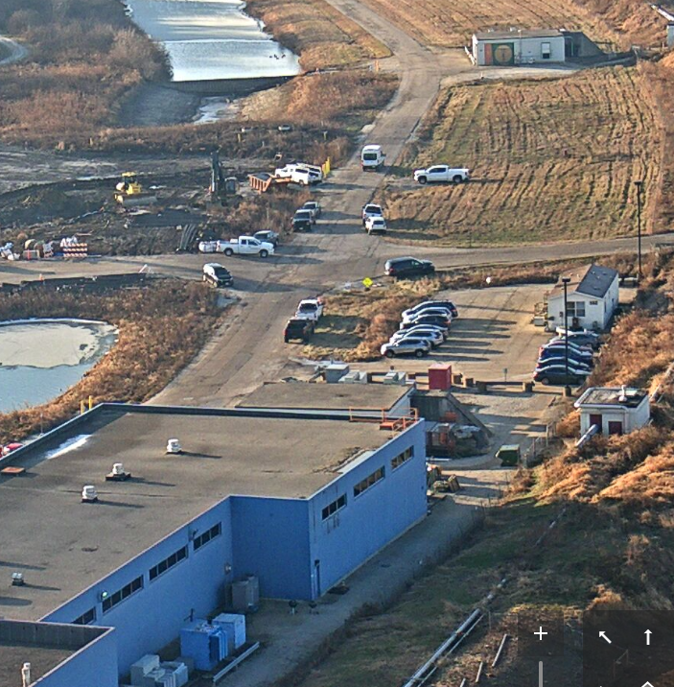
PIP-ll Linac Construction Overview
(Courtesy : Steve Dixon)
F4
Ductbank Location
F4
A0
Main Ring Road
F3
F4
Main Ring Road View looking South where excavation will begin Jan 6, 2025 - 18DEC24
4

Slide 5
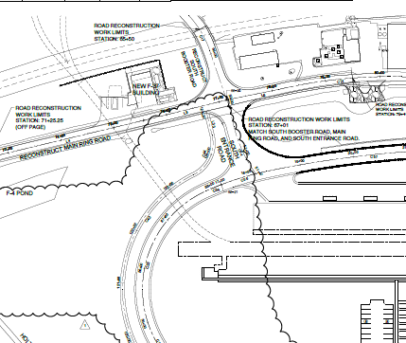
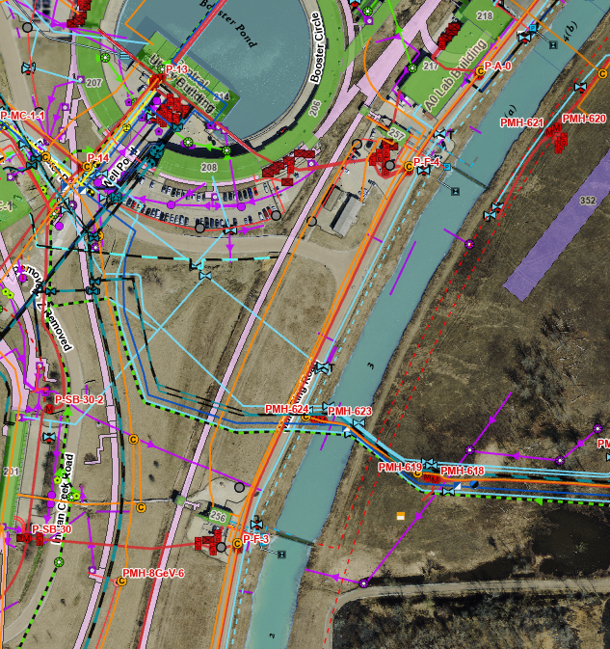
Feeder and Communication Duct Overview
(Courtesy : Steve Dixon)
F4
Ductbank Location
A0
Main Ring Road
F4
Communication duct will have a backup fiber pulled to mitigate any issues.
BTL Enclosure
Screenshot from drawing C-14
GIS Overview showing buried power feeders and communication ducts
5

Slide 6
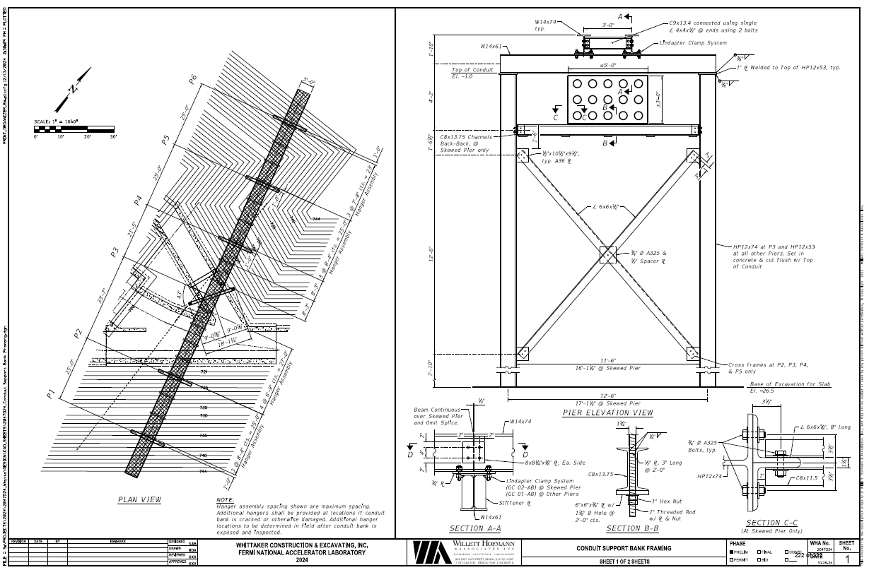
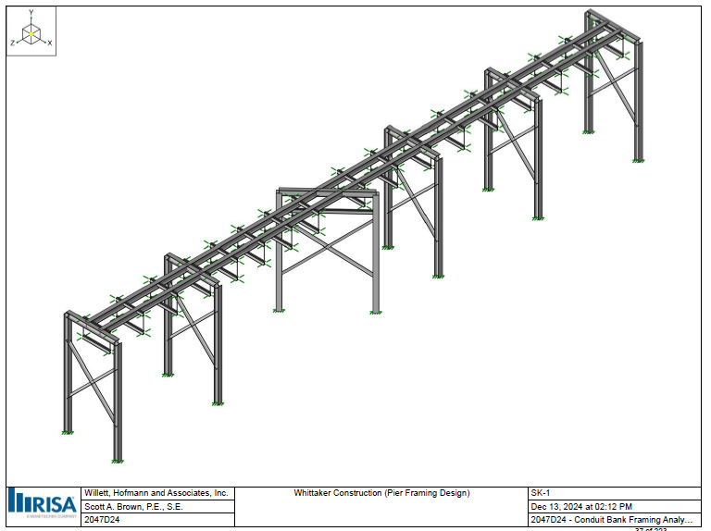
Subcontractor’s Feeders Support Plan
F4
F4
(Courtesy : Steve Dixon)
6

Slide 7
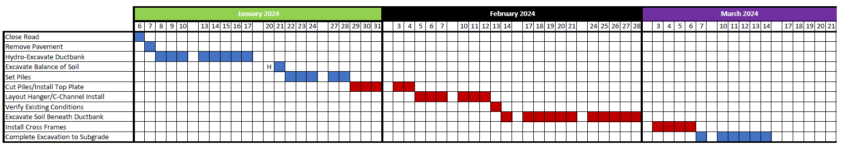
Subcontractor’s Current Schedule Plan
(Courtesy : Steve Dixon)
F4
Potential impacted areas due to daily power outages:
  A0 Building
  All of F sector (potentially all Tevatron service buildings)
  E4R
  AP0
  AP10
  AP30
  AP50
  Mu2e Building (MC-2)
  MC-1
  It is believed this work will not impact beam to BNB
Daily Power Outages
This plan is being discussed to try to
minimize the impact to loss of power.
It looks like there is at least a back feed
path to Muon Campus feeder 24
7

Slide 8
Road Impacts
There will be a change in road access during construction between F3 and F4.
Booster Road to Main Ring road will remain open at times with limited travel.
This section of the Main Ring Road will be closed.

