Slide 1
Mu2e report
Greg Rakness (FNAL)
Friday 9am AD meeting
20-Dec-2024
https://indico.fnal.gov/event/67526/

Slide 2
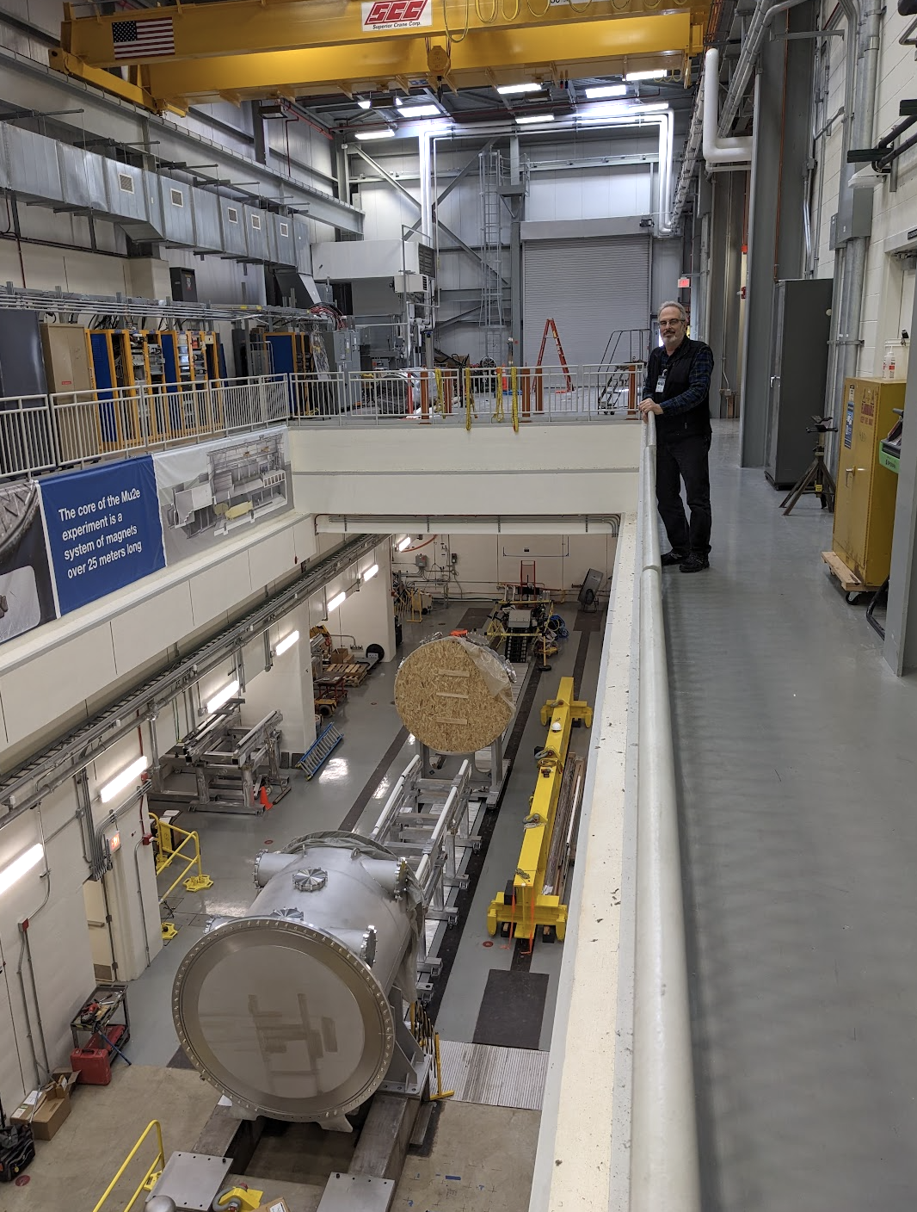
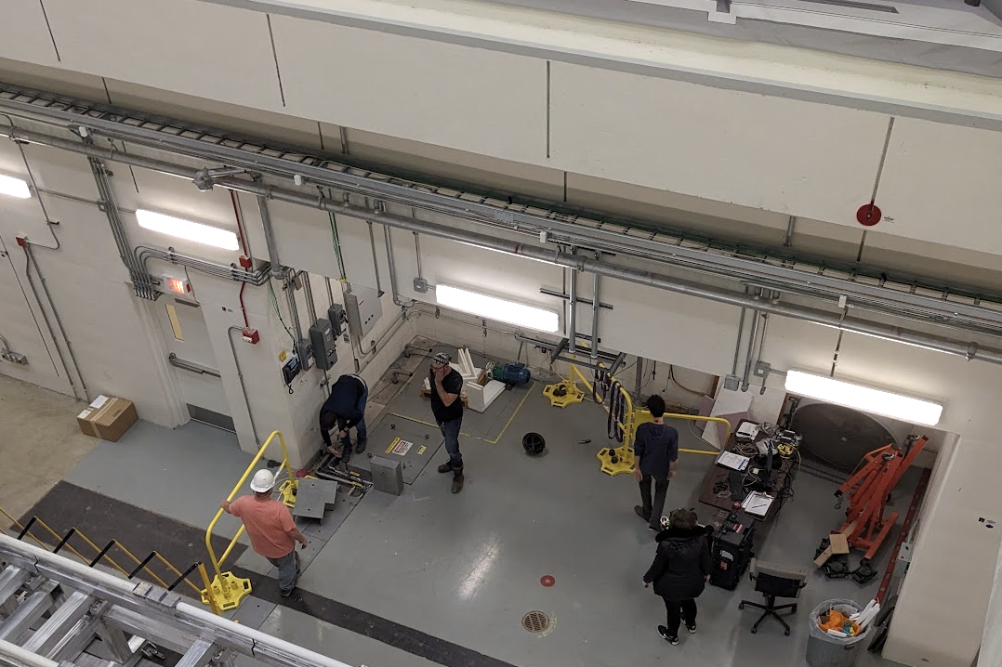
Some of the work ongoing at Mu2e
Alignment ongoing in M4 area
Electricians continue installation for
beam enclosures
full flow purifier
Lowered Instrumentation Feedthrough Bulkhead to lower level
Installed and ran DT generator

Slide 3
3-Jan-2024
This and following pictures from George Ginther

Slide 4
11-Dec-2024
Upstream and downstream Transport Solenoids (transport muons from production target to stopping target)
Vacuum Pump Spool Piece (pump out Muon Beamline vacuum)
External Stands (support Tracker and Calorimeter when servicing)

Slide 5
13-Dec-2023

Slide 6
17-Dec-2024
Instrumentation Feedthrough Bulkhead (power and optical fiber to detectors and seal muon beamline)
Cables, fibers, articulating cable tray (power and optical fiber to detectors)
External Stands
DT generator (calibrate calorimeter)
Vacuum Pump Spool Piece

Slide 7
After the Winter Break
Install sump level monitor
Following in Jim’s footsteps
Replace Automatic Transfer Switch at MC1
To automatically switch to backup power for Mu2e cryo plant
Hang collimator in extinction monitor area
Understanding flexibility in concrete pour contract to make room to receive other items
Continue preparations to bring over Calorimeter and Tracker
Lots to do here
Coordinating with PIP-II + ISD + AD + PPD on work for PIP-II that affects power to the Muon Campus
Appreciate the willingness on all sides to keep both PIP-II and Mu2e Projects moving forward with no undue delay
Thanks especially to Mary, Randy, Dean, Jim

