Slide 1
Muon Campus Shutdown Report
Jim Morgan
Friday 09:00 Ops Meeting
December 20, 2024

Slide 2
Muon Campus status
Did not complete remaining safety system testing
Needed to turn on Critical Device power supplies
Electrostatic Septum ESS2 installation and new stand check-out for both septa
High Voltage Conditioning deferred until holidays
ESS2 has been at 5 kV for about a week, off now
PESD calibrated the voltage readback on both ESS power supplies yesterday
Still waiting to install new limit switch brackets for horizontal motion
Q205 LCW manifold replaced by TD techs last Friday
Delivery Ring safety system dropped during access; Ops re-secured on Sunday
Final pre-operational tunnel walk-throughs Wednesday
Vacuum work
Completed, hand vacuum valves around Electrostatic Septa opened
Muon LCW resistivity back to normal after remaining three DI bottles replaced
Fluids techs continued to address remaining LCW leaks
F-27 water skid turned back on yesterday with assistance from ISD
AP-0 A/C work remains paused
Study – M1-M3 Optics
Study – Alternative M5 optics

Slide 3
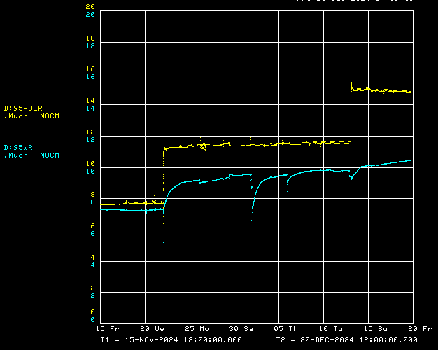
Muon LCW resistivity
2 of 5 DI bottles replaced
Remaining 3
DI bottles replaced

Slide 4
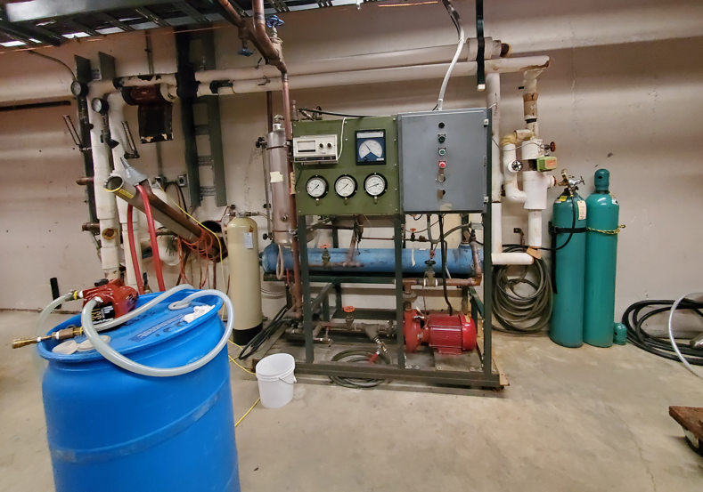
F-27 LCW skid
CW Lines
Reservoir
Control panel
DI Resin
Heat Exchanger
Make-up water

Slide 5
Upcoming work
Limited remaining tunnel work
Install new limit switch hardware for horizontal motion on ESS1 & ESS2
Sump monitors in Mu2e area, Pre-Vault later
A few remaining small LCW leaks
ESS2 High Voltage Conditioning on hold
Expert will be out of town beginning Tuesday, back 12/27
Remaining Radiation Safety System testing
After power supplies are deemed ready for operation
Other upcoming work
Repair Kirk Key hardware on disconnects, requires more modifications to disconnect
Replace several power supply circuit breakers and some primary wiring
Installation of Mu2e Extinction Monitor Collimator in Absorber area
M4 Final Focus vacuum installation, A/C dipole installation
Preparing for beam operation
Work towards power supply check-out and preparations for beam
MI heat exchanger and Kautz Road transformer issues need to be resolved
PIP-II construction could impact Muon beam operation for more than five weeks

