Slide 1
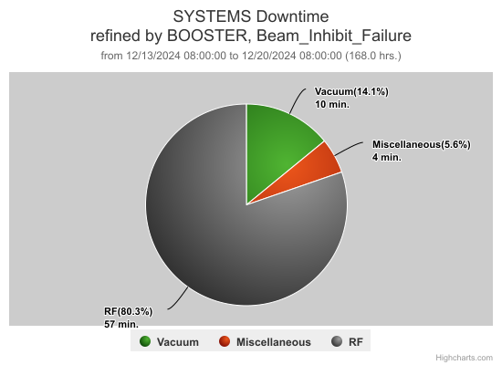
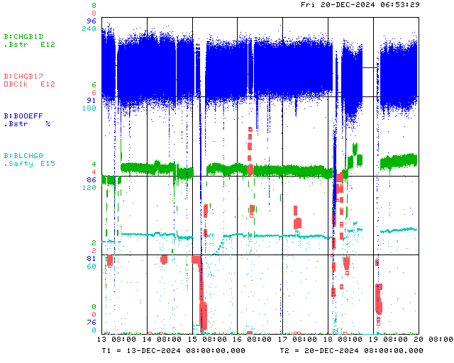
Booster Operations 12/13/24 – 12/20/24
F
Sa
Su
M
Tu
W
Th
F
F
Collimator Commissioning
Also:
Thanks to all the folks who spent their Sunday to do L8 Collimator commissioning!
Thanks to Scott & contractors for getting BLLRF Aaon AC set up correctly on Monday
5 DI bottles changed out at CUB for 95 system this week
Testing New Digital BLLRF, running operationally since 18th.
A few BRF trips. BRF08 on mod door, BRF15 turned off due to bias supply water leak
15Hz measurements & 20Hz upgrade effort at E4R continues.
BLMW1 BLME1 stale data
Having subtle issues with CNS2 & 3 due to DPM Set Capability for Epics on new L8 collimator controls.
Thanks to Ops for diligence & tuning on the off shifts
Collimator Commissioning Prep
MI-12B access
MI-10 access
This week:
Booster running well. Tuning up, working to increase intensity.
Beam to BNB currently ~ 4.3E12/pulse 5Hz.
L8 Collimator initial commissioning on Sunday 15th
Switched to new Digital LLRF on 18th
Various Booster Studies

Slide 2
Booster Dedicated/Parasitic Study Report:12/13/2024-12/20/2024
Booster Flat injection (Continued) (For PIP&PIP-II)
Participants: CBhat, SChaurize, JKuharik, KTriplett, Ralitsa
Goal: Flatting the injection front-porch for ~300 μs using Booster dipole correctors in current operation
Type of Study: Parasitic
What has been done
Studied the effect of
Corrector bump size and shape
Varied the ON and OFF time of the corrector bump
2SCollimator Test (For PIP&PIP-II)
Participants: VKapin, SChaurize, JKuharik, DJohnson, KTriplett, PHanlet, JFulgham & (+many personnel from Safety Group)
Goal: Validate the 2SC system for safety
Type of Study: Dedicated, (~7 hr on Sunday 12/15)
What has been done
Run the new 2SC to create beam losses to be registered by Safety's chipmunks at BTE entrance (@Long8)
Booster beam on $17 at 1 Hz, 1.8 & 3.5E12ppp, 92% efficiency
New 2SC: H&V primary jaws into beam until efficiency drops from 92% till 50%
Safety's group (Joel) derived relation between readings by TLM4(P8-10) and chipmunks @BTE entrance.
Data is being analyzed for approving the collimator commissioning
Booster Digital LLRF study (For PIP/PIP-II)
Participants: ECullerton, BSchupbach, SChaurize, JKuharik, KTriplett, CBhat
Goal: Test and commission the upgraded DLLRF hardware with beam to Beam-dump, BNB.
Type of Study: Dedicated (~2 hr) + parasitic tuning on $17 and $1D beam
What has been done
Swapped from old Booster LLRF to Digital LLRF
Tuned multiple LLRF parameters for better beam efficiency
Beam to BNB target with beam intensity ~3E12ppp
Injection, orbit, damper tuning
Intensity was raised from ~3E12-~4.5E12ppp and finally settled down to 4.3E12ppp for rest of the time with acceptable efficiency (~91%).
Monitored its performance, system seems to be robust
Milestone: With Digital LLRF beam to beam-dump and BNB for the past 40 hrs. Thanks to Ed Cullerton and Brian Schupbach
Not yet decided if we want to keep DLLRF for weeks
Booster IPM calibration
Participants: JElded and Mbalcewicz
Goal: Calibrate the Booster IPM by using known scraped beam
Type of Study: Dedicated
What has been done:
Scraped the beam in each plane using L6 collimator and bump the beam in the vicinity of IPM. Data have been taken for offline analysis.
Above studies are in progress. As the analysis progresses results will be posted in the PS Study Sharepoint
https://fermipoint.fnal.gov/org/as/ad/hqsupport/PSStudy/Shared%20Documents/Forms/AllItems.aspx
Notes:
https://fermipoint.fnal.gov/org/as/ad/hqsupport/PSStudy/Shared%20Documents/Forms/AllItems.aspx

