Slide 1
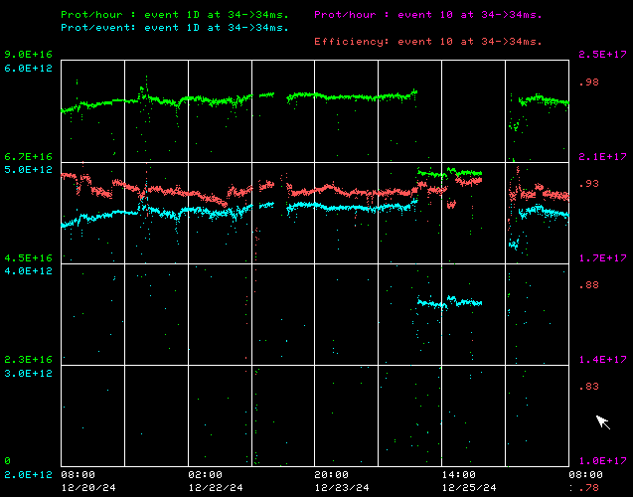
Booster Operations
Fri: Rf Folks repaired small water leak on BRF15 Bias Supply. Plan was to continue using new Digital LLRF system into weekend.
Saturday/Sunday Ops general tuning.
Mon: Performed some flat injection studies with new digital LLRF system.
Tues: Gerneral tuning .
Wed Christmas: Had BRF1,2, and 7 go down. Reduced beam intensity due to RFSUM decrease by about 1E12. Also lost cooling fan on CUB Booster 95 LCW Supply pump #1 VFD controller box. ISD installed external fan. This still needs attention.
Thursday: Access was made while KRF1 work was going on to recover BRF7 (cavity short replacement). BRF1 and was recovered, 2 still has issues being looked at.
Fri: Good Running to BNB at 5Hz. 4.5E212/p
Thanks to Ops for keeoign things running well with reduced RF and ISD for keeping pumps running
Access for BRF7
Downtime over week : ~2.25hrs, RF systems

