Slide 1
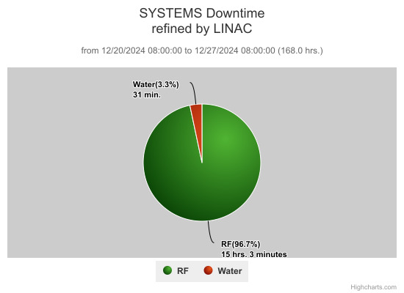
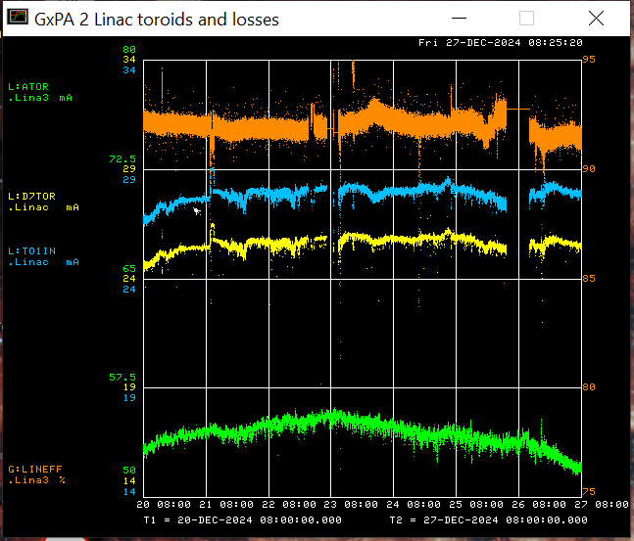
Linac Operations Report
Monday
KRF5 trips
Klystron Collector H₂O flow trips
Replaced flow meter
Cleaned filter strainer
Filament low trips
Raised filament voltage
Thursday
KRF1 CS ignitron status trips
Replaced ignitron firing circuit
Klystron Vernier cavity regulation problems persist, able to run in manual for now
Beam output: Source: 54.5 mA
TO1IN: 27.8mA
D7TOR: 25.6 mA
Efficiency: 92 %
Linac studies
Longitudinal drift compensation

