Slide 1
Mu2e report
Greg Rakness (FNAL)
Friday 9am AD meeting
27-Dec-2024
https://indico.fnal.gov/event/67539/

Slide 2
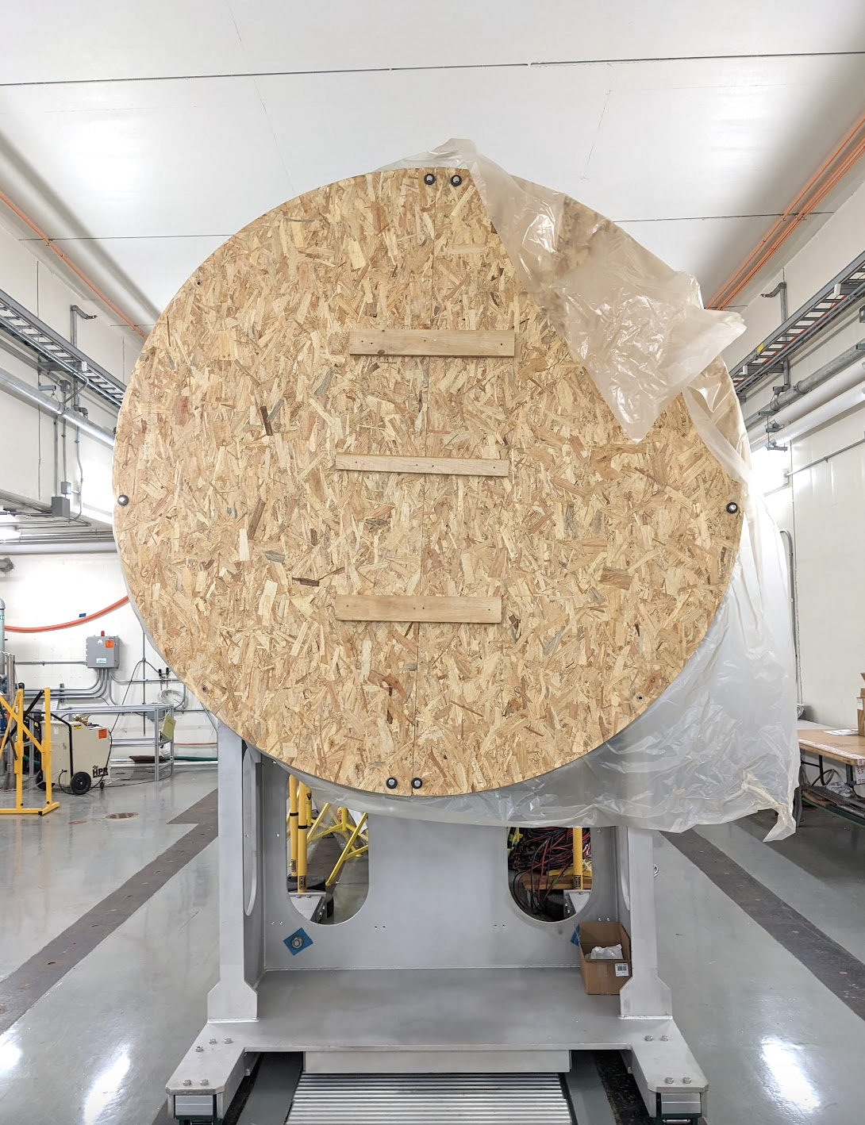
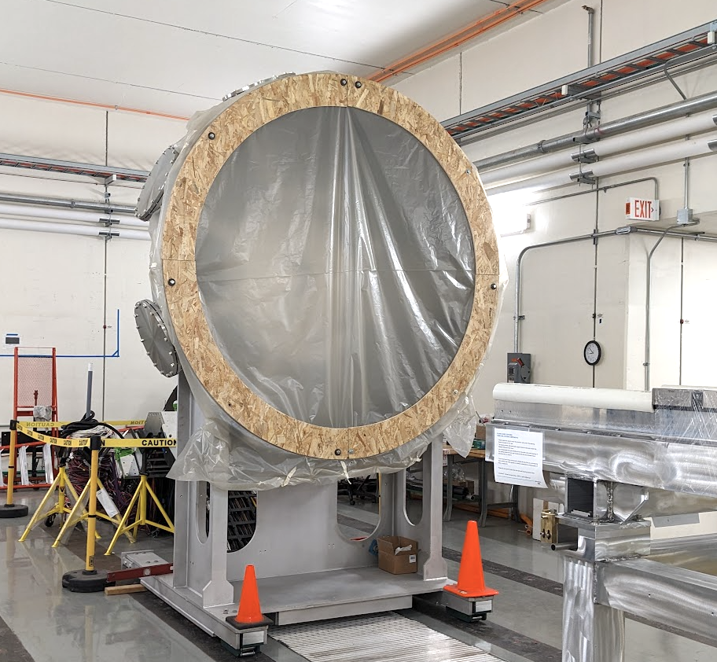
Couple of things at Mu2e
Modifying wooden cover for IFB
Cover the vacuum flange while keeping interior open for access
Electricians continue working on safety enclosures
Preliminary tests of air pressure change in hall when ODH fans on
(aiming not to crush straw tracker if in the hall and ODH fans turn on…)
Found solution to keep power to MC1 + MC2 (Mu2e) buildings during PIP-II work
Thanks to PIP-II + ISD + AD + PPD for figuring out how to keep both PIP-II and Mu2e Projects moving forward with no undue delay

Slide 3
After the Winter Break
Install sump level monitor
Following in Jim’s footsteps
Replace Automatic Transfer Switch at MC1
To automatically switch to backup power for Mu2e cryo plant
Hang collimator in extinction monitor area
Understanding flexibility in concrete pour contract to make room to receive other items
Continue preparations to bring over Calorimeter and Tracker
Lots to do here

