Slide 1
9 AM Meeting
Erin Cook
MCR Crew Chief
Friday, December 27, 2024

Slide 2
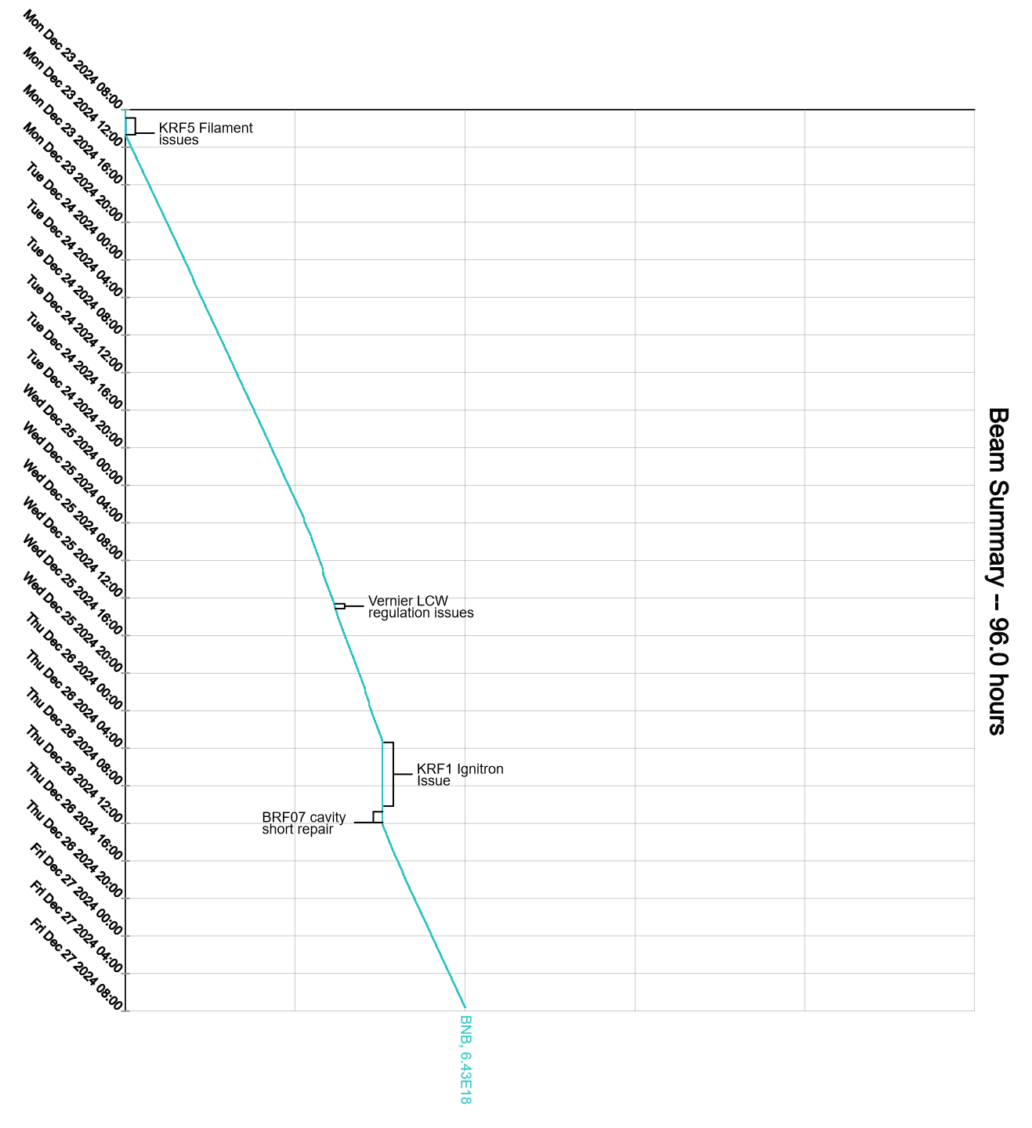
Since Monday…
Monday:
Experts fixed KRF5 filament
Tuesday:
Continued to have infrequent BNB permit trips on Target Cave Exhaust Fan
Wednesday:
Various Booster RF Issues
Ran at slightly reduced intensity
Vernier cavity temperature regulation issues
CUB pump #1 high temp fault
Duty Personnel monitored overnight
Thursday:
Resolved CUB pumps
Cleared fault on #2, fixed #1. No swapping of pumps occurred
KRF1 Ignitron board replacement
Opportunistic Booster Access for BRF07 Cavity Short
Experts looked at Vernier LCW
Work ongoing

