Slide 1
This Week Summary
Matthew Hartung
MCR Crew Chief
January 3rd, 2025

Slide 2
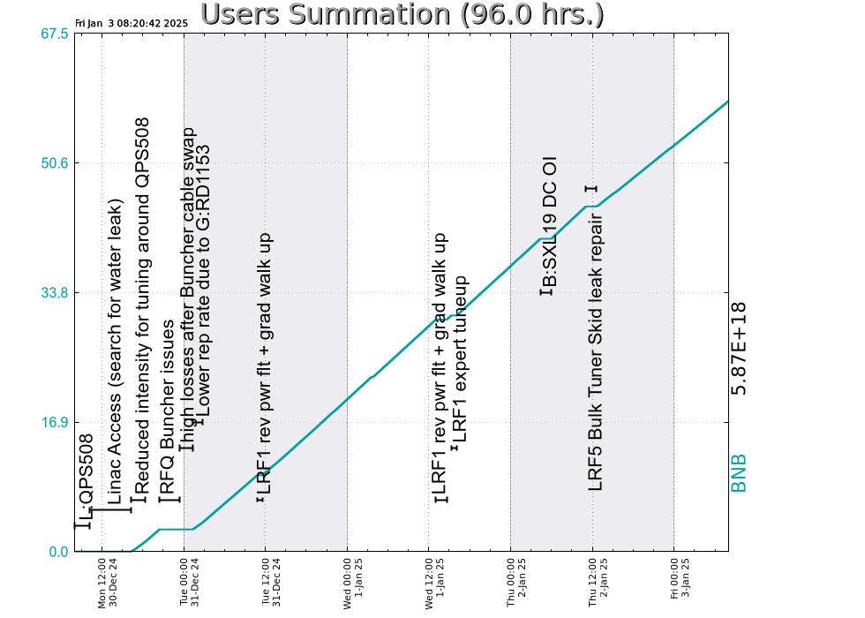
Summary
Monday:
Linac Access for QPS508 repairs
Pre-Acc Buncher Troubleshooting
Tuesday:
Tuning
Wednesday:
LRF1 Reverse Power Issues
Thursday:
Replaced B:SXL19 corrector P.S.
MIRF Cavity Leak found at the Test Stand
LRF5 Bulk Tuner Skid repairs
Currently:
8.4e16 p/hr to BNB

