Slide 1
Linac Weekly Report
R. Sharankova
AD Operations meeting
3 Jan 2024

Slide 2
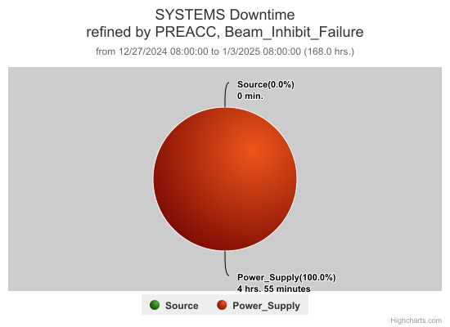
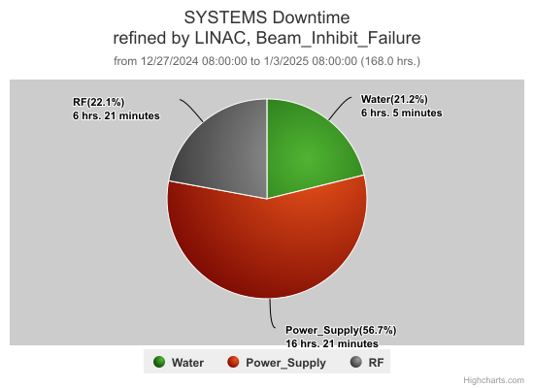
Preacc & Linac Weekly Performance
Fri: LRF3 spark trip, LRF3 OI, LRF2 cell trip
Sat: LIP601 failure
Sun: LRF2 spark trip, QPS508 replacement & debugging
Mon: DTL5 stem box inspection , KRF5 CS fault, MEBT Buncher gradient
Tue: LRF3 DA OL
Wed: LRF1 rev. pwr & slug tuner position tuning
Thur: LRF5 bulk tuner skid repair
All week:
LRF1 reverse power
KRF5 phase wandering

Slide 3
Current Conditions/Plans
Source A – 49.2 mA
Linac input – 26.8 mA
Linac output - 24.9 mA / 4.6e12 to Booster
Linac efficiency – 91.5%
Remaining tasks:
KRF buncher water regulation – replace flow meter?
MEBT buncher sparking/gradient drop out – replace cable & Isolator
LRF1 reverse power – adjust Marx ramp down curve?
Opportunistic downtime requests:
30 min to install capacitance meters on KRF pulse transformer (Linac +PESD)
4h to flush sand filter on LRF1 skid (MSD Water)
2h access to install components for translation BLM

