Slide 1
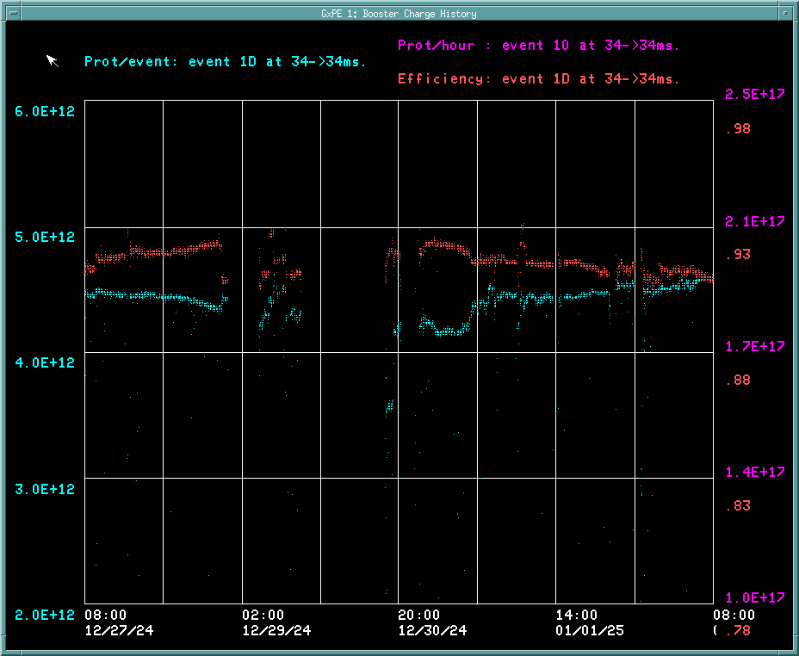
Booster Operations
Fri: General tuning.
Saturday/Sunday Ops general tuning. GMPS Vac trip Sunday caused brief timing glitch.
Mon: Assisted ISD, providing them with a fan for LP1 VFD temp reduction.
Tues: General tuning . RF Folks recovered BRF02
Wed New Year: Running okay.
Thursday: B:SXL19 Reg failure/ replacement. Repaired 8GeV TV system to CNS1-4 MCR TVs
Fri: Good Running continues to BNB at 5Hz. 4.5E212/p
Thanks to Ops for keeping things running well.
Linac QPS508
GMPS timing glitch trip
Access for BRF7
SXL19 Regulator failure
Downtime over week : ~2.88hrs
Mostly BRF01 screen DC OC, IPRF14/21 vac trips and SXL19 Regulator

