Slide 1
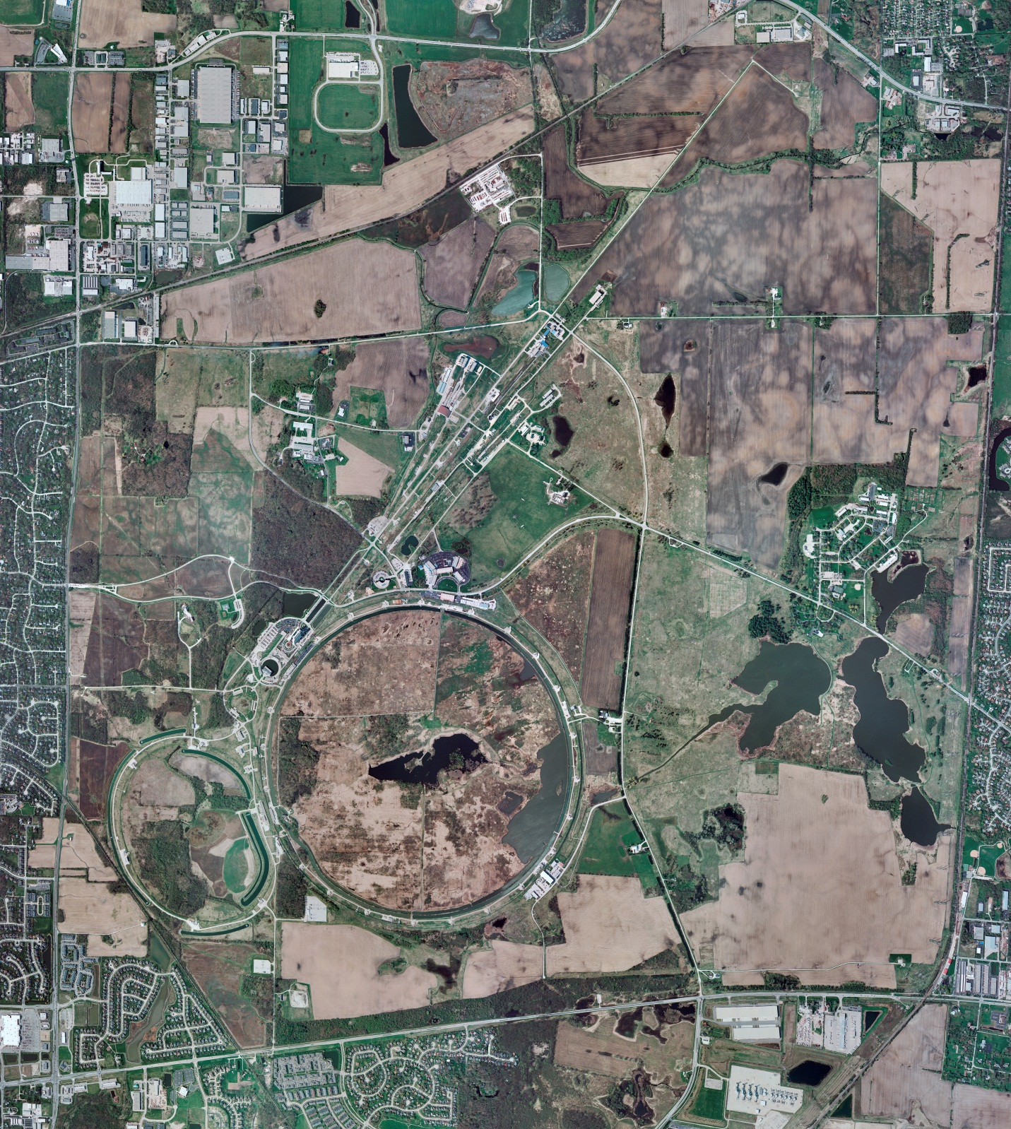
Helium Cryogenics
Status 1/3/2025 J.Makara
CMTF: SCP shut down w/ ongoing warmup to RT w/ 2 Comprs and Purifier CMTS: HECM26 at RT with pvjt and pvcd issues being investigated
PIP2IT: South Stand being modified for SSR2 pCM
North Stand empty
MCTF cryo system cold with 3 compr and 2 Fridges online
MDB/HTS: at RT
MDB/STC: at RT, to be cooled down soon
MDB Magnet: at RT
NML/FAST: Cryo system is shut down and isolated for extended shutdown period
CC1: at RT
CC2: at RT
CM: at RT
IB1: cryo system cold using ALAT CBx and running fine
Muon Campus: at RT with comprs off and system depressurized; LN2 system at RT; g-2 Expt Hall at ODH=0 (not ODH area)
Misc: …MR service bldg. temperatures need vigilance against frozen water during intermittent power outages.

