Slide 1
9 O’Clock Meeting
Nathan Ruffatti
MCR Crew Chief
Monday, Jan 6th, 2025

Slide 2
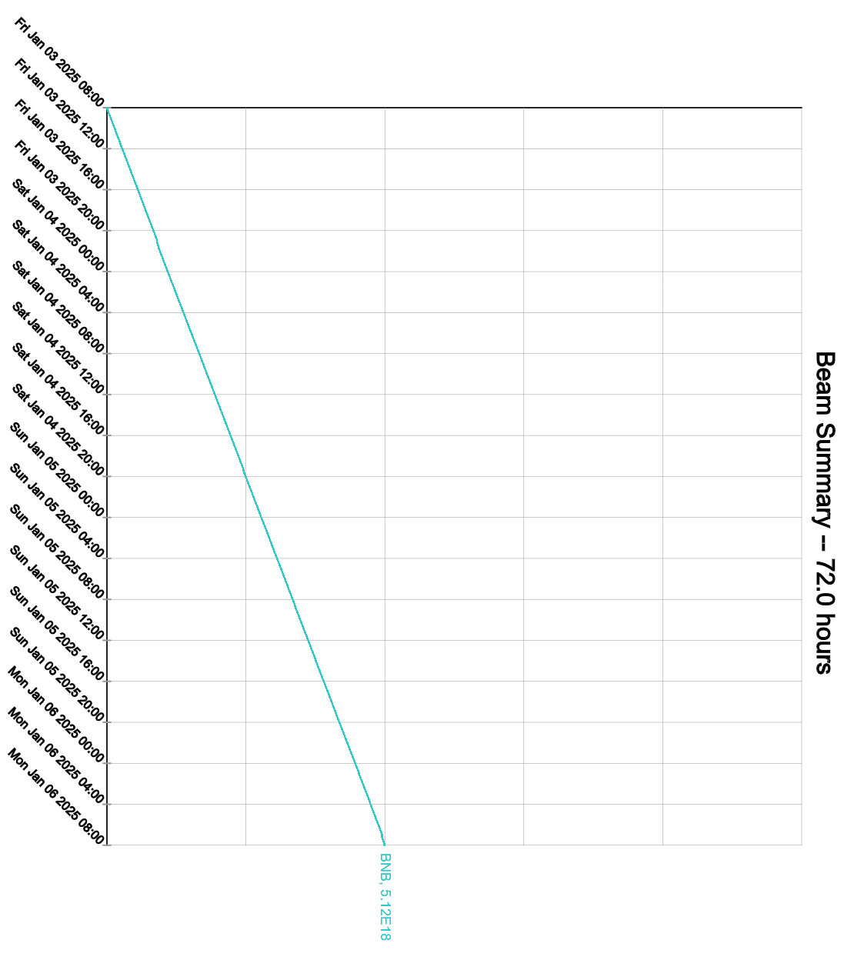
Since Friday…
Sunday:
TeV Camac crate $A3 dead, Ops swapped out
Monday:
BRF11 tripped off, GE issues remained. Swapped to BRF20

