Slide 1
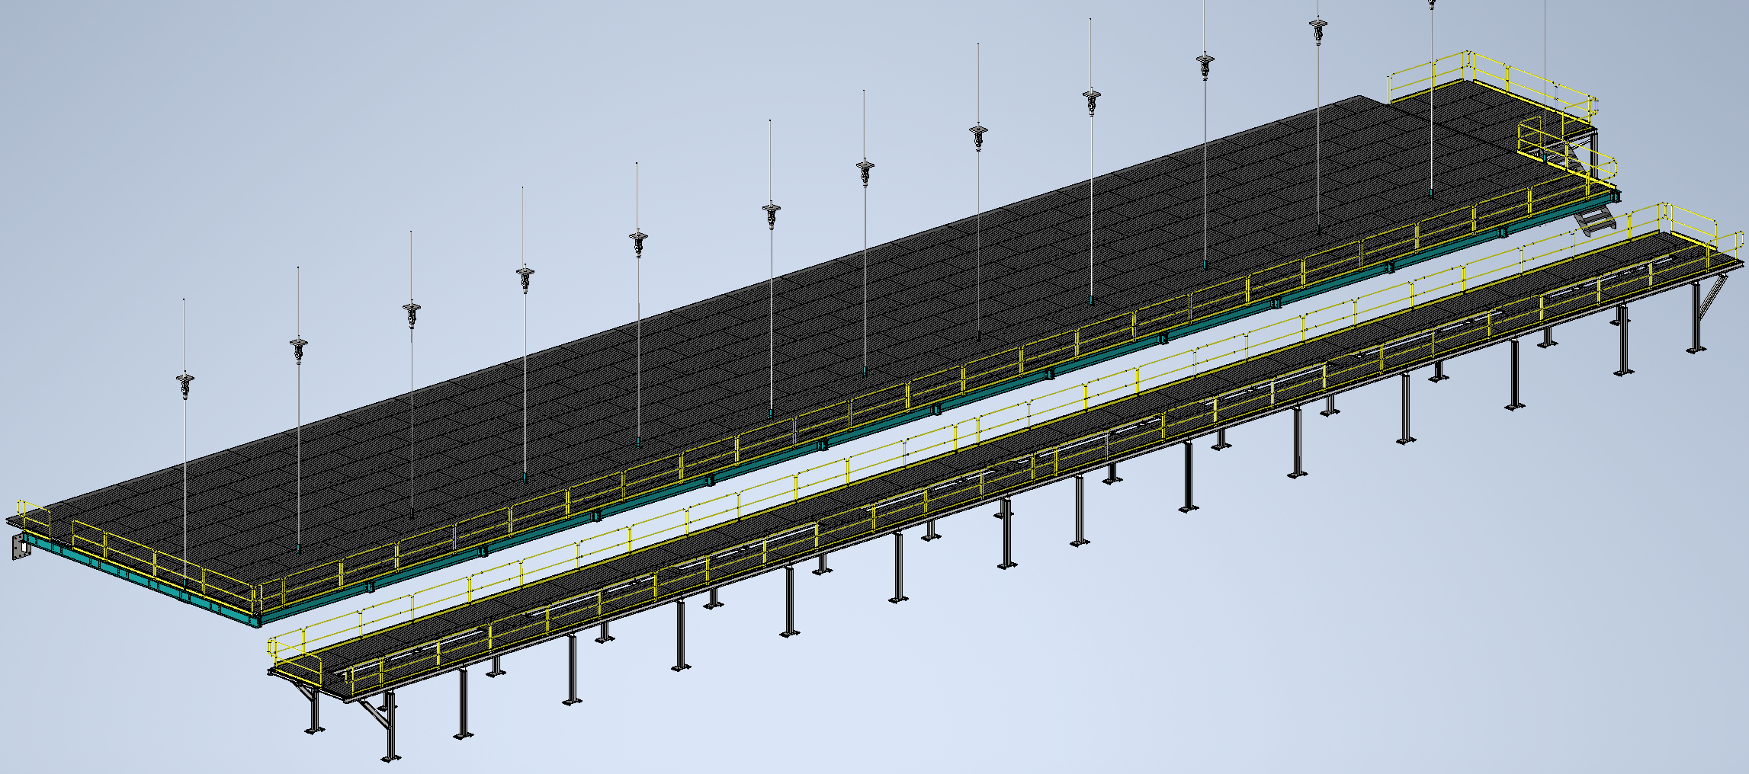
Mezzanine Flooring and Railing
Status
Design note and calculation note uploaded to edms
264185
Working on updates from CO
Walking surface and railings for mezzanines
Install Activity:
Install flooring and railing onto detector, cryo, and ledge mezzanines
16-Sept-26
Tech Spec. | N/A | Empty
3D Model | N/A | Complete | 11/1/24
Design Note | N/A | First Draft Complete | 11/8/24
Eng. Analysis | N/A | First Draft Complete | 12/2/24
CO Report | N/A | Empty
2D Drawings | N/A | Empty
Schedule Contact | N/A | Empty
Install Procedure | N/A | In Process
Store/Move 120d - 4mo
Fabrication
30d – 1mo
Procurement plan
Decking and railings are COTS
Two types of custom railing mounts will be required
Self install
Procurement
90d – 3mo
Latest “Submit to Procurement”
16-Jan-26
Fabrication/delivery
PRR Target: Dec. 2024

Slide 2
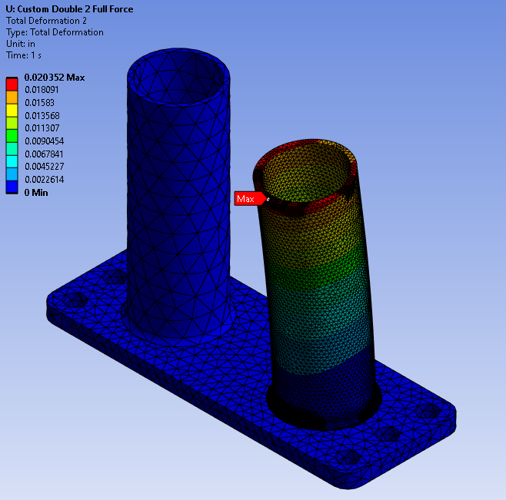
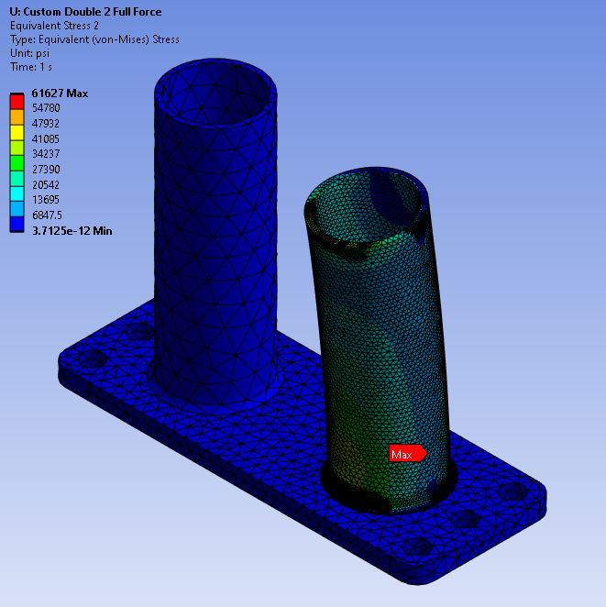
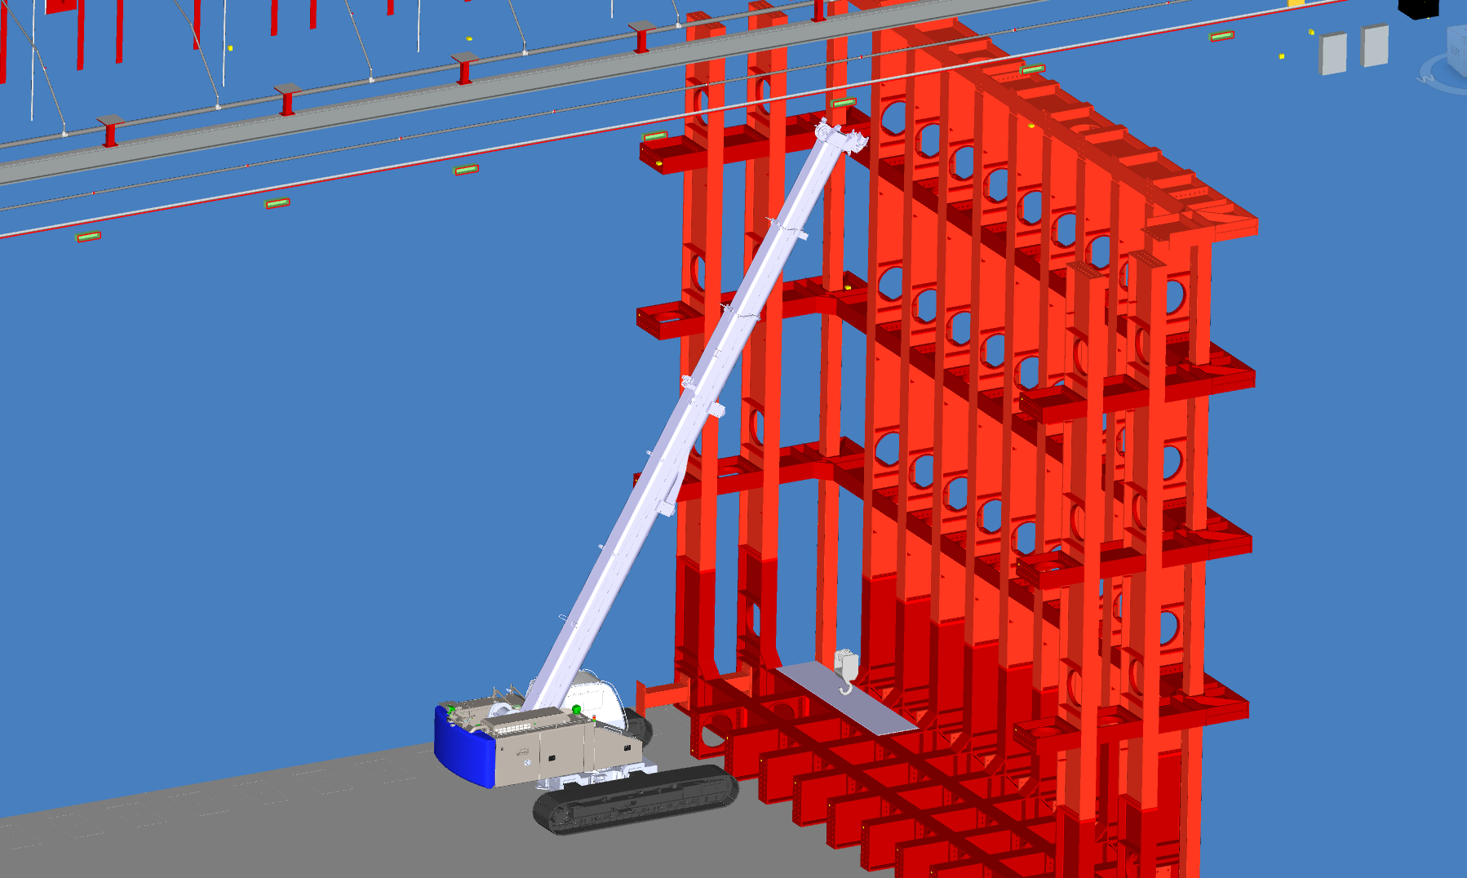
Last Week(s)
Railing Base Analysis
Received feedback from CO
Working through revisions to analysis
Changed materials of the tube section of the base to allow for higher stresses
Waiting on clarification from CO on bolt analysis
Cavern Material Handling
Working through various material movements through caverns
Checking load charts, movement paths, and physical clearances to rock

