Slide 1
FD1/FD2 Installation Engineering Update
Nicholas Joniak
01/07/2025

Slide 2
Engineering Updates
Procurement Status:
  Upcoming:
    See updates.
  Existing:
    No update.
FD2 TCO:
  Analysis Plans submitted to compliance office for review:
    TCO Hoist Beam.
  Engineering Notes submitted for review:
    TCO Platform.
      2D drawings in progress.
      Installation plan and floor design finalization required.

Slide 3
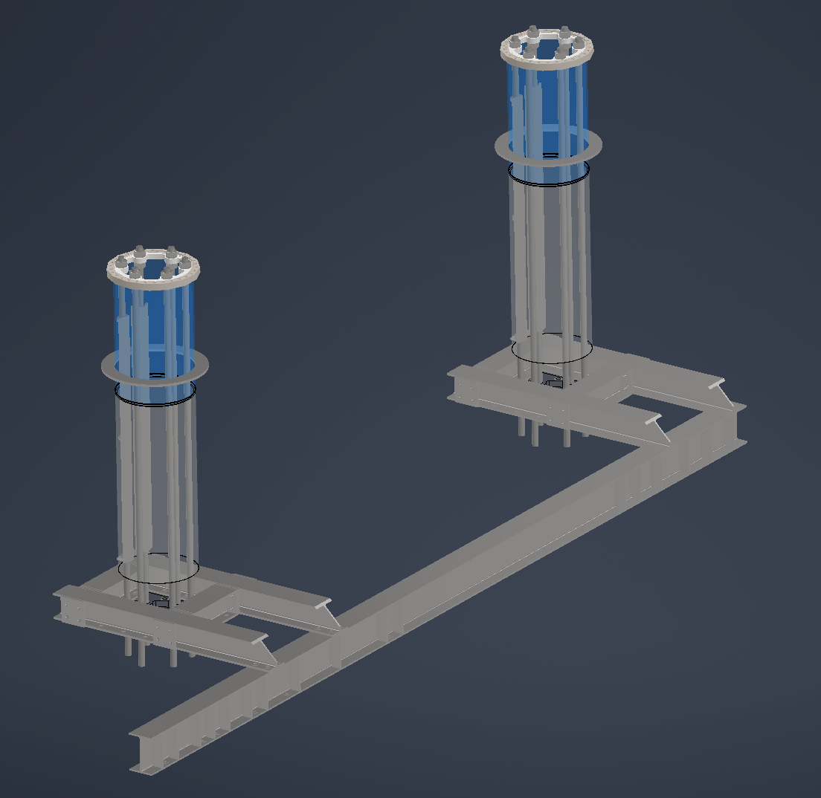
Engineering Updates
Vertical Drift – BDE Cable Tray Support
  Simplified design with only thread rod supports.
  Full model simulation (ambient) presents results with reasonable stresses, deflections, and buckling safety factors.
    Buckling concerns addressed with compression supports on select support rods.
  Thermal simulations to be completed.
    TCO platform analysis and holidays delayed this.
  BDE has concerns about cable fitment but might just need some readjustment of strain relief plate layout.
Is this enough to continue pursuing further?
  Or is alternate concept required?

Slide 4
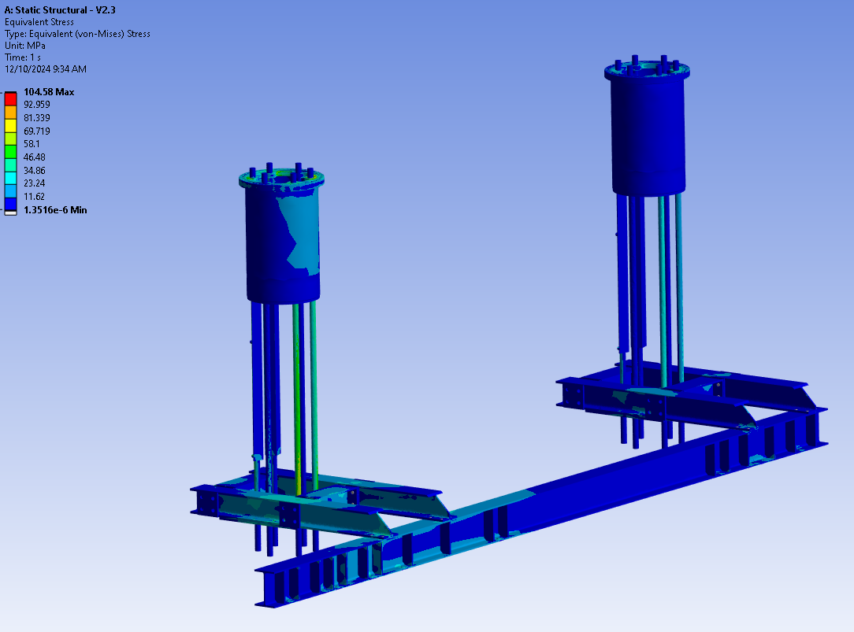
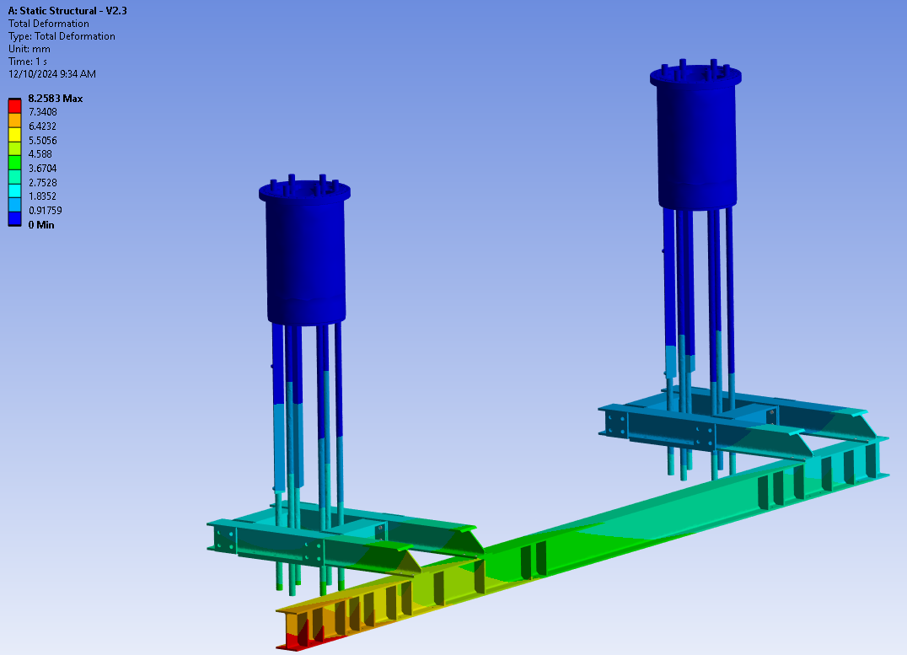
Engineering Updates

Slide 5
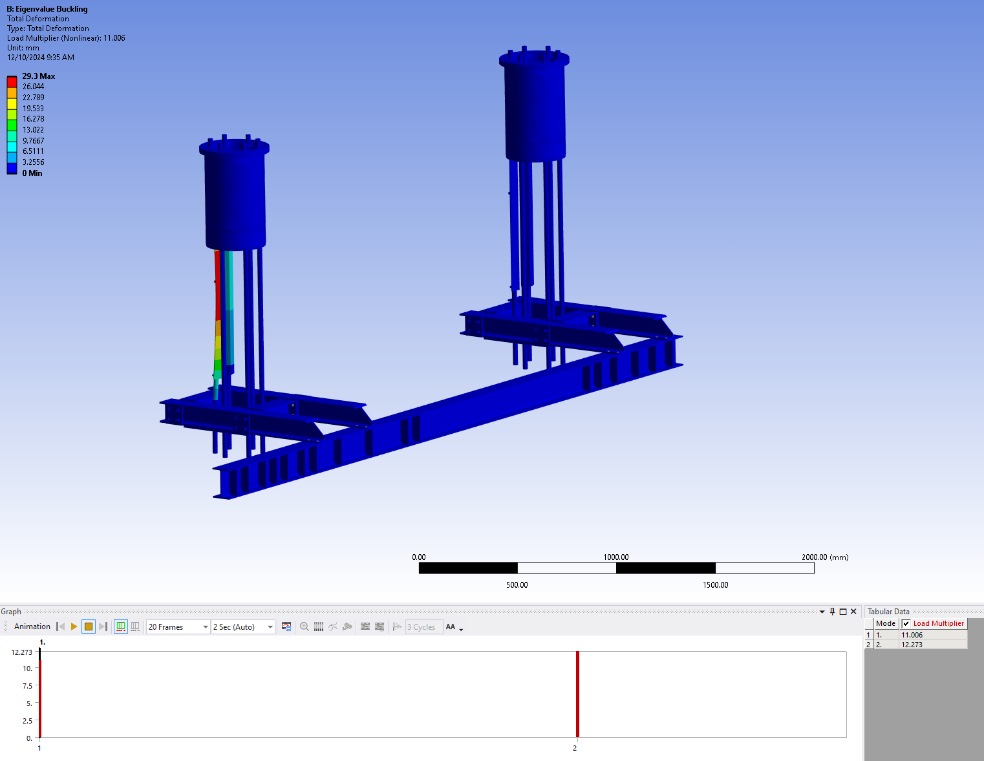
Engineering Updates

Slide 6
Next SURF Meeting
Confirmation of next engineering meeting?
  Potential partial conflict if week of March 24th – but this can be handled offline.

