Slide 1
FD2 Cryostat False Floor
https://edms.cern.ch/project/CERN-0000252173
Status
Layout updated to allow for early access to membrane walls at start of installation.
Analysis plan and engineering note to be completed.
Includes revision of pedestals to accommodate increased loads.
Tech Spec. | 0000252207 | FDR Requirements | mm/dd/yy
3D Model | 0000252237 | Empty | mm/dd/yy
Eng. Analysis | 0000252267 | Empty | mm/dd/yy
CO Report | 0000252300 | Empty | mm/dd/yy
2D Drawings | 0000252330 | Empty | mm/dd/yy
Schedule Contact | 0000252390 | Empty | mm/dd/yy
Install Procedure | 0000252420 | Empty | mm/dd/yy
Install the temporary floor inside the South Cavern cryostat
27-Jan-27
Store/Move 120d - 4mo
Fabrication
180d – 6mo
Procurement plan
Low bid contract.
Pedestals and ESD painted plywood are separate contracts.
Procurement
120d – 4mo
Latest “Submit to Procurement”
03-December-25
PRR Target: September 2025

Slide 2
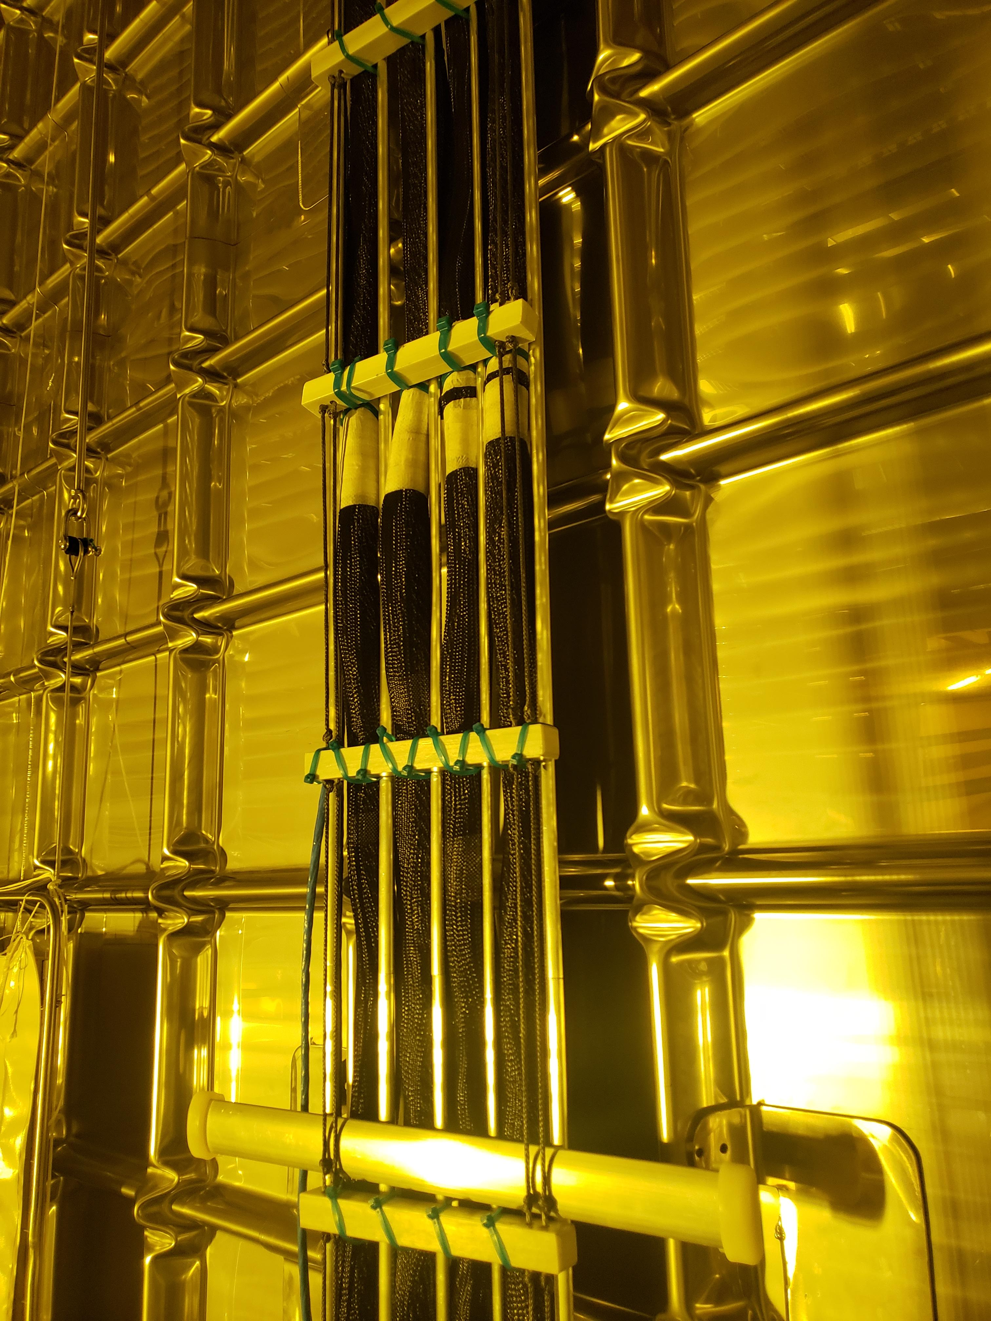
FD2 Internal Cable Trays and Supports
https://edms.cern.ch/project/CERN-0000252191
Status
VE has started. Alternate roof support concept is developed but needs roof penetration work to complete.
Also requires collaboration with Cryostat team to ensure applied loads are acceptable.
Drawings will need updated after VE is complete.
Cable test at CSU is planned.
Tech Spec. | 0000252222 | Old Spec FDR | mm/dd/yy
3D Model | 0000252252 | Old Model FDR | mm/dd/yy
Eng. Analysis | 0000252283 | Old E-note FDR | mm/dd/yy
CO Report | 0000252315 | FDR report | mm/dd/yy
2D Drawings | 0000252345 | FDR drawings | mm/dd/yy
Schedule Contact | 0000252405 | Empty | mm/dd/yy
Install Procedure | 0000252435 | Empty | mm/dd/yy
T4 MS - Begin VD Detector Clean Cryostat, Install Cables, & PD Membranes
23-April-27
Store/Move 120d - 4mo
Fabrication start date to be verified: Needs to tie to BDE cable fabrication.
Fabrication
180d – 6mo
Procurement plan
Fabrication of parts.
Assembly at CSU (or location of cable fabrication).
Procurement
180d – 6mo
Latest “Submit to Procurement”
29-December-25
PRR Target: March 2025 (?)

Slide 3
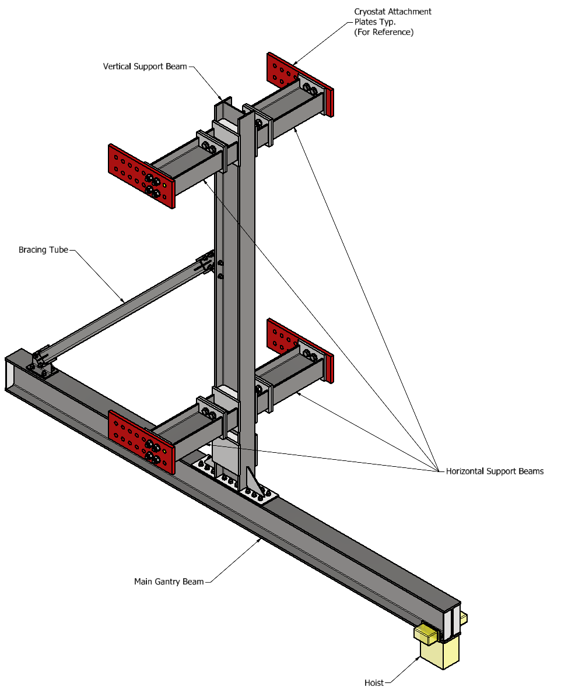
FD2 TCO Hoisting
https://edms.cern.ch/project/CERN-0000252172
Status
Revised analysis plan submitted – revised engineering note asap.
Drawings to be updated.
Lift plan and supplemental installation engineering note to follow.
Tech Spec. | 0000252206 | Old Spec FDR | mm/dd/yy
3D Model | 0000252236 | Old Model FDR | mm/dd/yy
Eng. Analysis | 0000252266 | Old E-note FDR | mm/dd/yy
CO Report | 0000252299 | FDR report | mm/dd/yy
2D Drawings | 0000252329 | FDR drawings | mm/dd/yy
Schedule Contact | 0000252389 | Empty | mm/dd/yy
Install Procedure | 0000252419 | Empty | mm/dd/yy
Install the TCO beam and the corresponding crane for the South Cavern cryostat
27-Feb-26
Store/Move 120d - 4mo
Fabrication
90d – 3mo
Procurement plan
Fabrication of TCO beam parts.
Hoist procurement.
Procurement
180d – 6mo
Latest “Submit to Procurement”
02-February-25
Original PRR Target: December/Early January 2025 – Late February Realistic
Procurement early/mid March

Slide 4
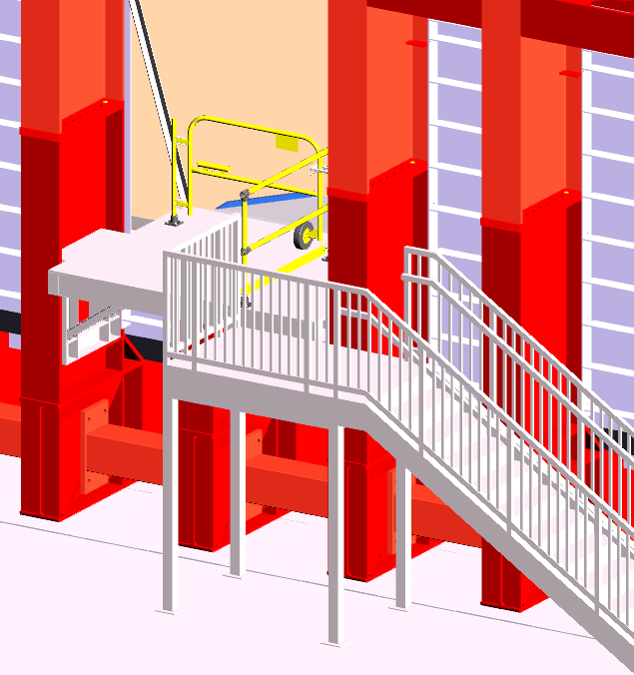
FD2 TCO Hoisting and Entry w/ Stairs
https://edms.cern.ch/project/CERN-0000251905
Status
Engineering Note submitted.
Tech Spec. | 0000251910 | In Progress | mm/dd/yy
3D Model | 0000251917 | Current | 01/07/25
Eng. Analysis | 0000251925 | Current | 01/07/25
CO Report | 0000252132 | - | mm/dd/yy
2D Drawings | 0000252141 | In Progress | 01/07/25
Schedule Contact | 0000252158 | - | mm/dd/yy
Install Procedure | 0000252166 | - | mm/dd/yy
Install the TCO beam and the corresponding crane for the South Cavern cryostat
27-Feb-26
Store/Move 120d - 4mo
Fabrication
90d – 3mo
Procurement plan
Fabrication of TCO platform parts.
Procurement
180d – 6mo
Latest “Submit to Procurement”
02-February-25
Original PRR Target: December/Early January 2025 – Early/Mid February Realistic
Procurement early March

