Slide 1
48 Hour Summary
Patrick Dowdle
MCR Crew Chief
January 8th, 2025

Slide 2
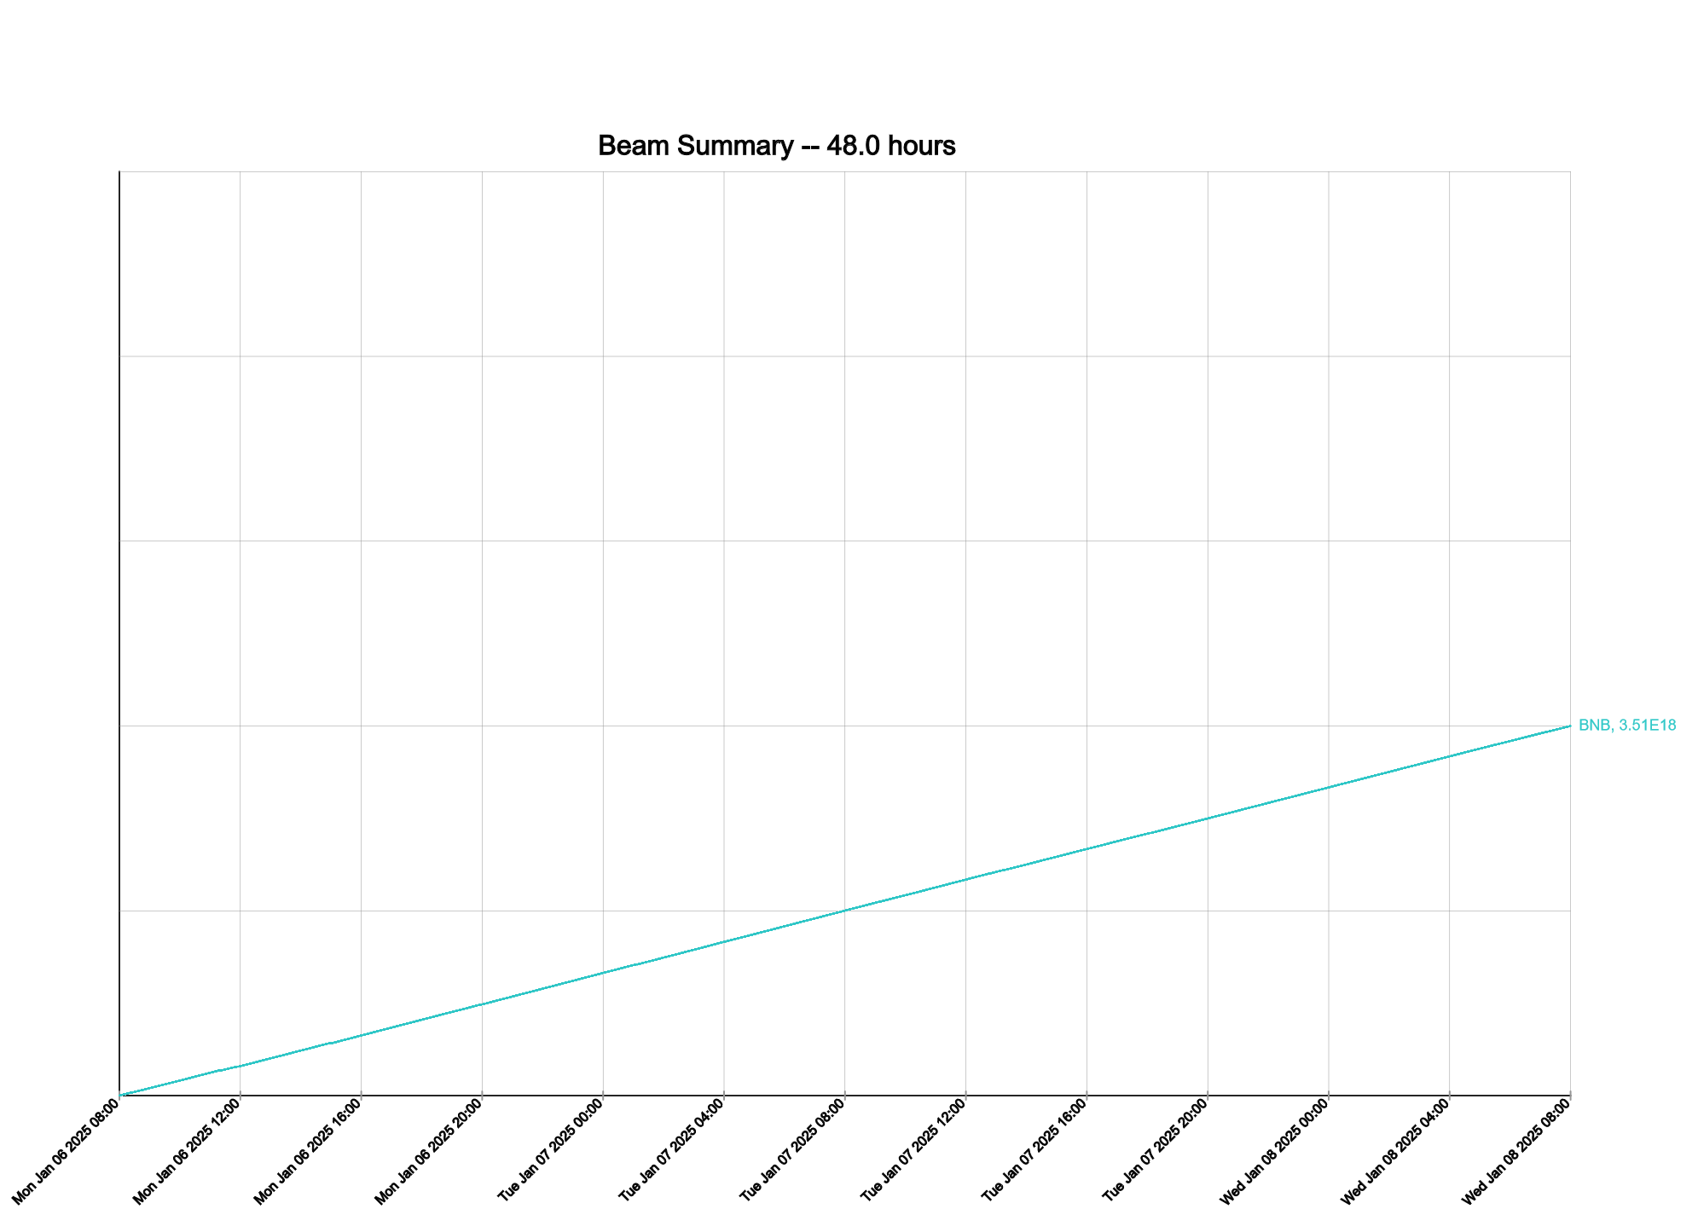
Summary
Since Monday
  LOTO unlocked Muon campus, turning on supplies
  Tuning up beam to BNB
  Debuncher trip on PFN fault
Current Conditions
  Beam to BNB

