Slide 1
Long-term Stability Measurement Between Synchronized Nodes
Md Shariful Islam (ANL)
Andrew Cameron(FermiLab)
Ji Liu (ANL)

Slide 2
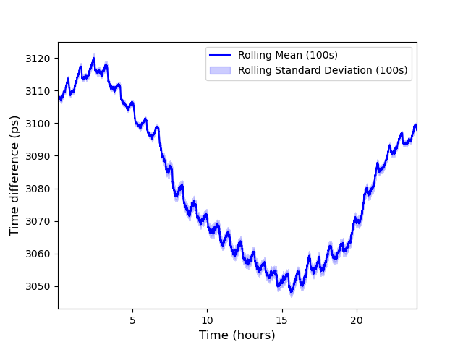
Long Term Stability Measurement Between FCC and Dzero

Slide 3
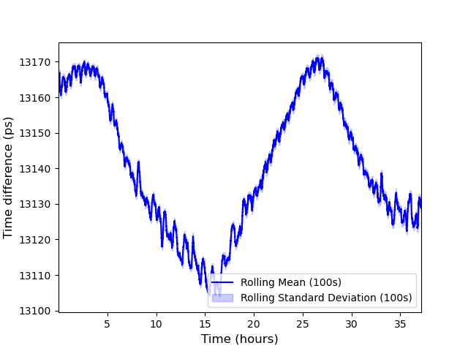
Long Term Stability Measurement Between FCC and Dzero

Slide 4
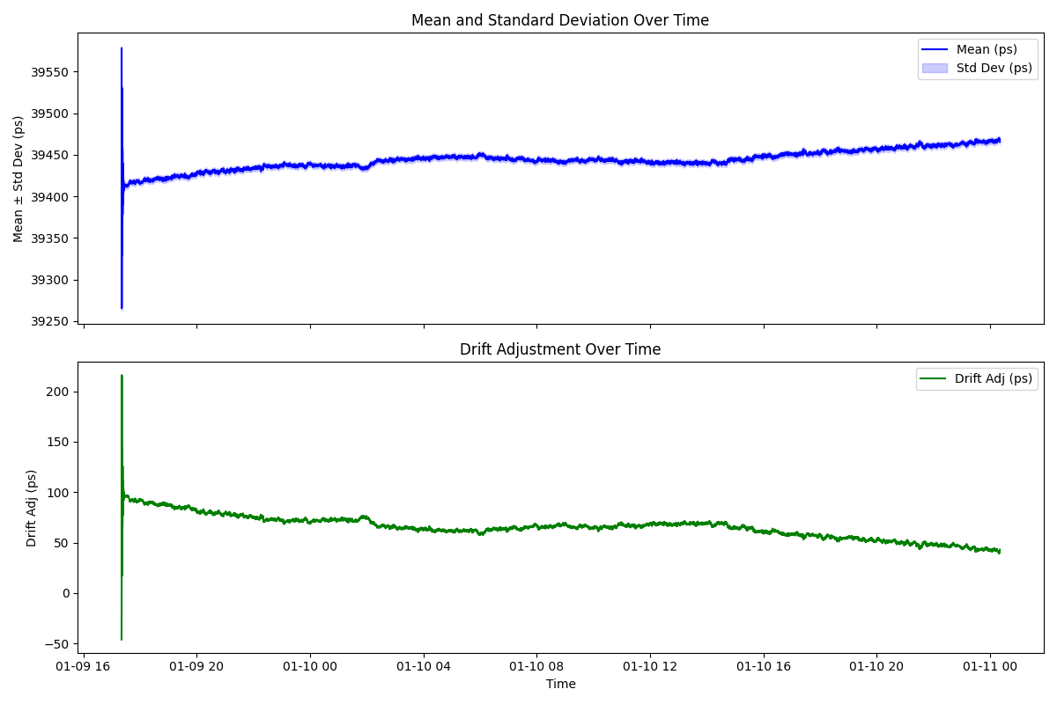
Long Term Stability Between FCC and Dzero (Drift Adjustment)

Slide 5
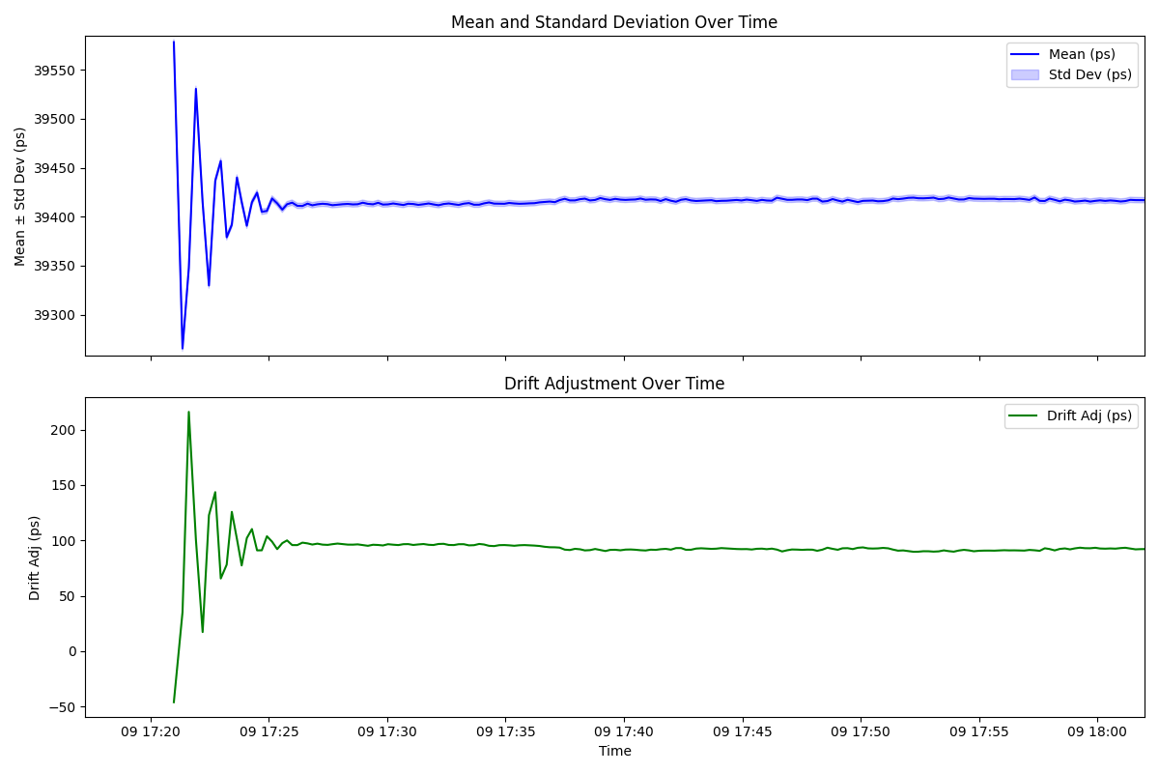
Long Term Stability Between FCC and Dzero (Drift Adjustment)

Slide 6
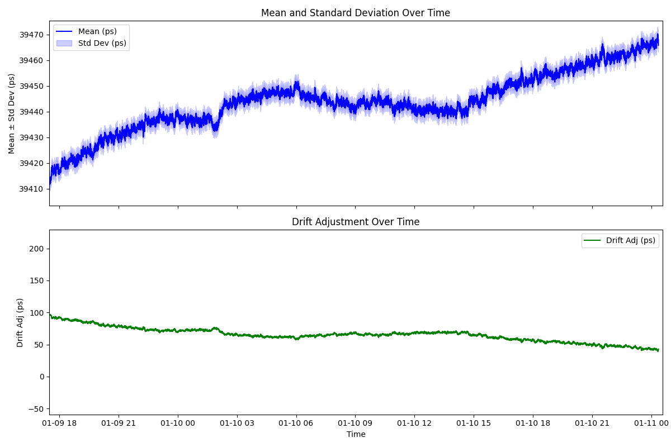
Long Term Stability Between FCC and Dzero (Drift Adjustment)

