Slide 1
FBK IV analysis and first measurements M. Andreotti, R. Calabrese, D. Casazza, A. Cotta Ramusino, S. Chiozzi, R. D’amico, M. Fiorini, T. Giammaria, M. Guarise, E. Luppi, I. Neri, L. Pierini, L. Tomassetti
DUNE photo-sensor meeting
14/01/2025

Slide 2
Last update (12/11/2024)
Analysis of data from FBK HD pre-production
Differences with CACTUS typical data
Results and conclusions
Link to slides
https://indico.fnal.gov/event/66999/contributions/303448/attachments/183172/251722/DUNE_meeting_Tommaso_Giammaria_12_11_2024.pdf

Slide 3
Last update - General info
Aim compare the IV characterization methods
CACTUS : Normalized First Derivative (NFD) → $\frac{d}{dV}(ln⁡(I))$
Vendor : 2nd logarithmic derivative (SLD) → $\frac{d^{2}}{{dV}^{2}}(\ln\left(I\right))$
Samples (HD pre-production)
100 SiPM strips
FBK model
Received from FBK:
IV Data
Results of NFD and SLD analyses
SiPMs (December)

Slide 4
Last update - General info
IV curve types (room T)
Packaging IV:
Strip (or single SiPM ?) level
Large V_{step}: 50 mV (CACTUS: 20 mV)
Parametric IV, also called Wafer Level (WL) IV:
WL → same temperature for all the SiPMs → more stable
Larger V_{step}: 100 mV (!!)
Task: analyze IV Data with the CACTUS algorithm, then compare the results with the ones provided by FBK
NFD/SLD analyses
Packaging/Parametric IV type

Slide 5
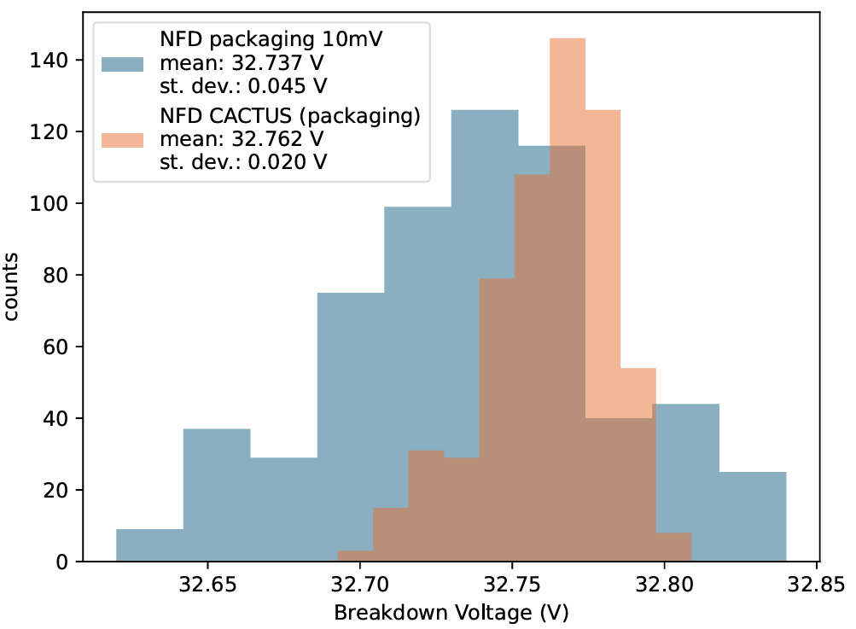
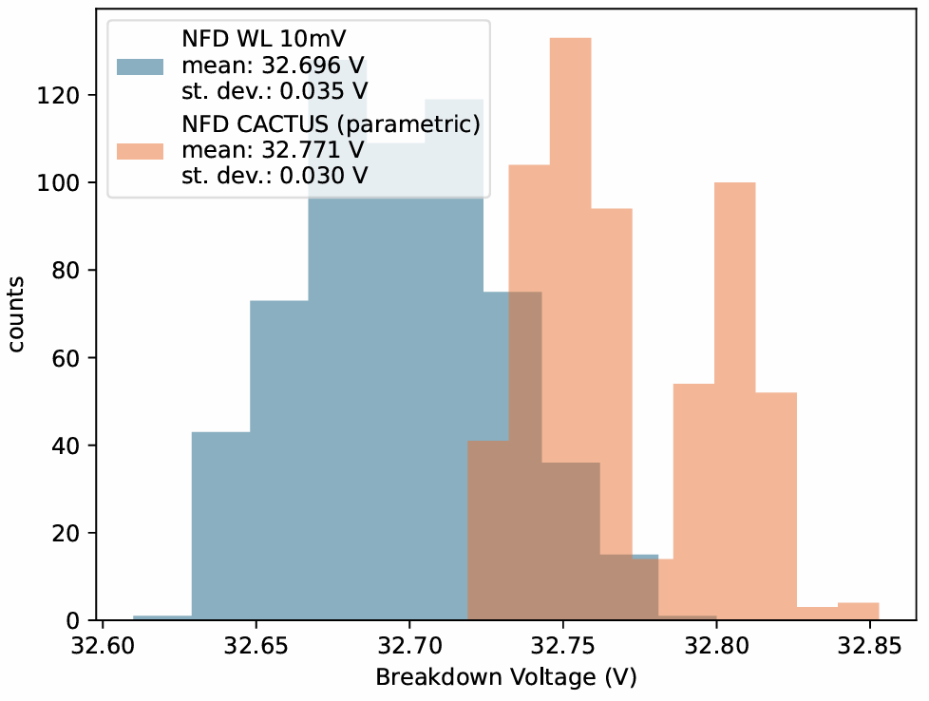
Last update – Results - NFD
Packaging
Parametric

Slide 6
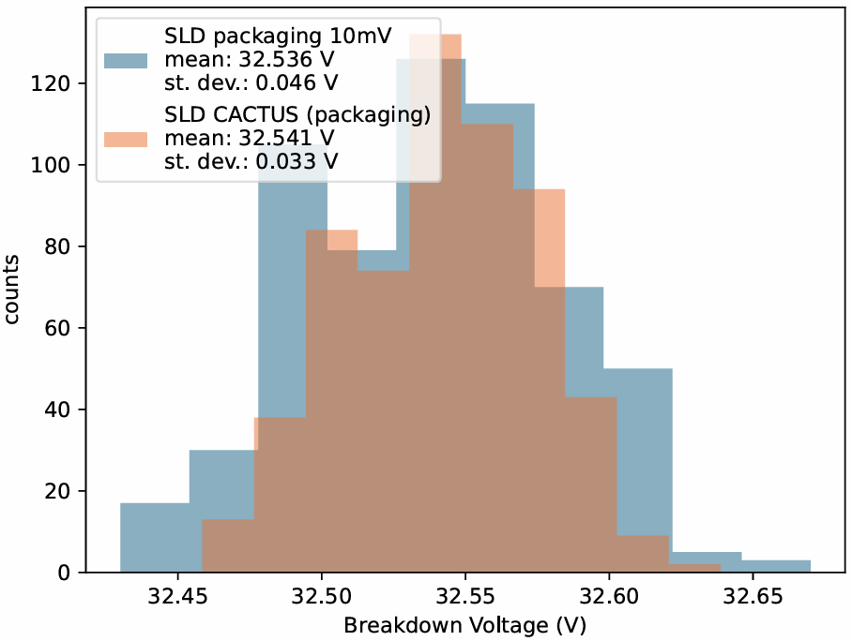
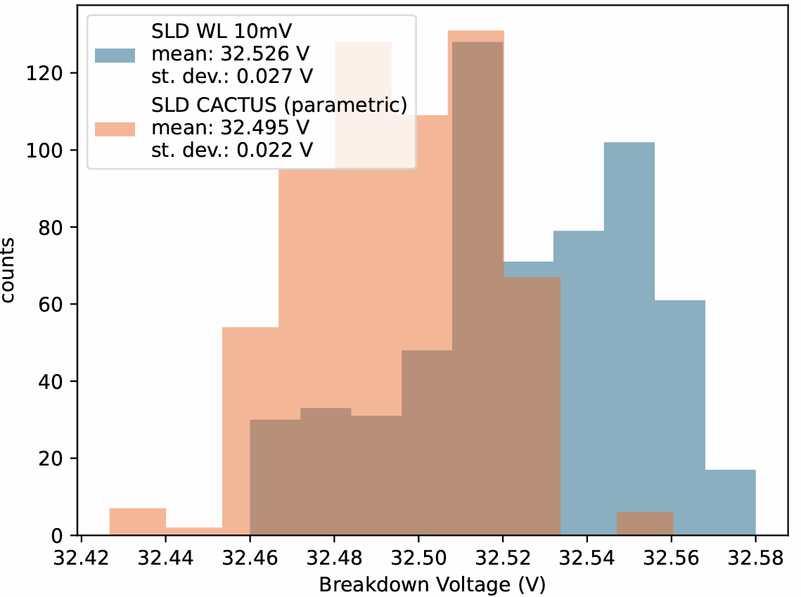
Last update – Results - SLD
Packaging
Parametric

Slide 7
Last update – Conclusions
Comparison of CACTUS/FBK analyses on the same data set
Parametric (wafer level) IV (100 mV step)
Packaging IV (50 mV step)
Need a finer resolution for grouping SiPMs
waiting for data with higher resolution* from FBK
*50 mV step and 10 mV step

Slide 8
What’s new?
Strips arrived @Fe on December
Started first Tray (S0001, IV @RoomT)
Some differences w.r.t. HPK samples
Geometric mismatch issue: solved but lost 2 SiPMs
Uploaded some data to DB
Currently working on automatization

Slide 9
New - Measurements
Started tests with CACTUS (roomT only, no LN₂ until tomorrow)
1st test in December 2024 (Tray S0001) ➡ OK
Standby period
Re-calibration of amplification cards and correction factor
2nd test (S0001) last week to check instrumentation ➡ OK
Some differences w.r.t. HPK strips in (following slides)

Slide 10
New – FBK/HPK differences
Differences between FBK and HPK samples:
Different strip geometry (next slide)
Char in Tray name (S000X), how many strips per tray??
Each strip contains 2 QR codes, which one to use? And how?
Back:
SMB05825-FBK3T-07/24
Front: 55825

Slide 11
New – issue in mounting procedure
SiPMs detached from the first two strips (one each) due to geometric mismatch with the mounting tool
Solution: change mounting tool

Slide 12
New - Database
Tested the new script to upload data on HWDB
Uploaded data:
Delivery: I04, Box: 11, Batch: Fer13, Trays: 40, 41, 43, 44, 46, 47
Currently working to automatize upload procedure with LabVIEW:
Configuration and/or upload procedure will change?
How to check a whole tray in DB?
Additional info besides xlsx tables needed for the upload?
Next step: implement as SubVI for the CACTUS main interface

Slide 13
Conclusions
Comparison of IV data analysis with FBK
Started measurements (Tray S0001, RoomT)
Started uploading data on DB
QUESTIONS
Database:
Procedure will change
How to check a whole tray?
Non-xlsx info?
Measurements
N strips per tray?
Front/back QR?
Trim QR?

Slide 14
BACKUP

Slide 15
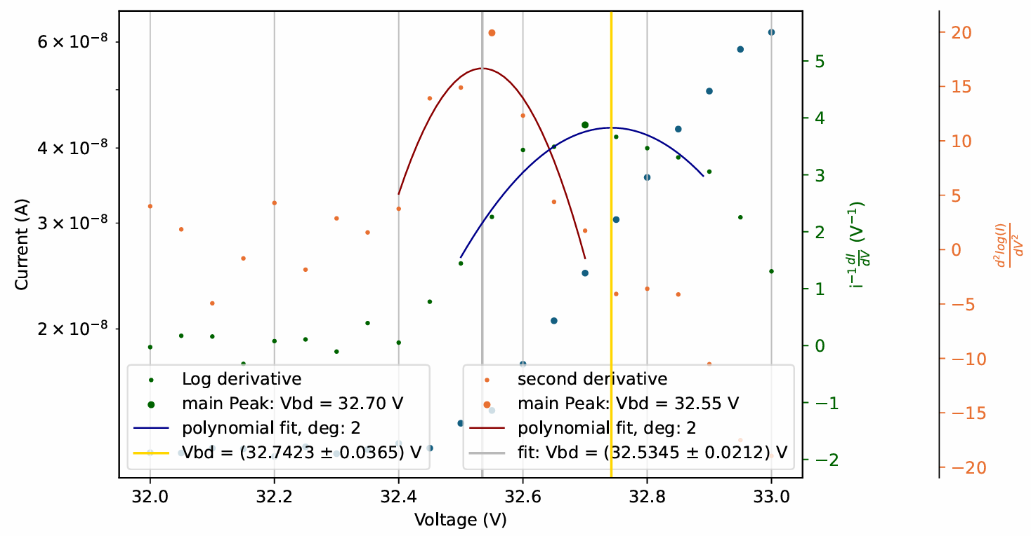
Single IV curve – packaging
SLD
NFD

Slide 16
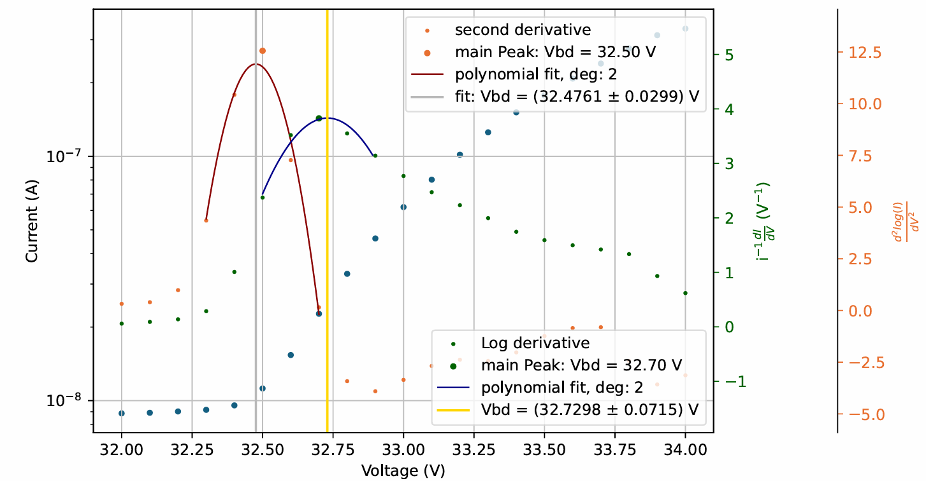
Single IV curve – parametric (or WL)
SLD
NFD

Slide 17
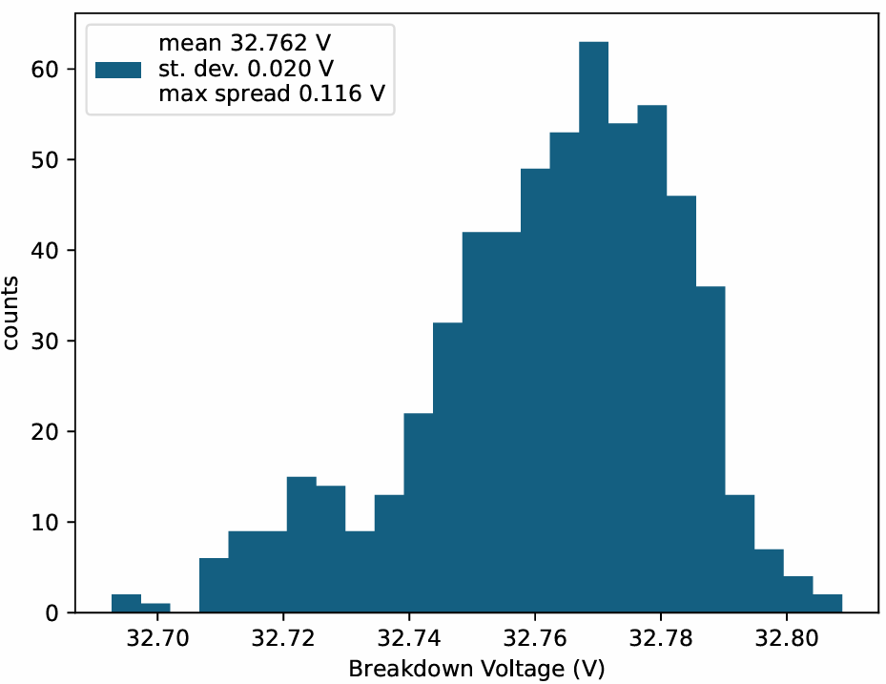
Results – V_{BD} distribution
IV curve type
Packaging IV
Parametric IV
Method
NFD
SLD

Slide 18
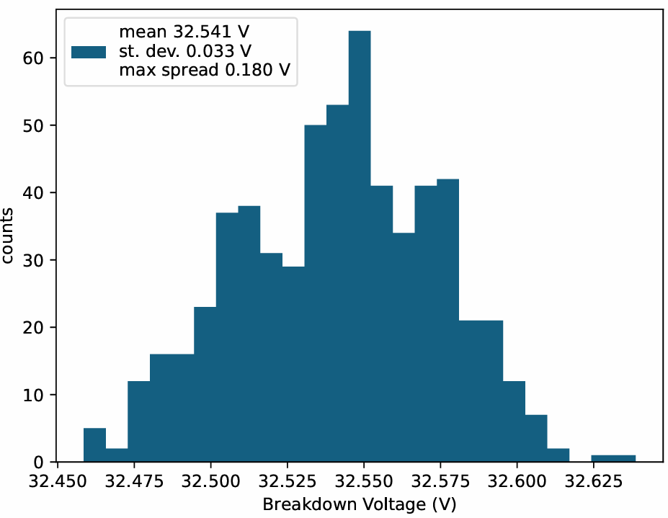
Results – V_{BD} distribution
IV curve type
Packaging IV
Parametric IV
Method
NFD
SLD

Slide 19
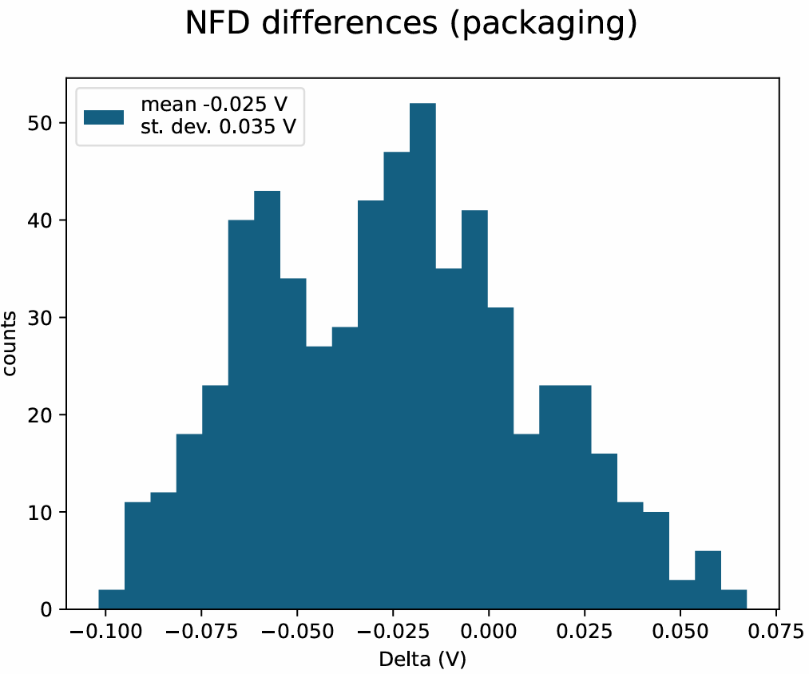
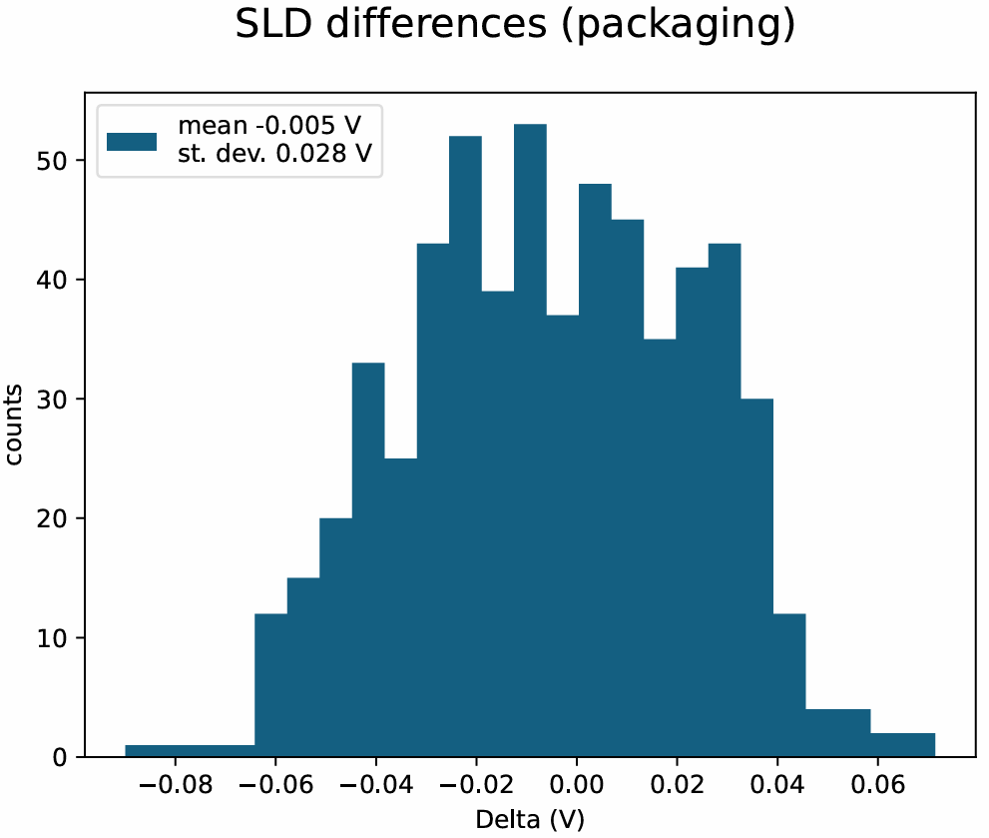
Results – V_{BD} distribution – packaging - differences

Slide 20
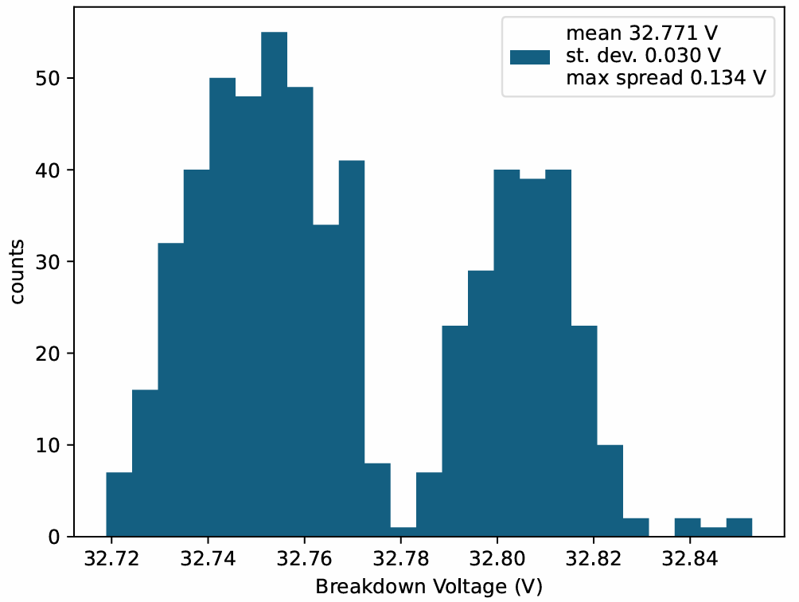
Results – V_{BD} distribution
IV curve type
Packaging IV
Parametric IV
Method
NFD
SLD

Slide 21
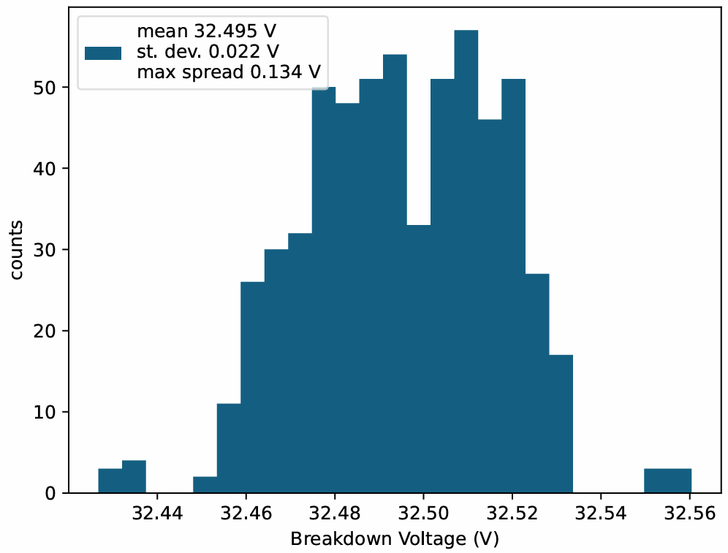
Results – V_{BD} distribution
IV curve type
Packaging IV
Parametric IV
Method
NFD
SLD

Slide 22
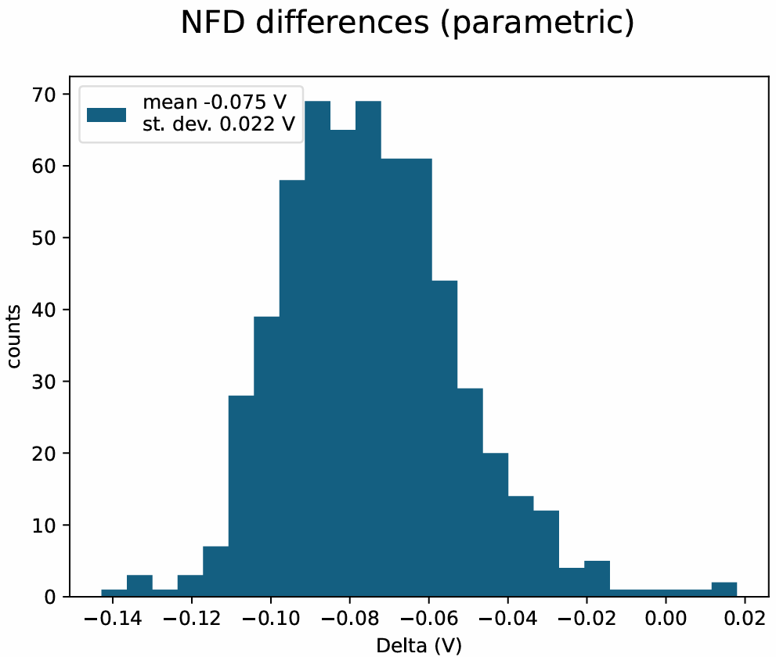
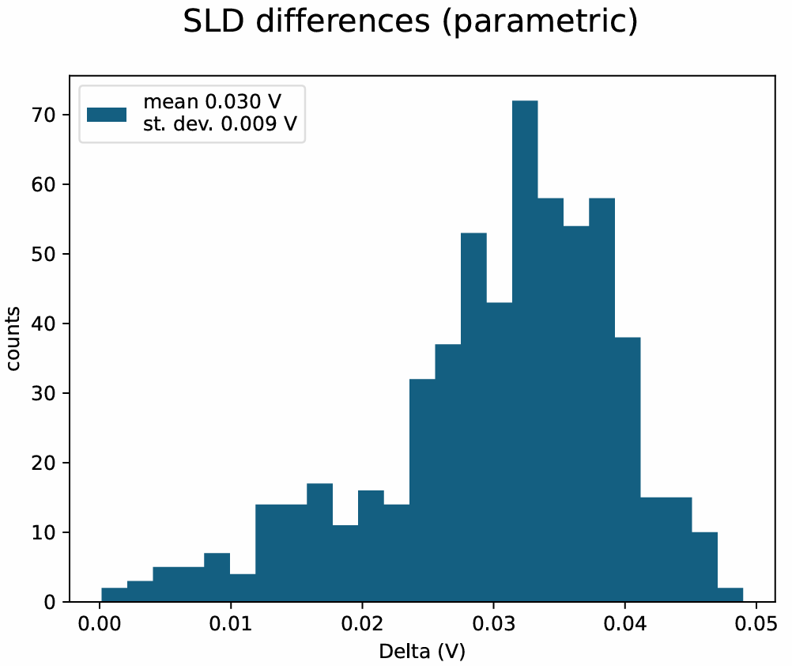
Results – V_{BD} distribution – parametric - differences

Slide 23
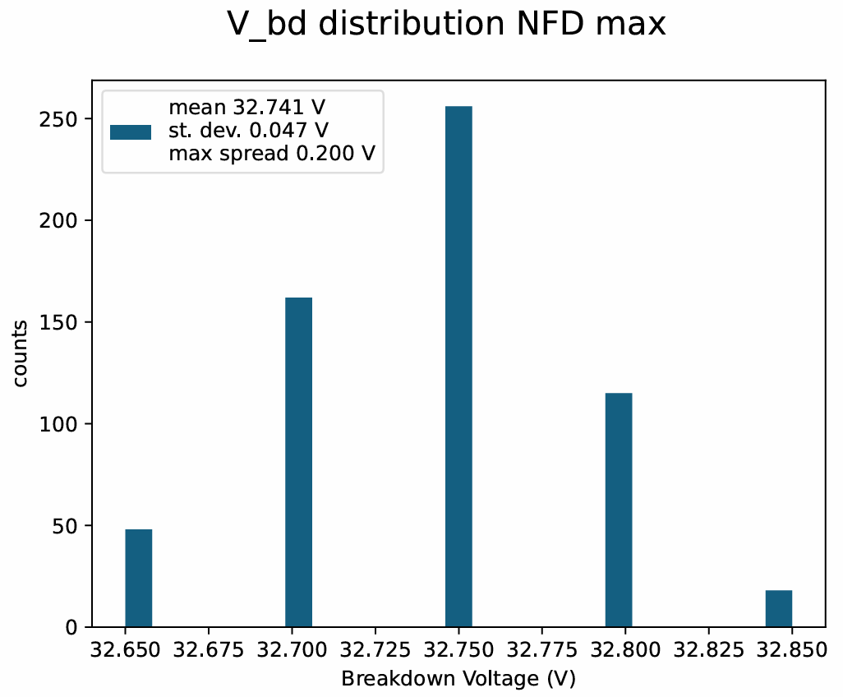
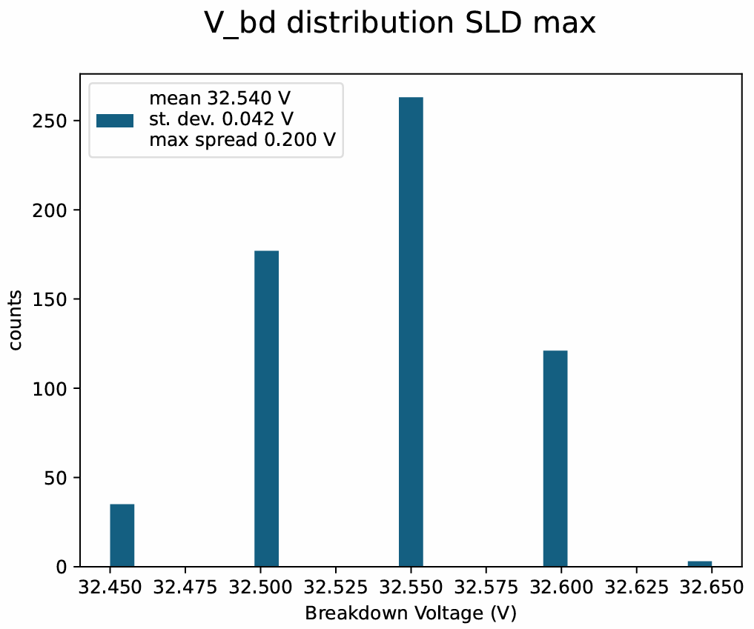
Results – V_{BD} distribution - packaging – max

Slide 24
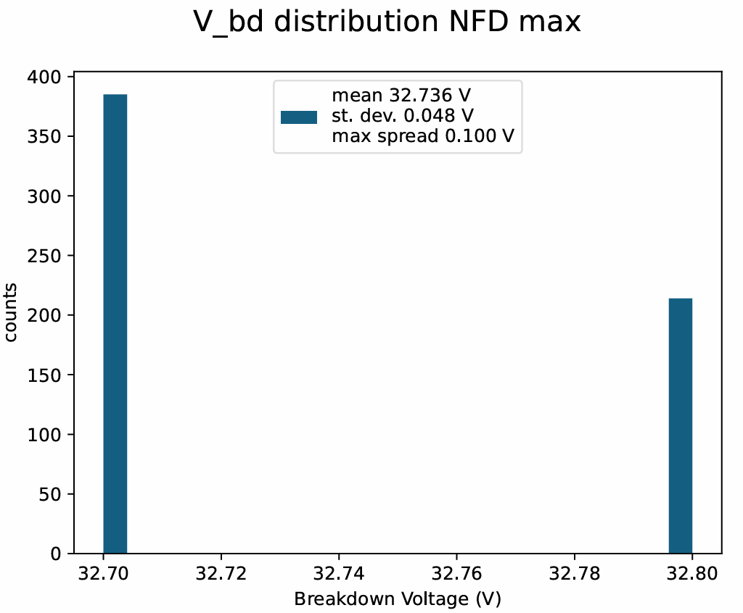
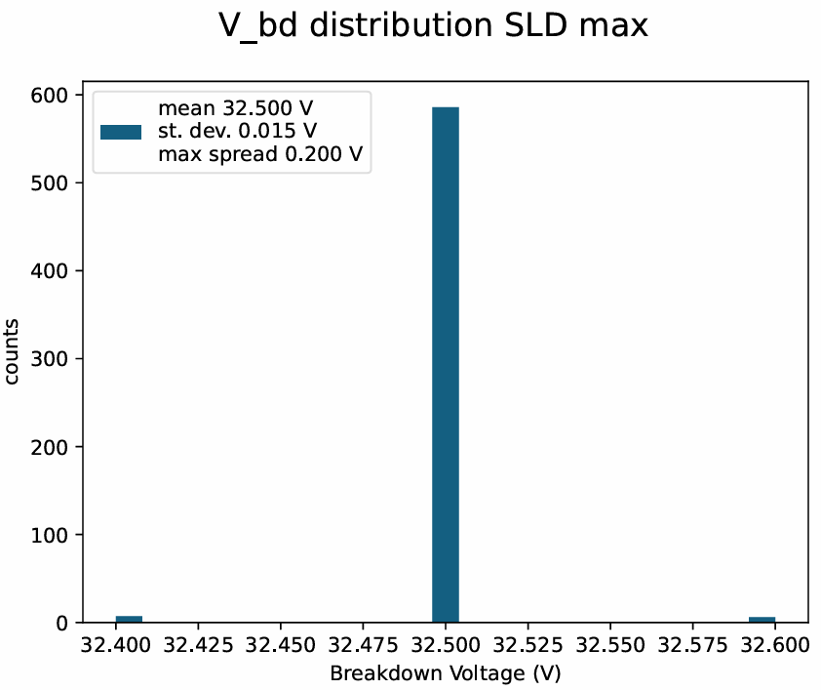
Results – V_{BD} distribution - parametric – max

Slide 25
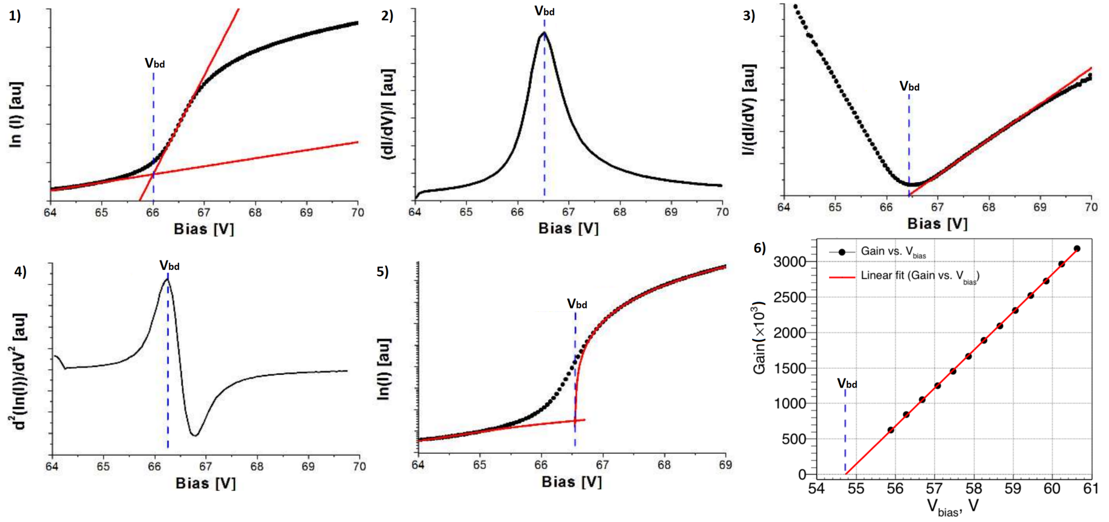
Reverse IV analysis methods
CACTUS
FBK

Slide 26
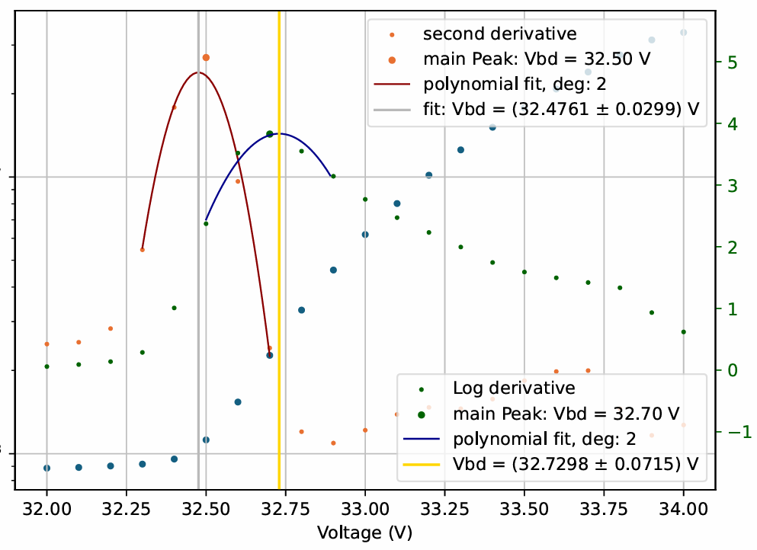
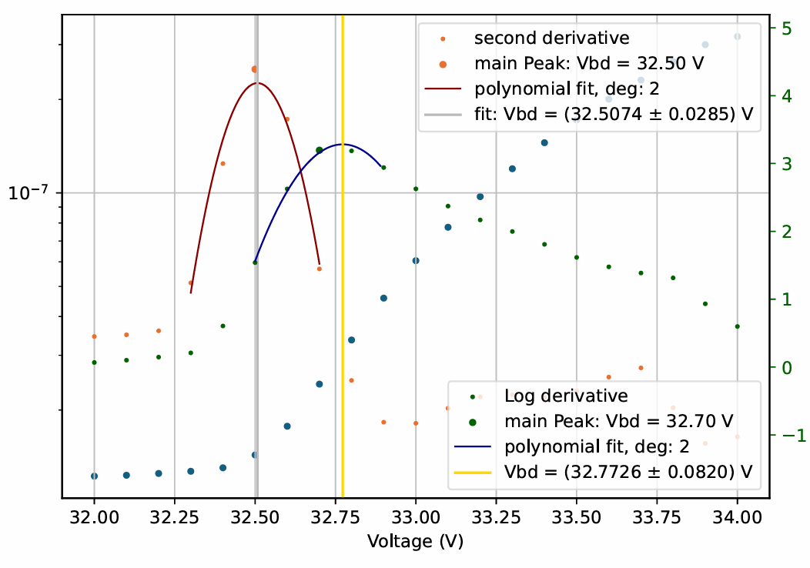
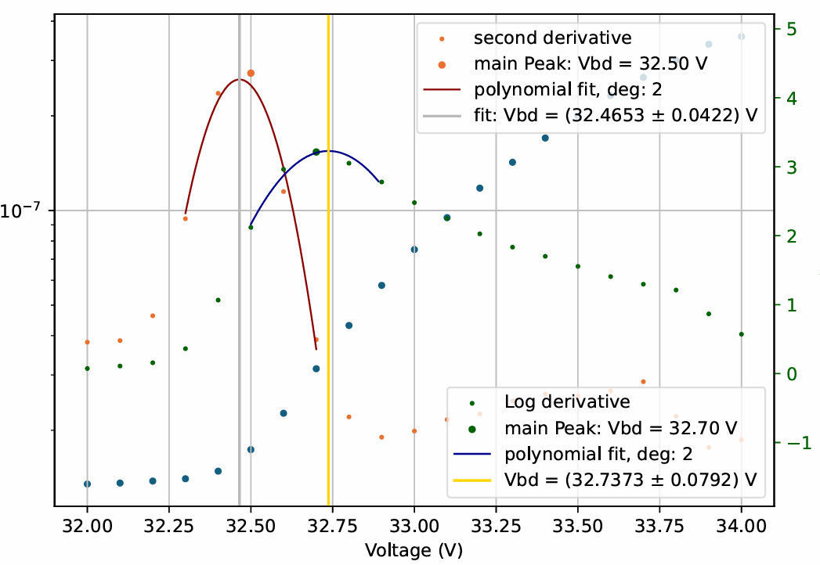
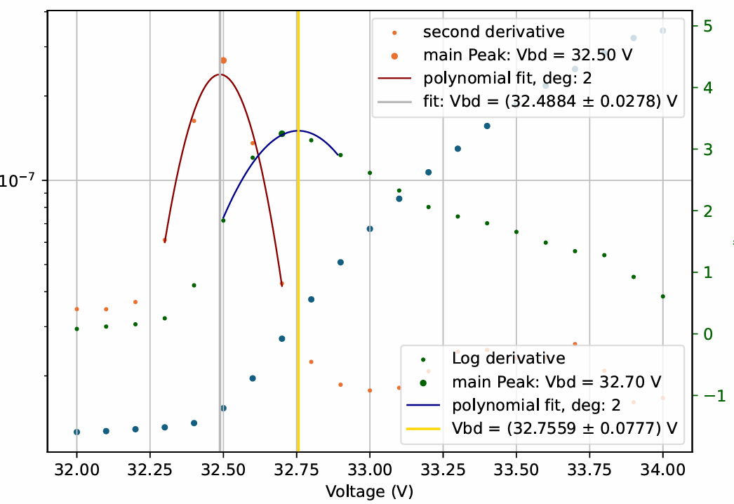
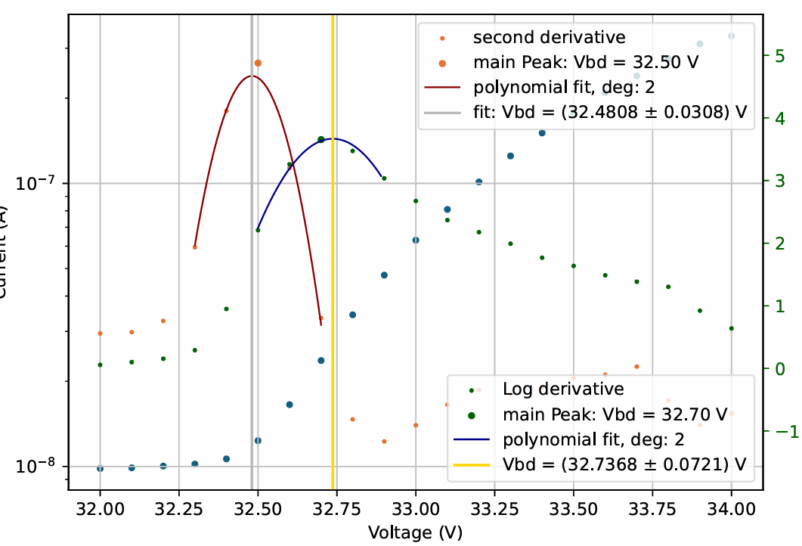
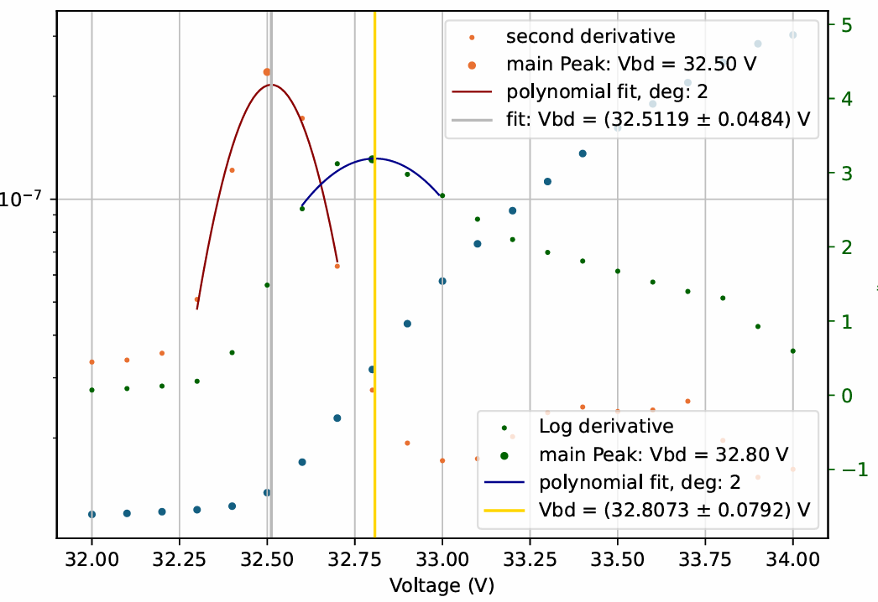
100 mV step, SLD maximum

