Slide 1
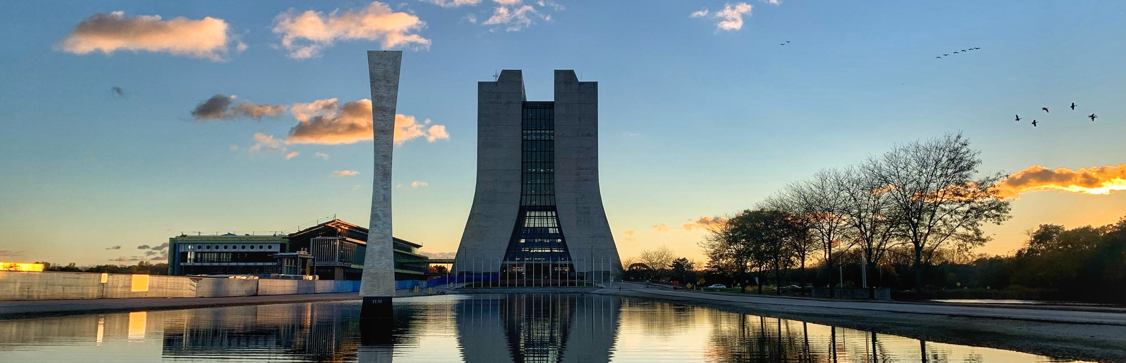
Accelerator Operations
Power Reconfig for PIPII work
Cons Gattuso
1

Slide 2
Feeder Re-Configuration
FDR 94/95 will stay deenergized, but the feeder leg F3 and the F4 service building will be disconnected and isolated.
FDR46A (A0 Compress Bld. N2 to MC 1 &2) cable is faulted A0 to KRS and will stay de-energized. Power to A0 Cryo compressors will stay energized and fed from MSS.
FDR 21/22-1,2,3 will stay energized as they are available for your testing until back feed is shutdown for the PIP2 work (projected to be Jan 28th ).
  Given the off normal power configuration and the limited backfeed options that we currently have ANY power outages in this area will be to be Approved/Reviewed by ISD/AD/PIPII
Outage times for the MCR on Tuesday January 14th 2025
0800 – 0830 Muon Campus Feeder manipulations
  FDR24 – Will switch to from MSS to KRS feed (back feed on FDR 53).
    Outage to FDR-24 MUON CAMPUS Mu2e area, AP0, AP10, AP30, AP50, F27, MC1, MC2
0830 – 1030 FDR45 Main Ring Convectional Feeder and FDR 94/95 Pulse power
  Will switch / unbolt / boot / tie back cable on the downstream side F3 service building and the Upstream side of F4 service building.
    This will keep F3 service building powered but disconnect the leg that goes to F4
    Outage to service building conventional power ALL MR service buildings. Which includes A0 service building E4R service building
1030 – 1200 – FDR46B AC power to old TEV compressor room in F0 - Will switch / unbolt / boot / tie back cable in F0 transformer.
1330 – 1400 – FDR 48 F0 RF Power– will switch from MSS to KRS. RF power to F0 service building.
    Outage to transformer Y-RF2 at F0.
This power distribution re-configuration will only result in one power outage being take the PIP installation work that crosses the Main Ring Road.

Slide 3
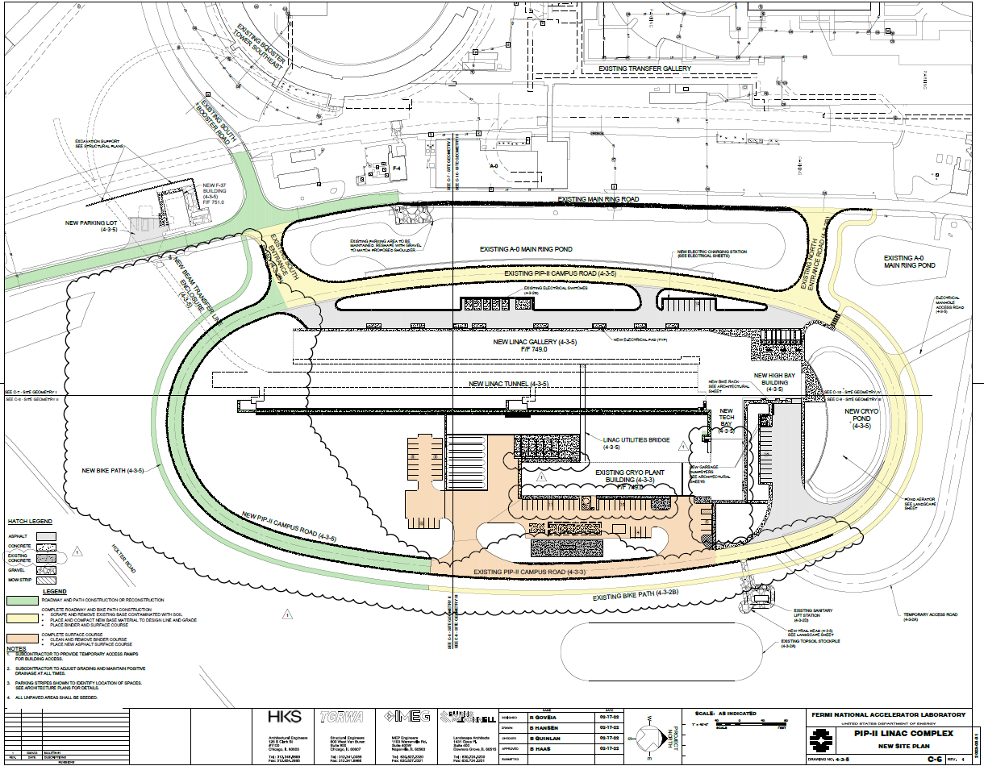
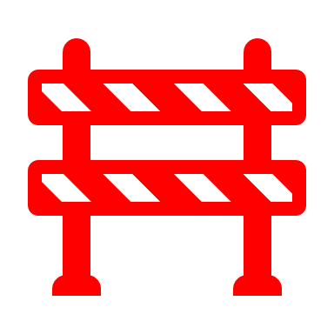
PIPII work
Impact to Accelerator Operations
  Communication Path
    Plan on install a temporary “19” conductor path that is not impacted by construction
  Power outage
    Develop a safe power configuration
    Minimize the number total power outage and areas impacted
    Keep open future power configurations
    Communicating to the world
Courtesy: Alcaraz | Booster Connection | PIP-II 2024 DOE Independent Project Review 17-Apr-2024
3

Slide 4
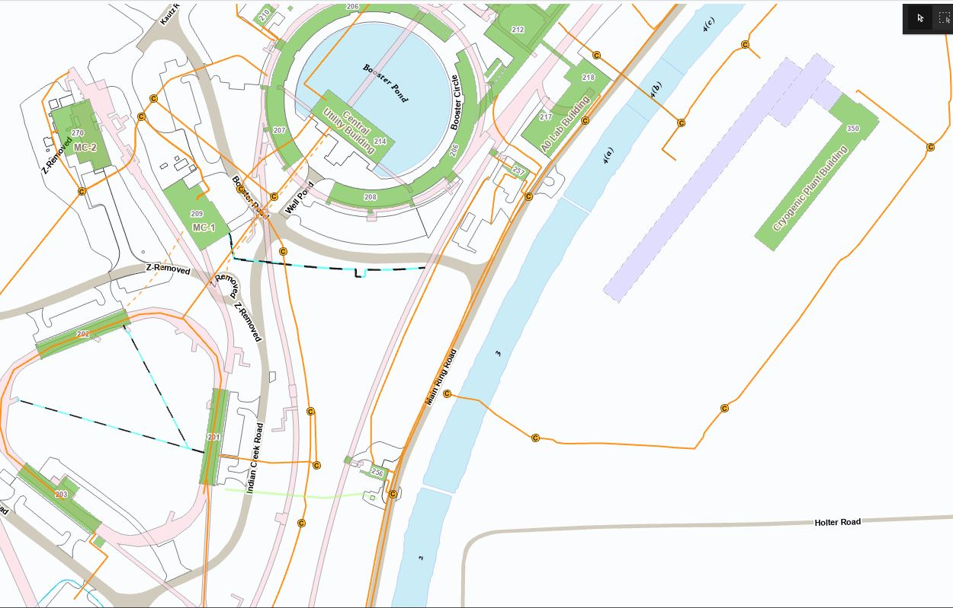
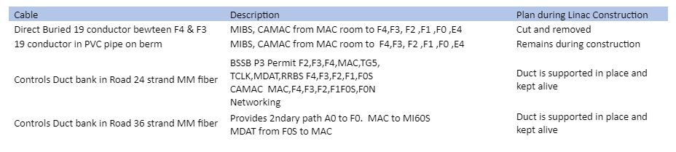
  Communication Path Plan
MR road will be reinstalled 7 – 11 months from Jan 2025.
PLAN:
MR road controls duct will remain intact and be physically supported by contractor during excavation. Controls will remain alive.
Direct Buried 19 conductor will be excavated and supported by the same power duct bank superstructure.
A new 36 MM fiber will be pulled in the Tevatron tunnel from F4 to F3 to serve as a backup for controls - will remain until F-sector break through to install new beamline.
New 36 MM fiber pulled in tunnel as controls backup
Direct buried 19 Conductor – CAMAC, MIBS (previously damaged)
Repaired 19 Conductor PVC pipe near berm.
MR road Controls duct – 24 & 36 strand MM fiber – P3 permit, TCLK, CAMAC, Networking and Power Duct bank.
Linac Construction Zone

Slide 5
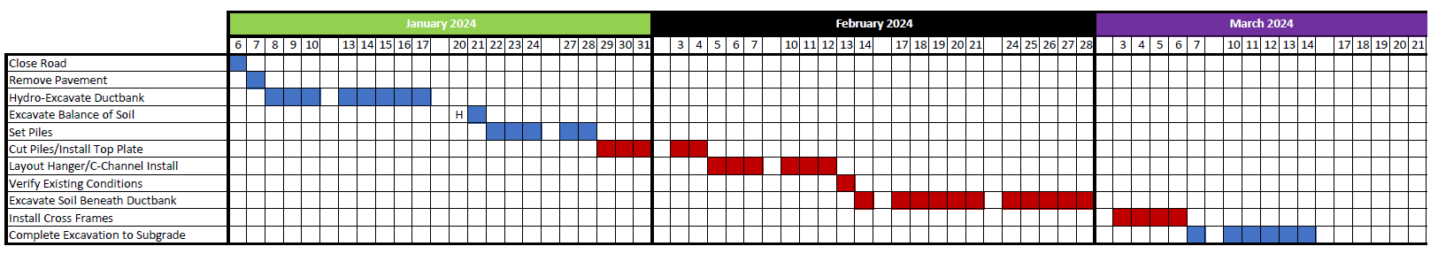
Subcontractor’s Current Schedule Plan
(Courtesy : Steve Dixon)
F4
Today
Potential impacted areas for power outages: (original plan had daily power outages for 7 weeks.)
  A0 Building
  A0 Compressor Building
  All of F sector (potentially all Tevatron service buildings)
  E4R
  AP0
  AP10
  AP30
  AP50
  Mu2e Building (MC-2)
  MC-1
  It is believed this work will not impact beam to BNB
Feeder Alley would need to be de-energized for support structure installation
Feeder Alley
5

Slide 6
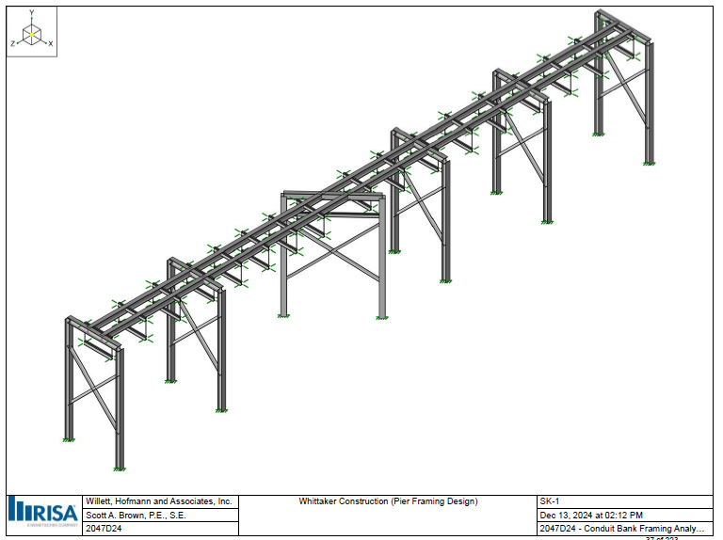
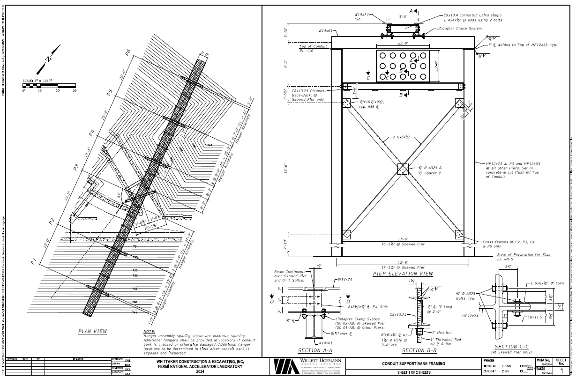
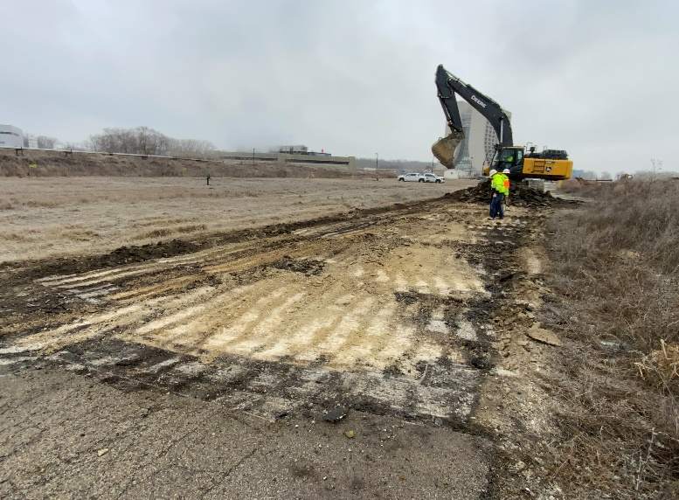

Slide 7
Feeder Re-Configuration
FDR 94/95 will stay deenergized, but the feeder leg F3 and the F4 service building will be disconnected and isolated.
FDR46A (A0 Compress Bld. N2 to MC 1 &2) cable is faulted A0 to KRS and will stay de-energized. Power to A0 Cryo compressors will stay energized and fed from MSS.
FDR 21/22-1,2,3 will stay energized as they are available for your testing until back feed is shutdown for the PIP2 work (projected to be Jan 28th ).
  Given the off normal power configuration and the limited backfeed options that we currently have ANY power outages in this area will be to be Approved/Reviewed by ISD/AD/PIPII
Outage times for the MCR on Tuesday January 14th 2025
0800 – 0830 Muon Campus Feeder manipulations
  FDR24 – Will switch to from MSS to KRS feed (back feed on FDR 53).
    Outage to FDR-24 MUON CAMPUS Mu2e area, AP0, AP10, AP30, AP50, F23 & 27, MC1, MC2
0830 – 1030 FDR45 Main Ring Convectional Feeder and FDR 94/95 Pulse power
  Will switch / unbolt / boot / tie back cable on the downstream side F3 service building and the Upstream side of F4 service building.
    This will keep F3 service building powered but disconnect the leg that goes to F4
    Outage to service building conventional power ALL MR service buildings. Which includes A0 service building E4R service building
1030 – 1200 – FDR46B AC power to old TEV compressor room in F0 - Will switch / unbolt / boot / tie back cable in F0 transformer.
1330 – 1400 – FDR 48 F0 RF Power– will switch from MSS to KRS. RF power to F0 service building.
    Outage to transformer Y-RF2 at F0.
This power distribution re-configuration will only result in one power outage being take the PIP installation work that crosses the Main Ring Road.

