Slide 1
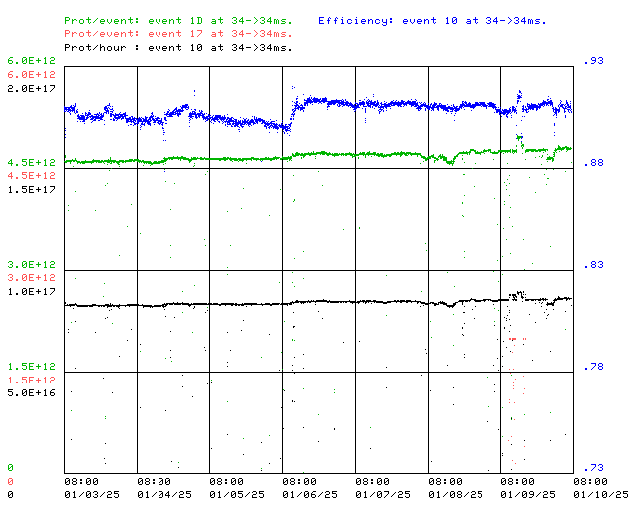
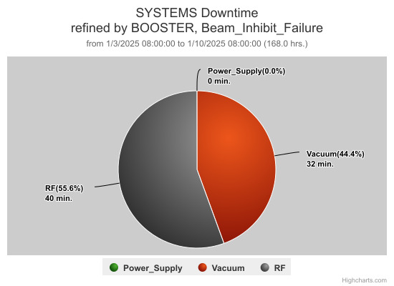
Booster Operations 01/03/25 – 01/10/25
F
F
Sa
Su
M
Tu
W
Th
F
Downtime:
~ 1hour 12 minutes
A few BRF trips, mostly BRF4, BRF11
Also several ion pump trips causing vacuum permit trips for some RF stations.
Debuncher changes
Also:
Seeing increased periodic argon-cycle kinds of activity, most with IPRF14, IPRF21, IPRF22, but other ion pumps seeing similar. Investigating.
RF folks got BRF11 back on for us, has been stable since.
Considerable debuncher phase and gradient changes needed for optimal running Monday.
377 card replaced in crate $B0.
Nice 8 Gev line tuning help, thanks Mike & Mike.
15Hz measurements & 20Hz upgrade effort at E4R continues.
Thanks to Ops for diligence & tuning on the off shifts
This week:
Booster running well. Good steady running all week.
Beam to BNB currently ~ 4.7E12/pulse @ 5Hz ~8.7E16 P/hr.
Intensity increased as Linac output as increased. Thanks to Linac folks for their good tuning and efforts.
Continuing to run on the new Digital LLRF
A couple of Booster Studies

Slide 2
Booster Dedicated/Parasitic Study Report:01/03/2025-01/10/2025
Booster Digital LLRF study (For PIP/PIP-II)
Participants: ECullerton
Goal: Improve the performance of the DLLRF by adding a 300kHz filter to the radial loop to reduce the RPOS oscillations after turned on.
Type of Study: Parasitic (a short interruption)
What has been done
Added a 300kHz filter to the radial loop to the current Booster DLLRF
Some beam data have been collected for off-line analysis.
Booster BPM Emittance Measurements (For PIP/PIP-II)
Participants: MBalcewicz
Goal: Testing the BPM emittance measurement code developed by Tan.
Type of Study: Parasitic
What has been done:
A new 6 turn baseline for 2025 was taken, and further measurements using this baseline were made at 6, 12, 14 turns.
.
Booster Beam loss vs 400 MeV Debuncher Cavity Settings (For PIP)
Participants: CBhat, SChaurize, KTriplett
Goal: Understand the Booster Beam loss at S07 vs 400 MeV Debuncher cavity phase (L:LDPADJ ) and gradient (L:LDGADJ) settings.
Type of Study: Parasitic & took ~1 hr
Why & What has been done
Over the time, ~40 deg shift in debuncher cavity phase from 129.6 deg → 92.6 deg and shift of gradient from 1.7 to 1.0 found to give lower beam loss in the Booster and improved efficiency as we started going up in beam intensity.
Keeping the C7 phase (L:L7PADJ) constant the debuncher phase and cavity gradient were changed. Some WCM and BPM data were collected for three different scenarios to see if data indicate any change in energy spread or beam energy. Analysis is in progress.
L:LDPADJ=129.6 deg and L:LDGADJ =1.7 (suggested value)
2) L:LDPADJ=92.5 deg and L:LDGADJ =1.0 3) L:LDPADJ=92.5 deg and L:LDGADJ =0.1
Above studies are in progress. As the analysis progresses results will be posted in the PS Study Sharepoint
https://fermipoint.fnal.gov/org/as/ad/hqsupport/PSStudy/Shared%20Documents/Forms/AllItems.aspx
Notes:
https://fermipoint.fnal.gov/org/as/ad/hqsupport/PSStudy/Shared%20Documents/Forms/AllItems.aspx

