Slide 1
Muon Campus Shutdown Report
Jim Morgan
Friday 09:00 Ops Meeting
January 10, 2025

Slide 2
Muon Campus status
Power supplies turned on Wednesday
LCW temperature has been high, forced to reduce power load
Several power supplies didn’t come on and were worked on
D:IB and associated supplies weren’t ready for turn-on yet
Checked out pulsed devices
D:QF power supply had internal water leak, repaired with assistance from TD
Pre-Vault and Pre-Target supplies couldn’t be tested with Feeders 94/95 off
Electrostatic Septa conditioning
Began December 27, generally progressing well
Both septa approaching target operational voltage
Limited work during holiday period
ESS motion-control modifications
Mu2e area M4 Line sump monitor installed
Mu2e safety system electrician work
Safety system testing
Unable to power M1 Line, CDC testing deferred until we can power Feeders 94/95
Small but manageable LCW leak rate of ~20 Gal/Day
AP-0 A/C work remains paused
Study – M1-M3 Optics
Study – Alternative M5 optics

Slide 3
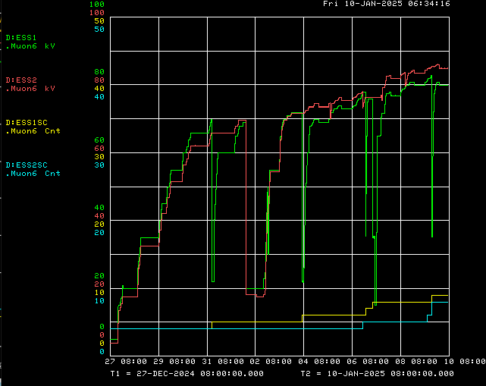
Electrostatic septa conditioning
Operational target voltage
ESS2 Voltage
Delivery Ring access
ESS1 Voltage
ESS2 Spark Counter
ESS1 Spark Counter

Slide 4
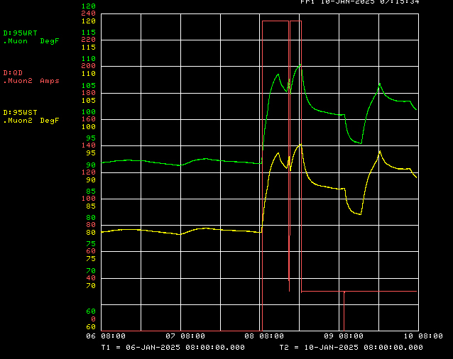
Muon LCW temperature after turn-on
D:QD power supply
Return temperature
Supply Temperature
Delivery Ring turn-on
Reduced heat load

Slide 5
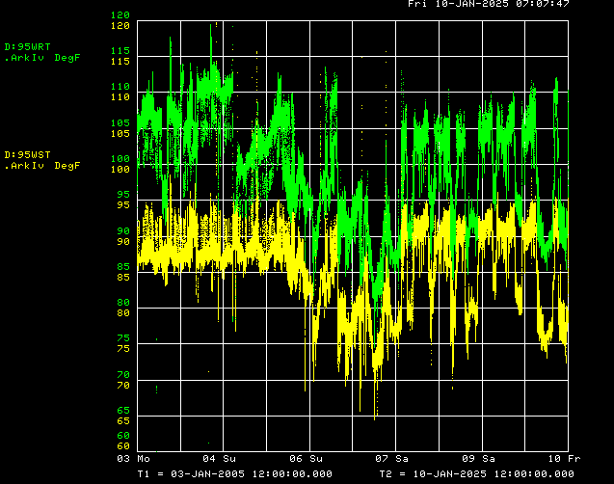
Pbar/Muon LCW temperature over the past 20 years
Return temperature
Supply Temperature
Pbar Operation
g-2 Operation

Slide 6
Upcoming work
Need more LCW cooling at CUB
Turn on D:IB and other power supplies that haven’t been turned on yet
Limited remaining tunnel work
Sump monitor for the Mu2e Detector Hall and Pre-Vault Enclosure
D:QSS shows a false high temperature indication, need to check Klixon wiring
A few remaining small LCW leaks
Finish ESS2 High Voltage Conditioning
Target operational voltage is 85.7 kV
Finish Critical Device Testing
Need Beamline Feeders 94/95 to be powered
Access into Transport, Delivery Ring and M4 Enclosures early next week
Beam Stop air pressure checks for safety system testing
Investigate false high temperature indication on D:QSS circuit
Preparing for beam operation
Work towards resolving remaining power supply problems
MI heat exchanger and Kautz Road transformer issues need to be resolved
Expect short power outage Tuesday to backfeed Muon Feeder 24 from MI
Expect PIP-II BTL construction will prevent Muon Campus beam for 6 weeks
Starting approximately January 29

