Slide 1
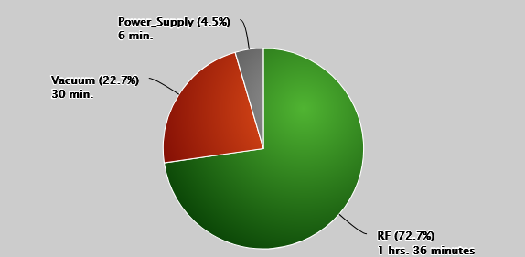
Linac/Preacc Operation (Jan 3 – Jan 10, 2024)
PREACC (0 min)
LINAC (2 hrs 12 min)
27 mA on D7TOR, 91% efficiency.
We have multiple opportunistic downtime requests!
Notable Events:
SCL Module 4 Vacuum Spikes
Troubleshooting Tank 5 Bulk Tuner Chiller Flow Readback
Debuncher & KRF2 PFN faults

Slide 2
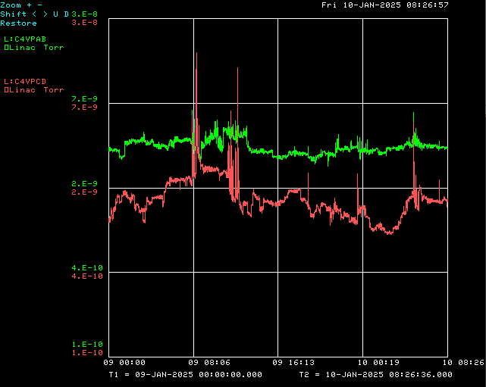
Module 4 Vacuum Spikes
Gradient drops out, reverse power & vacuum spike. Sparking? Vacuum leak?

