Slide 1
Mu2e report
Greg Rakness (FNAL)
Friday 9am AD meeting
10-Jan-2025
https://indico.fnal.gov/event/67712/

Slide 2
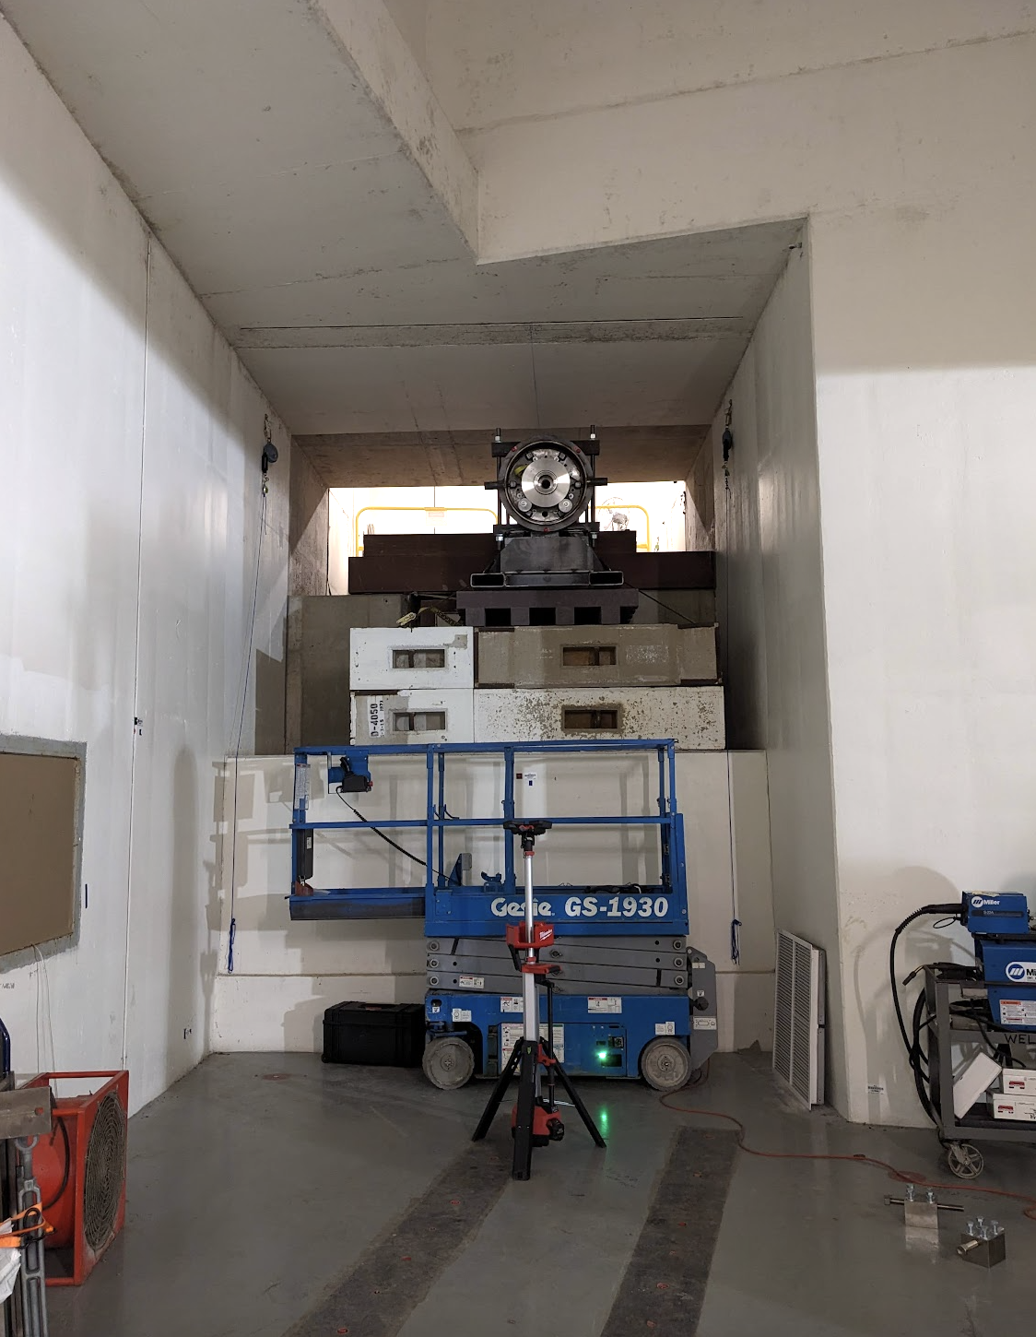
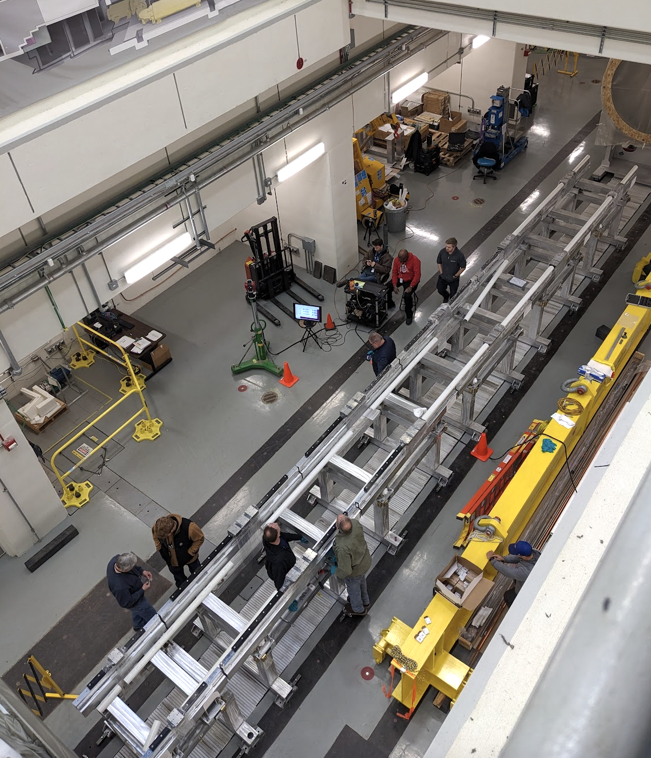
Some work at Mu2e (1 of 2)
Dan V and co hanging collimator in extinction monitor area
Jeff B working with alignment crew to determining shim pack configuration to set height of external rails

Slide 3
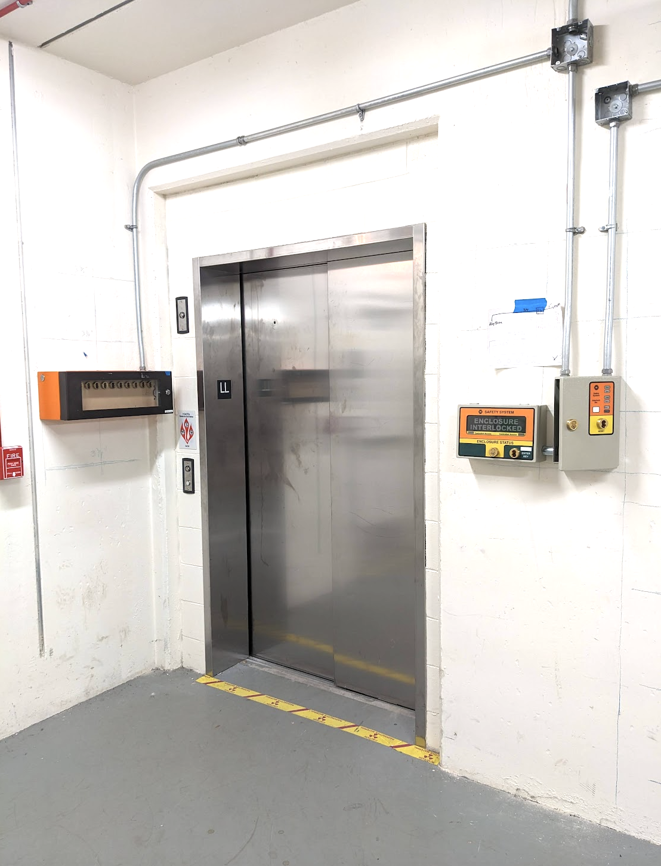
Some work at Mu2e (2 of 2)
Electricians continue working on safety enclosures
Love to see this stuff at Mu2e
Discussing details of sump level monitoring
Happily following in Jim’s footsteps
Thanks Denise for help w ACNET
Dump resistors at DAB: waiting for remaining hardware for mods
Leak testing full flow purifier @DAB

Slide 4
Incoming
Jan (hopefully): Replace Automatic Transfer Switch at MC1
To automatically switch to backup power for Mu2e cryo plant
Continue preparations to bring over Calorimeter and Tracker
Lots to do here
Ready for Feeder 24 → 53 switchover 14-Jan 08:00-08:30
… to accommodate PIP-II work

