Slide 1
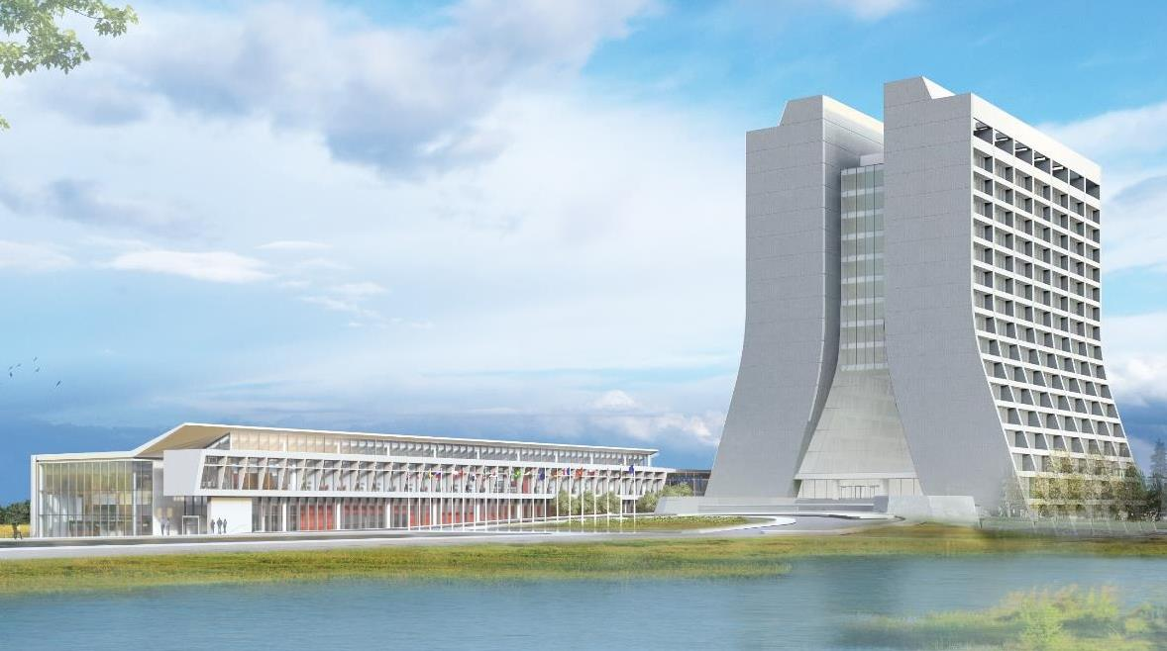
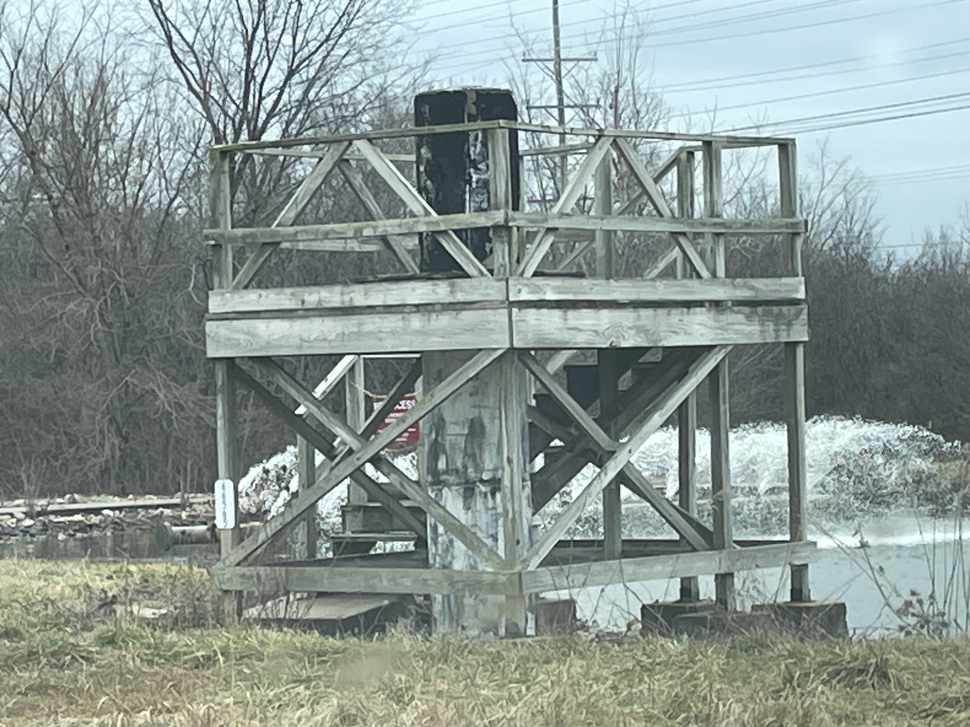
Infrastructure Services Division Updates
Pressing Issues / Special Topic: Worked with the Alignment group this week discussing the Monument structures
Repair planning is next, plus it’s a super cool history talking with the group.
Noteworthy Items: Power outage information link is full again, dates starting in July however there is quite a bit of PIPII disruptions coming.
Link: Power Outage Schedule

Slide 2
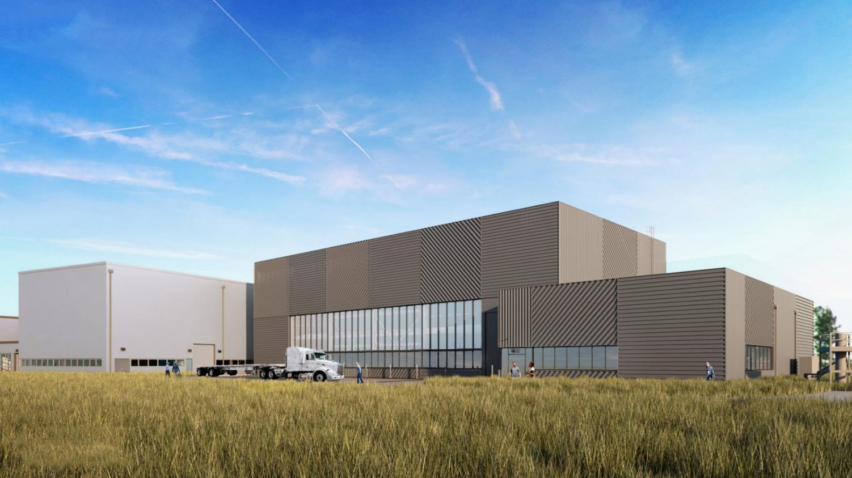
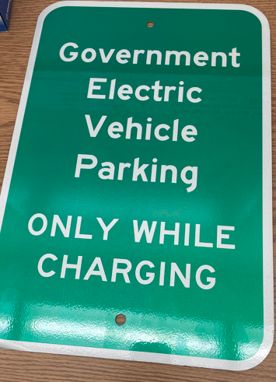
Special Topic:
EV Charging Stations – Contract was awarded! DCR is working the design right now with a plan to start construction and install in May. There will be 2 phases for the construction and a substantial portion will be done in Phase 1.

Slide 3
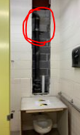
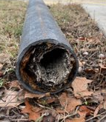
Noteworthy Items
Transfer Gallery – project complete – thank you all for your patience during this bathroom shutdown. (see pictures to the right)
Safety Concern – Fun Story – The safety folks were called yesterday to the village for what looked like a murder scene cleanup. What was found were a bunch of towels soaked/stained in a red fluid, rubber gloves, and a syringe with red fluid in it.
New Roofs
Village Gym/Fuel Station - are pretty much done just doing punch list items and waiting on tin work.
Minos – Emergency Roof – In review process. In Progress
12 Roof Package – We’ve been meeting with contractor and procurement and are so close to finalizing the plans to get started. Projected start time in spring 2025.
A0 Kicker A0 Lab A0 Service Building
IB#3 IB #4 MI30
AP50 MI52 MI60
MI62 NTSB Site 40

Slide 4
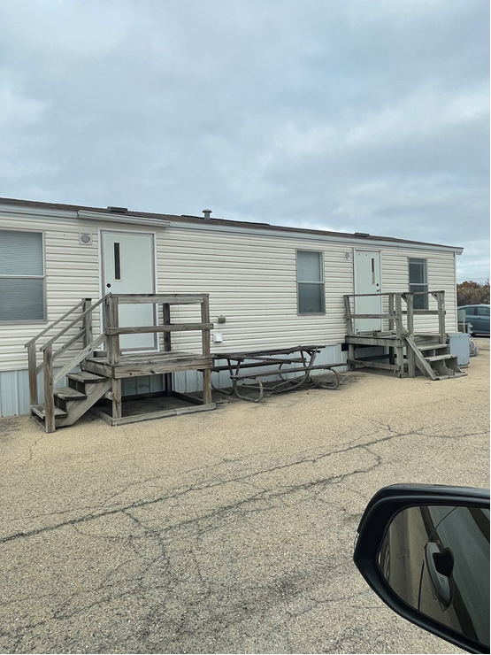
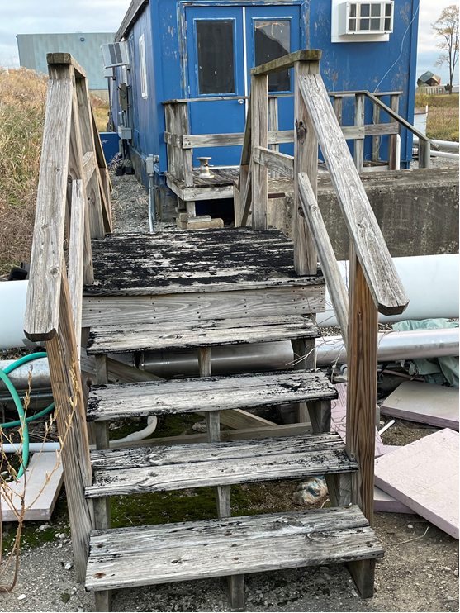
Active Projects still in motion and Contractors on Site
Other Happenings:
FREP (Fermilab Resilience & Efficiency Project) - has been walking various buildings working out details of the future scope of work (SOW) for controls and HVAC upgrades.
NWA – Split Unit at NS4 was installed this week.
Structure Moves – We are in the planning phase of moving 3 trailers, one at F4 and two at ME7.
TSIB – Punch list walk throughs for concerned parties have been completed. Follow up items are in progress with turnover sometime in July. In the meantime, some equipment is starting to be installed.
C0 – Is moving to the next phase of the project. Planning for window replacements and door repairs are coming.
MT6 – Epoxy injecting has been completed so the leaks during the wet season should be stopped.
.

