Slide 1
48 Hour Summary
Patrick Dowdle
MCR Crew Chief
January 10th, 2025

Slide 2
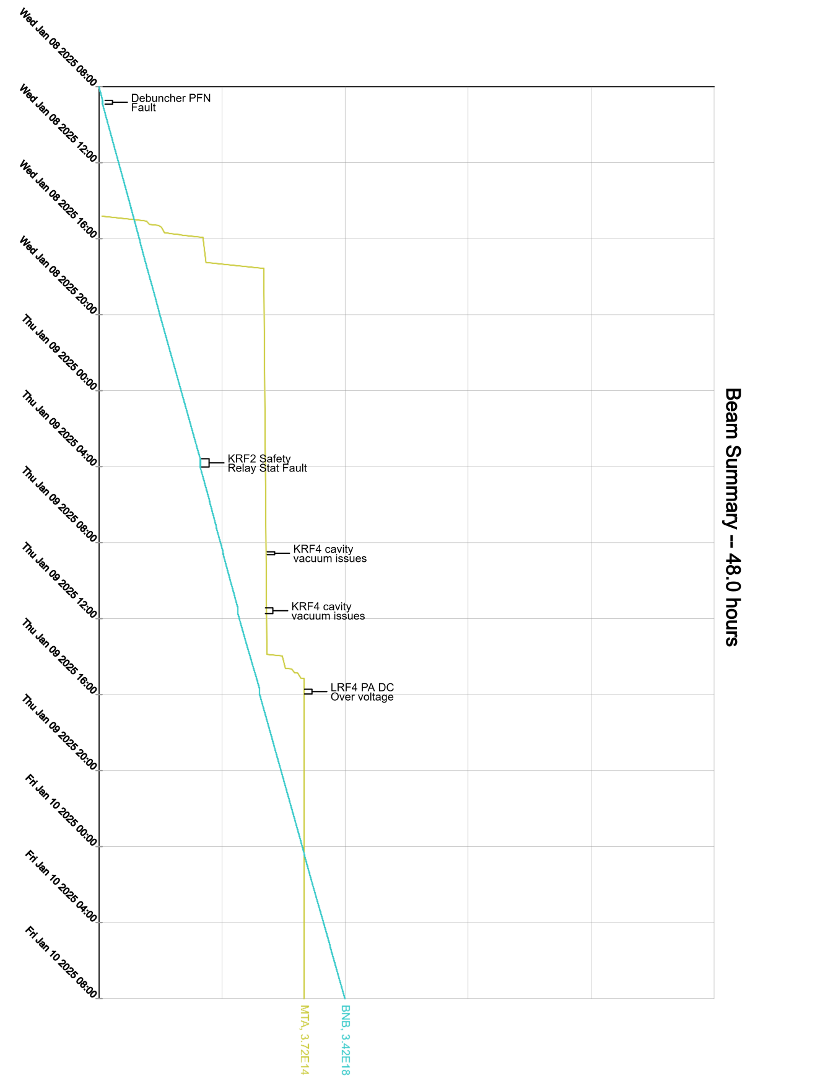
Summary
Wednesday:
Turned on Muon Campus supplies
Turned down due to lack of cooling
MTA studies
Thursday:
KRF4 vacuum spiking
KRF2 trip required local attention
MTA and Booster studies
Turned Muon supplies back on
Ramped down again due to lack of cooling
Currently:
8.8 E16 p/hr to BNB

