Slide 1










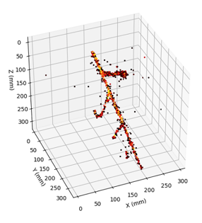
Plans for a ProtoDUNE-III Run with Optical Readout in the NP02 Cryostat
Kostas Mavrokoridis
(on behalf of the ProtoDUNE-III run collaborators)
Workshop on Neutrinos @ CERN, Jan 2025
k.mavrokoridis@liverpool.ac.uk

Slide 2
Talk Outline
Background to the proposed new technologies
  The ARIADNE program and Optical TPX3Cam results taken with the ARIADNE⁺ 15-ton dual phase LAr detector at the CERN neutrino platform
  APEX technology
  Pixelated CRP (will not cover current vertical drift strip CRPs)
  DarkSide-20k type PDUs
The optical protoDUNE III run proposal
  Design progress, Integration and technical coordination
  Timeline and LoI

Slide 3
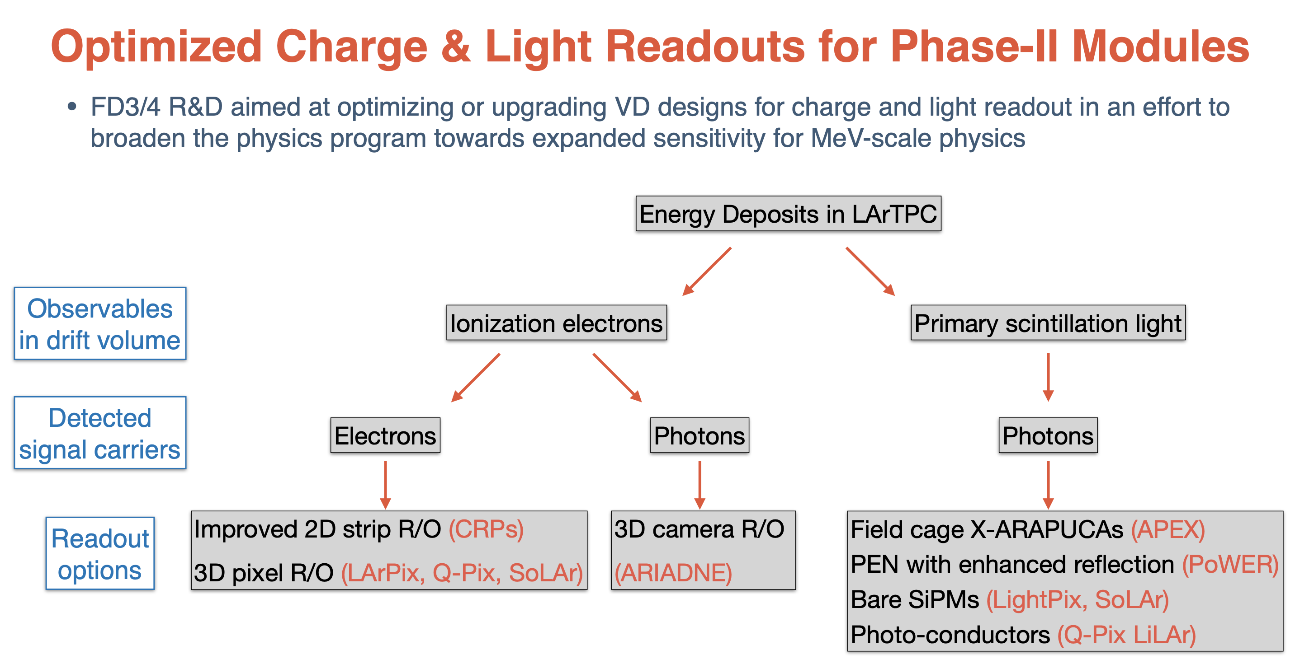
Impacting DUNE phase II technology scopes
(Slide from Stefan’s phase II talk)

Slide 4


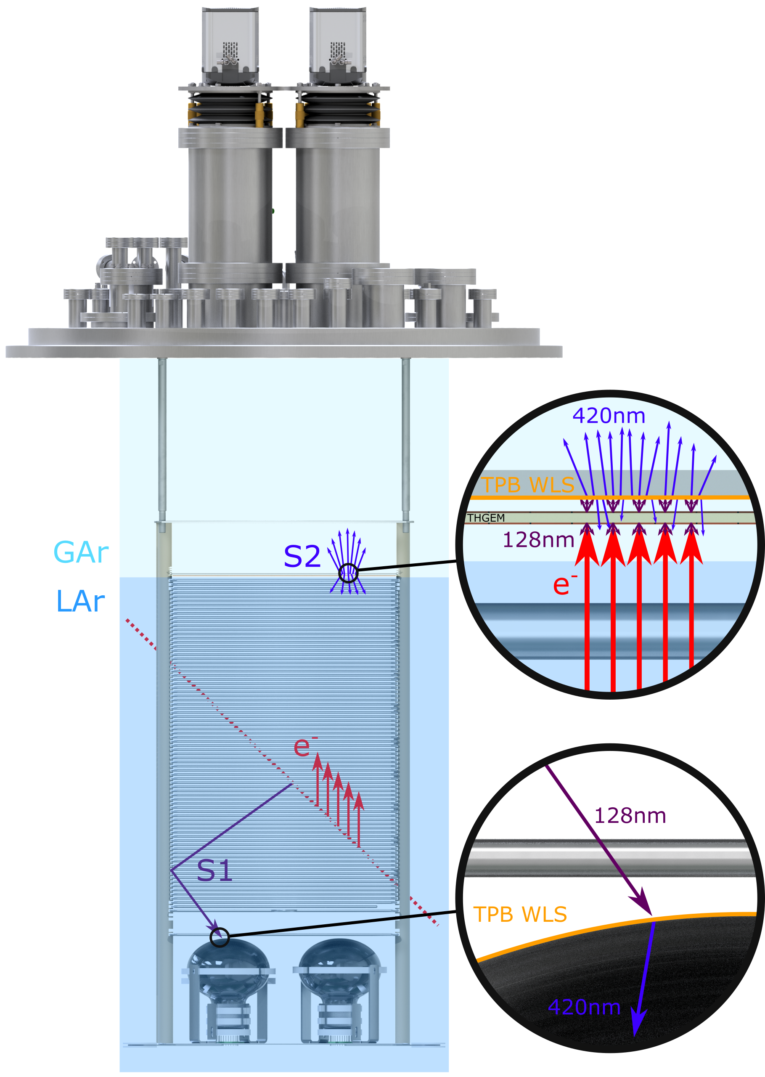
3D Optical TPC Detection Principle
Cameras
ARIADNE has demonstrated light readout as a viable alternative to charge in dual-phase TPC neutrino experiments
Benefits over previous charge readout techniques:
High resolution
Sensitivity to low energies
Very low noise, decoupled from TPC
Ease of access
Cost efficient
Incoming particles ionise LAr and create prompt scintillation light (S1)
Electrons drift towards the extraction grid situated below the liquid level
A THGEM (THick-Gaseous Electron Multiplier) amplifies drift charge (capable of >30 kV/cm in LAr) generating secondary scintillation light (S2)
WLS (Wavelength Shifting) before imaging with ultrafast Timepix3 camera
Can aid to enable low energy Physics for DUNE
ie Supernova neutrinos
Solar neutrinos
and DM
https://iopscience.iop.org/article/10.1088/1748-0221/14/06/P06001
https://www.mdpi.com/2410-390X/4/4/35
ARIADNE (ARgon ImAging DetectioN chambEr)

Slide 5
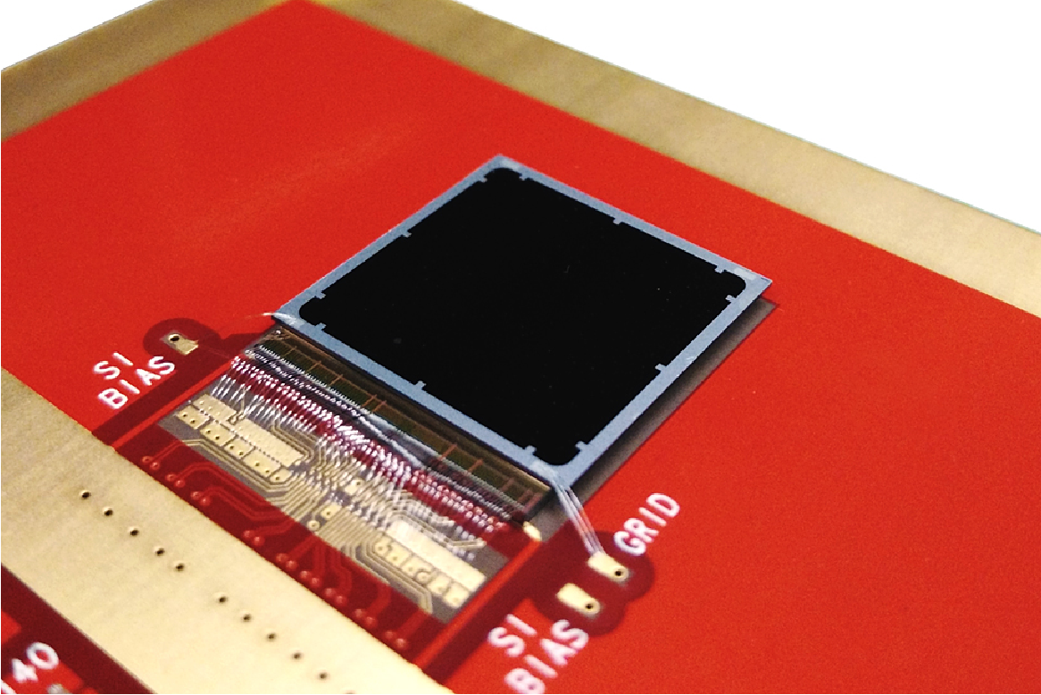
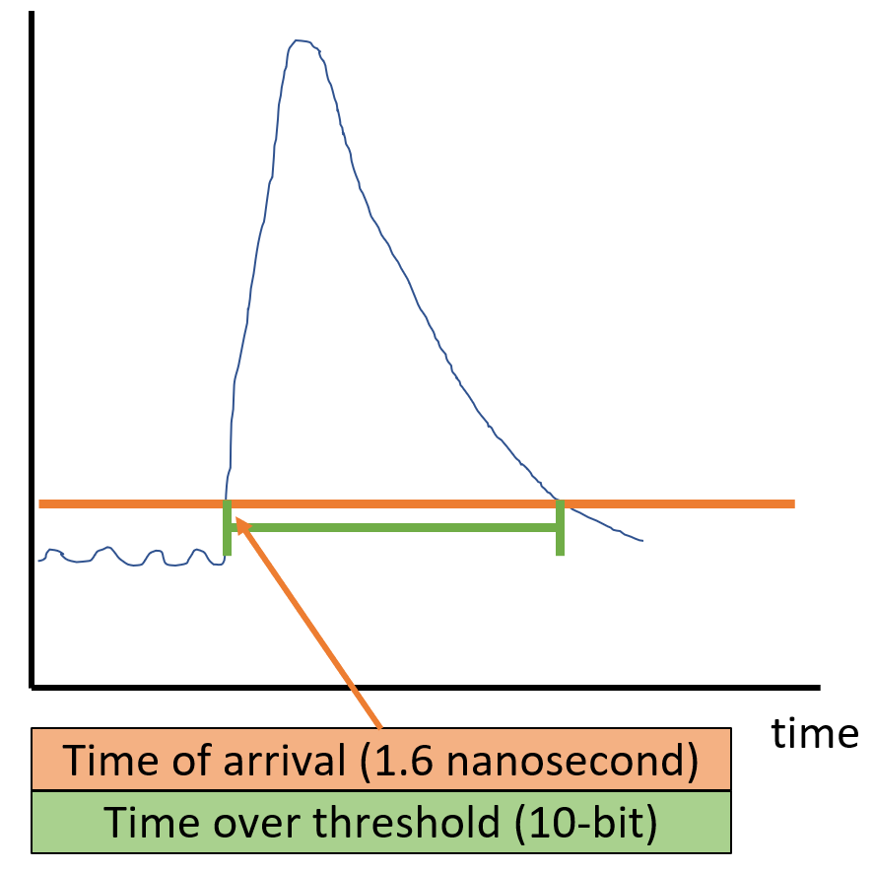
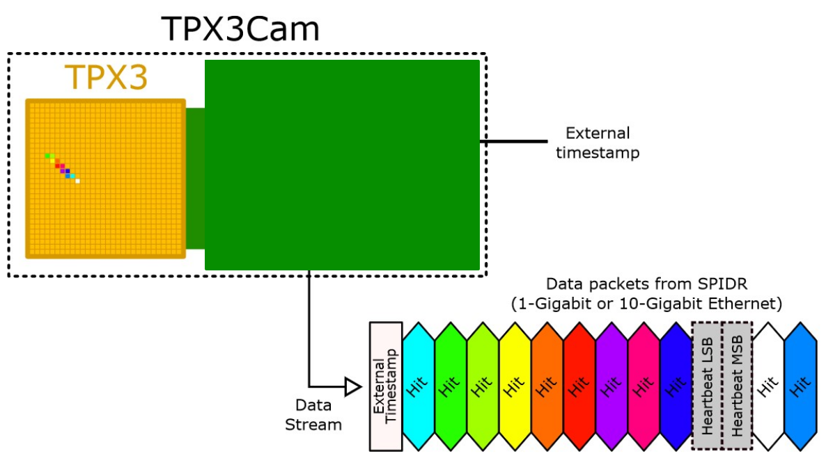
2D-> Full 3D Optical Readout
Silicon pixel readout chip developed by the Medipix collaboration. Very well established technology at CERN.
TPX3 ASIC bonded to optical sensor
TPX3 provides simultaneous time-over-threshold (ToT) and time-of-arrival (ToA). Complete (x,y,z,E) event reconstruction using a single device.
Time over threshold provides intensity / energy measurement ->10-bit resolution.
Time of arrival provides z (drift) axis position information -> 1.6 nanosecond resolution.
Data driven readout -> Event streaming with native zero suppression.
Efficient raw data storage. Triggerless operation.
Sensor resolution | 256x256 pixels
Pixel size | 55µm x 55µm
Max readout rate | 40Mhits•cm⁻² •sec⁻¹
Time resolution | 1.6 ns

Slide 6
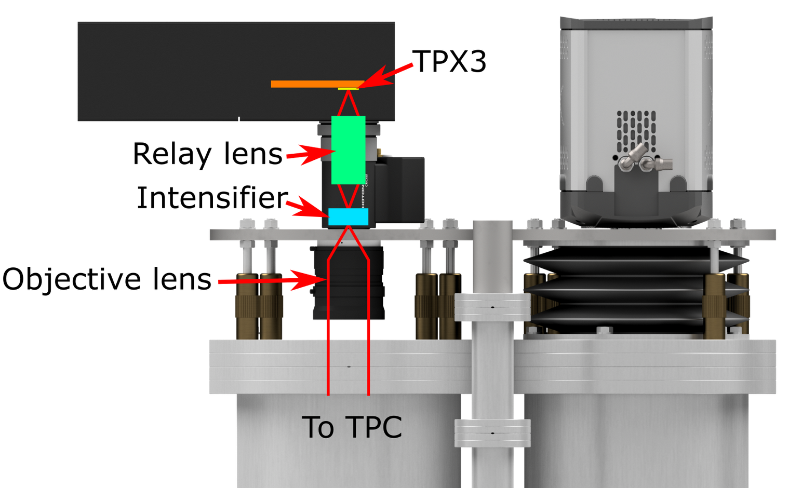
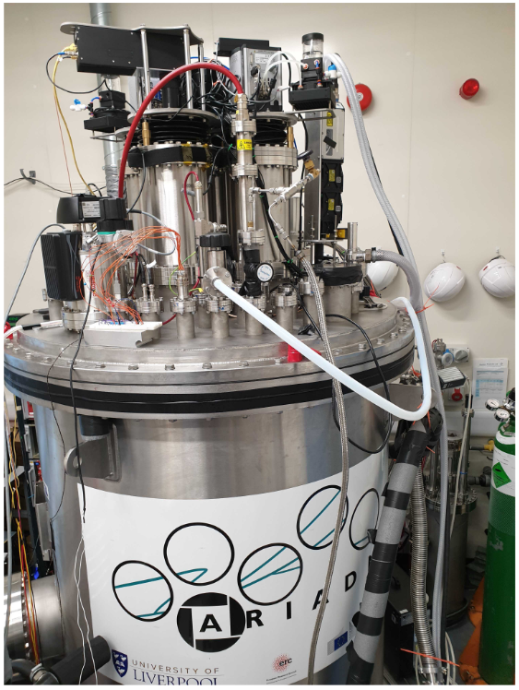
TPX3Cam Optical Readout
Single photon sensitivity when combined with image intensifier.
Intensifier gain ~1E6 photons/photon.
Relay lens couples intensified image onto light sensitive
sensor which is bump bonded onto TPX3 ASIC.
Intensifier provides flexibility -> Many photocathode options are available to customise spectral sensitivity.
– Now also Direct VUV!
Timepix3 camera installed in place of an EMMCD camera.
~ 30cm x 30cm field of view
Photonis Cricket image intensifier with Hi-QE green photocathode.
30% quantum efficiency at 430nm (TPB peak emission)
Coldbox Intensifier
ARIADNE results
TPB emission

Slide 7
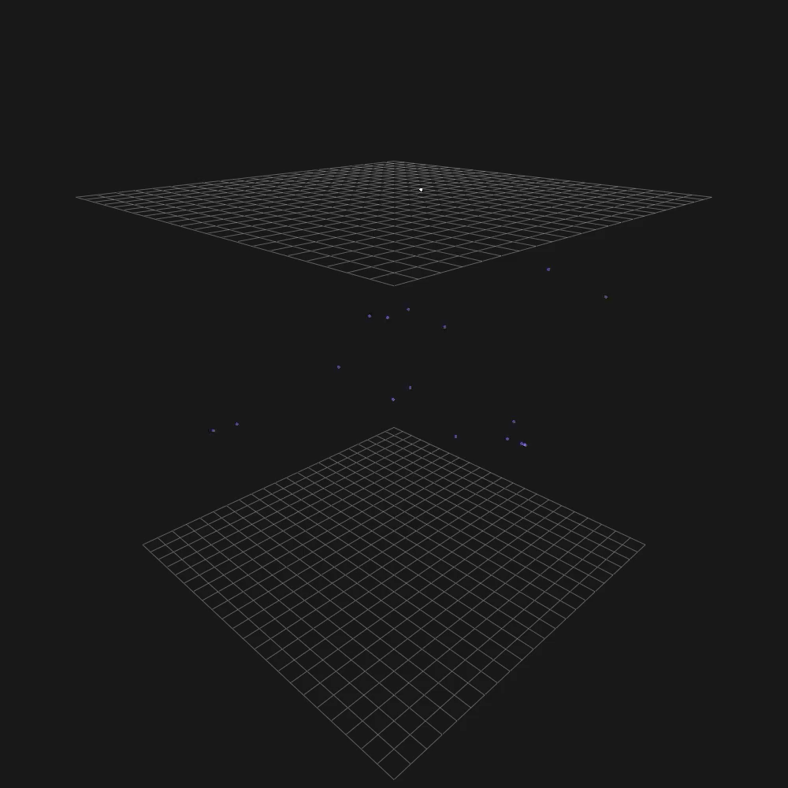
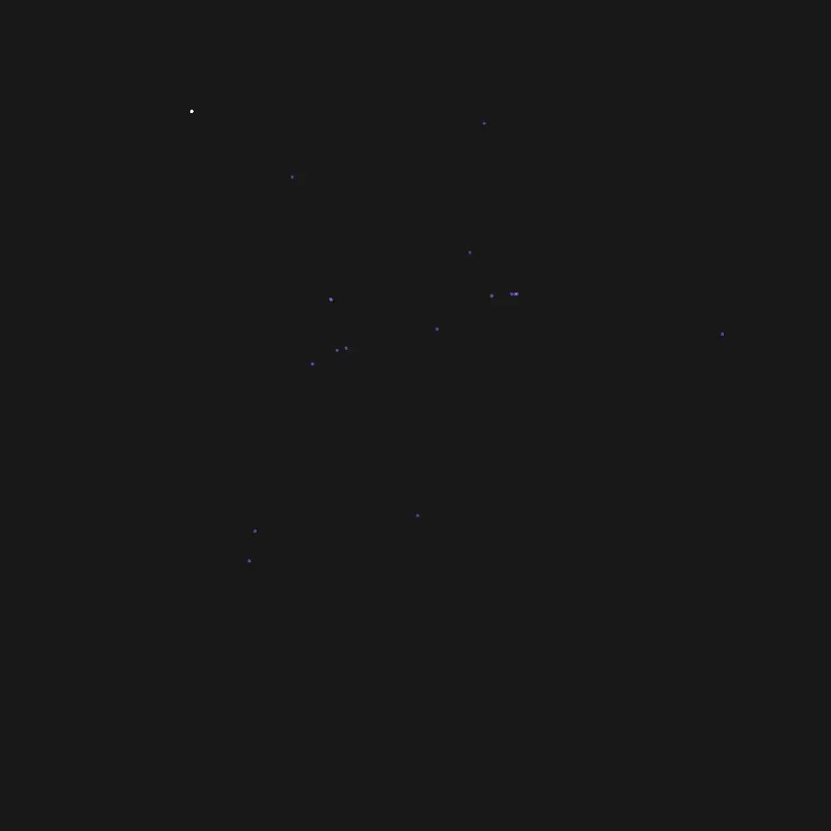
TPX3Cam 3D Cosmics LAr
Continuous streaming, 10 msec slice (playing 1ms jump per frame)
Side View
Top View

Slide 8
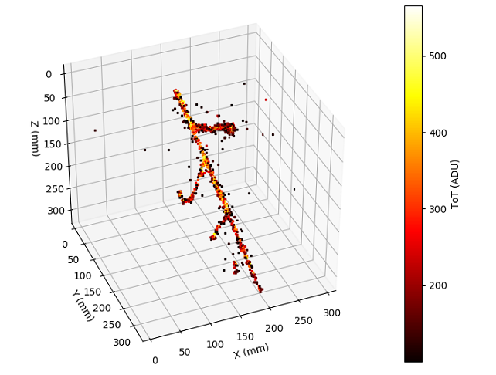
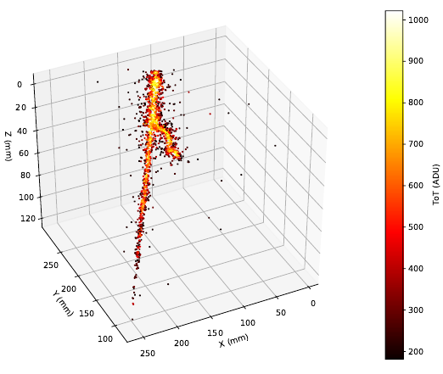
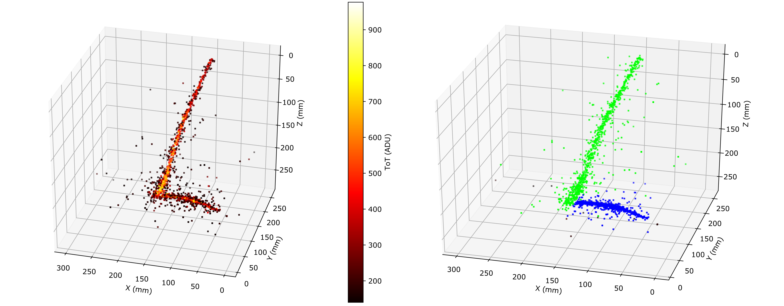
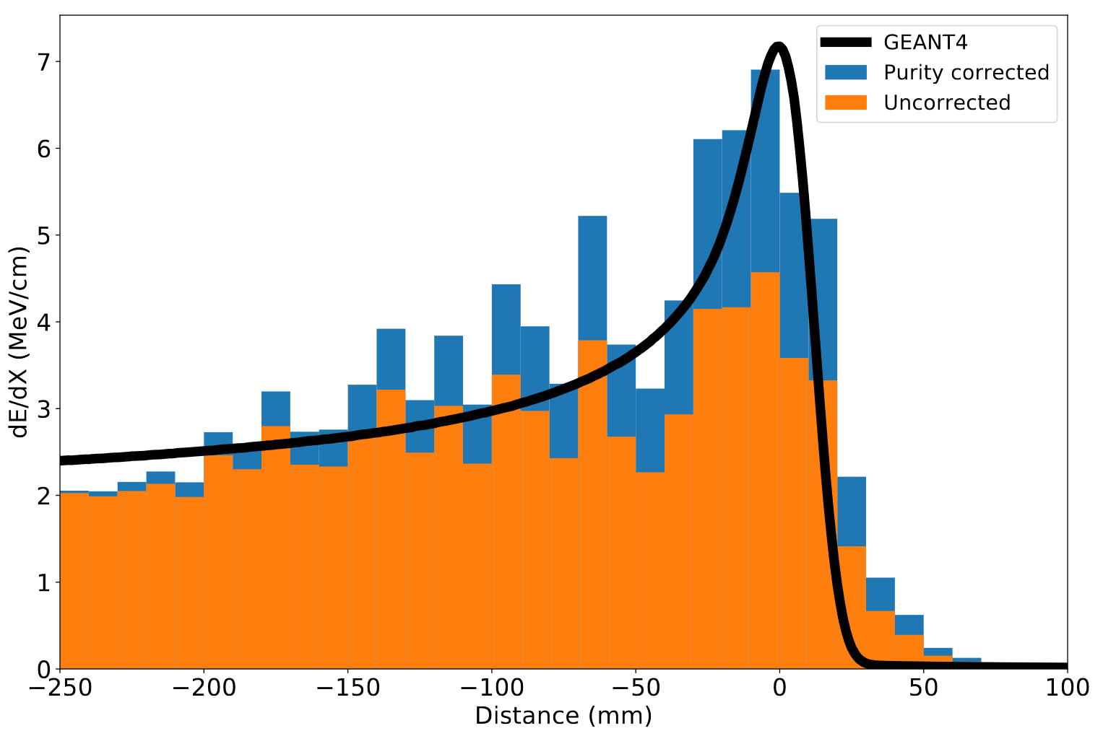
ARIADNE 1-ton TPX3 Results
https://www.mdpi.com/2410-390X/4/4/35
Stopping Muon
MIP Energy Calibration
ADU (ToT) vs. THGEM Bias
11% energy resolution
Cameras are sensitive to the linear light production regime

Slide 9



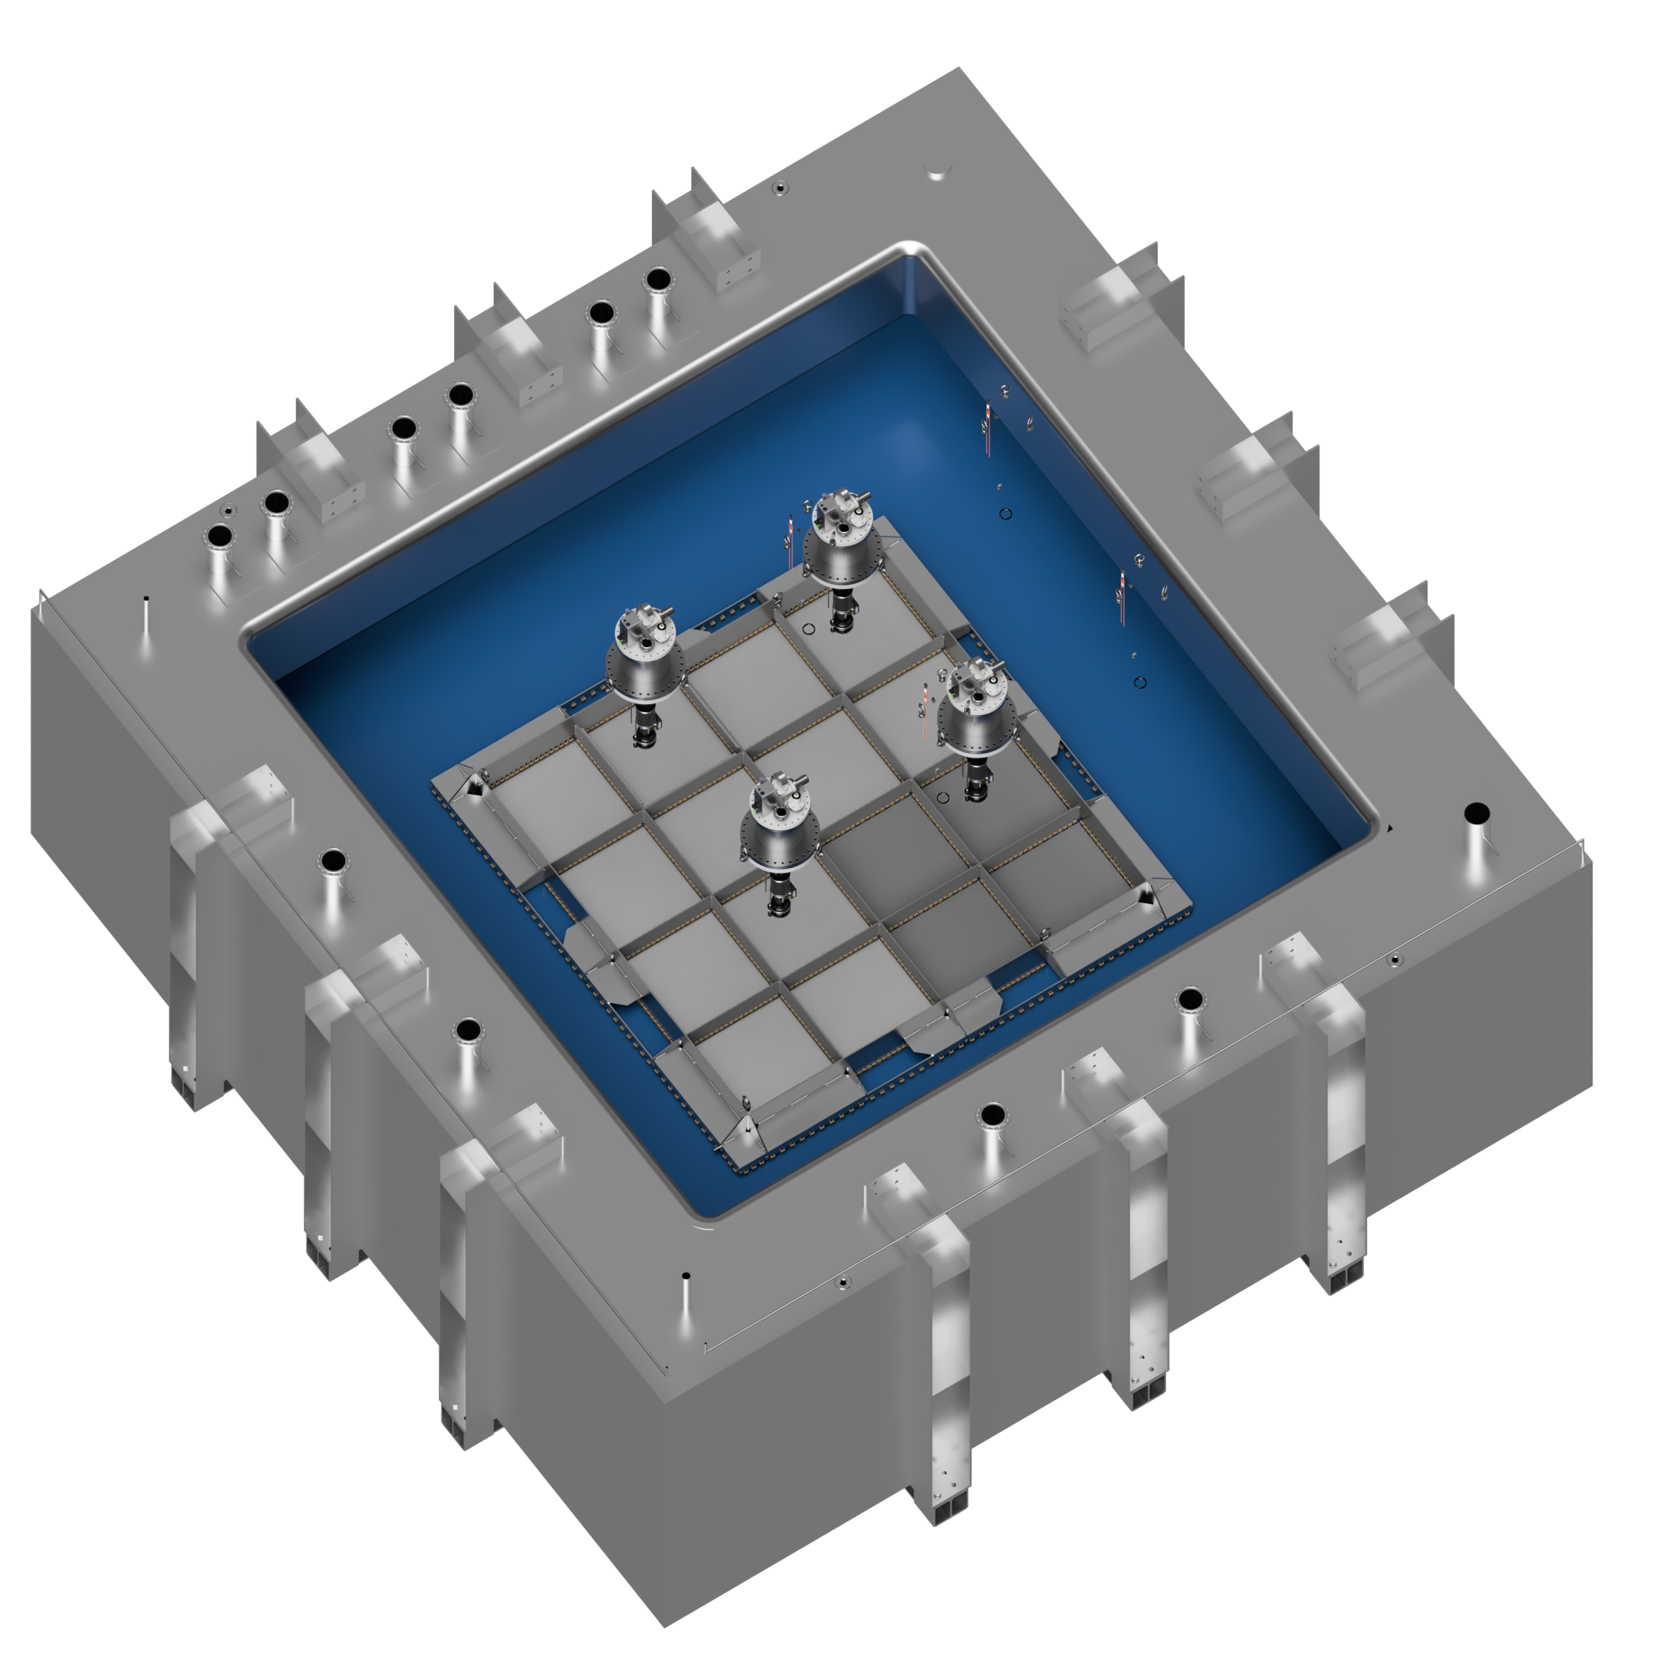
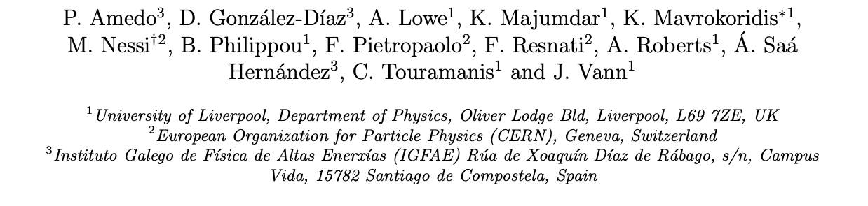
Larger Scale Demonstration at the CERN Neutrino Platform
Operation March/April 2022
+
Test optical readout on a scale relevant for DUNE using the existing cold box
CERN LOI: https://cds.cern.ch/record/2739360

Slide 10
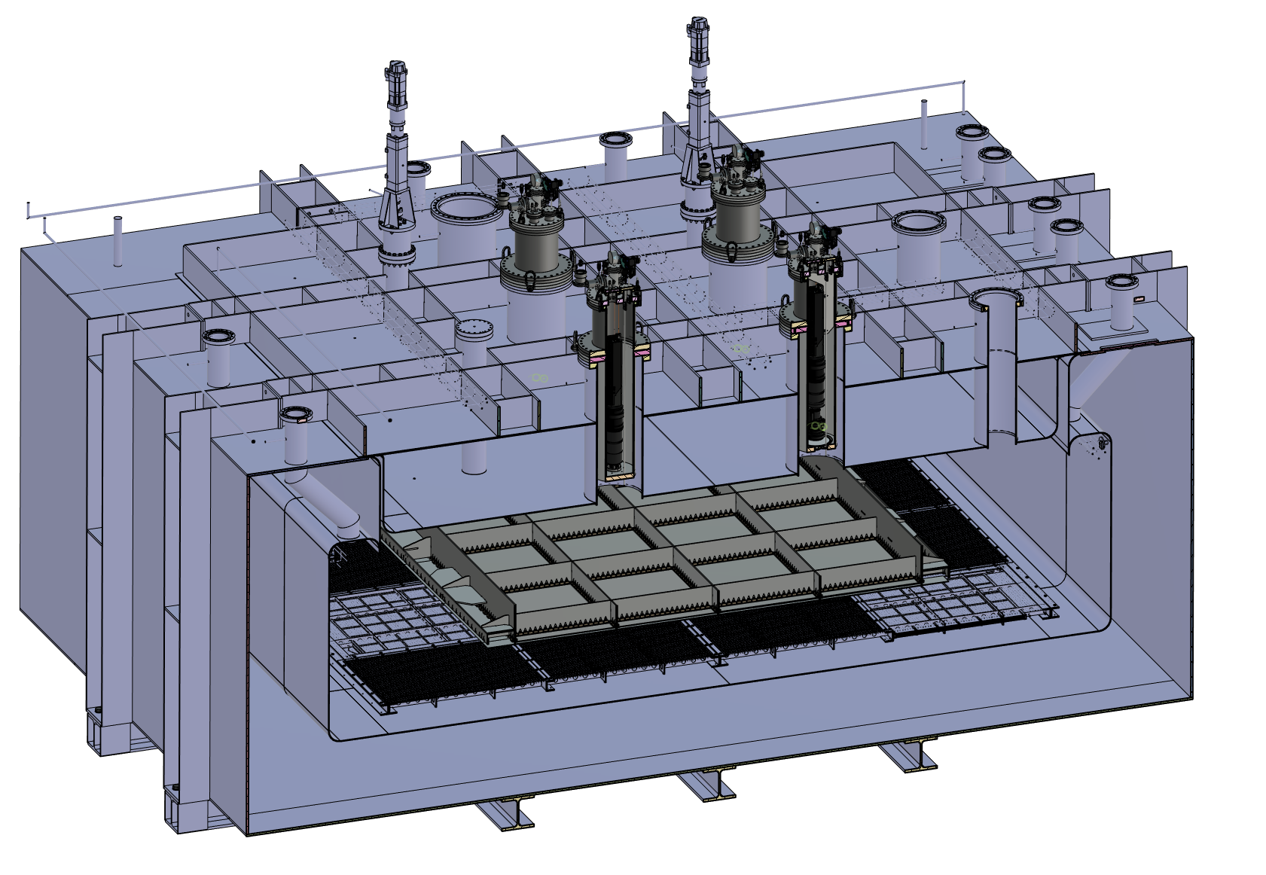
ARIADNE⁺: Cryostat Optical Configuration
TPX3 Camera
Assembly (1 x VUV)
TPX3 Camera
Assembly (3 x visible)
Large scale test of ARIADNE optical readout principle for dual-phase LArTPCs.
Four Timepix3 based cameras, each covering 1m x 1m readout area.
Three cameras detect visible light (wavelength shifter installed above THGEMs)
One camera directly detects VUV.
Light Readout Plane (LRP)
Cathode

Slide 11
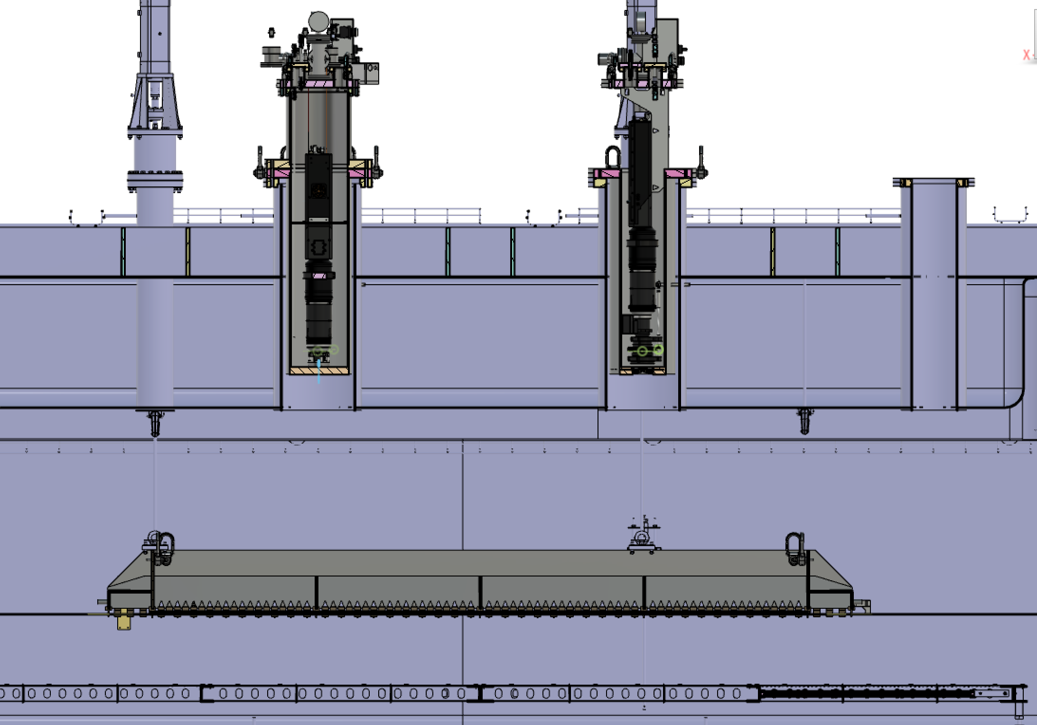
ARIADNE⁺: Cryostat Optical Configuration
Reentrance viewports, cameras in gas nitrogen
20 cm electron drift

Slide 12
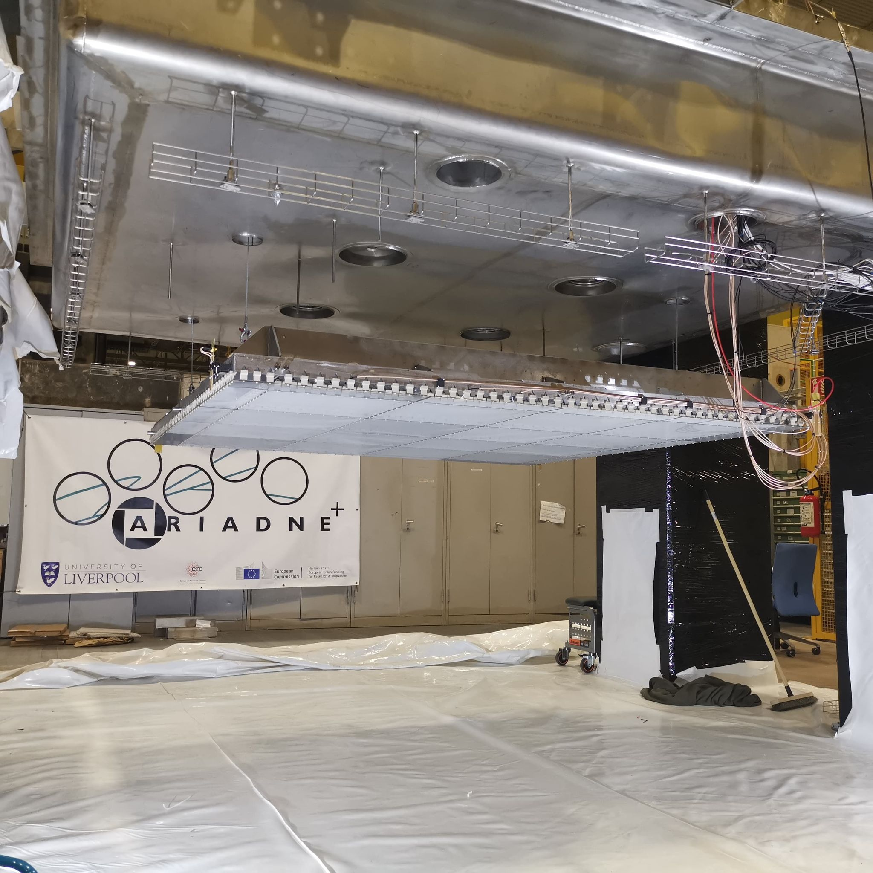
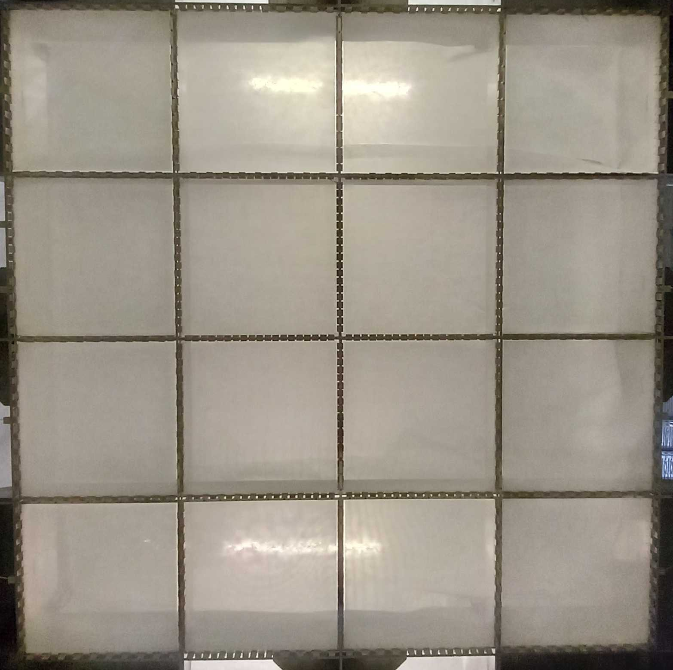
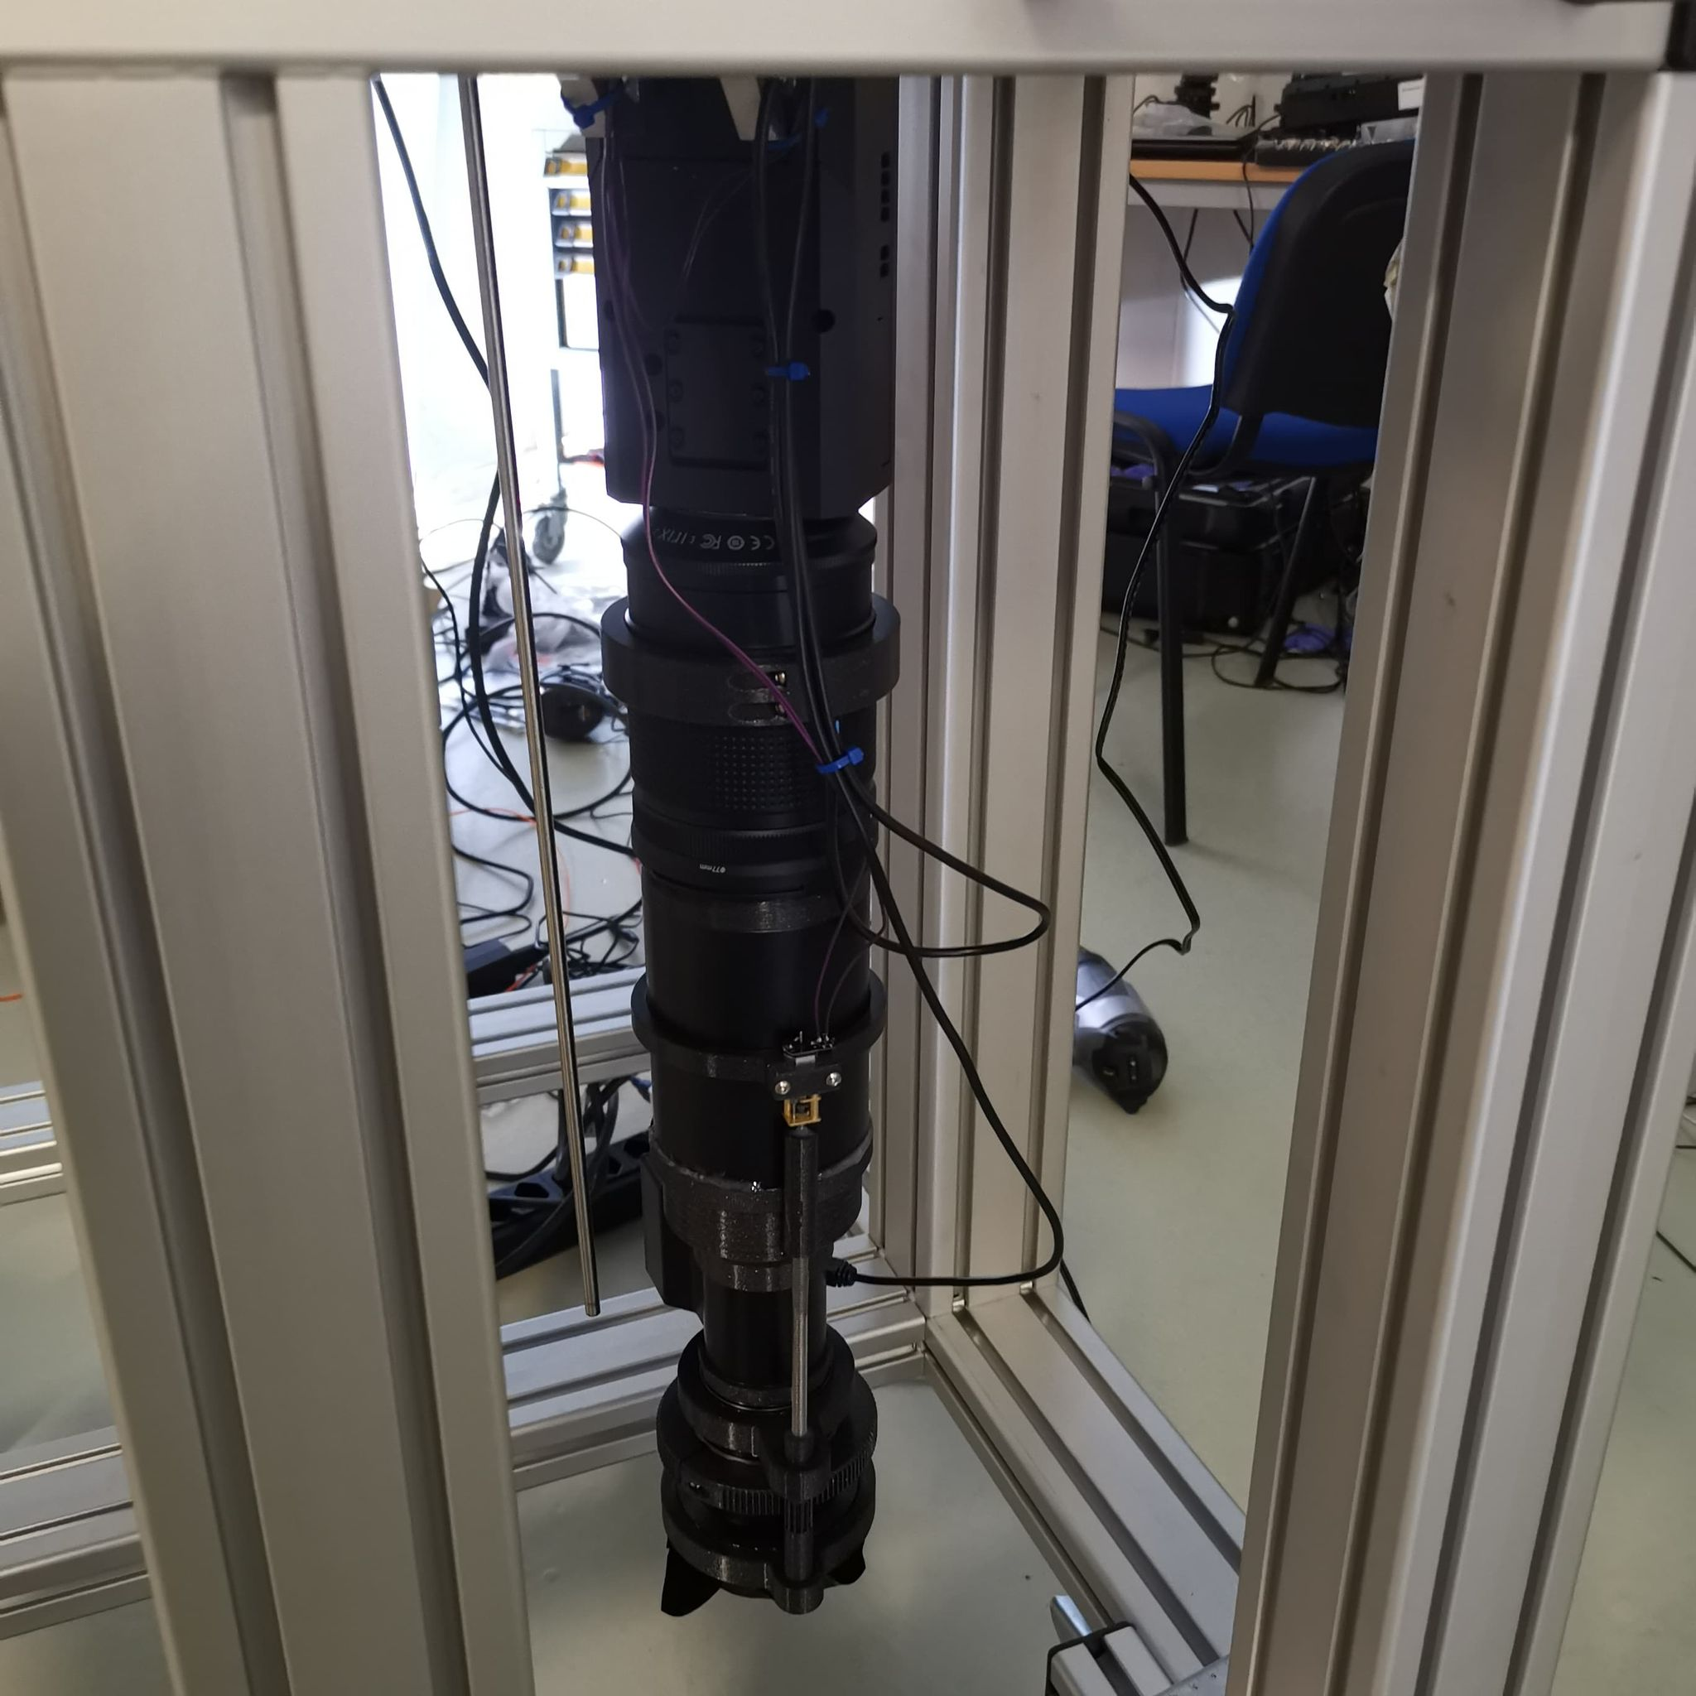
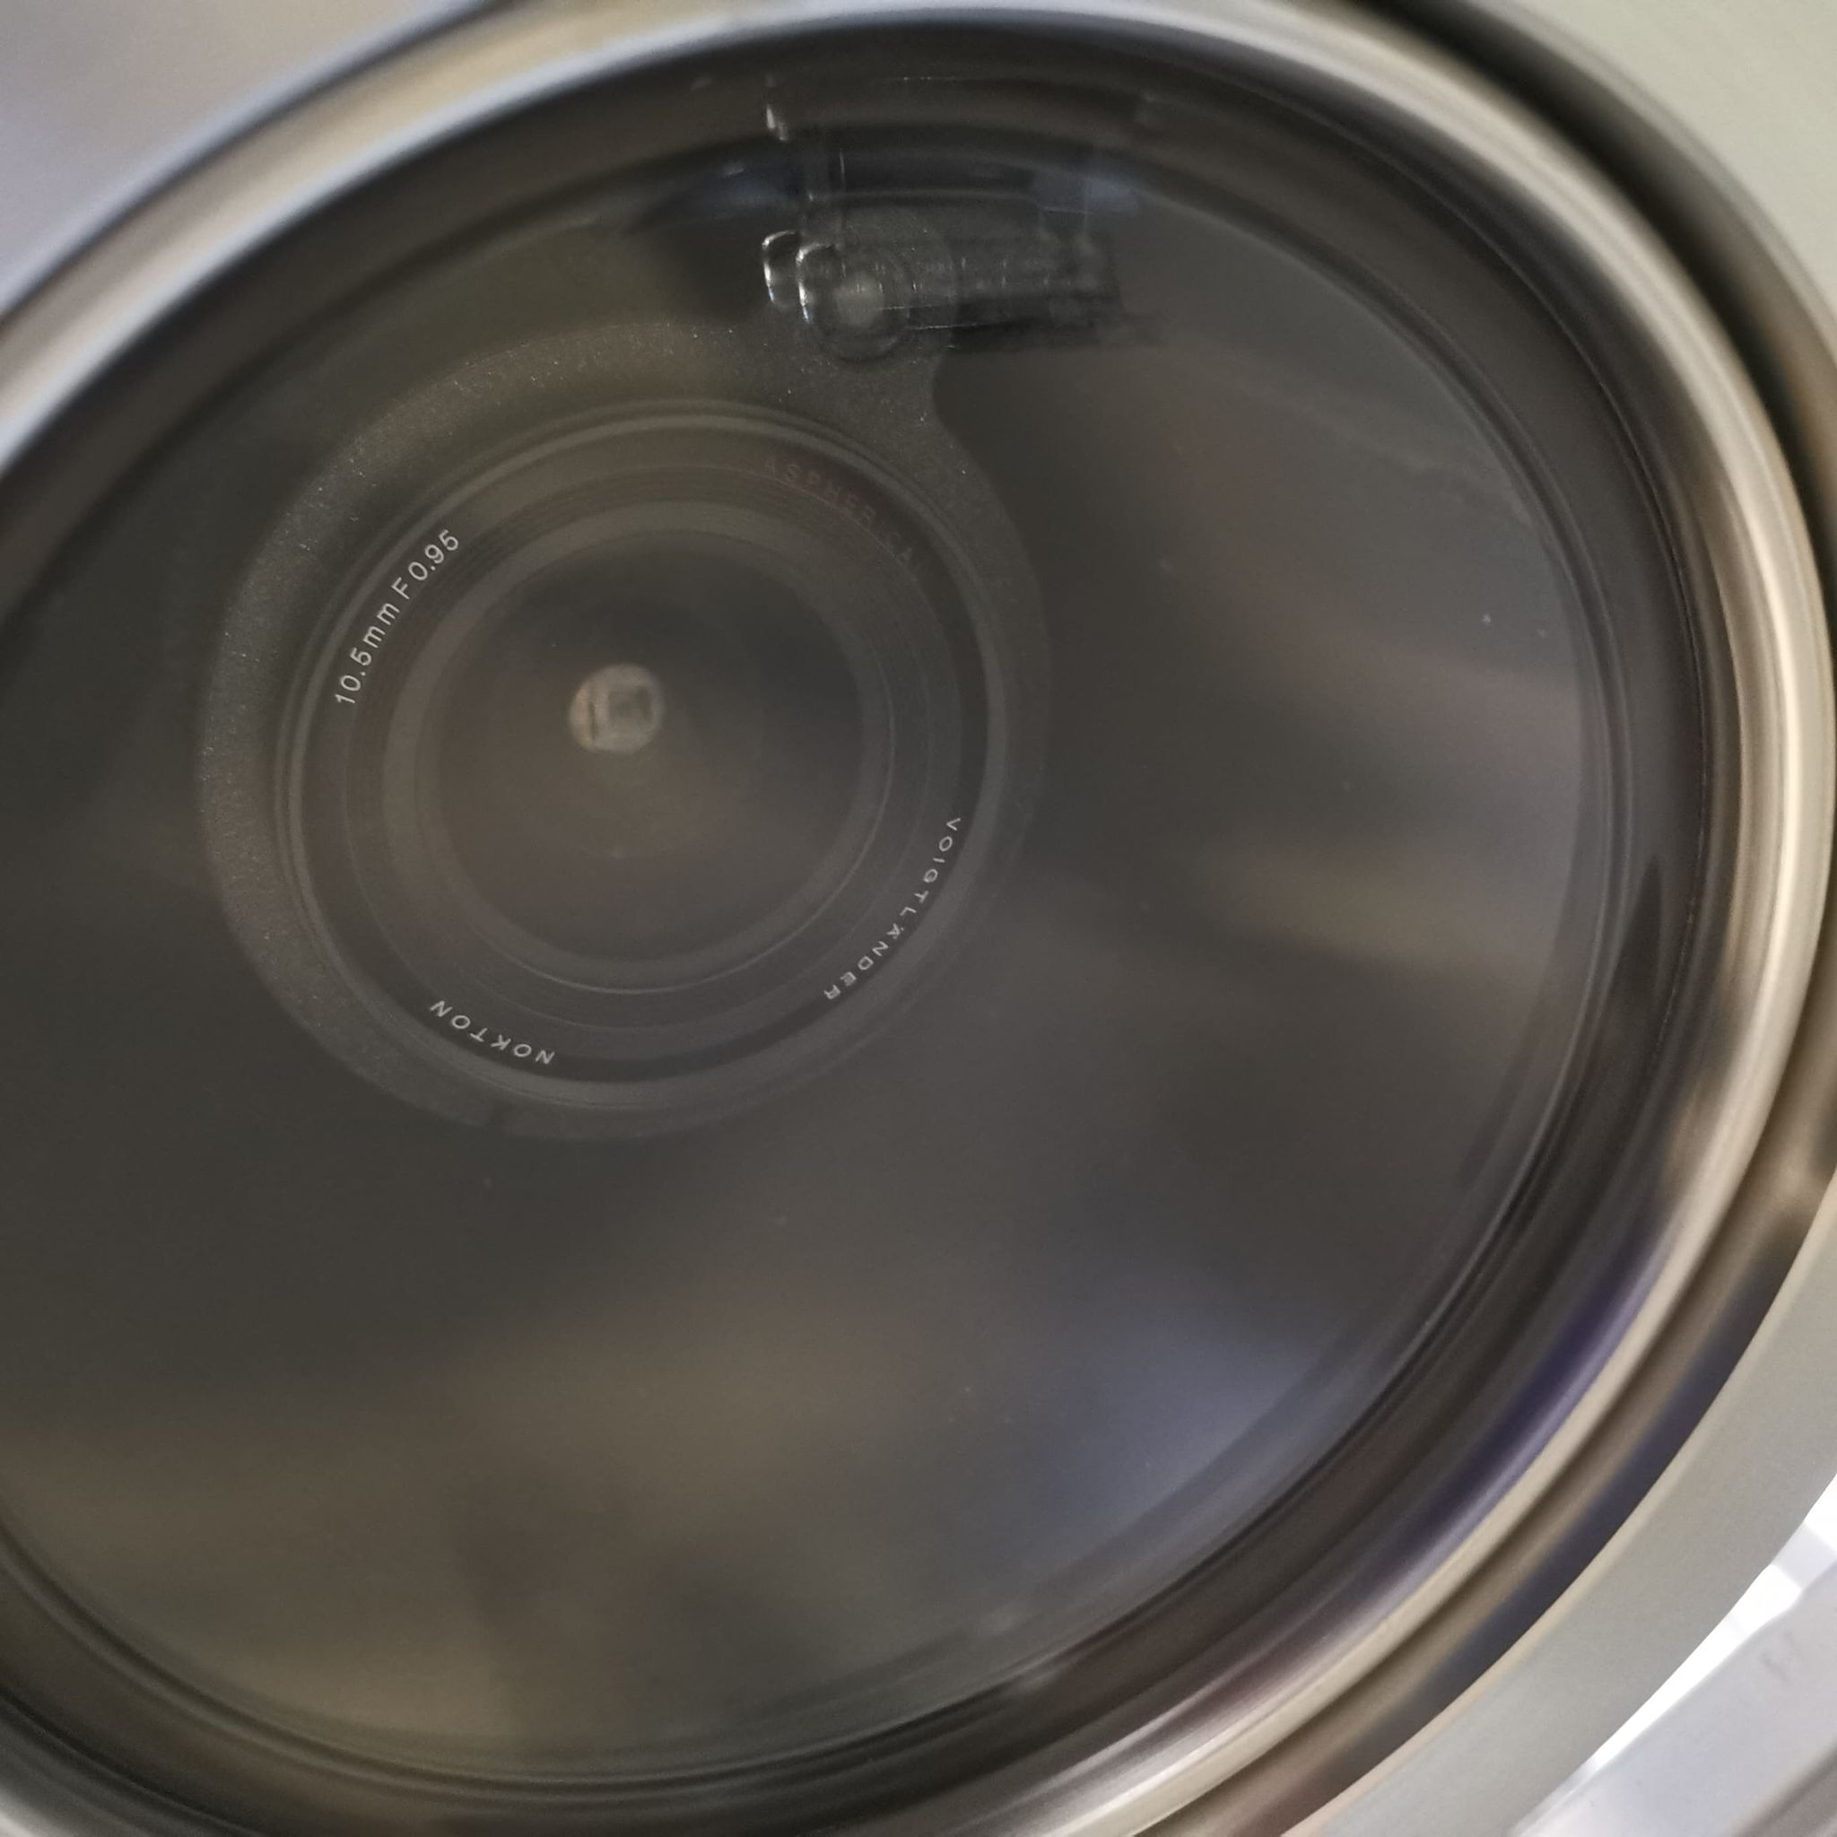
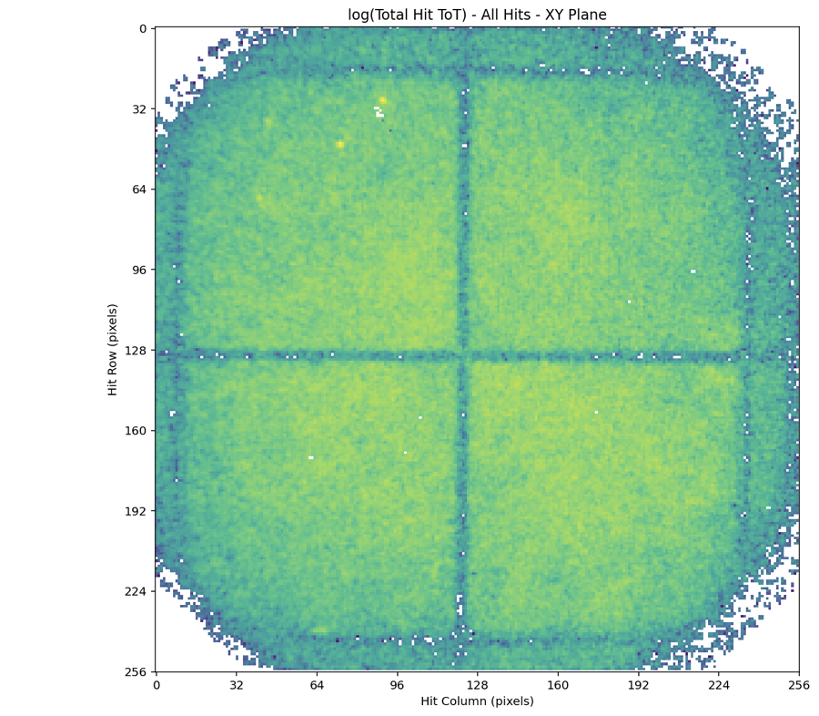
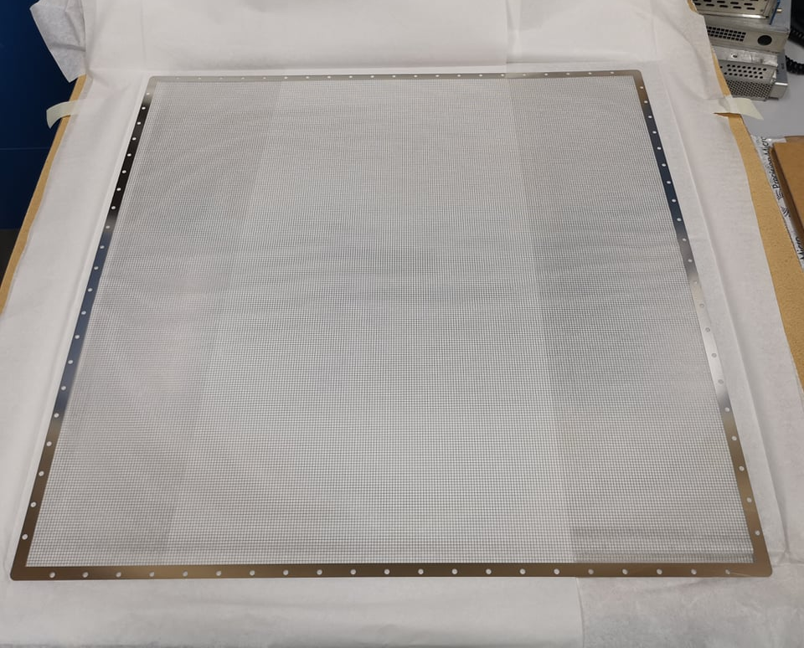
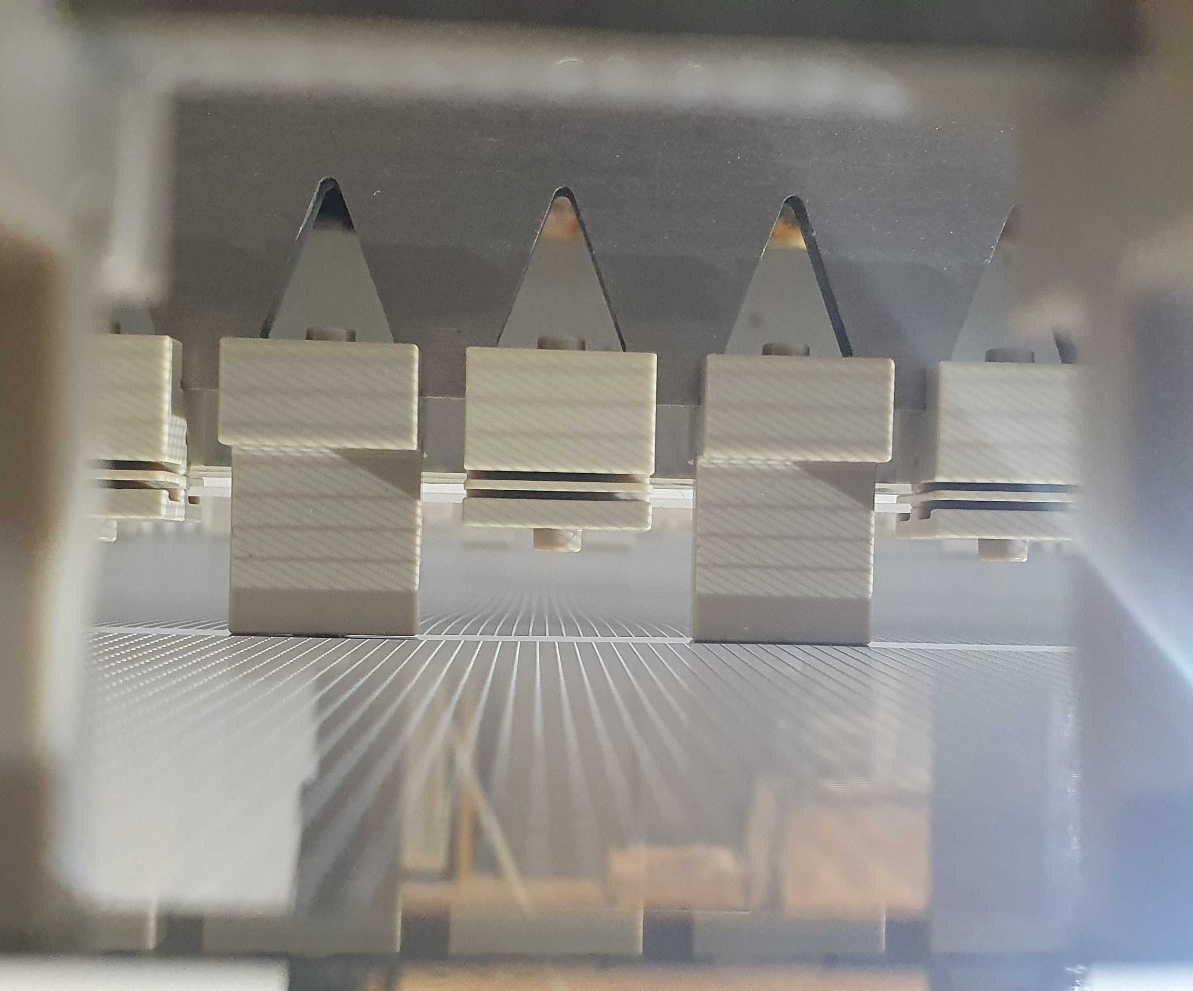
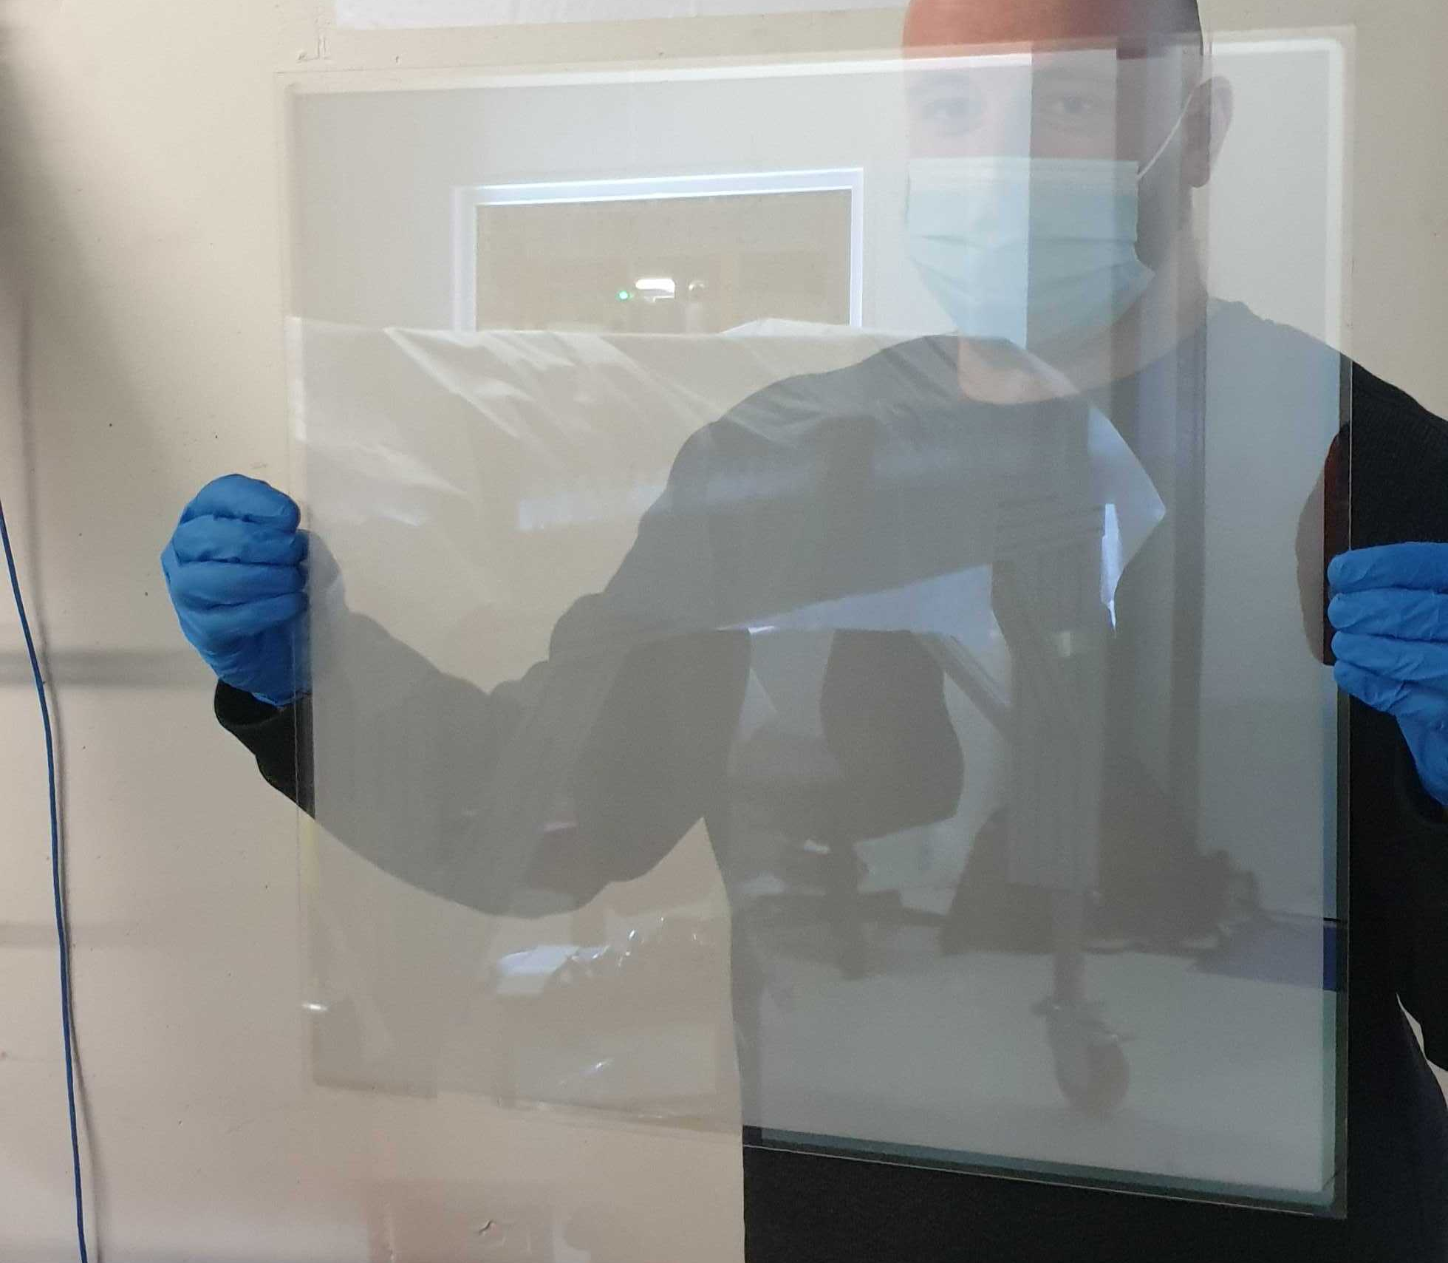
ARIADNE⁺: Key components
Visible lenses (f0.95, 10.5 mm
TPX3Cam
2mx2m LRP G-THGEMs from underneath
Photochemically etched extraction grids, 15mm extraction region
Cosmics 30 sec exposure
1.1mm 50cm² glass THGEM
https://arxiv.org/pdf/2301.02530v2.pdf

Slide 13
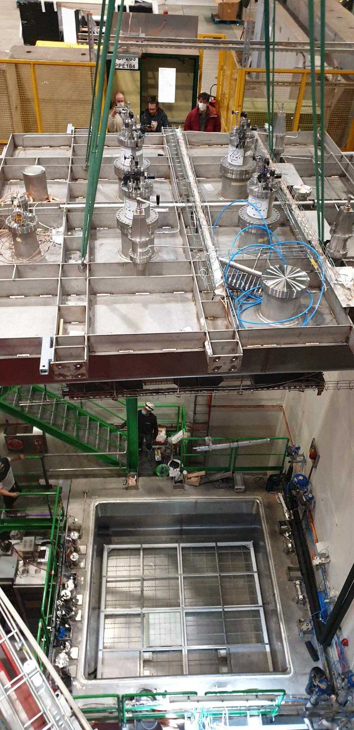
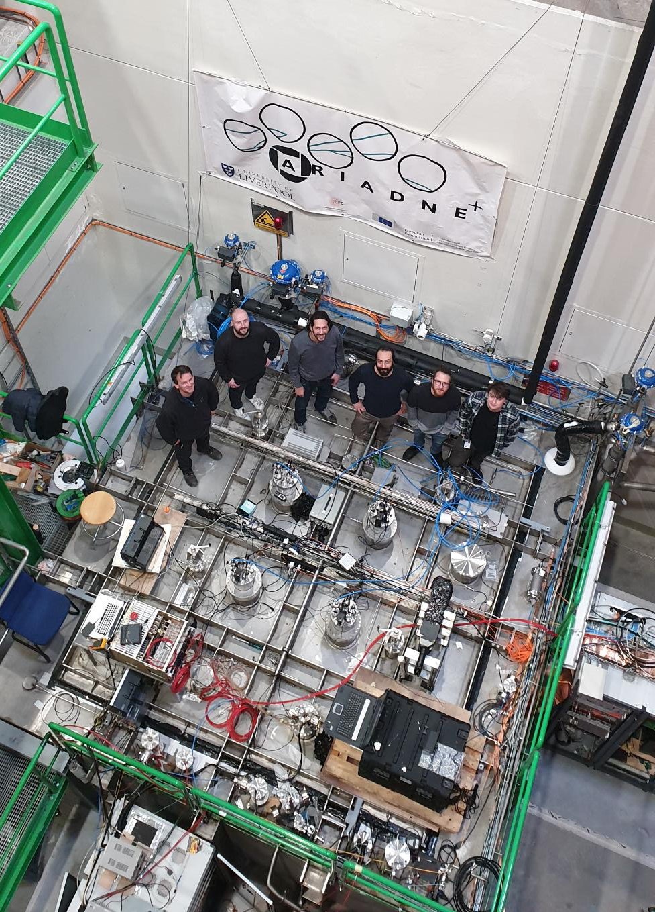
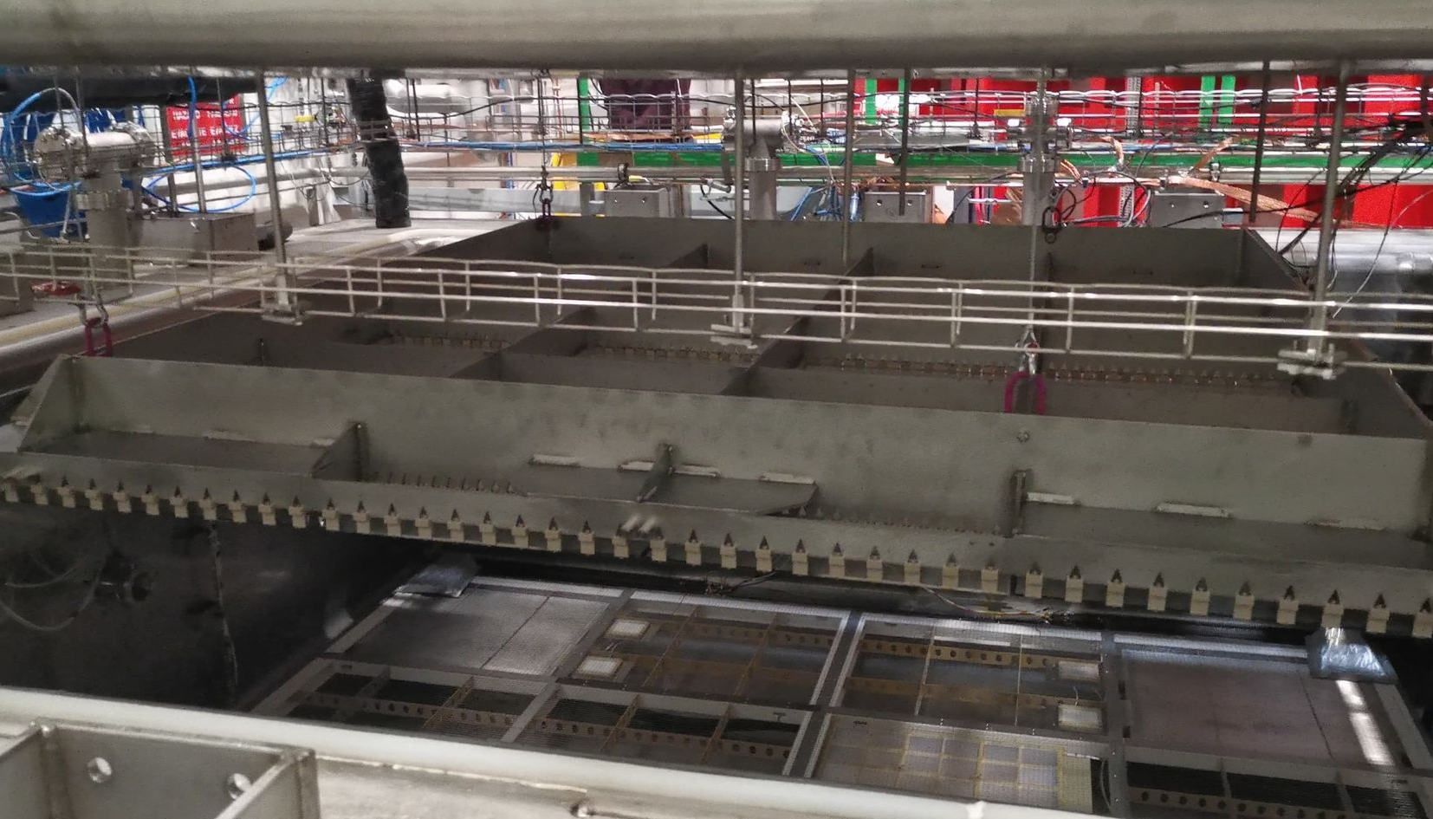
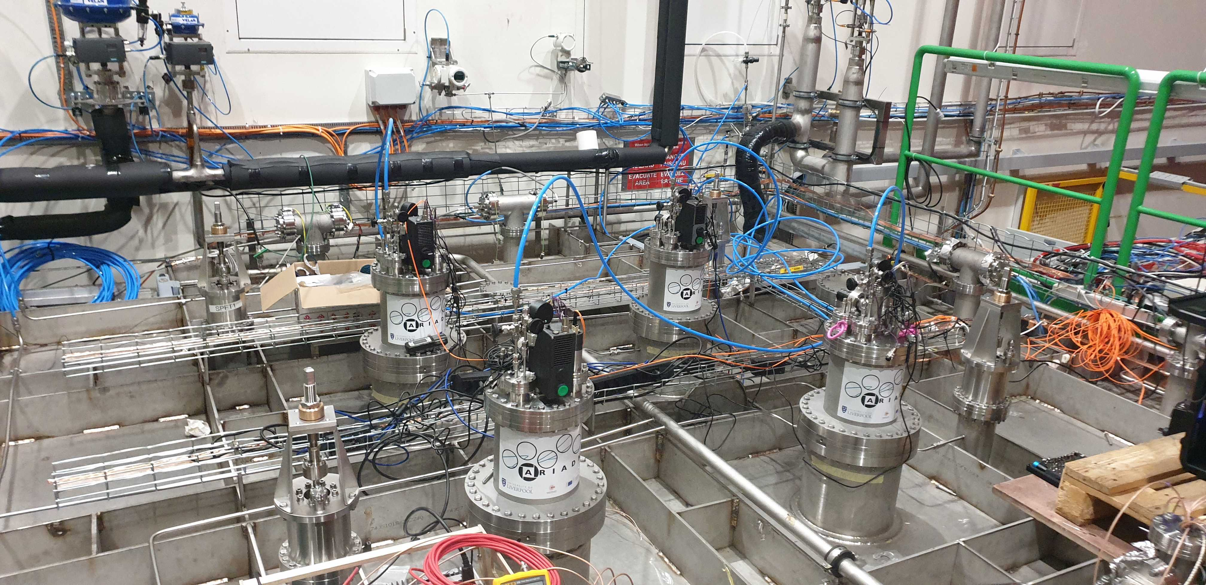
Commissioning at CERN
3 weeks data collection

Slide 14
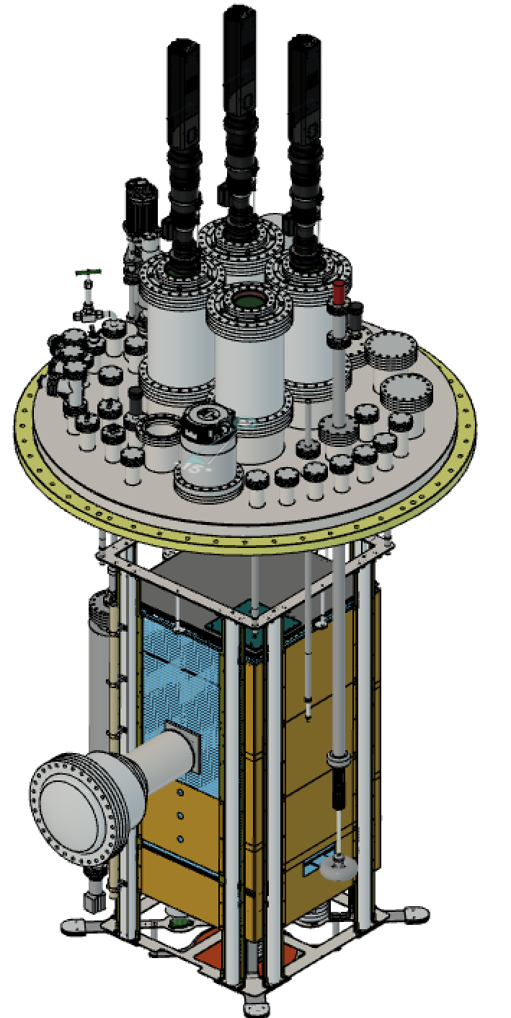
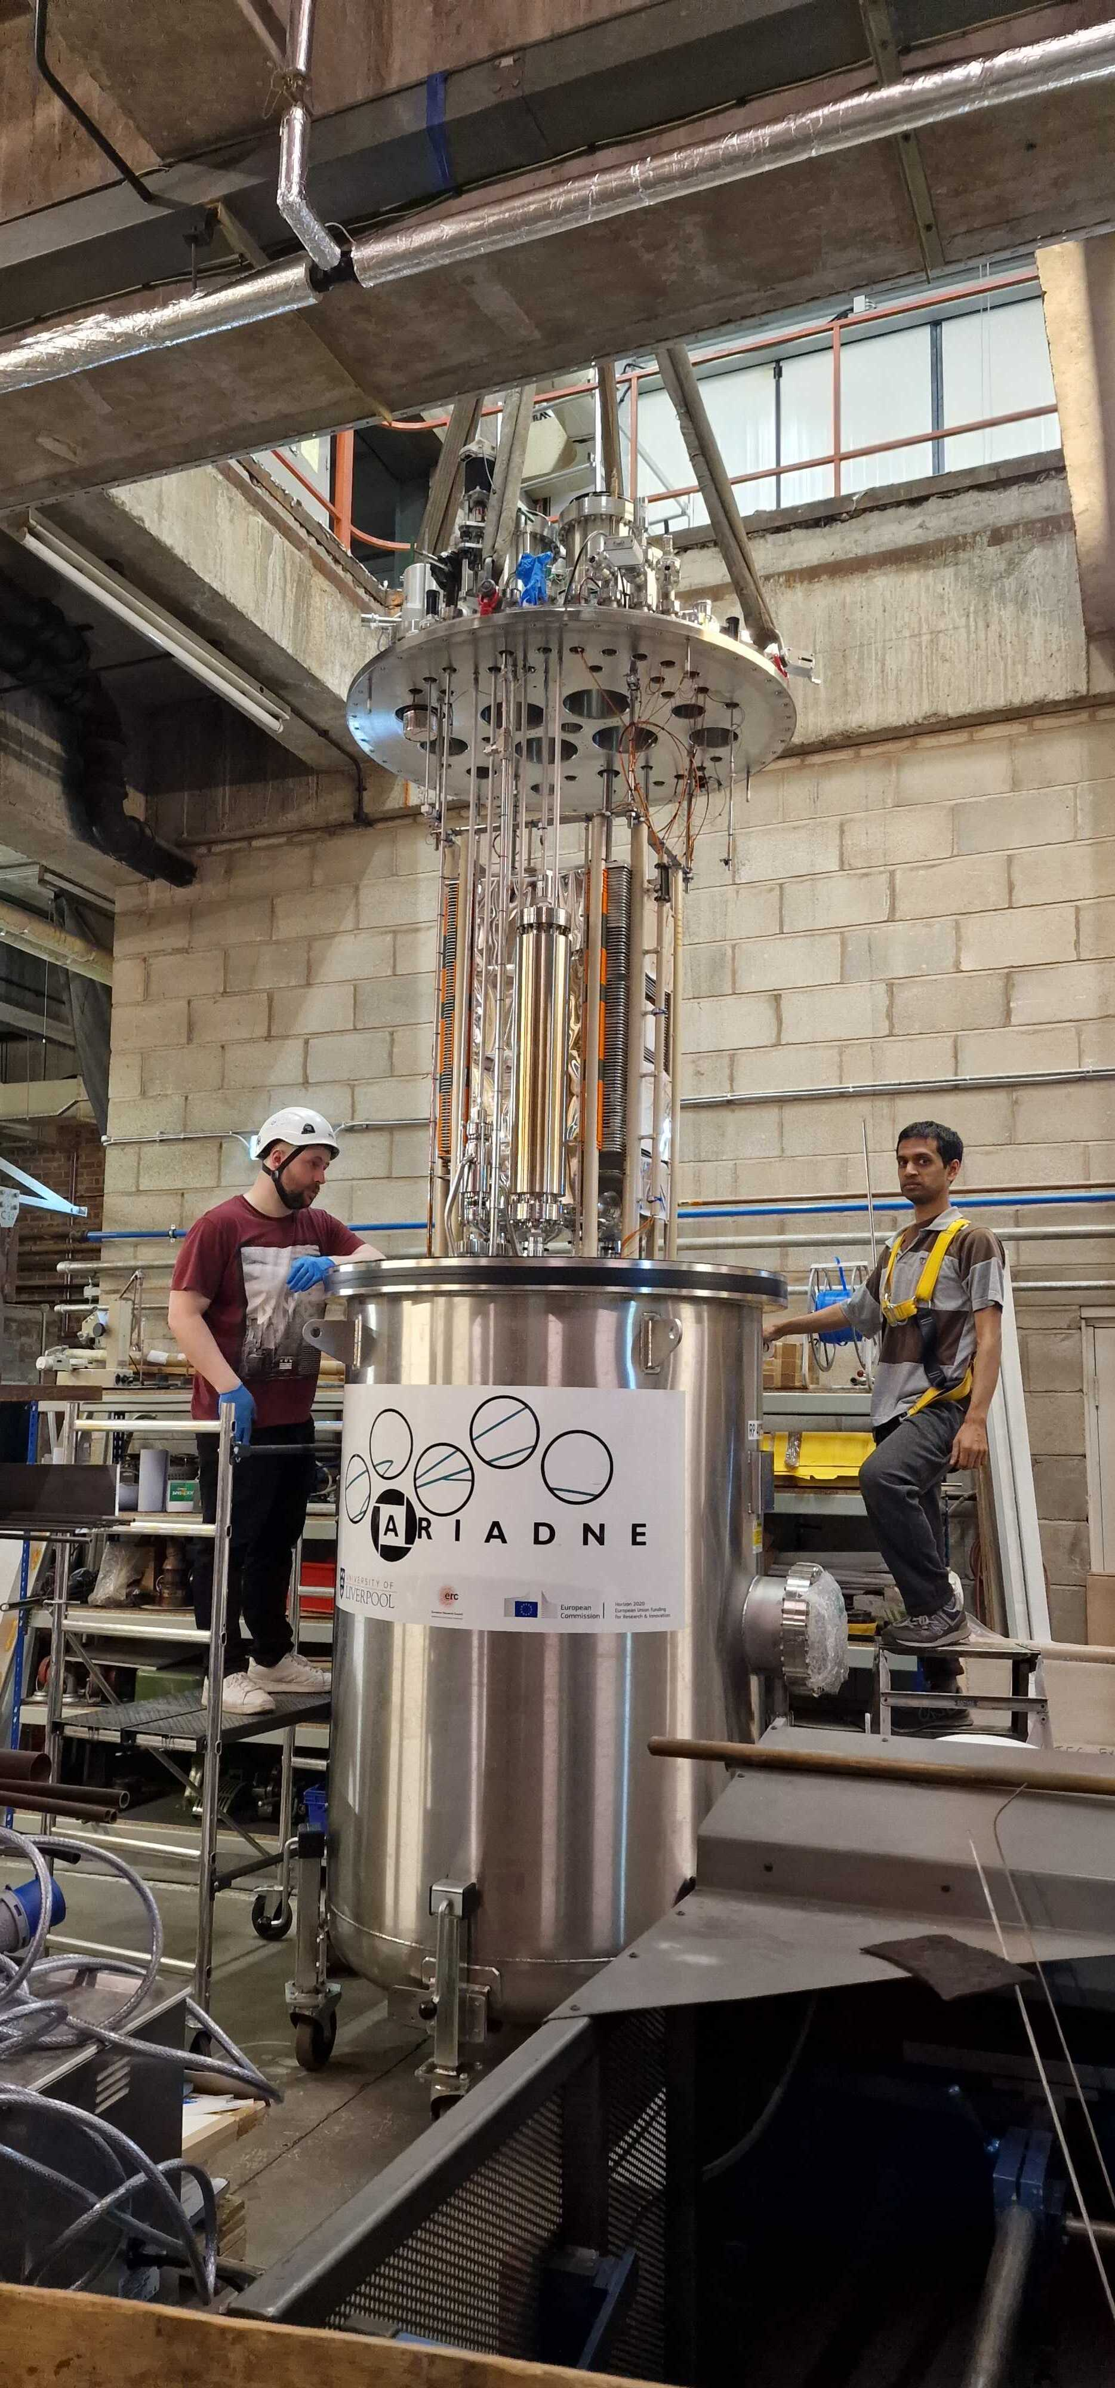
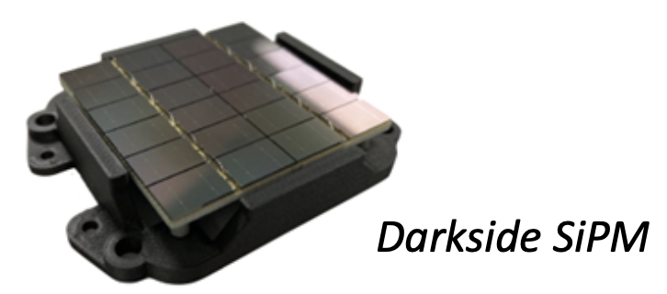
ARIADNE 1-ton Run @Liverpool
ARIADNE run just finished, tested some of the proposed instrumentation for protoDUNE.
Three TPX cameras installed, with the remaining ¼ of the detector dedicated to Darkside SiPMs.
Measure the response of Darkside SiPMs to varying THGEM bias and determine the correct gain for ProtoDUNE operation (in collaboration with Naples)
Test different types of intensifier - one previously used on ARIADNE and the new intensifier on ARIADNE⁺
Test TPB coated glass for WLS instead of PEN - assessing difference in light quantity
Calibration gamma sources tests

Slide 15
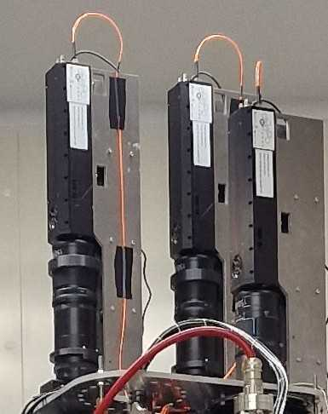
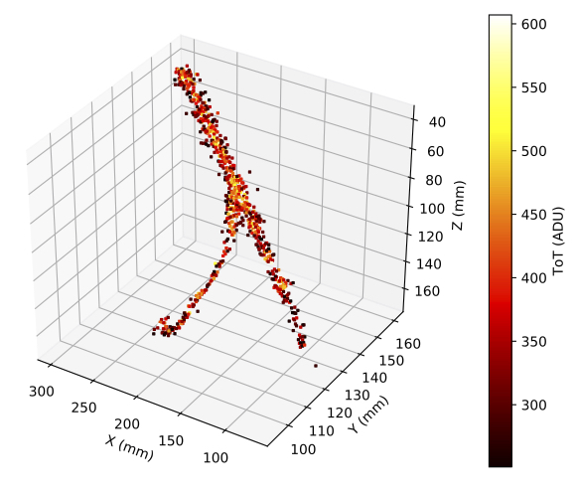
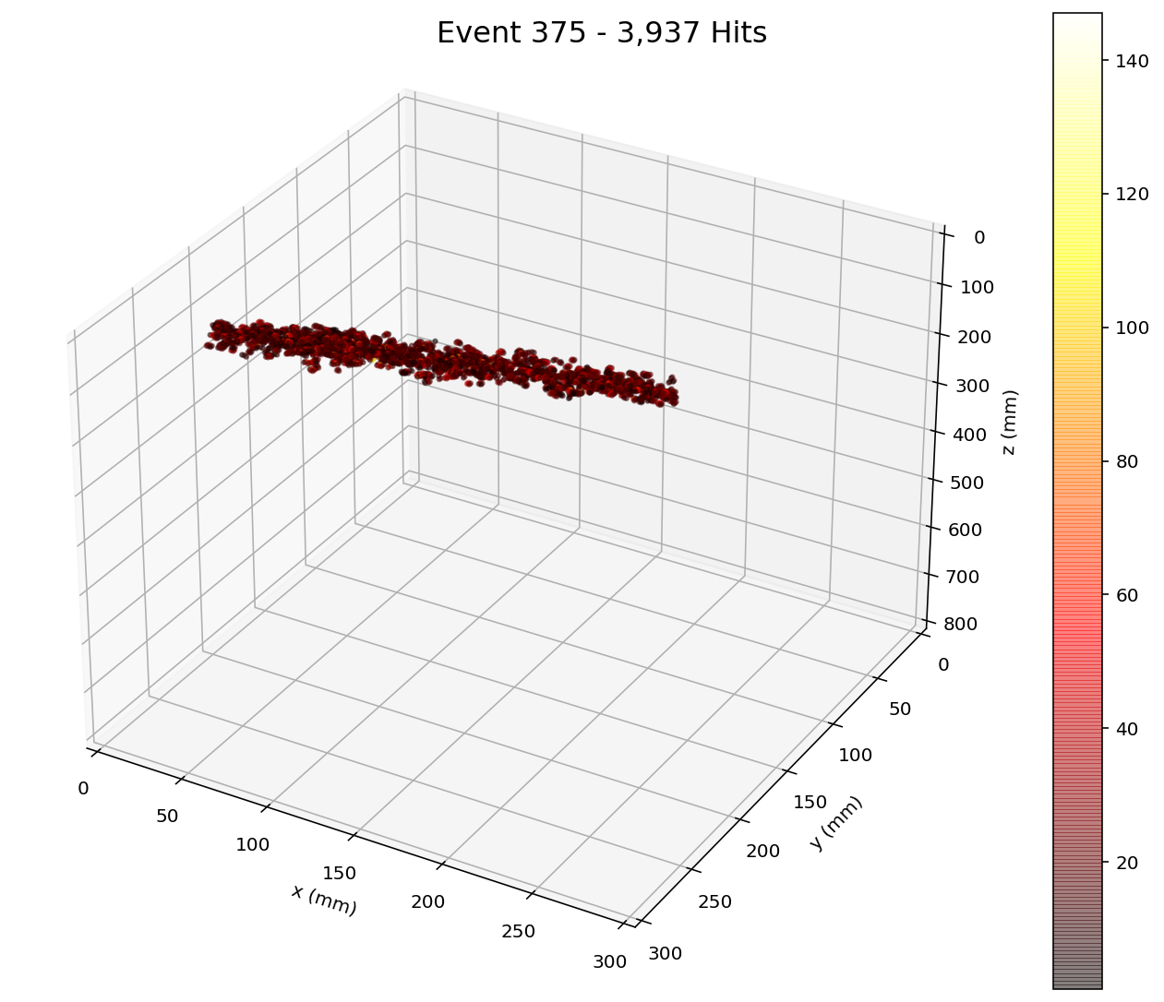
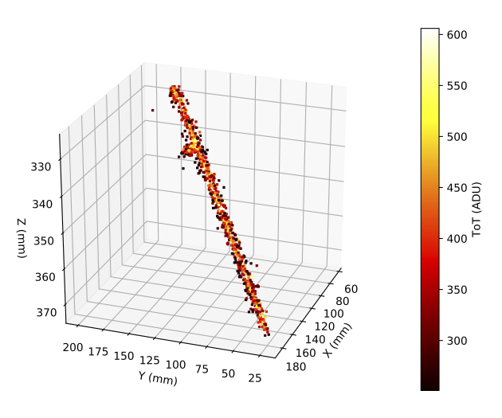
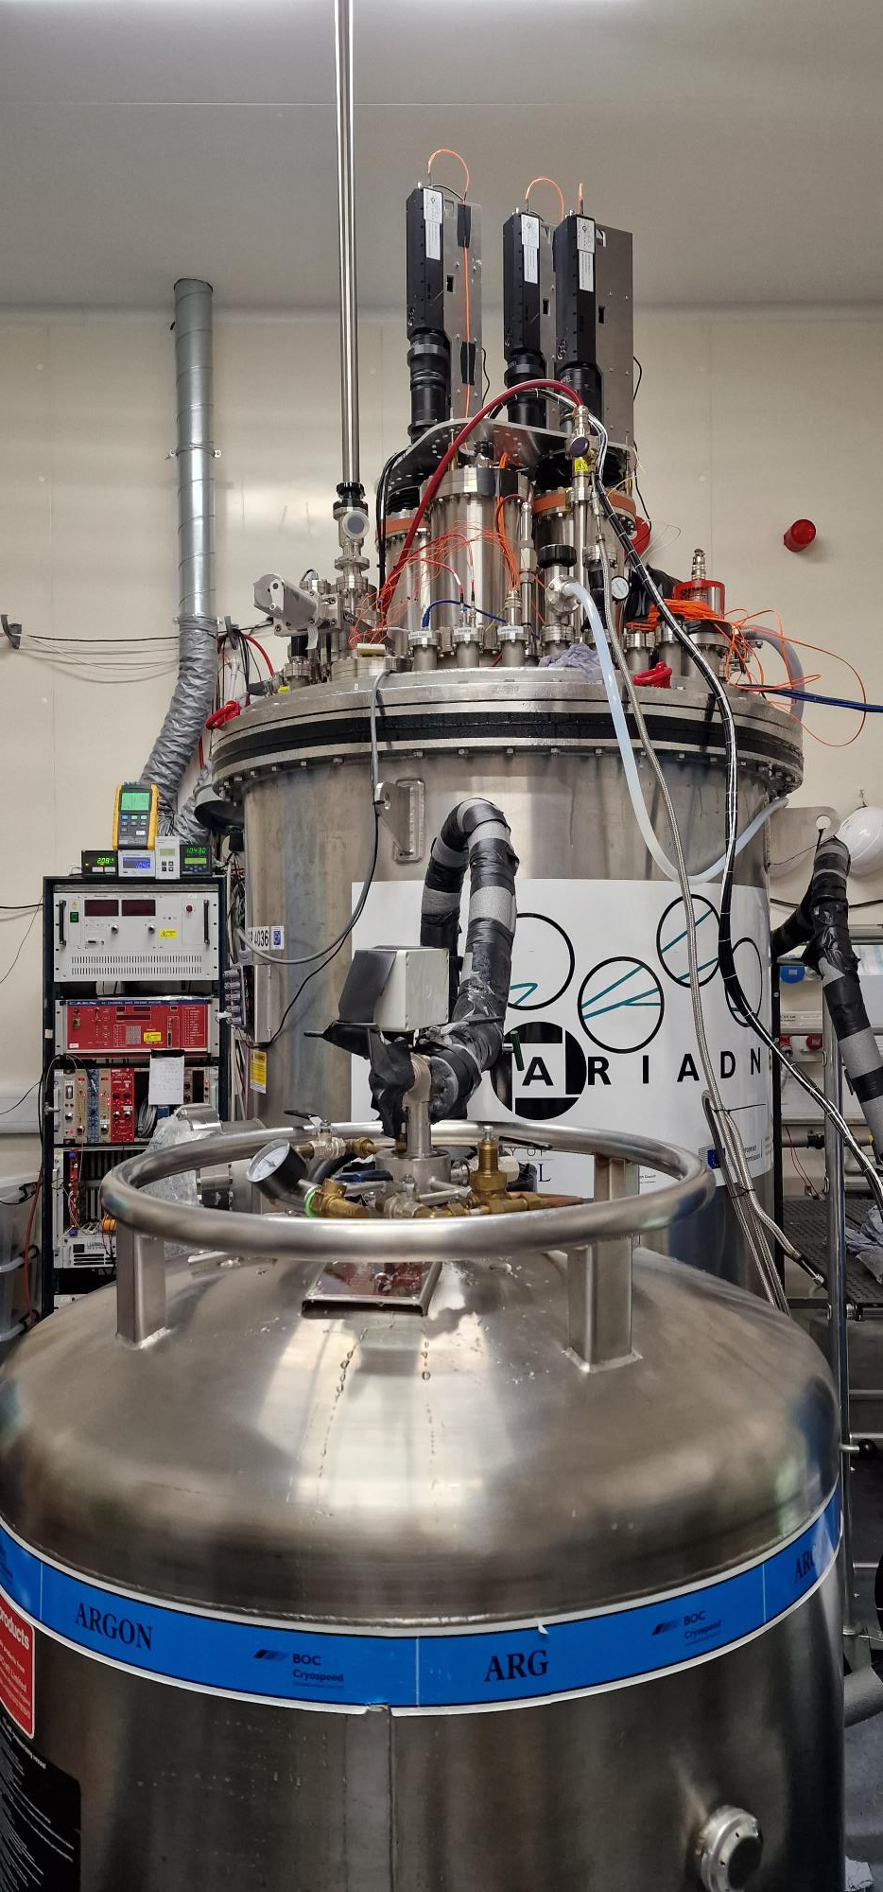
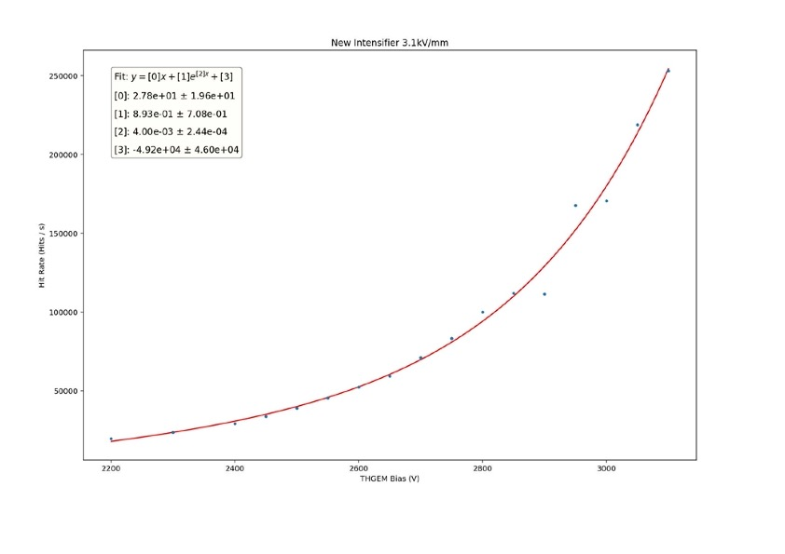
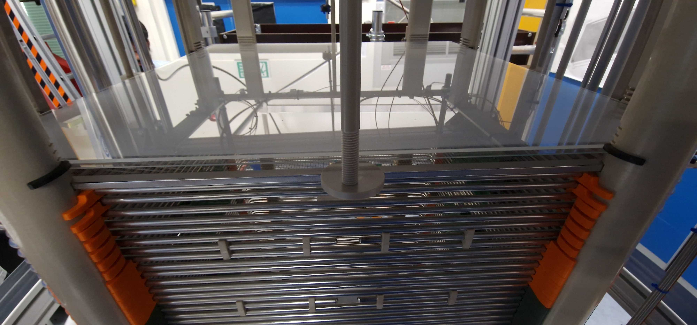
ARIADNE-1ton LAr Run with new G-THGEM
THGEM Bias scan

Slide 16
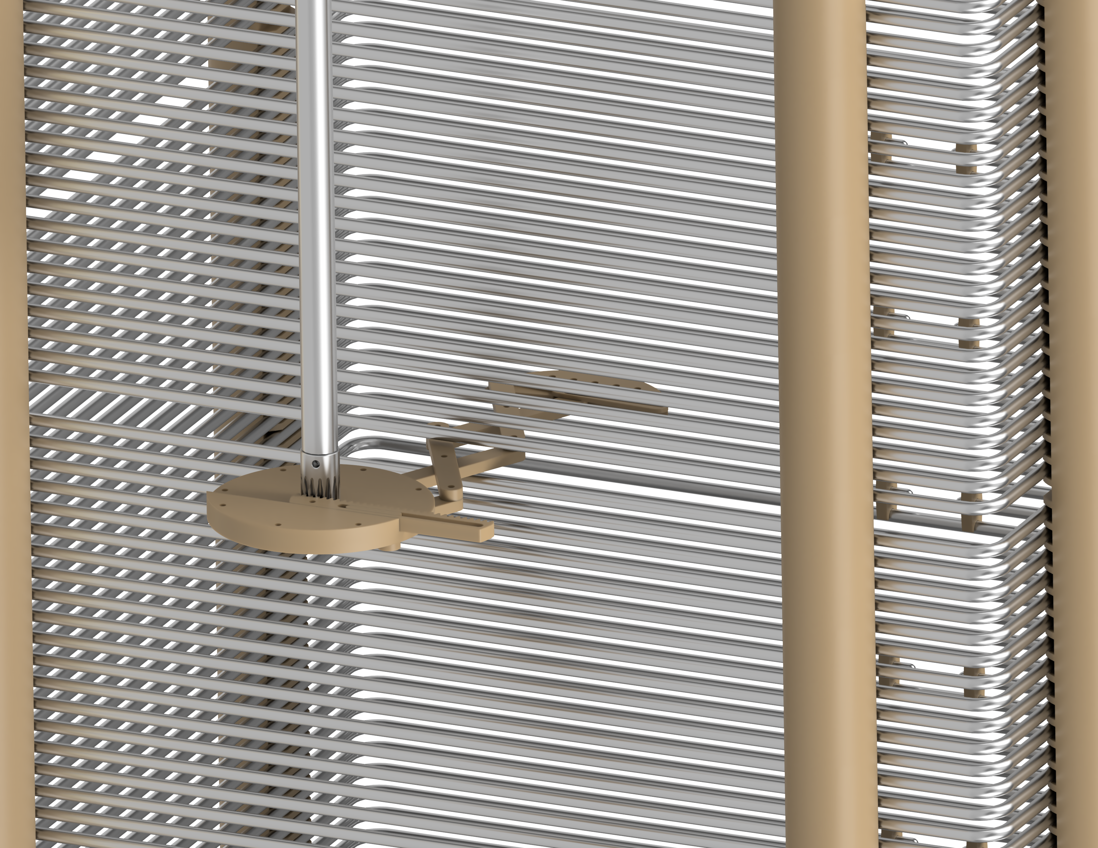
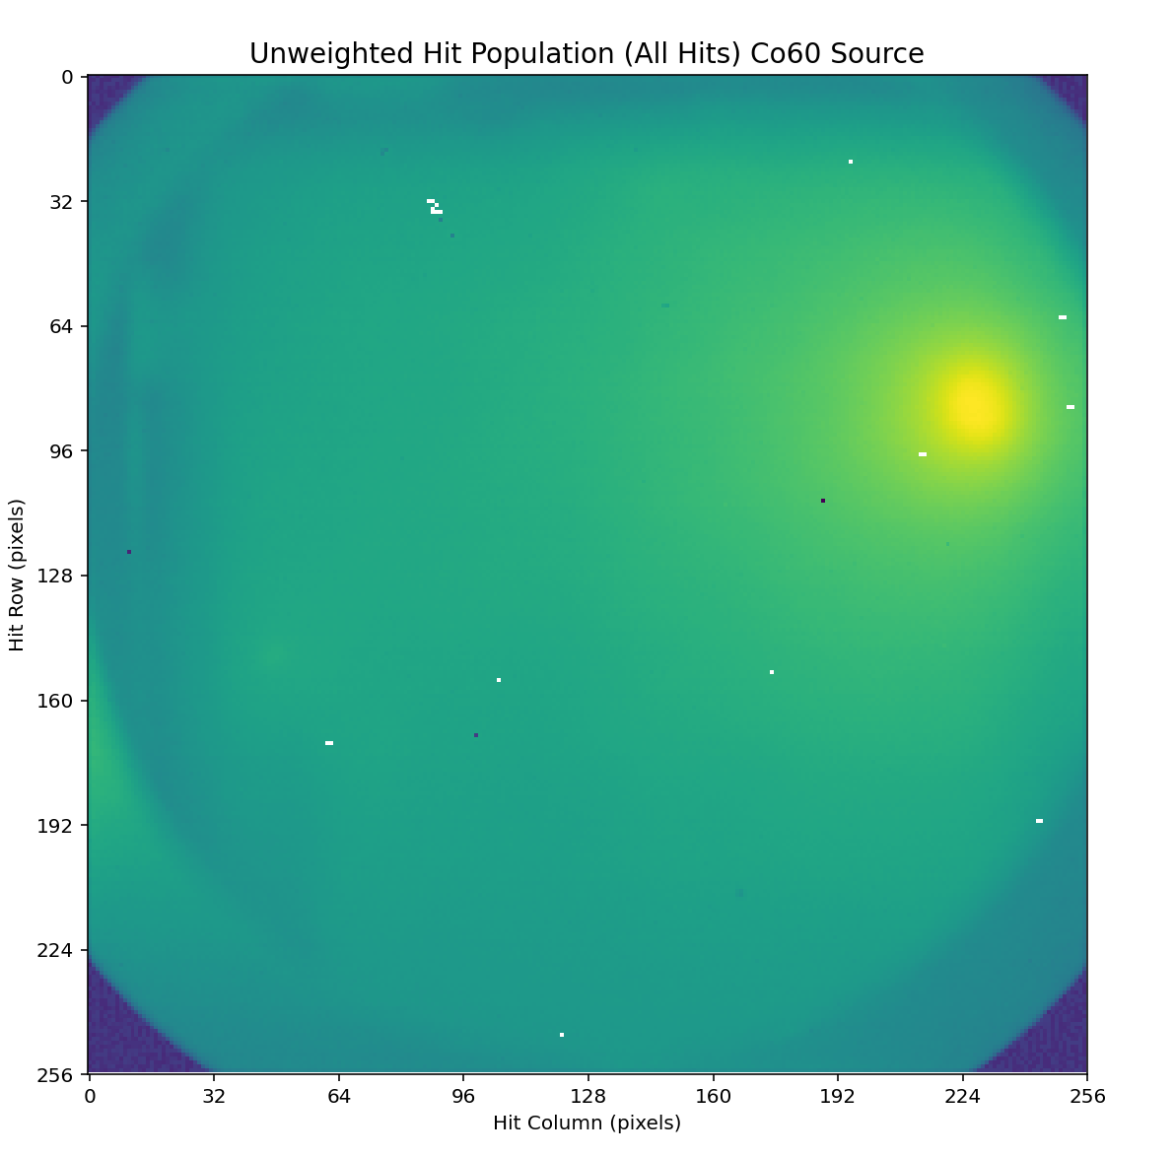
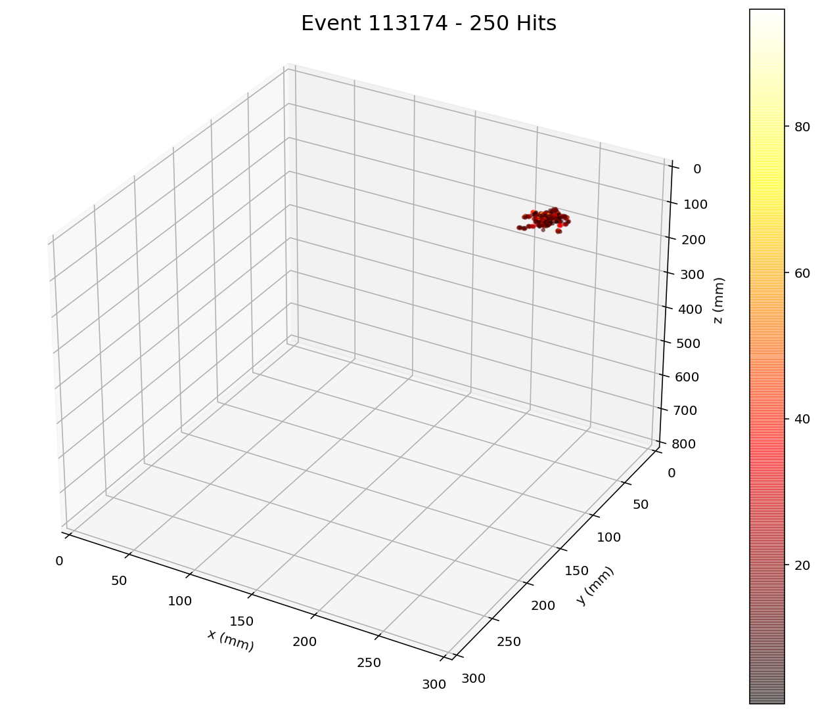
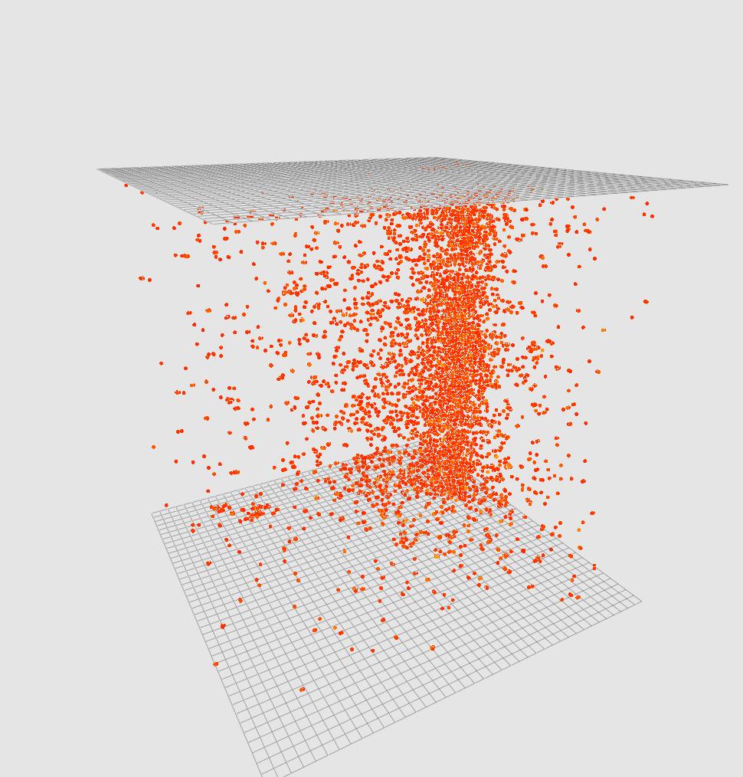
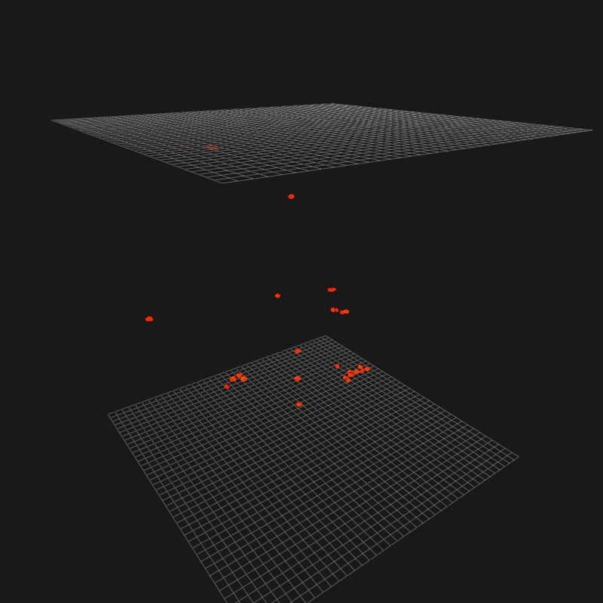
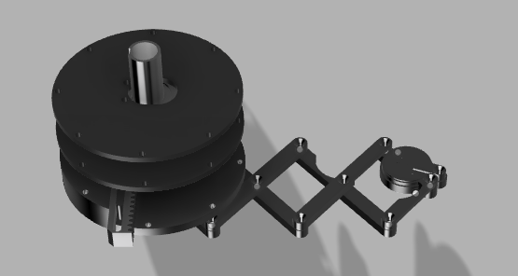
Calibration sources on ARIADNE
Co60 Heatmap - 14 mins long
Individual 1.2 MeV gamma
SIPM tiles above the glass THGEM
1sec stream gamma source
0.5 msec

Slide 17
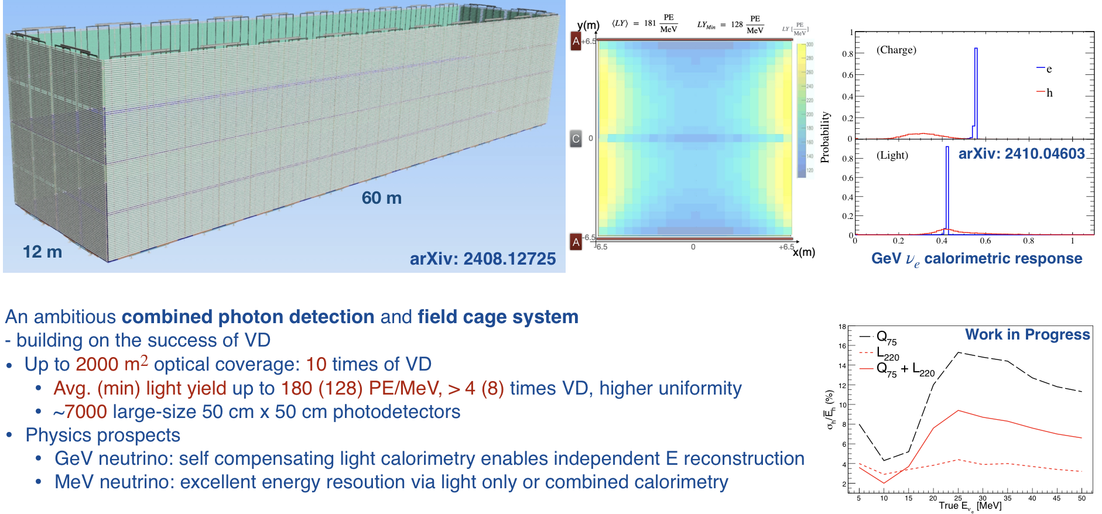
APEX Field Cage
APEX (Aluminum Profiles with Embedded X-Arapucas)
(Slide from Wei Shi)

Slide 18
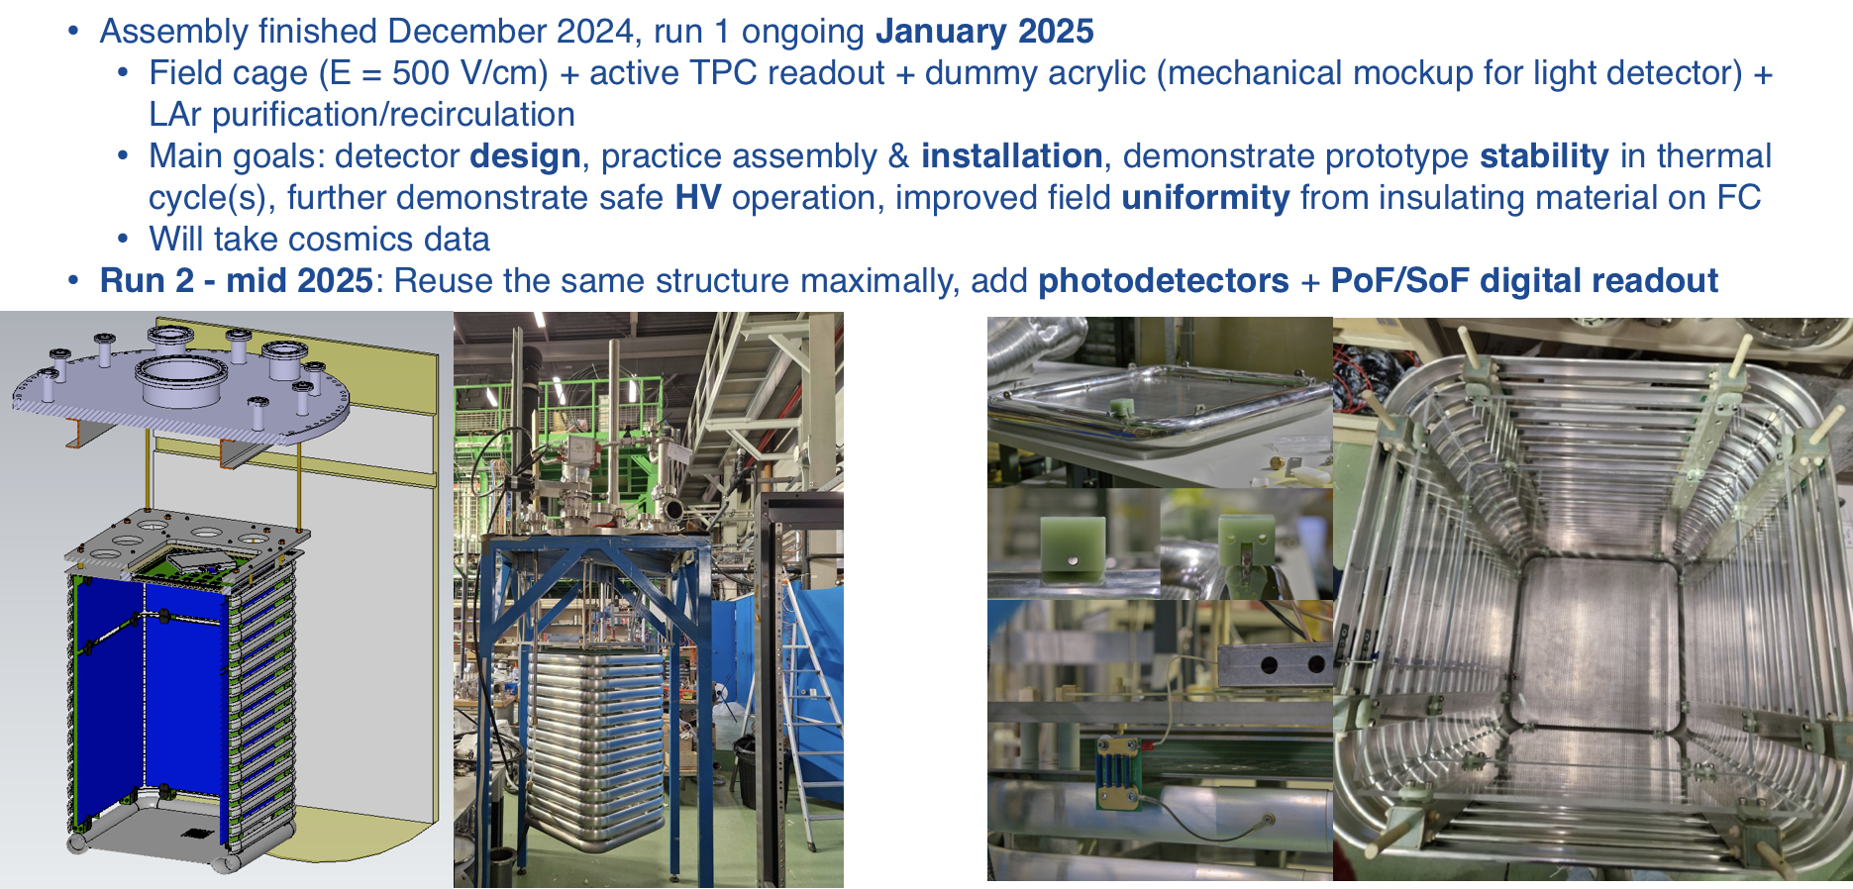
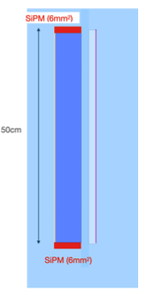
Staged CERN-2ton APEX Prototype Runs
(Slide from Wei Shi)

Slide 19
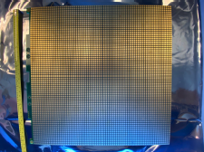


Pixelated CRP for ProtoDUNE III run
Pixelated Readout:
Propose to use the same LArPix tiles as Near Detector
Provide 3-D charge readout
Raw 3D images of cosmic ray
Sensor Pads (front side)
LArPix ASICs (back side)
(Slide from Cheng-Ju Lin)

Slide 20

Pixelated CRP for ProtoDUNE III run
  Install one pixelated CRP (pCRP) on the bottom of NP02
  Same dimensions as FD-VD CRP (~3m x 3m)
  To use the same tiles as DUNE-ND → 60 FSD size tiles
  Incorporate a custom cryo-compatible digital multiplexer (MADCAP) to aggregates data I/O from 16 tiles
Proposed LArPix FD
Anode Unit (3m x 3m)
  Short-Term R&D:
  Install 1 LArPix tile in 50L setup in B182 CERN this month
  Construct a full-size CRP (60 LArPix tiles) this summer and test in CRP Cold Box in EHN1
  Prototype MADCAP ASIC expected to be available in 2026
(Slide from Cheng-Ju Lin)

Slide 21


DarkSide-type PDUs
20.0 cm
For low background DUNE phase II operation scenario ( ie SloMo proposal*), a far detector module could be instrumented with SiPM devices covering the S2 light production and enabling single keV energy thresholds. The low background SiPMs developed for the DarkSide-20k experiment are an excellent technology candidate to achieve this and is proposed to be tested at ProtoDUNE III.
(Slide from Giuliana Fiorillo)
Conceived for DarkSide-20k
Large Surface per readout ch. (100 cm²/ch)
High PDE (40%), compact design
High radiopurity materials
4 differential readout channels
13 mV photoelectron at 7 V o.v.
Made by 16 SiPM tiles, each can be switched on/off remotely
Low noise, cryogenic trans-impedence amplifier on each tile (for TPC PDUs)
< 2 W consumption in Lar
Produced in Nuova Officina Assergi at LNGS (Assergi, L’Aquila, Italy)
Tested in INFN Cryolab, Napoli, Italy
  Both ISO 6 facilities for radiopurity constraints
*SloMo: https://iopscience.iop.org/article/10.1088/1361-6471/acc394
Disassembly of PDU support structure, at INFN Cryolab, Napoli

Slide 22

Using ProtoDUNE dual phase to test optical readouts for Neutrinos and DM; TPX3Cams, Pixel readout, DarkSide type PDUs & X-Arapucas (APEX)
Planned Proposal to SPSC:
TPX Cameras

Slide 23

ProtoDUNE dual phase instrumentation with optical readout
Darkside PDUs, along the beam line
TPX3 Cams in the existing cryostat ports
X-ARAPUCAs
Two LRPs with glass THGEMs, similar to the ARIADNE cold box test
Modify partially existing field cage, with embedded X-ARAPUCAS in CT shape profile. Low energy threshold S1 (APEX)
Cathode remains middle of TPC
CRPs (strips+pixels)

Slide 24

TOP VIEW Optical protoDUNE
12 Darkside-20k type PDUs produced in the UK/Naples
In dark green shade is the FoV of the TPX cameras(1mx1m) using the current cryostat ports
TPX3Cams ports
Space to test more optical sensors for very low energy thresholds such as Darkside-20k SiPMs
X- Arapucas will be used to cover the field cage (sides only and retain the rest of the field cage). X-Arapucas in the Field cage are of high importance to correlate S2/S1 signals for DM
X-ARAPUCAs
Cathode will remain in the middle for simplification and additional CRP tests

Slide 25

Design effort -LRP
One LRP to contain 6x5 Glass THGEMS (very similar design concept as the ARIADNE cold box test)
Made out of Invar
Similar size to a vertical drift CPR
Will hang from four top cryostat ports and will be able to move up down using the existing levelling motors
CAD Models By George Stavrakis

Slide 26

Design effort –LRP FEA
Hanging from four points under cryostat ports
FEA with tall beams and no weight of cathode
Max deflection 0.7mm
CAD Models & FEA By George Stavrakis

Slide 27



Design effort
To minimize LRP deflection the weight of the cathode will be held from the field cage structure.
Custom made add on cathode holders (installed without any drilling).

Slide 28
Design Effort -Assembly
Field cage support structure (hangs from cryostat ports)

Slide 29

Design Effort -Assembly
First LRP installation (independently hangs from cryostat ports)

Slide 30

Design Effort -Assembly
Second LRP (hangs also independently)

Slide 31

Design Effort -Assembly
Cathode planes hangs from field cage structure

Slide 32


Design Effort -Assembly
Field cage installation (mixture of the old and new square X-ARAPUCAs)
(APEX, Flavio Cavanna et.al)

Slide 33

Proposed Timeline
LRPs and pCRP final production drawings by Q4 2025
LRPs, pCRP & APEX procurements and assembly starts Q4 2025
LRPs/pCRP Completion Q4 2026
Cold Box tests Q4 2026
Start TPC integration in cryostat end Q1 2027
Start LAr filling Q3 2027

Slide 34

LOI & Requests to CERN
Use of the excellent infrastructure at the CERN Neutrino Platform:
Use of the NP02 cryostat
Cryogenic operation and re-circulation of LAr for purification (cryogenics team).
Design effort for integration
Installation support of the detector components
In general, all logistics for the smooth and safe operation of the cryogenic detector.
LoI letter to be submitted soon

Slide 35
Extra Slides

Slide 36


TPX3 -> TPX4

Slide 37


THGEM S2 light production
VUV (126nm) light produced through de-excitation of Argon gas.
TPB Wavelength shifter above THGEM converts to 430nm.
At low field (<2kV/cm), S2 light production is linearly proportional to THGEM field. No charge gain. Very stable operation without discharges. No ion production.
At higher fields, electron multiplication occurs (Townsend avalanche).
Exponentially increasing S2 light production -> Improved sensitivity/threshold
Simulation

Slide 38



G-THGEM Characterisation
THGEM charging behaviour
Bi-conical holes lead to “upwards” charging over time.
Straight wall holes lead to “downwards” charging over time
The charging behaviour of fused silica THGEMs results in greater light production for the same applied field.
All circle hole glass THGEMs produced more light than the equivalent FR4 THGEM.
THGEM bias scan
https://www.mdpi.com/2076-3417/11/20/9450

Slide 39





Glass THGEM Facility
G-THGEM: https://www.mdpi.com/2076-3417/11/20/9450
Abrasive machining facility in the University of Liverpool physics building
Fully automated
Capable of machining 850mmx850mm active area
Not limited to glass, any brittle material i.e. ceramic, carbon fibre etc.
Will lead glass THGEM R&D
And capable of protoDUNE large scale THGEMs
G-THGEM with ITO electrodes and holes formed by abrasive machining.

Slide 40


50cm Glass THGEMs
Novel Glass THGEMs developed at Liverpool (Patent GB2019563.2)
Sixteen 50cm x 50cm glass THGEMs
1.1mm thick,
500μm ID holes,
800μm pitch hexagonal array
See for more details:
https://www.mdpi.com/2076-3417/11/20/9450

Slide 41


PEN WLS
Two grades of TEONEX PEN foil investigated Q51 and Q53.
Thinner PEN consistently found to have a better conversion efficiency than thicker sheets (surface interaction).
Q51 consistently found to have a better conversion efficiency than Q53.
50cmx50cm Q51 25μm PEN film glued on glass panel

Slide 42





Focusing VUV Intensifier using GAr TPC
Alphas from Am-241 in 1100mb pure argon
+1mm
+2mm
Spacer rings
MgF₂ objective lens position is fixed into viewport.
Spacers change focal length position between objective lens and intensifier photocathode.
+2mm found produce sharpest image (in GAr).
+3mm
Intensifier photocathode QE

Slide 43




Light Readout Plane (LRP) Design
Modular design and can be applied directly to a DUNE module
Bottom view
Welded Invar structure (Uniquely low coefficient of thermal contraction)
16x 50cm square G-THGEMs
2.3m
Photochemically etched extraction grids
THGEMs/Extraction grids supported by PEEK Spacers

Slide 44


Light Readout Plane (LRP)
LRP assembly at CERN

Slide 45

Light Readout Plane
LRP CAD
LRP grids, G-THGEMs and WLS
2x2m LRP G-THGEMs from underneath
The 15mm modular extraction region provided a very stable extraction field!

Slide 46
ProtoDUNE new FCage
Drawing by G. Stavrakis

Slide 47

ProtoDUNE cathode, X-ARAPUCAS

