Slide 1
MQXFA20 Structure & Shim Review Introduction & Charge
Giorgio Ambrosio
Magnets L2
U.S. HL-LHC Accelerator Upgrade Project
MQXFA20 Structure & Shim Review
January 23, 2025

Slide 2
Committee
Peter Wanderer, chairperson (BNL)
Mike Anerella (BNL)
Rodger Bossert (FNAL)
Susana Izquierdo Bermudez (CERN)
Date and Time
January 23, 2024. Start time is 7/9/10/16 (LBNL/FNAL/BNL/CERN,CEA)
Location/Connection
Video-link by Zoom, info by email.
Link to agenda with talks and other documents
MQXFA20 Structure & Shims Review (January 23, 2025) · INDICO-FNAL (Indico)

Slide 3
Review Goals
The HL-LHC AUP project is starting the assembly of MQXFA20 quadrupole magnet. If MQXFA20 meets MQXFA requirements [1] it will be used in a Q1/Q3 cryo-assembly to be installed in the HL-LHC.
MQXFA20 coils were presented and approved at the MQXFA20 Coil Acceptance Review [2].
Discrepancy or Non-Conformity Reports are generated whenever a component does not meet specifications [3-4].
The goal of this review is to evaluate MQXFA20 structure and the proposed shim plan including tapered load shims.

Slide 4
CHARGE Questions
The committee is requested to answer the following questions:
Have all recommendations from previous reviews [5] been adequately addressed?
Have discrepancies and non-conformities been adequately documented and processed?
If there are major/critical non-conformities, have they been adequately documented and processed?
Are the proposed shims adequate for allowing MQXFA20 to meet MQXFA requirements [1]?
Do you have any other comment or recommendation to assure MQXFA20 is going to meet requirements?

Slide 5
Major/Critical DR/NCR:
Critical nonconformance: a nonconformance which meets at least one of the following:
affects form, fit, or function in the as-found condition
involves damage, or suspected damage, to the coil conductor
is likely to trigger yellow or red schedule or cost variance reporting thresholds
meets the requirements of “Moderate” or higher per the CERN Impact Matrix (for collaborations) in EDMS 1863763
Handling of Discrepancies and Nonconformances
US-HiLumi-doc-2484

Slide 6
References
MQXFA Functional Requirements Specification, US-HiLumi-doc-36.
MQXFA20 Coils Acceptance Review, US-HiLumi-doc-5434.
MQXFA Series Magnet Production Specification, US-HiLumi-doc-4009.
Handling of Discrepancies and Nonconformances, US-HiLumi-doc-2484.
MQXFA19 Structure and Shims Review, US-HiLumi-doc-5381.

Slide 7
Traveler Upload Status
Update by Jamie:
“I just went through the travelers and we still need to complete/close the four coil interface travelers (coil review report is still missing). I've initiated step signoffs for a number of items.
For the magnet, I did manage to sign off a couple of steps in MTF, but most still remain open because LBNL is still to complete and sign off in Vector. I know Jennifer is working on getting their travelers uploaded to the Vector traveler.
All the coils are now attached to the magnet asset in MTF.
All remaining documentation for CA03 has been sent to Hector in the last batch. We are working to complete CA04 documentation”

Slide 8
MQXFA19 Review Recommendations
Proceed with the assembly of MQXFA19.
MQXFA19 assembly is in progress. Coil pack magnetic measurements were taken before the holidays and shared with CERN.

Slide 9
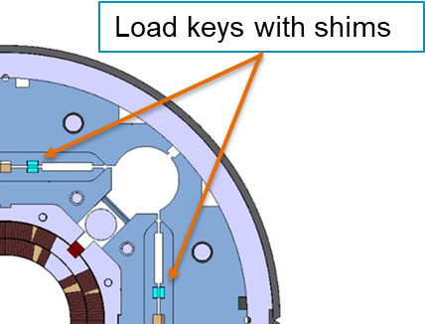
MQXFA19 Review Comment
In regard to the issue of using tapered load keys in the non-lead end, it was noted that the coil lead end is undersized at two positions, whereas the non-lead end is undersized at only one position, that being where the shim contacts only the metal part of the end shoe. This may not be desirable, because the larger shim over the metal area may have the effect of reducing the preload where the cable is making the turn. Coupled with the adage (“if it ain’t broke, …”), the committee supports the decision to not use tapered shims at the non-lead end.
We are planning FEM analysis to understand the impact of Tapered Load Shims in the non-lead end.
+ 100 μm + 0 μm
Tapered load shims in Lead End

Slide 10
Schedule
Today:
Talks
Q&A
Following days:
Closed session(s)
Possibly Q&A by email
Report by email or Zoom mtg in ~2 weeks

