Slide 1


MQXFA20
Coil Pack and Shimming Proposal
Dan Cheng, Katherine Ray, Paolo Ferracin, Mike Solis
Jan 23, 2025
LBNL

Slide 2
Outline
Coil Selection Review Recap
Coil CMM Summary
Coil Matrix
Proposed Coil Pack and shimming
Summary

Slide 3
Coil Selection Review Report Summary
MQXFA20 Coil Selection Review was held 12-Dec-2024
  Five coils reviewed, see https://indico.fnal.gov/event/67067/
    Coils 121, 125, 142, 146 chosen
    Coils 254 on hold for now
  All coils have b6 correction
  All electrical QC passed
  Fabrication reports and CMM reported
    Outer radial sizes appear similar
    Midplanes (“arc length excess”) appear to be similar

Slide 4
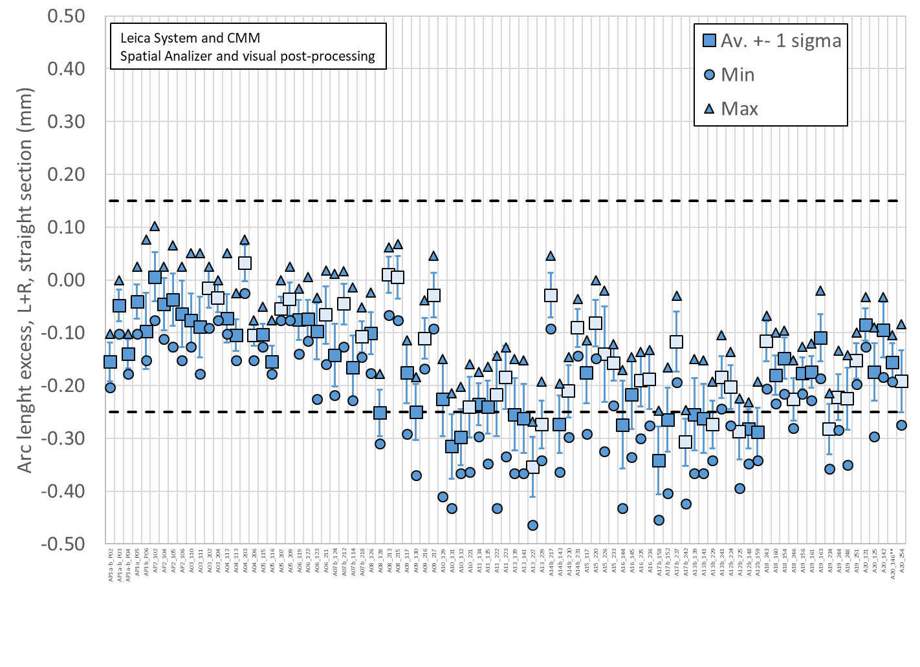
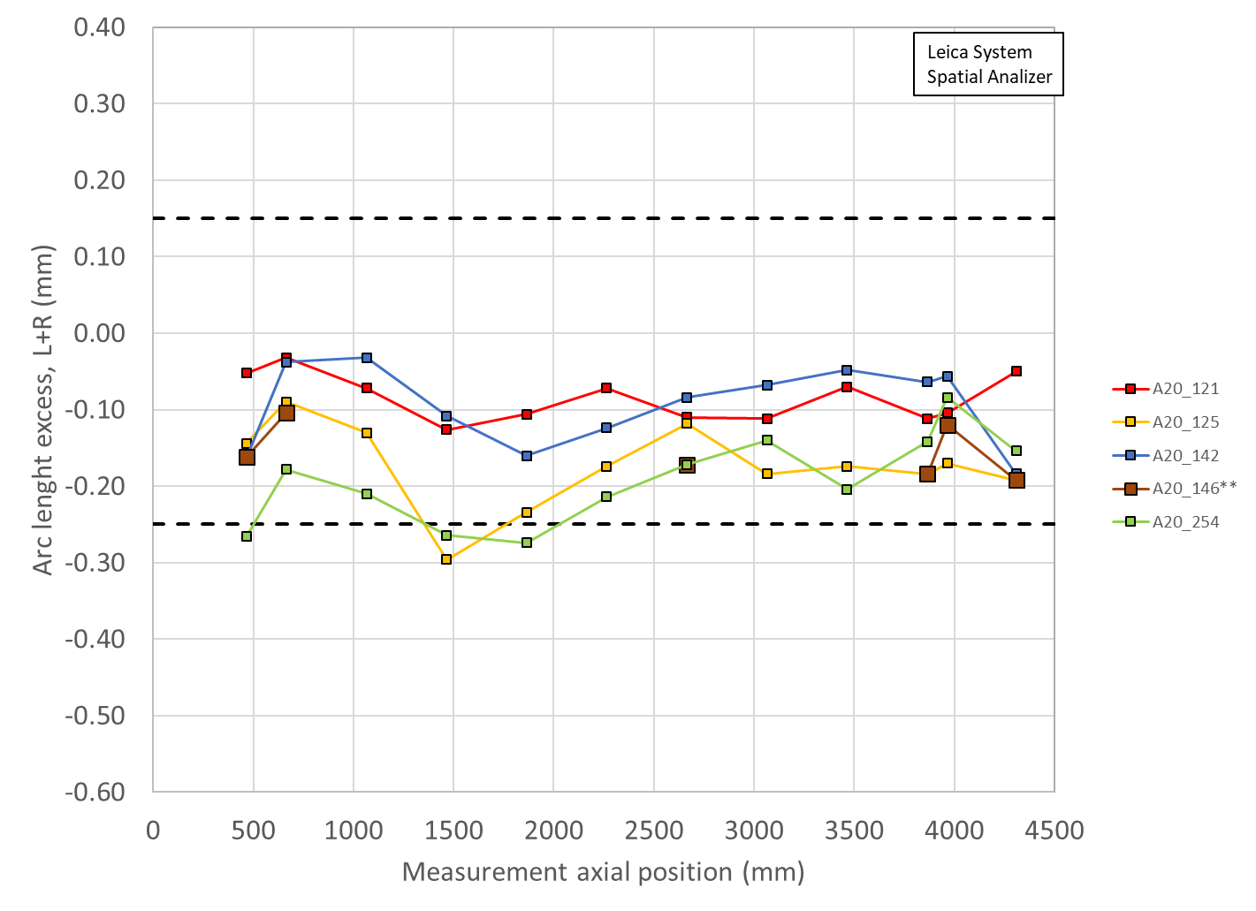
Total Arc Length Excess (Leica)
3965 mm is location of SG:
121 -104 µm (-85 µm avg)
125 -170 µm (-174 µm avg)
142 -56 µm (-94 µm avg)
146** -120 µm (-156 µm avg)
254 -84 µm (-192 µm avg)

Slide 5
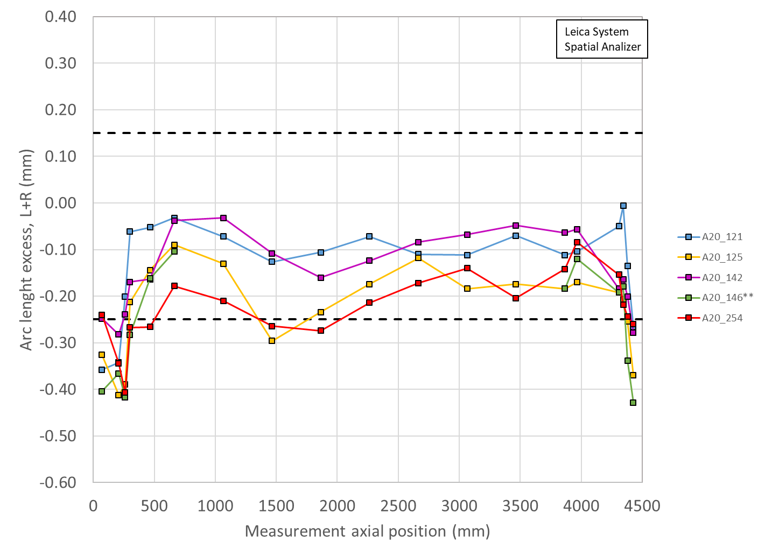
Arc length excess full length

Slide 6
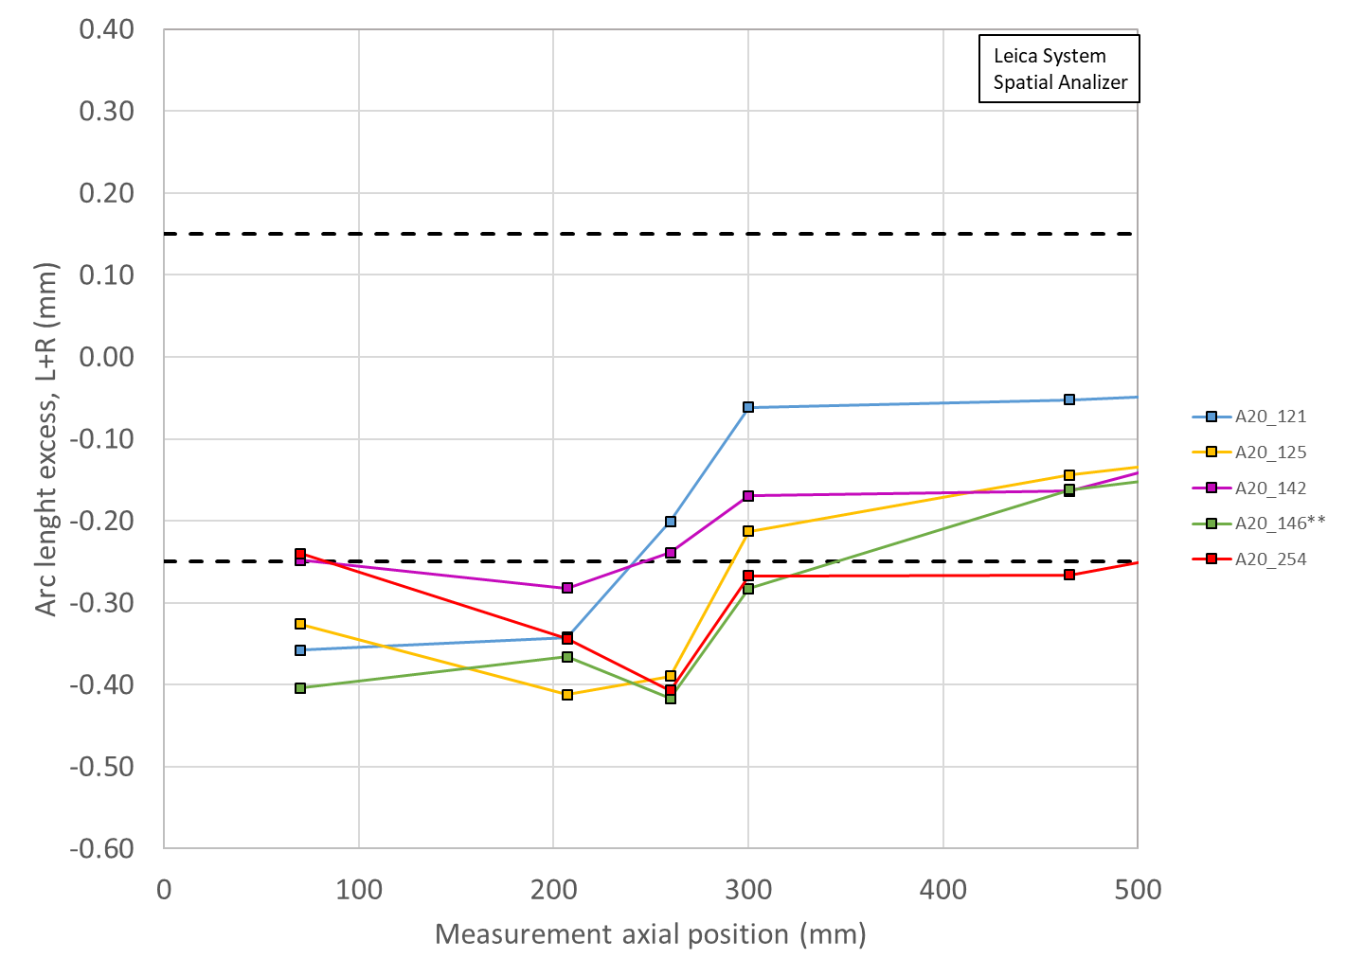
Arc length excess LE

Slide 7
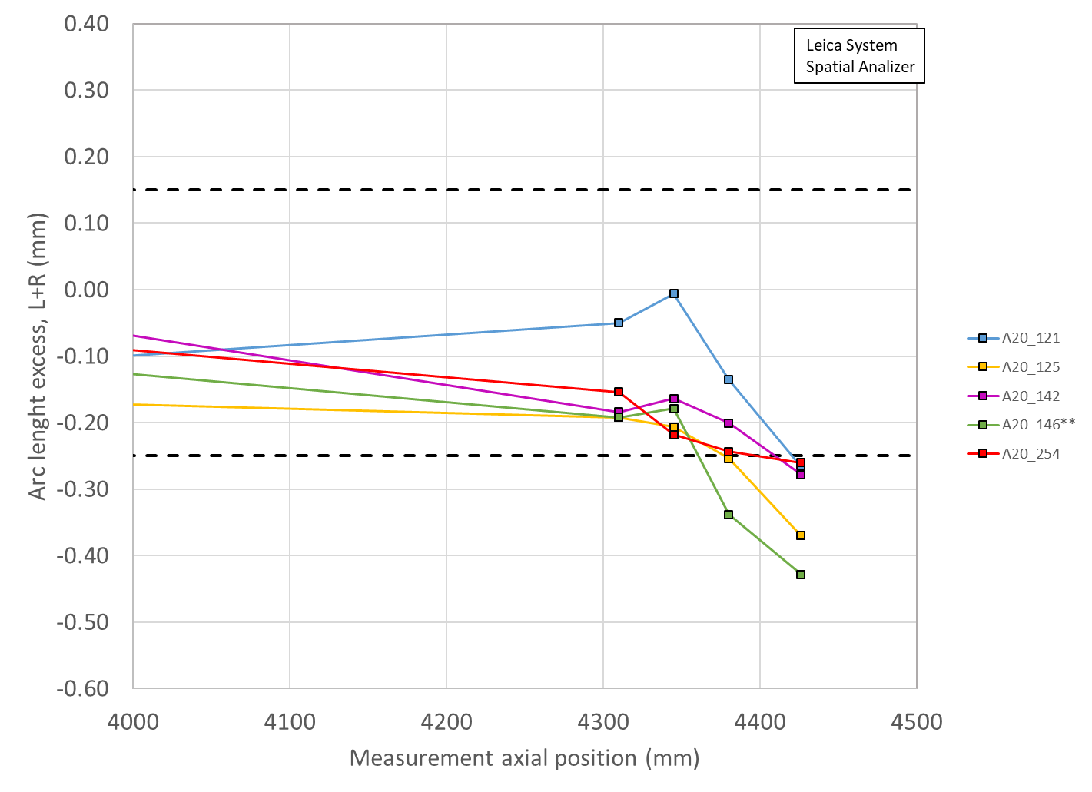
Arc length excess RE

Slide 8
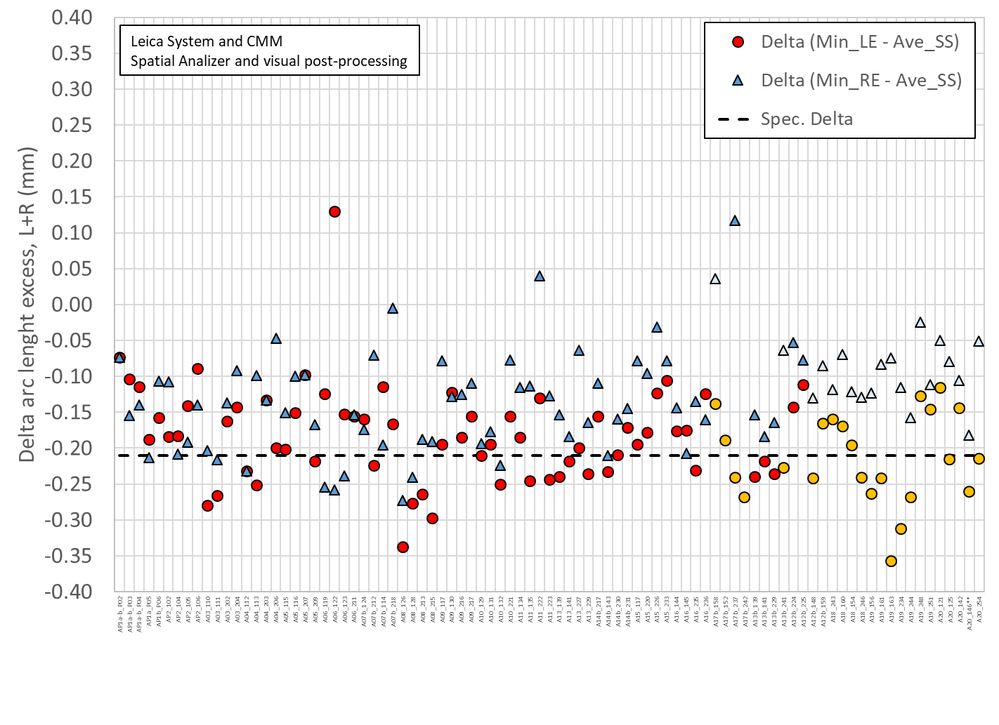
Delta arc length

Slide 9
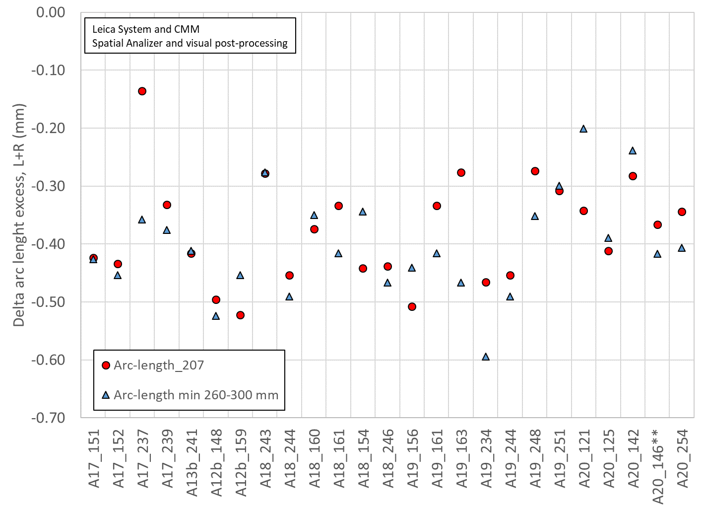
Delta arc length
The “min 260-300 mm” is, on average 0.025 mm smaller than the 207 mm value

Slide 10
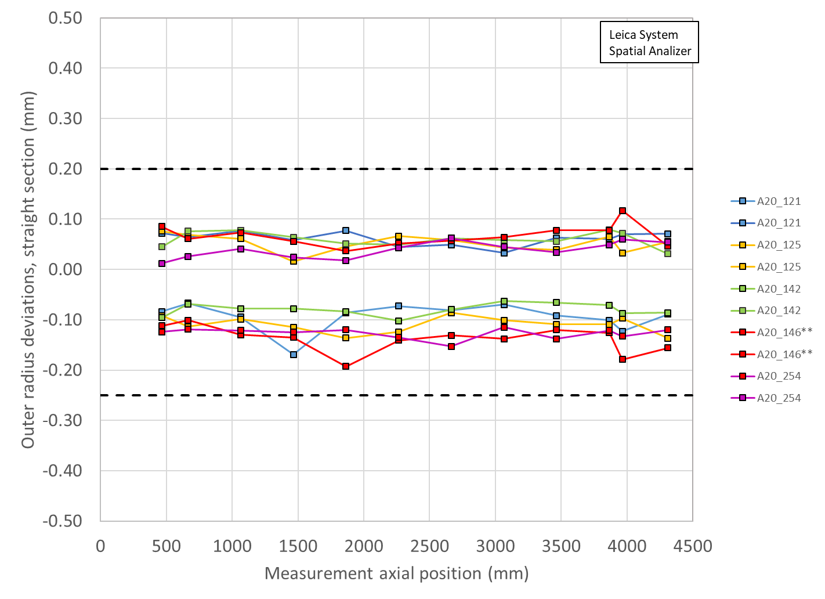
Outer Radius Profile Deviations (Leica)
All Coils within spec
Outer Radius deviation ranges are all similar among the coils

Slide 11
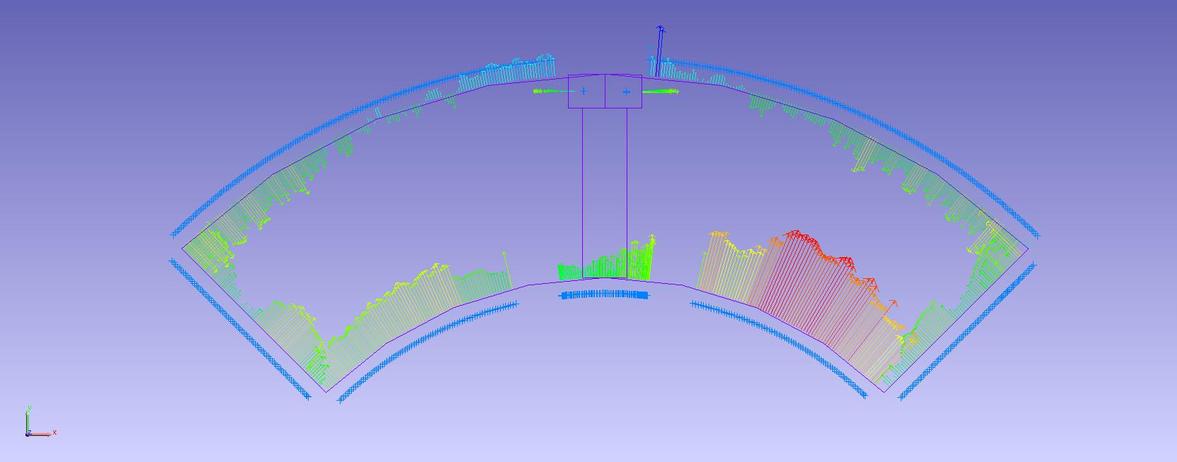
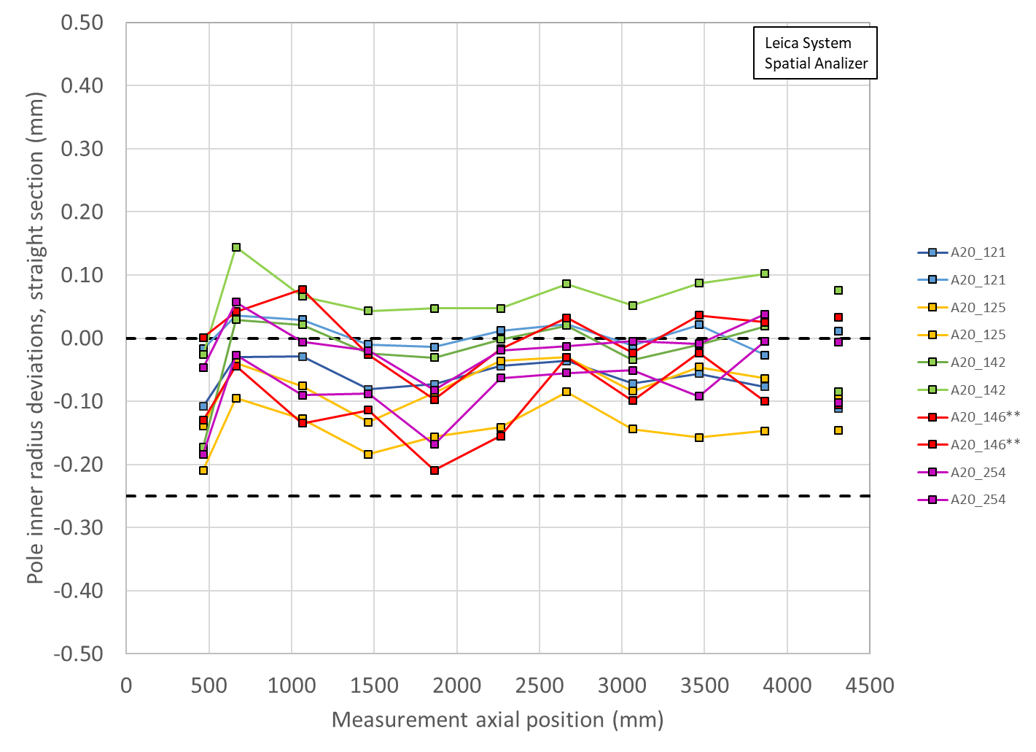
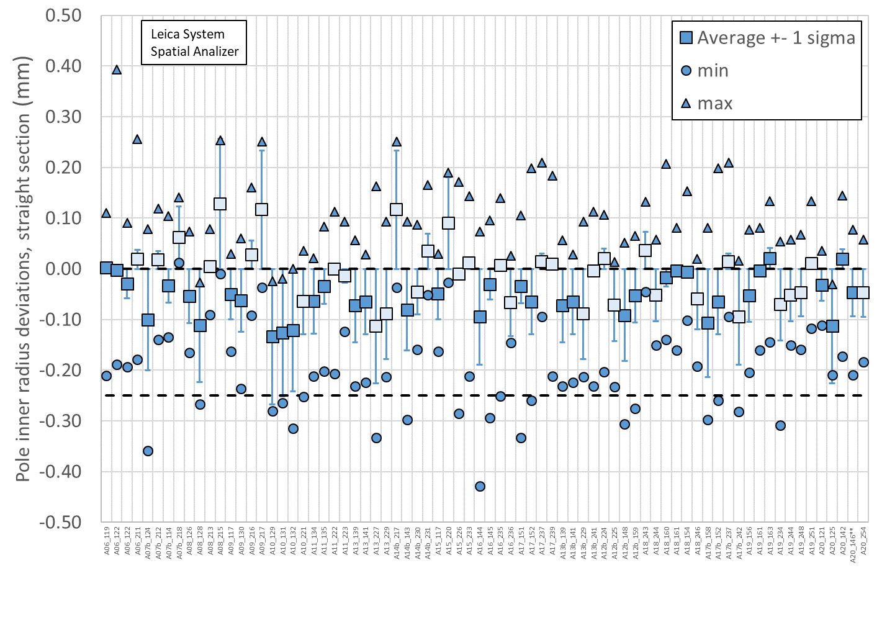
Pole Inner Radius Deviations (Pion Locations)
Inner Radius of the pole key is small (deviation into the bore)

Slide 12
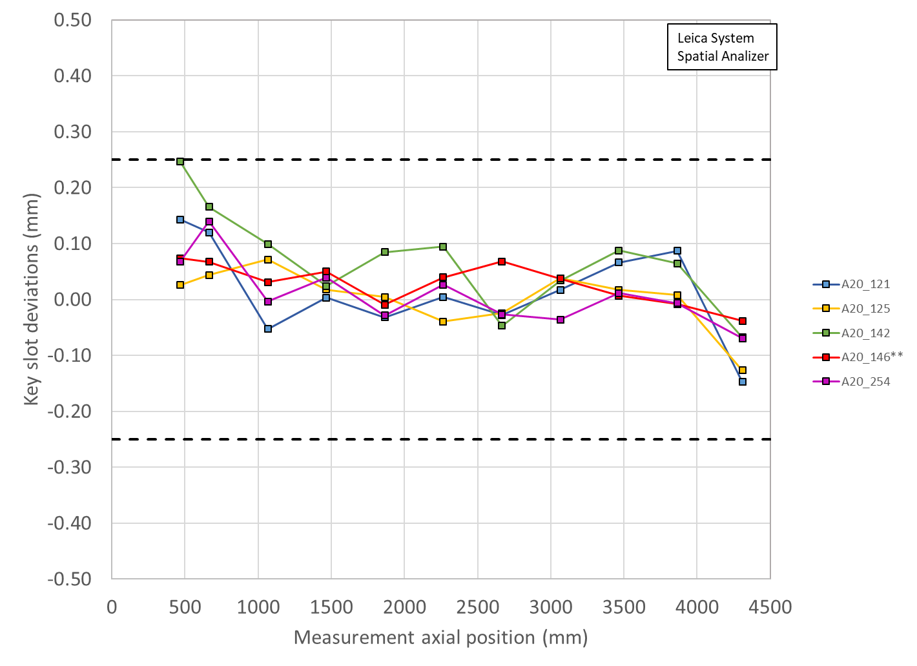
Key Slot Deviations

Slide 13
MQXFA20 Coils Matrix
Coil | b6 Corr. | Keyway shift | Avg. Pole Inner R Dev | Avg R Dev. | Avg. Midpl Dev. | Ends Delta Arc Length
121 | Yes | Ok | -43 µm | -17 µm | -42 µm | -116 µm
125 | Yes | Ok | -113 µm | -32 µm | -87 µm | -215 µm
142 | Yes | Ok | 21 µm over | -19 µm | -47 µm | -145 µm
146** | Yes | Ok | -44 µm | -36 µm | -78 µm | -261 µm
254 | Yes | Ok | -38 µm | -36 µm | -86 µm | -215 µm
Midplane: all coils are undersized, will require extra midplane shim
OD: all coils are slightly undersized
Most coils’ pole inner radii show deviations into the bore; pions will need to be machined in these locations
LBNL measurements are using Leica system data
  Coil 146 has significant midplane delamination
Coil 121 has Pre-Series voltage tap traces present
  Cannot place LE strain gauge for TLS

Slide 14
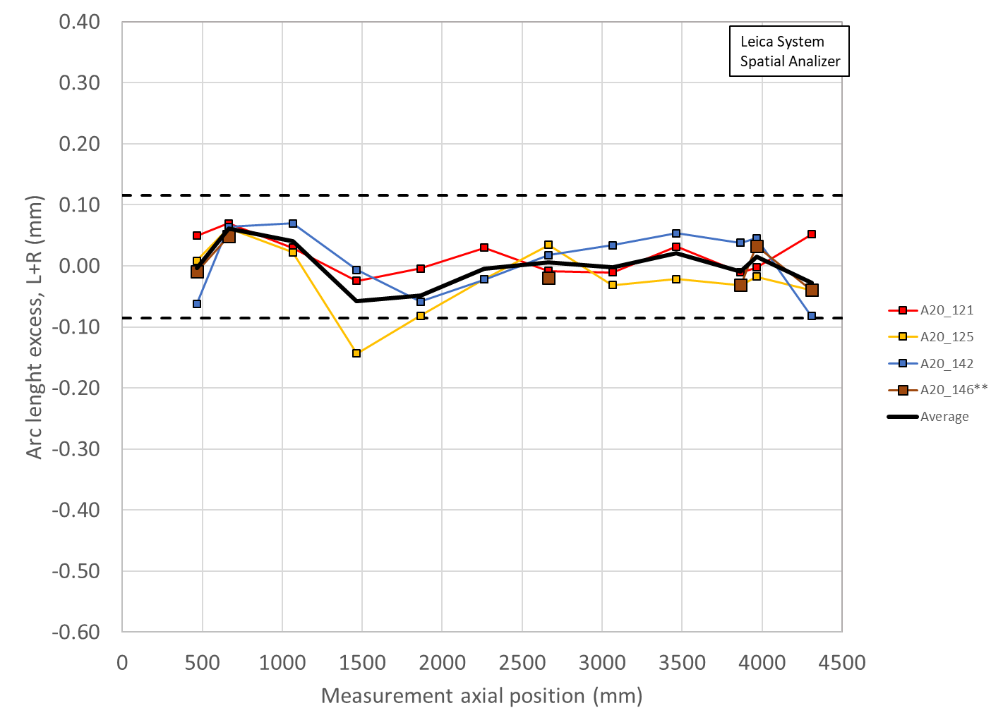
Coil Size estimates with midplane shims
Coil measurement plots created to show the effect of adding shims to both midplanes of Coils 121, 125, 142, 146
Limited by thicknesses of Kapton midplane shim availalble
Shimmed
0.002” on 121
0.003” on 125
0.002” on 142
0.003” on 146
Unshimmed

Slide 15
MQXFA20 Peak voltages
Coils reported in mechanical ordering from CSR
Peak voltages evaluated in usual failure scenarios
Will not use Coil 254
Will use Coil 121 as an upper coil
P1 | P2 | P3 | P4 | Volt
146 | 142 | 254 | 125 | 328
146 | 142 | 254 | 121 | 330
146 | 142 | 121 | 254 | 330
142 | 146 | 254 | 125 | 330
142 | 146 | 254 | 121 | 332
142 | 146 | 121 | 254 | 332
254 | 146 | 121 | 142 | 333
254 | 142 | 121 | 146 | 333
146 | 142 | 121 | 125 | 335
146 | 121 | 254 | 125 | 335
142 | 121 | 254 | 125 | 335
254 | 146 | 125 | 121 | 336
142 | 146 | 121 | 125 | 336
254 | 142 | 125 | 121 | 337
121 | 146 | 254 | 125 | 338
121 | 146 | 125 | 254 | 338
121 | 142 | 254 | 125 | 338
121 | 142 | 125 | 254 | 338
P1 | P2 | P3 | P4 | Volt
121 | 146 | 254 | 142 | 340
121 | 146 | 125 | 142 | 340
121 | 142 | 254 | 146 | 340
121 | 142 | 125 | 146 | 340
254 | 142 | 125 | 146 | 341
254 | 146 | 125 | 142 | 342
146 | 254 | 121 | 125 | 342
142 | 254 | 121 | 125 | 343
254 | 146 | 121 | 125 | 344
254 | 142 | 121 | 125 | 344
142 | 121 | 146 | 254 | 346
254 | 121 | 146 | 142 | 347
142 | 254 | 146 | 121 | 348
254 | 142 | 146 | 121 | 349
121 | 254 | 146 | 142 | 349
121 | 142 | 146 | 254 | 349
142 | 121 | 254 | 146 | 353

Slide 16
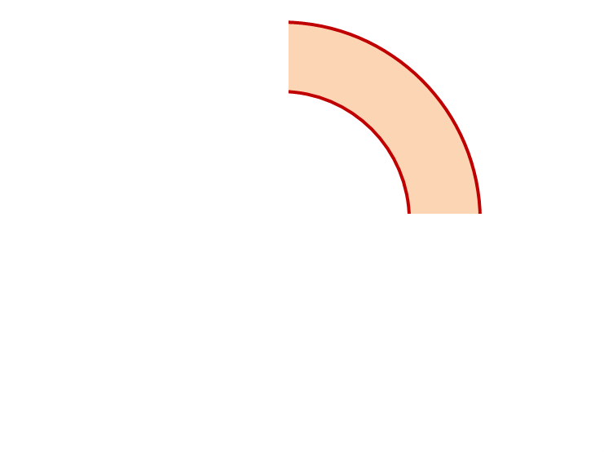
MQXFA20 Proposed Coil Arrangement
8 x δ_{midplane} = 2 π x δR_{OR}
~0.001” Undersized R
neglected
~.003” Undersized per Midpl.
Add 0.003” shim per side
~0.001” Undersized R
Neglected
~0.0015” Undersized per Midpl.
Add 0.002” shim per side
146
121
Q2
Q1
Q3
Q4
125
142
~0.001” Undersized R
Neglected
~0.0035” Undersized per Midpl.
Add 0.003” shim per side
~.001” Undersized R
Neglected
~0.002” Undersized per midpl.
Add 0.002” shim per side
Coil Electrical Order: A :121 – 142 – 146 – 125: B
Conforms to a favorable order based on RRR data

Slide 17
MQXFA20 Coil Pack Build 1 (Fuji)
Nominal Collar R: 114 mm
Nominal Coil R: 113.376 mm
Nominal Radial shim = 0.025” (0.624 mm)
  But we still target ~0.020”
Fuji radial stack up is ~0.021” (~0.54 mm)
  0.0045” Coil GPI + 0.007” Fuji + 0.005” Kapton & 0.003” Kapton
Add Kapton to various midplanes
 | 121 | 146 | 125 | 142
Kapton Ground plane insulation | 0.0045” (0.114 mm)
Coil Specific Radial Shim | 0 | 0 | 0 | 0
Coil-specific midplane shim | 0.002” 0.050 mm | 0.003” 0.075 mm | 0.003” 0.075 mm | 0.002” 0.050 mm
Fuji paper | 0.007” (0.175 mm)
Radial Shim | 0.005” Polyimide + 0.003” Kapton (~0.200 mm)

Slide 18
MQXFA20 Coil Pack Build (Final)
Nominal Collar R: 114 mm
Nominal Coil R: 113.376 mm
Nominal Radial shim = 0.025” (0.624 mm)
  But we still target ~0.020”
Actual radial stack up is ~0.020” (~0.51 mm)
  0.0045” Coil GPI + 0.005” Kapton + 0.005” Kapton & 0.003” Kapton
Add Kapton to various midplanes
 | 121 | 146 | 125 | 142
Kapton Ground plane insulation | 0.0045” (0.114 mm)
Coil Specific Radial Shim | 0 | 0 | 0 | 0
Coil-specific midplane shim | 0.002” 0.050 mm | 0.003” 0.075 mm | 0.003” 0.075 mm | 0.002” 0.050 mm
Fuji paper | 0.000” (0.0 mm)
Radial Shim | 0.005” Polyimide + 0.005” Polyimide + 0.003” Kapton (~0.33 mm)

Slide 19
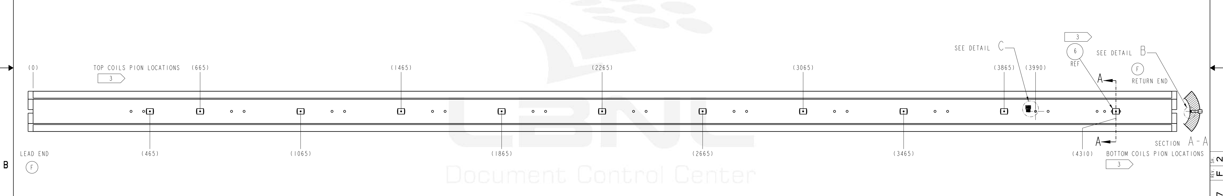
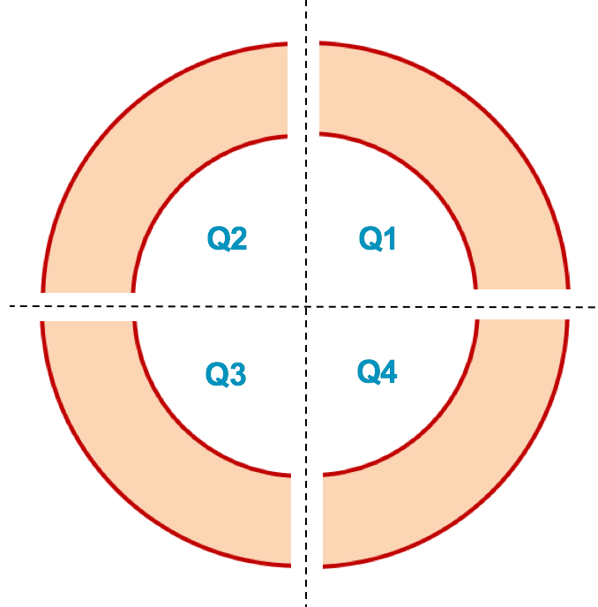
MQXFA20 Pion Machining Positions
Upper Coils, Pion thickness (mm)
Loc. | 665 | 1465 | 2265 | 3065 | 3865
121 | 1.16 | 1.20 | 1.18 | 1.20 | 1.20
146 | 1.15 | 1.20 | 1.20 | 1.20 | 1.17
1.00
1.05
1.10
Lower Coils, Pion thickness (mm)
1.15
Loc. | 465 | 1065 | 1865 | 2665 | 3465 | 4310
125 | 1.20 | 1.20 | 1.20 | 1.20 | 1.20 | 1.20
142 | 1.20 | 1.12 | 1.15 | 1.11 | 1.11 | 1.12
Upper Coils
Upper Coils
146 121
Lower Coils
Lower Coils
125 142

Slide 20
Summary
Coils 121, 125, 142, 146 chosen for the MQXFA20 magnet
  Midplane shimming determined to be added:
    Coil 121 will have 0.002” per side added
    Coil 146 will have 0.003” per side added
    Coil 125 will have 0.003” per side added
    Coil 142 will have 0.002” per side added
  Coil 121, 146 will be upper coils
    Coil 121 still has Pre-Series VT traces; cannot place LE SG for TLS, so will want FBG data on that coil
Will plan to use 0.003” Kapton radial shim instead of 0.005” G11
Coil circuit order is 121-142-146-125
  Conforms to a favorable order based on RRR data

Slide 21
Additional Slides

