Slide 1


MQXFA20 Structure and Status
Dan Cheng, for the AUP team
23-Jan-2025
LBNL

Slide 2
MQXFA20 Structure Assembly
Coil Pack Assembly Plans
Tapered Loading Shim
Improving the “LQ Effect”
Status and Summary

Slide 3
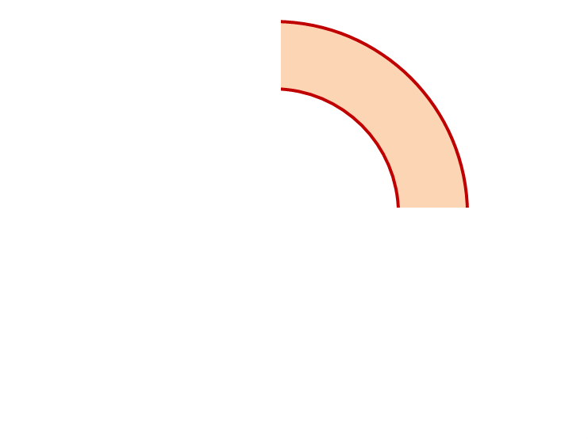
MQXFA20 Proposed Coil Arrangement
8 x δ_{midplane} = 2 π x δR_{OR}
~0.001” Undersized R
neglected
~.003” Undersized per Midpl.
Add 0.003” shim per side
~0.001” Undersized R
Neglected
~0.0015” Undersized per Midpl.
Add 0.002” shim per side
146
121
Q2
Q1
Q3
Q4
125
142
~0.001” Undersized R
Neglected
~0.0035” Undersized per Midpl.
Add 0.003” shim per side
~.001” Undersized R
Neglected
~0.002” Undersized per midpl.
Add 0.002” shim per side
Coil Electrical Order: A :121 – 142 – 146 – 125: B
Conforms to a favorable order based on RRR data

Slide 4
MQXFA20 Coil Pack Build 1 (Fuji)
Nominal Collar R: 114 mm
Nominal Coil R: 113.376 mm
Nominal Radial shim = 0.025” (0.624 mm)
  But we still target ~0.020”
Fuji radial stack up is ~0.021” (~0.54 mm)
  0.0045” Coil GPI + 0.007” Fuji + 0.005” Kapton & 0.003” Kapton
Add Kapton to various midplanes
 | 121 | 146 | 125 | 142
Kapton Ground plane insulation | 0.0045” (0.114 mm)
Coil Specific Radial Shim | 0 | 0 | 0 | 0
Coil-specific midplane shim | 0.002” 0.050 mm | 0.003” 0.075 mm | 0.003” 0.075 mm | 0.002” 0.050 mm
Fuji paper | 0.007” (0.175 mm)
Radial Shim | 0.005” Polyimide + 0.003” Kapton (~0.200 mm)

Slide 5
MQXFA20 Coil Pack Build (Final)
Nominal Collar R: 114 mm
Nominal Coil R: 113.376 mm
Nominal Radial shim = 0.025” (0.624 mm)
  But we still target ~0.020”
Actual radial stack up is ~0.020” (~0.51 mm)
  0.0045” Coil GPI + 0.005” Kapton + 0.005” Kapton & 0.003” Kapton
Add Kapton to various midplanes
 | 121 | 146 | 125 | 142
Kapton Ground plane insulation | 0.0045” (0.114 mm)
Coil Specific Radial Shim | 0 | 0 | 0 | 0
Coil-specific midplane shim | 0.002” 0.050 mm | 0.003” 0.075 mm | 0.003” 0.075 mm | 0.002” 0.050 mm
Fuji paper | 0.000” (0.0 mm)
Radial Shim | 0.005” Polyimide + 0.005” Polyimide + 0.003” Kapton (~0.33 mm)

Slide 6
Tapered Loading Shims
Shell 1 is now instrumented
  As with recent magnets, shell 1 will be monitored during cold testing
  Shell 2 no longer has instrumentation
LE strain gauges will be installed on Coils
  Coil 121 cannot have LE SG due to presence of Pre-Series voltage tap traces
    It will be an Upper coil with extra FBG instrumentation though

Slide 7
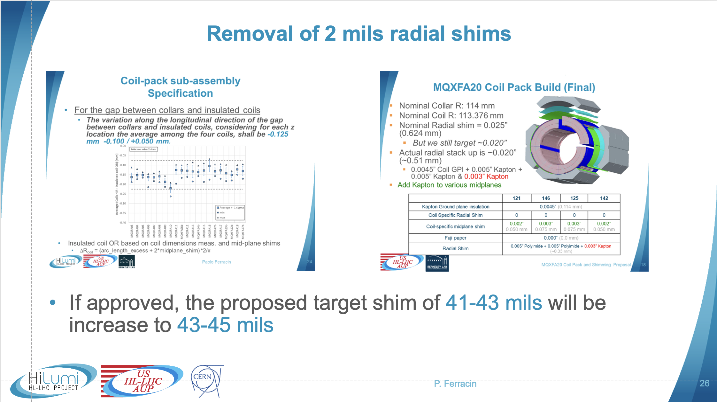
Improving the “LQ Effect”
MQXFA20 will replace the 0.005” (125 µm) G11 radial shim layer with 0.003” (75 µm) Kapton
  Similar to CERN’s implementation of 0.003” (75 µm) radial shim layer on collar in MQXFB08
  Net effect may also increase preload shim packages from ~41-43 mils to ~43-45 mils
Will observe Fuji impression to verify

Slide 8
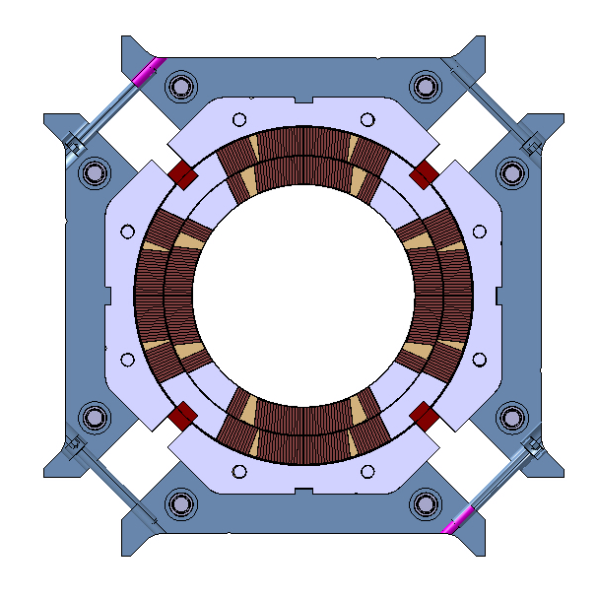
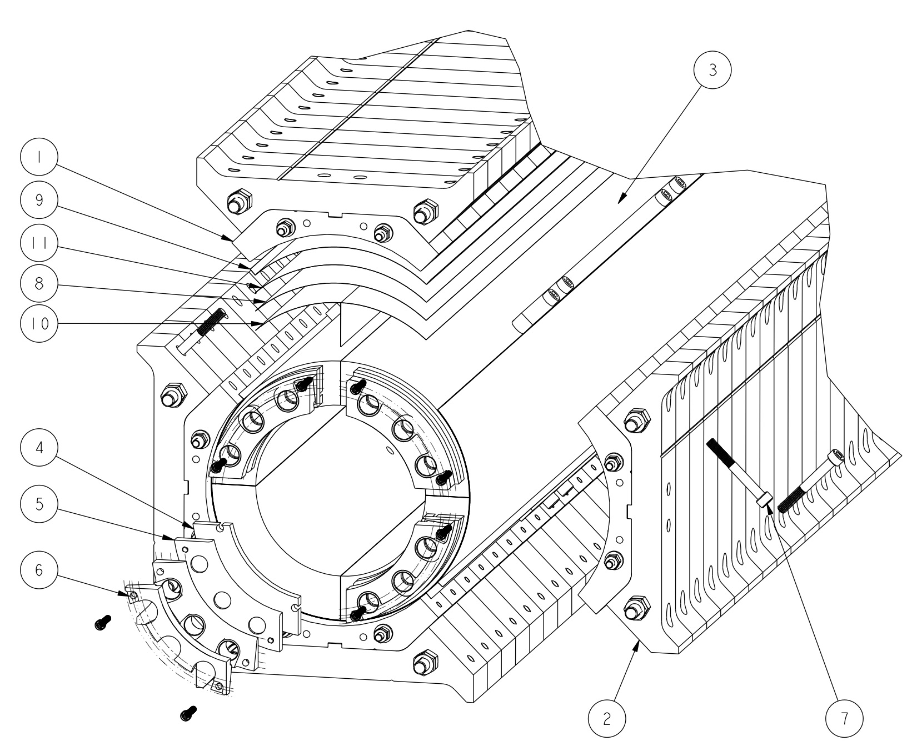
Coil-pack sub-assembly
Coil OR and radial shims
Nominal radial gap coil to collars
  0.624 mm (GPI + radial shims)
Final layers of radial shims depend on
  Coil size: larger/smaller coils after mid-plane shimming can be compensated by less/more radial shims
  Missing shims for “LQ effect”
    0.175 remove from radial shims (MQXFA20 removing 50 µm more)
So, from 0.624 mm to 0.450 mm

Slide 9
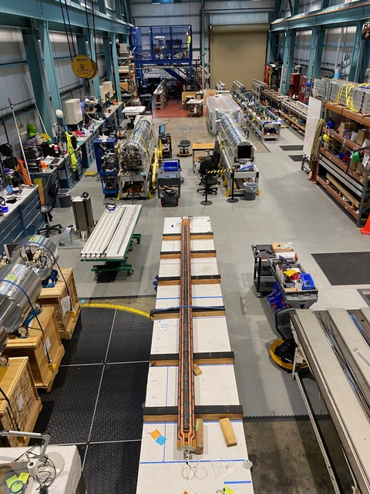
MQXFA20 Structure Status
MQXFA20
  Shell-yoke assembly complete
  Dressing coils now
  Fuji pack build prep this week
  Expected completion mid-March
MQXFA19
  Preload operations took place this week
  Expect to ship out ~3rd week of Feb
MQXFA21
  Processing pad-collar assemblies
  Shells, Rods being instrumented
MQXFA19
MQXFA20
Coil 146

Slide 10
Summary
MQXFA20 is ready to be assembled
Tapered loading shims (TLS) will be used
Removing 50 µm additional radial shim for the “LQ Effect”
MQXFA20 is expected to ship in March 2025

Slide 11
Additional Slides

