Slide 1
Loading shim proposal for A20
Paolo Ferracin, Dan Cheng, Laura Garcia Fajardo, Giorgio Vallone
on behalf of the MQXF collaboration
MQXFA20 Structure & Shims Review
LBNL, USA
January 23th, 202

Slide 2
Outline
A14b and A05 and A13 quench performance
Computation radial build-up in A14b and A05
Target loading shim size in A20

Slide 3
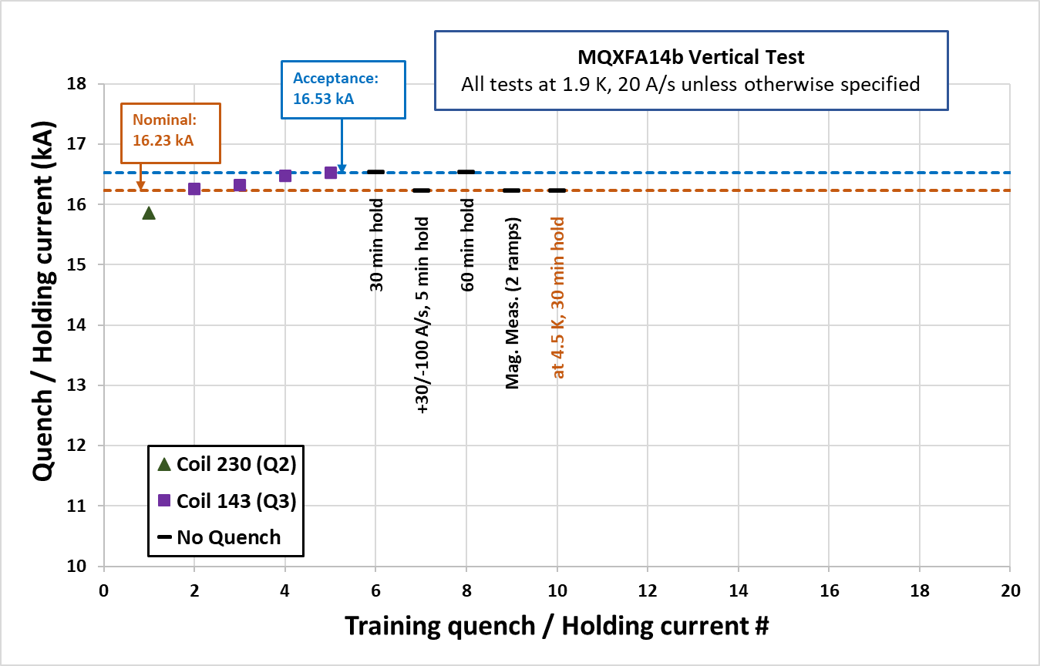
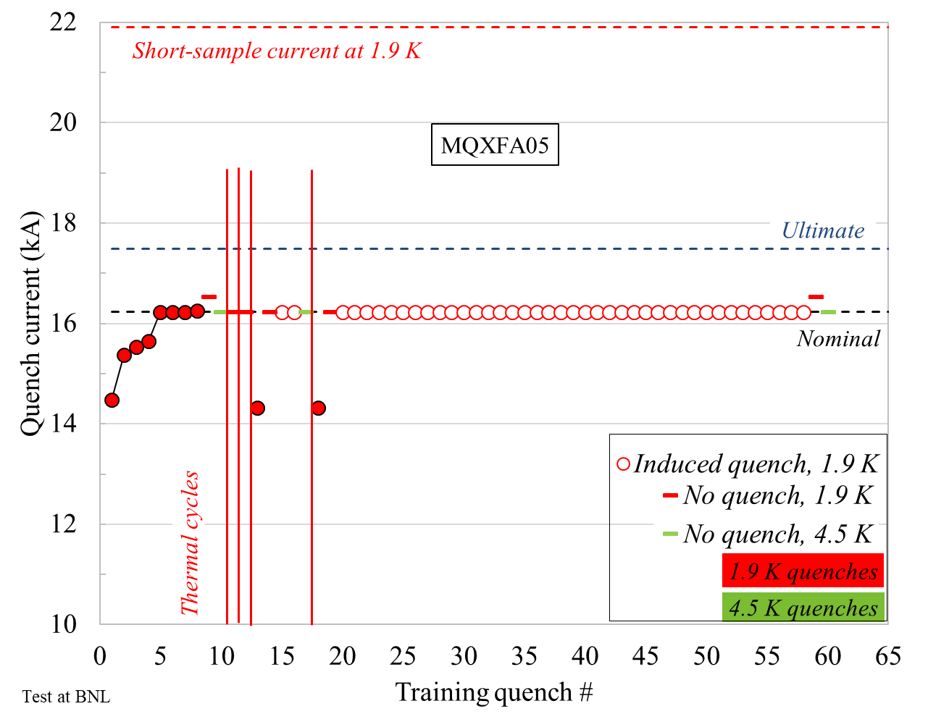
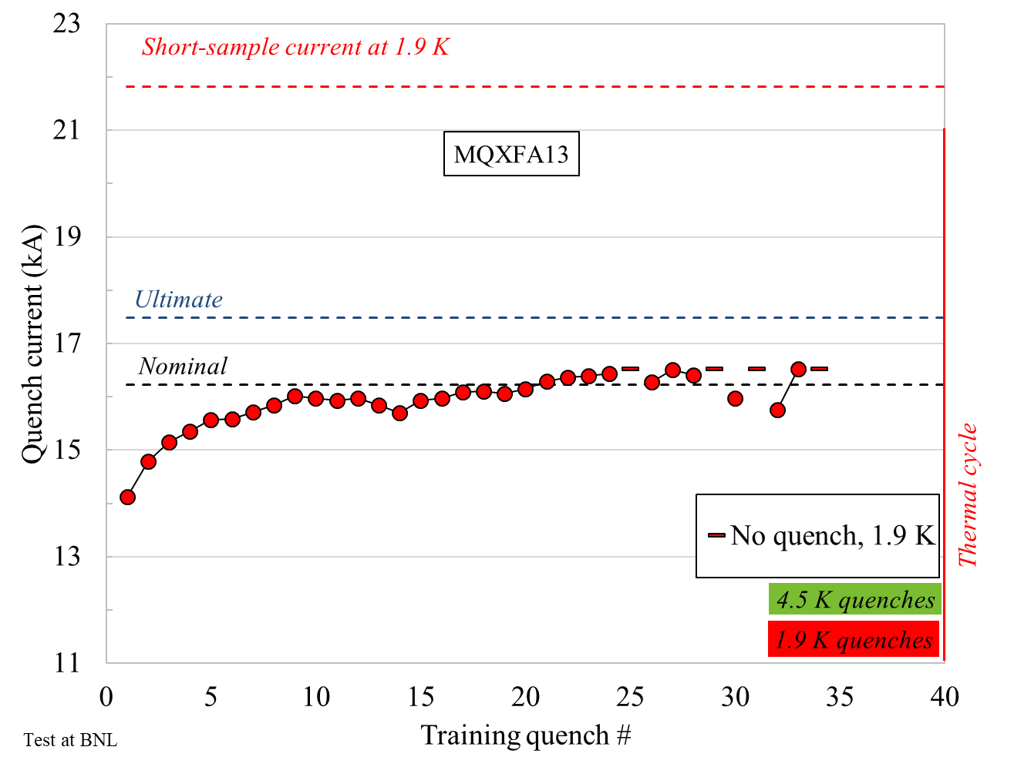
Quench performance
After the test of A13, we focused on the analysis of the pre-load in A14b and A05
  At that time, they had the fewest training quenches up to the acceptance current, and both of them met requirements
A14b
A05
A13

Slide 4
Outline
A14b and A05 and A13 quench performance
Computation radial build-up in A14b and A05
Target loading shim size in A20

Slide 5
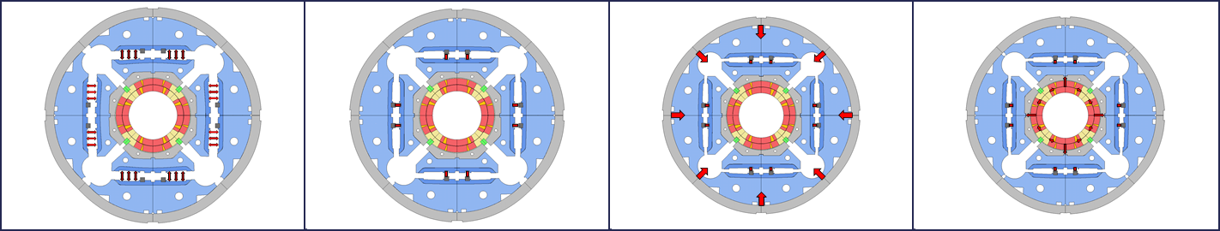
Room temperature pre-stress
The final coil and shell pre-load achieved at the end of the bladder and key operation is determined by the combination of
  the size of the load key shim
  the radial dimensions of the shimmed coil pack
    (under the assumption that collars, pads, masters, yoke, and shell have nominal dimensions).

Slide 6
Size of the load key shim
Loading shim size: 43 mils, 1.092 mm
Total key size: 13.84 mm
A14b
Loading shim size: 41 mils, 1.041 mm
Total key size: 13.79 mm
A05

Slide 7
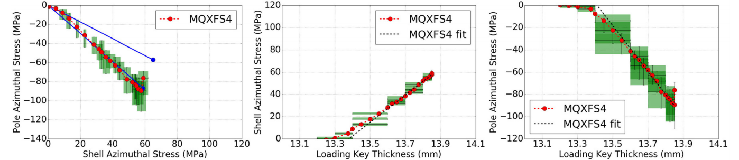
Size of the load key shim
A14b
Loading shim size: 43 mils, 1.092 mm
Total key size: 13.84 mm
Loading shim size: 41 mils, 1.041 mm
Total key size: 13.79 mm
A05
A portion of the total key/shim is to create contact (contact key/shim), and a portion to produce the pre-load (interf. Key/shim)
contact shim : 22 mils, 0.483 mm
contact key size: 13.31 mm

Slide 8
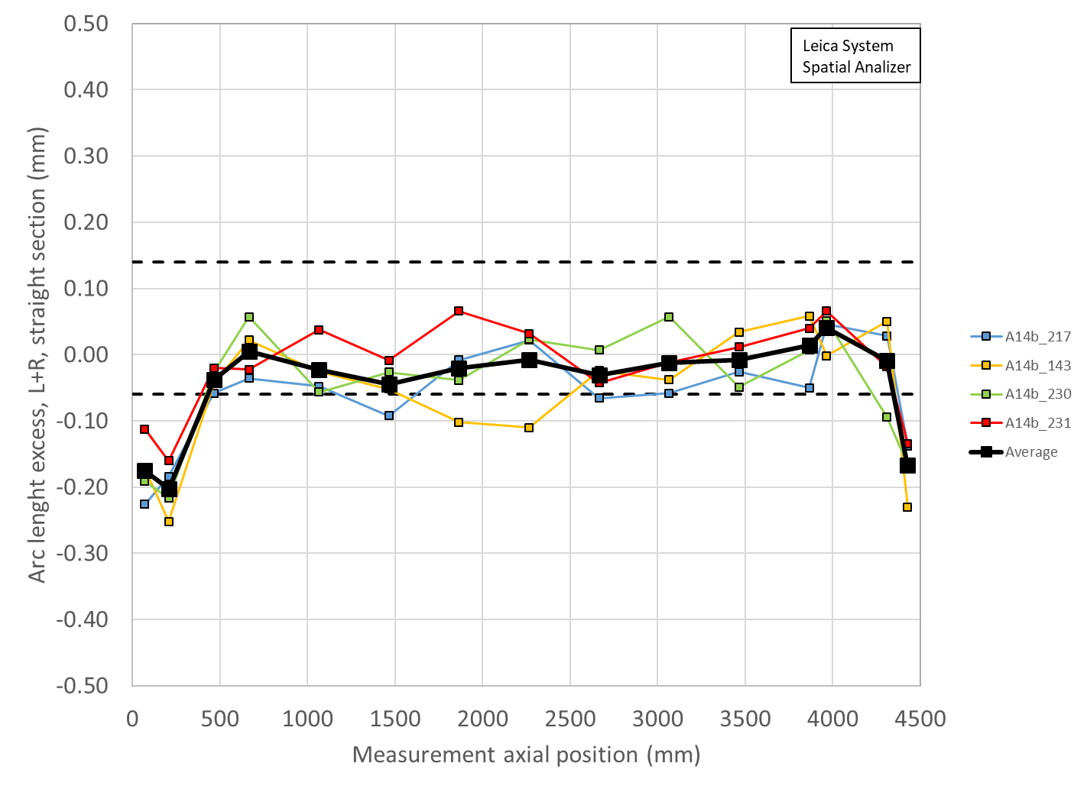
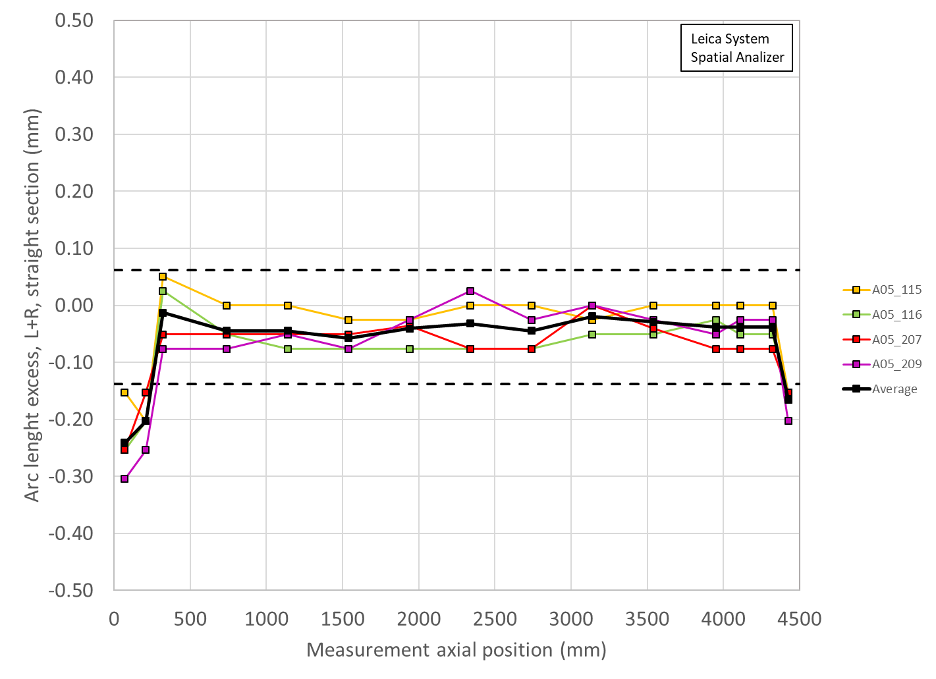
Radial dimensions of the shimmed coil pack
The coil arc-length is usually undersized
With the mid-plane shim we bring the coil “almost” to the nominal dimensions
  In reality 1) shim has finite given thickness and 2) coil has size variations along the length (and shim is full length with constant thickness)
So, we can produce a radial deviation resulting from the final shimmed azimuthal deviation (average of the coils)
  Δr_{_ave} = Δ_arc-length_{_ave} * 2/ π
 | Ave ss | Location ss | LE min | Location LE | RE min | Location RE
 | mm | mm | mm | mm | mm | mm
A14b | -0.007 | 465-4310 | -0.129 | 207 | -0.107 | 4426
A5 | -0.025 | 465-4310 | -0.154 | 207 | -0.105 | 4426
A14b
A05

Slide 9
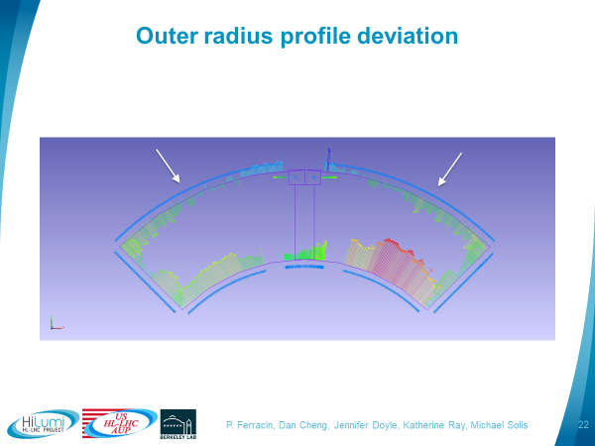
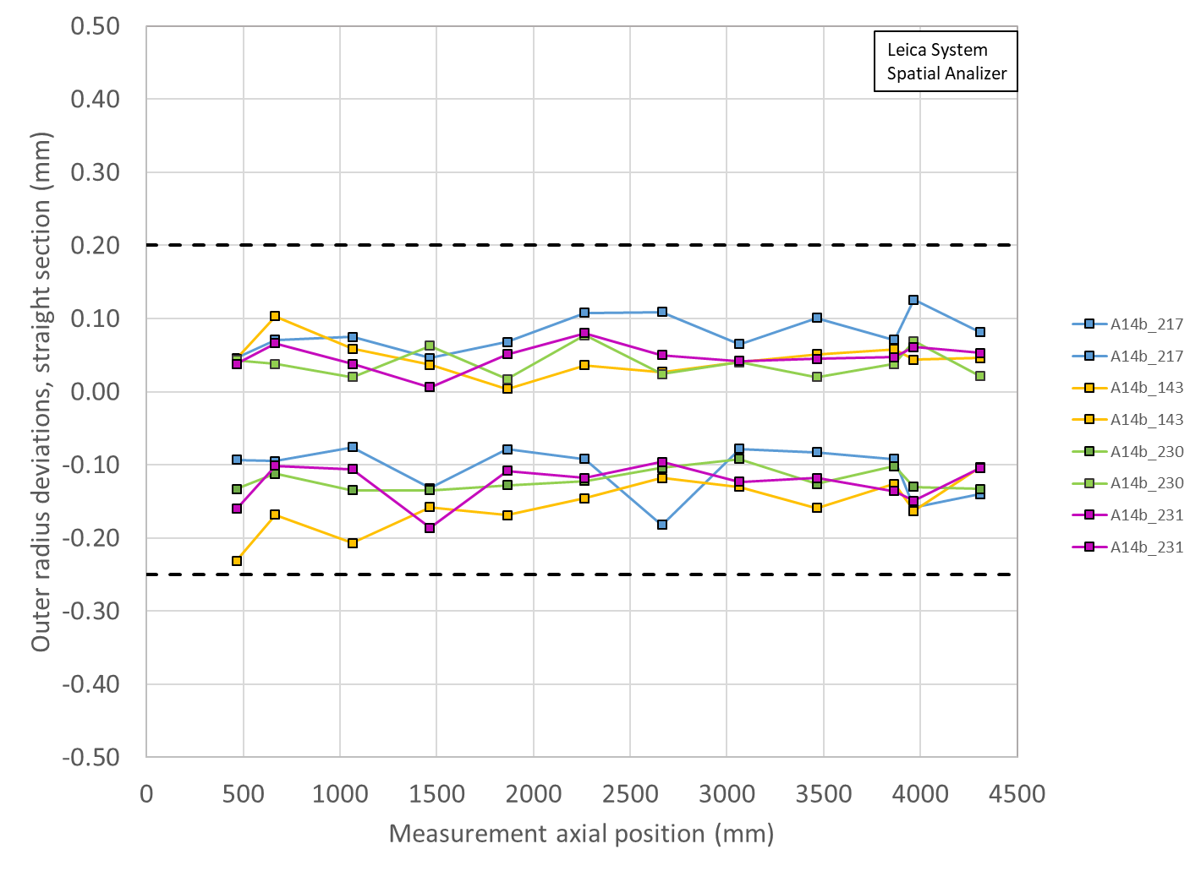
Radial dimensions of the shimmed coil pack
There is also a radial deviation due to OR+mid-plane fit of the coil dimensional measurement data
 | OR Ave ss | Location ss | OR LE min | Location LE | OR RE min | Location RE
 | mm | mm | mm | mm | mm | mm
A14b | -0.029 | 465-4310 | -0.056 | 207 | -0.050 | 4426
A5 | -0.025 | 465-4310 | -0.050 | 207 | -0.050 | 4426

Slide 10
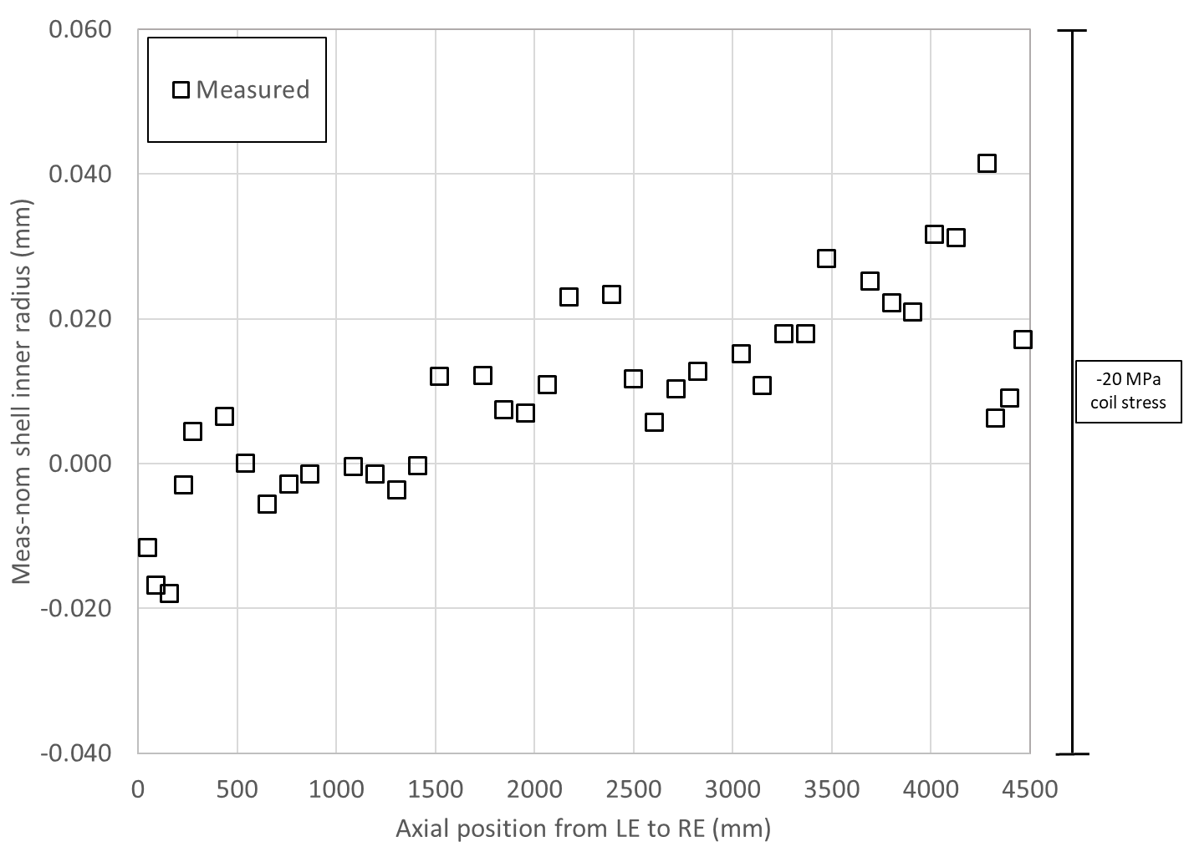
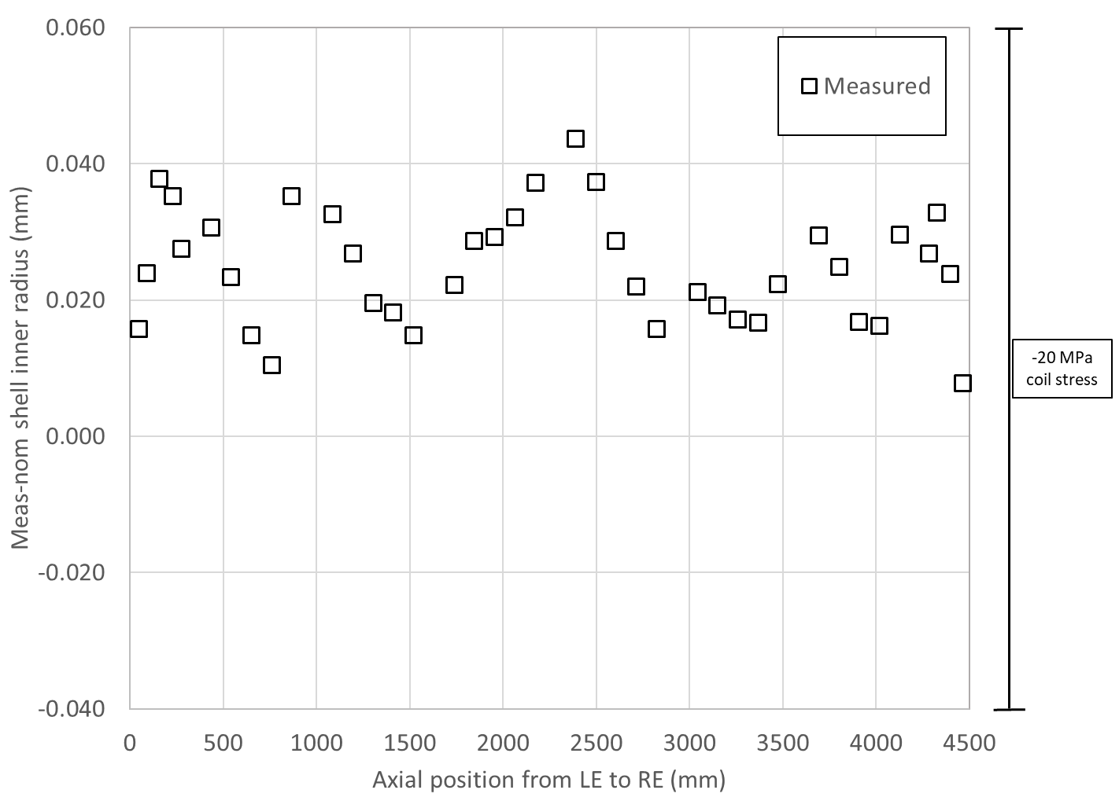
Radial build-up of the structure
“under the assumption that collars, pads, masters, yoke, and shell have nominal dimensions”
A14b
A05

Slide 11
Summary
By adding up the interf. Shim and the coil radial size……
  We get an upper bound (A14b) and a lower bound (A05)
 | Ave ss | OR_Ave ss | Sum_ss | LE min | OR_LE_min | Sum_LE | RE min | OR_RE_min | Sum_RE | Key | Key contact | Interf key | Shim | Shim contact | Interf shim | Interf shim | LE tapered shim | Ave ss + shim | LE + shim | RE + shim
 | mm | mm | mm | mm | mm | mm | mm | mm | mm | mm | mm | mm | mils | mils | mils | mm | mm | mm | mm | mm
A14b | -0.007 | -0.029 | -0.037 | -0.129 | -0.056 | -0.185 | -0.107 | -0.050 | -0.157 | 13.84 | 13.31 | 0.53 | 43 | 22 | 21 | 0.533 | 0.000 | 0.497 | 0.348 | 0.377
A5 | -0.025 | -0.025 | -0.050 | -0.129 | -0.050 | -0.179 | -0.105 | -0.050 | -0.155 | 13.79 | 13.31 | 0.48 | 41 | 22 | 19 | 0.483 | 0.000 | 0.433 | 0.303 | 0.327

Slide 12
Outline
A14b and A05 and A13 quench performance
Computation radial build-up in A14b and A05
Target loading shim size in A20

Slide 13
Specs
Target loading key shim
For final loading key shim size reached during the pre-load operations, the following target is set:
At the end of the pre-loading operation, the sum of the loading shim size and the coil-pack radial dimension deviations in straight section, LE and RE shall be within the range achieved in magnets MQXFA14b and MQXFA05
  If, with such load key shim targets, the coil stress measured in 2+ strain gauges during the loading or during bladder inflation indicate that the coil stress may reach values above the coil stress spec. during subsequent loading steps or at the end of the loading, priority should be given to keeping the coil stress within the specs.

Slide 14
Specs
Pre-loading sequence and Tapered Load Shim
For the pre-load operation sequence:
The loading operation shall follow the sequence described below:
  Pre-load axial rods with average to a measured of strain ~50 µε
  Apply 50% azimuthal pre-load
  Apply 50% axial pre-load
  Apply 100% azimuthal pre-load
    This step shall include the insertion of 0.100 mm thick Tapered Load Shims (TLS) in the LE [35] if
      CMM measurements of the coils size indicates that the average arc-length of the 4 coils is smaller by more than 0.150 mm in the 260-300 mm location from the LE with respect to the average straight section arc- length
      Mechanical analysis with TLS and measured coil dimensions indicated that the coil stress and shell stress are within the spec limits.
      0.050 mm thick Tapered Load Shims (TLS) may be used if i or ii are not met and with L2 permission.
  Apply 100% axial pre-load

Slide 15
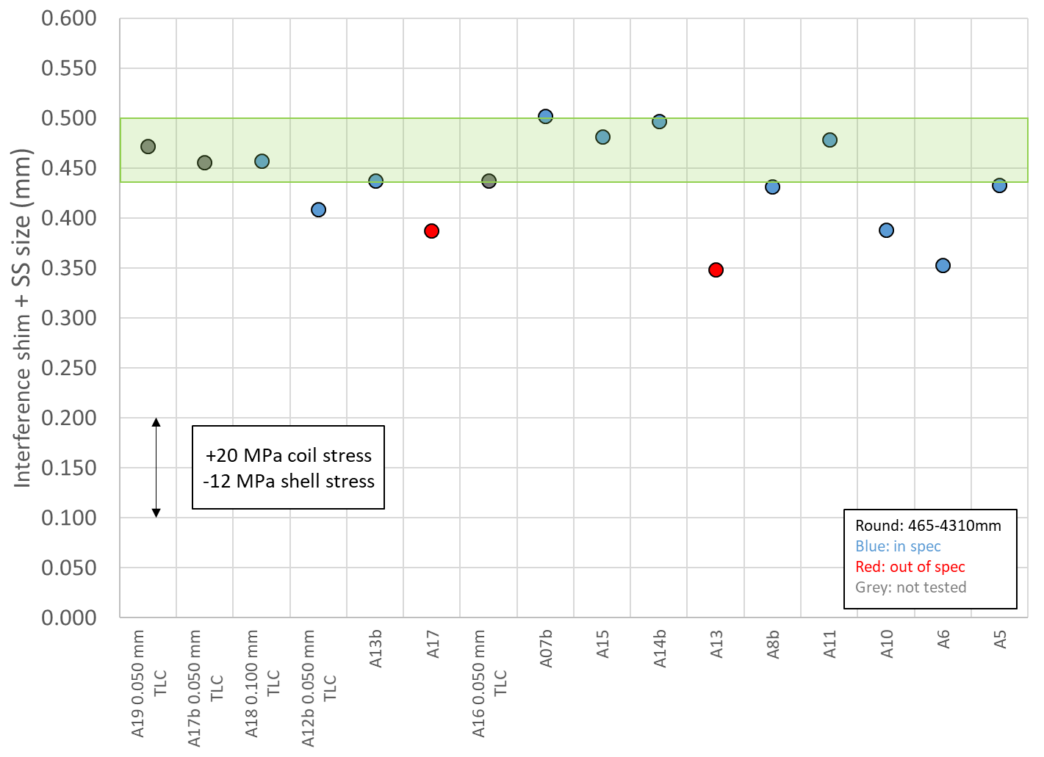
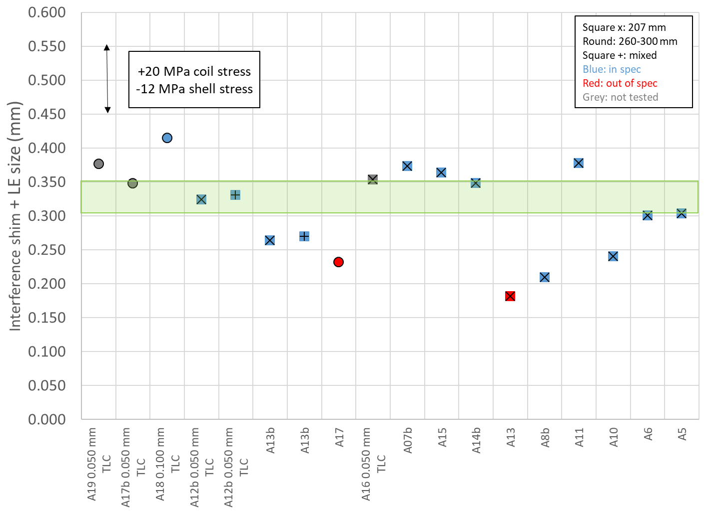
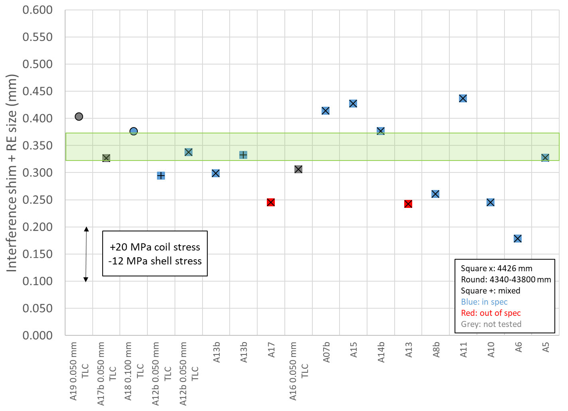
Review of all magnets, so far
Straight section
LE
RE

Slide 16
Specs
Shell, coil, rod stress
For the pre-load targets at the end of the pre-load:
  The target average measured stress on coils, shells and rods at the end of the loading (after at least 24 h) shall be
    Shells 2-7 average azimuthal stress: +58 ± 6 MPa
    Shell 1 average azimuthal stress: <80 MPa
    Coil (winding pole) average azimuthal stress: -90 ± 10 MPa
    Rod average strain: +950 µε ± 95 µε
For the maximum stress reached during the pre-load operations:
  During the entire pre-load operation, the maximum compression measured on each coil shall never exceed -135 MPa

Slide 17
In summary
We target a A14b-A05 overall loading shim
  The “green zone”
If the coils are smaller in the LE (so far basically always), we add the TLS
  Thickness of 0.050-0.100 mm, after analysis of shell and coil stress
    Important: the TLS will bring us (probably) above the green zone in the LE, but definitely and closer to the straight section conditions.
We target the spec stress on coil and shell
  Updates coil stress of -90 ± 10 MPa
And we keep coil
  stress below -135 MPa
  shell 1 stress below 80 MPa

Slide 18
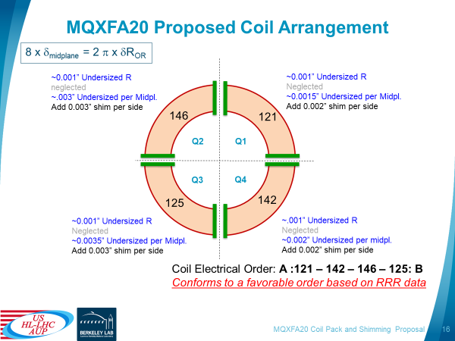
Proposed mid-plane shim for A20

Slide 19
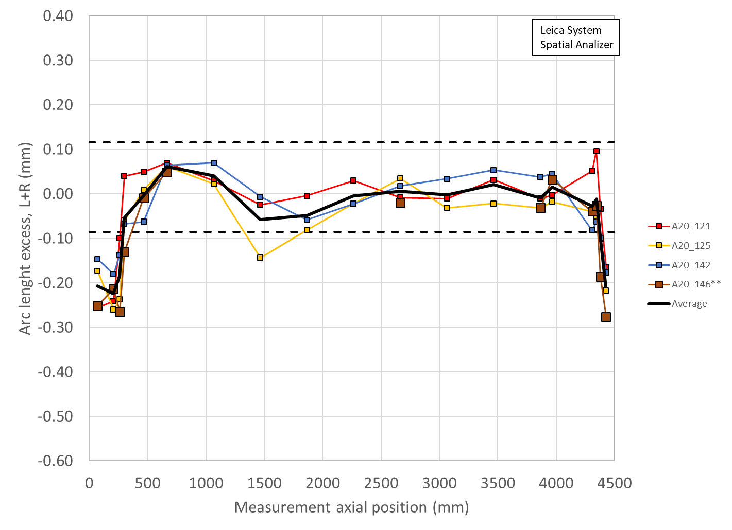
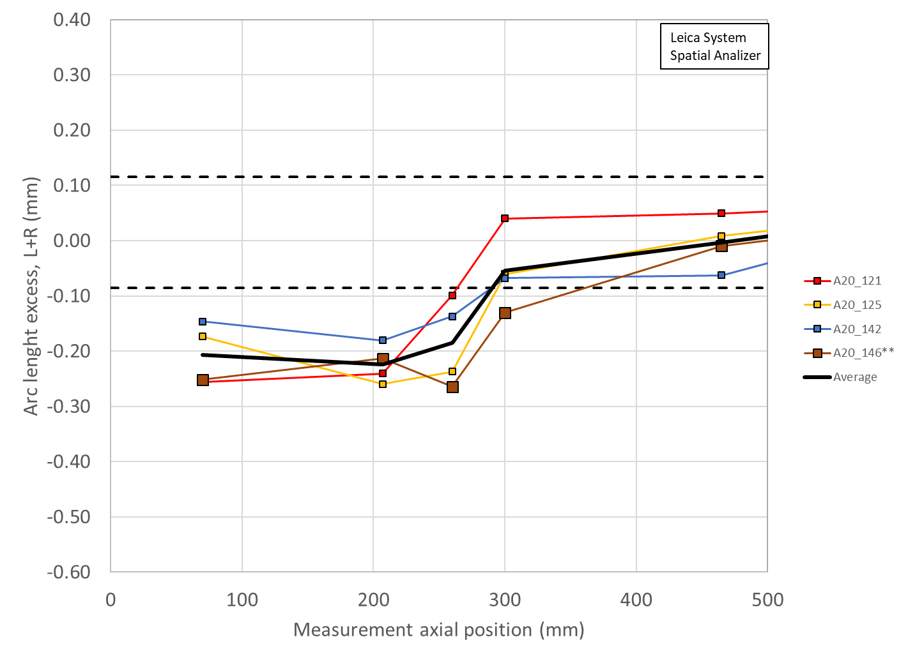
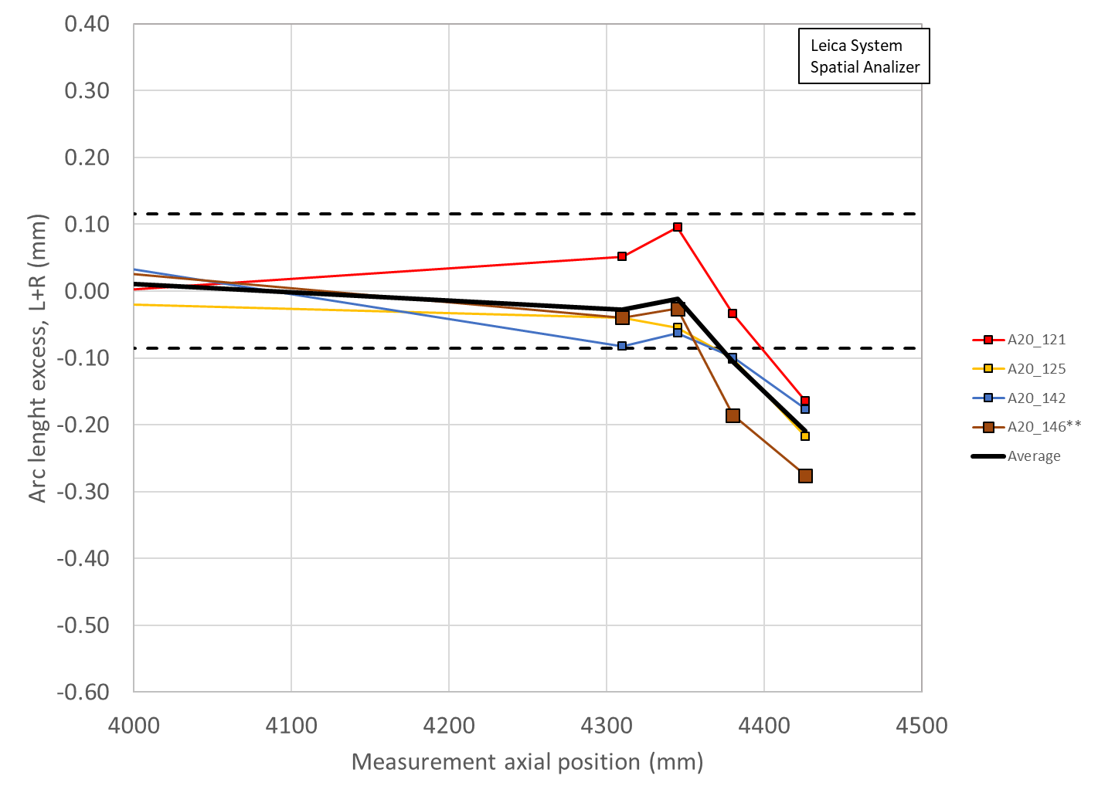
Radial deviations of A19
 | Ave ss | OR_Ave ss | Sum_ss | LE min | OR_LE_min | Sum_LE | RE min | OR_RE_min | Sum_RE
 | mm | mm | mm | mm | mm | mm | mm | mm | mm
A20 | -0.001 | -0.026 | -0.026 | -0.117 | -0.048 | -0.165 | -0.067 | -0.036 | -0.103

Slide 20
Summary straight section
Coil radial (shimmed) deviation + key/shim size
 | Ave ss | Key | Shim | Ishim | Ave ss + ishim
 | mm | mm | mils | mm | mm
A20 up | -0.026 | 13.84 | 43 | 0.533 | 0.507
A20 low | -0.026 | 13.79 | 41 | 0.483 | 0.456
A14b | -0.037 | 13.84 | 43 | 0.533 | 0.497
A5 | -0.050 | 13.79 | 41 | 0.483 | 0.433

Slide 21
Summary LE
Coil radial (shimmed) deviation + key/shim size
 | LE | Key | Shim | Ishim | LE + Ishim
 | mm | mm | mils | mm | mm
A20 up | -0.165 | 13.82 | 42 | 0.508 | 0.343
A20 low | -0.165 | 13.79 | 41 | 0.483 | 0.317
A14b | -0.185 | 13.840 | 43 | 0.533 | 0.348
A5 | -0.179 | 13.790 | 41 | 0.483 | 0.303

Slide 22
Summary RE
Coil radial (shimmed) deviation + key/shim size
 | RE | Key | Shim | Ishim | RE + Ishim
 | Mm | mm | mils | mm | mm
A20 up | -0.103 | 13.79 | 41 | 0.483 | 0.380
A20 low | -0.103 | 13.74 | 39 | 0.432 | 0.329
A14b | -0.157 | 13.84 | 43 | 0.533 | 0.377
A5 | -0.155 | 13.79 | 41 | 0.483 | 0.327

Slide 23
Summary and proposal
 | Ave ss | Key | Shim | Ishim | Ave ss + ishim
 | mm | mm | mils | mm | mm
A20 up | -0.026 | 13.84 | 43 | 0.533 | 0.507
A20 low | -0.026 | 13.79 | 41 | 0.483 | 0.456
 | LE | Key | Shim | Ishim | LE + Ishim
 | mm | mm | mils | mm | mm
A20 up | -0.165 | 13.82 | 42 | 0.508 | 0.343
A20 low | -0.165 | 13.79 | 41 | 0.483 | 0.317
 | RE | Key | Shim | Ishim | RE + Ishim
 | mm | mm | mils | mm | mm
A20 up | -0.103 | 13.79 | 41 | 0.483 | 0.380
A20 low | -0.103 | 13.74 | 39 | 0.432 | 0.329
Proposed target: 41-43 mils

Slide 24
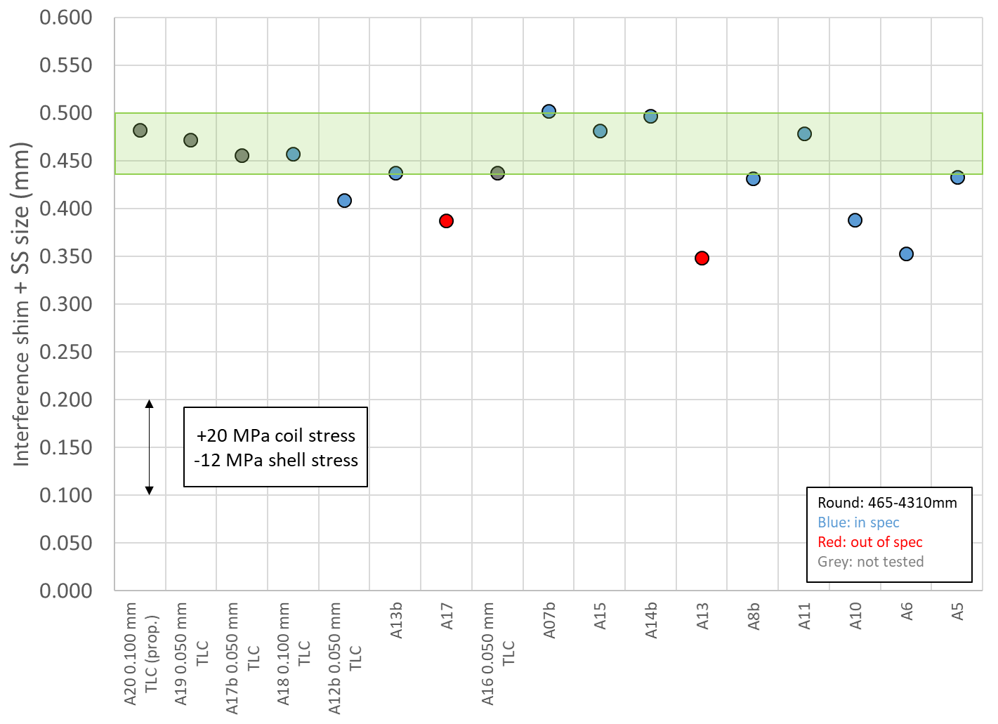
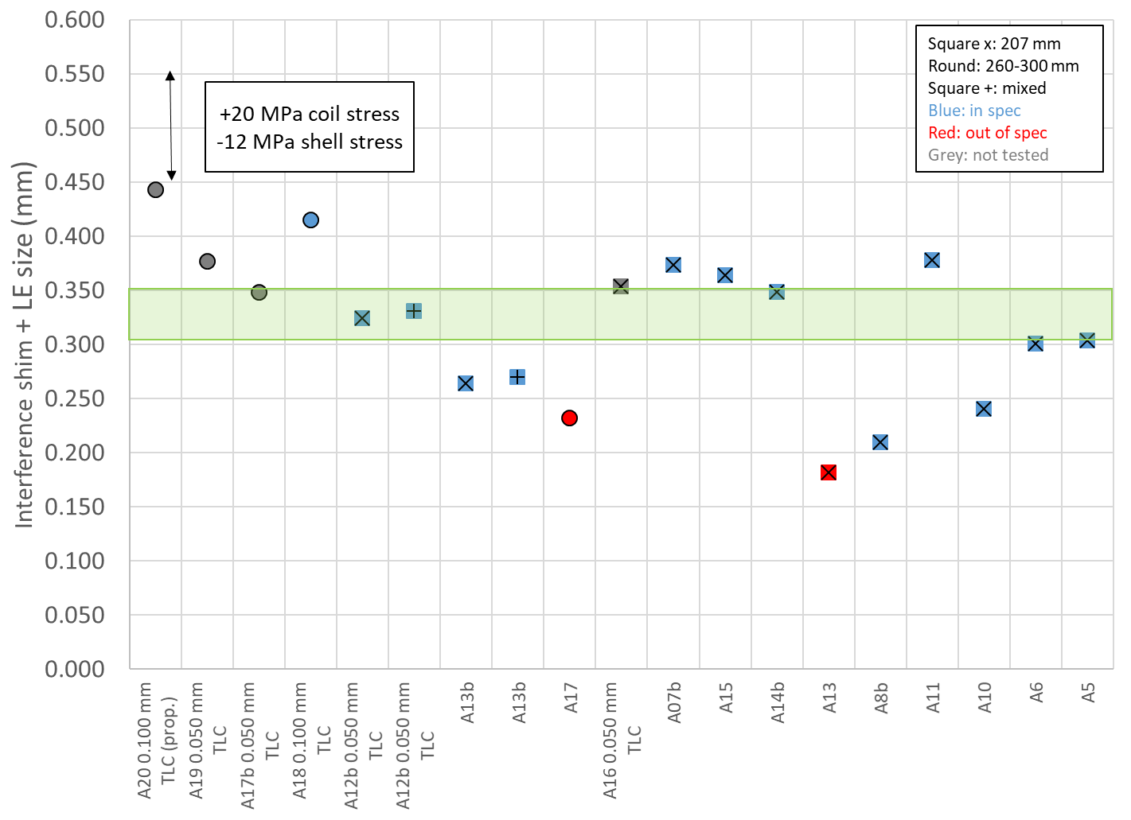
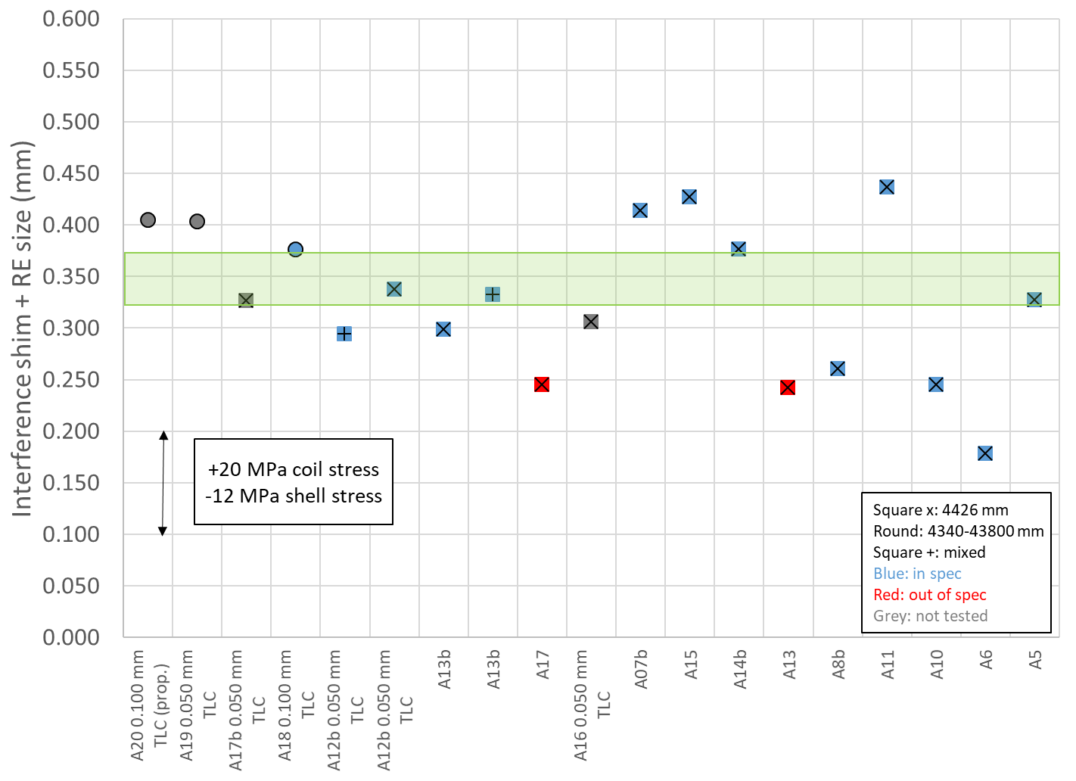
A20 with 42 mil shim (13.82 mm) and 0.100 mm TLS
Straight section
LE
RE

Slide 25
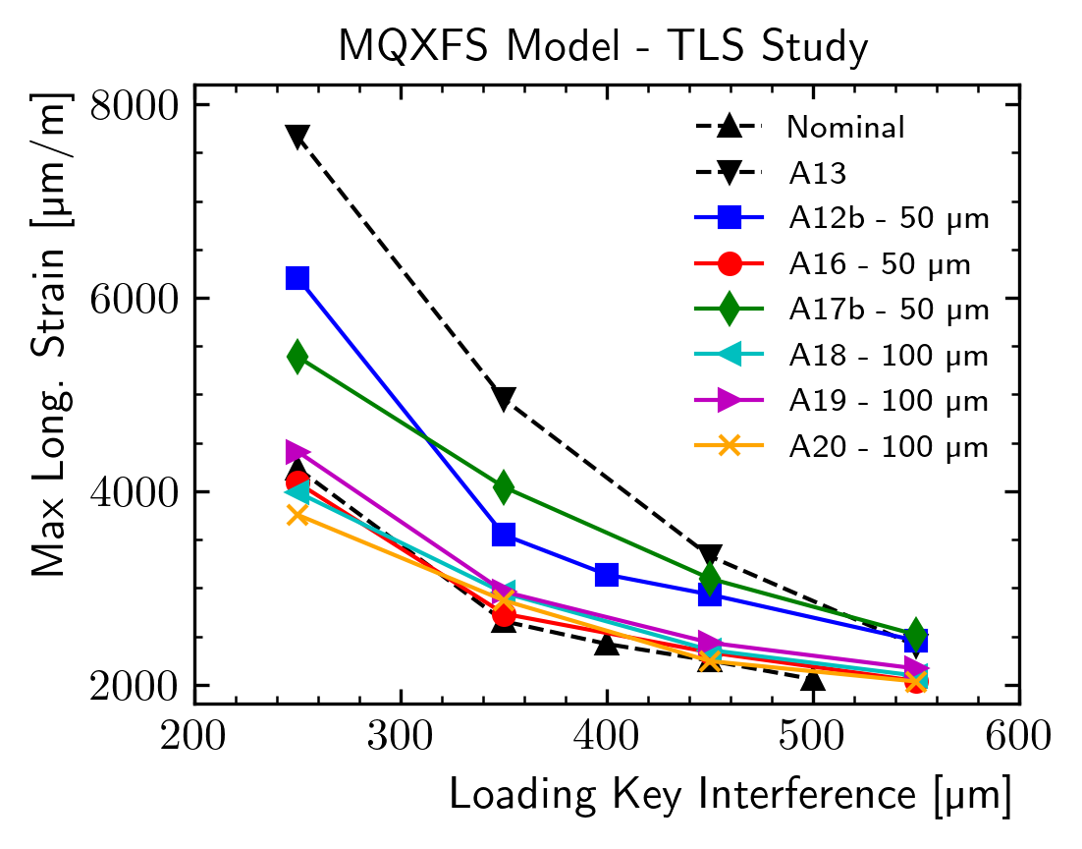
3D FE model results

Slide 26
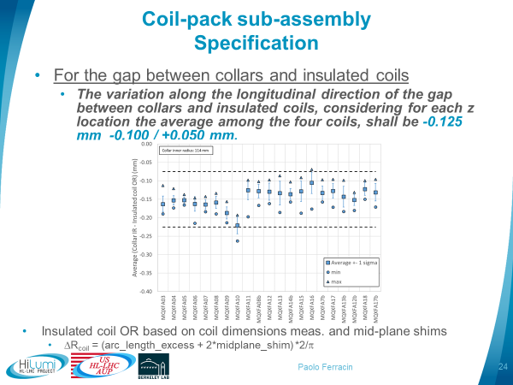
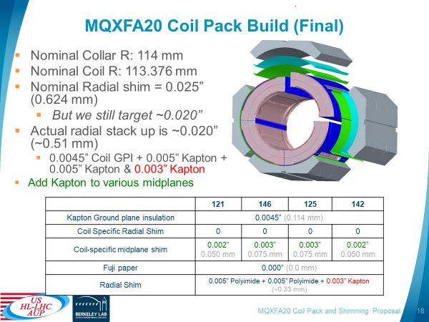
Removal of 2 mils radial shims
If approved, the proposed target shim of 41-43 mils will be increased to 43-45 mils

Slide 27
Appendix

Slide 28
From arc length deviation to radial deviation
Δ_arc-length_{_ave} * 4 = 2π Δr_{_ave}
Δr_{_ave} = Δ_arc-length_{_ave} * 2/ π

Slide 29
Magnet assembly and loading
Sensitivity analysis
+0.100 mm of coil outer radius increase
  -20 MPa of coil stress variation
  +12 MPa of shell stress variation
+0.100 mm of total coil arc-length increase (0.050 per mid-plane)
  -13 MPa of coil stress variation
  +8 MPa of shell stress variation
FE values confirmed in short models, like MQXFS4
By E. Takala

Slide 30
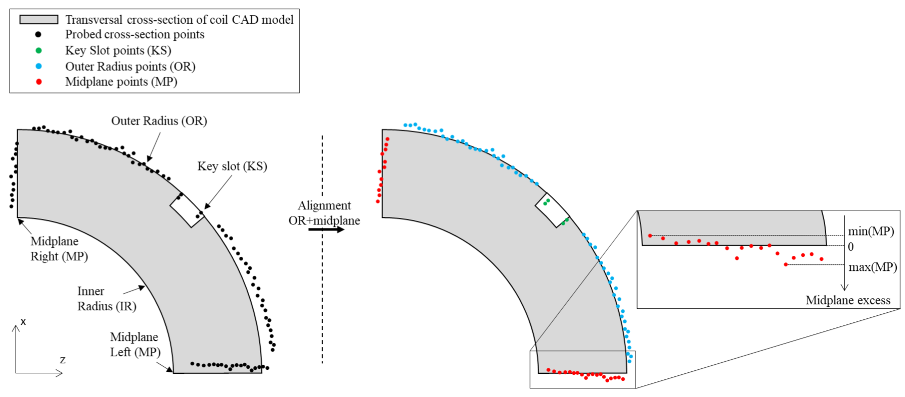
Impregnated coil dimensional tolerances
Arc length excess (ends)
At 260 and 300 mm (for the lead end) and at 4340 and 4380 mm (for the return end) the absolute value of the coil delta arc-length must not exceed 210 mm.
  The coil delta arc-length is the difference between the coil arc length at each location in the ends and the average coil arc-length in the straight section.

Slide 31
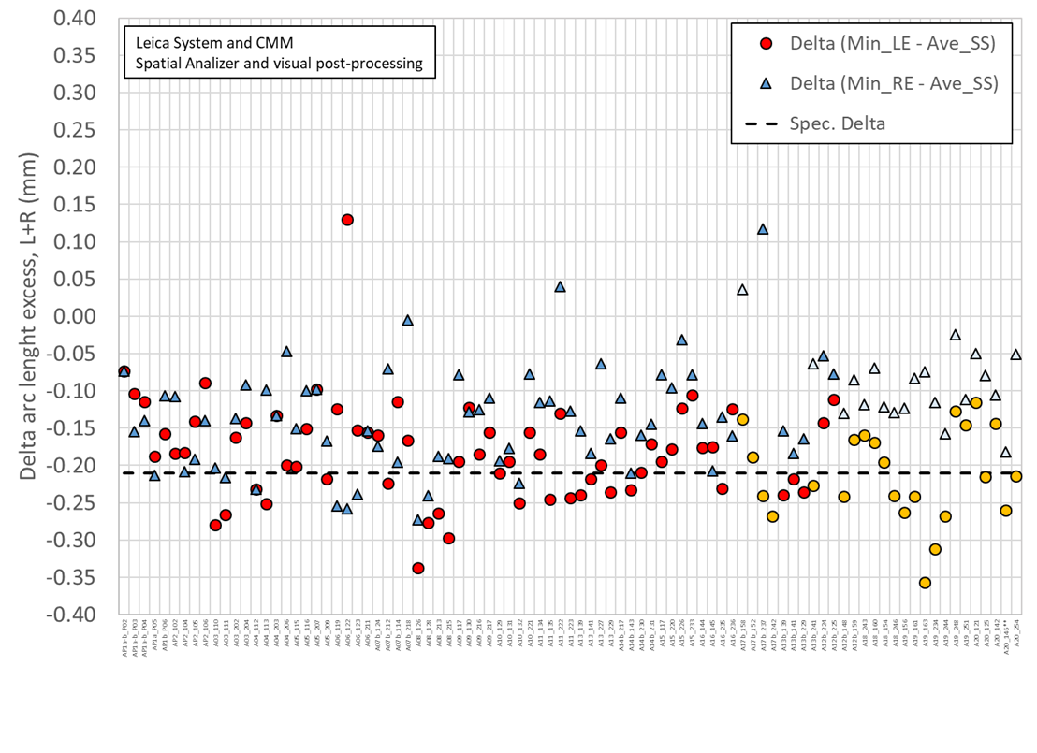
Only few coils have the measurements in the 260-300 mm positions, but all in the 207 mm position

Slide 32
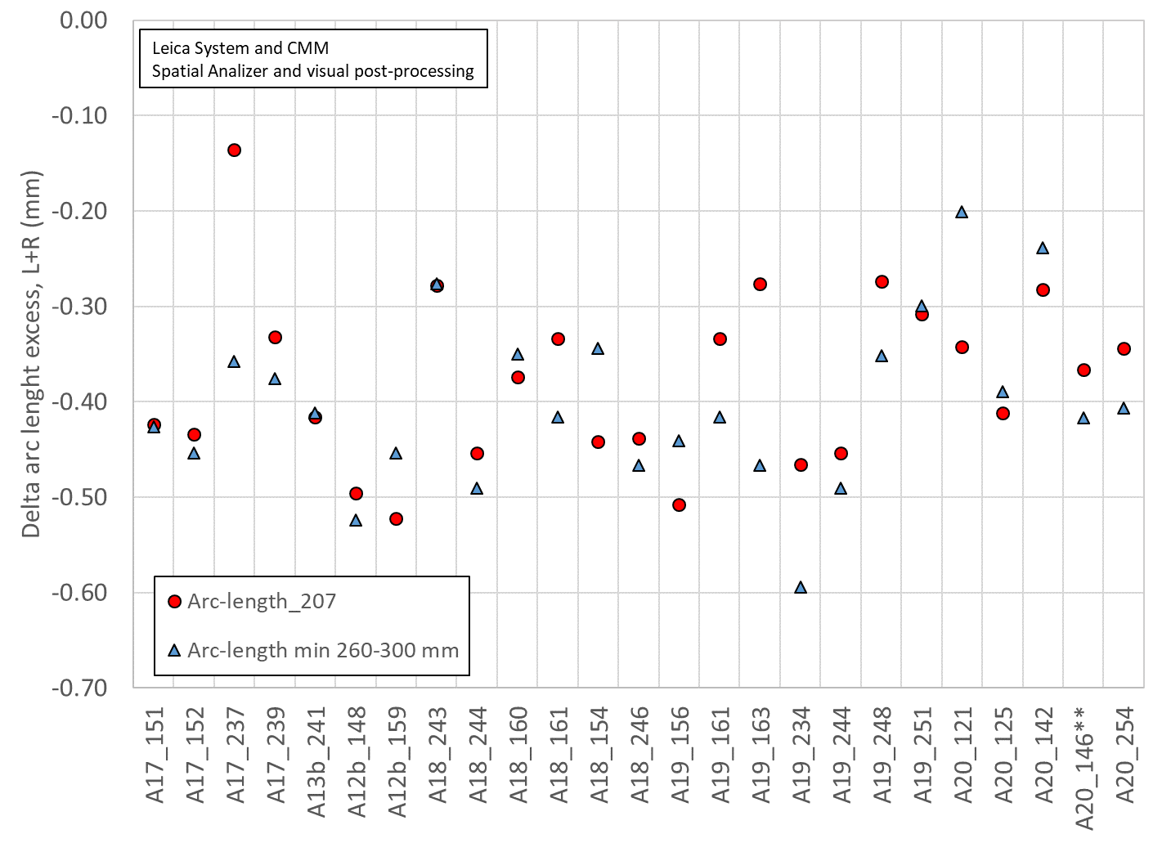
Only few coils have the measurements in the right position
Except for 1 coil (A17_237), the 207 mm position is a relatively good representation of the minimum of 260-300 mm positions
All included, the average difference is -0.021 mm (260-300 mm slightly smaller than 207 mm

