Slide 1
302.4.01 Magnets Vertical Test at BNL Weekly Status
Febin Kurian
13-Jan-2025

Slide 2
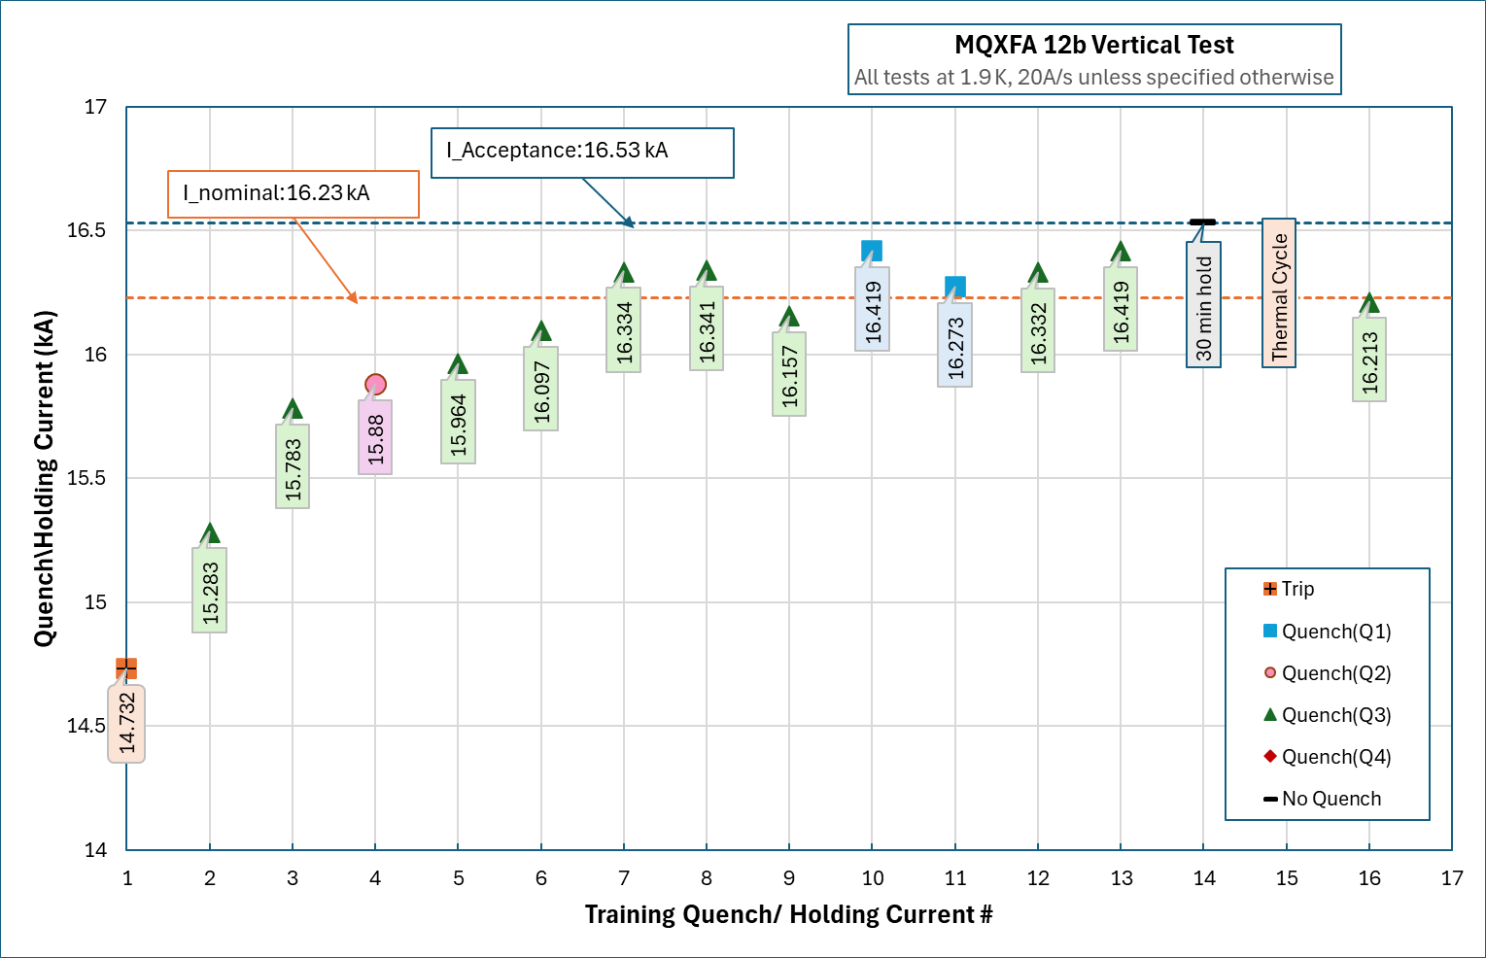
MQXFA12b-Quench Summary-So Far

Slide 3
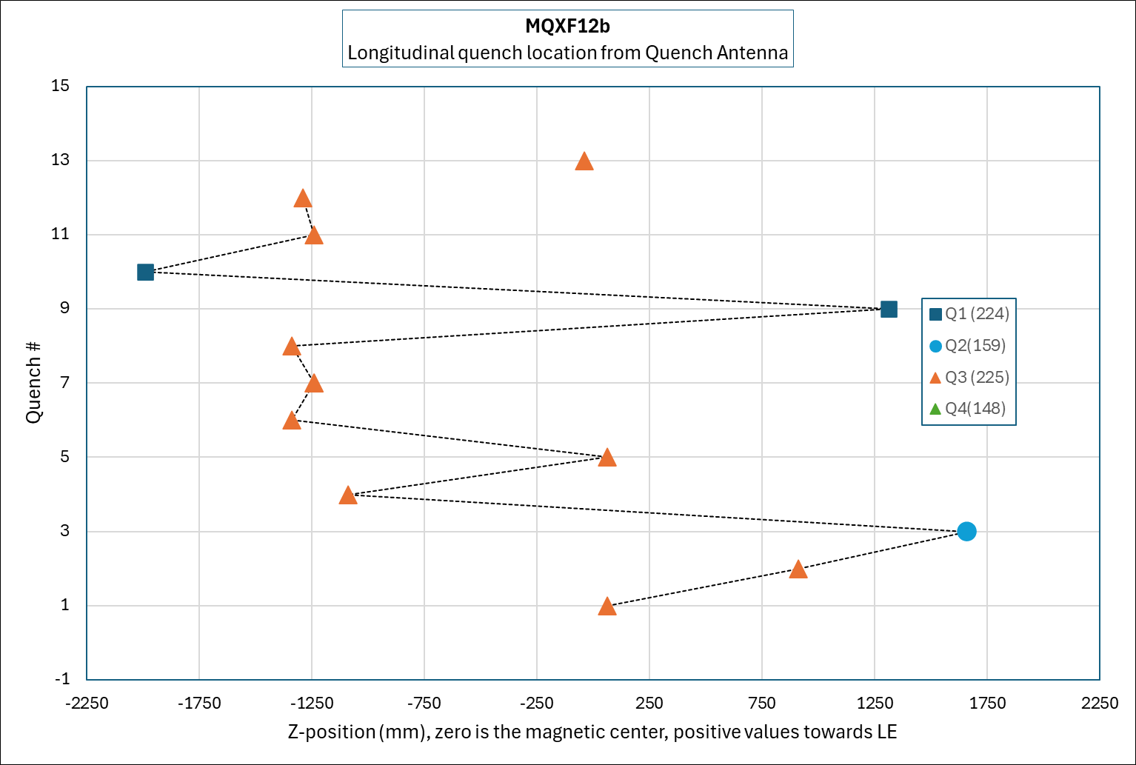
MQXFA12b-Quench Locations

Slide 4
Second Top Hat Repair
V-taps:
VT5 replaced with VT7
All passed Hipot
Heaters:
Heater box2 modifications are finished. Passed HiPot
All individual components have passed HiPot.

Slide 5
CRYOGENIC STATUS
CTI 4000 system Status:
Running
Linde 1610 Status
Not Running, diagnosing the issues after power failure

