Slide 1
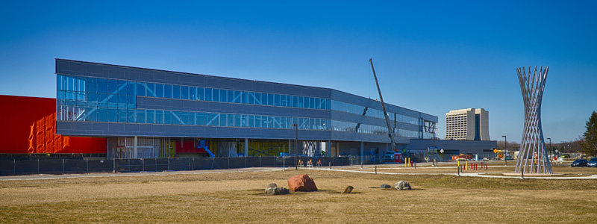
OTE Building PMG Report April 29, 2013

Slide 2
Agenda
CDF D&D: J. Lewis
OTE Building Project: R. Merchut
Coordination
State Activities
Schedule
Fiscal
Summary Action Items

Slide 3
OTE Outfitting GPP G13-211
FY 13: $2M for VoIP/networking & Contingency.
Develop Plan for moving ahead with VoIP/Networking w/out tenant layouts.
Discussions with CD to incorporate independent network underway.

Slide 4
IASU Update (IGPP)
Phase 2 scope approximately 85% complete.
CDF Coordination
Schedule coordination required for CDF west ramp replacement with D&D.
Approx 3 weeks required for demo & replacement.
Cure time dependent on anticipated CDF loads (steel plates from detector demo). 7-30 days

Slide 5
OTE Project Status:
Shop drawing review continues. Expect to be substantially complete in the next 4 weeks.
250 RFI’s rec’d from contractor have been responded to. (15 RFI’s last month).
Schedule Oversight on-going. Continue to work with contractor to provide coordinated information.
Financial Oversight on-going.
Safety procedures continue to be expanded as more subs come onto the project.

Slide 6
OTE Project Status:
LEED procedures & Action Plan implemented.
Contractor reporting 99% construction waste has been recycled.
On track to meet goal of 20% (by cost) of regionally manufactured materials.
On track to meet goal of 20% (by cost) of recycled content in materials used.

Slide 7
OTE Construction Status:
15-35 workers daily in the past month (rain)
Exterior enclosure
Corrugated Metal Panels - 2nd & 3rd floor
1st floor framing, densglass, & weather barrier
Window framing & glazing 1st, 2nd, & 3rd floors
High roofing substantially complete. Low roofing underway.
Above ceiling MEP & FP pipe, raceways & ductwork hanging substantially complete 2nd & 3rd floors.
In-wall MEP underway.
Interior Studs underway.
Geothermal field: work has resumed after 1 month delay due to equipment breakdown.

Slide 8
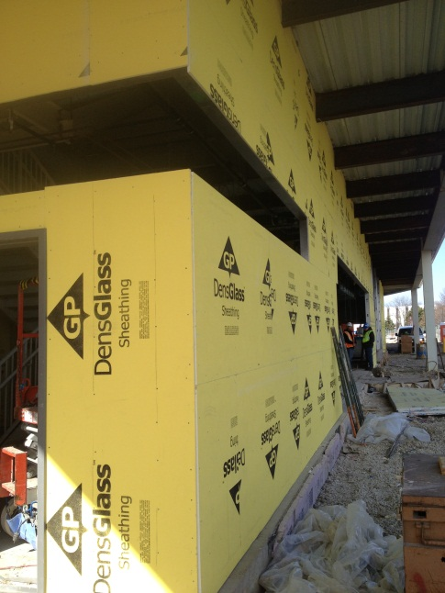
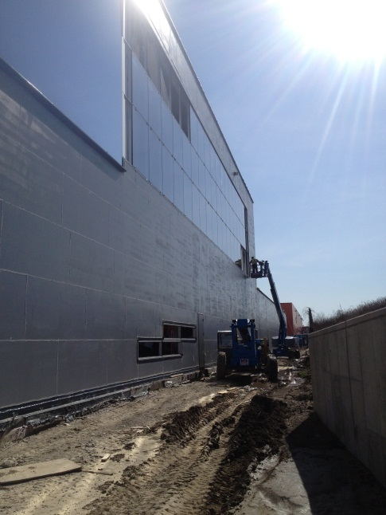
Exterior Enclosure

Slide 9
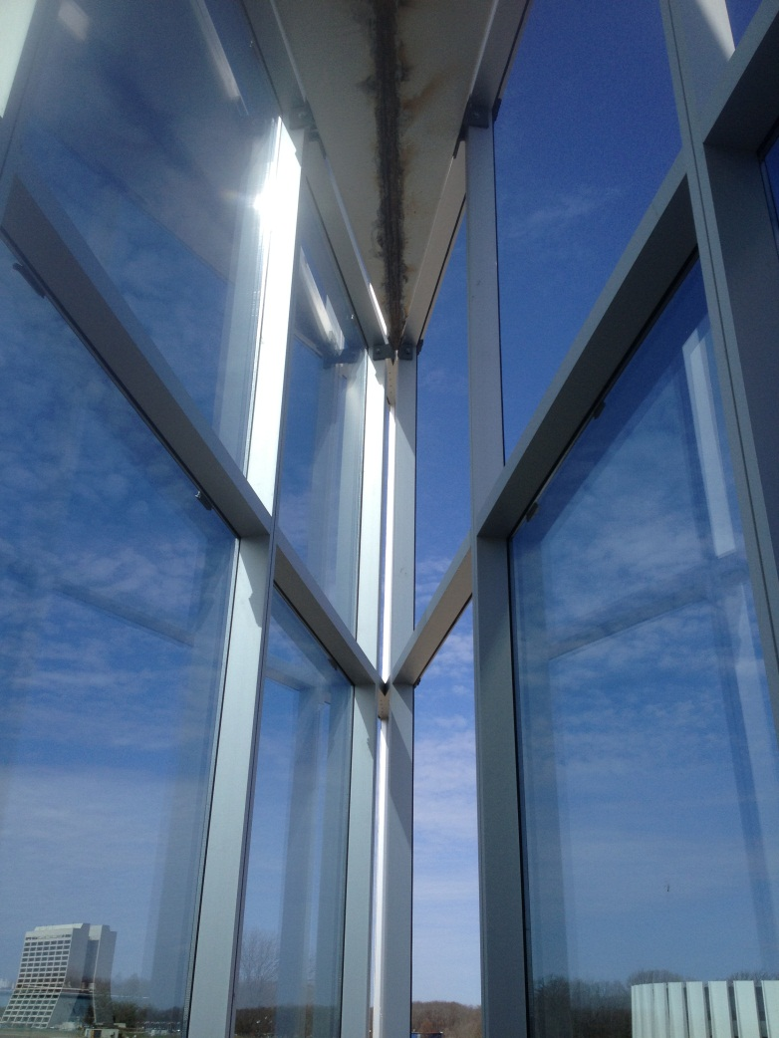
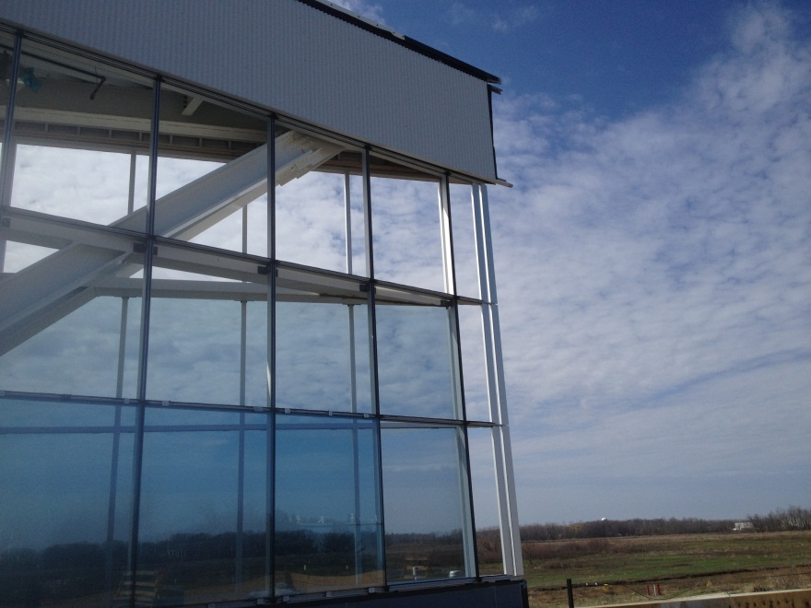
Lunch Room Enclosure

Slide 10
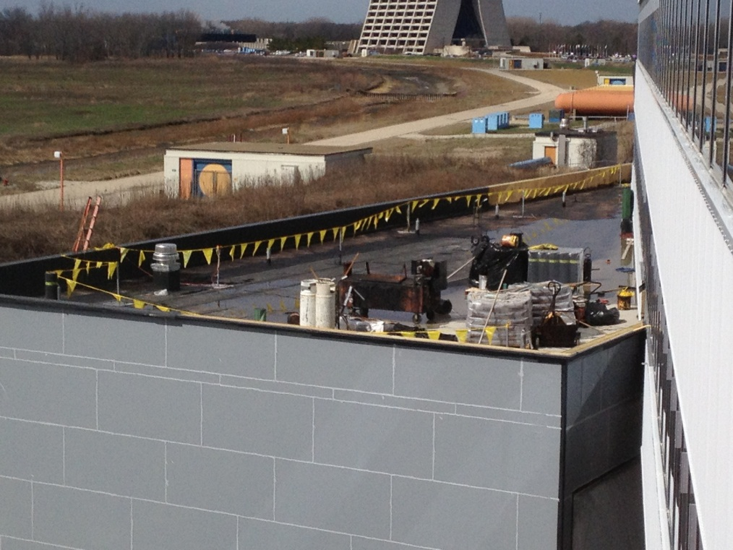
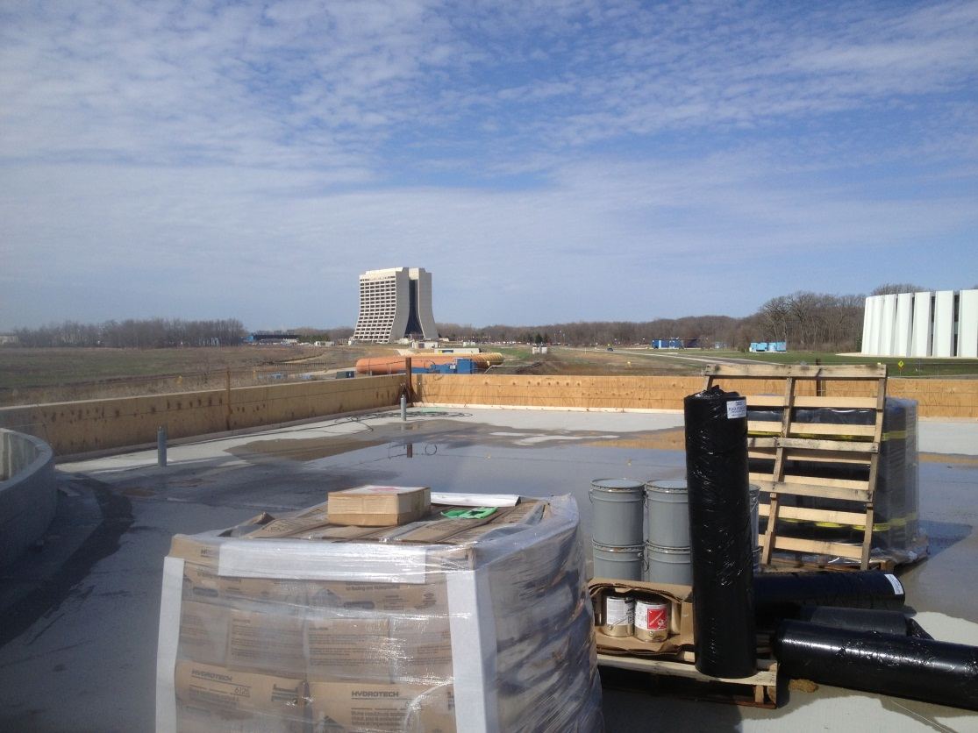
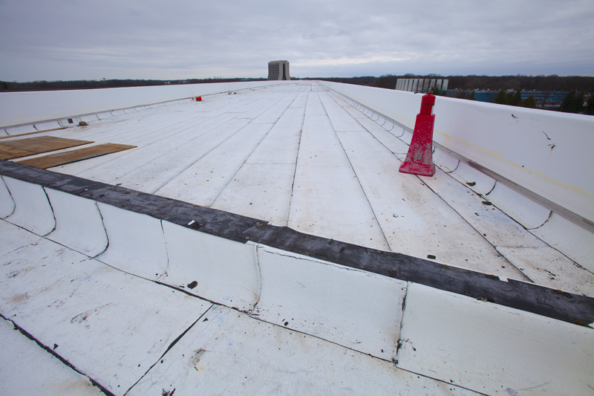
Low Roofs
High Roof

Slide 11
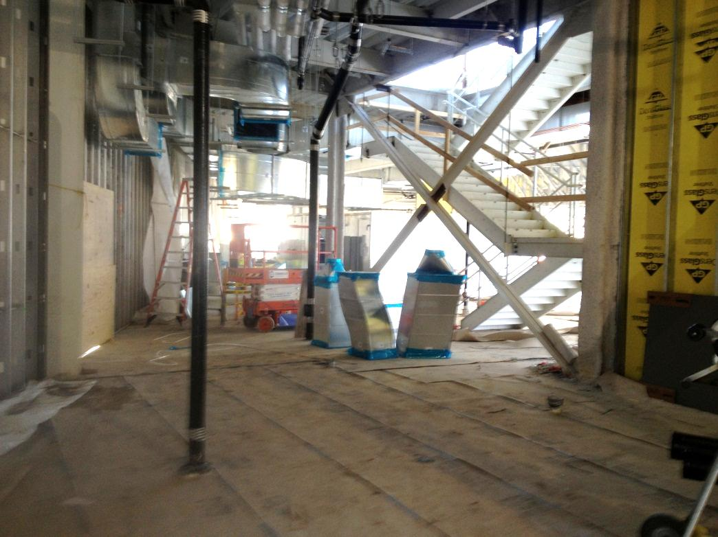
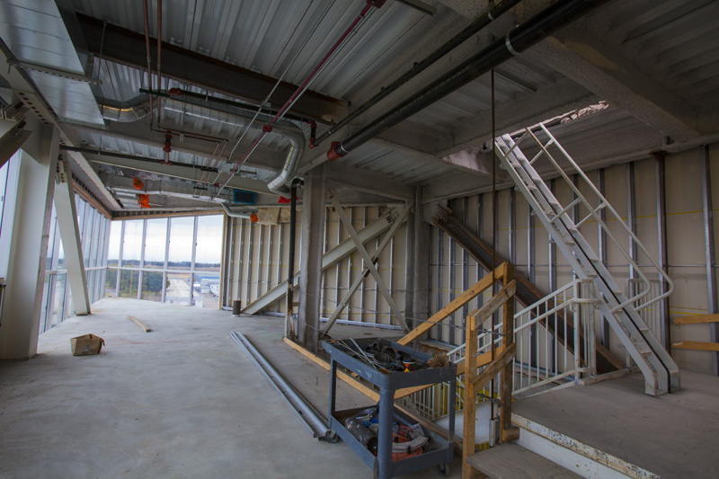
OTE/CDF Elevator Pit & Stair
West Stair
Roof Access

Slide 12
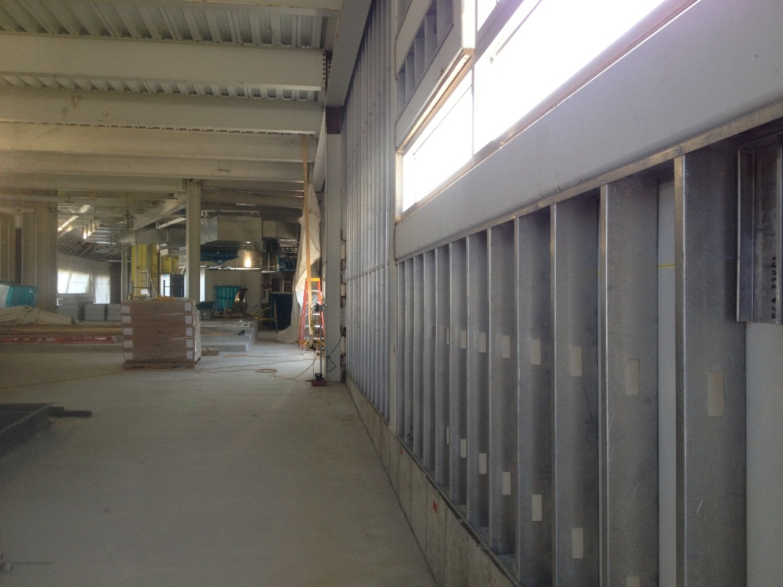
Interior Fit-up

Slide 13
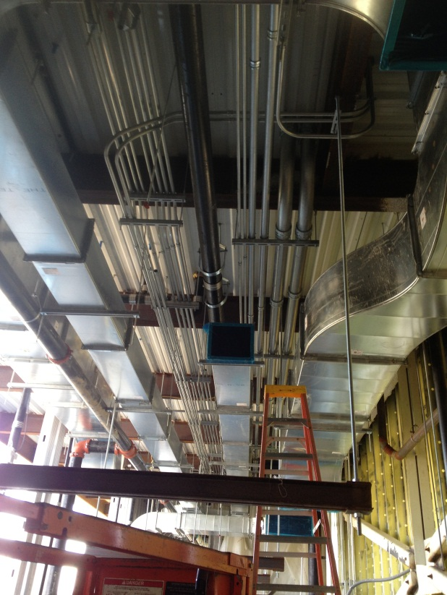
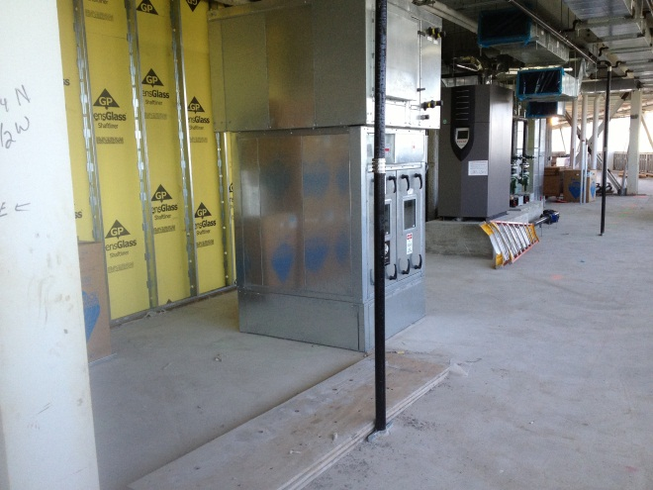
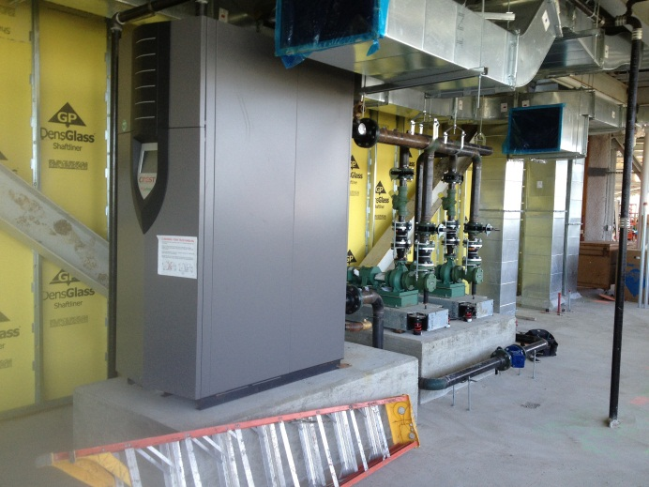
MEP

Slide 14
Two Week Look Ahead
Roofing on low roofs
Detail gazing 2nd & 3rd floors.
Exterior panels 2nd & 3rd floors.
1st floor storefront installation
MEP, FP equipment & in-wall pipe runs
Geothermal
Interior partitions

Slide 15
State DCEO Activities
DCEO quarterly report to State for quarter ending 2/28/13 submitted.
$8,434,758 Total Grant Expense
Project on schedule for grants to be 100% costed by 5/31/14 grant requirement.

Slide 16
Contractual Schedule Adjustments
MS 1 Bldg Shell Complete: 6/19/13*
MS 2 Substantial Completion: 11/5/13
(Project is fully costed at MS 2, retention remains)
MS 3, Project Complete: 1/29/14
*MS-1 (only) extended due to change order work requiring long lead times.

Slide 17
BMC Schedule

Slide 18
Schedule
Weather Impact

Slide 19
Schedule

Slide 20
Project Plan Tracking Milestones
Project is fully costed at MS 2, retention remains

Slide 21
Pacing Milestones & Contractual Milestones

Slide 22
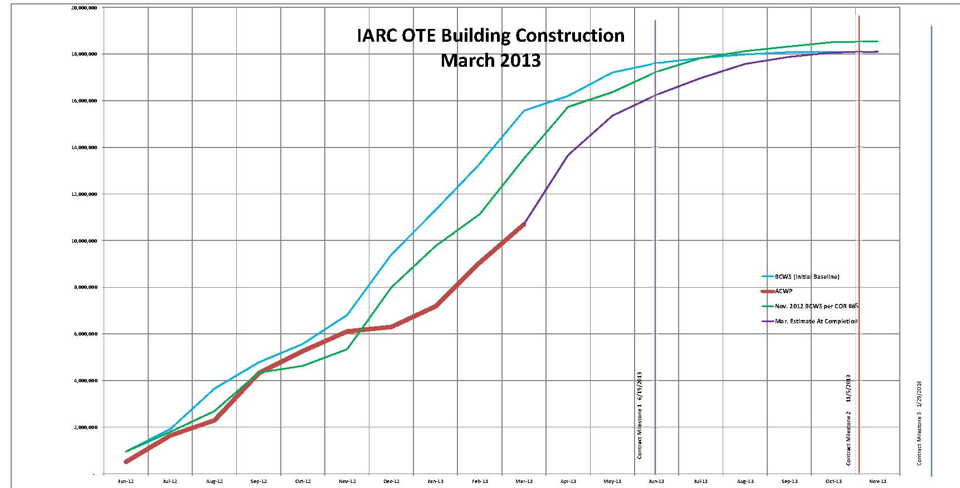
BMC Construction BCWS & ACWP

Slide 23
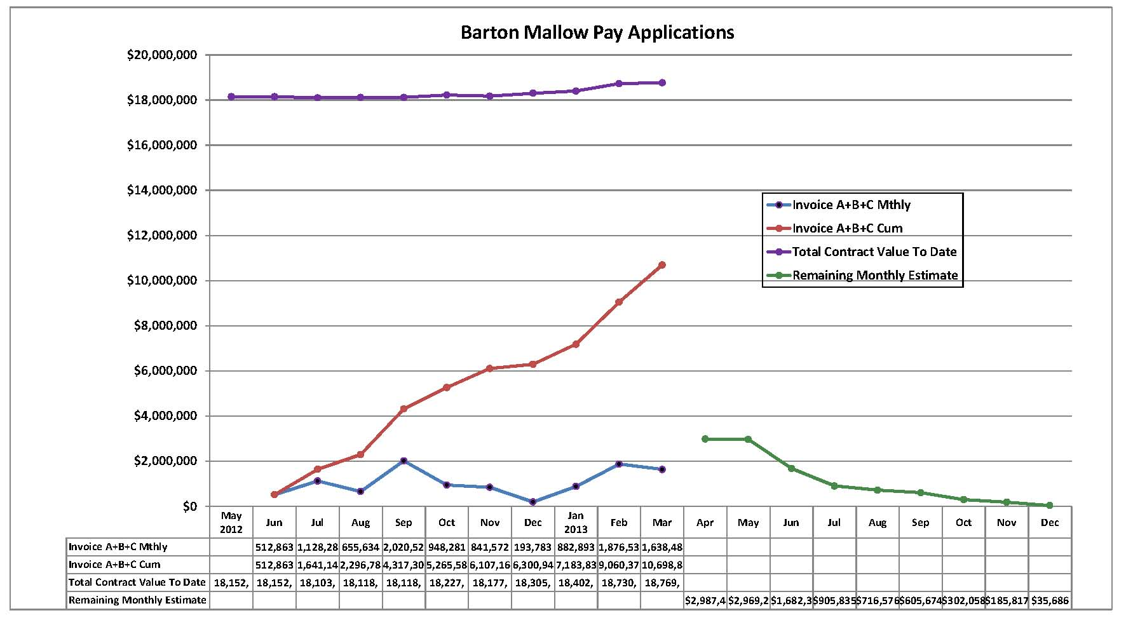
BMC Monthly Costing
Monthly Average to date: $1,069,885.63
Required Monthly Average to complete: $896,757.52
Weather Impact

Slide 24
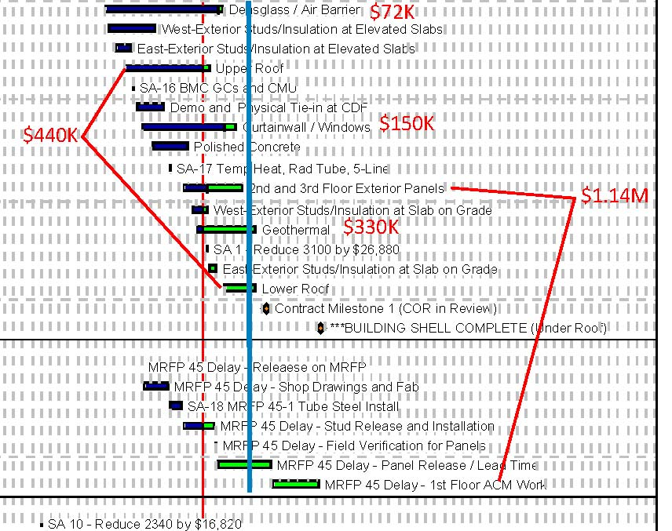
BMC Monthly Costing Weather Impact
Weather Impact: 10 rain days out of 20 work days
Roofing
Siding

Slide 25
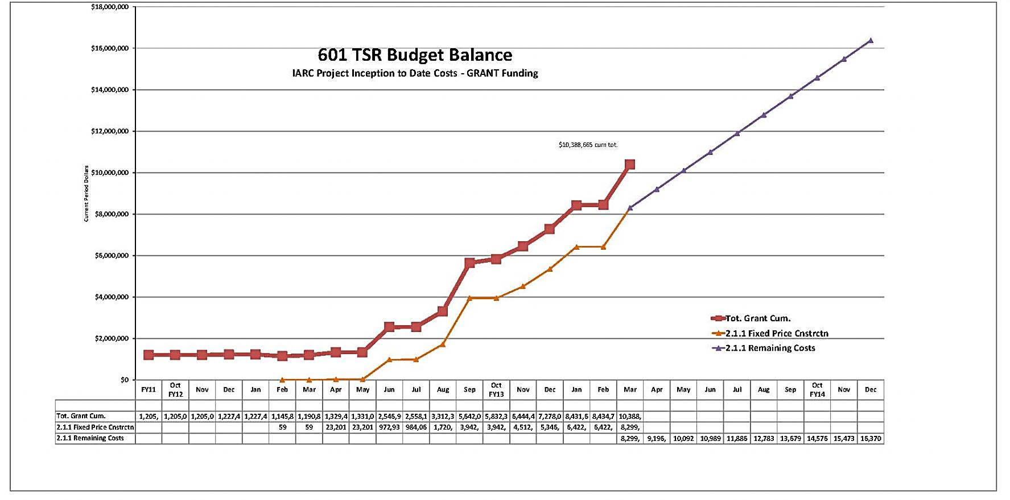
601 TSR Budget Balance
ALL Grant Costing w/ BMC Projection

Slide 26
Financial
OTE Grant Costs with FY13 GPP Contingency
(Does Not Include FY13 Equipment & Furnishings or IGPP)
Projected Cost Analysis
Project 601 |  | Reallocated Baseline Budget (obligates full grants) 12/31/12 |  |  | Budget to Complete as of 3/31/13 (SA 19) |  |  | Project Budget Balance to Complete
 |  | Indirect Baseline Direct Budget Budget BAC |  |  | ITD Obl ITD Obligations Indirect Costs Total
1.0 | EDI
1.1 | Grant 1 Design ED | $1,120,958 | $86,261 | $1,207,218 | $1,120,958 | $82,671 | $1,203,629 | $3,589
1.2 | Grant 1 Design Contingency | $0 | $0 | $0 | $0 | $0 | $0 | $0
1.3 | Grant 2 Construction Support I | $764,532 | $121,507 | $886,039 | $764,532 | $105,565 | $870,097 | $15,942
2.0 | Construction
2.1.1 | Fixed Price Construction | $17,550,249 | $90,193 | $17,640,442 | $17,514,466 | $90,193 | $17,604,659 | $35,783
2.2.1 | T&M Construction | $65,983 | $11,851 | $77,834 | $65,983 | $11,851 | $77,834 | $0
2.3.1 | Adv Procurement | $157,495 | $30,971 | $188,467 | $157,495 | $30,971 | $188,467 | $0
Project G13-211 Contingency
2.1 | Fixed Price Const Contingency | $950,000 | $0 | $950,000 | $299,281 | $0 | $299,281 | $650,719
2.2 | T&M Const Contingency | $40,683 | $9,317 | $50,000 | $0 | $0 | $0 | $50,000
 |  |  |  |  | $0 | $0 | $0 | $0
TOTALS |  | $20,649,900 $350,099 $21,000,000 |  |  | $19,922,715 $321,251 $20,243,967 |  |  | $756,033

Slide 27
Financial – Estimated at Completion

Slide 28
Financial – Available Contingency
March ’13:
55% based on Cost
57% based on Time

Slide 29
Contingency Management
Sources available to fund change orders:
IGPP;
De-scope from anticipated T&M work;
De-scope from A/E support work;
DOE backstop (GPP Outfitting project);
De-scope from main construction work (will not recover all funds);
Value engineering main construction work

Slide 30
Summary Action Items
Continue shop drawing & change order review, RFI responses
Continue construction coordination & oversight.
Continue schedule oversight
Continue financial oversight
Initiate plan for engineering design Outfitting GPP.
Continue discussions with CD for VoIP, networking.

