Slide 1
AD Scheduling Meeting - PIP-II Report
Darren Crawford, PIP-II Beam Commissioning L3 Manager
17-Jan-25

Slide 2
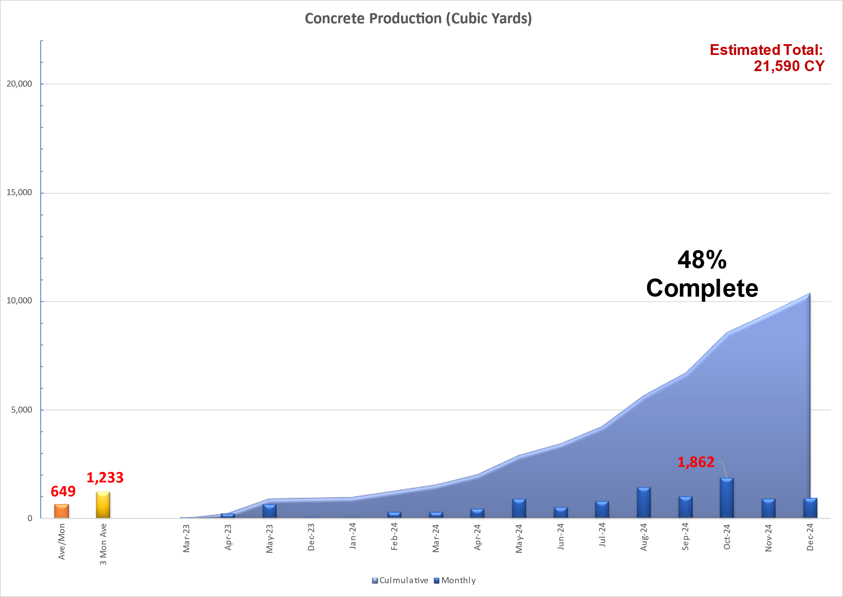
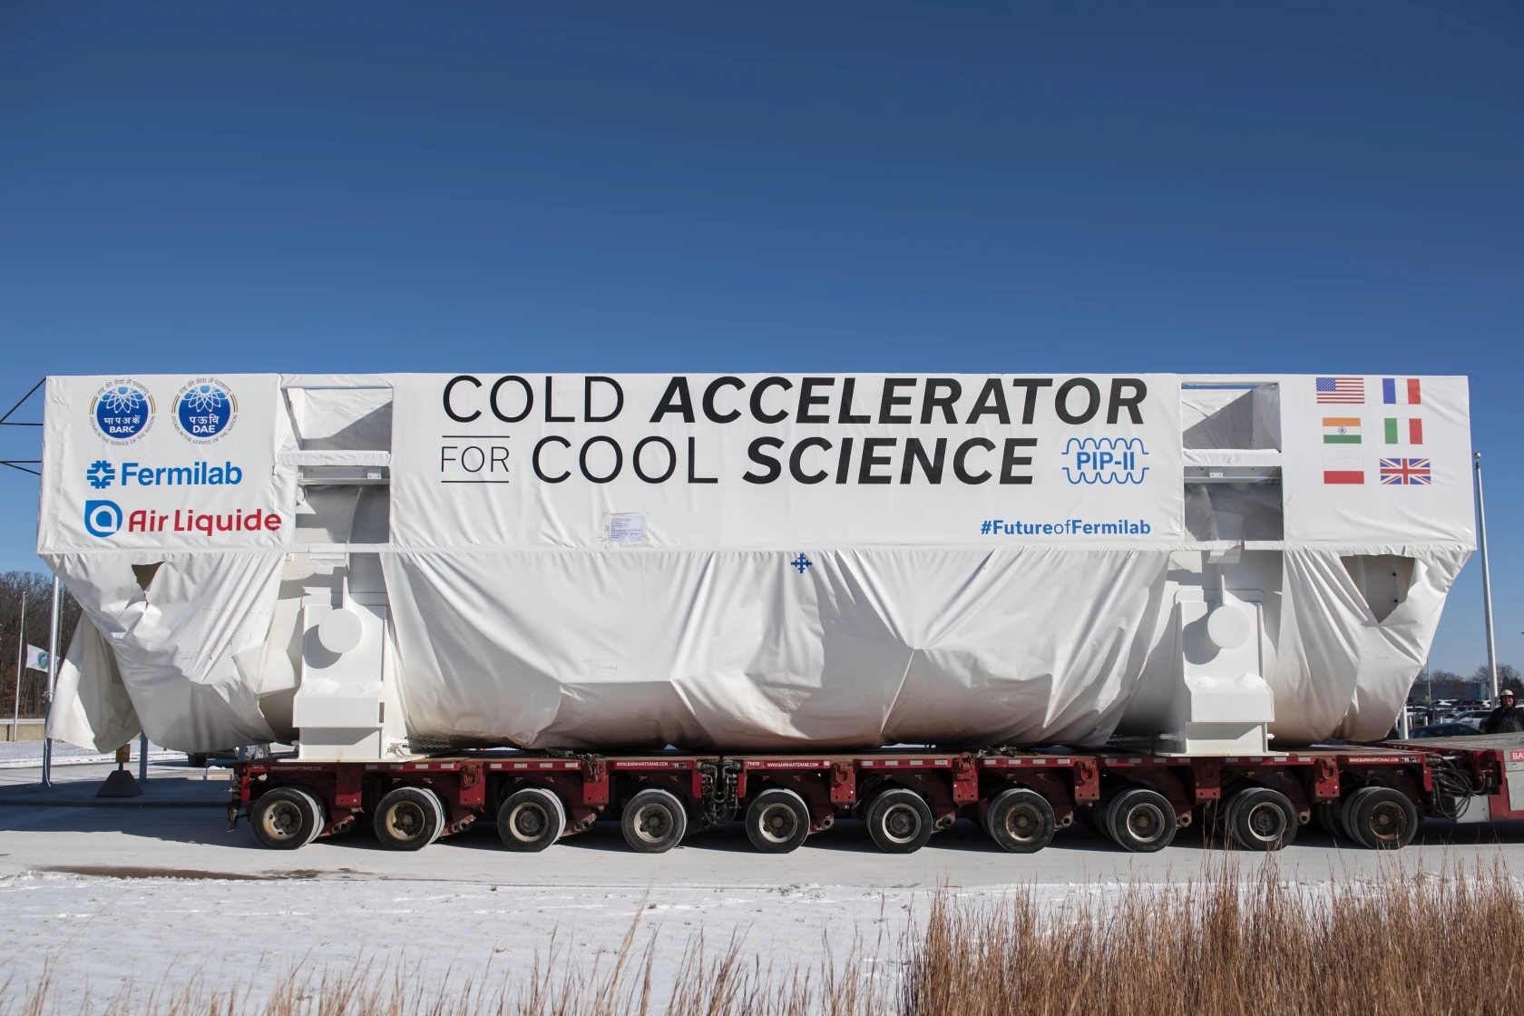
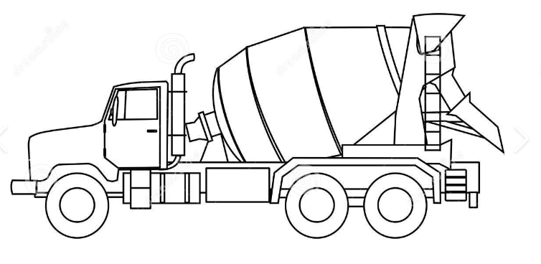
PIP-II Update
Linac Tunnel 59% complete
RF Trench 43% complete
Coldbox arrival 15-Jan-25
High Bay Building AUP 23-Jun-25
Linac Tunnel AUP 19-Sep-25
240 trucks

Slide 3
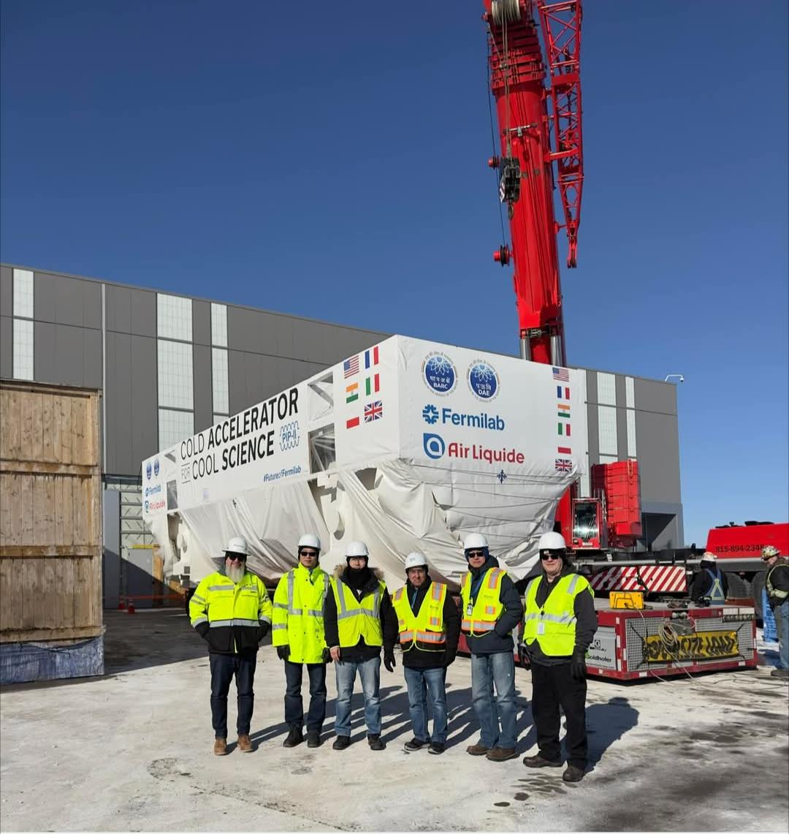
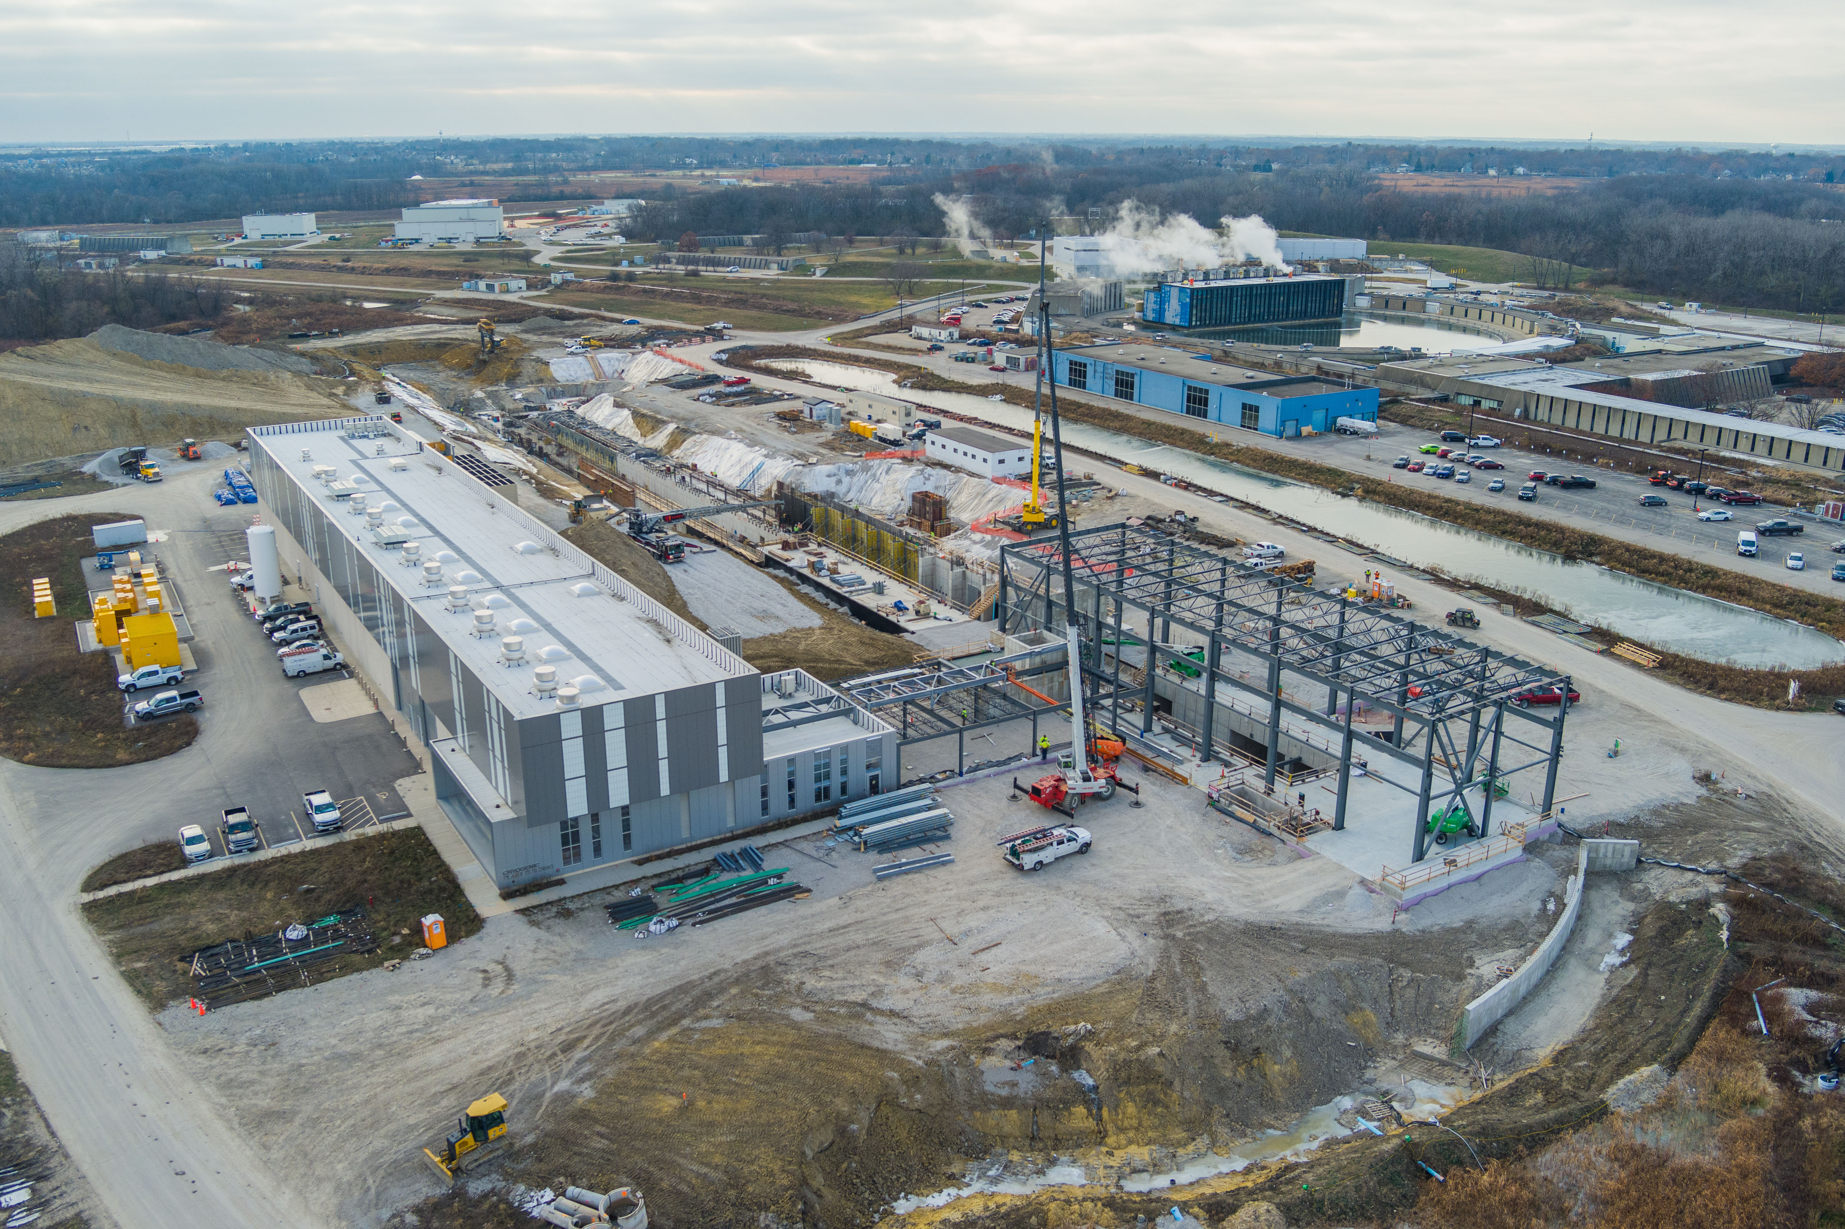
PIP-II Construction Site

Slide 4
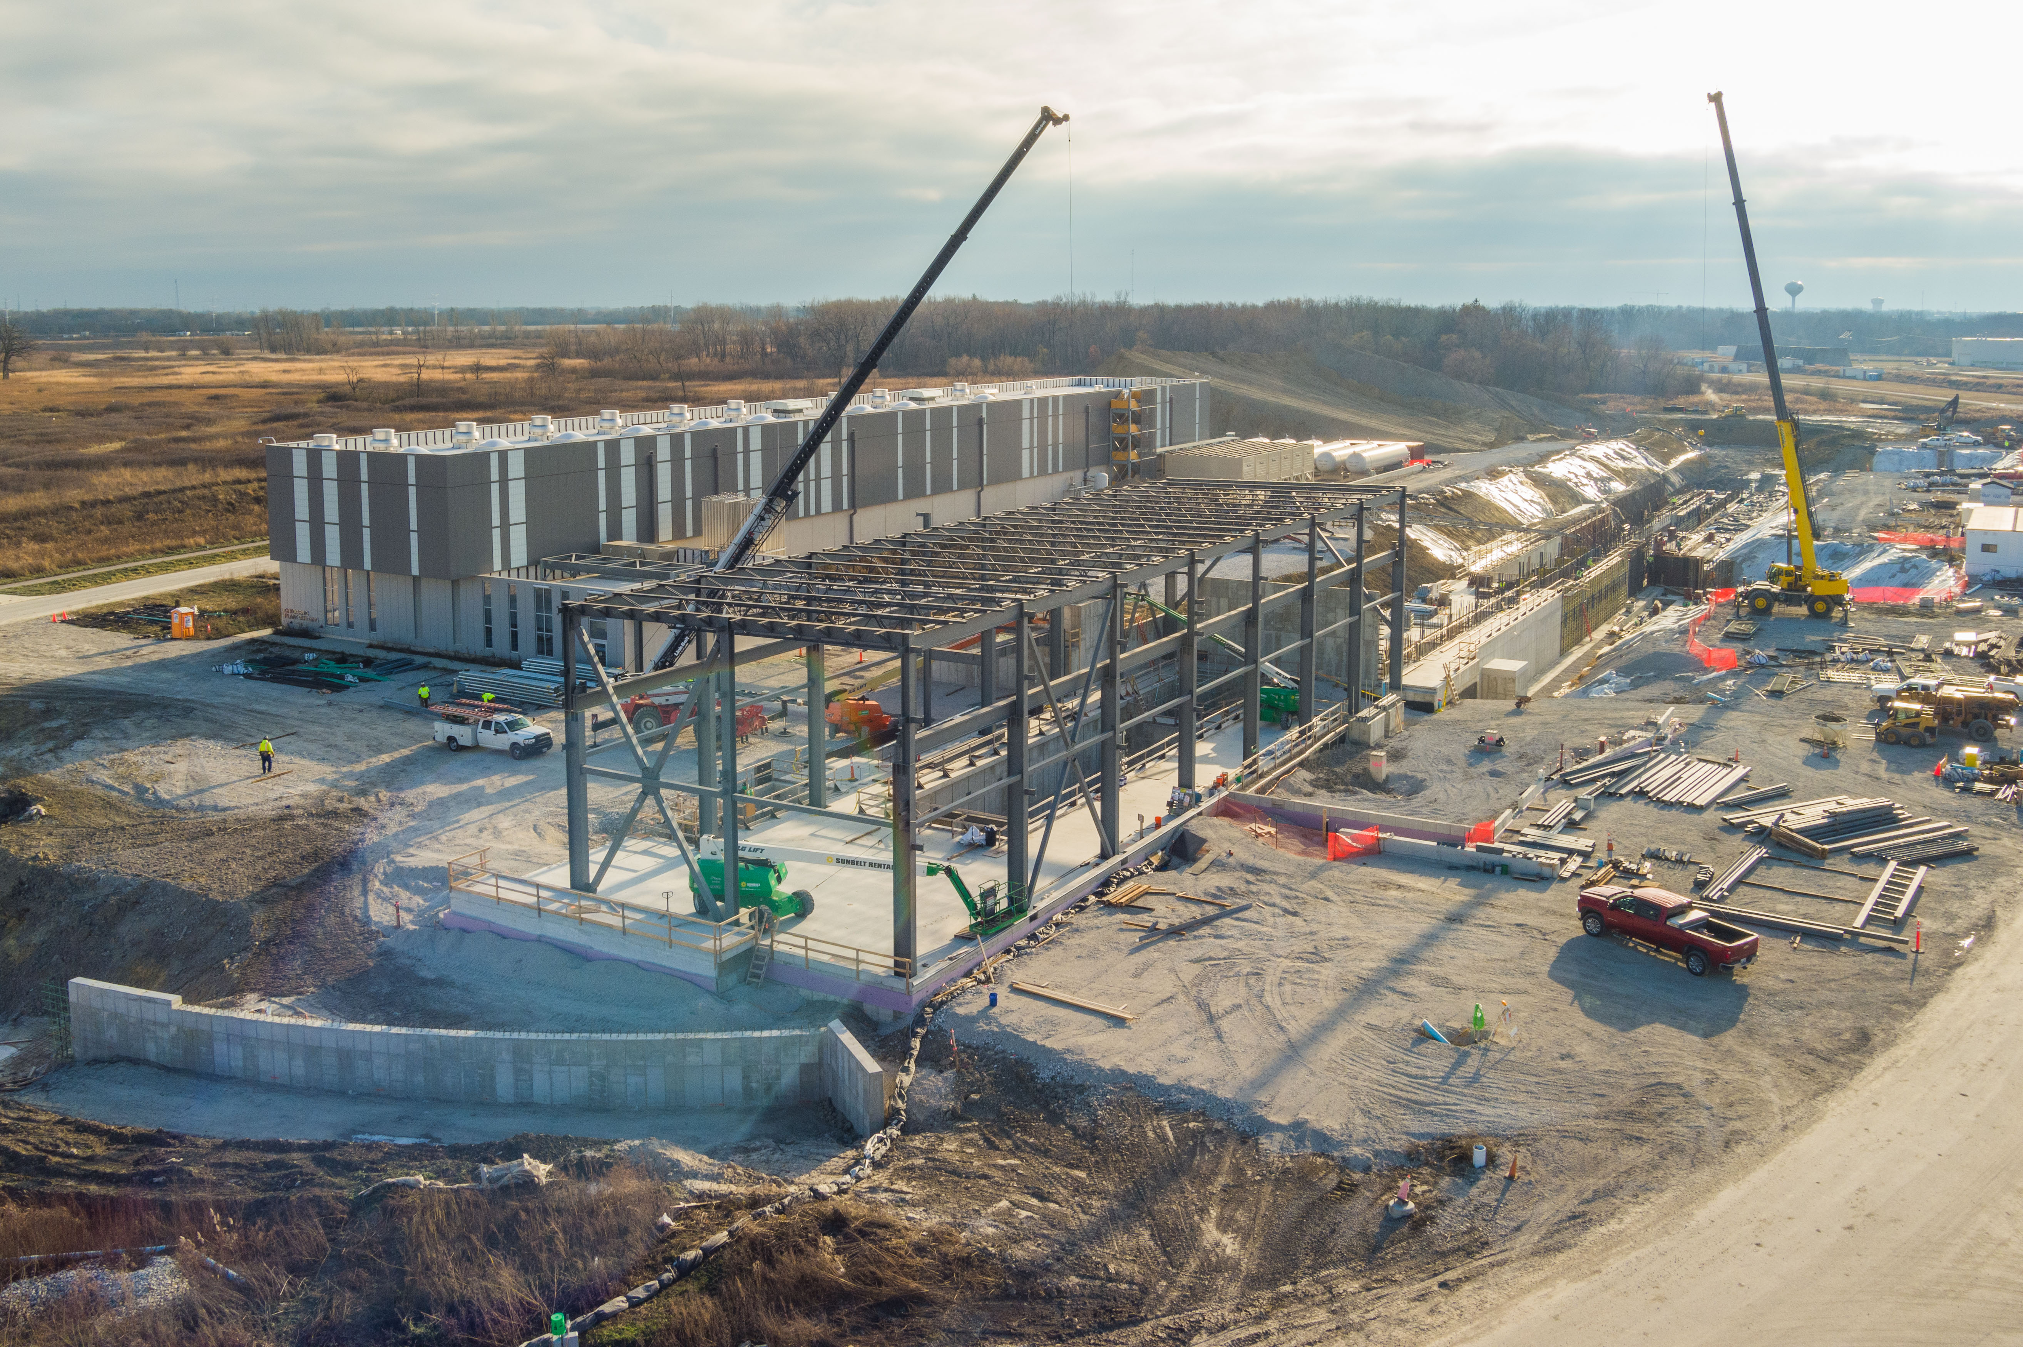
Thank you

Slide 5
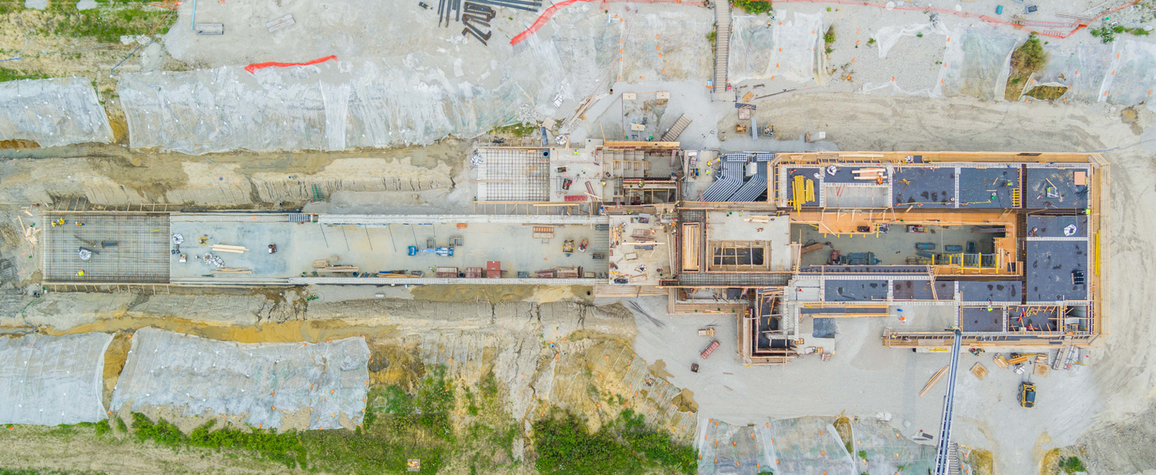
PIP-II Construction Site

