Slide 1
9 AM Meeting
Linh Pham
MCR Crew Chief
Friday, January 17, 2024

Slide 2
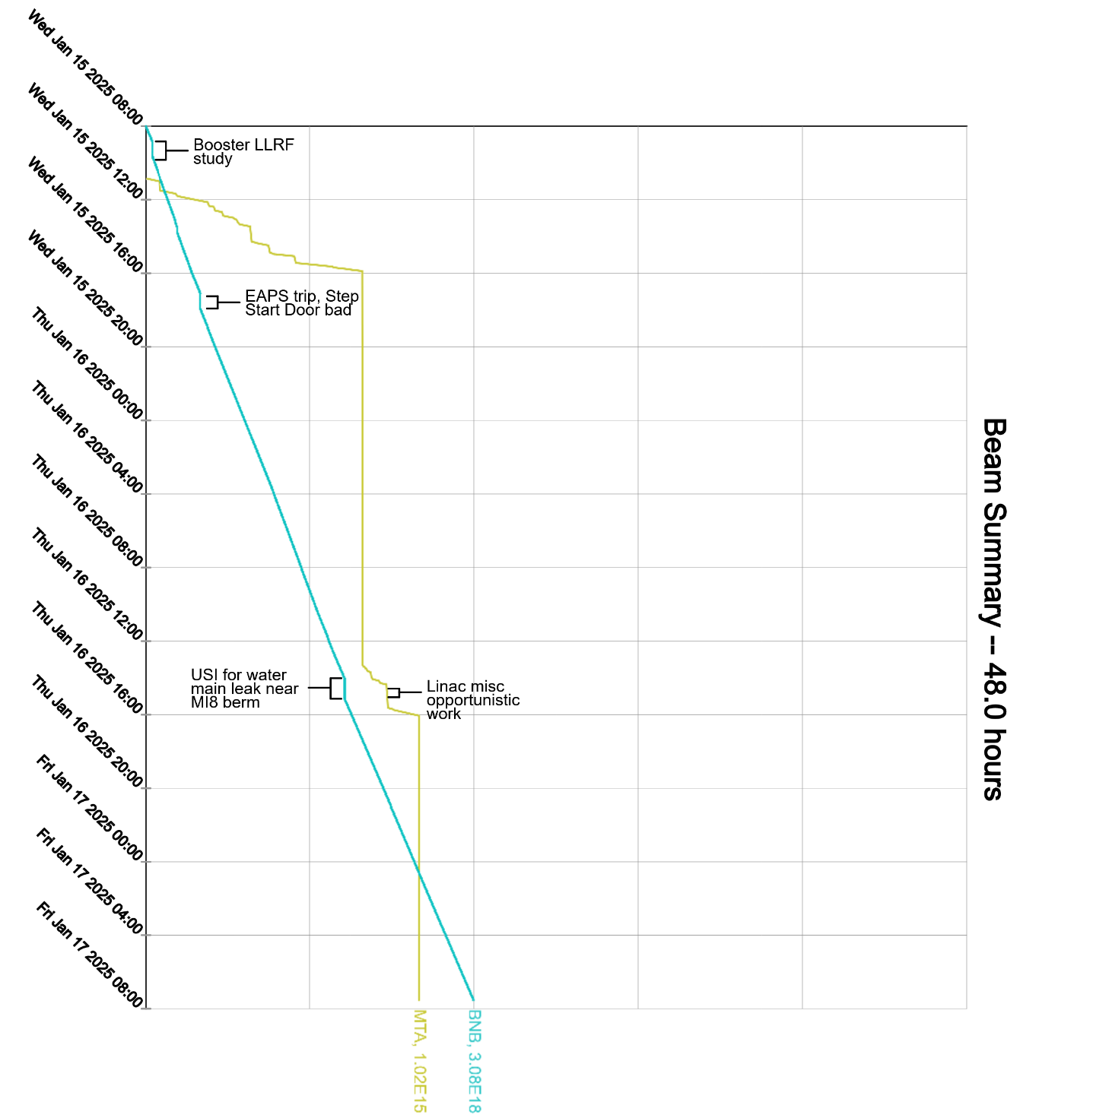
Since Wednesday…
Beam to BNB and MTA when available
Operator tuning in the off-shifts
Wednesday:
Muon Campus LOTO
Booster LLRF phase lock studies
Thursday:
F-sector/Muon power outages
Domestic water leak near MI8 and Muon berm.
Beam to BNB

