Slide 1
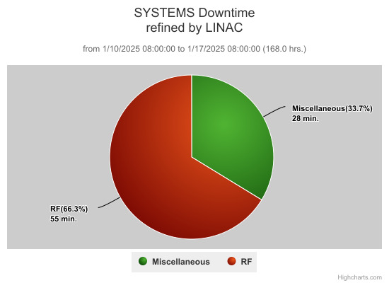
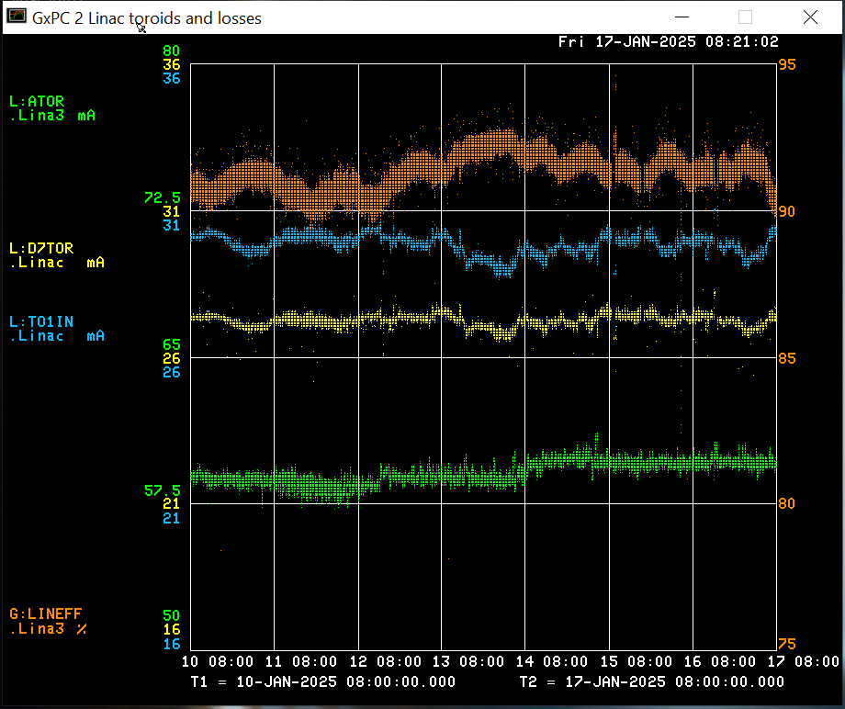
Linac Operations Report
Downtime:
Assorted RF trips
Opportunistic work on Buncher(s)
Opportunistic work done this week:
Buncher TPR module replaced
LRF1 Marx code updated
LRF5 LLRF rebooted for readbacks
KRFB waveform tuning
Beam output: Source: 59.1 mA
TO1IN: 29.8 mA
D7TOR: 27.2 mA
Efficiency: 91.3 %

